Slide 1
Restoring Hope, Rewarding Change: A Contingency Management Pilot for Unhoused Communities
Anusha Chandrakanthan, MD
Valley Homeless Healthcare Program
Clinical Assistant Professor, Stanford School of Medicine

Slide 2
Restoring Hope, Rewarding Change
A Contingency Management Pilot for Unhoused Communities
Anusha Chandrakanthan, MD
Valley Homeless Healthcare Program
Clinical Assistant Professor, Stanford School of Medicine

Slide 3
No Disclosures
Notes:
I just want to give a hige shout out to UCSF for generously sharing their CM funds calculator from a prior AMERSA workshop which was really the foundation of this pilot

Slide 4
What is Contingency Management?
Behavioral intervention using operant conditioning
Creates and strengthens associations between voluntary behaviors and rewards
Notes:
We also know that it works.

Slide 5
Key Features of Contingency Management
Frequent Monitoring
Tangible immediate positive reinforcement
Withhold reinforcement when target behavior not demonstrated
Notes:
Some of the basic features of contingency management as well as know it are identifying target behavior, frequent monitoring, positive reinforcement and then withholding the reinforcement when behavior is not demonstrated

Slide 6
Program Context & Population
Traditional Contingency Management
Our Population
Fixed cohort with a set timeline
Primarily unhoused individuals. Multiple psychosocial barriers.
Notes:
This pilot aimed to tailor a small CM program to unhoused individuals with methamphetamine use served by a healthcare clinic in Santa Clara County, California. Unlike typical fixed cohort/period CM programs, our objective was to modify implementation to suit clients' unique challenges and to try to be as fluid and dynamic as possible

Slide 7
Notes:
These are some of clinical touch points : mobile medical units, traditional brick and mortar clinics, colocation with shelter sites. The 2023 point in time count for homelessness in the county found that around 9900 people were experiencing homelessness and we see around 7500 of them

Slide 8
Pilot Program Design
Initiated and funded internally at VHHP
Goals
Understand patient challenges
Develop harm-reduction based contingency management model
Used fishbowl method
Rewards calculated using UCSF contingency management funds calculator
Notes:
Since it was an internally funded initiative, our sample size was limited to 5. I reached out to around 10-15 individuals with ongoing stimulant use in order to narrow it down to 5, based on their interest and transport.

Slide 9
Target Behavior
Positive Reinforcement
Clinic engagement
Continued abstinence from stimulants
Affirmations
Gift cards
Objective Assessment
Negative urine screens

Slide 10
Implementation
12-week program
Weekly drop-in rapid urine screening
Reward structure

Slide 11
Reward structure
Gift cards
$10, $20 and $100
Affirmations from fishbowl
Progressive reward opportunities
Additional draw for every week attended in addition to draw for negative urine screen
Max of 6 draws
Draws were reset to 1 for positive urine screens
Notes:
Our program design followed established contingency management principles. Participants could earn up to six draws from our fishbowl for each negative urine drug screen. The fishbowl contained 500 slips – half were encouraging messages, and the other half were monetary rewards ranging from $10 to $20, with one special $100 prize. Based on participant feedback, we offered gift cards to grocery stores and Target. We deliberately kept the program structure simple: participants would come in on a set day each week, provide a urine sample, make their draws if eligible, and leave. We specifically chose not to mandate additional psychotherapy or group services to minimize potential barriers to participatio

Slide 12
Initial Outcomes
Participant results (n=5):
1 participant: Maintained complete abstinence for 12 weeks
1 participant: Achieved intermittent abstinence with continued engagement. Longest time period was 6 weeks
1 participant: 5 weeks abstinence before dropout
2 participants: First-week dropout
No group therapy requirement to minimize barriers

Slide 13
Initial Outcomes
Participants (n=5)
Week 0
Week 2
Week 4
Week 6
Week 8
Week 10
Week 12
Complete (12 weeks)
Intermittent (6 weeks max)
Dropout (5 weeks)
Early dropout (1 week)
Early dropout (1 week)
Note: No group therapy requirement was imposed to minimize barriers

Slide 14
Implementation Barriers
Rapid Urine Testing
Enrollment
Patient Feedback
Lab buy-in
Staff re-training
Results are entered manually and sent to lab for verification
Fixed timeline limitations
Need for rolling enrollment identified
Patient transportation
Stigma associated with fears of relapse
Notes:
We encountered several significant challenges. First, our internal funding limited both our sample size and the monetary value of rewards we could offer. Second, our county phased out point-of-care urine drug screens. This required us toget some lab buy in and then implement a two-step verification process and retrain staff on new testing protocols. Perhaps most significantly, we discovered that our program structure, which required fixed appointments, represented a substantial departure from our usual walk-in model – a change that proved challenging for many of our clients who value flexibility.
These challenges led to several key insights. We learned to adapt by implementing a rolling enrollment model, allowing participants to begin when timing worked best for them. While this complicated our tracking processes somewhat, it better served our population's needs. We also gained valuable insight into the psychological barriers to participation – several potential participants expressed that the inability to draw from the fishbowl after a positive screen felt punitive, leading to feelings of shame that discouraged enrollmen

Slide 15
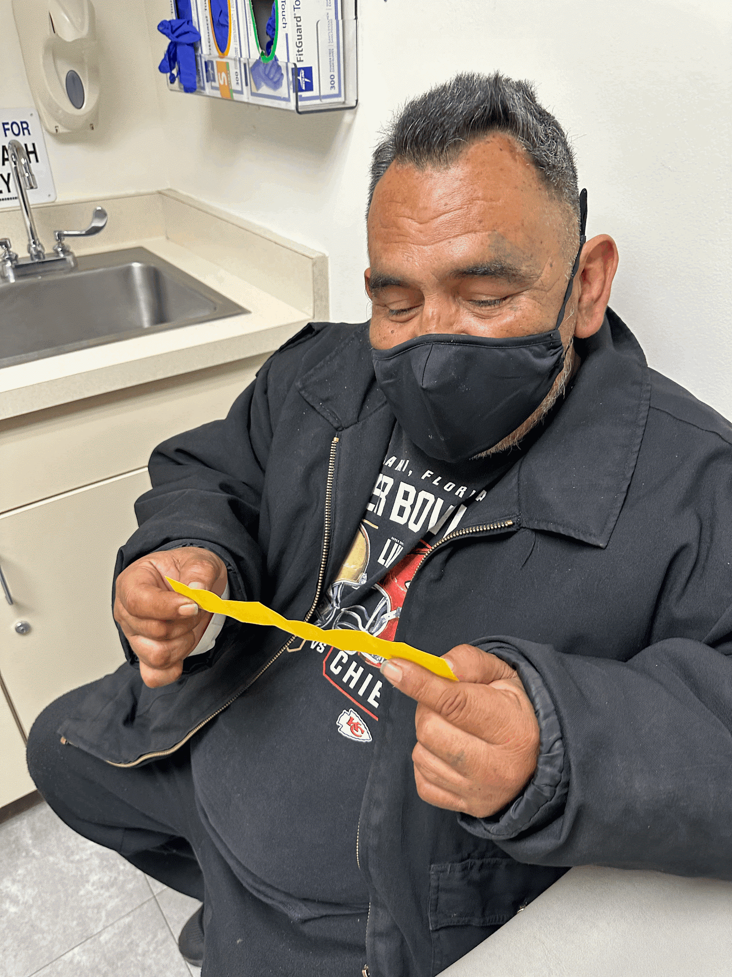

Slide 16
Program Evolution
Received additional community partner funding to
Integrate harm reduction principles
Expand to two sites
Shelter-based location
Walk-in clinic
Notes:
Looking ahead, we're planning to expand this pilot to two sites next year. One will be our shelter-based clinic, where we hope to minimize transportation barriers, while continuing at our original location. This expansion will allow us to better understand how different settings might influence program success.
In conclusion, while our pilot was small, it provided valuable insights into implementing contingency management in a homeless healthcare setting. We believe these lessons – particularly around program flexibility, barrier reduction, and the importance of considering psychological impacts – can inform similar initiatives in other communities serving vulnerable populations.

Slide 17
Future Directions
Implement rolling enrollment
Incentivize participation regardless of screen results
Transportation
Manage multi-site program

Slide 18
Thank you!!
Email : anusha.chandrakantha@hhs.sccgov.org

