Slide 1
Reimagining Recovery
A Health Justice-Oriented Training for Professionals
Lauren E. Kennedy, PhD
Michigan State University Extension

Slide 2

What is Extension?

Slide 3
Michigan State University Extension
Four institutes: Child and Youth, Community, Food, & Environment, Agriculture & Agribusiness, Health and Nutrition
HNI:
  ~150 staff statewide
  Master’s-prepared educators and Bachelor’s-level instructors
  Nutrition and physical activity, food safety, health (incl. behavioral/SUD, chronic disease/pain, falls prevention, diabetes, sleep, stress/mindfulness, etc.)
Menu of research- and evidence-based programs
Community-based experts with MSU Extension
Notes:
Social-emotional and mental health
Chronic disease and diabetes management
Food safety and food preservation
Aging and caregiving
Nutrition and physical activity, and more.

Slide 4

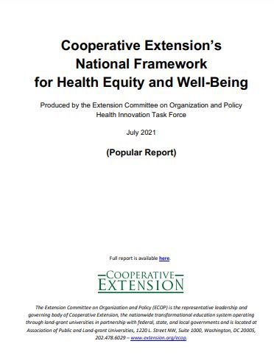
National Framework for Health Equity and Well Being

Slide 5

National Framework for Health Equity and Well Being

Slide 6

60-minute basic opioid training
Healthcare provider training
Stories of Hope video series
Regional treatment guides
Digital media anti-stigma campaign

Slide 7


In 2021 – SAMHSA changed ROTA to a regional model
Reimagining Recovery
a series by MSU Extension

Slide 8

Content covered:
Structural and social determinants of health
Limitations of the brain disease model of addiction
History of criminalizing and punitive approaches to address substance use
Person-first language
Spectrum of substance use
Harm reduction
Recovery myths and multiple pathways to recovery

Slide 9
Job Title | % | n
Social Worker | 15% | 15
Community Health Worker/Educator/Health Educator | 11% | 11
Peer recovery specialist | 12% | 12
Prevention specialist | 13% | 13
Addictions Professional | 5% | 5
Counselor/therapist (all types) | 6% | 6
*not all categories are represented on the slide, so percentages will not equal 100

Slide 10
Evaluation
86% of participants reported an increase in self-efficacy to address the stigma associated with substance use (CMHA)
87% of participants reported an intention to use the information provided in the training with their job (CMHA)
92% of participants expected the training to improve their ability to work effectively (ROTA)
I would recommend this series to others
  98% of ROTA participants; 78% of CMHA of MI participants
Participant satisfaction
  99% of ROTA participants; 93% of CMHA of MI participants

Slide 11
Participants say they intend to apply what they learned to their work.
Sharing with the community
  “I am hosting a Town Hall in a few weeks on the different recovery pathways and I plan to include some of this information prior to the panel discussion.”
Supervisors are sharing with their teams
  “As I do not work directly with customers anymore, my application of this information will to continue to be guiding my staff to understand how trauma may play a role in SUD.”
  “I am a supervisor of clinicians that reach out to mbrs with co-occurring disorders. I plan to share resources and information specifically from this training to assist them when providing care management and care coordination for their health and wellness.”

Slide 12
continued
Working differently with criminal legal
  “Working with local probation and parole agents and encouraging a harm-reduction approach.”
  “coordination with the recovery court”
Policy change
  “Some of this information will also be included in new hire staff training for the agency.”
  ”I have already started incorporating some of the information into a presentation I am giving on Monday to the Attorney General’s office.”

Slide 13
“The holistic, humanistic, and empathetic approach to recovery is refreshing. The info and words shared will help me to lead conversations in my community.”

Slide 14

Connect with me
Lauren Kennedy, PhD
Specialist @ Michigan State University Extension
  Email: kenne552@msu.edu
  MiSUPER: https://www.canr.msu.edu/misuper/

Slide 15
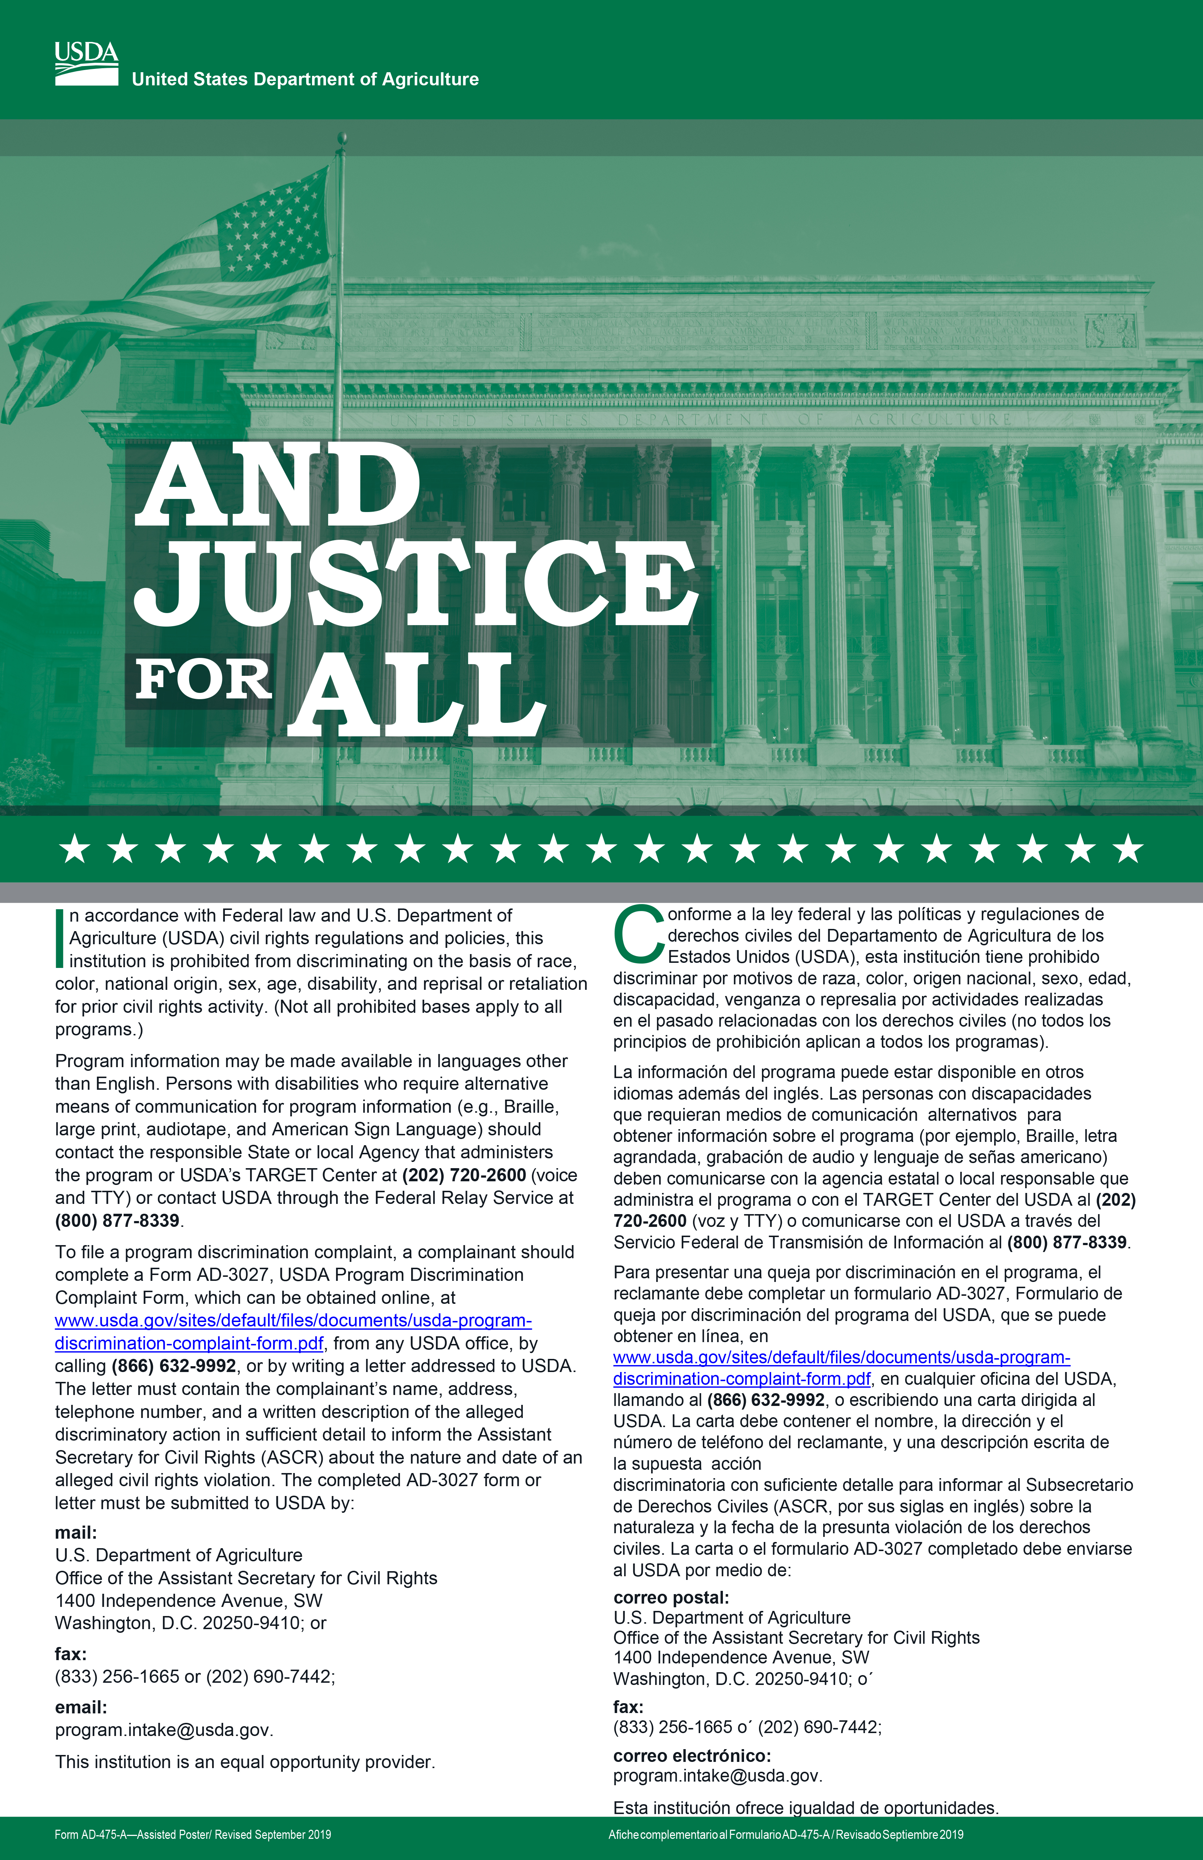
MSU is an affirmative-action, equal-opportunity employer. Michigan State University Extension programs and materials are open to all without regard to race, color, national origin, sex, gender, gender identity, religion, age, height, weight, disability, political beliefs, sexual orientation, marital status, family status or veteran status.

