Slide 1
Rethinking Harm Reduction Conversations: An Oronasal Fistula in a Woman Snorting Xylazine-Fentanyl
Elizabeth Ferro, MD
Addiction Medicine Physician
Allegheny County Jail
Allegheny Health Network
Ashish Thakrar, MD, MS
Assistant Professor of Medicine
Division of General Internal Medicine
University of Pennsylvania

Slide 2
Disclosures & Acknowledgements
No disclosures
Patient, K, provided signed permission to share and discuss the information in this case

Slide 3
Xylazine: An Animal Sedative in the Unregulated Drug Supply
Colloquially known as “tranq”
Non-opiate, alpha-2 adrenergic receptor agonist
Approved in the US for veterinary use only; used as a sedative
Found as an adulterant in the unregulated opioid supply
First described in Puerto Rico in the 2000s¹
Increasingly found in the drug supply and among overdose deaths in the US²
As of June 2023, 98% of dope samples in Philadelphia contained xylazine³
Average drug content in dope samples in Philadelphia, quarters 1 and 2 of 2023.
DeBord, J et al. “Drug Checking Quarterly Report (Q1 and Q2 2023): Philadelphia, PA, USA.” Center for Forensic Science Research and Education, 2023.
Notes:
Tables: CFSRE Quarterly Drug Checking Report for Philadelphia, PA, Jan 1, 2023 to Jun 30, 2023 via https://www.cfsre.org/images/content/reports/drug_checking/2023_Q1_and_Q2_Drug_Checking_Quarterly_Report_CFSRE_NPS_Discovery.pdf
Notes: Results in a reduction of NE release at centrally-located pre-synaptic alpha-2 receptors, resulting in sedation and muscle relaxation

Slide 4
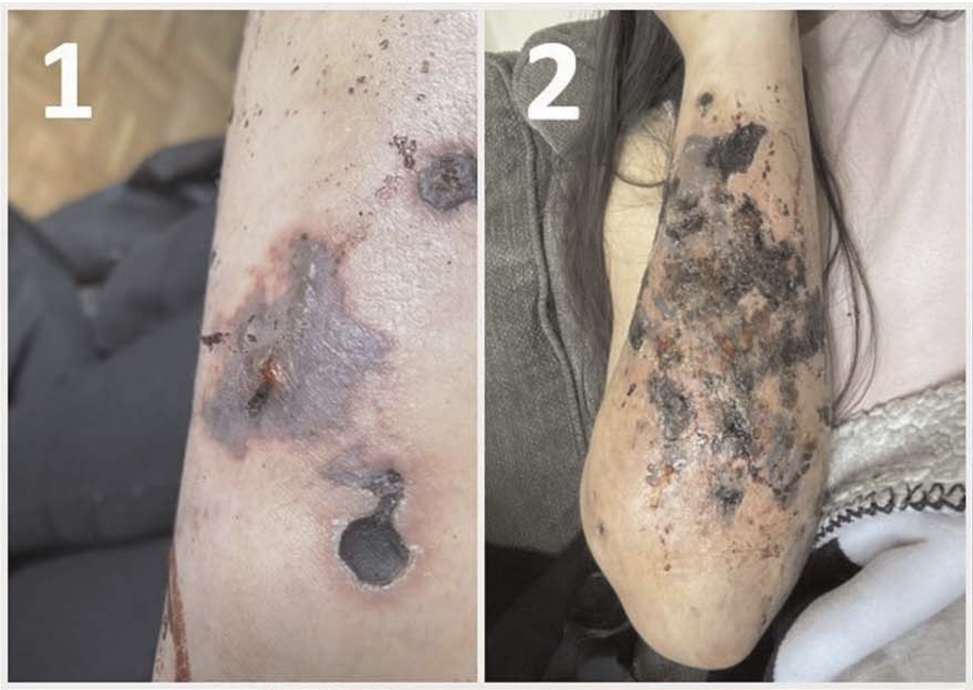
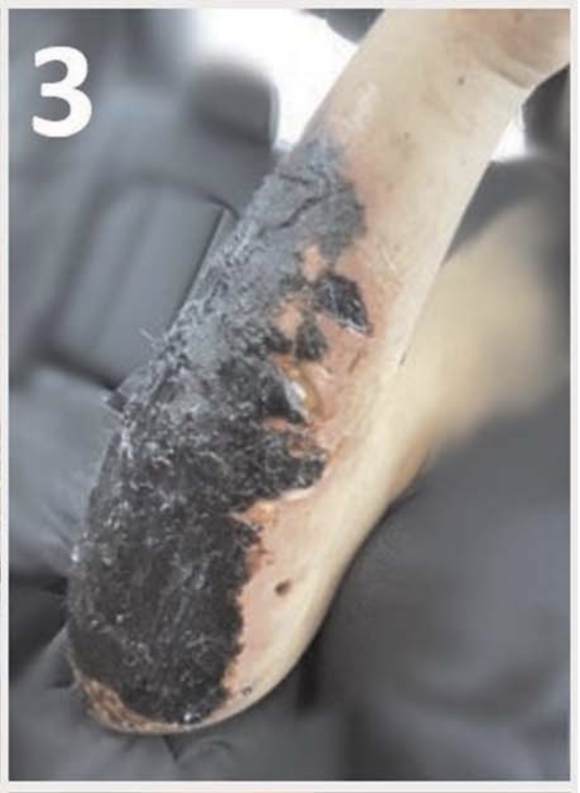
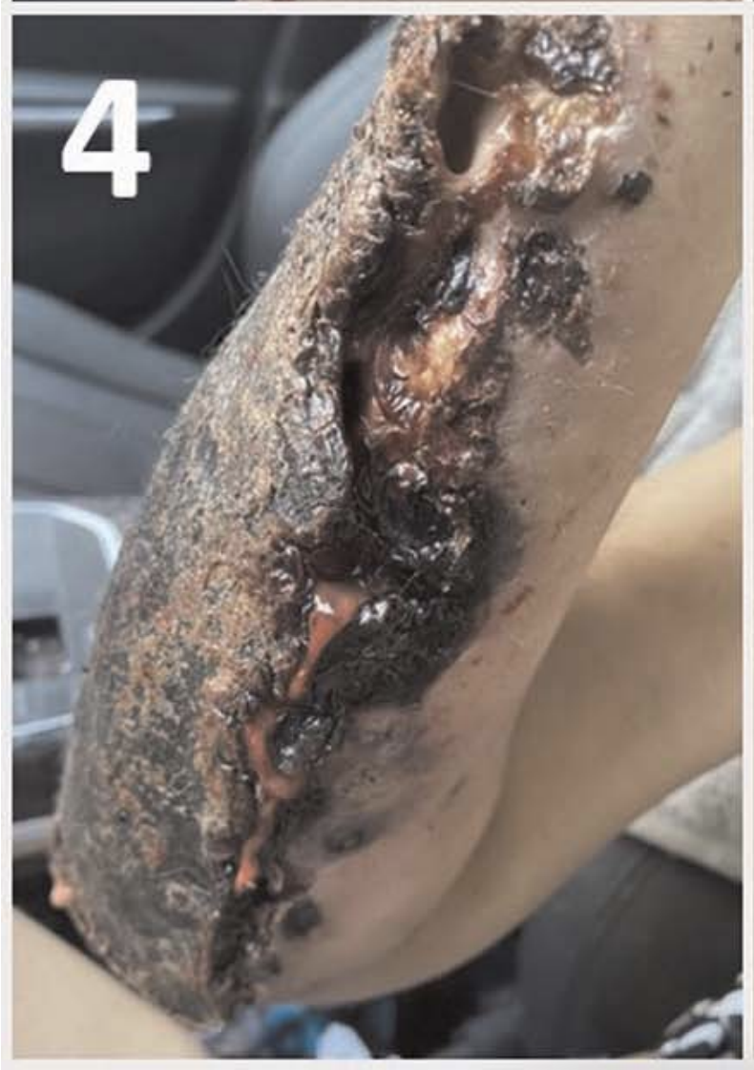
Wounds in People Using Xylazine-Fentanyl⁴
Appear to be different than skin and soft tissue infections like cellulitis and abscesses historically associated with injection drug use
Found at sites distant from injection or use, including in those who exclusively snort or smoke drugs in an attempt to minimize risks associated with injection xylazine use
McFadden, Rachel et al. “Xylazine-associated Wounds: Clinical Experience From a Low-barrier Wound Care Clinic in Philadelphia.” Journal of addiction medicine vol. 18,1 (2024): 9-12.
Notes:
Proposed description of wound progression as described by our colleagues (Rachel McFadden et al)
“Starting as dark purple blisters with irregular borders and intact skin, they commonly emerge around injection sites on the posterior forearms (Fig. 1, photo 1) or lower legs. These blisters often coalesce (photo 2) and harden into dry, adherent eschar, sometimes opening into deep ulcers (photos 3–4).
The wound bed may initially contain islands of preserved tissue, although these are at risk of eventual erosion. Ulceration depth may reach full-thickness, with exposed tendon and bone. While these wounds generally lack classic signs of infection, untreated eschar may foster superimposed infection characterized by periwound cellulitis and purulent drainage.”

Slide 5
K: A Case to Rethink Harm Reduction Conversations

Slide 6
Case Presentation
35-year-old woman from the Philadelphia metropolitan area
Severe opioid use disorder (OUD)
Developed lower extremity wounds suspected to be related to xylazine use; began exclusively snorting drugs 2 years ago
Extremity wounds healed with change in method of use
Presented to the hospital (3/2024) with two weeks of headache and worsening right eye pain and vision
Several weeks prior to presentation, had started methadone for treatment of OUD
Resulted in reduced, but ongoing, xylazine-fentanyl use

Slide 7
Exam & Imaging
CT Sinuses Impression (hospital day 2):
Large sinonasal cavitation with numerous areas of osseous erosion that extended to the orbits, right pterygopalatine fossa, and hard palate
MRI Orbits Impression (hospital day 5):
Presumed chronic fungal sinusitis with possible necrotic tissue along superior margin of sinonasal cavity and more infiltrative tissue along its deep margins involving the orbits (R > L) as well as right pterygopalatine fossa and right foramen rotundum
Notes:
Had previously had a percutaneous endoscopic gastrostomy (PEG) tube placed at another institution

Slide 8
Hospitalization
Admitted and followed by otorhinolaryngology (ENT), ophthalmology, infectious disease, and addiction medicine teams
Direct visualization of the nasopharynx showed destruction of intranasal and sinus architecture and a single, large cavitary space with a thick layer of crusting and pus
Sinus tissue biopsy cultures grew methicillin-resistant Staphylococcus aureus, Candida albicans, and Candida glabrata
Started broad-spectrum IV antimicrobials including amphotericin B, daptomycin, and ampicillin-sulbactam
K noted improvement in vision with ongoing treatment
Notes:
Biopsy results grew both bacteria, in the form of MRSA, and fungus, with multiple candida species
Amphotericin for fungal coverage; daptomycin for MRSA coverage, ampicillin-sulbactam for GNR/anaerobic coverage

Slide 9
Hospitalization, continued
Infectious disease and ENT consultants suspected palatal defect and oronasal fistula were complications of chronic xylazine insufflation
ENT recommended palate reconstruction with an obturator prosthesis or free flap construction
Transferred to another hospital within the institution for planned reconstruction (hospital day 19)
Underwent nasal endoscopy with debridement (hospital day 20)
Stable repeat imaging (hospital day 23)
Transitioned to oral antimicrobials (hospital day 26)
Left before medically advised (hospital day 27)
Notes:
Methadone was titrated to 135 mg while hospitalized

Slide 10
Follow Up
K’s ability to engage with our institution for her care was limited by insurance network restrictions
Some notes available from recent hospitalization (9/2024) for fever and syncope:
K noted right eye vision loss and worsening left eye vision
Imaging redemonstrated sinonasal destruction extending to the hard palate and bilateral orbital floors
Remains engaged in methadone program
Notes:
Also found to have bilateral mastoid effusions, extensive fluid in right middle ear, consistent with OM
Concern for endocarditis given fever, syncope, recent infections

Slide 11
Discussion
Is xylazine the culprit, or maybe a culprit in a multifactorial process, that led to K’s sinonasal cavitation and oral fistula?
No definitive answer!
Similar fistulas have been described in individuals regularly snorting cocaine⁵
If xylazine is a culprit, is every individual exposed at the same risk?
The drug supply is ever-changing and ill-defined
Could it be a combination of exposures?
Non-injection routes of drug use (snorting, smoking, rectal administration) are important harm reduction strategies
But what are the risks of exposing various tissue to xylazine via non-injection routes?
Notes:
- We have a patient who was previously injecting her drugs and chose another route of use to avoid wounds she thought were related to injecting xylazine
- Is xylazine at work here? ENT and ID thought so...but we don't know!
- The reality is that we're working with a drug supply that's every-changing and ill-defined
- It begs the question: How does this impact our harm reduction conversations with people who use drugs?

Slide 12
Future Work
Basic science and clinical research will help us gain a greater understanding of the clinical consequences of xylazine exposure by various routes of administration, including snorting
Improved access to community-based drug checking
Notes:
The work of Dr. Lutz (Lootz) and her colleagues is a great example of ongoing research in this area that can push us forward
The unregulated drug supply in the US remains unpredictable and we are mostly forced to act reactively

Slide 13
Questions & Discussion

Slide 14
References
Rodríguez, Nayra et al. “GC-MS confirmation of xylazine (Rompun), a veterinary sedative, in exchanged needles.” Drug and alcohol dependence vol. 96,3 (2008): 290-3. doi:10.1016/j.drugalcdep.2008.03.005
Drug Enforcement Administration. The Growing Threat of Xylazine and its Mixture with Illicit Drugs: DEA Joint Intelligence Report. Justice Department, 2022, https://www.dea.gov/sites/default/files/2022-12/The%20Growing%20Threat%20of%20Xylazine%20and%20its%20Mixture%20with%20Illicit%20Drugs.pdf. Accessed 8 Aug. 2024.
DeBord, J et al. “Drug Checking Quarterly Report (Q1 and Q2 2023): Philadelphia, PA, USA.” Center for Forensic Science Research and Education, 2023.
McFadden, Rachel et al. “Xylazine-associated Wounds: Clinical Experience From a Low-barrier Wound Care Clinic in Philadelphia.” Journal of addiction medicine vol. 18,1 (2024): 9-12. doi:10.1097/ADM.0000000000001245
Chaudhry, H et al. “Hazards of cocaine misuse.” British dental journal vol. 229,7 (2020): 399. doi:10.1038/s41415-020-2242-y

