Slide 1
Reversal of Opioid Overdose with Intravenous Buprenorphine and Rapid Transition to Extended-Release Buprenorphine
Michelle Patregnani, MD and Josh Luftig, PA-C
Alameda Health System
Emergency Medicine & Addiction Medicine

Slide 2
No conflicts of interest

Slide 3
Learning objectives
Discuss IV buprenorphine pharmacology for fentanyl overdose
Identify patients and scenarios to maximize benefits and minimize risks of IV buprenorphine reversal for overdose
Describe a protocol using IV buprenorphine for opioid overdose reversal and rapid advancement to full-dose XR buprenorphine

Slide 4
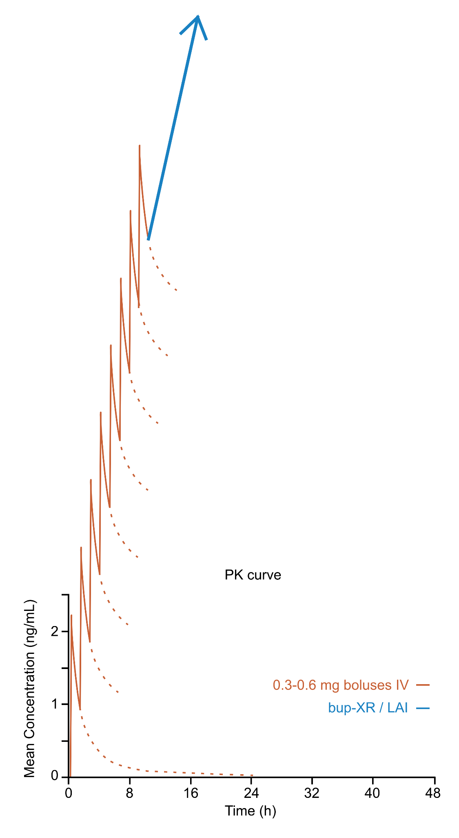
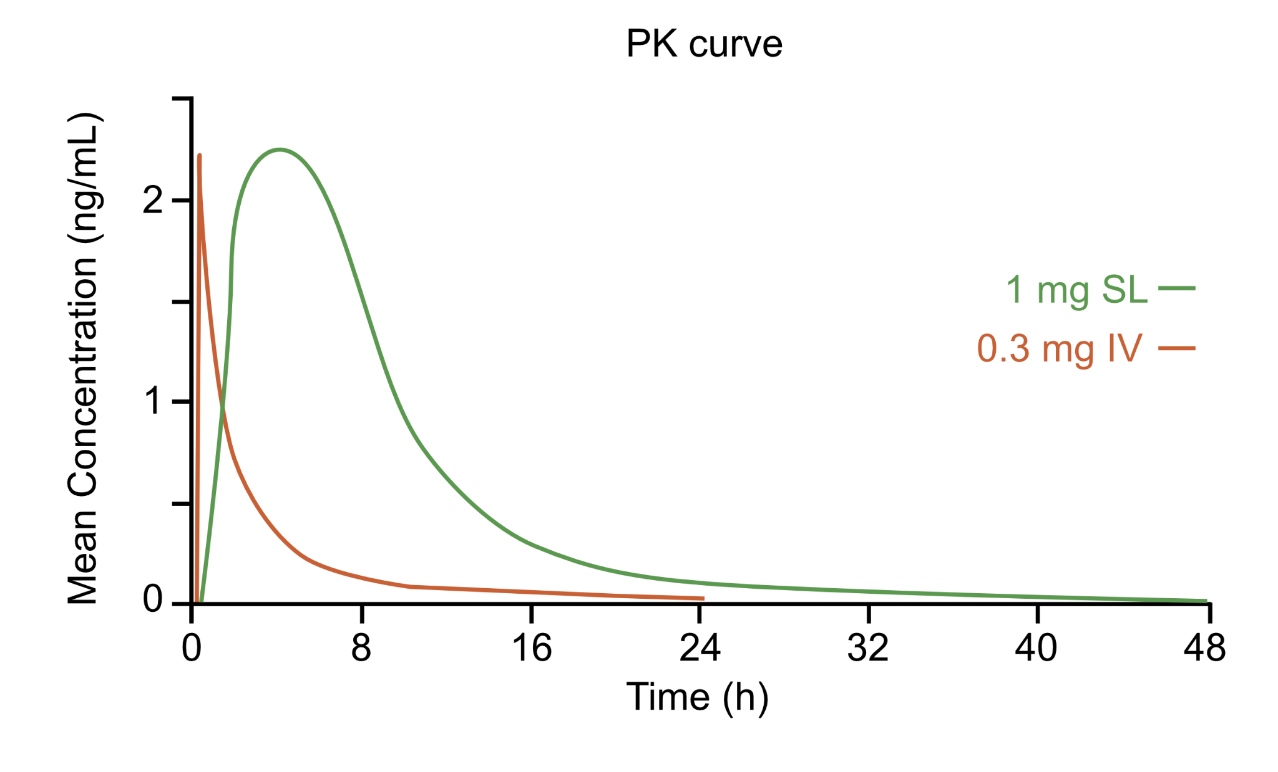
Bup pharmacology
Route | SL | IV
Peak plasma concentrations (Cmax) | 45-60 minutes | 2-5 minutes (“quick on / quick off”)
Dose equivalence | 1 mg | 0.3 mg
Notes:
high affinity high potency Semisynthetic partial mu opioid receptor agonist

Slide 5
Case 1
A 57-year-old female with opioid, alcohol, and stimulant use disorders
She was unresponsive with respiratory depression and responded to naloxone.
She received IV bup starting at 0.15 mg, then 0.3 mg and 0.6 mg increments hourly, titrated to responsiveness.
She received a total of 2.85 mg IV (roughly equivalent to 8.6 mg SL) administered over 7 hours, followed by buprenorphine-XR 300 mg.
She was observed for 4 hours, then discharged. At follow-up, denied opioid withdrawal symptoms.

Slide 6
Case 2
A 26-year-old male with OUD recent incarceration, presented to ED with opioid intoxication
He became unresponsive after fentanyl overdose in the bathroom.
He had no respiratory depression, naloxone not administered.
He received IV bup at 0.3 mg and 0.6 mg increments hourly.
3.3 mg IV (roughly equivalent to 9.9 mg SL) was administered over 7 hours, followed by buprenorphine-XR 300 mg.
He was observed for 40 minutes, then discharged. At follow-up, he reported feeling well.

Slide 7
Use of IV buprenorphine for reversal
High opioid load in OD setting permits rapid IV microdosing
High load mitigates withdrawal symptoms
IV bup’s “Quick on / Quick off” allows careful uptitration
Rapid IV microdosing
Safely, quickly, and precisely titrates to OD reversal
Smoothly transitions to bup-XR over the course of a single encounter

Slide 9
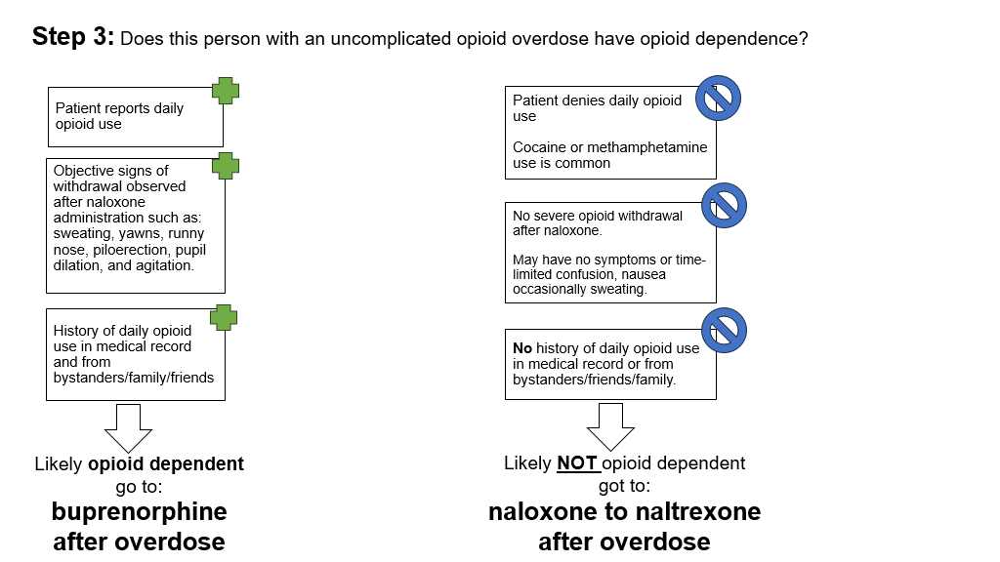

Slide 10
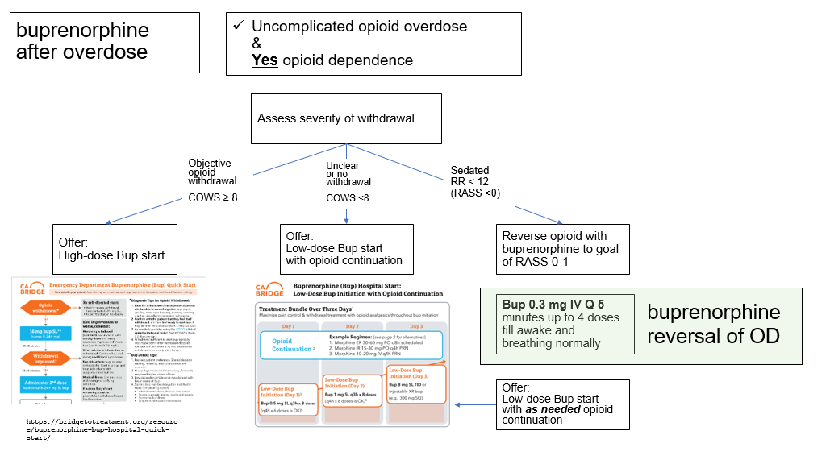
Bup 0.3 mg IV q ~1h to wakefulness

Slide 11
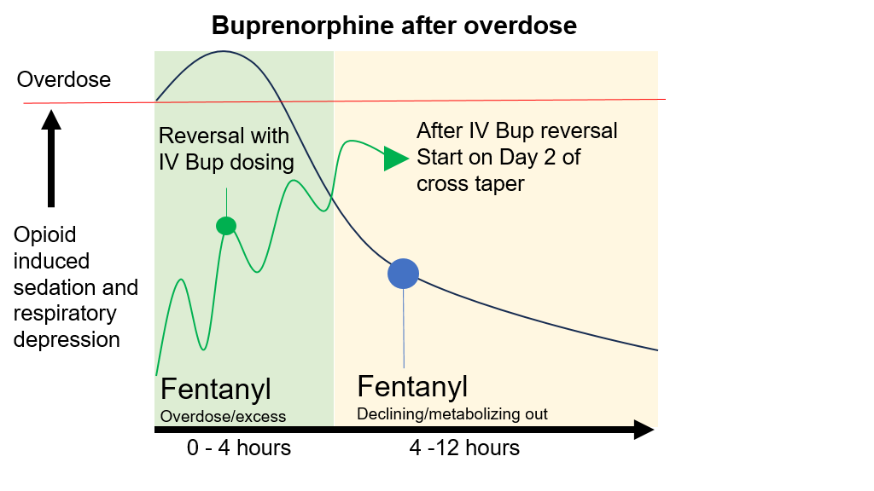
Bup-XR
Notes:
Graphic representation of how IV bup works for overdose and transitioning to bup XR. You continue to have fentanyl in the background while administering doses of IV buprenorphine

Slide 12
Conclusions
Buprenorphine reverses respiratory depression by displacing full agonist
IV buprenorphine allows seamless transition from OD to XR-bup
High load of agonist in overdose setting protects against precipitated withdrawal symptoms
Potential to reduce OD rates during high risk post OD windows
Potential to increase retention in this high risk population
Creates a rapid pathway to long term treatment

Slide 13
Health Equity Considerations
BIPOC patients are less likely to receive buprenorphine treatment compared to white patients
Barriers: insurance coverage disparities, availability of prescribers in underserved areas, treatment bias
Protocol benefits:
Standardizes care reducing bias
Overcomes transportation and pharmacy barriers

Slide 14
Thanks! Questions?

