Slide 1
Rich Saitz’ “What’s the Evidence Really?”
Stimulant Use Disorder-Emerging Pharmacotherapies, Behavioral Therapies and Harm Reduction

Slide 2
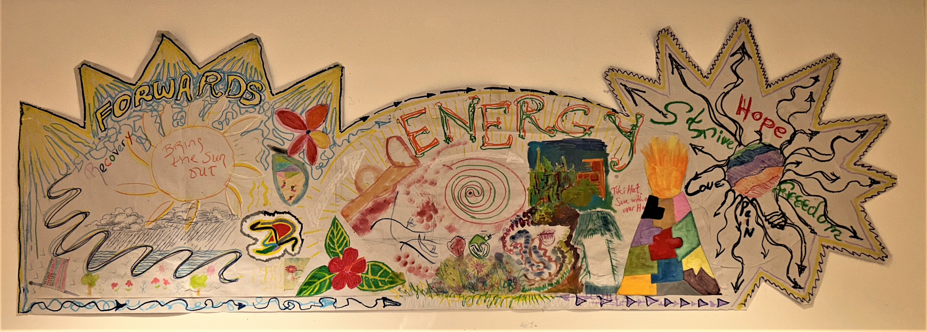

Slide 3
Stimulant Harm Reduction
Developed and Presented by:
Stephen Murray, MPH, NRP
Director, Massachusetts Overdose Prevention Helpline at Boston Medical Center
Member, Massachusetts Harm Reduction Advisory Council
Member, Massachusetts Drug Supply Data Stream (MADDS) Advisory Board
Lieutenant, Northern Berkshire EMS (Retired)
Licensed Paramedic, Massachusetts and Vermont

Slide 4
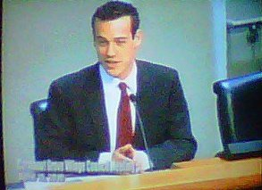
What did stimulant use and overdose look like for me?
Person who uses drugs
Struggled from 2007-2011
Multiple overdose survivor of both opioids and methamphetamine
No access to harm reduction or overdose prevention

Slide 5
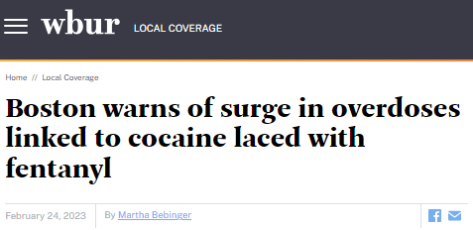
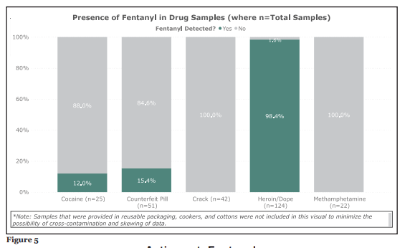
Fentanyl contamination occurs in Cocaine, Methamphetamine and Pressed Pills
In a 2021 study in Massachusetts which surveyed 465 PWUD, those who only used cocaine (and not opioids) had significantly less awareness that fentanyl was in the drug supply, were less likely to carry naloxone, and had not received naloxone training.
The key finding was that people who used only cocaine were “largely unprepared to recognized and respond to an overdose”
J. Hughto, L. Gordon, et al. Substance Abuse (2021)
Massachusetts Drug Supply Data Stream Community Drug Checking Boston Report (2021)
Notes:
Dispell myths about malicious intent: it goes like this: Dealers rush the cleanup, sloppily wiping down the area with a rag, which means traces of fentanyl remain. Then they begin to cut and package another product — in this case, cocaine — on the same table, with the same tools.
“They’re not cleaning the scales. They’re not cleaning the grinders. They’re not cleaning the strainers,” he tells Rolling Stone. “So whatever’s left there is going to be picked up in the first batch of coke.” So the cocaine becomes contaminated, Fuentes says, unbeknownst to the street dealers selling the product to their clients.
And that’s the key part here: Most drug dealers, experts say, don’t know that the substance they’re distributing is laced with fentanyl.

Slide 6
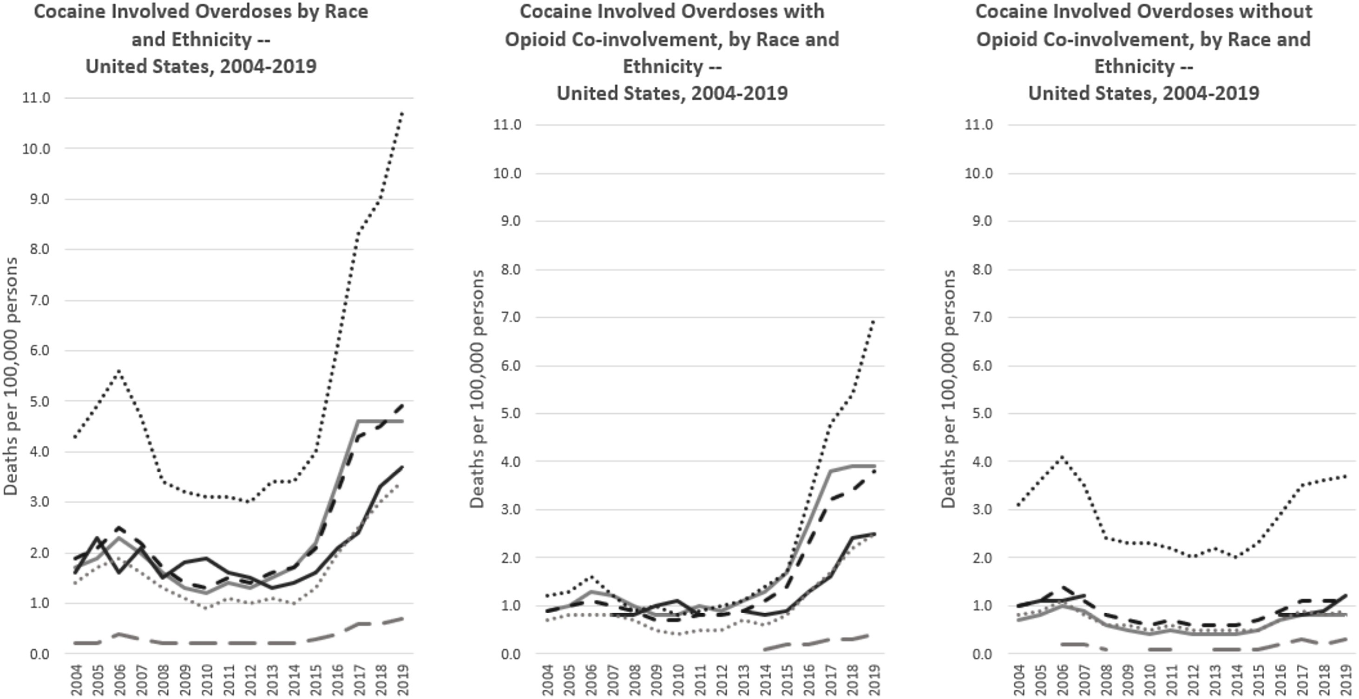
Fentanyl in stimulants changes the overdose risk pool
While fatal overdose rates increased 22% among white persons from 2019-2020, rates rose 44% amongst black individuals
Among white persons, the 15-24 year age group had the largest overdose rate increase (34%)
This points to a change in the risk pool:
BIPOC
Youth
Infrequent/Recreational users
Kariisa M. et al. Drug and Alcohol Dependence (2021)

Slide 7
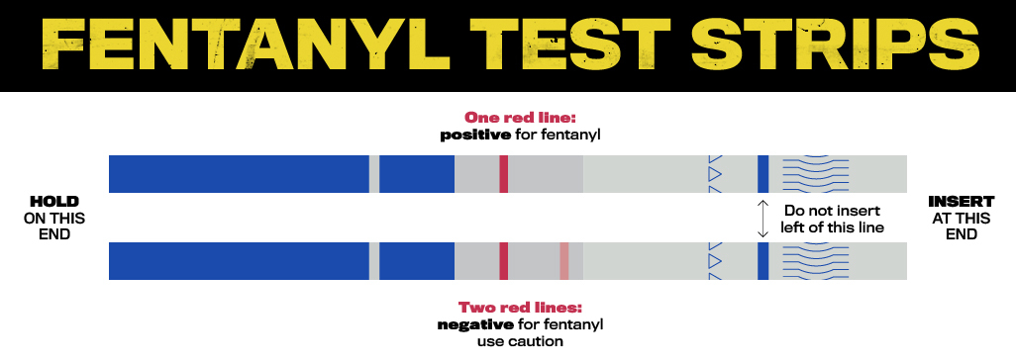
In Hughto et al. (2021), PWUD reported that feel, color or taste were the primary methods of detecting fentanyl in their supply (71.7%)
Fentanyl test strips can be re-deployed to people who use cocaine, crack and methamphetamine and counterfeit pills
Reed et al. (2021), found mixed interest by PWUS in utilizing FTS
Barriers cited included issues finding a place to conduct a test, legal implications, not being able to test until they had already used crack, too long of a duration to get a result
J. Hughto, L. Gordon, et al. Substance Abuse (2021)
M. Reed, A. Roth, et al. International Journal of Drug Policy (2021)

Slide 8
From Jan 2023-Oct 2023, the Mass Overdose Helpline spotted more than 550 use events
While 69% were opioid only, 31% of use events were stimulant only, or stimulant/opioid combos such as speedballs
Overdose helplines may be useful ways to engage people using stimulants in overdose prevention
Murray, S.P., Walley, A.Y. (2023, October). Overdose safety helplines – an evolving intervention to prevent fatal overdose death. Poster presented at the International Network on Health and Hepatitis in Substance Users, Geneva, Switzerland.

Slide 9
Overdose Prevention Sites
Overdose Prevention Sites have been used around the world for decades to offer supervised spaces for people to use
Stimulant users vary in route of consumption and include injection, inhalation and insufflation
In 2018, the first inhalation-designed space opened in Canada providing this service (previously this had been done in Vancouver in a repurposed bathroom)
In 4 months, they had reversed 11 overdoses in this space
S. Bourque, EM. Pijl, et al. Can J Public Health (2019)

Slide 10
Overdose Prevention Sites
A 2020 scoping review found that 48 overdose prevention sites around the world allowed non-injection routes of administration, with most programs located in Germany
Locations used included a backyard of the facility, a washroom with a fan, dedicated smoking rooms, mixed use rooms
As we develop overdose prevention sites in the United States, we should look to our partners in other countries to understand how to integrate safer smoking
Speed K.A., Gehring, N.D. et al. Harm Reduction Journal (2020)

Slide 11
Missed opportunities for overdose prevention
Overdose prevention efforts often miss people who use stimulants
They may not identify occasional use of opioids/benzos when asked
People who use stimulants who may use opioids or benzos only to come down
Access to naloxone, fentanyl test strips, referrals to overdose detection helplines and other safe use strategies are essential
“I just tell them to run or do you have any Valium, Valium or take a shot a bit of down [heroin], if you have any down, take a shot of that, that would bring you, calm you down... Anything that kind of, you know, calms your system down”
M. Mansoor, R. McNeil, T. Fleming et al. International Journal of Drug Policy (2022)

Slide 12
Stimulant Safe Supply
With the risk of fentanyl contamination in stimulants, there is a need to assess and consider safe supply as a solution
A study conducted in Canada during COVID-19 pandemic assessed the impact of stimulant safe supply
Medication could be taken orally, crushed, injected or snorted
Over 1,059 person-days in isolation there were zero overdoses and only 8% left during their 14 days isolation, showing potential for treatment retention
Brothers et al, Drug and Alcohol Dependence (2022)

Slide 13
Stimulant consumption harm reduction (pipes)
The distribution of crack pipes in Vancouver likely coincided with reduction of rates of reported health problems associated with smoking, including burns, mouth sores, cut fingers, raw throat or coughing blood
Hepatitis-C (HCV) can be transmitted through sharing of pipes
SmokeWorks distributes pipes to programs around the country on a sliding scale
One study found that syringe program participants were more likely to wipe their pipe with alcohol pad before sharing or use a rubber mouthpiece compared with nonengaged PWUD
This study also found that 61% injected their stimulants instead of smoked because of lack of access to pipes
Applewhite D., et al. Journal of Addiction Medicine (2023)
Prangnell A., et al. BMC Public Health (2017)
Fischer B., et al. Eur J Gastroenterol Hepatol (2008)
Image source: https://smokeworkspipes.com/

Slide 14
Stimulant consumption harm reduction
Distributing syringes and acidifiers for injecting crack is a very important harm reduction tool
When PWID do not have access to vitamin-C they will often use lemon juice or vinegar, which are far more acidic.
“[I use lemon and vinegar] loads of times, maybe for every ten times I inject probably two or three times, yeah, because I use so much citric for one bag, like the whole sachet, I run out of it constantly.”
M. Harris, J. Scott, et al. Harm Reduction Journal (2019)

Slide 15
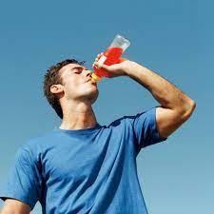
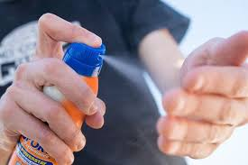
Harm Reduction is More than Pipes and Syringes
Stimulant use can result in other harms and it is important to work with PWUS to improve:
Hydration
Sleep
Environmental protection (sunburn, heat stroke, hypothermia)
“Hydration. […]I mean literally staying hydrated and having nutrition [inaudible] I guess my body was just in a point of severe, severe like two, three days without water walking around”
“That paranoia comes with the meth after a couple of days awake. Of course, your mind’s in a [inaudible] with you. You haven’t slept. So that’s when paranoia comes in with that.”
In one study of ICU admissions for people experiencing heatstroke, it was found that 27.8% of patients had positive UDS for stimulants, and this subgroup was more likely to need mechanical ventilation than nonusers (68 vs 29%), had significantly more complications and higher risk of death
Harding et al. Harm Reduction Journal (2022)
Levine et al. Journal of Medical Toxicology (2012)

Slide 16
HIV/STI Prevention and Risk in PWUS
People who use stimulants are at elevated risk of HIV infection, including MSM, sex workers, people who inject drugs
A 2019 study found through modelling that people who inject stimulants “shoulder a disproportionate burden of new HIV infections”
This model also found that scaled up syringe programs could reduce overall HIV incidence by 27-69% in 10 years in this population
Supervised consumption sites also play an important role in HIV reduction, as they reduce syringe sharing and increase condom use
Syringe programs can also be important access point for the uptake of PrEP, with one study finding greater retention in WWID who frequently utilized a syringe program
Roth, A., et al. Journal of Acquired Immune Deficiency Syndromes (2021)
Farrell M., et al. Lancet (2019)
Milloy M.J. & Wood E. Addiction (2009)
Marshall, B. et al. BMJ Sexually Transmitted Infections (2009)

Slide 18
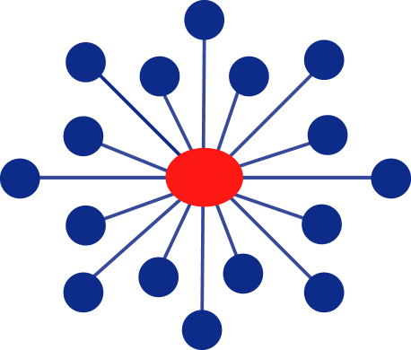
Medications for Methamphetamine Use Disorder
Steve Shoptaw PhD
UCLA Department of Family Medicine
November 4, 2023

Slide 19
Disclosures
Dr. Shoptaw has received clinical supplies for research from:
Alkermes, Inc
Indivior, Inc
Gilead Sciences, Inc
He provides consultation services to Aelis, Inc. and to Clear Scientific, Inc.

Slide 20
Objectives
Understand the evidence regarding for medications for methamphetamine use disorder that have strongest data supporting use
Understand the evidence for the range of medications that have limited evidence of efficacy for methamphetamine use disorder

Slide 21
Status of Medication Development for Stimulant Use Disorder
There are no FDA approved medications for stimulant use disorder
No medications that might be FDA approved within the next five years
A small suite of medications have strong evidence of efficacy
Most medications trialed have weak signals for efficacy

Slide 22
Strongest Evidence for Use XR-NTX @ 3 weeks + bupropion @ 450 q d Mirtazapine @ 30mg q d

Slide 23
Broadly Effective Medication for Meth Use Disorder
XR-NTX: 380mg @ 3 wks
Bupr: 450mg @ day
NNT 12 Wks=9
1:3, active to placebo 1:1, active to placebo
Trivedi MH et al., N Engl J Med. 2021 Jan 14;384(2):140-153.
Notes:
Mechanism for this effect is unknown – but it is a strong signal of efficacy. This trial randomized 403 participants to 6 weeks of medication combination or to placebo. Primary outcome was defined as participants who produced two weeks of meth-negative urine screens in weeks 5+6 and again in weeks 11+12
Those assigned to placebo who failed outcome in weeks 5+6 were re-randomized (1:1) to active or placebo
Findings show 11.1 percentage points difference

Slide 24
Findings and Targets
Mechanism for combination medication is unknown – but the combination produces the strongest signal of efficacy in over 30 years of addiction research
Fully powered trial: 403 participants randomized
Primary outcome response: # participants with two weeks of meth-negative urine screens in weeks 5+6; weeks 11+12
450 mg bupropion is a significant dose of a weak stimulant
XR-NTX produces a significant dose full mu opioid antagonist and kappa opioid antagonist
Combination produces synergized effect
Similarly, lower doses efficacious for weight loss (Contrave™)

Slide 25
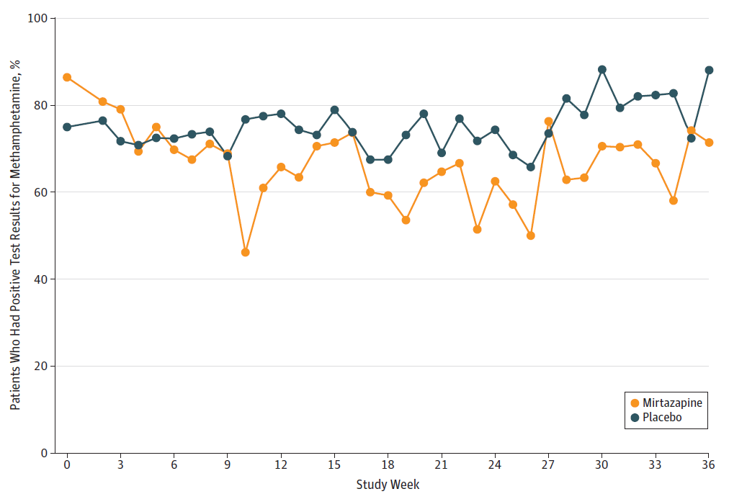
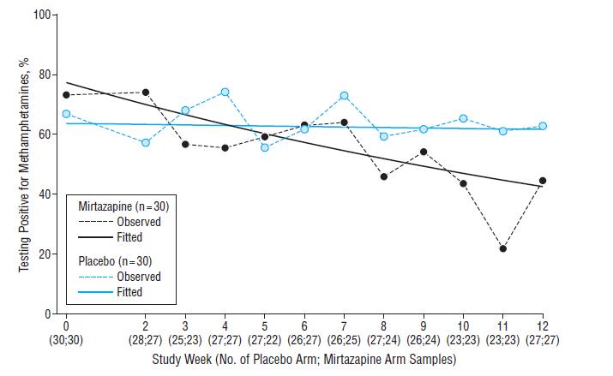
Pharmacotherapy for Stimulant Use in MSM: Mirtazapine 30 mg/day
NNT 12 Wks=8
NNT 24 Wks=11
Colfax et al. Archives Gen Psych, 2011 68: 1168-1175
Coffin et al., doi:10.1001/jamapsychiatry.2019.3655

Slide 26
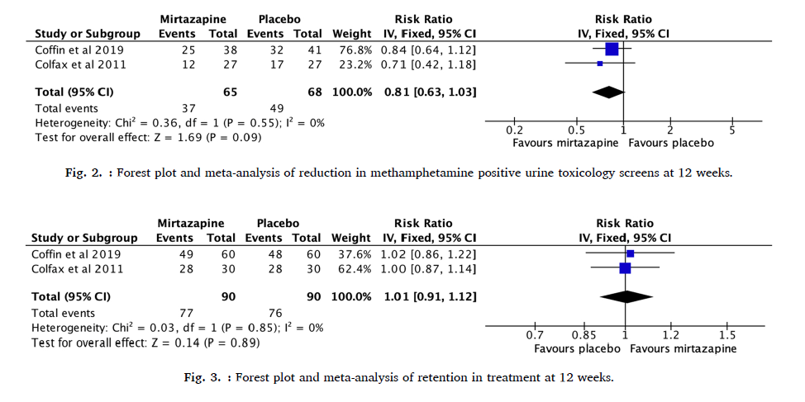
Mirtazapine Meta-Analysis
Naji L et al. Drug Alcohol Depend. 2022 Mar 1;232:109295. doi: 10.1016/j.drugalcdep.2022.109295.

Slide 27
PSYCHIATRIC MEDICATIONS
Medication/Class | Conditions | Outcomes | Reference
Bupropion | 6 studies | No significant signal to reduce MA use 2⁰ ↓ for 150mg bid in lower use (5) ↓ ad libitum smoking (6) | 1-6
Sertraline | Sert 50mg bid, CM | Sertaline less likely to achieve MA 3 wk abstinence | 7
Atomoxetine | 80mg/d | In OUD+ATS; ↓ MA use, but weak signal | 8
Aripiprazole, methylphenidate | Arip = 15mg/d Methyl = 54mg/d | Arip ↑ MA+ UDS vs placebo Methyl ↓ MA+ UDS vs placebo | 9
Topiramate Oxytocin | Top 200mg/d 40 IU (4 weeks) | In OUD+ATS; ↓ MA+ UDS at 6, not 12 weeks, ASI drug use severity and need; no diff crav or dep ↓ depression, craving; ↓ ACTH, ↓cortisol | 10 11
For systematic review, see Siefried KJ, et al. CNS Drugs. 2020 Apr;34(4):337-365.
For Practice Guideline: https://www.asam.org/quality-care/clinical-guidelines/stimulant-use-disorders

Slide 28
PSYCHOSTIMULANTS
Medication/Class | Conditions | Outcomes | Reference
d-Amphetamine | 30mg/d, 60mg/d | ↓ in craving, withdrawal severity | 12
 | 110mg/d | ↓ in withdrawal severity | 13
Methylphenidate | 54mg/d | ↑ in retention at 6 wks | 14
 | 54mg/d | 2⁰ ↓ MA use at 10 wks | 15
 | 54mg/d | ↓ craving, fewer MA+ UDS, ↓ dep | 16
Modafinil | 3 studies | No consistent signal | 17-19
Amineptine | 300mg/d | ↓ withdrawal symptoms (?), now off mkt | 20
For systematic review, see Siefried KJ, et al. CNS Drugs. 2020 Apr;34(4):337-365.
For Practice Guideline: https://www.asam.org/quality-care/clinical-guidelines/stimulant-use-disorders

Slide 29
GABA & OPIOID MEDICATIONS
Medication/Class | Conditions | Outcomes | Reference
Gabapentin+Baclofen | GPN – 800mg/tid B – 20mg tid | No differences | 21
Buprenorphine | 6mg/d SL Bupe | ↓ craving, fewer MA+ UDS | 22
Buprenorpine, methadone | 8mg/d SL Bupe 40mg/d methadone | No differences | 23
XR-NTX | 380mg Injection | No differences | 24, 25
Naltrexone | 1000mg implant | No differences | 26
Naltrexone | 50mg/d | ↓ MA+ UDS | 27
For systematic review, see Siefried KJ, et al. CNS Drugs. 2020 Apr;34(4):337-365.
For Practice Guideline: https://www.asam.org/quality-care/clinical-guidelines/stimulant-use-disorders

Slide 30
OTHER MECHANISMS
Medication/Class | Conditions | Outcomes | Reference
Ondansetron (5HT3) | 0.5mg, 2mg, 8mg/d | No differences; 5-hour half-life | 28
Varenicline | 1mg bid | No differences; reduced smoking | 29
Riluzole | 50mg/d | ↑ retention and abstinence | 30
NAC+Naltrexone NAC | NAC - 2400mg/d NTX – 200mg/d NAC – 2400mg/d | No differences No differences | 31 32
PROMETA | Flumazenil 2mg IV Gabapentin 1200/d Hydroxyzine 50/d | 2 studies; No differences | 33, 34
tDCS | Active | ↓ craving ↑ neurocog (35) ↓ craving ↑ memory tests (36) | 35, 36
Meth Psychosis | 6 antipsychotics | Olanzapine, Quetiapine preferred for antipsychotic effects; no effect on MA | 37
For systematic review, see Siefried KJ, et al. CNS Drugs. 2020 Apr;34(4):337-365.
For Practice Guideline: https://www.asam.org/quality-care/clinical-guidelines/stimulant-use-disorders

Slide 31
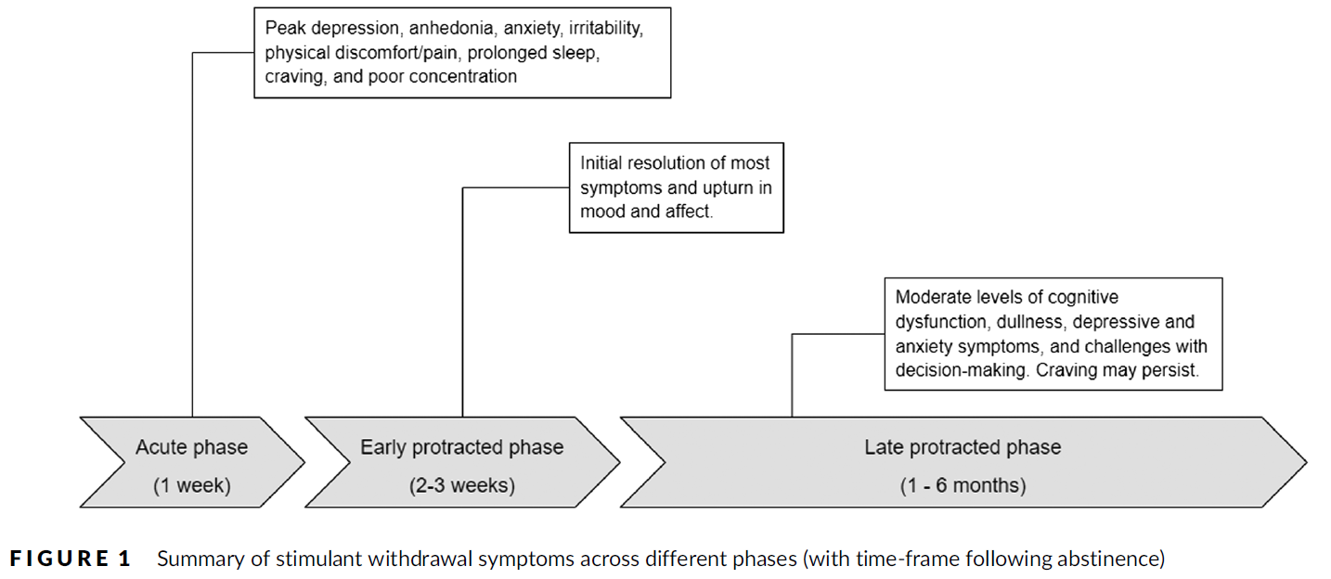
Withdrawal
Amineptine is the only medication that shows strong efficacy for withdrawal symptoms (20).
Strong stimulant, agonist effects
Still off-market in most parts of the world
Overall, there is inconsistent signal for biomedical treatments on MA withdrawal
Symptom relief for MA withdrawal seen for a few medications (mirtazapine, naltrexone, bupropion) and repetitive transcranial magnetic stimulation during acute (first week), early protracted (weeks 2–4) and late protracted (> 4 weeks) withdrawal phases
For Clinical Review, see Li MJ et al. Addiction. 2023 Apr;118(4):750-762.
For Systematic Review, see Acheson LS et al. Acheson LS, Drug Alcohol Rev. 2023 Jan;42(1):7-19.

Slide 32
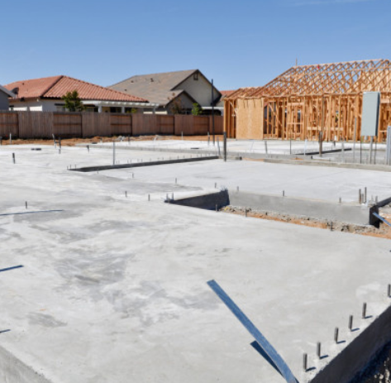
Summary Current Evidence
After 25 years, there are some signals for efficacy, though there still is no FDA approved treatment for cocaine or methamphetamine addiction:
Mirtazapine effects in MSM are impressive, particularly replication
Effect is reduction in use, not abstinence (like naltrexone for heavy alcohol drinking)
So far only tested in San Francisco and only in MSM
Large trial, strong signal for XR-NTX+Bupropion over placebo for reducing methamphetamine use
Other medications with mixed mechanisms show little signal
Strong evidence for use of antipsychotics for psychosis
Some evidence for symptom relief for withdrawal
Evidence to consider medication as a foundation of treatment for stimulant use disorder

Slide 33
References
Elkashef AM, et al. Bupropion for the treatment of methamphetamine dependence. Neuropsychopharmacology. 2008;33(5):1162–70.
Anderson AL, et al. Bupropion for the treatment of methamphetamine dependence in non-daily users: a randomized, double-blind, placebo-controlled trial. Drug Alcohol Depend. 2015; 150:170-4.
Heinzerling KG, et al. Pilot randomized trial of bupropion for adolescent methamphetamine abuse/dependence. J Adolesc Health. 2013; 52(4):502–5.
Heinzerling KG, et al. Randomized, placebo-controlled trial of bupropion in methamphetamine-dependent participants with less than daily methamphetamine use. Addiction. 2014; 109(11):1878–86.
Shoptaw S, et al. Randomized, placebo-controlled trial of bupropion for the treatment of methamphetamine dependence. Drug Alcohol Depend. 2008; 96(3):222–32.
Winhusen TM, et al. A randomized trial of concurrent smoking cessation and substance use disorder treatment in stimulant dependent smokers. J Clin Psychiatry. 2014; 75(4):336–43.
Shoptaw S, et al. Randomized, placebo-controlled trial of sertraline and contingency management for the treatment of methamphetamine dependence. Drug Alcohol Depend. 2006; 85(1):12–8.
Shearer J, et al. A double-blind, placebo-controlled trial of modafinil (200 mg/day) for methamphetamine dependence. Addiction. 2009; 104(2):224–33.
Tiihonen J, et al. A comparison of aripiprazole, methylphenidate, and placebo for amphetamine dependence. Am J Psychiatry. 2007; 164(1):160–2.
Elkashef A, et al. Topiramate for the treatment of methamphetamine addiction: a multi-center placebo-controlled trial. Addiction. 2012; 107(7):1297–306.
Azadbakht A, et al. The Effects of Oxytocin on Craving, Mental Health Parameters, and Stress Hormones in Methamphetamine-Dependent Patients Undergoing Matrix Treatment Model: A Randomized, Double-Blind Clinical Trial. Eur Addict Res. 2022; 28(5):340-349.

Slide 34
References
Galloway GP, et al. A randomized, placebo-controlled trial of sustained release dextroamphetamine for treatment of methamphetamine addiction. Clin Pharmacol Therapeutics. 2011; 89(2):276–82.
Longo M, et al. Randomized controlled trial of dexamphetamine maintenance for the treatment of methamphetamine dependence. Addiction. 2010; 105(1):146–54.
Miles SW, et al. Extended-release methylphenidate for treatment of amphetamine/ methamphetamine dependence: a randomized, double blind, placebo-controlled trial. Addiction. 2013; 108(7):1279–86.
Ling W, et al. Sustained-release methylphenidate in a randomized trial of treatment of methamphetamine use disorder. Addiction. 2014; 109(9):1489–500.
Rezaei F, et al. Sustained-release methylphenidate in methamphetamine dependence treatment: a double-blind and placebo controlled trial. Daru. 2015;23:2.
Anderson AL, et al. Modafinil for the treatment of methamphetamine dependence. Drug Alcohol Depend. 2012; 120(1–3):135–41.
Heinzerling KG, et al. Randomized, double-blind, placebo-controlled trial of modafinil for the treatment of methamphetamine dependence. Drug Alcohol Depend. 2010; 109(1–3):20–9.
Jittiwutikan J, et al. Amineptine in the treatment of amphetamine withdrawal: a placebo-controlled, randomised, double-blind study. J Med Assoc Thai. 1997; 80(9):587–92.
Lee N, et al. A pilot randomised controlled trial of modafinil during acute methamphetamine withdrawal: feasibility, tolerability and clinical outcomes. Drug Alcohol Rev. 2013; 32(1):88–95.
Heinzerling KG, et al. Randomized, placebo-controlled trial of baclofen and gabapentin for the treatment of methamphetamine dependence. Drug Alcohol Depend. 2006; 85(3):177–84.
Salehi M, et al. The effect of buprenorphine on methamphetamine cravings. J Clinical Psychopharmacol. 2015; 35(6):724–7.
Ahmadi J, et al. Comparing the effect of buprenorphine and methadone in the reduction of methamphetamine craving: a randomized clinical trial. Trials. 2017; 18(1):259.
Coffin PO, et al. Extended-release naltrexone for methamphetamine dependence among men who have sex with men: a randomized placebo-controlled trial. Addiction. 2018; 113(2):268–78.

Slide 35
References
Runarsdottir V, et al. Extended-release injectable naltrexone (XR-NTX) with intensive psychosocial therapy for amphetamine-dependent persons seeking treatment: a placebo controlled trial. J Addict Med. 2017; 11(3):197–204.
Tiihonen J, et al. Naltrexone implant for the treatment of polydrug dependence: a randomized controlled trial. Am J Psychiatry. 2012; 169(5):531–6.
Jayaram-Lindström N, et al. Naltrexone for the treatment of amphetamine dependence: a randomized, placebo-controlled trial. Am J Psychiatry. 2008; 165(11):1442–8.
Johnson BA, et al. A preliminary randomized, double-blind, placebo controlled study of the safety and efficacy of ondansetron in the treatment of methamphetamine dependence. Int J Neuropsychopharmacol. 2008; 11(1):1–14.
Briones M, et al. Varenicline treatment for methamphetamine dependence: a randomized, double-blind phase II clinical trial. Drug Alcohol Depend. 2018; 189:30–6.
Farahzadi MH, et al. Riluzole for treatment of men with methamphetamine dependence: a randomized, double blind, placebo-controlled clinical trial. J Psychopharmacol. 2019; 33(3):305–15.
Grant JE, et al. A double-blind, placebo controlled study of N-acetyl cysteine plus naltrexone for methamphetamine dependence. Eur Neuropsychopharmacol. 2010; 20(11):823–8.
McKetin R, et al. N-acetylcysteine (NAC) for methamphetamine dependence: A randomised controlled trial. EClinicalMedicine. 2021 Jul 13;38:101005.
Ling W, et al. Double-blind placebo-controlled evaluation of the PROMETA protocol for methamphetamine dependence. Addiction. 2012; 107(2):361–9.
Urschel HC 3rd, et al. A controlled trial of flumazenil and gabapentin for initial treatment of methylamphetamine dependence. J Psychopharmacol. 2011; 25(2):254–62.
Fayaz Feyzi Y,et al. Synergistic effect of combined transcranial direct current stimulation and Matrix ‎Model on the reduction of methamphetamine craving and improvement of cognitive ‎functioning: a randomized sham-controlled study. Am J Drug Alcohol Abuse. 2022 May 4;48(3):311-320.
Xu X, et al. The transcranial direct current stimulation over prefrontal cortex combined with the cognitive training reduced the cue-induced craving in female individuals with methamphetamine use disorder: A randomized controlled trial. J Psychiatr Res. 2021 Feb;134:102-110.
Srisurapanont M, et al. Efficacy and dropout rates of antipsychotic medications for methamphetamine psychosis: A systematic review and network meta-analysis. Drug Alcohol Depend. 2021 Feb 1;219:108467.

Slide 36
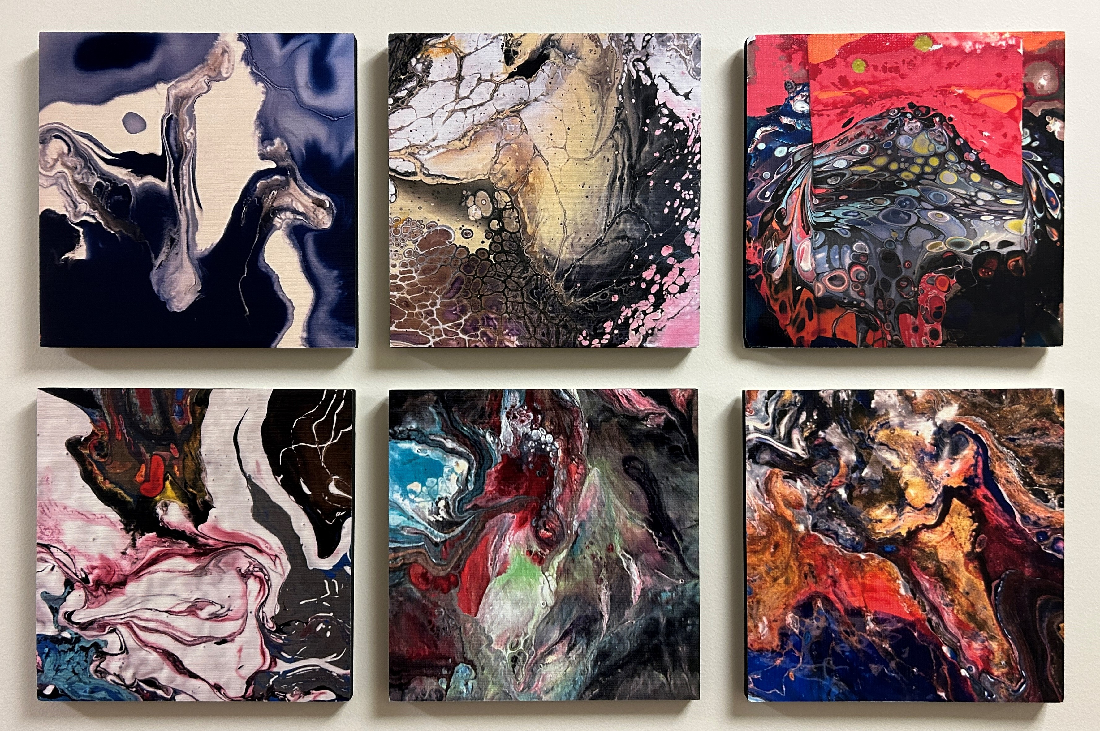

Slide 37
Pharmacotherapy for Cocaine Use Disorder
Daryl Shorter, MD
Medical Director, Addictions Services, The Menninger Clinic
Associate Professor, Baylor College of Medicine
November 4, 2023

Slide 38
Disclosure of Interests
No financial conflicts of interest to disclose.
Off-label and non-FDA approved medicines and clinical trials will be discussed

Slide 39
Cycle of Addiction
Binge/
Intoxication
Withdrawal/
Negative Affect
Preoccupation/
Anticipation

Slide 40
Goals of SUD Medications
Abstinence initiation
Block reward/substance
Reduce craving
Manage withdrawal
Aversive therapy
Change behavior

Slide 41
Targets of Medication Therapy
Aversive Therapy
Block Reward
Binge/
Intoxication
Withdrawal/
Negative Affect
Preoccupation/
Anticipation
Reduce Craving
Change
Behavior
Manage Withdrawal
Abstinence Initiation

Slide 42
Medications for Cocaine Use Disorder
Positive Signal and/or Promising Agent
Topiramate¹
Modafinil²
Bupropion³
Amphetamine salts⁴
Disulfiram (mixed, poorer retention)⁵
Buprenorphine + naltrexone⁶
1. Kampman et al., 2004, 2013; Johnson et al., 2013; 2. Dackis et al., 2005, 2012; Anderson et al., 2009; Kampman et al., 2015; 3. Shoptaw et al., 2008; Poling et al., 2006; 4. Mariani et al., 2012; Levin et al., 2015, 2020; 5. Carroll et al., 2004; Pani et al., 2010; Schottenfeld et al., 2014; 6. Ling et al., 2016.

Slide 43
Cocaine Vaccines, mAb
Naltrexone + Bupropion
Binge/
Intoxication
Withdrawal/
Negative Affect
Preoccupation/
Anticipation

Slide 44
Cocaine Vaccines
One (1) completed Phase 3, multi-site trial – TA-CD
Succinyl norcocaine hapten conjugated to cholera toxin B (rCTB)
2-weeks abstinence observed vaccine > placebo (NSS)
Currently enrolling: two (2) Phase 2 trials and one (1) Phase 1 trial
Pre-clinical trials in non-humans (i.e., rodents, primates) ongoing
Adjuvant selection remains complicated
Recent data suggest role for IgA secretion (in c/w IgM or IgG)
Notes:
Phase 1 – dAd5GNE (disrupted serotype 5 adenovirus (Ad) gene transfer vector coupled to a third-generation cocaine hapten, termed GNE (6-(2R,3S)-3-(benzoyloxy)-8-methyl-8-azabicyclo [3.2.1] octane-2-carboxamido-hexanoic acid))
Phase 2 - TV-1380
Phase 2 - RBP-8000
Kosten TR et al., Vaccine for cocaine dependence: a randomized double-blind, placebo-controlled efficacy trial. Drug Alcohol Depend. 2014; 140: 42-47.
Kosten TR et al., Anti-cocaine IgA rather than IgG mediates vaccine protection from cocaine use. Pharmacetics. 2022 Nov 3; 14(11):2368.

Slide 45
Naltrexone for Cocaine Use Disorder
Preclinical findings
↓ Ccn self-admin (rats (VTA), rhesus monkeys)
Clinical observation
NTX in pts w/comorbid OUD and CUD showed ↓ccn+ urines in c/w methadone
Positive signal for NTX in CUD and Alcohol Use Disorder
No diff b/w NTX and pbo in reducing craving in response to ccn-related film (Modesto-Lowe)
NTX 150mg - ↓%drink days; $ spent on ccn/wk, %ccn use days (Oslin)
NTX vs NTX + Disulfiram – no diff in ccn abstinence rates (Pettinati)
Notes:
Rats – Ramsey NF et al., Naltrexone affects cocaine self-administration in naïve rats through the ventral tegmental area rather than dopaminergic target regions. Eur Neuropsychopharmacol. 1999; 9(1-2): 93-99.
Mello et al., Buprenorphine and naltrexone effects on cocaine self-administration by rhesus monkeys. J Pharmacol Exp Ther. 1990 Sep; 254(3):926-39
Kosten et al., 1989
Modesto-Lowe V et al., Effects of naltrexone on cue-elicited craving for alcohol and cocaine. Drug Alcohol Depend. 1997 Dec; 49(1):9-16. 29 pts w/comorbid CUD and AUD are given NTX 50mg/day and shown two 5-min films. One focused on ccn, the other focused on EtOH. Ccn-related film induced greater desire for ccn than the alcohol-related film did for EtOH.
Oslin DW et al., The effects of naltrexone on alcohol and cocaine use in dually addicted patients. J Subst Abus Treat. 1999; 16(2): 163-167.
Ahmadi J, Kampman KM, Oslin DM, et al. Predictors of treatment outcome in outpatient cocaine and alcohol dependence treatment. Am J Addict. 2009; 18(1): 81-86. -- Baseline variable most consistently predicting cocaine abstinence in persons with comorbid CUD and AUD who were prescribed NTX 150mg/day = cocaine severity (CSSA score); initial UDS (abstinence at start of trial); and frequency of recent cocaine use.
Pettinati HM et al., A double-blind, placebo-controlled trial that combines disulfiram and naltrexone for treating co-occurring cocaine and alcohol dependence. Addict Behav. 2008; 33(5): 651-667.

Slide 46
Naltrexone + Bupropion
Human laboratory study, non-treatment seekers (N=31)
Randomized to NTX 50mg vs pbo plus bupropion in escalating doses (0, 100, 200, 400mg/day x 4 days each)
Only Bupropion 100mg blunted effects of cocaine, measures of “like drug” and “stimulated” in response to self administration
However, no impact on cocaine self-administration observed
Notes:
Regnier SD, Stoops WW, Lilie JA, et al. Naltrexone-bupropion combinations do not affect cocaine self-administration in humans. Pharmacol Biochem Behav. 2023; 224: 173526

Slide 47
Cocaine Vaccines, mAb
XR-Naltrexone + Bupropion
Binge/
Intoxication
Withdrawal/
Negative Affect
Preoccupation/
Anticipation
Naltrexone + Buprenorphine
Antidepressants

Slide 48
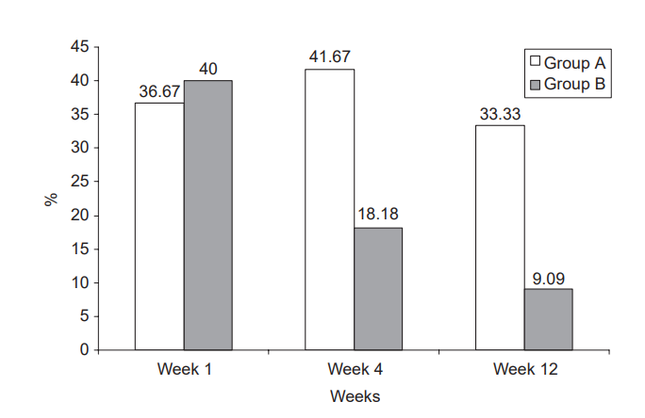
Naltrexone + Buprenorphine
Figure: Rates (%) of positive urines for cocaine metabolites in Group A (Naltrexone alone) and Group B (Naltrexone plus Buprenorphine) patients at week 1, 4, and 12
Naltrexone 50mg/day versus Naltrexone 50mg/day + Buprenorphine 4mg/day in heroin-dependent persons (N=60)
MOA - Kappa-antagonism
Findings
NTX + BUP group had higher treatment retention (p=0.018), lower rates of morphine & cocaine pos urines
Greater reductions in irritability, depression, craving in NTX + BUP
Gerra et al., 2006. Journal of Psychopharmacology
Notes:
Mechanism: Partial mu agonist/kappa antagonist (Bup) plus a mu antagonist (NTX) theoretically leaves primarily Kappa antagonism. The Kappa opioid system is thought to contribute to opioid protracted abstinence symptoms, dysphoria, and psychosomatic symptoms during NTX treatment.
Kappa antagonism as primary effect could improve mood

Slide 49
Naltrexone + Buprenorphine
Cocaine Use Reduction with Buprenorphine (CURB) Study
Buprenorphine/Naloxone (Suboxone®) given after admin of extended-release Naltrexone (XR-NTX, Vivitrol®)
N=302 participants with CUD and OUD, 8 wk study
XR-NTX plus Bup/Nx 4mg vs Bup/Nx 16mg vs PBO
No group diffs for primary outcome (UDS, self-report ccn use)
Significant reduction in ccn use btwn PBO and Bup/Nx 16 (p=0.030), but not PBO and Bup/NX 4 (p=0.529)
Ling et al., Addiction, 2016.

Slide 50
Antidepressants
Bupropion 1,2,3,4,5
Citalopram 6
Desipramine 7,8
Fluoxetine 9,10
Mirtazapine 11
Sertraline 12,13
Venlafaxine 14
Notes:
Margolin A, Kosten TR, Avants SK, et al. A multicenter trial of bupropion for cocaine dependence in methadone-maintained patients. Drug Alcohol Depend. 1995; 40:125-131.
Poling J, Oliveto A, Petry N, et al. Six-month trial of bupropion with contingency management for cocaine dependence in a methadone-maintained population. Arch Gen Psychiatry. 2006;63(2): 219-228.
Shoptaw S, Heinzerling KG, Rotheram-Fuller E, et al. Bupropion Hydrochloride versus placebo, in combination with cognitive behavioral therapy, for the treatment of cocaine abuse/dependence.
Ware OD, Sweeney MM, Cunningham C, et al. Bupropion Slow Release versus placebo with adaptive incentives for cocaine use disorder in persons receiving methadone for opioid use disorder: a randomized clinical trial. JAMA Netw Open. 2023;6(3):e232278.
Gao Z, Winhusen TJ, Gorenflo M, et al. Potential effect of antidepressants on remission from cocaine use disorder – A nationwide matched retrospective cohort study. Drug Alcohol Depend. 2023 Oct; 251:110958.
Suchting R, Green CE, de Dios C, et al. Citalopram for treatment of cocaine use disorder: A Bayesian drop-the-loser randomized clinical trial. Drug Alcohol Depend. 2021; 228: 109054.
Campbell J, Nickel EJ, Penick EC, et al. Comparison of desipramine or carbamazepine to placebo for crack cocaine-dependent patients. Am J Addict. 2003; 12:122-136.
McDowell D, Nunes EV, Seracini AM, et al. Desipramine treatment of cocaine-dependent patients with depression: a placebo-controlled trial. Drug Alcohol Depend. 2005; 80: 209-221.
Pani PP, Trogu E, Vecchi S, Amato L. Antidepressants for cocaine dependence and problematic cocaine use. The Cochrane database of systematic reviews. 2011(12):CD002950.
Schmitz JM, Averill P, Stotts AL, et al. Fluoxetine treatment of cocaine-dependent patients with major depressive disorder. Drug Alcohol Depend. 2001; 63(3): 207-214.
Afshar M, Knapp CM, Sarid-Segal O, et al. The efficacy of mirtazapine in the treatment of cocaine dependence with comorbid depression. Am J Drug Alcohol Abuse. 2012; 38(2): 181-186.
Mancino MJ, McGuagh J, Chopra MP, et al. Clinical efficacy of sertraline alone and augmented with gabapentin in recently abstinent cocaine-dependent patients with depressive symptoms. J Clin Psychopharmacol. 2014; 34(2): 234-239.
Oliveto A, Poling J, Mancino MJ, et al. Sertraline delays relapse in recently abstinent cocaine-dependent patients with depressive symptoms. Addiction (Abingdon, England). 2012; 107(1): 131-141.
Raby WN, Rubin EA, Garawi F, et al. A randomized, double-blind, placebo-controlled trial of venlafaxine for the treatment of depressed cocaine-dependent patients. Am J Addict. 2014; 23(1): 68-75.

Slide 51
Bupropion
Data suggesting potential role in specific subgroups?
No diff b/w Bupropion and pbo; but depressed persons (HAM-D > 12) receiving bupropion with greater reduction in ccn use** (Margolin)
No diff b/w Bupropion and pbo (UDS, craving, or depressive sx) (Shoptaw)
Bupropion plus CM w/SS diff from pbo plus CM and voucher control groups. Significant reductions in ccn-pos urines; higher mean consecutive weeks abstinent** (Poling)
Retrospective cohort study: higher rates of CUD remission with Bupropion c/w other antidepressants in persons with depression or nicotine dependence (Gao)
**Trial participants also methadone-maintained
Notes:
Margolin A, Kosten TR, Avants SK, et al. A multicenter trial of bupropion for cocaine dependence in methadone-maintained patients. Drug Alcohol Depend. 1995; 40:125-131.
Poling J, Oliveto A, Petry N, et al. Six-month trial of bupropion with contingency management for cocaine dependence in a methadone-maintained population. Arch Gen Psychiatry. 2006;63(2): 219-228.
Shoptaw S, Heinzerling KG, Rotheram-Fuller E, et al. Bupropion Hydrochloride versus placebo, in combination with cognitive behavioral therapy, for the treatment of cocaine abuse/dependence.
Gao Z, Winhusen TJ, Gorenflo M, et al. Potential effect of antidepressants on remission from cocaine use disorder – A nationwide matched retrospective cohort study. Drug Alcohol Depend. 2023 Oct; 251:110958.

Slide 52
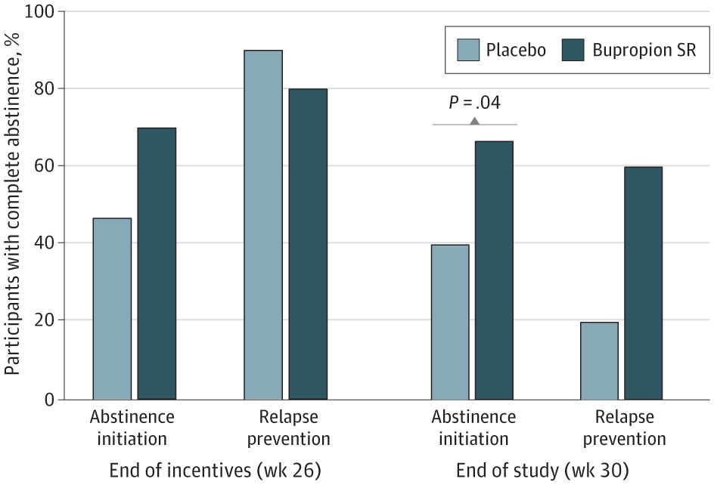
Bupropion
Figure: Percentage of Participants Testing Negative for Cocaine Use
Bupropion SR 300mg/day versus PBO in methadone-maintained persons w/OUD (N=80)
Conditions – 2 wks abstinent → Relapse Prevention group vs Abstinence Initiation
Findings
No significant overall effect of Bupropion SR and incentives versus placebo
Greater sustained abstinence in Bupropion group following cessation of incentives (wk 30)
Ware et al., 2023. JAMA Netw Open.
Notes:
Ware OD, Sweeney MM, Cunningham C, et al. Bupropion Slow Release versus placebo with adaptive incentives for cocaine use disorder in persons receiving methadone for opioid use disorder: a randomized clinical trial. JAMA Netw Open. 2023;6(3):e232278.

Slide 53
Other Antidepressants
Citalopram 40mg assoc w/higher probability of ccn-neg UDS in drop-the-loser Bayesian clinical trial (c/w 20mg dose, pbo)
Data re: depression scores not reported
In separate trials Desipramine (200 & 300mg/d) ↓ irritability & depression although no improvement in cocaine abstinence. Higher dropout due to medication side effects, medical AEs
Fluoxetine not assoc w/sustained abstinence, performs worse than pbo on study retention (Pani)
Notes:
Pani PP, Trogu E, Vecchi S, Amato L. Antidepressants for cocaine dependence and problematic cocaine use. The Cochrane database of systematic reviews. 2011(12):CD002950.
Note: In Fluoxetine trial with CBT, there was remission of depressive symptoms over time but not associated with medication effect. Schmitz JM, Averill P, Stotts AL, et al. Fluoxetine treatment of cocaine-dependent patients with major depressive disorder. Drug Alcohol Depend. 2001; 63(3): 207-214.

Slide 54
Other Antidepressants
Mirtazapine 45mg not assoc w/reduction in ccn use (UDS, self-report), greater craving reduction in pbo. Improved sleep, trend toward depression reduction
Sertraline 200mg better than pbo at preventing lapse (one use), relapse (two or more uses) in persons with co-morbid depression & abstinent at baseline
Venlafaxine 300mg showed no difference from pbo in sustained abstinence, ccn-negative UDS, retention
Notes:
Sertraline trials: 12-week trials with a 2-week residential stay followed by 10 weeks of outpatient study visits. Sertraline plus contingency management and once/week CBT. No diffs in study retention.
Venlafxine plus MI and weekly manualized relapse prevention therapy. No differences

Slide 55
Cocaine Vaccines, mAb
XR-Naltrexone + Bupropion
Binge/
Intoxication
Withdrawal/
Negative Affect
Preoccupation/
Anticipation
Topiramate
Clonidine
Lisdexamfetamine
MAS-ER
Ketamine
XR-Naltrexone + Buprenorphine
Antidepressants

Slide 56
Topiramate
Topiramate 300mg/day vs PBO in COC-dependent persons (N=142)
Figure: Weekly Mean Proportion of Coc-Nonuse Days (imputing missing data)
Findings
Topiramate increased cocaine nonuse days greater than PBO
Treatment increased likelihood of urinary cocaine-free weeks (16.6% vs 5.8%; OR=3.21; 95% CI, 1.24-8.32, p=0.02)
Craving reduction
Johnson et al., JAMA Psych. 2013.

Slide 57
Clonidine
Single dose of oral Clonidine 0.1mg or 0.2mg vs pbo
Craving (VAS, “Crave ccn”) ↑ in pbo group after stress script and drug-cue script but not neutral script
Clonidine 0.1mg: “Crave ccn” ↑ after drug-cue, not stress script
Clonidine 0.2mg: No increase in “Crave ccn” after either script
No effects on “Need ccn” or Cocaine Craving Questionnaire
Notes:
Jobes ML et al., Clonidine blocks stress-induced craving in cocaine users. Psychopharmacol. 2011; 218: 83-88.

Slide 58
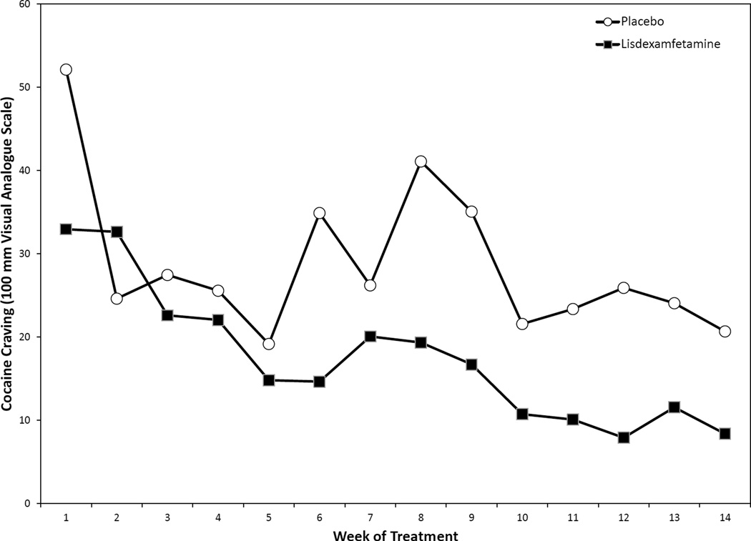
Lisdexamfetamine
Figure: Cocaine craving since last visit, “Needing Cocaine” rated on 100mm VAS
LDX 700mg/day vs PBO in COC-dependent persons (N=43)
Findings
No differences in cocaine use observed between groups
Retention higher in PBO group (71%) vs LDX (57%) (not SS)
Significant reduction in craving (“need cocaine”)
LDX group more likely to report SEs (diarrhea, headache, anxiety)
Mooney et al., Drug Alcohol Depend. 2015.
Notes:
Mooney ME, Herin DV, Specker S, et al. Pilot study of the effects of lisdexamfetamine on cocaine use: a randomized, double-blind, placebo-controlled trial. Drug Alcohol Depend. 2015; 153: 94-103.

Slide 59
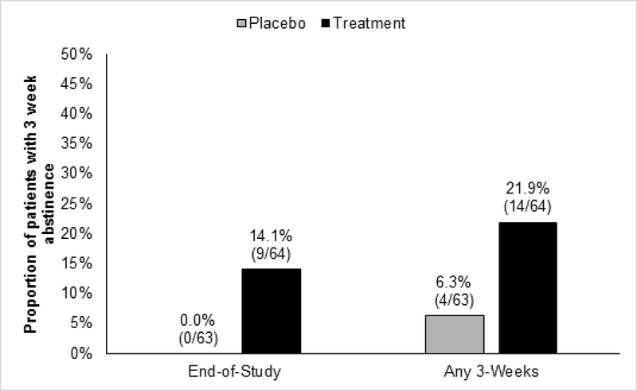
Mixed AMPH Salts ER (MAS-ER) + Topiramate
Figure: Proportion of patients achieving 3 weeks of abstinence
MAS-ER 60mg/day + Topiramate 100mg/day vs PBO in COC-dependent persons (N=127)
Findings
Proportion achieving three (3) abstinent weeks significantly larger in treatment group (14% vs 0%, p=0.03)
20% discontinuation from study med due to conservative cardiac safety parameters
Significant reduction in craving (“want cocaine”)
Levin et al., Drug Alcohol Depend. 2020.

Slide 60
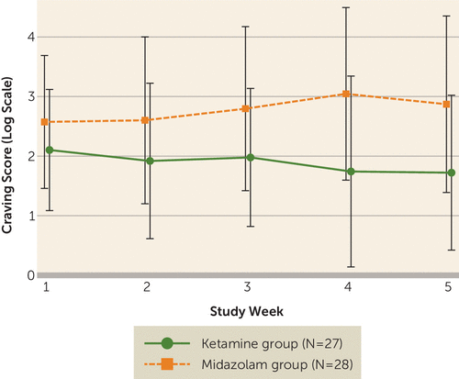
Ketamine
Figure: Observed mean craving score on log scale, by treatment group
Single Ketamine infusion (0.5mg/kg) vs Midazolam in COC-dependent persons (N=55) plus 5-week course of mindfulness-based relapse prevention
Design
Ketamine infusion was administered during 5-day inpatient stay, followed by outpatient treatment
Findings
Higher rates of 2-wk abstinence at study end in Ketamine group (48%) vs midazolam (11%)
Ketamine grp w/higher retention (53% less likely)
Significant reduction in craving with scores 58% lower in Ketamine grp
Dakwar et al., Am J Psych. 2019.
Notes:
Dakwar E, Nunes EV, Hart CL, et al. A single ketamine infusion combined with mindfulness-based behavioral modification to treat cocaine dependence: a randomized clinical trial. Am J Psych. 2019; 176(11): 923-930.

Slide 61
Progesterone
Inpatient, human lab studies
Oral micronized progesterone 400mg versus pbo (x 7 days)
Active group with ss lower post-imagery ccn craving
Notes:
Milivojevic V, Fox HC, Sofuoglu M, et al., Effects of progesterone stimulated allopregnanolone on craving and stress response in cocaine dependent men and women. Psychoneuroendocrinology. 2016; 65: 44-53.
Fox HC, Sofuoglu M, Morgan PT, et al. The effects of exogenous progesterone on drug craving and stress arousal in cocaine dependence: impact of gender and cue type. Psychoneuroendocrinology. 2013; 38: 1532-1544..

Slide 62
Cocaine Pharmacotherapy
Medications that blunt subjective cocaine effects in human laboratory studies show some promise in reducing cocaine reward; however, clinical trials have yet to identify a clear option.
Immunotherapy for cocaine use disorder including vaccines and monoclonal antibodies remain a viable and promising treatment approach

Slide 63
Cocaine Pharmacotherapy
Targeting cocaine withdrawal and/or craving with medications should be the clinical recommendation and can serve as a guide for patients and providers as to what symptoms should be the focus
Medications with potential benefit for reducing withdrawal symptoms, negative affect include XR-Naltrexone plus Buprenorphine and antdepressants such as Bupropion, Mirtazapine, and Sertraline

Slide 64
Cocaine Pharmacotherapy
Medications with potential benefit for reducing cocaine craving include Topiramate, Clonidine, Lisdexamfetamine, Mixed amphetamine salts, and Ketamine

Slide 65
DShorter@Menninger.Edu

Slide 66
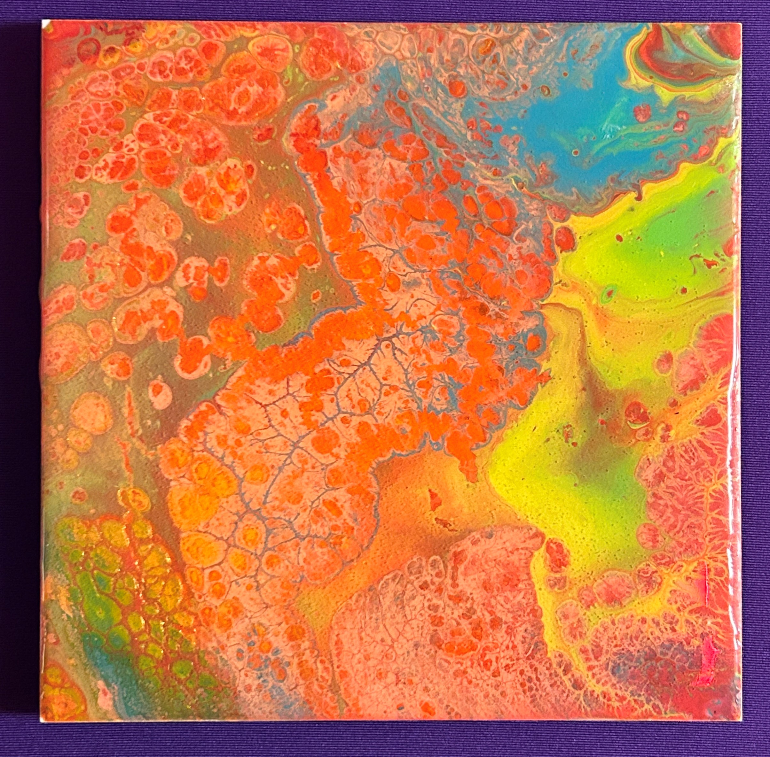

Slide 67
Behavioral Treatments for Stimulant Use Disorder
Joy Chudzynski, PsyD
Department of Family Medicine
Center for Behavioral & Addiction Medicine

Slide 68
Objectives
Describe the evidence for the use of behavioral health interventions for the treatment of stimulant use disorders and identify barriers to their implementation in clinical practice.
Describe CM, exercise, CBT, CRA
Provide evidence they are useful
Current implementation issues

Slide 69
Richard A. Rawson, Ph.D.
Professor Emeritus at the UCLA Department of Psychiatry
Research Professor at the Vermont Center for Behavior and Health at the University of Vermont

Slide 70
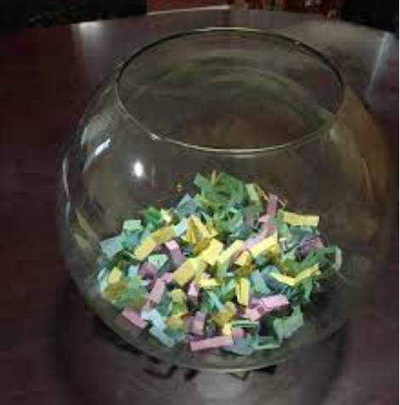
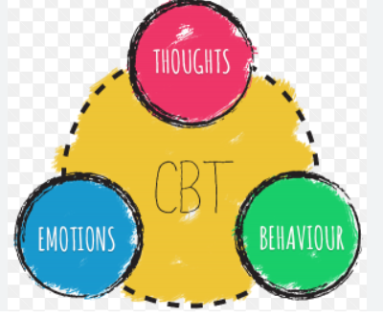
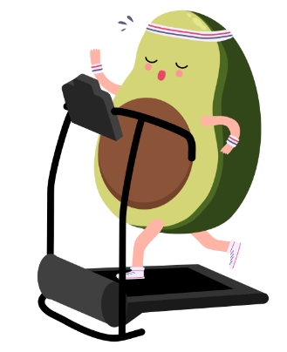
Treatments with Empirical Support
Contingency Management (CM)
CBT
CRA
Exercise

Slide 71
Current Status of Treatment Approaches for Methamphetamine Use Disorder
Contingency management unanimously (7 systematic reviews and meta-analyses) found to have the most robust evidence of effectiveness
Other approaches with lesser but evidence of support:
Cognitive Behavioral Therapy (CBT)
Community Reinforcement Approach (CRA)
Approach with recent studies showing benefit to individuals with methamphetamine use disorder:
Physical Exercise (PE) (e.g. Rawson et al, 2015)

Slide 72
Contingency Management
Systematic Reviews and Meta-analyses

Slide 73
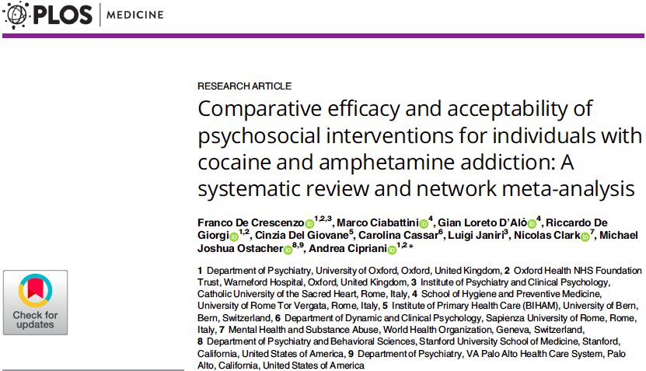
PLOS Medicine | December 26, 2018

Slide 74
Meta-Analysis Findings
Network meta-analysis was used to analyze 50 clinical studies
6,943 participants
12 different psychosocial interventions for cocaine and/or amphetamine addiction
CM alone or in combination with either CRA or CBT had superior efficacy and acceptability compared to TAU at 12 weeks and at the end of treatment
The combination of contingency management and community reinforcement approach was
most efficacious for abstinence
most acceptable treatment both in the short and long term
The combination was also associated with fewer dropouts than TAU at 12 weeks and end of tx

Slide 75
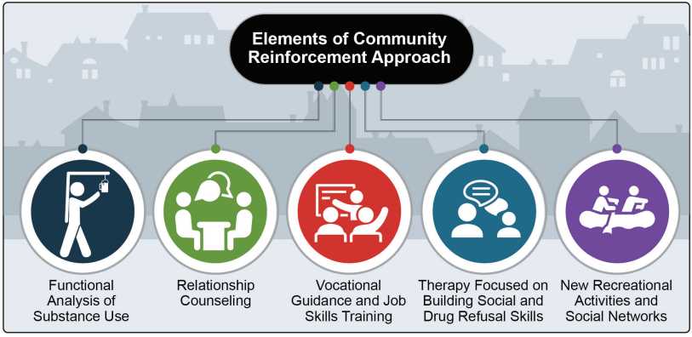
Meta-Analysis Findings - CRA
CRA alone was not different from TAU for abstinence at 12 weeks of treatment or at the end of treatment
At the longest follow-up, CRA was more effective than non-contingent rewards, supportive-expressive psychodynamic therapy, TAU, and 12-step programs
Combination of CRA with CM was superior also to CBT alone, CM alone, CM plus CBT, and 12-step program plus non-contingent rewards
De Crescenzo F, Ciabattini M, D'Alò GL, De Giorgi R, Del Giovane C, Cassar C, Janiri L, Clark N, Ostacher MJ, Cipriani A. Comparative efficacy and acceptability of psychosocial interventions for individuals with cocaine and amphetamine addiction: A systematic review and network meta-analysis. PLoS Med. 2018 Dec 26;15(12):e1002715. doi: 10.1371/journal.pmed.1002715. PMID: 30586362; PMCID: PMC6306153.

Slide 76
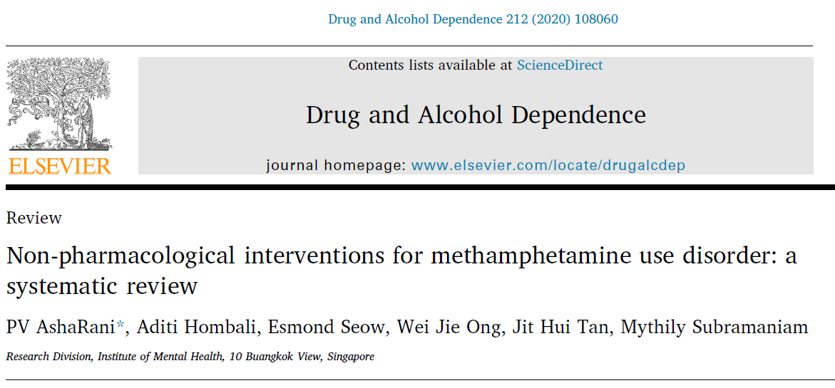

Slide 77
Systematic review findings
44 Studies reviewed
Contingency Management (CM) interventions showed the strongest evidence favoring the outcomes assessed

Slide 78
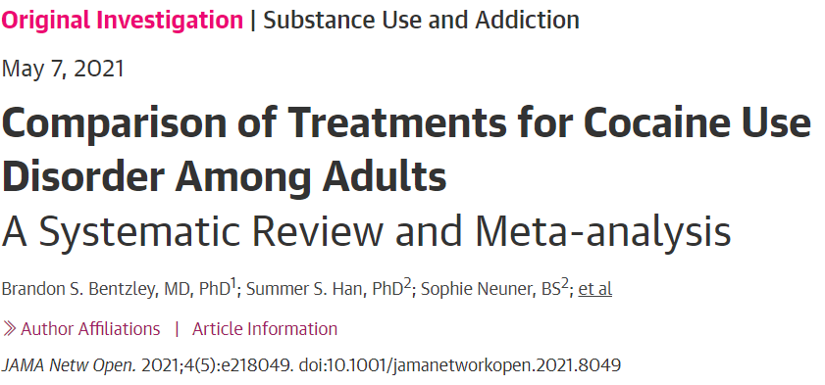

Slide 79
Systematic Review & Meta-analysis Results
Results A total of 157 studies comprising 402 treatment groups and 15,842 participants were included
Only contingency management programs were significantly associated with an increased likelihood of having a negative test result for the presence of cocaine (OR, 2.13; 95%)
Conclusions In this meta-analysis, contingency management programs were associated with reductions in cocaine use among adults

Slide 80
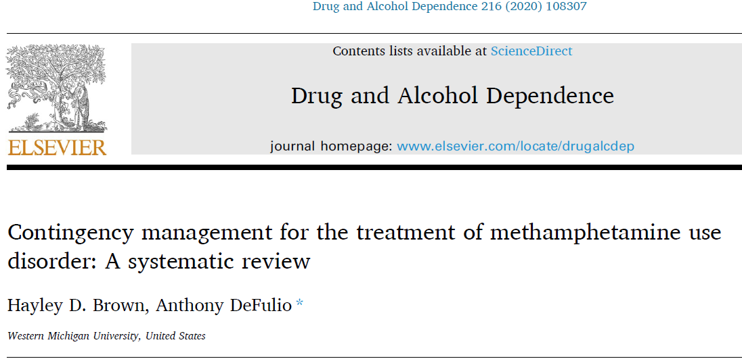

Slide 81
Brown and DeFulio, 2020 Systematic Review Results
A review of 27 studies
All included a contingency management intervention for individuals who use methamphetamine
Outcomes:
Drug abstinence
Retention in treatment
Attendance/treatment engagement
Sexual risk behavior
Mood/affect
Treatment response predictors

Slide 82
Results of CM Treatments
Reduced methamphetamine use in 26 of 27 studies
Longer retention in treatment
More therapy sessions attended; higher use of medical and other services
Reductions in risky sexual behavior
Increases in positive affect and decreases in negative affect

Slide 83
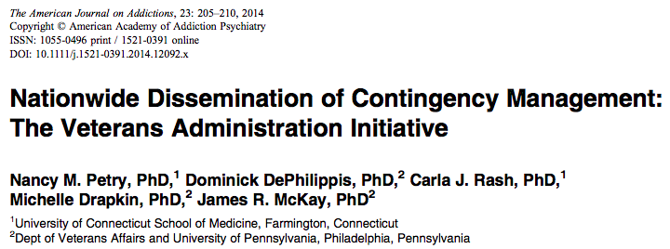

Slide 84
CM Implementation Challenges
Resistance to the concept of “paying addicts to not use” from politicians, state health leaders, state Medicaid officials, program administrators, clinical staff and potentially patients
Where does the money come from?
Currently, SAMHSA money, State Opioid Response grants and Block grants have a $75 max per patient
This is inadequate.
There is reassurance this $75 cap will be lifted, but when?
Using adequate incentive levels
Generally protocols that are 12-16 weeks with max earnings of $1000-$1200 are recommended
$599 max per patient per year may be used to avoid issuing 1099 tax forms
Earnings above $600 at present require 1099 tax forms.
Raises confidentiality issues

Slide 85
CM Implementation Challenges
Use of point of care test cups so results of UA are immediately available
Having a clear and evidence-based protocol for the program
Having a training/implementation plan that has a foundation in implementation science
This means that the training sessions need to be followed with a robust implementation/coaching process of biweekly/monthly sessions for the first 6 (12?) months (e.g., Science to Service, Becker, et al 2016)

Slide 86
Cognitive Behavioral Therapy

Slide 87
PLOS Medicine | December 26, 2018

Slide 88
Meta-Analysis Findings - CBT
Included seven RCTs comparing CBT to TAU
A significant benefit for CBT alone was found in the outcomes of dropout at 12 weeks and dropout at the end of treatment
For CBT alone, no significant benefit for abstinence at 12 weeks, at the end of treatment, or at longest follow up
CBT + CM better than TAU for abstinence at end to treatment
CBT + CM is superior to CBT alone

Slide 89
CBT Findings
AshaRani Review 2020
Tailored CBT alone or with CM was also effective in the target population
GCBT
CBT tailored for LGBTI clients
Marlatt CBT
AshaRani PV, Hombali A, Seow E, Wei Jie Ong, Jit Hui Tan, Subramaniam M., (2020) Non-pharmacological interventions for methamphetamine use disorder: a systematic review, Drug and Alcohol Dependence, Volume 212, 2020

Slide 90
CBT Findings
A systematic review by Harada et al. 2018
Evaluated the effectiveness of CBT for amphetamine-type stimulant use disorder included two RCTs
Was unable to determine the effectiveness of CBT due to poor quality data
Systematic review of reviews (Ronsley et al., 2020)
29 systematic reviews examining eleven intervention modalities)
found no significant benefit was identified for abstinence at 12 weeks, at the end of treatment, or at longest follow up
There are limited available systematic reviews and meta-analyses focusing on CBT for the treatment of stimulant use disorder

Slide 91
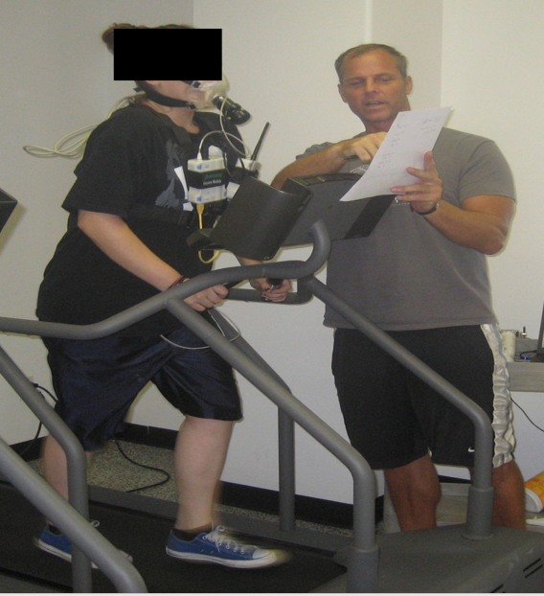
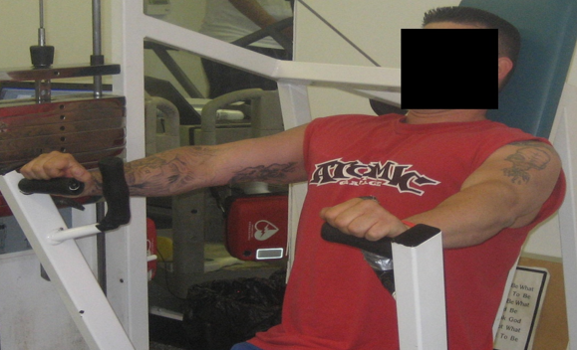
Exercise as a Treatment Intervention for Substance Use Disorder

Slide 92
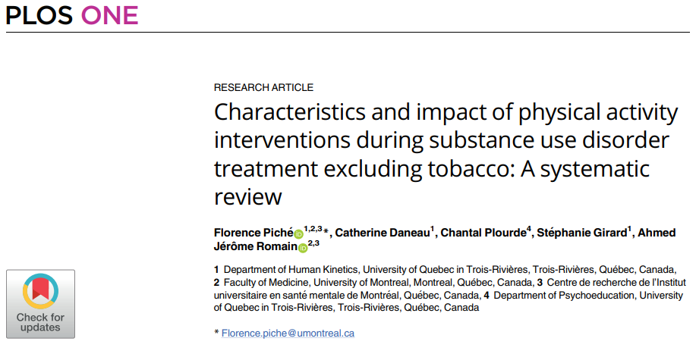
PLOS Medicine | April 26, 2023

Slide 93
Systematic Review Findings
Total of 43 articles, including 3135 participants were identified
Most studies were randomized controlled trial (81%), followed by pre-post design (14%) and cohort studies (5%)
Most common physical activity intervention identified was of moderate intensity, 3 times per week (≈ 1 hour) for 13 weeks
Cessation/reduction of substance use was the most studied outcome (21 studies, 49%), and 75% showed a decrease in substance use following physical activity intervention
Aerobic capacity was the second most studied effect (14 studies, 33%), with more than 71% of studies showing improvement
Twelve studies (28%) reported a decrease of depressive symptoms
Physical activity interventions in a treatment for substance use disorder are promising, but more methodologically rigorous scientific studies are needed

Slide 94
Exercise as a Treatment Intervention for Methamphetamine Use Disorder

Slide 95
Study Interventions
Participants randomized to 1 hour, 3 d/wk of exercise training (EX) or education (ED) over the 8-wk study period (24 sessions)
EX: 5 minutes warm-up followed by 30 minutes aerobic exercise on treadmill at 65%-85% max heart rate, followed by 15 minutes circuit-style resistance training of major muscle groups, 5 minute cool-down (light stretching)
ED: equal attention via health and wellness education sessions delivered by counselor. Topics include nutrition, health screening, meditation, acupressure, dental care, stress relief

Slide 96
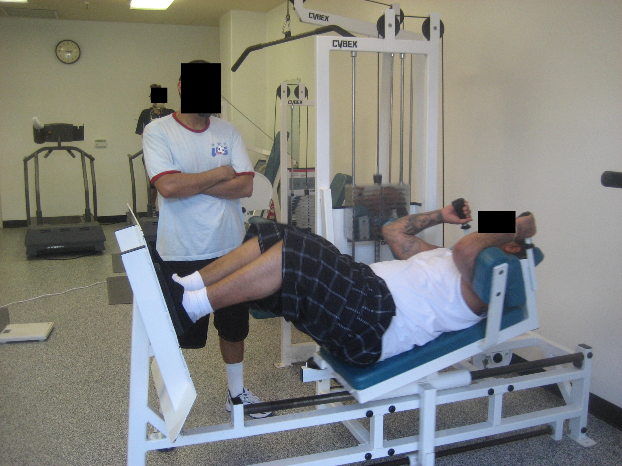
Notes:
1-RM leg press

Slide 97
Exercise Summary
For individuals in the first 100 days of meth recovery, exercise:
Improves physical conditioning
Reduces weight gain
Improves cardiovascular functioning (increases heart rate variability)
Reduces symptoms of anxiety and depression
Reduces craving for methamphetamine
Enhances recovery of dopamine system
Reduces relapse to methamphetamine post discharge (except in very heavy users)

Slide 98
Summary
CM works to reduce stimulant use and keep people in treatment
CM + CRA shows most efficacy
CRA works better than TAU, 12-Step and SEPT
“Show me the money!” - Implementation headaches with CM
CBT works better than TAU, but not as well as CM
Tailored CBT works to reduce use and retain in treatment
Exercise is promising treatment but needs more research

Slide 99
jchudzynski@mednet.ucla.edu

Slide 100
Questions?
Remember the Rich Saitz’ Rule:
Introduce yourself, then introduce your question/comment

