Slide 1
Rich Saitz’ Endowed Plenary “What’s the Evidence Really?”: Updates on Alcohol Use Disorder (AUD) Treatments
MODERATED BY: Anika A. H. Alvanzo, MD, MS, FACP, DFASAM
AMERSA 48th Annual Conference
Chicago, IL
Saturday, November 16, 2024
Notes:
Free stock photos are available on UNSPLASH:
https://unsplash.com/

Slide 2
DISCLOSURE INFORMATION
What’s the Evidence Really?: Updates on Alcohol Use Disorder Treatments
Saturday, November 16, 2024
Anika A. H. Alvanzo, MD, MS, FACP, DFASAM
Principal, Health Management Associates (HMA)
Addiction Medicine Physician, AbsoluteCare
No Financial Disclosures
Notes:
Disclosure slide option #1 for individual presenters. Select either option 1 or option 2, you don’t need to have both.
Please disclose all financial relationships that you've had with ineligible companies within the past 24 months regardless of them having ended. Ineligible companies are those whose primary business is producing, marketing, selling, re-selling, or distributing healthcare products used by or on patients. Please include the name of the ineligible company, your role (speaker's bureau, contracted research, employee, stockholder, etc), and if the relationship has ended

Slide 3
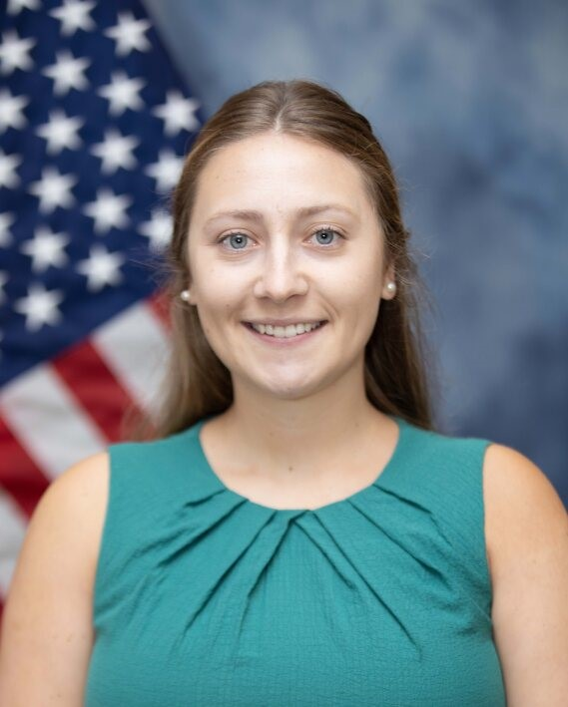
DISCLOSURE INFORMATION
What’s the Evidence Really?: Updates on Alcohol Use Disorder Treatments
Saturday, November 16, 2024
Alyssa Falleni, PharmD
Infectious Disease Clinical Pharmacy Specialist
Clinical Advisory Committee Consultant, SAMHSA Providers Clinical Support System - Medications for Alcohol Use Disorder
No Financial Disclosures
Off-label Disclosure: Some data presented in the following slides suggests the off-label use of topiramate, gabapentin, varenicline, and baclofen in treating alcohol use disorder.
Notes:
Dr. Alyssa Falleni is a clinical pharmacist who specializes in substance use disorders, infectious disease, and health professions education and research. She completed a pharmacy residency in ambulatory care focusing on HIV and primary care, and subsequently completed a two-year fellowship in health professions education, evaluation and research for addiction education. Her current clinical practice is at Hartford Healthcare Infectious Disease, providing medication management to people living with HIV and chronic Hepatitis C. She holds a clinical instructor position at the Yale School of Medicine in the Department of Psychiatry, teaching medical residents about substance use disorders and related harms employing gamification teaching methods.

Slide 4
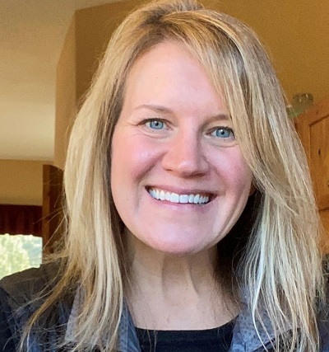
DISCLOSURE INFORMATION
What’s the Evidence Really?: Updates on Alcohol Use Disorder Treatments
Saturday, November 16, 2024
Katie Witkiewitz, PhD
Travel support by the American Society for Clinical Psychopharmacology’s Alcohol Clinical Trial Initiative, which is currently sponsored by Imbrium, Eli Lilly, and Indivior
NIAAA and NIDA funding (R01AA031159, RM1DA055301)
Notes:
Dr. Katie Witkiewitz is a Distinguished Professor of Psychology and Director of the Center on Alcohol, Substance use, and Addictions at the University of New Mexico. She is a licensed clinical psychologist and has worked extensively on the development of behavioral treatments for addiction and comorbid mental health and physical health conditions, mechanisms of successful alcohol treatment outcomes, and precision medicine approaches to alcohol use disorder treatment.

Slide 5
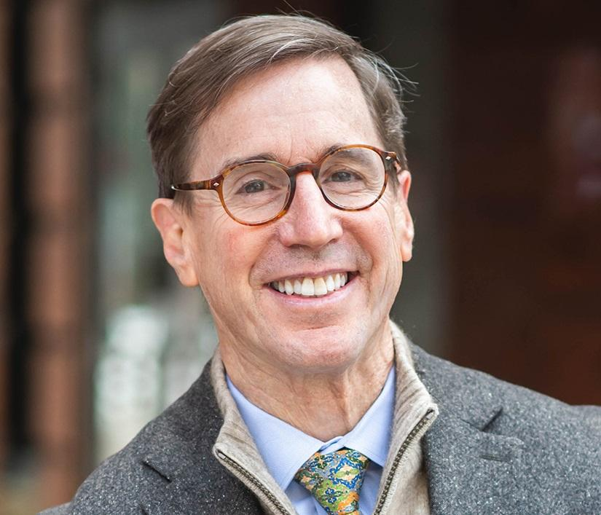
DISCLOSURE INFORMATION
What’s the Evidence Really?: Updates on Alcohol Use Disorder Treatments
Saturday, November 16, 2024
David H. Jernigan, PhD
Professor, Department of Health Law, Policy and Management, and Assistant Dean for Practice
Boston University School of Public Health
No financial disclosures
Notes:
David Jernigan, PhD, is a professor in the Department of Health Law, Policy and Management and Assistant Dean for Practice at the Boston University School of Public Health. He has written and worked on alcohol policy for more than 35 years, at local, state, national and global levels. He has written more than 170 peer-reviewed journal articles and contributed chapters to seven books on alcohol issues, as well as two chapters and a book on cannabis policy. He has also authored or co-authored pioneering works on alcohol, young people and health worldwide and in less-resourced countries, and on cannabis policy and public health.

Slide 6
LEARNING OBJECTIVES
Summarize available key literature that supports the use of pharmacotherapy in alcohol use disorder
Explain the theoretical and empirical foundations underlying psychosocial treatment approaches to the treatment of alcohol use disorder
Describe the key practices and adaptations for implementing psychosocial treatment approaches to the treatment of alcohol use disorder in real world settings
Recognize why population-level alcohol policies matter for reducing AUD
Identify the most effective and cost-effective population-level alcohol policy interventions
Notes:
ANIKA

Slide 7
OUTLINE
Dr. Alvanzo: Introductions and overview
Dr. Falleni: Pharmacotherapy for AUD
Dr. Witkiewitz: Behavioral interventions for AUD
Dr. Jernigan: Effective public health interventions
Questions & Answers
Notes:
ANIKA

Slide 8
EPIDEMIOLOGY OF UNHEALTHY ALCOHOL USE AND ALCOHOL USE DISORDER (AUD)

Slide 9
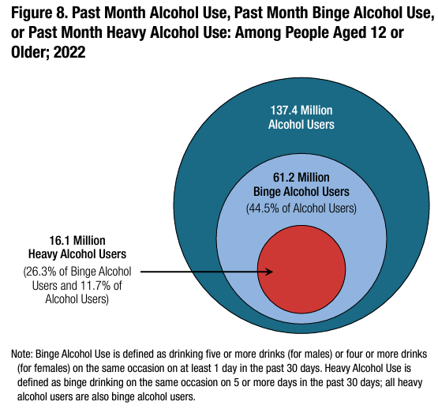
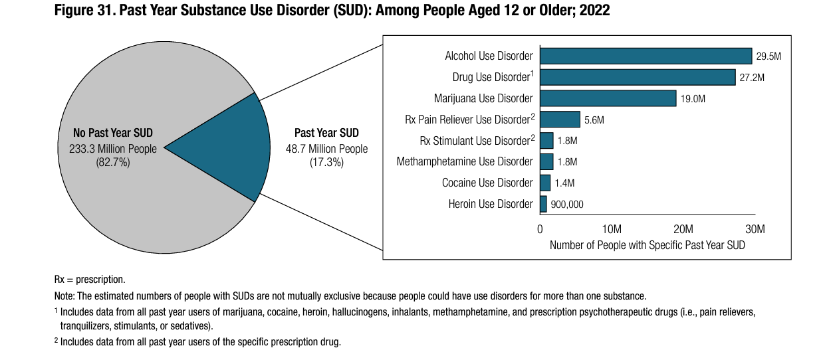
U.S. PREVALENCE OF UNHEALTHY ALCOHOL USE & ALCOHOL USE DISORDER
Insert Content Here
10.5%
2022 National Survey on Drug Use and Health (NSDUH)
Notes:
Data from the National Survey on Drug Use and Health (NSDUH), which is an annual, nationally representative study of civilian, noninstitutionalized population, aged 12 and older
~ 137 million Americans, 12 and older, report alcohol use in the past month with ~ 45% endorsing unhealthy alcohol use in the past month and ~ 11% reporting a past year alcohol use disorder
Not shown on the slide, data from the National Epidemiologic Survey on Alcohol and Related Conditions, the NESARC, estimated that the lifetime prevalence of AUD in the United States is 29%.

Slide 10
AUD PREVALENCE BY AGE AND RACE AND ETHNICITY
%
2022 National Survey on Drug Use and Health (NSDUH)
Notes:
Emerging Adults have the highest risk of alcohol use disorder
And with the exceptions of Asians, who have a lower risk of AUD, the risk is for past year AUD is comparable across race and ethnicities

Slide 11
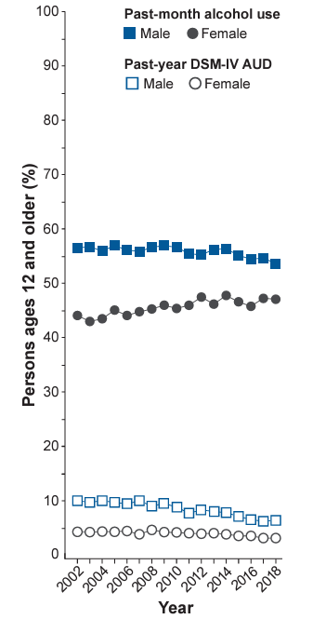
NARROWING GENDER GAP IN ALCOHOL USE AND CONSEQUENCES
Men drink more alcohol, have more alcohol-related injuries, and more AUD
Narrowing gender gap
Adolescents and Emerging Adults
Alcohol use among men decreased more than women
Adults
Alcohol use increasing among women but not men
Alcohol Res. 2020;40(2):01 • https://doi.org/10.35946/arcr.v40.2.01
Notes:
While men continue to drink at higher rates than women, over the decades, there has been a notable narrowing of this gender gap, fueled largely by increased rates of alcohol use among women.
Although more boys (19%) than girls (13%) start drinking before age 14, girls who begin drinking in early adolescence have a shorter time period between first drink and first episode of binge drinking.6,1

Slide 12
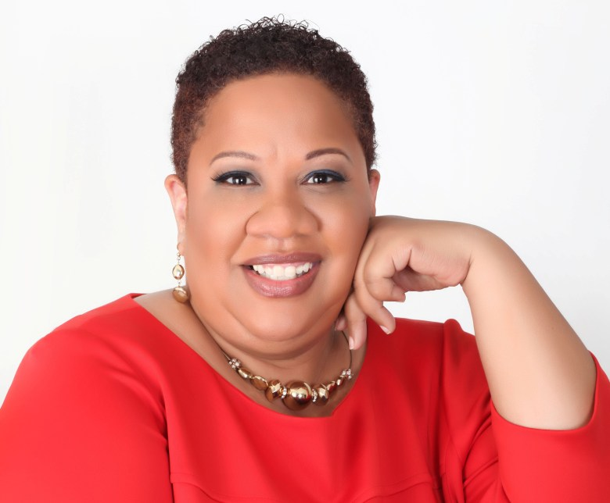
DISPARITIES IN AUD PREVALENCE
Race/Ethnicity
Lifetime prevalence of AUD highest among American Indian/Alaska Natives
43.4% AI/AN vs. 32.6% for Whites
Black women less likely to drink and initiate at older age
Those who do more likely to develop & sustain alcohol use disorder (AUD)
Nativity
US-born Asians and Hispanic/Latino (men) higher AUD prevalence than non-US born
Acculturation associated with increased AUD in Hispanic/Latina females
Sexual orientation
Sexual minoritized adults 1.5 – 3.0 times as likely to meet criteria for AUD
This Photo by Unknown Author is licensed under CC BY-NC-ND
This Photo by Unknown Author is licensed under CC BY
This Photo by Unknown Author is licensed under CC BY
Grant JD, Vergés A, et. al. Addiction.(2012)
Vaeth, PA. et. al. Alcohol Clin Exp Res (2017)
Fish, JN & Exten, C. Am J Prev Med (2020)
This Photo by Unknown Author is licensed under CC BY-SA
Notes:
There are notable disparities in alcohol use disorder.
While the NSDUH did not show any difference in past year prevalence of AUD by race/ethnicity, earlier data from the NESARC showed a significant disparity in lifetime prevalence of AUD with having the highest prevalence.
While Black women are significantly less likely to report drinking and start alcohol use at an older age, those who do drink are more likely to develop and sustain an AUD.
Data on AUD risk in Hispanic/Latinos in the US is variable, however, there are studies that indicated differential risk for AUD in Asian and Hispanic Americans based on nativity with those being born in the US having a higher prevalence; with some studies indicating that risk may be associated with the degree of acculturation or assimilation to the dominant culture.
There are also disparities in AUD prevalence by sexual orientation with those identifying as sexual minorities having higher rates

Slide 13
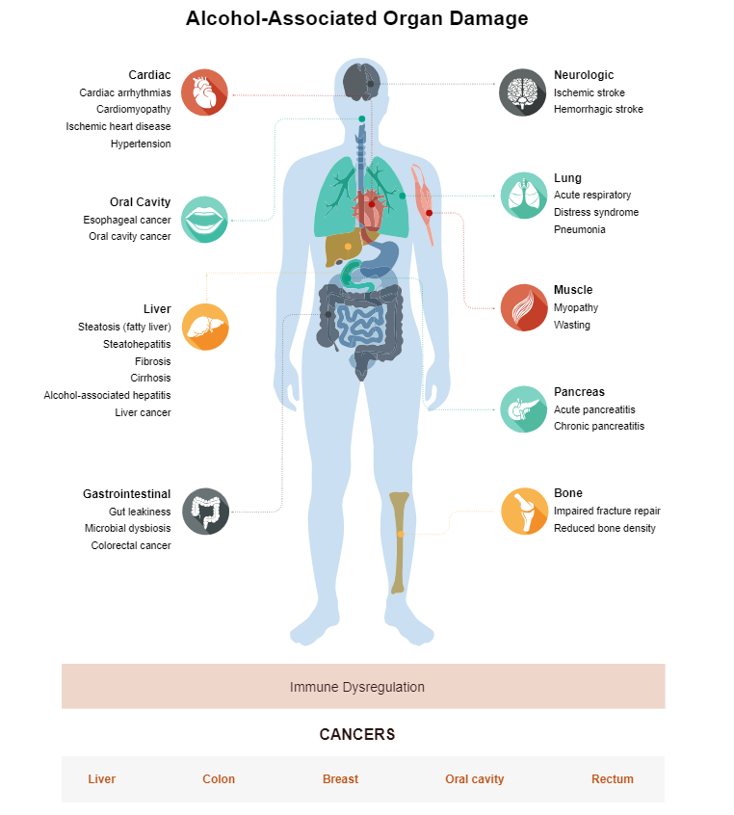
ALCOHOL-ASSOCIATED MORBIDITY AND MORTALITY
Alcohol use is associated with increased risk of injury
Falls
Drowning
Motor vehicle accidents
Burns
46% of liver disease deaths were alcohol-related
50.3% of cirrhosis deaths
4.1% of all new cancer cases globally
2.9% - 6.7% of new cancer cases in U.S.
https://www.niaaa.nih.gov/alcohols-effects-health/alcohol-topics/alcohol-facts-and-statistics/alcohol-and-human-body
Goding Sauer A. et. al. Cancer Epidemiol (2021); Rumgay H. et. al., Lancet (2021)
https://www.niaaa.nih.gov/alcohols-effects-health/alcohols-effects-body
Notes:
We know that alcohol affects multiple organ systems and is associated with substantial morbidity and mortality- ranging from traumatic injuries, and inclusive of neurologic effects, cardiovascular effects, gastrointestinal disease and malignancy
Alcohol is also associated with multiple malignancies, including:
female breast cancer, oropharyngeal cancer, esophageal cancer, liver cancer, colorectal

Slide 14
DISPARITIES IN CONSEQUENCES OF AUD
Sex disparities
Women with AUD: more likely to develop alcohol-associated cardiovascular disease and liver cirrhosis than men with AUD
Increases in alcohol-related consequences larger for women
ED visits, hospitalizations, deaths
Race and ethnicity disparities
Blacks with AUD: more alcohol-associated malignancies and cirrhosis than Whites with AUD
American Indian/Alaska Natives: more alcohol-associated injury
Blacks and Hispanics: more alcohol-associated injury mortality
Socioeconomic status (SES)
Lower SES associated with increased risk of alcohol-related mortality (66% for men and 78% for women
White A. Alcohol Res. (2020); Collins SE. Alcohol Res (2016); Erol A and Karpyak VM. Drug Alc Depend. 2015; Keyes KM et. al. Epidemiol Rev. 2012; Yoon YH and Yi HY. NIAAA. 2012; Chartier K and Caetano R. Addiction. 2010
Notes:
There are disparities in the consequences of AUD by sex, race, ethnicity and socioeconomic status.
Women and Blacks develop and die from liver cirrhosis at rates higher than men and Whites respectively.
10% higher mortality for alcohol-related disease.
Women also more likely to develop and increases in alcohol-related consequences have been greater for women
Blacks are also at increased risk for developing certain alcohol-related malignancies.
Indigenous populations have higher rates of alcohol associated injury, and
Blacks and Hispanics have higher rates of alcohol-associated injury resulting in mortality.
Similarly, those with lower SES are more likely to die as a result of their AUD compared to those with higher SES.

Slide 15
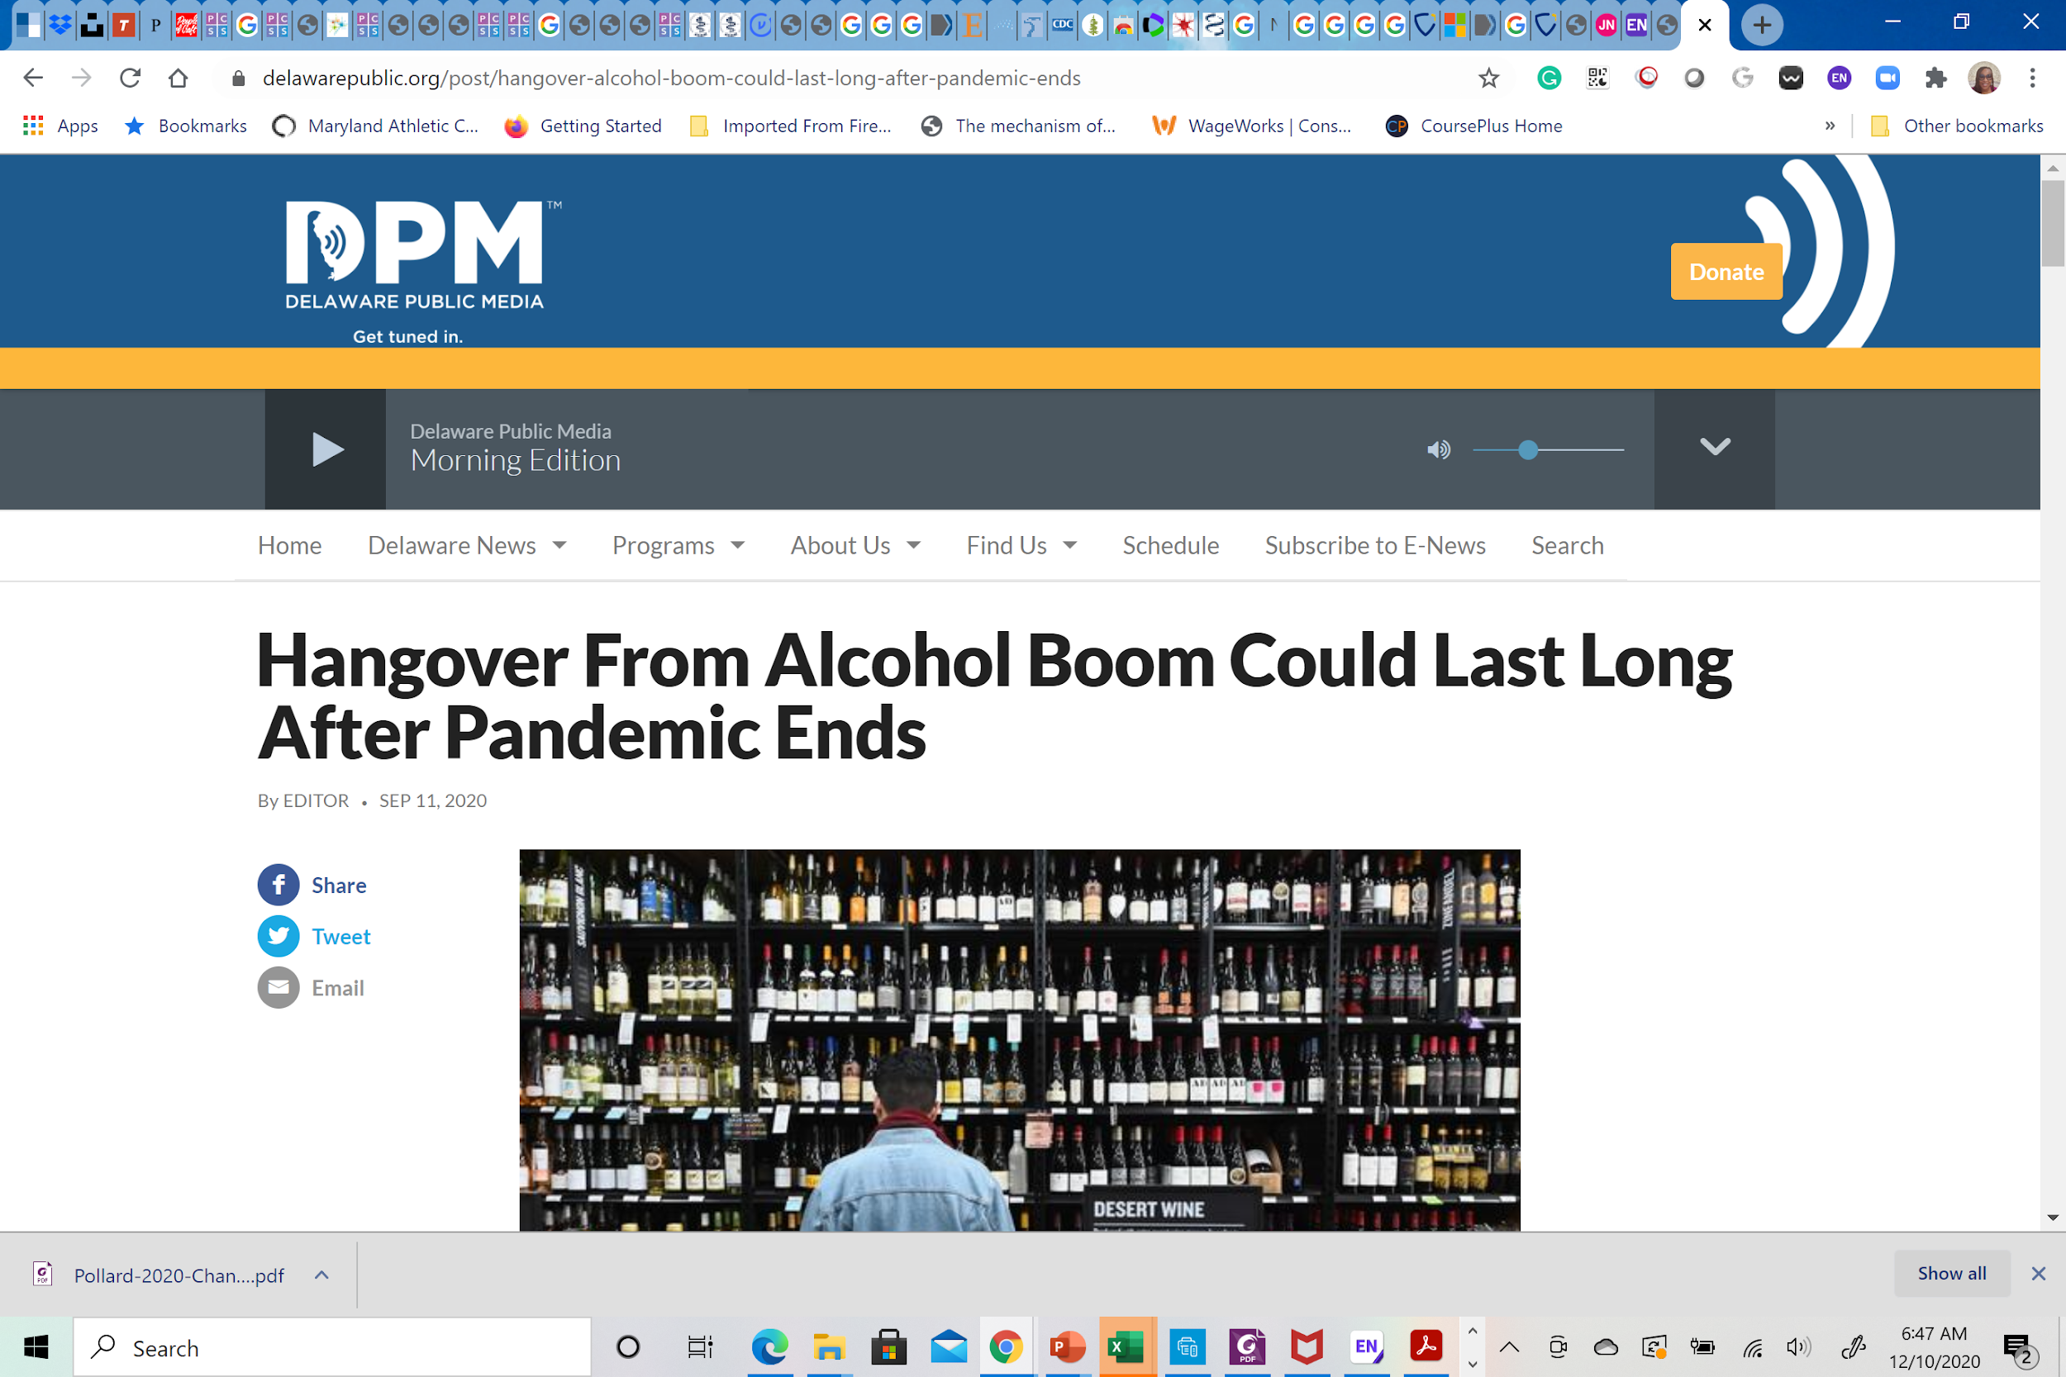
CHANGES IN ALCOHOL CONSUMPTION DURING THE COVID-19 PANDEMIC
Notes:
We know that the Covid-19 pandemic resulted in concerning changes in alcohol use with a marked increase in consumption and alcohol-related consequences in early part of the COVID-19 pandemic
25% increase in alcohol-related deaths between 2019-2020

Slide 16
UNHEALTHY ALCOHOL USE AND AUD ARE COSTLY
Excessive drinking cost the U.S. $249 billion dollars annually
Direct and indirect costs
38.8% direct costs (health care, crime, MVAs)
61.2% indirect costs (lost productivity)
2023 study found $10.2 billion annual expenditures in commercially insured persons with AUD
Li, M. et. al., JAMA (2023); Manthey, J. et. al., PhamacoEconomics (2021); Sacks JJ. Et. al., Am J Prev Med (2015)
Notes:
A 2006 study estimated that alcohol costs $249 billion annually

Slide 17
TREATMENT FOR AUD, PARTICULARLY MAUD, IS UNDERUTILIZED
Of the 29.5 million, aged 12 and older with past year AUD:
14.7% (4.3 million) received treatment for AUD
2.1% (634,00) received medication for alcohol use disorder (MAUD)
2.9% of males with AUD vs. 1.1% of females with AUD
2.9% of American Indian/Alaska Native
2.6% Non-Hispanic Blacks
2.2% Non-Hispanic Whites
1.6 % Hispanic/Latine
0.9% Multiracial
2022 National Survey on Drug Use and Health (NSDUH)
This Photo by Unknown Author is licensed under CC BY-SA-NC
Notes:
Only a minority of people with AUD receive treatment for their disease and pharmacotherapy is greatly underutilized, with about 15% reporting any treatment for AUD and only 2% reporting receipt of medication for alcohol use disorder in the past year

Slide 18
REFERENCES
Collins, S. E. (2016). Associations Between Socioeconomic Factors and Alcohol Outcomes. Alcohol Res, 38(1), 83-94. Retrieved from https://www.ncbi.nlm.nih.gov/pmc/articles/PMC4872618/pdf/arcr-38-1-83.pdf
Esser, M. B., Leung, G., Sherk, A., Bohm, M. K., Liu, Y., Lu, H., & Naimi, T. S. (2022). Estimated Deaths Attributable to Excessive Alcohol Use Among US Adults Aged 20 to 64 Years, 2015 to 2019. JAMA Network Open, 5(11), e2239485-e2239485. doi:10.1001/jamanetworkopen.2022.39485
Fish, J. N., & Exten, C. (2020). Sexual Orientation Differences in Alcohol Use Disorder Across the Adult Life Course. Am J Prev Med, 59(3), 428-436. doi:10.1016/j.amepre.2020.04.012
Goding Sauer, A., Fedewa, S. A., Bandi, P., Minihan, A. K., Stoklosa, M., Drope, J., . . . Islami, F. (2021). Proportion of cancer cases and deaths attributable to alcohol consumption by US state, 2013-2016. Cancer Epidemiol, 71(Pt A), 101893. doi:10.1016/j.canep.2021.101893
Grant, B. F., Goldstein, R. B., Saha, T. D., Chou, S. P., Jung, J., Zhang, H., . . . Hasin, D. S. (2015). Epidemiology of DSM-5 Alcohol Use Disorder: Results From the National Epidemiologic Survey on Alcohol and Related Conditions III. JAMA Psychiatry, 72(8), 757-766. doi:10.1001/jamapsychiatry.2015.0584
Li, M., Peterson, C., Xu, L., Mikosz, C. A., & Luo, F. (2023). Medical Costs of Substance Use Disorders in the US Employer-Sponsored Insurance Population. JAMA Network Open, 6(1), e2252378-e2252378. doi:10.1001/jamanetworkopen.2022.52378
Manthey, J., Hassan, S. A., Carr, S., Kilian, C., Kuitunen-Paul, S., & Rehm, J. (2021). What are the Economic Costs to Society Attributable to Alcohol Use? A Systematic Review and Modelling Study. Pharmacoeconomics, 39(7), 809-822. doi:10.1007/s40273-021-01031-8
Rumgay, H., Shield, K., Charvat, H., Ferrari, P., Sornpaisarn, B., Obot, I., . . . Soerjomataram, I. (2021). Global burden of cancer in 2020 attributable to alcohol consumption: a population-based study. The Lancet Oncology, 22(8), 1071-1080. doi:10.1016/S1470-2045(21)00279-5
Sacks JJ, Gonzales KR, Bouchery EE, Tomedi LE, Brewer RD. 2010 National and State Costs of Excessive Alcohol Consumption. Am J Prev Med. 2015 Nov;49(5):e73-e79. doi: 10.1016/j.amepre.2015.05.031. Epub 2015 Oct 1. PMID: 26477807.

Slide 19
REFERENCES
Substance Abuse and Mental Health Services Administration. (2023). Key substance use and mental health indicators in the United States: Results from the 2022 National Survey on Drug Use and Health (HHS Publication No. PEP23-07-01-006, NSDUH Series H-58). Center for Behavioral Health Statistics and Quality, Substance Abuse and Mental Health Services Administration. https://www.samhsa.gov/data/report/2022-nsduh-annual-national-report
Vaeth, P. A., Wang-Schweig, M., & Caetano, R. (2017). Drinking, Alcohol Use Disorder, and Treatment Access and Utilization Among U.S. Racial/Ethnic Groups. Alcohol Clin Exp Res, 41(1), 6-19. doi:10.1111/acer.13285
White, A. M., Castle, I.-J. P., Powell, P. A., Hingson, R. W., & Koob, G. F. (2022). Alcohol-Related Deaths During the COVID-19 Pandemic. JAMA, 327(17), 1704-1706. doi:10.1001/jama.2022.4308
White, A. M. (2020). Gender Differences in the Epidemiology of Alcohol Use and Related Harms in the United States. Alcohol Res, 40(2), 01. doi:10.35946/arcr.v40.2.01

Slide 20
PHARMACOTHERAPY FOR AUD

Slide 21
What do we look for? How do we compare?
What is the eligibility criteria?
“[We must] acknowledge that the ﬁeld has not uniﬁed in the choice of the single best outcome for long-term treatment of alcohol use disorder.”¹
Number of drinks per week
Number of heavy drinking days
Desire to quit/treatment seeking or not
No other substance use
AUD diagnosis
What are the outcomes?
1
Number of days abstinent
Return to drinking (time of abstinence)
Alcohol cravings
Percentage of heavy drinking days
Total alcohol consumption
Patient perspectives
Achieving patient drinking goal
How are the outcomes measured?
2
Self-reporting
Laboratory testing
Medication adherence/fills
Validated screeners
What is a standard drink? Who is measuring?
3
Notes:
NOTES:
Clinical trials reviewing the efficacy of medications for alcohol use disorder use similar standardized outcomes to compare medications across trials
This is where you start when you look at a study
Heavy drinking constitutes = >4 drinks per day for women, >5 drinks per day for men
What if outcomes reflected alcohol’s impact on quality of life and not just the amount someone consumes?
CITATIONS:
Bschor, T., Henssler, J., Müller, M., Baethge, C., 2018. Baclofen for alcohol use disorder-a systematic meta-analysis. Acta Psychiatr. Scand. 138, 232–242. https://doi.org/ 10.1111/acps.12905.

Slide 22
Medication Options:
FDA-Approved | Recommended by American Psychiatric Association/ VA/Department of Defense
Naltrexone (oral, injectable) Acamprosate Disulfiram | Topiramate Gabapentin
Emerging Evidence*
Baclofen Varenicline Glucagon-like peptide-1 agonists (GLP1s)
*This is not a comprehensive list of tried medications
Notes:
How do we determine treatment duration? Duration of tx 6 months -1 yr —2, 7, 24

Slide 23
Naltrexone - What’s Known
Mechanism of action: competitive antagonist at opioid receptor sites, multiple theories about how it works in AUD specifically
Historical efficacy:
Improved control over the decision to drink
Reduced the amount of alcohol consumed and urge to drink
Increased the number of days abstinent
Minimized the risk of return to heavy drinking
20 years ago patients who benefited the most were:
“Highly motivated”
“Supported with observed dosing”
Abstinent at time of tx
“Intense” cravings for alcohol
Family history of AUD
Notes:
NOTES:
ER formulation came after Low rate of retention and adherence with oral formulation led to development of injectable extended-release (ER) in 2006 [1]
The actual neurobiological mechanisms are not entirely understood.
MOA: Hemby 1997 and Lee 2005 theorize relationship with endogenous opioids involved in modulating alcohol’s reinforcing effects [2,3] O’Malley 2002 and Williams 2004 believe it modifies the hypothalamic-pituitary-adrenal (HPA) axis to suppress alcohol consumption.
CITATIONS:
Alkermes. Vivitrol prescribing information. Waltham, MA: Author, January, 2024. http://www.Vivitrol.com/Content/pdf/prescribing_info.pdf Accessed September 20, 2024.
O'Malley SS, Krishnan-Sarin S, Farren C, Sinha R, Kreek MJ. Naltrexone decreases craving and alcohol self-administration in alcohol-dependent subjects and activates the hypothalamo-pituitary-adrenocortical axis. Psychopharmacology (Berl). 2002 Feb;160(1):19-29. doi: 10.1007/s002130100919. Epub 2002 Jan 22. PMID: 11862370.
Williams KL, Broadbear JH, Woods JH. Noncontingent and response-contingent intravenous ethanol attenuates the effect of naltrexone on hypothalamic-pituitary-adrenal activity in rhesus monkeys. Alcohol Clin Exp Res. 2004 Apr;28(4):566-71. doi: 10.1097/01.alc.0000121655.48922.c4.
O'Malley SS, Froehlich JC. Advances in the use of naltrexone: an integration of preclinical and clinical findings. Recent Dev Alcohol. 2003;16:217-45.
Anton RF, Oroszi G, O’Malley SS, et al. An evaluation of µ-opioid receptor (OPRM1) as a predictor of naltrexone response in the treatment of alcohol dependence: results from the Combined Pharmacotherapies and Behavioral Interventions for Alcohol Dependence (COMBINE) study. Arch General Psych. 2008; 65(2):135-144.
Volpicelli JR, Watson NT, King AC, et al. Effect of naltrexone on alcohol “high” in alcoholics. Am J Psychiatry. 1995; 152:613-615.
Monterosso JR, Flannery BA, Pettinati HM, et al. Predicting treatment response to naltrexone: the influence of craving and family history. Am J Addictions. 2001; 10(3):258-268.
Rubio G, Ponce G, Rodriguez-Jimenez R, et al. Clinical predictors of response to naltrexone in alcoholic patients: who benefits most from treatment with naltrexone? Alcohol. 2005; 40(3):227-233.
_________________________________

Slide 24
Naltrexone - What’s New
Pharmacogenomics
Epigenetic factors may enhance naltrexone efficacy in reducing heavy drinking
Methylation in the μ-opioid receptor (OPRM1), dopamine transporter (SLC6A3), and catechol-O-methyltransferase (COMT) genes
16-week randomized, placebo-controlled trial
145 treatment-seeking AUD patients
Side Effects
No hepatotoxicity with ER formulation in people who continued to drink
No change in liver enzymes between groups over 3 months
Increases sedation, increases negative mood, reduces stimulation found in laboratory studies
Laboratory vs. clinical studies: light and heavy drinkers vs. people with AUD^{3,4}
Optimizing Treatment
Greater reduction in heavy drinking days/month on ER naltrexone
No lead-in abstinence
>3 months treatment
People who use alcohol as a reward may find greater benefit from naltrexone than acamprosate.
Notes:
NOTES:
Recent studies from our group (Ray et al., 2017) and others (Rohn et al., 2017) suggested that non-treatment seekers = majority of participants in human laboratory studies of naltrexone, vary widely from treatment-seeking individuals with AUD. Further, a recent meta-analysis by Klemperer and colleagues (2018) found that study characteristics accounted for 48% of the variance among naltrexone clinical trials for AUDs after controlling for medication characteristics (Klemperer et al., 2018).
CITATIONS:
Vutien P, Kim NJ, Merrill JO, Duncan MH, Ioannou GN, Collins SE. Extended-release Naltrexone Is Not Linked to Hepatotoxicity in Adults Experiencing Homelessness and Alcohol Use Disorder. J Addict Med. 2023 May-Jun 01;17(3):363-366. doi: 10.1097/ADM.0000000000001121. Epub 2023 Jan 5. PMID: 37267194; PMCID: PMC10248188.
Ray LA, Green R, Roche DJO, Magill M, Bujarski S. Naltrexone effects on subjective responses to alcohol in the human laboratory: A systematic review and meta-analysis. Addict Biol. 2019 Nov;24(6):1138-1152. doi: 10.1111/adb.12747. Epub 2019 May 30.
Ray LA, Bujarski S, Yardley MM, Roche DJO, Hartwell EE (2017) Differences between treatment-seeking and non-treatment-seeking participants in medication studies for alcoholism: do they matter? Am J Drug Alcohol Abuse 43:703–710.
Rohn MC, Lee MR, Kleuter SB, Schwandt ML, Falk DE, Leggio L (2017) Differences Between Treatment-Seeking and Nontreatment-Seeking Alcohol-Dependent Research Participants: An Exploratory Analysis. Alcohol Clin Exp Res 41:414–420.
Schacht JP, Hoffman M, Chen BH, Anton RF. Epigenetic moderators of naltrexone efficacy in reducing heavy drinking in Alcohol Use Disorder: a randomized trial. Pharmacogenomics J. 2022 Feb;22(1):1-8. doi: 10.1038/s41397-021-00250-8. Epub 2021 Aug 11. PMID: 34381173; PMCID: PMC8799481.
Murphy CE 4th, Wang RC, Montoy JC, Whittaker E, Raven M. Effect of extended-release naltrexone on alcohol consumption: a systematic review and meta-analysis. Addiction. 2022 Feb;117(2):271-281. doi: 10.1111/add.15572. Epub 2021 Jun 28. PMID: 34033183.
Mann K, Roos CR, Hoffmann S, Nakovics H, Leménager T, Heinz A, Witkiewitz K. Precision Medicine in Alcohol Dependence: A Controlled Trial Testing Pharmacotherapy Response Among Reward and Relief Drinking Phenotypes. Neuropsychopharmacology. 2018 Mar;43(4):891-899. doi: 10.1038/npp.2017.282. Epub 2017 Nov 20. PMID: 29154368; PMCID: PMC5809801.

Slide 25
Acamprosate - What’s Known
Multiple daily dosing due to poor bioavailability
MOA: unknown, thought to attenuate withdrawal symptoms via glutamate receptors
Effective for reducing alcohol dependence, no harmful use potential or significant drug-drug interactions
COMBINE Study did not find improvement in drinking outcomes
Number needed to treat to achieve one additional case of abstinence: 7
improved rate and duration of continuous abstinence
May be most effective for:
Completed detoxification
Abstinent and motivated
Hepatic disease
Treated with opioids for pain
Receive combination behavioral treatment
Notes:
NOTES:
Since 1989 in Europe, 1.5 million pharmacovigilance data points show no serious health risks or abuse potential for acamprosate
Associated with significantly higher rates of treatment completion and medication compliance than placebo among both women and men and had a comparable safety and tolerability profile.
CITATIONS:
Witkiewitz K, Saville K, Hamreus K. Acamprosate for treatment of alcohol dependence: mechanisms, efficacy, and clinical utility. Therapeutics Clin Risk Management. 2012; 8:45-53.
Yahn SL, Watterson LR, Olive MF. Safety and efficacy of acamprosate for the treatment of alcohol dependence. Subst Abuse. 2013;6:1-12. doi: 10.4137/SART.S9345. Epub 2013 Jan 31.
Harris BR, Prendergast MA, Gibson DA, Rogers DT, Blanchard JA, Holley RC, Fu MC, Hart SR, Pedigo NW, Littleton JM. Acamprosate inhibits the binding and neurotoxic effects of trans-ACPD, suggesting a novel site of action at metabotropic glutamate receptors. Alcohol Clin Exp Res. 2002 Dec;26(12):1779-93. doi: 10.1097/01.ALC.0000042011.99580.98.
Kiefer F, Jahn H, Tarnaske T, Helwig H, Briken P, Holzbach R, Kämpf P, Stracke R, Baehr M, Naber D, Wiedemann K. Comparing and combining naltrexone and acamprosate in relapse prevention of alcoholism: a double-blind, placebo-controlled study. Arch Gen Psychiatry. 2003 Jan;60(1):92-9. doi: 10.1001/archpsyc.60.1.92.
Whitworth AB, Fischer F, Lesch OM, Nimmerrichter A, Oberbauer H, Platz T, Potgieter A, Walter H, Fleischhacker WW. Comparison of acamprosate and placebo in long-term treatment of alcohol dependence. Lancet. 1996 May 25;347(9013):1438-42. doi: 10.1016/s0140-6736(96)91682-7.
Carmen, B., Angeles, M., Ana, M. and María, A.J. (2004), Efficacy and safety of naltrexone and acamprosate in the treatment of alcohol dependence: a systematic review. Addiction, 99: 811-828. https://doi.org/10.1111/j.1360-0443.2004.00763.x
Mann K, Lehert P, Morgan MY. The efficacy of acamprosate in the maintenance of abstinence in alcohol-dependent individuals: results of a meta-analysis. Alcohol Clin Exp Res. 2004 Jan;28(1):51-63. doi: 10.1097/01.ALC.0000108656.81563.05. PMID: 14745302.
Anton RF, O'Malley SS, Ciraulo DA, Cisler RA, Couper D, Donovan DM, Gastfriend DR, Hosking JD, Johnson BA, LoCastro JS, Longabaugh R, Mason BJ, Mattson ME, Miller WR, Pettinati HM, Randall CL, Swift R, Weiss RD, Williams LD, Zweben A; COMBINE Study Research Group. Combined pharmacotherapies and behavioral interventions for alcohol dependence: the COMBINE study: a randomized controlled trial. JAMA. 2006 May 3;295(17):2003-17. doi: 10.1001/jama.295.17.2003.
Maisel NC, Blodgett JC, Wilbourne PL, Humphreys K, Finney JW. Meta-analysis of naltrexone and acamprosate for treating alcohol use disorders: when are these medications most helpful? Addiction. 2013 Feb;108(2):275-93. doi: 10.1111/j.1360-0443.2012.04054.x. Epub 2012 Oct 17.
Verheul R, Lehert P, Geerlings PJ, et al. Predictors of acamprosate efficacy: results from a pooled analysis of seven European trials including 1,485 alcohol-dependent patients. Psychopharm (Berl). 2005; 178(2-3):167-173
Mason BJ, Goodman AM, Chabac S, et al. Effect of oral acamprosate on abstinence in patients with alcohol dependence in a double-blind, placebo-controlled trial: the role of patient motivation. J Psych Research. 2006; 40:383-393.
Yahn SL, Watterson LR, Olive MF. Safety and efficacy of acamprosate for the treatment of alcohol dependence. Subst Abuse. 2013;6:1-12. doi: 10.4137/SART.S9345. Epub 2013 Jan 31.
Mason BJ, Lehert P. Acamprosate for alcohol dependence: a sex-specific meta-analysis based on individual patient data. Alcohol Clin Exp Res. 2012 Mar;36(3):497-508. doi: 10.1111/j.1530-0277.2011.01616.x. Epub 2011 Sep 6. PMID: 21895717; PMCID: PMC3288465.

Slide 26
Acamprosate - What’s New
Adherence:
Medication and contingency management models
Included abstinent individuals
Poor follow up at 12 months = unable to detect differences in secondary analysis
Conclusion: There isn’t a good way to measure [adherence] in clinical trials, which may have implications for determining acamprosate efficacy.
Notes:
NOTES:
CITATIONS:
Donoghue K, Boniface S, Brobbin E, Byford S, Coleman R, Coulton S, Day E, Dhital R, Farid A, Hermann L, Jordan A, Kimergård A, Koutsou ML, Lingford-Hughes A, Marsden J, Neale J, O'Neill A, Phillips T, Shearer J, Sinclair J, Smith J, Strang J, Weinman J, Whittlesea C, Widyaratna K, Drummond C. Adjunctive Medication Management and Contingency Management to enhance adherence to acamprosate for alcohol dependence: the ADAM trial RCT. Health Technol Assess. 2023 Oct;27(22):1-88. doi: 10.3310/DQKL6124.
Donoghue K, Hermann L, Brobbin E, Drummond C. The rates and measurement of adherence to acamprosate in randomised controlled clinical trials: A systematic review. PLoS One. 2022 Feb 3;17(2):e0263350. doi: 10.1371/journal.pone.0263350. PMID: 35113930; PMCID: PMC8812903.

Slide 27
Disulfiram - What’s Known/ What’s New
Did not have to show effectiveness prior to approval
Doses can range from 125 mg to 500 mg (poor bioactivation)^{1,2}
High dropout rates (up to 46% in one)³
Setting is highly influential in the success rate of disulfiram^{3,4}
Good candidates for use:³⁻⁸
Motivated for treatment
Goal of abstinence
Medically appropriate
Supervised dosing
Understand consequences of drinking alcohol while taking
Short term therapy for someone in long-term recovery who anticipates being in a situation that may trigger craving for alcohol and requests an additional incentive to remain abstinent
What’s New:
Being repurposed for certain cancer treatments and cocaine use disorder.⁹⁻¹²
Notes:
NOTES:
Last big trials were in 1973-1985
Faulty bioactivation in some patient can yield too low a concentration of the active metabolite needed to inhibit aldehyde dehydrogenase, and the 500 mg dose may be more effective in these patients.
Studies 47/48 show effectiveness in prevention and limitation of relapse
Methodologic limitations and mixed results make it difficult to state with certainty what % of patients will benefit from disulfiram.
CITATIONS:
Chick J. Safety issues concerning the use of disulfiram in treating alcohol dependence. Drug Safety. May 1999; 20(5):427-435. Review.
Youick JJ, Faiman MD. Disulfiram metabolism as a requirement for the inhibition of rat liver mitochondrial low Km aldehyde dehydrogenase. Biochem Pharmacology. 1991; 42(7):1361-1366.
Laaksonen E, Koski-Jannes A, Salaspuro M, et al. A randomized, multicenter, open-label, comparative trial of disulfiram, naltrexone and acamprosate in the treatment of alcohol dependence. Alcohol. 2008; 43(1):53-61.
Brewer C, Myers RJ, Johnsen J. Does disulfiram help to prevent relapse in alcohol abuse? CNS Drugs. 2000; 14:329-341.
Center for Substance Abuse Treatment. Incorporating Alcohol Pharmacotherapies Into Medical Practice. Treatment Improvement Protocol 49. (HHS Publication No. [SMA] 12-4389.) Rockville, MD: Substance Abuse and Mental Health Services Administration; 2009
Williams SH. Medications for treating alcohol dependence. Am Family Phys. 2005; 72(9):1775-1780.
Fuller RK, Gordis E. Does disulfiram have a role in alcoholism treatment today? Addiction. 2004; 99(1):21-24.
Martin B, Clapp L, Alfers J, et al. Adherence to court-ordered disulfiram at fifteen months: a naturalistic study. J Sub Abuse Treat. 2004; 26:233-236.
DeVito EE, Dong G, Kober H, Xu J, Carroll KM, Potenza MN. Functional neural changes following behavioral therapies and disulfiram for cocaine dependence. Psychol Addict Behav. 2017 Aug;31(5):534-547. doi: 10.1037/adb0000298. Epub 2017 Jul 17. PMID: 28714728; PMCID: PMC5548432.
Traccis F, Minozzi S, Trogu E, Vacca R, Vecchi S, Pani PP, Agabio R. Disulfiram for the treatment of cocaine dependence. Cochrane Database Syst Rev. 2024 Jan 5;1(1):CD007024. doi: 10.1002/14651858.CD007024.pub3. PMID: 38180268; PMCID: PMC10767770.
Carroll KM, Nich C, Petry NM, Eagan DA, Shi JM, Ball SA. A randomized factorial trial of disulfiram and contingency management to enhance cognitive behavioral therapy for cocaine dependence. Drug Alcohol Depend. 2016 Mar 1;160:135-42. doi: 10.1016/j.drugalcdep.2015.12.036. Epub 2016 Jan 13. PMID: 26817621; PMCID: PMC4767616.
Ekinci E, Rohondia S, Khan R, Dou QP. Repurposing Disulfiram as An Anti-Cancer Agent: Updated Review on Literature and Patents. Recent Pat Anticancer Drug Discov. 2019;14(2):113-132. doi: 10.2174/1574892814666190514104035. PMID: 31084595.

Slide 28
Topiramate (TPM)
A 2023 meta-analysis (13 RCTs, 1397 individuals, doses 200-300 mg) - favored TPM over placebo⁴
Tolerability (?)
Reduced cravings (?)
Topiramate (doses <200 mg) is at least as effective and safe as naltrexone in reducing heavy alcohol consumption⁵
Topiramate (max 200 mg) vs. placebo – TPM reduced the odds of heavy drinking by 74% on any given day⁷
3 key inclusion criteria: average weekly consumption of ≥24/≥18 standard drinks (men/women); a current DSM-5 AUD diagnosis; desire to reduce/stop drinking
Key exclusions psych disorder or if taking any psych meds
Efficacious for reducing heavy drinking and maintaining abstinence^{1,2,3}
Two meta-analyses (10 RCTs) and a systematic review
Decreased drinking and increased abstinence
Two double-blind, randomized, placebo-controlled trials
Improvement in patients' quality of life, blood pressure, liver-enzymes, and cholesterol levels
Still need to determine optimal dose and duration. Overall positive for reducing consumption and maintaining abstinence. Tolerability is poor and effectiveness beyond 14 weeks is unknown.
Notes:
NOTES:
Tell the audience what theyre thinking – why you use FDA approved meds vs. off label
Who prescribes off-label ? audience question
What is the call to action – someone get these FDA approved, do the seminal study
Tolerability is questionable; ADRs reported were paresthesia, drowsiness, memory impairment, fatigue, taste change, insomnia, pruritus, and impaired concentration were more often reported. Based on the information gathered, there is a 95% probability that only paresthesia (μ=30.569, BF=8.533), drowsiness (μ=10.339, BF=4.079), and memory impairment (μ=17.675, BF=3.999) have a true clinical impact statistically
No benefit for participants with co-occurring anxiety
N-acetylcysteine does not reduce cognitive effects, but is safe⁶
CITATIONS:
Arbaizar B, Diersen-Sotos T, Gómez-Acebo I, Llorca J. Topiramate in the treatment of alcohol dependence: a meta-analysis. Actas Esp Psiquiatr. 2010 Jan-Feb;38(1):8-12. English, Spanish. Epub 2010 Jan 1. PMID: 20931405.
Blodgett JC, Re ACD, Maisel NC, Finney JW. A meta-analysis of topiramate’s effects for individuals with alcohol use disorders. Alcohol Clin Exp Res. 2014. Jun;38(6):1481–8.
Pani PP, Trogu E, Pacini M, et al. (2014) Anticonvulsants for alcohol dependence. Cochrane Database Syst Rev 2: CD008544.
Fluyau D, Kailasam VK, Pierre CG. A Bayesian meta-analysis of topiramate's effectiveness for individuals with alcohol use disorder. J Psychopharmacol. 2023 Feb;37(2):155-163. doi: 10.1177/02698811221149643. Epub 2023 Jan 17. PMID: 36648091.
Morley KC, Kranzler HR, Luquin N, Jamshidi N, Adams C, Montebello M, Tremonti C, Dali G, Logge W, Baillie A, Teesson M, Trent R, Haber PS. Topiramate Versus Naltrexone for Alcohol Use Disorder: A Genotype-Stratified Double-Blind Randomized Controlled Trial. Am J Psychiatry. 2024 May 1;181(5):403-411. doi: 10.1176/appi.ajp.20230666. PMID: 38706338.
Tiouririne NA, Kalelioglu T, Seneviratne C, Wang XQ. Safety and tolerability of topiramate and N-acetyl cysteine combination in individuals with alcohol use disorder: a 12 week, randomized, double-blind, pilot study. Alcohol Alcohol. 2024 Jan 17;59(2):agad082. doi: 10.1093/alcalc/agad082. PMID: 38069498.
Votaw VR, Witkiewitz K, Van Horn ML, Crist RC, Pond T, Kranzler HR. An intensive longitudinal examination of topiramate treatment for alcohol use disorder: a secondary analysis of data from a randomized controlled trial. Addiction. 2023 Jun;118(6):1040-1052. doi: 10.1111/add.16126. Epub 2023 Jan 25. PMID: 36606295; PMCID: PMC10175136.

Slide 29
Gabapentin (GBP) - we use it for everything!
Mariani et al. 2021 Pilot RCT⁴
High dose gabapentin 3600 mg/day vs. placebo for 8 weeks (gabapentin was titrated over 5 days, 1200 mg three times a day)
40 patients, at least 4 heavy drinking days per week
Primary outcome - proportion of heavy drinking days → resulted in reduction
Secondary outcome - percent days abstinent → resulted in increase per week
May be effective for: ^{1,2,3}
reducing heavy drinking days
withdrawal symptoms
alcohol cravings
Not effective for:
reducing alcohol consumption overall
achieveing abstinence
Notes:
Notes:
Cheng et al. 2020 Meta-analysis and systematic review of 8 RCTs with 413 patients³
Outcomes used: reducing alcohol consumption or achieving abstinence
Duration ranged from 8 days - 26 weeks (182 days)
No difference compared to placebo for reducing alcohol consumption
Secondary analysis favored GBP in reducing percentage of heavy drinking days
No effect on cravings
Helpful to decrease drinking, not achieve abstinence
CITATIONS:
Ahmed S, Bachu R, Kotapati P, Adnan M, Ahmed R, Farooq U, Saeed H, Khan AM, Zubair A, Qamar I, Begum G. Use of Gabapentin in the Treatment of Substance Use and Psychiatric Disorders: A Systematic Review. Front Psychiatry. 2019 May 7;10:228. doi: 10.3389/fpsyt.2019.00228. PMID: 31133886; PMCID: PMC6514433.
Kranzler HR, Feinn R, Morris P, Hartwell EE. A meta-analysis of the efficacy of gabapentin for treating alcohol use disorder. Addiction. 2019 Sep;114(9):1547-1555. doi: 10.1111/add.14655. Epub 2019 Jun 5. PMID: 31077485; PMCID: PMC6682454.
Cheng YC, Huang YC, Huang WL. Gabapentinoids for treatment of alcohol use disorder: A systematic review and meta-analysis. Hum Psychopharmacol. 2020 Nov;35(6):1-11. doi: 10.1002/hup.2751. Epub 2020 Jul 15. PMID: 32667088.
Mariani JJ, Pavlicova M, Basaraba C, Mamczur-Fuller A, Brooks DJ, Bisaga A, Carpenter KM, Nunes EV, Levin FR. Pilot randomized placebo-controlled clinical trial of high-dose gabapentin for alcohol use disorder. Alcohol Clin Exp Res. 2021 Aug;45(8):1639-1652. doi: 10.1111/acer.14648. Epub 2021 Jul 5. PMID: 34120336; PMCID: PMC8462978.

Slide 30
New and Emerging Therapies - Reuse & Recycle
Considerations:
Efficacy
Tolerability
Dosing
Treatment duration
Genetic testing to aid in medication selection
Examples:
Baclofen
Varenicline (most studies for heavy drinking in people who smoke)
Glucagon-like peptide 1 receptor agonists (NIAAA Semaglutide Study)
Notes:
NOTES:
Varenicline significantly reduced alcohol consumption and craving among people with AUD
Further, testing combination pharmacotherapy for AUD represents an important direction in the field, particularly using medications such as naltrexone and varenicline, which are approved for treating AUD and smoking, respectively. The objective of the current study was to test the utility of the WHO risk drinking levels as a drinking outcome in a randomized clinical trial of combined varenicline and naltrexone for smoking cessation and drinking reduction.
secondary analysis of a phase 2, randomized, double-blind clinical trial, wherein participants (N = 165) who were daily smokers and heavy drinkers were randomly assigned to receive either 2 mg/day of varenicline plus 50 mg/day of naltrexone or 2 mg/day of varenicline plus placebo for 12 weeks.
In logistic growth curve models individuals receiving the combined treatment had greater reductions in WHO risk drinking levels than individuals taking varenicline alone when assessed at 4 weeks into the active medication period.
This tells us more about the safety of the combined treatment than its efficacy or rather efficacy of varenicline for AUD. but no other trials to go off of WHO drinking levels – outcome of this trial was doing something new and seeing if there could be demonstrated outcomes based on the who drinking levels –HOWEVER, it differs from all other efficacy AUD outcomes, limiting comparability.
Also wonder how smoking and alcohol relationships played into this trial and if investigators looked at that relationship at baseline. We know that daily routine impacts smoking and how people quit. We also know that a lot of people associate smoking cigarettes with alcohol and vice versa. So wondering if in individuals who do not endorse that association would see the same benefit with varenicline + naltrexone.
Are benefits from varenicline + naltrexone synergistically? OR really only from naltrexone component in combination (since we know naltrexone already demonstrated efficacy for AUD)?
GLP1S - Retrospective cohort study of electronic health records of 83,825 patients with obesity, we show that semaglutide compared with other anti-obesity medications is associated with a 50%-56% lower risk for both the incidence and recurrence of alcohol use disorder for a 12-month follow-up period. Consistent reductions were seen for patients stratified by gender, age group, race and in patients with and without type 2 diabetes. Similar findings are replicated in the study population with 598,803 patients with type 2 diabetes.
CITATIONS:
Ray, L.A., Green, R., Enders, C., Leventhal, A.M., Grodin, E.N., Li, G. et al.(2021) Efficacy of combining varenicline and naltrexone for smoking cessation and drinking reduction: a randomized clinical trial.American Journal of Psychiatry, 178, 818–828.
Nieto SJ, Enders CK, Witkiewitz K, O'Malley SS, Ray LA. Combination treatment with varenicline and naltrexone reduces World Health Organization risk drinking levels. Alcohol Clin Exp Res. 2022 Dec;46(12):2258-2266. doi: 10.1111/acer.14953. Epub 2022 Dec 14. PMID: 36515648.
Chuong V, Farokhnia M, Khom S, Pince CL, Elvig SK, Vlkolinsky R, Marchette RC, Koob GF, Roberto M, Vendruscolo LF, Leggio L. The glucagon-like peptide-1 (GLP-1) analogue semaglutide reduces alcohol drinking and modulates central GABA neurotransmission. JCI Insight. 2023;8(12):e170671. PubMed PMID: 37192005
Wang, W., Volkow, N.D., Berger, N.A. et al. Associations of semaglutide with incidence and recurrence of alcohol use disorder in real-world population. Nat Commun 15, 4548 (2024). https://doi.org/10.1038/s41467-024-48780-6

Slide 31
Baclofen
General AUD Population:
Meta-analysis #1 <600 patients, doses 30 - >80 mg, mixed findings for superiority to placebo
https://doi.org/10.1111/add.14191
Meta – analysis #2
-14 double-blind, placebo-controlled RCTs, 1500 patients (all AUD), 30 mg dose
- Highly variable outcomes, populations, methodological quality
- Outcomes: from studies
1) Drop-out rates: no differences
2) Abstinence: non-significant advantage of baclofen
3) Reduced drinking: ?
4) Tolerability: minimal side effect burden
- No clear evidence to support use and no standardized dose
Alcohol-Related Liver Disease (ARLD):
Treatment duration: 84 -247 days
Average dose 30 mg (max 150 mg)
Lower doses had better efficacy and tolerability
Primary outcome = abstinence during study period
Avila and Szabo any reduction in alcohol benefits liver disease
Greater severity of disease could mean greater motivation for abstinence
Overall abstinence rate was 53%
Secondary outcome = not enough data for % of days abstinent, heavy drinking
Baclofen has repeatedly failed to reduce heavy drinking/ reduce drinking days ---more evidence for abstinence outcomes
Notes:
NOTES:
Thanks to French cardiologist Olivier Ameisen’s case report in 2005 baclofen became a highly researched drug for AUD. His report of sustained suppression of alcohol craving with baclofen, peaked interest, but concerns remain about it’s clinical significance especially since he used high doses of 270 mg/day (vs. usual max 80 mg).
Future Studies: A RCT study of baclofen treatment in patients with AUD with different etiologies is urgently required to guide clinical abstinence management in patients with liver diseases.
Treatment duration we know is chronic!!! Not short term
Abstinence is primary outcome for patients with ALD d/t risk of irreversible liver damage with continued alcohol use
Overall abstinence rate was 53% (95% CI: 0.23–0.84), similar to 61% (95% CI: 0.25–0.88) rate in Cheng et al., 2020 with both ARLD and non-ARLD patients.
1/322 had severe acute confusion, resolved with D/C
Severity of liver disease, severity of AUD, and comorbid conditions (ie. Veterans with PTSD and more severe AUD = less effective) –greater severity of disease could mean greater motivation to abstain
CITATIONS:
Rose AK, Jones, A. Baclofen: its effectiveness in reducing harmful drinking, craving, and negative mood. A meta-analysis. Addiction 2018. [epub ahead of print]. https://doi.org/10.1111/add.14191
Bschor, T., Henssler, J., Müller, M., Baethge, C., 2018. Baclofen for alcohol use disorder-a systematic meta-analysis. Acta Psychiatr. Scand. 138, 232–242. https://doi.org/10.1111/acps.12905.
Cheng HY, McGuinness LA, Elbers RG, MacArthur GJ, Taylor A, McAleenan A, Dawson S, López-López JA, Higgins JPT, Cowlishaw S, Lingford-Hughes A, Hickman M, Kessler D. Treatment interventions to maintain abstinence from alcohol in primary care: systematic review and network meta-analysis. BMJ. 2020 Nov 25;371:m3934. doi: 10.1136/bmj.m3934. PMID: 33239318; PMCID: PMC7687021.
Duan F, Zhai H, Liu C, Chang C, Song S, Li J, Cheng J, Yang S. Systematic review and meta-analysis: Efficacy and safety of baclofen in patients with alcohol use disorder co-morbid liver diseases. J Psychiatr Res. 2023 Aug;164:477-484. doi: 10.1016/j.jpsychires.2023.06.042. Epub 2023 Jun 30. PMID: 37441998.
Avila et al., 2020; Szabo et al., 2019
Cheng et al., 2020 found not superior to placebo (maintaining abstinence) 10.1136/bmj.m3934

Slide 32
Other Thoughts
Two May Be Better Than One – Combined therapy:
Pharmacotherapy:
COMBINE: naltrexone vs. acamprosate vs. naltrexone + Acamprosate +/- behavioral treatment
Pharmacotherapy + behavioral interventions:
Next presenter!
Use of MAUD with Comorbid Conditions
Topiramate + PTSD in Veteran population
Topiramate + Traumatic brain injury in Veteran population
AUD + Depression
People experiencing homelessness
HIV
Schizophrenia
Cirrhosis
Notes:
NOTES:
How do i treat AUD with pharmacotherapy when people are also on SSRis/ Antipsychotics? CNS concerns of meds → alcohol in unmeasured quantities may have worse impact than CNS-modulating medications at controlled doses
Concern for drug-drug interactions!!
CITATIONS:
Anton RF, O'Malley SS, Ciraulo DA, Cisler RA, Couper D, Donovan DM, Gastfriend DR, Hosking JD, Johnson BA, LoCastro JS, Longabaugh R, Mason BJ, Mattson ME, Miller WR, Pettinati HM, Randall CL, Swift R, Weiss RD, Williams LD, Zweben A; COMBINE Study Research Group. Combined pharmacotherapies and behavioral interventions for alcohol dependence: the COMBINE study: a randomized controlled trial. JAMA. 2006 May 3;295(17):2003-17. doi: 10.1001/jama.295.17.2003. PMID: 16670409.
Substance Abuse and Mental Health Services Administration and National Institute on Alcohol Abuse and Alcoholism, Medication for the Treatment of Alcohol Use Disorder: A Brief Guide. HHS Publication No. (SMA) 15-4907. Rockville, MD: Substance Abuse and Mental Health Services Administration, 2015.
Batki SL, Pennington DL, Lasher B, Neylan TC, Metzler T, Waldrop A, Delucchi K, Herbst E. Topiramate treatment of alcohol use disorder in veterans with posttraumatic stress disorder: a randomized controlled pilot trial. Alcohol Clin Exp Res. 2014 Aug;38(8):2169-77. doi: 10.1111/acer.12496. Epub 2014 Aug 4. PMID: 25092377; PMCID: PMC4146719.
Pennington DL, Bielenberg J, Lasher B, Herbst E, Abrams G, Novakovic-Agopian T, Batki SL. A randomized pilot trial of topiramate for alcohol use disorder in veterans with traumatic brain injury: Effects on alcohol use, cognition, and post-concussive symptoms. Drug Alcohol Depend. 2020 Sep 1;214:108149. doi: 10.1016/j.drugalcdep.2020.108149. Epub 2020 Jul 2. PMID: 32712569; PMCID: PMC8370467.
Li J, Wang H, Li M, Shen Q, Li X, Rong X, Peng Y. CNS Neurosci Ther. 2020 Nov;26(11):1185-1197. doi: 10.1111/cns.13437. Epub 2020 Jul 19. PMID: 32686291
Vutien P, Kim NJ, Merrill JO, Duncan MH, Ioannou GN, Collins SE. Extended-release Naltrexone Is Not Linked to Hepatotoxicity in Adults Experiencing Homelessness and Alcohol Use Disorder. J Addict Med. 2023 May-Jun 01;17(3):363-366. doi: 10.1097/ADM.0000000000001121. Epub 2023 Jan 5. PMID: 37267194; PMCID: PMC10248188.
Korthuis PT, Lum PJ, Vergara-Rodriguez P, Ahamad K, Wood E, Kunkel LE, Oden NL, Lindblad R, Sorensen JL, Arenas V, Ha D, Mandler RN, McCarty D; CTN-0055 CHOICES Investigators. Feasibility and safety of extended-release naltrexone treatment of opioid and alcohol use disorder in HIV clinics: a pilot/feasibility randomized trial. Addiction. 2017 Jun;112(6):1036-1044. doi: 10.1111/add.13753. Epub 2017 Feb 8. PMID: 28061017; PMCID: PMC5408318.
Sawicka M, Tracy DK. Naltrexone efficacy in treating alcohol-use disorder in individuals with comorbid psychosis: a systematic review. Ther Adv Psychopharmacol. 2017 Sep;7(8-9):211-224. doi: 10.1177/2045125317709975. Epub 2017 May 24. PMID: 28959434; PMCID: PMC5593217.
Gratacós-Ginès J, Bruguera P, Pérez-Guasch M, López-Lazcano A, Borràs R, Hernández-Évole H, Pons-Cabrera MT, Lligoña A, Bataller R, Ginès P, López-Pelayo H, Pose E. Medications for alcohol use disorder promote abstinence in alcohol-associated cirrhosis: Results from a systematic review and meta-analysis. Hepatology. 2024 Feb 1;79(2):368-379. doi: 10.1097/HEP.0000000000000570. Epub 2023 Aug 25. PMID: 37625154.

Slide 33
Who is missing from this data?
WOMEN AND MINORITIZED GROUPS
A systematic review from 2020 revealed that despite NIH research requirements, there is dramatic underrepresentation of women and minoritized groups in AUD pharmacotherapy research.
Naltrexone has the most evidence supporting successful outcomes in these groups
Acamprosate has the least evidence
Disulfiram has lowest percentage of women in clinical trials
Only 1 study reported outcomes for transgender participants (only 2% of overall study)
If you are planning to conduct research in this area of pharmacotherapy for AUD, please be intentional about your population!
Create protocols that encourage and support these individuals in research.
Identify critical recruitment language and incentives specific to different populations.
Notes:
NOTES:
only 10.9% of studies included in this review reported on full sex and racial/ ethnic characteristics of their samples
This isn’t just about fair inclusion, it’s also about optimizing treatment.
there are differences among racial/ethnic subgroups in the physiological effects of alcohol on the body. For instance, polymorphisms of genes for the alcohol-metabolizing enzymes alcohol dehydrogenase and aldehyde dehydrogenase are found in about 35% of East Asian (i.e., Chinese, Japanese, and Korean) –this would affect how disulfiram would work in this population theoretically
FEMALES ASSIGNED AT BIRTH: females who engage in hazardous alcohol use are significantly more likely to experience negative health-related consequences (Erol and Karpyak, 2015) and are more susceptible to the neurobehavioral effects of alcohol (e.g., hand movement accuracy, driving skills; Miller et al., 2009). Physiological differences between males and females may influence the way alcohol is processed in the body. For instance, females have been shown to have a lower propor- tion of body water and therefore require smaller amounts of alcohol to reach the same blood alcohol concentration as males (Ely et al., 1999). Women also generally have lower levels of alcohol dehydrogenase (Thomasson, 1995), the enzyme primarily responsible for the metabolism of alcohol (Crabb et al., 1993).
Interestingly, in this review looking at reporting of sex/ethnicity/race within the MAUD research, the proportion of studies for naltrexone, acamprosate, and disulfiram reflect the clinical practice proportion of use of these medicines.
Naltrexone had the most
Acamprosate 2nd
Disulfiram the least
Naltrexone outcomes: better response in men than women for reduced number of drinks and overall reduction in drinking days higher for White individuals than Black individuals.
Acamprosate outcomes: Sex differences have been identified in the efficacy of acamprosate for AUD, with 1 meta-analysis finding acamprosate to be more effective in targeting cumulative days abstinent in stud- ies with higher proportions of females compared to males (Kranzler and Van Kirk, 2001).
Disulfiram outcomes: Some work has suggested that disulfiram may be less effective for females, as estradiol administration has been found to lead to increased DBH in rats (Serova, 2002)
CITATIONS:
Schick MR, Spillane NS, Hostetler KL. A Call to Action: A Systematic Review Examining the Failure to Include Females and Members of Minoritized Racial/Ethnic Groups in Clinical Trials of Pharmacological Treatments for Alcohol Use Disorder. Alcohol Clin Exp Res. 2020 Oct;44(10):1933-1951. doi: 10.1111/acer.14440. Epub 2020 Sep 30. PMID: 32997374.

Slide 34
Providers Clinical Support System – Medications for Alcohol Use Disorder
Technical support and consultative services
Technical support and consultative services
Funding Organization: Substance Abuse and Mental Health Services Administration (SAMHSA)
Purpose: Nationwide education and training program for healthcare and counseling professionals treating AUD
Goal: Increase education and training on MAUD for multidisciplinary healthcare professionals and addiction treatment counselors to improve access to and quality of prevention, treatment, and recovery services and support for individuals with AUD. ​
Mentoring
Case-based discussions, live meetings
Webinars, online modules
Mini-videos
Digital resources (fact sheets, infographics, tool kits)

Slide 35
BEHAVIORAL INTERVENTIONS FOR AUD

Slide 36
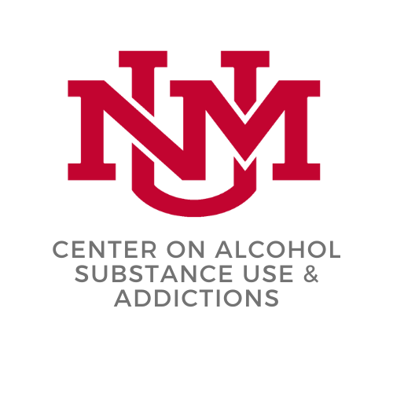
BEHAVIORAL INTERVENTIONS FOR TREATING HARMFUL ALCOHOL USE AND ALCOHOL USE DISORDER
Katie Witkiewitz, PhD
UNIVERSITY OF NEW MEXICO
DISTINGUISHED PROFESSOR OF PSYCHOLOGY
DIRECTOR, CENTER ON ALCOHOL, SUBSTANCE USE, AND ADDICTIONS

Slide 37
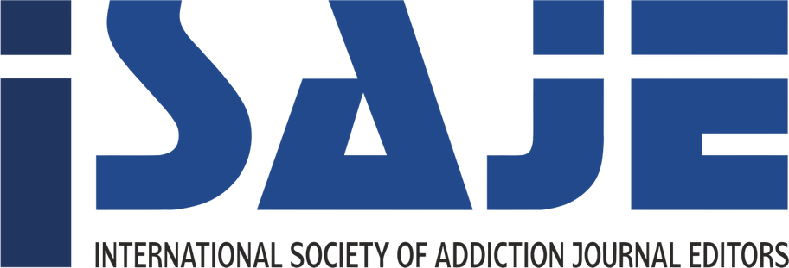
ACKNOWLEDGING RICH SAITZ

Slide 38
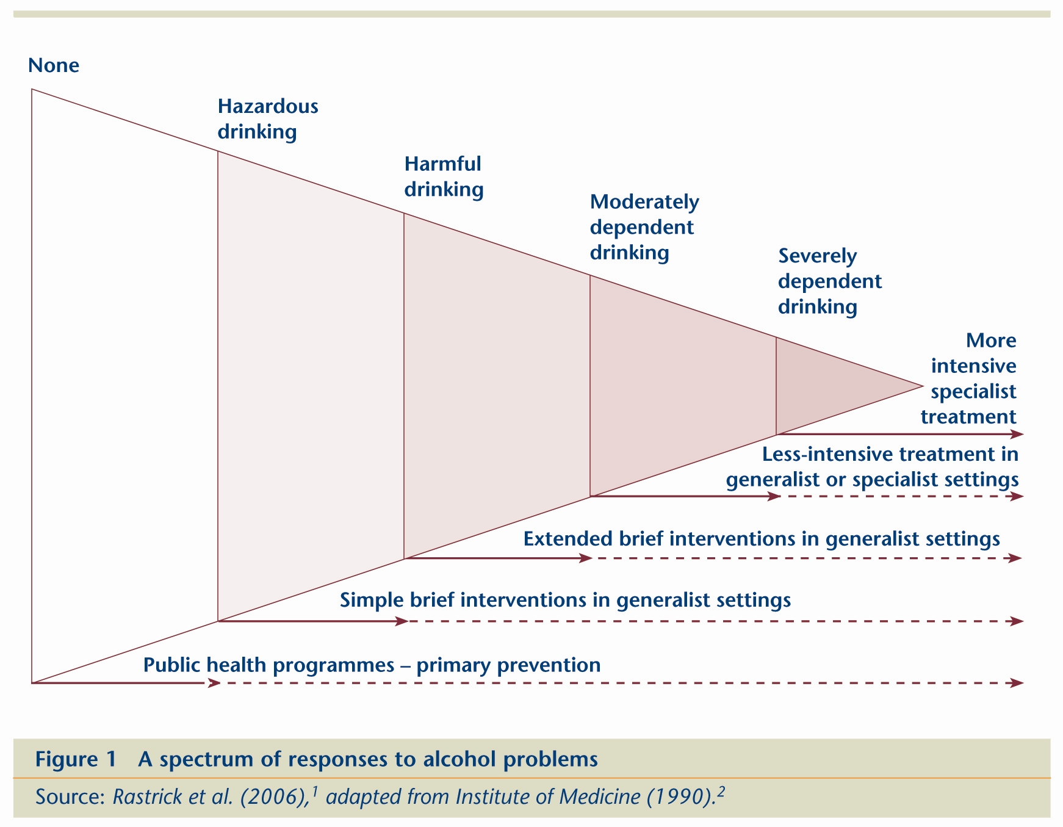
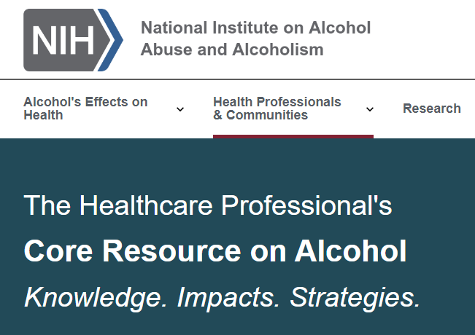
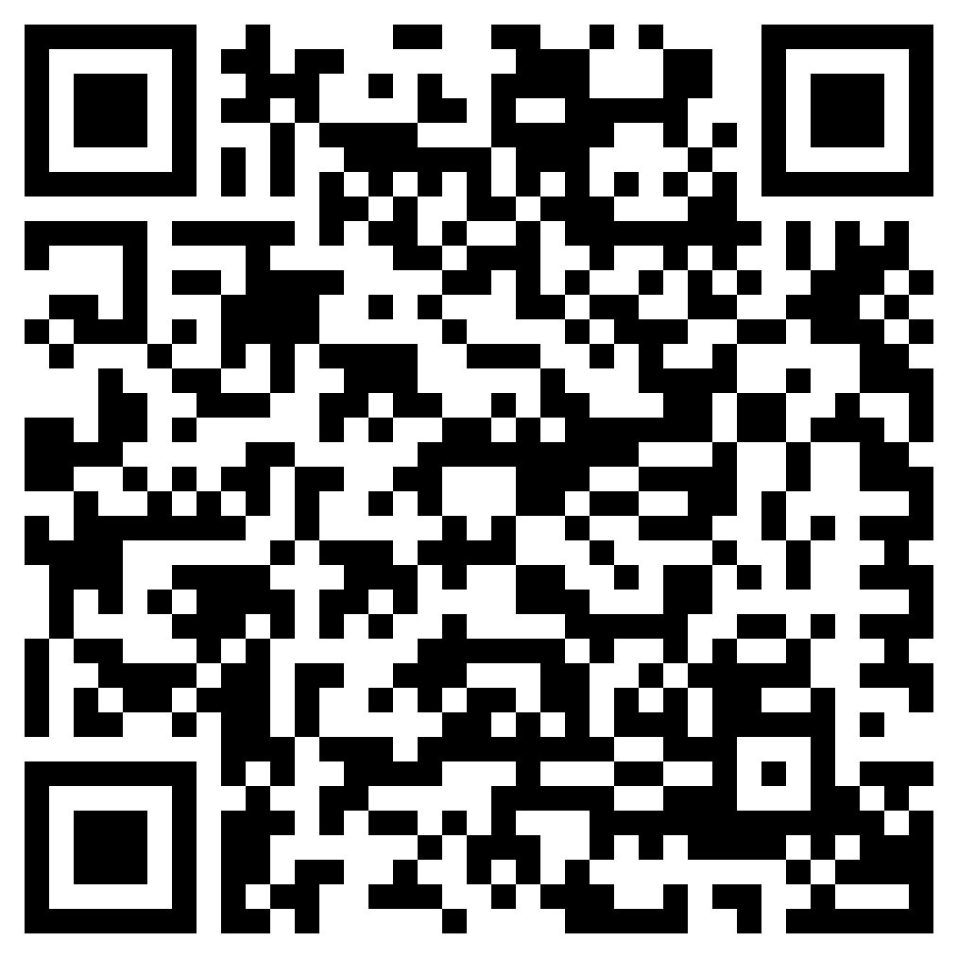
TREATMENT SHOULD BE MATCHED TO SEVERITY
https://www.niaaa.nih.gov/health-professionals-communities/core-resource-on-alcohol

Slide 39
“TREATMENT” SETTINGS
Any point of contact
Medical offices, hospitals, shopping malls, web
brief intervention, as little as 5 minutes
Outpatient settings
Traditional therapy office
Treatment program – intensive outpatient, groups
Inpatient/Residential settings
Criminal legal settings
Drug court and probation/parole officers
During incarceration

Slide 40
BEHAVIORAL TREATMENTS
Predicated on the idea that alcohol use is a learned behavior with identifiable antecedents and consequences, and that harmful drinking is maintained by environmental and contextual factors that can potentially be modified.
Incorporates cognitive and behavioral theory
Strong evidence base with effect sizes similar to or larger than medication-based treatments
Often delivered by treatment specialists with training in evidence-based treatments, however there is evidence that a range of health care professionals and peer support workers can also deliver treatments with fidelity, computerized and mobile app based versions also have good evidence of efficacy

Slide 41
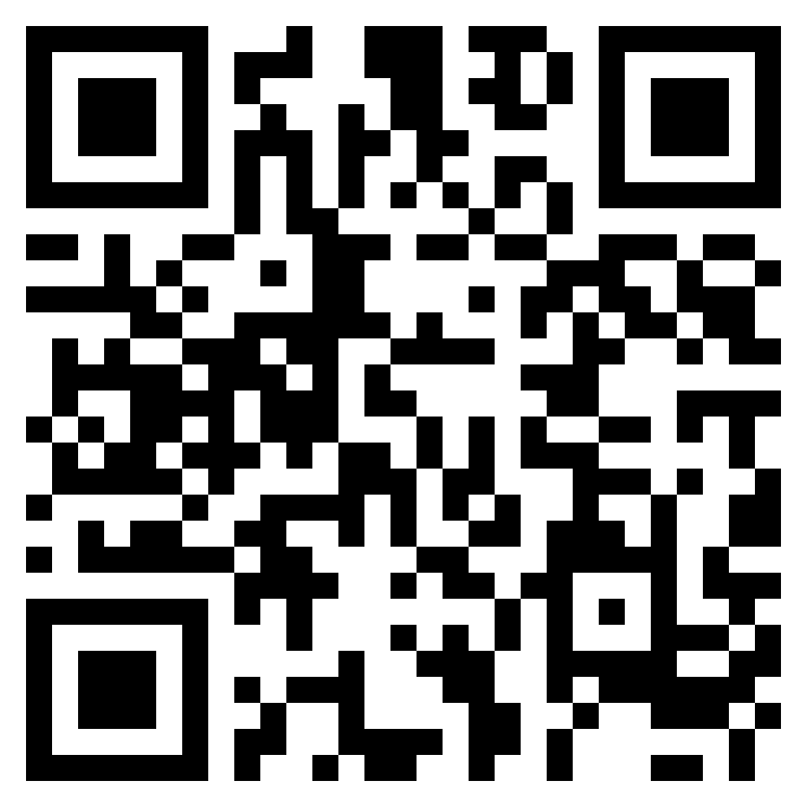
EXAMPLES OF EVIDENCE-BASED BEHAVIORAL TREATMENTS
Cognitive-behavioral treatments (coping skills training, relapse prevention)
Contingency management
Community reinforcement
Motivation enhancement
Twelve-step facilitation
Behavioral couples therapy
Community reinforcement and family training
Mindfulness- and acceptance-based treatments
https://alcoholtreatment.niaaa.nih.gov/

Slide 42
COGNITIVE BEHAVIORAL TREATMENT (CBT)
CBT is structured, goal-oriented, and focused on immediate problems. It is a flexible, individualized approach that can be adapted to a range of clients, settings and formats using a number of different manuals. Several techniques are common:
Functional analysis
Thoughts-emotions-behavior - testing cognitive distortions and cognitive reappraisals
Homework to identify triggers and risky situations, practice coping skills, and improve interpersonal functioning

Slide 43
CONTINGENCY MANAGEMENT
Contingency management (CM) treatments are based upon a simple behavioral principle -- if a behavior is reinforced or rewarded, it is more likely to occur in the future.
1. Frequently monitor target behavior.
2. Provide tangible reinforcement when target behavior occurs.
3. Remove reinforcement when target behavior does not occur.

Slide 44
COMMUNITY REINFORCEMENT APPROACH (CRA)
CRA is based on the belief that environmental contingencies can play a powerful role in encouraging or discouraging drinking or drug use.
1. Utilizes social, recreational, familial, and vocational reinforcers
2. Goal is to make living more rewarding without drinking or with less drinking

Slide 45
MOTIVATION ENHANCEMENT
Motivation enhancement treatment, based on motivational interviewing, is a directive, person-centered approach that focuses on increasing an individual’s intrinsic interest in changing drinking behavior and building intrinsic motivation to change.
Active listening
Reflecting change talk
Practices to evoke change talk

Slide 46
TWELVE-STEP FACILITATION (TSF)
TSF is designed to systematically link individuals with mutual help programs and encourage active participation in community-based 12-step mutual-help organizations.
Emphasis on the engagement and active participation with 12-step mutual-help organizations, like AA, as the primary means of achieving and sustaining long-term remission from alcohol use disorder.
Facilitates the patient’s attendance at meetings. Collaboratively, the provider and patient may track meeting attendance and active involvement (e.g., finding a sponsor) through logs or journals.
Discuss and explore patient’s attitudes about mutual support group engagement, and any barriers to engagement

Slide 47
COUPLES AND FAMILY APPROACHES
Based on both family systems and behavioral models, goals are to improve relationship and reduce drinking problems, as well as train family members in coping with and actively supporting individuals with alcohol problems through behavioral reinforcement principles.
Alcohol Behavioral Couples Therapy – largely based on CBT and behavioral couples therapy, focus on CBT techniques, as well as communication skills and interpersonal triggers
Community Reinforcement and Family Training – largely based on CRA, provides treatment to family members to increase psychosocial functioning, and provide resources to increase treatment engagement
Other family therapy methods – multidimensional family therapy, unilateral family therapy focus on improving family functioning

Slide 48
MINDFULNESS/ACCEPTANCE BASED TREATMENTS
Several different techniques that are largely based in Eastern traditions and focused on bringing one’s attention to the immediate experience of the present moment (i.e. craving, sadness, pain, etc.) without judgment, and without a need to engage with, including actively avoiding, those feelings through alcohol use.
Mindfulness-Based Relapse Prevention
Mindfulness Oriented Recovery Enhancement
Acceptance and Commitment Therapy
Mindfulness-Based Addiction Treatment

Slide 49
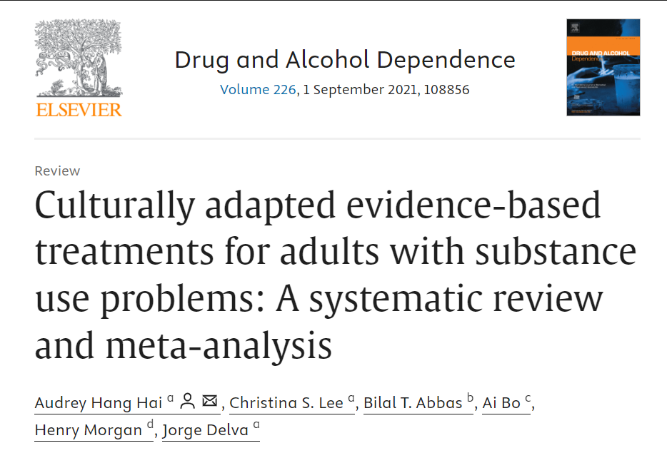
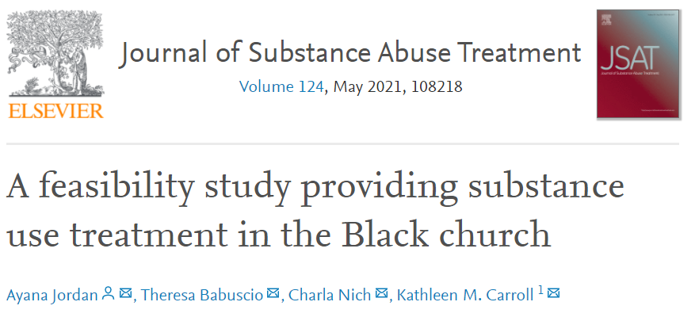
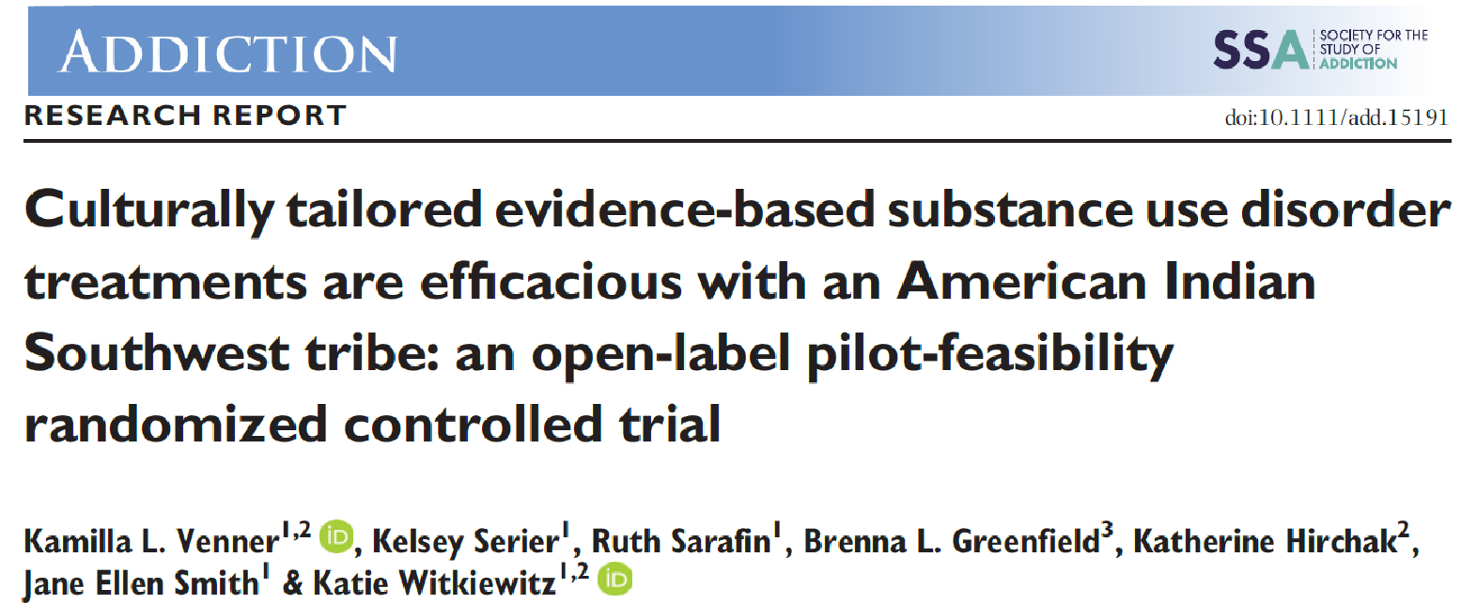
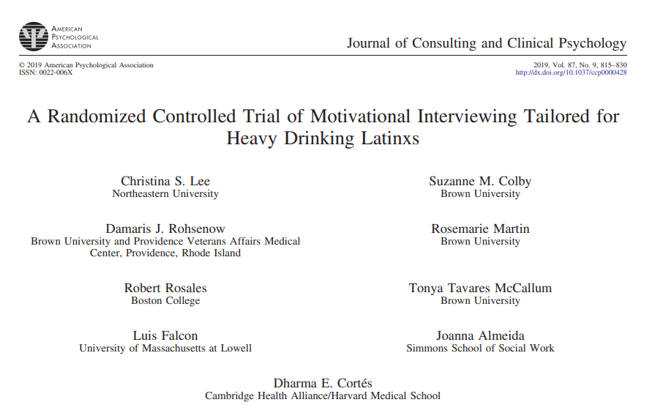
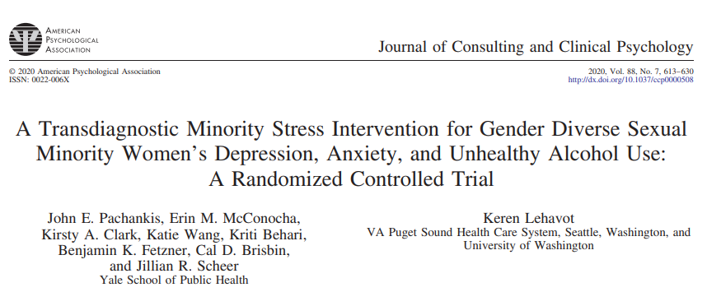
CULTURAL ADAPTATIONS
Cultural context and health equity in the development and evaluation of behavioral interventions for alcohol and other substance use disorder, a few examples of promising interventions, but more work is needed:

Slide 50
MINDFULNESS-BASED INTERVENTIONS FOR ALCOHOL USE DISORDER
Individuals with minoritized identities have better outcomes in mindfulness-based relapse prevention (MBRP)
Both men and women benefit more from receiving MBRP in gender diverse group
Witkiewitz et al. (2013). Addictive Behaviors.
Greenfield et al (2018). Addictive Behaviors.
Roos et al (2019). Mindfulness.

Slide 51
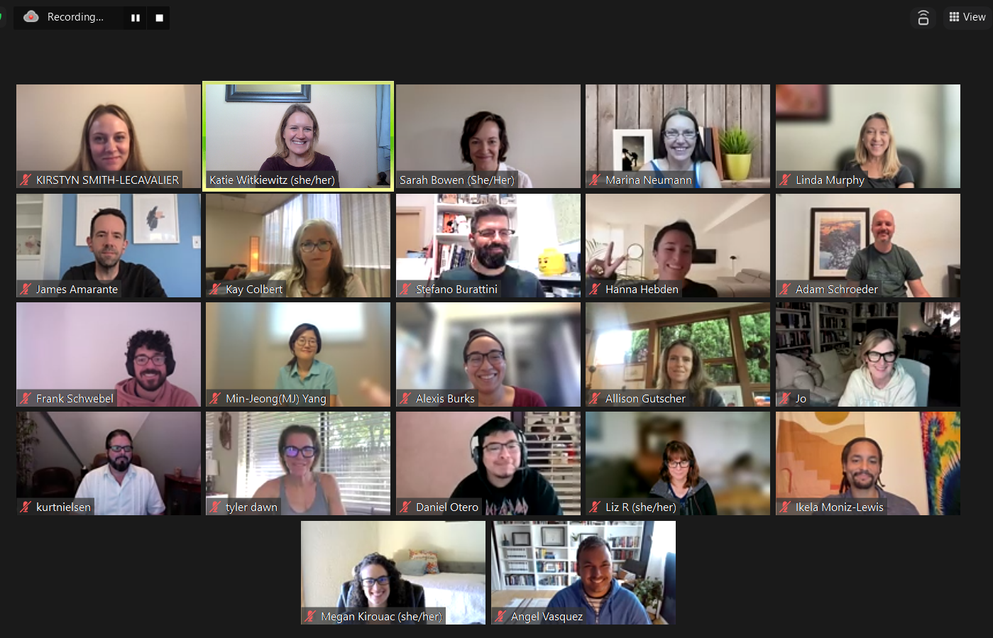
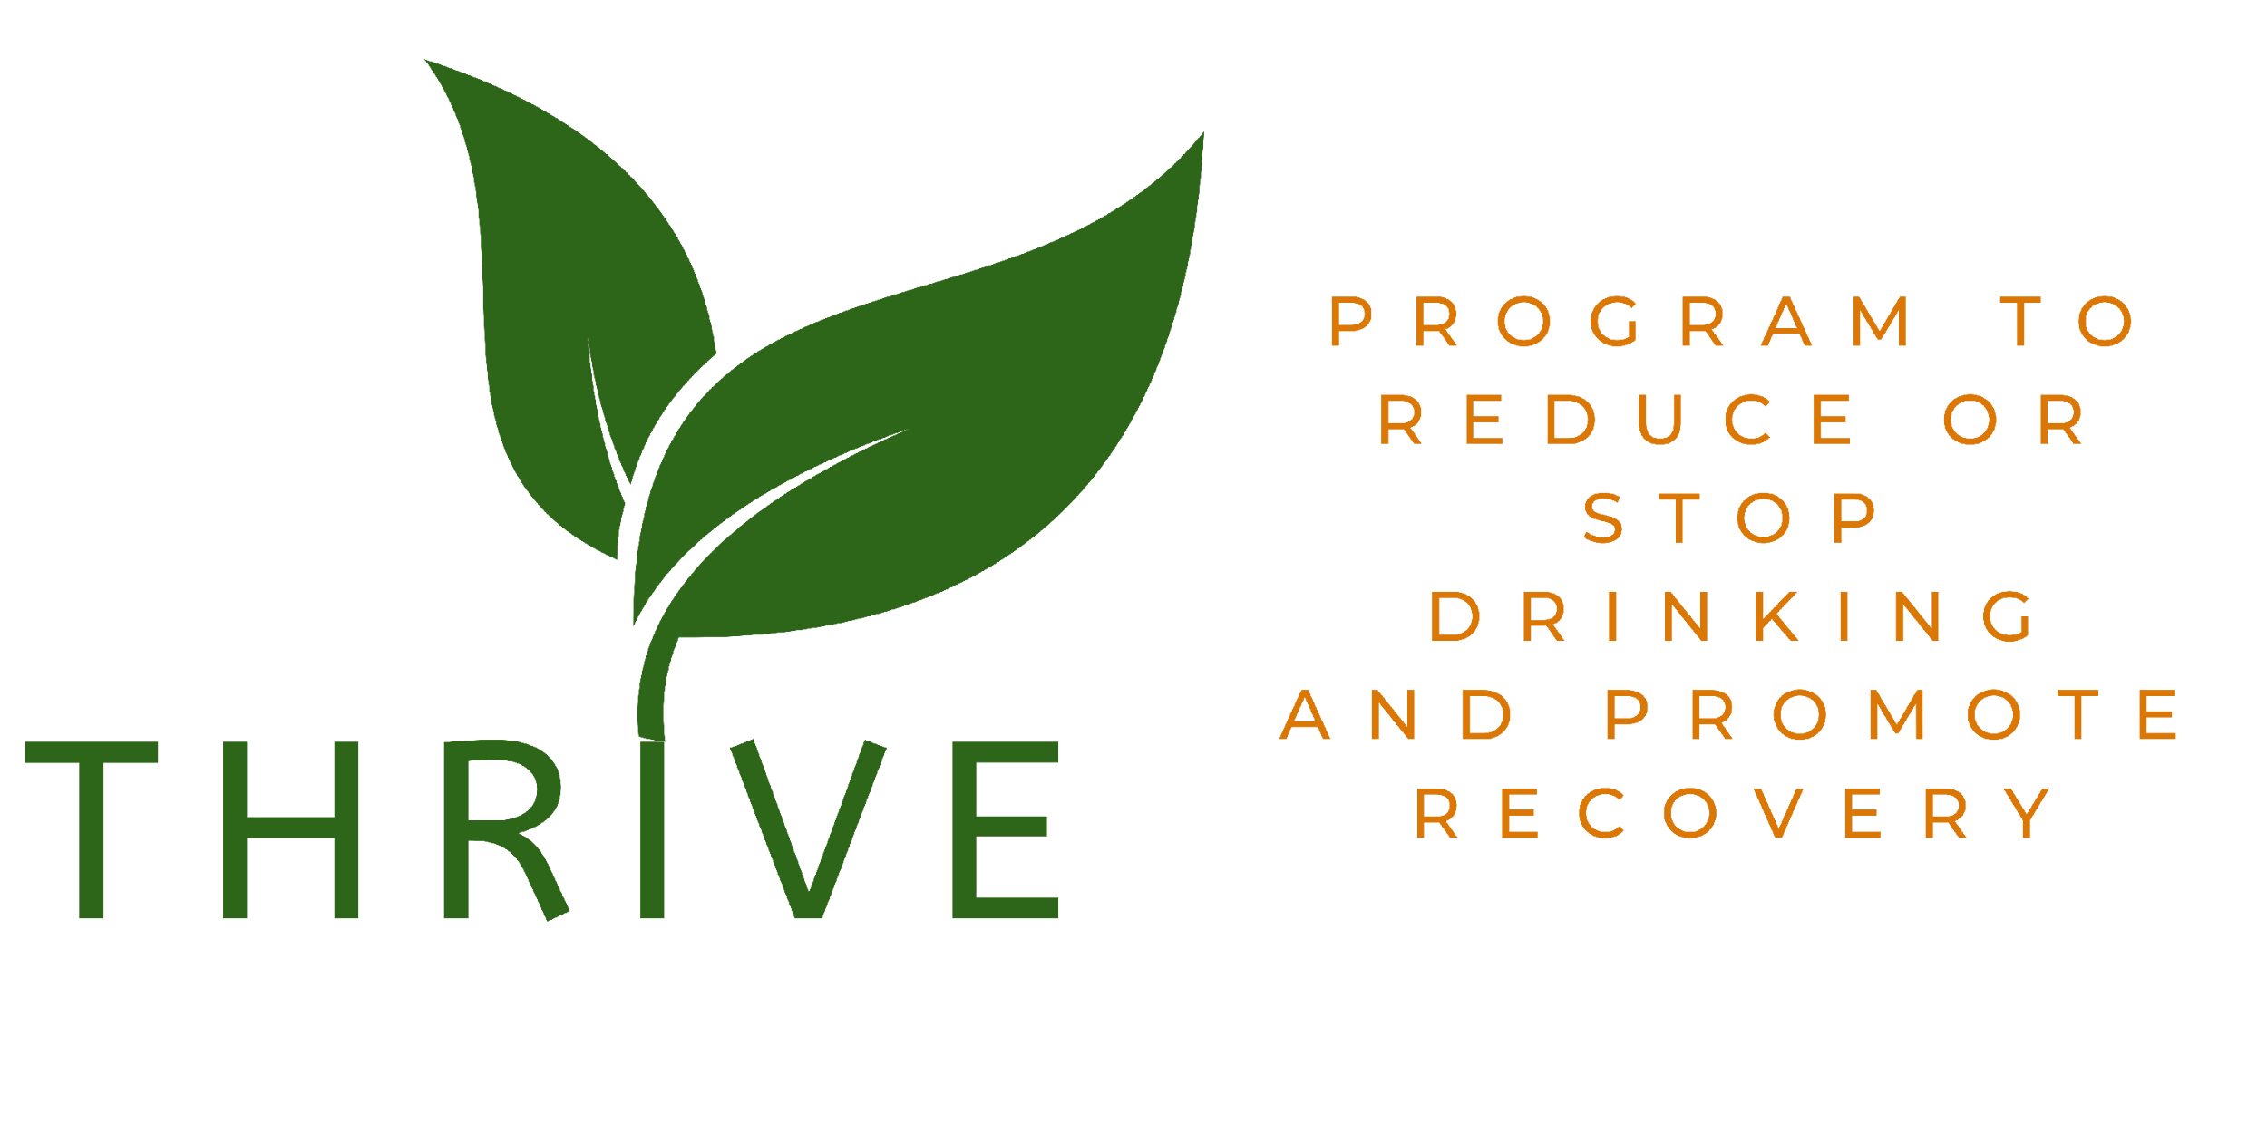
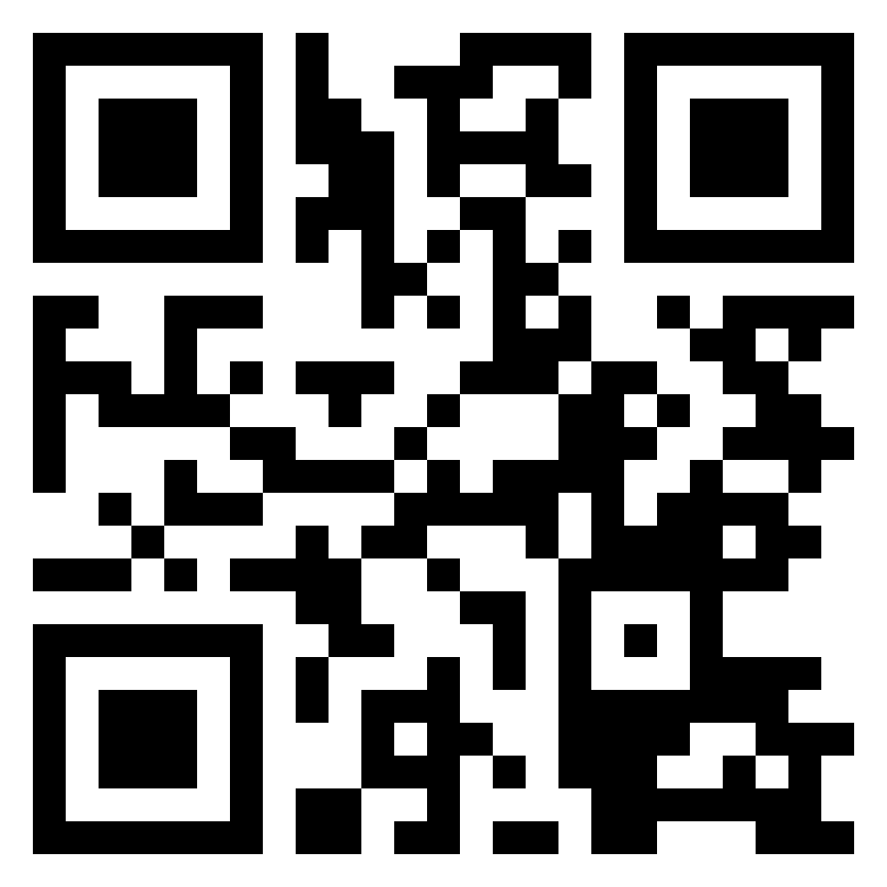
NEW PROJECT TO TEST MBRP
R01AA031159 Witkiewitz (PI)
MBRP via zoom nationwide!
Volunteer community therapists (n=20)
Target N=430
3 year follow-up
+ Qualitative study, Hannah Carlon
+ EMA/Qualitative study, Ikela Moniz-Lewis
https://thrivestudy.net/

Slide 52
References
Witkiewitz K, Litten RZ, Leggio L. Advances in the science and treatment of alcohol use disorder. Sci Adv. 2019;5(9):eaax4043. doi:10.1126/sciadv.aax4043
McCrady BS, Wilson AD, Muñoz RE, Fink BC, Fokas K, Borders A. Alcohol-Focused Behavioral Couple Therapy. Fam Process. 2016;55(3):443-459. doi:10.1111/famp.12231
Wallhed Finn S, Bakshi AS, Andréasson S. Alcohol consumption, dependence, and treatment barriers: perceptions among nontreatment seekers with alcohol dependence. Subst Use Misuse. 2014;49(6):762-769. doi:10.3109/10826084.2014.891616
Kelly JF, Humphreys K, Ferri M. Alcoholics Anonymous and other 12‐step programs for alcohol use disorder. Cochrane Database Syst Rev. 2020;2020(3). doi:10.1002/14651858.CD012880.pub2
Edlund MJ, Booth BM, Han X. Who Seeks Care Where? Utilization of Mental Health and Substance Use Disorder Treatment in Two National Samples of Individuals with Alcohol Use Disorders. J Stud Alcohol Drugs. 2012;73(4):635-646. doi:10.15288/jsad.2012.73.635
Schuckit MA, Danko GP, Smith TL, Hesselbrock V, Kramer J, Bucholz K. A 5-year prospective evaluation of DSM-IV alcohol dependence with and without a physiological component. Alcohol Clin Exp Res. 2003;27(5):818-825. doi:10.1097/01.ALC.0000067980.18461.33
Foy A, Kay J. The incidence of alcohol-related problems and the risk of alcohol withdrawal in a general hospital population. Drug Alcohol Rev. 1995;14(1):49-54. doi:10.1080/09595239500185051

Slide 53
PUBLIC HEALTH INTERVENTIONS

Slide 54
Why alcohol policy? Making the world safe for recovery – and everything else
David H. Jernigan PhD
Department of Health Law, Policy and Management
Boston University School of Public Health

Slide 55
Rich Saitz
Complementary and Complimentary

Slide 56
Why alcohol? Our favorite drug…
Kills nearly 500 people per day in the U.S. (178,000 per year)
Number one drug among young people and adults
Related to more than 200 disease and injury conditions, including seven cancers
Major cause of social inequities:
White, upper income people drink the most
African American, Latinx, indigenous and lower-income people suffer the most
Notes:
Sources:
Centers for Disease Control and Prevention. Alcohol-Related Disease Impact (ARDI) Application. Centers for Disease Control and Prevention. 2024. Accessed March 3, 2024. Available at https://nccd.cdc.gov/DPH_ARDI/default/default.aspx.
Miech, R. A., Johnston, L. D., Patrick, M.E.,
Miech RA, Johnston LD, Patrick ME, O’Malley PM, Bachman JG, Schulenberg JE. Monitoring the Future national survey results on drug use, 1975-2022: Secondary school students. Institute for Social Research, University of Michigan. 2023. Accessed March 5, 2024. Available at https://monitoringthefuture.org/wp-content/uploads/2022/12/mtf2022.pdf.
Patrick ME, Miech RA, Johnston LD, O’Malley PM. Monitoring the Future Panel Study annual report: National data on substance use among adults ages 19 to 60, 1976-2022. Institute for Social Research, University of Michigan. 2023. Accessed December 5, 2023. Available at https://monitoringthefuture.org/wp-content/uploads/2023/07/mtfpanel2023.pdf.
Probst C, Kilian C, Sanchez S, Lange S, Rehm J. The role of alcohol use and drinking patterns in socioeconomic inequalities in mortality: a systematic review. The Lancet Public Health. 2020;5(6):e324-e332.

Slide 57
Where we have come from
Post-repeal of prohibition
Control systems put in place with three key elements:
High taxes
Limits on advertising
Limits on numbers of outlets, hours of sale, ban on vertical integration (”three-tier” system)
These limits have faded over time
Dominant post-prohibition paradigm: “Alcoholism”
Alcohol problems are the fault of the minority of drinkers who abuse the product
These “alcoholics” need to be identified and treated, and problems will abate

Slide 58
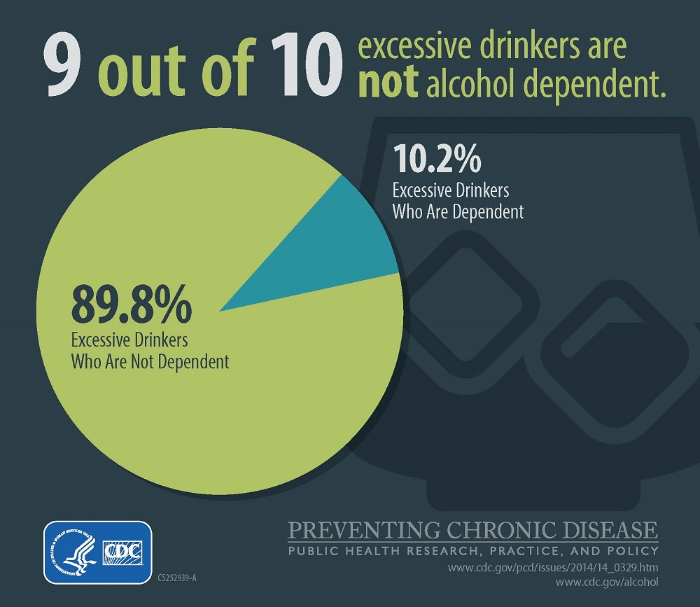
Alcohol dependence (severe alcohol use disorder) is an important outcome of excessive alcohol use. However, it is only part of the problem.
Esser MB, 2014
Notes:
Laura – DSM V dropped “alcohol dependence” – it is the equivalent of severe alcohol use disorder.

Slide 59
What does work? World Health Organization’s “best buys”
Most effective and cost-effective ways to reduce alcohol problems:
Increase alcohol taxes (Affordability)
Limit where and when and to whom alcohol can be sold (Availability)
Ban alcohol marketing and sponsorship (Attractiveness)
Notes:
World Health Organization. Technical Annex (version dated 26 December 2022) Updated Appendix 3 of the Global NCD Action Plan 2013-2030.
World Health Organization. 2022. Available at https://cdn.who.int/media/docs/default-source/ncds/mnd/2022-app3-technical-annex-v26jan2023.pdf?sfvrsn=62581aa3_5.

Slide 60
Alcohol taxes and health
Increases in prices (e.g., through raising taxes) are associated with reduced demand for alcohol consumption.
Policies that raise alcoholic beverage taxes, and consequently prices, are effective in reducing alcohol use, unhealthy use, and related health, economic, and social consequences:
Binge drinking
Drinking and driving
Violence and crimes
Reproductive outcomes (risky sexual behaviors, STI)
Liver cirrhosis mortality
Notes:
Sources:
Burton R, Sharpe C, Bhuptani S, et al. The relationship between the price and demand of alcohol, tobacco, unhealthy food, sugar-sweetened beverages, and gambling: an umbrella review of systematic reviews. BMC Public Health. May 10 2024;24(1):1286. doi:10.1186/s12889-024-18599-3.
Elder RW, Lawrence B, Ferguson A, et al. The effectiveness of tax policy interventions for reducing excessive alcohol consumption and related harms. American Journal of Preventive Medicine. 2010;38(2):217-229.
Wagenaar AC, Tobler AL, Komro KA. Effects of alcohol tax and price policies on morbidity and mortality: a systematic review. American Journal of Public Health. 2010;100(11):2270-2278.

Slide 61
Source: Brewers Almanac, 2013, ATTTB, 2014, and F. Chaloupka calculations

Slide 62
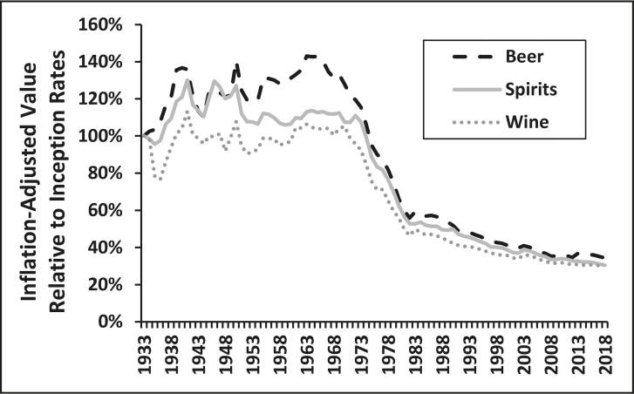
State Excise Taxes for Beer, Distilled Spirits, and Wine, U.S., 1933–2018
¹All rates were inflation-adjusted to 2018 dollars
Blanchette JG, 2020
Blanchette JG, 2020
¹All rates were inflation-adjusted to 2018 dollars
Notes:
Source: Naimi TS, Blanchette JG, Xuan Z, Chaloupka FJ. Erosion of State Alcohol Excise Taxes in the United States. Journal of studies on alcohol and drugs. 2018;79(1):43-48. doi:10.15288/jsad.2018.79.43.

Slide 63
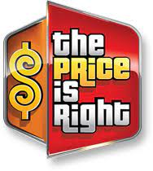
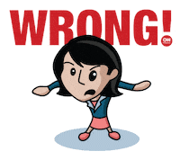
The result:
Off-premise, beer is often cheaper than water, orange juice, milk and soda
On-premise, alcohol is widely discounted (drink specials, ladies’ nights, etc.)
Every year that there is inflation alcohol gets cheaper compared to everything else
2017 tax cut package included 18% federal alcohol tax cut worth an estimated $321 million
According to the Department of the Treasury, more than two-thirds of those tax benefits went to the largest alcohol producers.
Notes:
Sources: U.S. Department of the Treasury. Competition in the Markets for Beer, Wine, and Spirits. U.S. Department of the Treasury. Accessed April 4, 2022. https://home.treasury.gov/system/files/136/Competition-Report.pdf.
Looney A. Measuring the loss of life from the Senate’s tax cuts for alcohol producers. Brookings. Accessed June 30, 2018. https://www.brookings.edu/research/measuring-the-loss-of-life-from-the-senates-tax-cuts-for-alcohol-producers/.

Slide 64
AVAILABILITY:
Violent crime increases when neighborhoods have too many places that sell or serve alcohol
Notes:
Source: Campbell CA, Hahn RA, Elder R, et al. The effectiveness of limiting alcohol outlet density as a means of reducing excessive alcohol consumption and alcohol-related harms. American Journal of Preventive Medicine. 2009;37(6):556-559.

Slide 65
REDLINING AND ALCOHOL OUTLETS
Equity issue:
Over and over again, we find more outlets in poor, Black and Latinx neighborhoods, even though the people in these neighborhoods drink less than the rest of the population.
Multiple studies have found one of the biggest factors in this is a history of federally-backed disinvestment in these neighborhoods – known as “redlining.”
OAKLAND, CA
Notes:
Sources: Trangenstein PJ, Gray C, Rossheim ME, Sadler R, Jernigan DH. Alcohol outlet clusters and population disparities. Journal of Urban Health. 2020;97(1):123-136.
Lee JP, Ponicki W, Mair C, Gruenewald P, Ghanem L. What explains the concentration of off-premise alcohol outlets in Black neighborhoods? SSM Popul Health. Dec 2020;12:100669. doi:10.1016/j.ssmph.2020.100669.

Slide 66
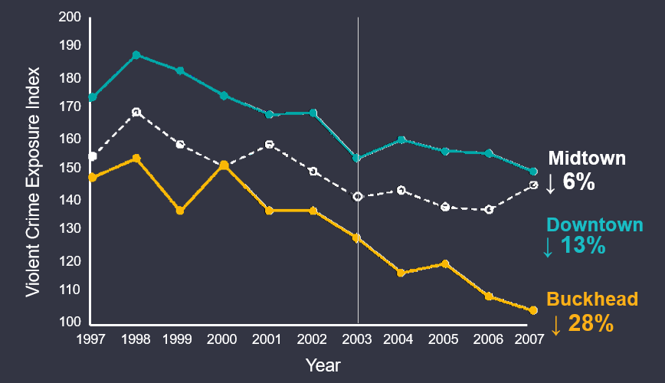
Effectiveness of reducing # of outlets
Atlanta, GA
A 3% reduction in alcohol outlets in the Buckhead neighborhood resulted in a 2-fold greater reduction in exposure to violent crime in the neighborhood than in two other comparable neighborhoods
Zhang, X., Hatcher, B., Clarkson, L., Holt, J., Bagchi, S., Kanny, D., & Brewer, R. D. (2015). Peer Reviewed: Changes in Density of On-Premises Alcohol Outlets and Impact on Violent Crime, Atlanta, Georgia, 1997–2007. Preventing chronic disease, 12.

Slide 67
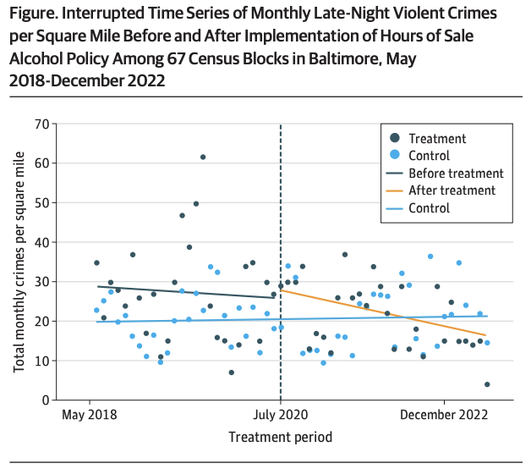
Effectiveness of reducing hours of sale
Baltimore, MD
A 7-hour reduction in alcohol sales hours (from 6 am to 2 am, to 9 am to 10 pm) in a single neighborhood was associated with a 48% drop in homicide and a 29% drop in all violent crime in the neighborhood, compared to similar neighborhoods, over the next year.
Rosen EM, Trangenstein PJ, Fullem PL, Yeh JC, Jernigan DH, Xuan Z. Interrupted Time Series Analysis of Bar/Tavern Closing Hours and Violent Crime. JAMA Intern Med. Apr 1, 2024; doi:10.1001/jamainternmed.2024.0255.

Slide 68
Attractiveness: The importance of alcohol marketing
Modern alcoholic beverages are of their essence marketed beverages
Marketing plays a key role for the industry nationally and globally
Functions as significant barrier to entry
AB Inbev’s cost of advertising per barrel sold significantly lower than its competitors – same is likely true of Diageo
Helps to generate oligopoly profits, which in turn support more marketing spend
Counters increasingly bad health news

Slide 69
Alcohol industry marketing spend
AB Inbev is the 14th largest marketer in the world – according to Advertising Age, spent $6.7 billion globally in 2022, $1.4 billion in the U.S. – globally, spend more than McDonald’s, Coca-cola or Toyota
Diageo is the 29th largest marketer in the world – according to Advertising Age, spent $3.7 billion globally in 2022-2023, $397 million in the U.S.
Also in the top 100 spenders:
Beam Suntory (#35,$3.1 billion worldwide)
Heineken (#41, $2.8 billion worldwide)
Pernod Ricard (#66, $2 billion worldwide)
Notes:
Source: Advertising Age DataCenter

Slide 70
DISCUS code: The content of beverage alcohol advertising and marketing materials should not primarily appeal to individuals below the legal purchase age.

Slide 71
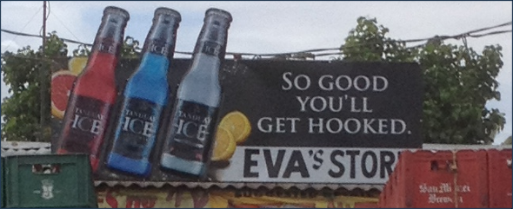
Marketing addiction

Slide 72
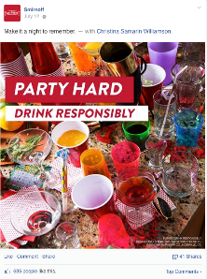
Alcohol advertising and youth: What is the effect?
Multiple systematic reviews have found that the more young people are exposed to alcohol marketing, the more likely they are to start drinking, or if already drinking, to drink more
The latest comprehensive review concluded that, based on the standard criteria for determining causality, this relationship is causal – that is, exposure to alcohol marketing plays a role in convincing young people to drink or to drink even more
Notes:
Sources: Anderson P, De Bruijn A, Angus K, Gordon R, Hastings G. Impact of alcohol advertising and media exposure on adolescent alcohol use: a systematic review of longitudinal studies. Alcohol and Alcoholism. 2009;44(3):229-43.
Jernigan D, Noel J, Landon J, Thornton N, Lobstein T. Alcohol marketing and youth alcohol consumption: a systematic review of longitudinal studies published since 2008. Addiction. Aug 26 2017;112:7-20. doi:10.1111/add.13591.
Sargent JD, Babor TF. The Relationship Between Exposure to Alcohol Marketing and Underage Drinking Is Causal. J Stud Alcohol Drugs Suppl. Mar 2020;Sup 19(Suppl 19):113-124. doi:10.15288/jsads.2020.s19.113.

Slide 73
If the evidence is so clear, why don’t we do the right thing?

Slide 74
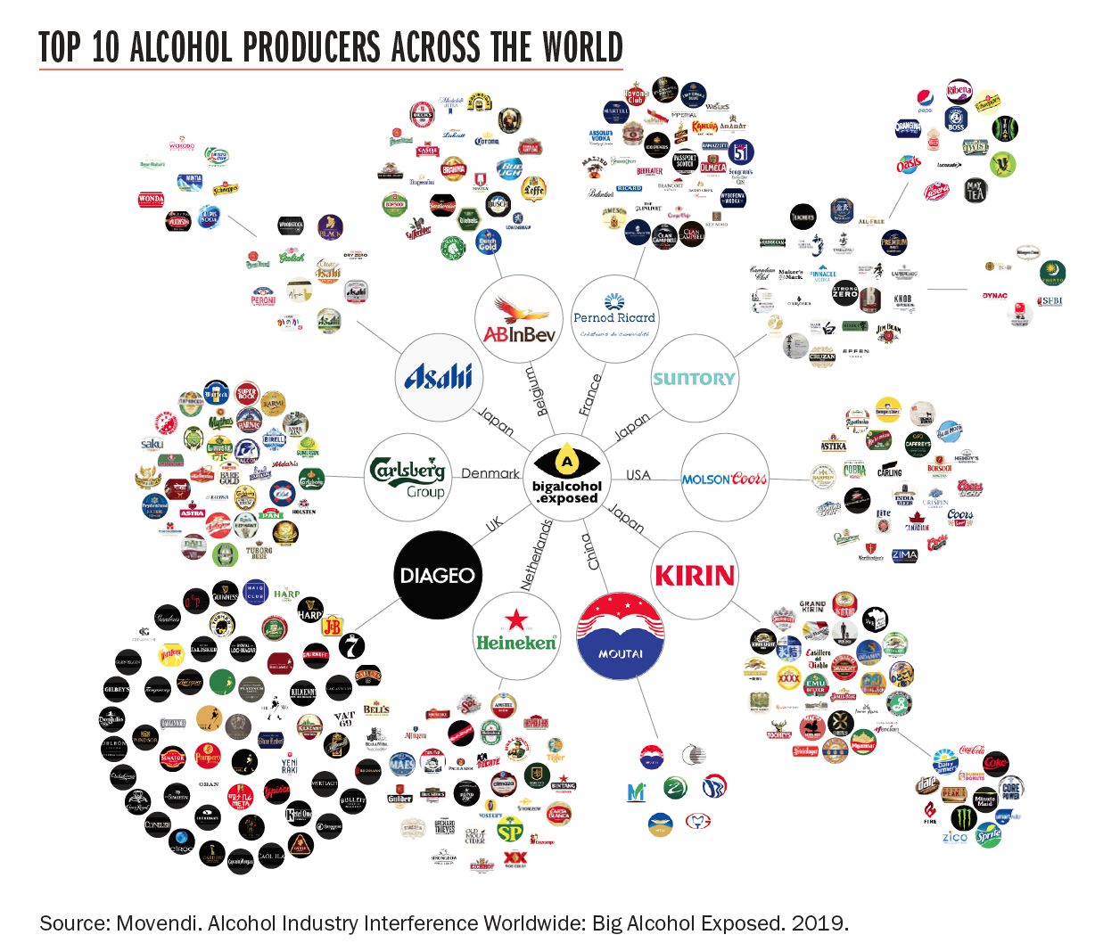
The global alcohol industry
If the ten largest companies by sales were a country, they would be the 23rd^{th} largest economy in the world
As of 2019, alcohol was the 8th most profitable industry in the world – more than banking, pharmaceuticals, or soda
Notes:
Sources:
World Bank, World Development Indicators, July 25, 2023; Euromonitor.
Damodaran A. Margins by Sector (US). NYU Stern. 2019. Accessed April 25, 2019. Available at http://pages.stern.nyu.edu/~adamodar/New_Home_Page/datafile/margin.html.

Slide 75
Alcohol industry influence on U.S. policy
$14.9 million in lobbying state legislatures in 2019
$22.8 million in contributions to federal-level candidates and parties in the 2020 election cycle
280 lobbyists working for them at the federal level
More than 1 lobbyist for every 2 members of Congress
Notes:
Source: www.Followthemoney.org

Slide 76
Alcohol industry influence on U.S. policy
2017 tax cut, made permanent in 2020
Repeatedly defeat efforts to raise alcohol taxes at the state level
Widespread repeal of Sunday sales bans
Pressure to add more outlets
Massachusetts – more places to buy alcohol than Dunkin’ Donuts
Look to alcohol to “revitalize” downtowns – never take into account the costs
Pandemic policy changes:
Home delivery
Physical expansion of outlets (“parklets”)
Notes:
Source: www.Followthemoney.org

Slide 77
What can be done?
AFFORDABILITY: alcohol tax increases, minimum unit pricing
AVAILABILITY: limits on outlets, days/hours of sale, minimum age laws
ATTRACTIVENESS: local ad bans (billboards, public transit), retail signage restrictions and counteradvertising

Slide 78
Alcohol and equity
In general, lower-income, indigenous people and people of color are less likely to drink than White people, but suffer higher levels of harm.
The same amount of alcohol, in a poor family, community or country, will cause far more damage than in a wealthier setting.
According to one review, alcohol use explains as much as 27% of socioeconomic inequalities in mortality.
Collins SE. Associations Between Socioeconomic Factors and Alcohol Outcomes. Alcohol Res. 2016;38:83-94.
Probst C, Kilian C, Sanchez S, Lange S, Rehm J. The role of alcohol use and drinking patterns in socioeconomic inequalities in mortality: a systematic review. The Lancet Public Health. 2020;5(6):e324-e332.
Nandi A, Glymour MM, Subramanian SV. Association among socioeconomic status, health behaviors, and all-cause mortality in the United States. Epidemiology. Mar 2014;25(2):170-7. doi:10.1097/ede.0000000000000038.

Slide 79
Bottom line
“…Of all the forms of inequality, injustice in health is the most shocking and the most inhuman”
-- Dr. Martin Luther King Jr., Chicago, 1966
Notes:
We have enormous health disparities arising from alcohol use, and we have significant injustice being perpetrated by giant, highly-profitable industries. My friends, I truly believe we can do better.

Slide 80
We are many
We are powerful
Our stories are powerful
We can act as one
Change begins with us
Notes:
We CAN do this. We can organize and build the coalitions and advocate for the change that needs to happen, if we are prepared, and if we are open to the opportunities that are present before us.

Slide 81
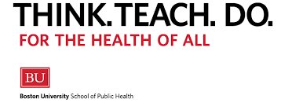
THANK YOU!
dhjern@bu.edu
david@cityhealth.org
@dhjalcohol

Slide 82
References
Centers for Disease Control and Prevention. Alcohol-Related Disease Impact (ARDI) Application. Centers for Disease Control and Prevention. 2024. Accessed March 3, 2024. Available at https://nccd.cdc.gov/DPH_ARDI/default/default.aspx.
Miech, R. A., Johnston, L. D., Patrick, M.E.,
Miech RA, Johnston LD, Patrick ME, O’Malley PM, Bachman JG, Schulenberg JE. Monitoring the Future national survey results on drug use, 1975-2022: Secondary school students. Institute for Social Research, University of Michigan. 2023. Accessed March 5, 2024. Available at https://monitoringthefuture.org/wp-content/uploads/2022/12/mtf2022.pdf.
Patrick ME, Miech RA, Johnston LD, O’Malley PM. Monitoring the Future Panel Study annual report: National data on substance use among adults ages 19 to 60, 1976-2022. Institute for Social Research, University of Michigan. 2023. Accessed December 5, 2023. Available at https://monitoringthefuture.org/wp-content/uploads/2023/07/mtfpanel2023.pdf.
Probst C, Kilian C, Sanchez S, Lange S, Rehm J. The role of alcohol use and drinking patterns in socioeconomic inequalities in mortality: a systematic review. The Lancet Public Health. 2020;5(6):e324-e332.
Woerle S, Roeber J, Landen MG. Prevalence of alcohol dependence among excessive drinkers in New Mexico. Alcoholism: Clinical and Experimental Research. 2007;31(2):293-298.
The Community Guide. Excessive Alcohol Consumption. Centers for Disease Control and Prevention. Accessed October 24, 2024. https://www.thecommunityguide.org/topics/excessive-alcohol-consumption.html.
World Health Organization. Technical Annex (version dated 26 December 2022) Updated Appendix 3 of the Global NCD Action Plan 2013-2030. World Health Organization. https://cdn.who.int/media/docs/default-source/ncds/mnd/2022-app3-technical-annex-v26jan2023.pdf?sfvrsn=62581aa3_5.
Wagenaar AC, Salois MJ, Komro KA. Effects of beverage alcohol price and tax levels on drinking: A meta-analysis of 1003 estimates from 112 studies. Addiction. 2009;104(2):179-190.
Wagenaar AC, Tobler AL, Komro KA. Effects of alcohol tax and price policies on morbidity and mortality: a systematic review. American Journal of Public Health. 2010;100(11):2270-2278.
Naimi TS, Blanchette JG, Xuan Z, Chaloupka FJ. Erosion of State Alcohol Excise Taxes in the United States. Journal of studies on alcohol and drugs. 2018;79(1):43-48. doi:10.15288/jsad.2018.79.43.
U.S. Department of the Treasury. Competition in the Markets for Beer, Wine, and Spirits. U.S. Department of the Treasury. Accessed April 4, 2022. https://home.treasury.gov/system/files/136/Competition-Report.pdf.

Slide 83
References
Campbell CA, Hahn RA, Elder R, et al. The effectiveness of limiting alcohol outlet density as a means of reducing excessive alcohol consumption and alcohol-related harms. American Journal of Preventive Medicine. 2009;37(6):556-559.
Trangenstein PJ, Gray C, Rossheim ME, Sadler R, Jernigan DH. Alcohol outlet clusters and population disparities. Journal of Urban Health. 2020;97(1):123-136.
Lee JP, Ponicki W, Mair C, Gruenewald P, Ghanem L. What explains the concentration of off-premise alcohol outlets in Black neighborhoods? SSM Popul Health. Dec 2020;12:100669. doi:10.1016/j.ssmph.2020.100669.
Zhang, X., Hatcher, B., Clarkson, L., Holt, J., Bagchi, S., Kanny, D., & Brewer, R. D. (2015). Peer Reviewed: Changes in Density of On-Premises Alcohol Outlets and Impact on Violent Crime, Atlanta, Georgia, 1997–2007. Preventing chronic disease, 12.
Rosen EM, Trangenstein PJ, Fullem PL, Yeh JC, Jernigan DH, Xuan Z. Interrupted Time Series Analysis of Bar/Tavern Closing Hours and Violent Crime. JAMA Intern Med. Apr 1, 2024; doi:10.1001/jamainternmed.2024.0255.
Jernigan DH, Ross C. The alcohol marketing landscape: Alcohol industry size, structure, strategies, and public health responses. Journal of Studies on Alcohol and Drugs. 2020;Mar(Suppl 19):5-12.
Advertising Age. World’s Largest Advertisers 2023. Crain Communications. Accessed March 13, 2024. https://adage.com/datacenter/globalmarketers2023.
Jernigan D, Noel J, Landon J, Thornton N, Lobstein T. Alcohol marketing and youth alcohol consumption: a systematic review of longitudinal studies published since 2008. Addiction. Aug 26 2017;112:7-20. doi:10.1111/add.13591.
Open Secrets. State-level lobbyist spending by Marijuana growers and product sales spenders. . Accessed October 3, 2022. https://www.followthemoney.org/show-me?dt=3&lby-y=2022,2021,2020,2019,2018,2017,2016,2015,2014,2013,2012,2011,2010&lby-f-fc=2&lby-f-cci=151&lby-f-fc=2#[{1|gro=lby-y.
Open Secrets. Beer, Wine and Liquor Lobbying. Open Secrets. Accessed October 24, 2024. https://www.opensecrets.org/industries/lobbying?cycle=2022&ind=N02.
Collins SE. Associations Between Socioeconomic Factors and Alcohol Outcomes. Alcohol Res. 2016;38:83-94.
Probst C, Kilian C, Sanchez S, Lange S, Rehm J. The role of alcohol use and drinking patterns in socioeconomic inequalities in mortality: a systematic review. The Lancet Public Health. 2020;5(6):e324-e332.
Nandi A, Glymour MM, Subramanian SV. Association among socioeconomic status, health behaviors, and all-cause mortality in the United States. Epidemiology. Mar 2014;25(2):170-7. doi:10.1097/ede.0000000000000038.

Slide 84
QUESTIONS

