Slide 1
Risk Factors for Chronic Pain among People Who Inject Drugs (PWID) in Denver, CO and Los Angeles, CA 2021/2022
Jimi Huh, Siddi Ganesh, Gilbert Portillo, Eric Kovalsky, Patricia Wilkins, Karen Corsi, Ricky N. Bluthenthal
Department of Population and Public Health Sciences
Keck School of Medicine
University of Southern California
AMERSA
Chicago, November 2024

Slide 2
DISCLOSURES
No disclosure

Slide 3
Introduction
Chronic pain is common among people who inject drugs (PWID)
Approximately half of study samples¹ ²
A majority used drugs to manage pain³
Pain described as “usual part of life” rather than disruption³
Request for pain relief is often disregarded by healthcare providers due to concerns about misuse⁴ ⁵
Inadequate pain management is a barrier to needed care across the life course for people with opioid use disorder

Slide 4
Objectives of the study
To describe chronic pain among a sample of opioid-using people who inject drugs (PWID)
To examine factors associated with chronic pain
Experiencing violence, injection behaviors and history, and mental health diagnoses
To investigate factors associated with more severe pain and disability among PWID
Experiencing violence, injection behaviors and history, and mental health diagnoses

Slide 5
Methods
Opioid using PWID were interviewed during 2021/2022 in Denver, CO and Los Angeles, CA (N=472)
Behaviors were assessed in the last 3 months
Recruitment occurred in community settings associated with syringe service programs (in both LA & Denver) and other service providers (methadone program & shower facility in LA only)

Slide 6
Outcome variables
Chronic pain in the last 3 months
"In the last 3 months, have you experienced any chronic or ongoing pain due to an injury or other ailment (like arthritis or migraine headaches, but not counting withdrawal symptoms)?"

Slide 7
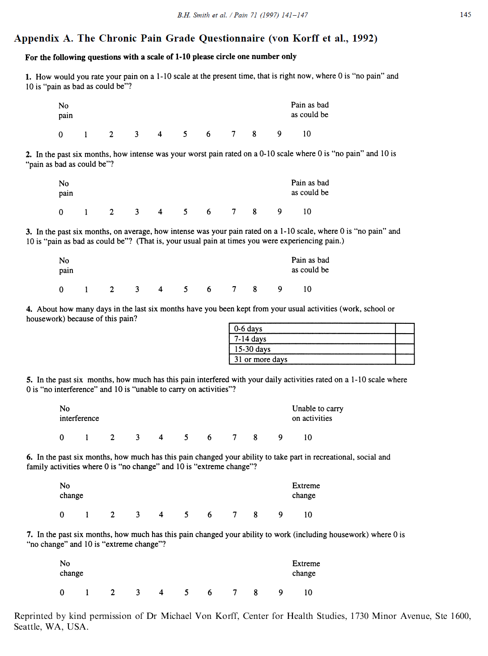
Chronic Pain Grade Questionnaire
Outcome variables
Smith, B.H., Penny, K.I., Purves, A.M., Munro, C., Wilson, B., Grimshaw, J., Chambers, W.A., Smith, W.C., 1997. The Chronic Pain Grade questionnaire: validation and reliability in postal research. Pain 71(2), 141-147.

Slide 8
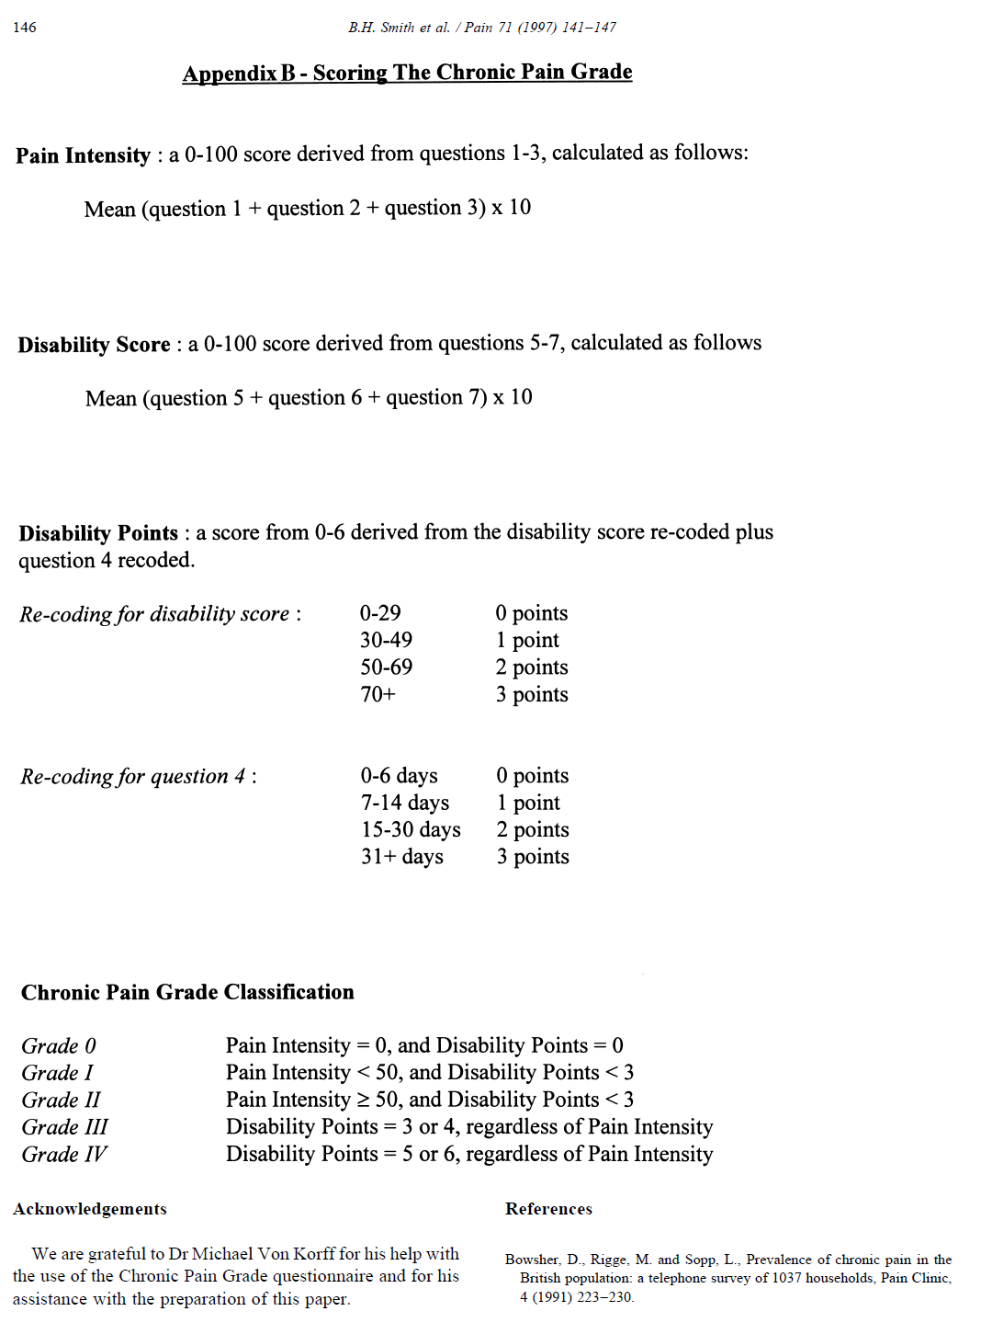
CPG classifications
Outcome variables
"Allows for patients with chronic pain to be classified according to the severity of their pain and the way it interferes with their daily functioning."

Slide 9
Independent variables and co-variates
Substance use patterns for heroin, methamphetamine, cocaine, goofball, speedball, non-prescribed use of medications (opioids, stimulants, sedatives, and tranquilizers), and cannabis
Route (injection & non-injection)
Frequency by route in the last 3 months
Experiences with violence (6 items)
Threatened with weapon; Punched; Attacked with weapon; Sexual coercion; Attacked by stranger; and Belongings stolen
Covariates
Demographic and socioeconomic characteristics, including housing

Slide 10
Analyses
Any chronic pain in the last 3 months (N=472)
Multivariable logistic regression
Chronic pain grade classification (n=255)
Multinomial logistic regression
IVs = Experience with violence, mental health diagnoses, drug use history and behaviors

Slide 11
Results: Demographic and socioecononmic characteristics (N=472)
23% female or transgendered
50% under 40 years old
53% reported monthly income <$1,000
84% unhoused/unstably housed

Slide 12
Drug use and routes in the last 3 months (n=472)
Variable | Percent | Variable | Percent
Any opioid use Heroin Fentanyl Non-prescribed pills | 82% 70% 28% | Injection frequency Less than daily 1 to 2 times a day 3 or more times a day | 30% 20% 50%
Any methamphetamine | 84% | Non-injection frequency
Any crack cocaine | 33% | None | 3%
Any goofball | 63% | Less than daily | 28%
Any speedball | 29% | 1 to 2 times a day | 29%
Any cannabis | 75% | 3 or more times a day | 40%

Slide 13
Pain, health, and violence characteristics (N=472)
Variable | %
Any chronic pain (yes=1) | 51%
Any mental health diagnosis ever (yes=1) | 67%
Chronic Pain Grade
Grade 0 | 49%
Grade I | 3%
Grade II | 15%
Grade III | 14%
Grade IV | 19%
Violence exposure/experiences
None | 19%
1 | 33%
2 or 3 | 24%
4 or more | 23%
19%
33%
24%
25%

Slide 14
Any chronic pain in the past 3 months as outcome (N=470)
 | Adjusted OR (AOR) | 95% CI
Experiencing violence, last 3 months
No violent events (ref) | -- | --
One violent event | 1.04 | 0.59-1.86
2 or 3 violent events | 2.11 | 1.14-3.88
4 or more violent events | 3.48 | 1.83-6.60
Injection history (in years)
<10 years of injection (ref) | -- | --
10-20 years of injection | 0.79 | 0.48-1.28
20+ years of injection | 2.16 | 1.33-3.51
Mental health diagnosis Yes | 1.67 | 1.10-2.52
Controlling for Latinx ethnicity.

Slide 15
Factors associated with chronic pain classification among those reporting chronic pain (n=245)
 | Grade II (30%)ª | Grade III (26%)ª | Grade IV (38%)ª
 | AOR (CI) | AOR (CI) | AOR (CI)
Experiencing violence
No violent events (ref) | -- | -- | --
One violent event | 0.30 (0.03-3.01) | 0.60 (0.06-6.51) | 0.63 (0.06-6.41)
2 or 3 violent events | 0.15 (0.02-1.30) | 0.23 (0.02-2.25) | 0.10 (0.01-0.91)
4 or more violent events | 1.57 (0.09-27.55) | 3.51 (0.19-65.01) | 2.81 (0.16-49.61)
Injection frequency
< daily (referent) | -- | -- | --
1 or 2 times a day | 1.24 (0.34-4.55) | 1.67 (0.44-6.40) | 1.47 (0.39-5.76)
3 or more times a day | 5.80 (1.12-30.1) | 9.54 (1.80-50.69) | 12.18 (2.33-63.76)
ªReference category: Chronic pain severity Grade I (6%)

Slide 16
Limitations
Self-report data. Reliability may be a concern, although other studies have found good reliability and validity of measures^{6,7}
Cross-sectional analysis; causality cannot be established.

Slide 17
Conclusions
Chronic pain is prevalent among PWID.
High pain intensity and disability, as captured in the chronic pain grade classification, is common for those with chronic pain. A third of participants had disabling chronic pain.
Injection frequency/history is associated with any chronic pain and severity of pain

Slide 18
Discussion
More research that is focused on disentangling injection frequency (e.g., self-medication/pain management) vs. injection as cause of injury is needed⁸
Structural interventions that impact the intersectional risk environment such as housing, violence prevention and intervention, and harm reduction services are indicated to manage chronic pain in this population.

Slide 19
References
Bicket, M. C., Park, J. N., Torrie, A., Allen, S. T., Weir, B. W., & Sherman, S. G. (2020). Factors associated with chronic pain and non-medical opioid use among people who inject drugs. Addictive Behaviors, 102, 10617
Dahlman, D., Kral, A. H., Wenger, L., Hakansson, A., & Novak, S. P. (2017). Physical pain is common and associated with nonmedical prescription opioid use among people who inject drugs. Substance Abuse Treatment, Prevention, and Policy, 12, 1-11;
Dassieu, L., Kaboré, J. L., Choinière, M., Arruda, N., & Roy, É. (2020). Painful lives: Chronic pain experience among people who use illicit drugs in Montreal (Canada). Social Science & Medicine, 246, 112734.
McNeil, R., Guirguis-Younger, M., 2012. Illicit drug use as a challenge to the delivery of end-of-life care services to homeless persons: perceptions of health and social services professionals. Palliat Med 26(4), 350-359.
Mayer, S., Langheimer, V., Nolan, S., Boyd, J., Small, W., McNeil, R., 2023. Emergency department experiences of people who use drugs who left or were discharged from hospital against medical advice. PLoS One 18(2), e0282215PMC9949621.
Smith, B.H., Penny, K.I., Purves, A.M., Munro, C., Wilson, B., Grimshaw, J., Chambers, W.A., Smith, W.C., 1997. The Chronic Pain Grade questionnaire: validation and reliability in postal research. Pain 71(2), 141-147.
Weatherby, N., Needle, R.H., Cesari, H., Booth, R., McCoy, C.B., Watters, J.K., Williams, M., Chitwood, D.D., 1994. Validity of self-reported drug use among injection drug users recruited through street outreach. Evaluation and Program Planning 17, 347-355.
Ceasar, R.C., Goldshear, J.L., Brothers, S., Wenger, L.D., Kral, A.H., Bluthenthal, R.N., 2021. Factors associated with injury and blood-borne infection risk when providing assisted injection among people who inject drugs. Int J Drug Policy 97, 103297.

Slide 20
Thank you! jimihuh@usc.edu

