Slide 1
Rural Community Pharmacist Knowledge of Drug Checking Test Strips and Willingness to Engage with Test Strip Activities
Grace Marley, Erin Blythe, Delesha Carpenter
Research Assistant Professor
UNC Eshelman School of Pharmacy
Southeast Area Health Education Center

Slide 2
Conflict of Interest
I do not have any conflicts of interest to disclose.

Slide 3
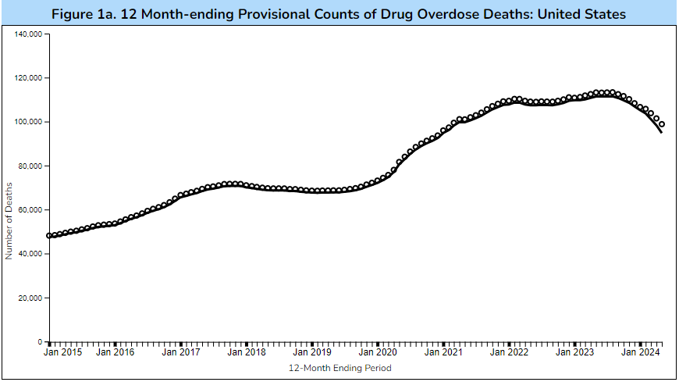
Background:
Fentanyl is in the unregulated drug supply, leading to substantial overdose death.
“Products - Vital Statistics Rapid Release - Provisional Drug Overdose Data,” October 10, 2024. https://www.cdc.gov/nchs/nvss/vsrr/drug-overdose-data.htm.
“DEA Reports Widespread Threat of Fentanyl Mixed with Xylazine | DEA.Gov.” Accessed November 11, 2024. https://www.dea.gov/alert/dea-reports-widespread-threat-fentanyl-mixed-xylazine.
Notes:
Recent surges in fentanyl, xylazine and other substances in the non-prescribed drug supply have increased the need for greater community access to drug testing supplies, such as fentanyl and xylazine test strips.
Like naloxone, test strips are an additional tool for preventing overdose that pharmacists can help distribute.

Slide 4
Fentanyl and Xylazine test strips:
Fentanyl Test Strips (FTS) and Xylazine test strips (XTS) are simple immunoassay tests to determine the presence of the named substance prior to drug use
When given access to testing technology, people who use drugs are more likely to engage in safer drug use behaviors to prevent overdose including:
Use less drug
Doing a test shot
Not using alone
Peiper NC et.al. Fentanyl test strips as an opioid overdose prevention strategy: findings from a syringe services program in the Southeastern United States. Int J Drug Policy. 2019;63:122–8. https://doi.org/10.1016/j.drugpo.2018.08.007.
Krieger et al. Use of rapid fentanyl test strips among young adults who use drugs. Int J Drug Policy. 2018;61:52–8. https:// doi.org/10.1016/j.drugpo.2018.09.009.
Bolinski et al. The impact of the COVID-19 pandemic on drug use behaviors, fentanyl exposure, and harm reduction service support among people who use drugs in rural settings. Int J Environ Res Public Health. 2022;19(4):2230. https://doi.org/10.3390/ijerph1904 2230
Allen ST, O’Rourke A, White RH, Sherman SG, Grieb SM. Perspectives on fentanyl test strip use among people who inject drugs in rural Appalachia. Subst Use Misuse. 2020;55(10):1594–600. https://doi.org/10.1080/10826084. 2020.1753773.
Notes:
Recent surges in fentanyl, xylazine and other substances in the non-prescribed drug supply have increased the need for greater community access to drug testing supplies, such as fentanyl and xylazine test strips.
Like naloxone, test strips are an additional tool for preventing overdose that pharmacists can help distribute.

Slide 5
Pharmacist practice
Pharmacists are one of the most accessible healthcare providers in US and engage with harm reduction services such as:
Non-prescription syringe sales
Naloxone distribution
Buprenorphine counseling and dispensing
HIV & HCV testing

Slide 6
Fentanyl test strips in pharmacies
Results from GA pharmacies
Results from NC pharmacies
Survey from Sept-January 2023
376 survey respondents
82.7% of pharmacists were not aware of the GA FTS legalization
94.9% did not stock FTS in their pharmacies
57.4% Reported feeling comfortable providing FTS information
Survey conducted in 2022
592 pharmacist respondents
79.3% of pharmacists surveyed were somewhat or very willing to sell FTS
44.9% noted discomfort initiating a conversation about FTS
88.3% of pharmacists were interested in receiving FTS training
Marley, G., Ostrach B, Carpenter D. “North Carolina Pharmacists’ Willingness to Sell Fentanyl Test Strips: A Survey Study.” Harm Reduct Journal 20 (January 24, 2023)
Rawal, S, Khail J, Stone R et al. “The Availability of Fentanyl Test Strips in Georgia Community Pharmacies.” JAPhA 64, no. 2 (March 1, 2024): 524-529.e1.

Slide 7
Harm Reduction Survey of Rural Community Pharmacists in Southeastern US

Slide 8
Objective
Assess rural Southeastern US pharmacist knowledge of FTS and XTS
Assess pharmacist willingness to engage with FTS and XTS
Identify barriers to pharmacist-dispensing of FTS

Slide 9
Methods
Rural Research Alliance of Community Pharmacies (RURAL-CP)
Practice based research network
Includes 135 rural community pharmacies spanning 7 southeastern states
Recruitment:
Pharmacists included in the RURAL-CP network recruited via email
Pharmacists received a $20 incentive to complete 20-minute survey

Slide 10
Results of Harm Reduction Survey of Rural Community Pharmacists in Southeastern US

Slide 11
Characteristics
Characteristic | N=61 n (%)
Rurality * Metropolitan (RUCA 1-3) Micropolitan (RUCA 4-6) Small town (RUCA 7-9) Isolated rural area (RUCA 10) | 7(11.4) 17(27.9) 26(42.7) 11(18.0)
State of practice Alabama Arkansas Georgia Mississippi North Carolina South Carolina Tennessee | 9 (14.8) 9 (14.8) 11 (18.0) 8 (13.1) 9 (14.8) 9 (14.8) 6 (9.8)
Characteristic | N=61 n(%)
Gender Female Male | 30(49.2) 31(50.8)
Race/ethnicity White Non-white Prefer not to answer | 56(91.8) 3(4.9) 2 (3.3)
Time worked in pharmacy practice 1-7 years 8-15 years Greater than 16 years | 10 (16.4) 14 (22.9) 37 (60.7)

Slide 12
Knowledge of FTS/XTS

Slide 13
Pharmacist Willingness to Engage with FTS

Slide 14
Pharmacist Willingness to Engage with XTS

Slide 15
Differences in Willingness by State
 | Willingness to sell FTS Mean (SD) | Willingness to Sell XTS Mean (SD)
Alabama | 3.56 (0.73) | 3.11 (1.05)
Arkansas | 3.22 (1.1) | 3.11 (1.17)
Georgia | 3.91 (0.30) | 3.45 (0.69)
Mississippi | 3.5 (0.93) | 3.13 (1.13)
North Carolina | 3.0 (1.22) | 3.11 (1.17)
South Carolina | 3.22(0.83) | 3.22 (0.67)
Tennessee | 3.83(0.41) | 3.17 (1.33)
Total: | 3.46 (0.87) | 3.20 (0.98)

Slide 16
Barriers to selling FTS
Not wanting to attract individuals with substance use disorder to the pharmacy
(29.5%)
Not knowing where to order FTS
(70.6%)
Not knowing how to identify patients who would benefit from FTS
(44.3%)
Concern for legality
(29.5%)
Lack of time to educate about FTS
(47.5%)
Discomfort initiating a conversation about FTS (31.5%)
Lack of interest in selling FTS (16.4%)

Slide 17
Limitations
Use of RURAL-CP practice-based research network
Completion rate of 45% (61/135) may limit generalizability
Almost all of pharmacists in our sample are independent pharmacists (n=59, 96.6%)

Slide 18
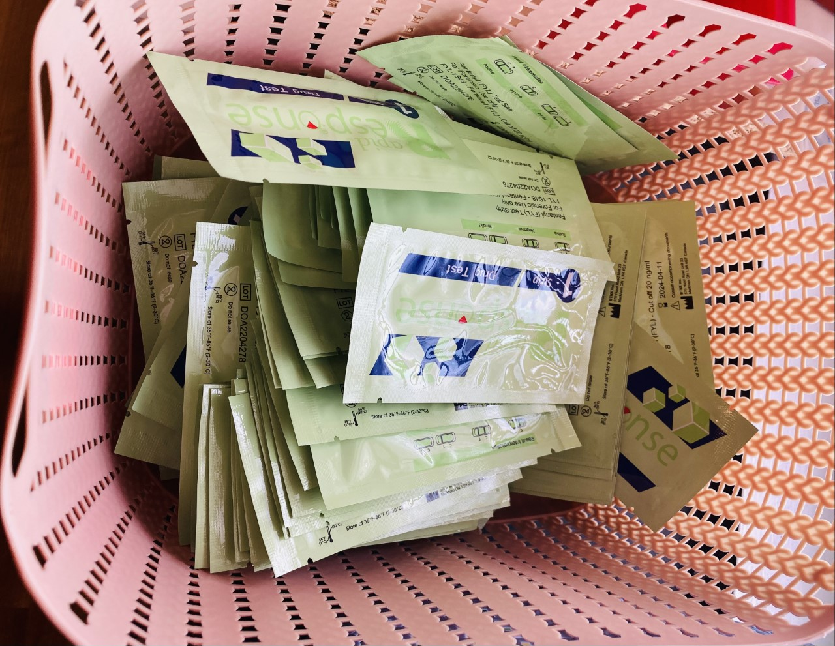
Implications
Pharmacists had limited knowledge of FTS and XTS
Over 75% of community pharmacists are at least “somewhat willing” to sell FTS and XTS
Access to FTS and XTS could be greatly increased with pharmacy distribution
Training for community pharmacy staff regarding FTS and XTS is needed
photo credit: @Bayla Ostrach

Slide 19
Main Takeaways
Most rural community pharmacists were unaware that FTS and XTS could be used to test drugs for the respective medication
When introduced to FTS and XTS, pharmacists are at least slightly willing to sell FTS and XTS
Rural southeastern community pharmacists were more willing to engage with FTS than XTS.
Training is needed for pharmacy staff regarding FTS and XTS implementation
Future work should evaluate the implementation of FTS and XTS into workflow,.

Slide 20
Rural Community Pharmacist Knowledge of Drug Checking Test Strips and Willingness to Engage with Test Strip Activities
Grace Marley, PharmD
Research Assistant Professor
UNC Eshelman School of Pharmacy
Southeast Area Health Education Center
Grace_trull@unc.edu

Slide 21
