Slide 1
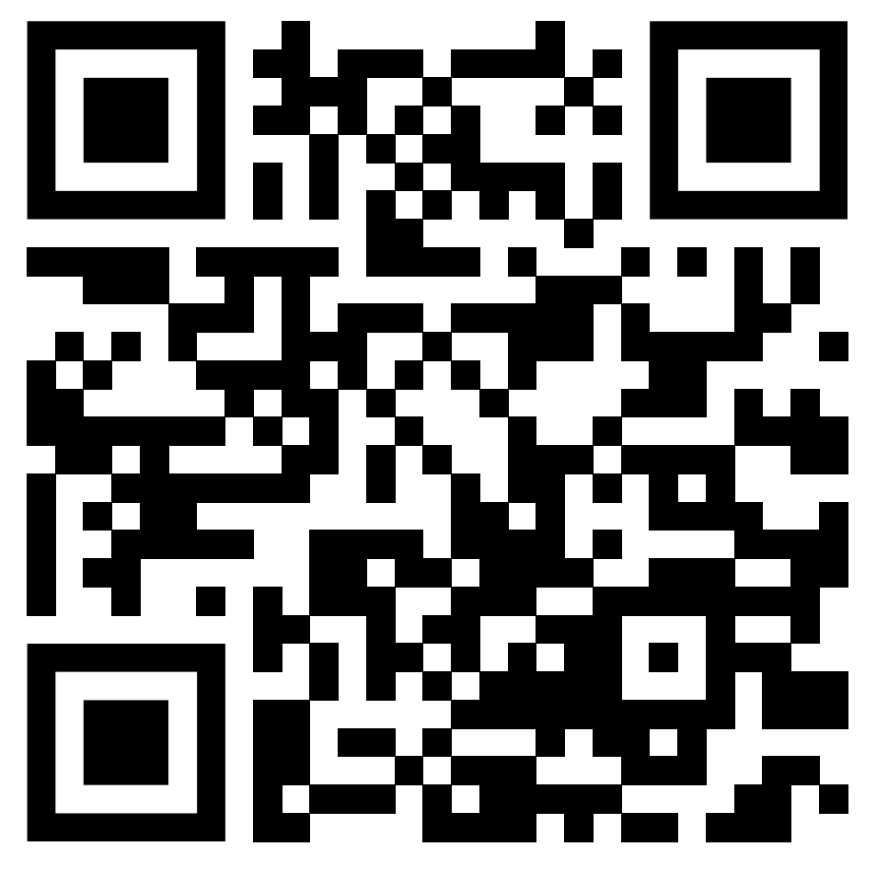
Rurality and Non-Prescribing Clinicians’ Treatment Orientations and Attitudes Toward Medications for Opioid Use Disorder
Aaron R. Brown LCSW PhD
Assistant Professor
College of Social Work

Slide 2
Importance of Non-prescribing Clinicians
NPCs: social workers, counselors, psychologists, MFTs, recovery coaches
Often initial & primary point of contact for SUD Tx.¹⁻³
NPCs’ attitudes affect practice behaviors: ⁴
Education
Referrals
Treatment planning
Program adoption

Slide 3
Research Questions
Do NPCs practicing in predominantly rural areas of the U.S. have different…
…treatment preferences for OUD?
…attitudes toward MOUDs?
Is the relationship between rurality of practice setting and attitudes toward MOUDs mediated by abstinence treatment orientation?
Notes:
Here, treatment preferences for OUD are defined as NPCs’ perceptions of comparative treatment efficacy and likelihood to recommend various treatments for OUD. Attitudes toward MOUDs are defined as agreement with the use of MOUDs as well as beliefs about their effectiveness and acceptability.

Slide 4
Methods
Eligibility
English-speaking; 18yo+
Involved in substance misuse treatment system
HS Diploma & certificate/license OR bachelor’s degree or higher
Not a prescriber
Mixed Sampling Approach (March – June 2019)
Social Media: Facebook, LinkedIn, Twitter, and Reddit ⁵
U.S. Department of Transportation's Substance Abuse Professionals (SAP) lists ⁶⁻⁷
SAMHSA’s Behavioral Health Services Locator ⁸
Online Survey (~15 minutes; Qualtrics)
Demographic & Practice Characteristics (including rurality of practice location)
Exposure & Training ⁹
Treatment Orientation (modified Abstinence Orientation Scale) ¹⁰
Treatment preferences for OUD
Attitudes toward MOUDs ⁹

Slide 5
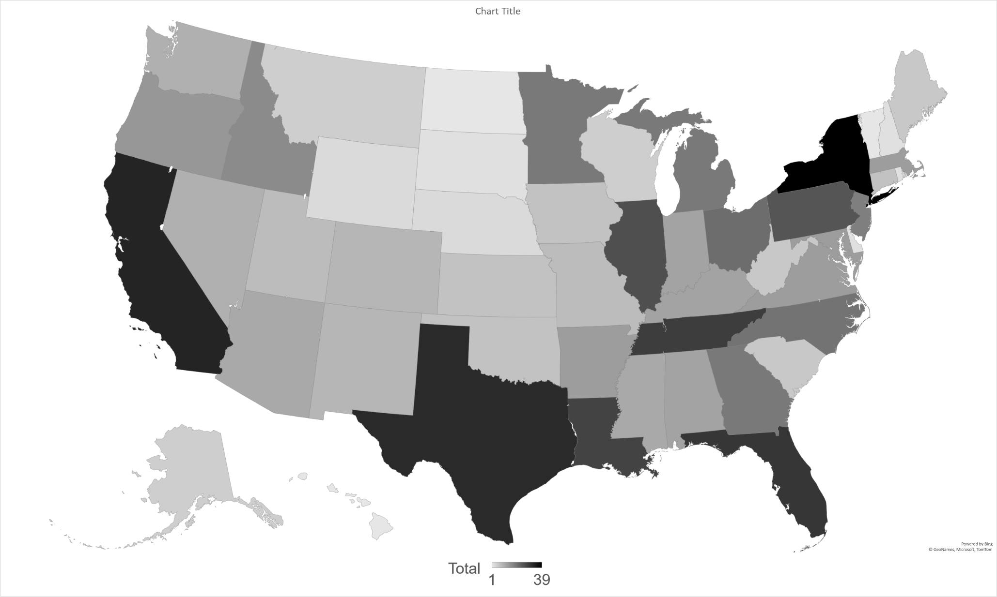
Sample Distribution by State (N = 636)
Notes:
N = 636 analytic sample
725 consented and were eligible
578 (79.7%) finished the survey
647 (89.2%) completed at least 50% of the survey
11 did not to report rurality of practice location
67.5% (n = 429) were recruited from social media
30.8% (n = 196) were recruited from the SAP list
1.7% (n = 11) were recruited from the BHTSL

Slide 6
Demographic Characteristics
Age – M (SD) | 46.7 (13.5) | Educational Attainment
Gender |  | High school diploma or GED | 3.3%
Cis-gender female | 74.1% | Associate's degree | 2.7%
Cis-gender male | 24.1% | Bachelor's degree | 10.5%
Transgender | 0.2% | Master's degree | 76.9%
Non-binary / genderqueer | 1.1% | Doctorate degree or higher | 6.6%
Prefer not to answer | 0.6% | Practice Location
Race |  | Rural | 21.2%
White* | 78.5% | Suburban | 34.4%
Black or African American* | 10.5% | Urban | 44.3%
Hispanic or Latino* | 4.9% | Religious or spiritual?
Asian or Pacific Islander | 0.9% | Yes* | 72.3%
Native American or American Indian | 1.4% | No | 22.2%
More than one race | 2.4% | Prefer not to answer | 5.5%
Prefer not to answer | 1.4%
Notes:
Mostly master-level clinicians, white, cis-gender female.
About half identified as social workers, whether bachelors or masters level.
Those practicing in rural or suburban locations were more likely to be white than urban clinicians.
Rural clinicians were more likely to identify themselves as religious or spiritual compared to those in urban settings.

Slide 7
MOUD Training & Exposure Frequencies
MOUD-specific training
None | 11.2%
1-2 hours | 19.7%
3-4 hours | 16.4%
5+ hours | 51.6%
Prefer not to answer | 1.1%
MOUD adoption – M (SD) | 1.07 (1.07)
None adopted | 39.7%
Methadone | 19.9%
Buprenorphine | 45.1%
Naltrexone | 35.2%
Prefer not to answer | 6.0%
% of clients with OUD on MOUDs
0-5 | 24.9%
5-25 | 19.4%
25-50 | 12.0%
50-75 | 9.0%
75-100 | 15.1%
Don’t know | 17.5%
Prefer not to answer | 2.1%
Notes:
There were no significant differences in adoption of MOUDs, amount of MOUD-specific training received, or percentage of clients on MOUDs based on rurality of practice location.

Slide 8
Treatment Orientation
52.8% agreed or strongly agreed that abstinence from all opioids (including MOUDs) should be the principal goal of treatment.
Those in rural settings were more oriented toward abstinence (vs. harm reduction) than those in urban settings (t = 2.82, p = .014, d = .30).
Item-level differences:
Medications for opioid use disorder patients who repeatedly fail to keep counseling appointments should be gradually withdrawn off medication (p = .011).
Left to themselves, most medications for opioid use disorder patients would stay in maintenance for life (p = .018).

Slide 9
OUD Treatment Preferences by Rurality of Practice Location
 | Rural | Suburban | Urban | Total
Which of the following treatments for opioid addiction is most effective?
MOUDs* | 3.8% | 1.4% | 0.7% | 1.6%
Psychosocial treatment | 14.6% | 8.8% | 9.5% | 10.3%
A combination of MOUDs and psychosocial treatment* | 75.4% | 86.6% | 86.2% | 84.1%
Don’t know / unsure | 3.8% | 2.8% | 3.6% | 3.4%
Prefer not to answer | 2.3% | 0.5% | 0.7% | 0.6%
Which of the following treatments for opioid addiction are you most likely to recommend?
MOUDs | 24.6% | 17.1% | 18.5% | 19.3%
Psychosocial treatment | 3.1% | 0.5% | 1.1% | 1.3%
A combination of MOUDs and psychosocial treatment | 70.8% | 82.0% | 79.3% | 78.5%
Prefer not to answer | 1.5% | 0.5% | 1.1% | 1.0%
Notes:
Those practicing in rural settings were more likely to rate MOUDs alone as most effective and less likely to endorse a combination of MOUDs and psychosocial treatment as most effective compared to both suburban and urban clinicians (χ² [4] = 10.05, p = .040).
A post hoc analysis where rurality was dichotomized (rural vs. suburban/urban) showed that rural clinicians were more likely to recommend MOUDs alone and less likely to recommend a combination of MOUDs and psychosocial treatment (71.9% rural vs. 81.1% suburban/rural; χ² [2] = 7.78, p = .020).

Slide 10
MOUD Treatment Preferences by Rurality of Practice Location
 | Rural | Suburban | Urban | Total
Which of the following types of MOUD is most effective?
Agonist-based MOUDs | 42.3% | 45.2% | 51.3% | 47.3%
Antagonist-based MOUDs | 29.2% | 30.9% | 25.1% | 28.0%
Neither of these are effective | 4.6% | 1.8% | 2.9% | 2.9%
Don’t know / unsure | 23.8% | 19.4% | 20.0% | 20.6%
Prefer not to answer | 42.3% | 2.8% | 0.7% | 1.3%
Which of the following types of MOUD are you most likely to recommend?
Agonist-based MOUDs | 40.8% | 39.2 | 45.5% | 42.3%
Antagonist-based MOUDs | 30.0% | 33.6 | 25.1% | 29.1%
I would not recommend either of these. | 7.7% | 7.4% | 7.6% | 7.6%
Don’t know / unsure | 19.2% | 17.5% | 20.4% | 19.1%
Prefer not to answer | 2.3% | 2.3% | 1.5% | 1.9%
Notes:
There were not any significant differences here, but it is interesting to note that rural and suburban clinicians in this sample tended to be less supportive of agonist medications. It is also important to note that about 20% of all of those sampled were unsure about the effectiveness of MOUDs and whether they should be recommended to people seeking recovery from OUD.

Slide 11
Attitudes towards MOUDs by Rurality of Practice Location
 | M (SD)
 | Rural | Suburban | Urban | Total
To what extent do you consider MOUDs to be an effective treatment option for opioid addiction?* (Range: 0-6) | 3.70 (1.62) | 4.12 (1.39) | 4.14 (1.49) | 4.05 (1.49)
To what extent do you consider MOUDs to be an acceptable treatment option for opioid addiction?* (Range: 0-6) | 4.13 (1.71) | 4.51 (1.50) | 4.64 (1.61) | 4.49 (1.60)
To what extent do you agree with the use of MOUDs as a treatment option for opioid addiction? (Range: 0-4) | 2.96 (1.06) | 3.06 (0.96) | 3.19 (0.92) | 3.09 (0.97)
Notes:
Rural clinicians tended to rate the effectiveness and acceptability of MOUDs lower than clinicians practicing in other settings. There were no significant rural differences in agreement with the use of MOUDs. These three items were combined to form a total score indicating overall attitudes toward MOUDs with a potential range from 0-16. There were significant rural differences in total scores (F[2] = 5.22, p = .006). A post-hoc test revealed that those in rural settings scored 11.00% lower on average than those in urban settings (t = -3.22, p = .004, d = -.35), indicating less positive attitudes toward MOUDs.

Slide 12
Notes:
Results of a mediation analysis indicated that practicing in a rural location compared to in an urban location directly and indirectly influenced attitudes toward MOUDs through an effect on abstinence treatment orientation when controlling for rural vs. suburban, gender, race, educational attainment, and identifying as spiritual or religious.
Rural clinicians were more oriented toward abstinence than those in urban settings (path a; β = -.30, p = .00). Clinicians who identified as spiritual or religious were more oriented toward abstinence, on average, than those who did not (β = .10, p = .029). Respondents who identified as Black were more oriented toward abstinence compared to White respondents (β = .10, p = .021). Compared to cis-gender male respondents, those who identified as transgender or non-binary tended to be less oriented toward abstinence (β = -.14, p = .001). Clinicians who were more oriented toward abstinence had less positive attitudes toward MOUDs (path b; β = -.55, p < .001). Compared to those working in urban settings, rural clinicians had less positive attitudes toward MOUDs (path c’; β = .21, p = .032) when controlling for abstinence treatment orientation and other covariates.

Slide 13
Implications
There is still a need for education and training about MOUDs among NPCs, particularly those who work in rural settings and/or have religious or spiritual convictions that may affect treatment orientation and preferences.
More efforts are needed to educate rural clinicians about harm reduction.
In doing so, rural clinicians may be more receptive to contextualizing MOUDs an effective harm reduction strategy.
Notes:
Despite reporting similar levels of training and exposure to MOUDs to clinicians practicing in other settings, rural clinicians were more likely to be oriented toward abstinence and to hold negative attitudes toward MOUDs

Slide 14
References
Aletraris, L., Edmond, M. B.inaino, M., Fields, D., & Roman, P. M. (2016). Counselor training and attitudes toward pharmacotherapies for opioid use disorder. Substance Abuse, 37(1), 47-53. https://doi.org/10.1080/08897077.2015.1062457
Bride, B. E., Abraham, A. J., Kintzle, S., & Roman, P. M. (2013). Social workers' knowledge and perceptions of effectiveness and acceptability of medication assisted treatment of substance use disorders. Social Work in Health Care, 52(1), 43–58. https://doi.org/10.1080/00981389.2012.725457
Varra, A. A., & Hayes, S. C. (2007). Assessing referrals for pharmacotherapy: A comparison of therapist and client report. Journal of Substance Abuse Treatment, 32(4), 411-413. https://doi.org/10.1016/j.jsat.2006.09.003
Brown, A. R. (2022). Health professionals’ attitudes toward medications for opioid use disorder. Substance Abuse, 43(1), 598-614. https://doi.org/10.1080/08897077.2021.1975872
Jones, A., Walters, J., & Brown, A. (2020). Participant recruitment in social work: A social media approach. Social Work Research, 44(4), 247-255. https://doi.org/10.1093/swr/svaa017
National Association for Alcoholism and Drug Abuse Counselors. (2019). DOT substance abuse professionals listings. https://www.naadac.org/sap-directory
SAPList (2022). Find a substance abuse professional. https://www.saplist.com/find-a-sap/
Substance Abuse and Mental Health Services Administration. (2019). Behavioral health treatment services locator. https://findtreatment.samhsa.gov/
Abraham, A. J., Rieckmann, T., McNulty, T., Kovas, A. E., & Roman, P. M. (2011). Counselor attitudes toward the use of naltrexone in substance abuse treatment: A multi-level modeling approach. Addictive Behaviors, 36(6), 576-583. https://doi.org/10.1016/j.addbeh.2011.01.030
Caplehorn, J. R. M., Hartel, D. M., & Irwig, L. (1997). Measuring and comparing the attitudes and beliefs of staff working in New York methadone maintenance clinics. Substance Use & Misuse, 32(4), 399-413. https://doi.org/10.3109/10826089709039361

