Slide 1
START Substance Use Treatment and Resources for Texas
November 2023
A Multidisciplinary Team to Screen for and Initiate Substance Use Treatment During Acute Hospitalization for Patients in Texas
Richard Bottner, DHA, PA-C
Richard.Bottner@cha.com
Alanna Boulton, MSHA, PMP
alanna.boulton@austin.utexas.edu
Nicholaus Christian, MD, MBA
christian.nicholaus@gmail.com
John Weems, MD, FASAM
John.Weems@communitycaretx.org

Slide 2
Disclosures and disclaimers
This project is supported by grant award PP220045 from the Cancer Prevention and Research Institute of Texas and by Texas Targeted Opioid Response, a public health initiative operated by the Texas Health and Human Services Commission through federal funding from the Substance Abuse and Mental Health Services Administration grant award number HS001054500001.
The authors have no other relevant financial relationships to disclose.
The views expressed do not necessarily reflect the official policies of the Department of Health and Human Services or Texas Health and Human Services; nor does mention of trade names, commercial practices, or organizations imply endorsement by the U.S. or Texas Government.

Slide 3
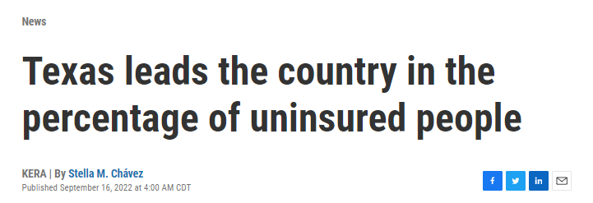
Welcome to Texas
https://www.keranews.org/news/2022-09-16/texas-leads-the-country-in-the-percentage-of-uninsured-people
https://cw33.com/news/texas/texas-ranks-on-the-list-of-2023-poorest-states-in-the-nation/
https://www.texastribune.org/2017/09/14/incomes-continue-rise-texans-color-still-face-gap/
Notes:
Highest uninsured rate in the country
Top 15 poverty rate
Top 15 income inequality rate
https://cw33.com/news/texas/texas-ranks-on-the-list-of-2023-poorest-states-in-the-nation/#:~:text=The%20state%20of%20Texas%20ranked,20%20of%20the%20poorest%20states.
https://www.statista.com/statistics/227249/greatest-gap-between-rich-and-poor-by-us-state/#:~:text=New%20York%20was%20the%20state,score%20of%200.51%20in%202021.

Slide 4
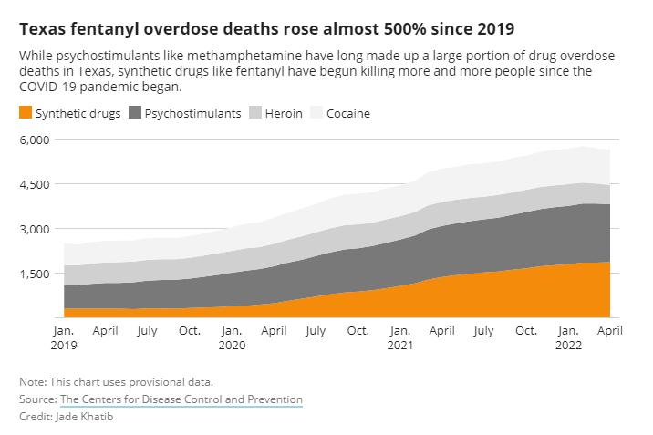
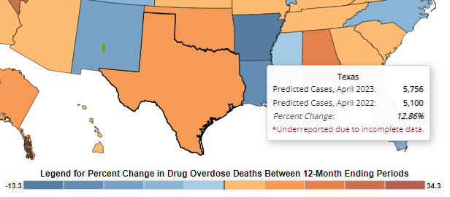
the SUD landscape in Texas
Ahmad F, Rossen L, Sutton P. National Center for Health Statistics - Provisional drug overdose death counts. Published 2022. Accessed September 2023.
https://krdo.com/news/2023/07/20/el-paso-countys-discriminatory-land-use-code-limited-access-to-addiction-recovery-facilities/
https://www.texastribune.org/2022/10/11/texas-harm-reduction-drugs/
Notes:
Increase in prevalence of SUD
Limited or no access to harm reduction
Systemic stigma preventing changes to these phenomena

Slide 5
Where we started (2018)
Travis County
(Austin, Texas)
16 hospitals
2500+ acute care hospital beds
5000+ direct patient care physicians and APPs
0 formal or informal acute care SUD treatment programs
Texas Landscape
Increased prevalence of SUD
Increased overdose rates
Low treatment access
Low medication access
Increased health disparities
Low/No harm reduction
Source: U.S. Department of Health & Human Services; Austin American Statesman
Notes:
Just under 1m people in Austin in 2018
Currently 2.5 million people

Slide 6
Substance Use Treatment and Resources for Texas (START) Team
Implement a multidisciplinary team to increase SUD screening and treatment rates during acute hospitalization at an academic safety-net hospital in Texas where no protocols for SUD treatment existed.

Slide 7
Methods
Phase 1:
Pilot Site HBOT
Single site QI project in Austin, Texas
Focus: MOUD and Stigma Reduction
Phase 2:
Dissemination and Scaling
Model dissemination to three additional hospital sites in Texas
Focus: MOUD and Implementation Science Evaluation
Phase 3:
Pilot Site Service Expansion
Service expansion at initial pilot site
Focus: MAUD, SBIRT, and Substance Use Navigation

Slide 8
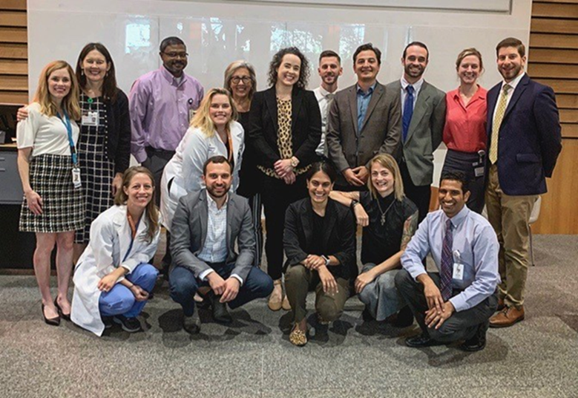
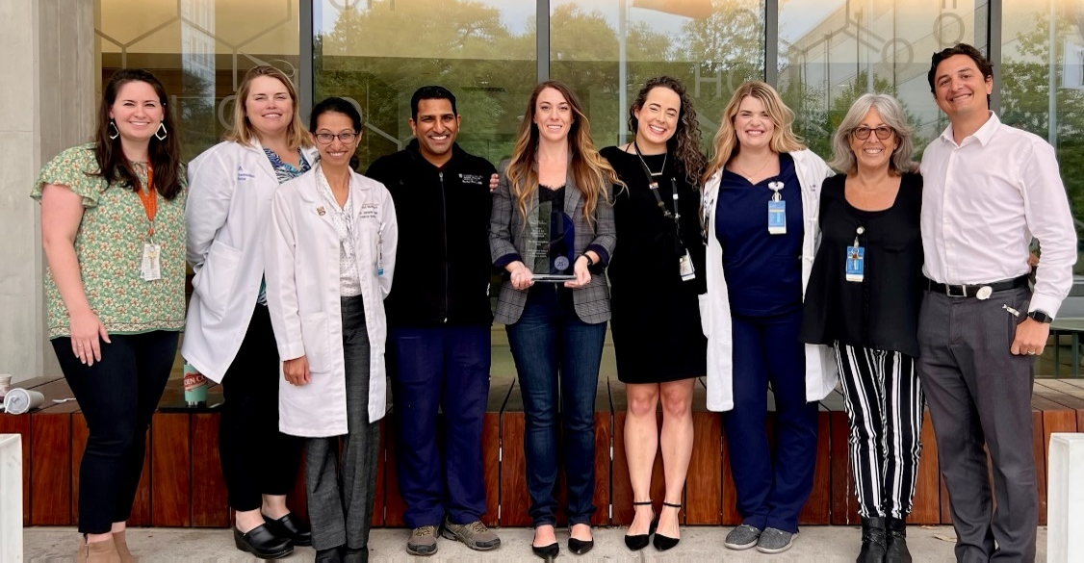
Phase 1: The B-Team (buprenorphine team)

Slide 9
Phase 1: HBOT Pilot Results (9/2019 – 8/2023)
Pilot HBOT Patient Demographics N = 641
Demographic | N | Percent of Patient Population
Gender
Female | 219 | 34.2%
Male | 421 | 65.7%
Transgender | 1 | 0.2%
Unknown / Not Reported | 0 | -
Age
< 25 Years | 16 | 2.5%
25 - 34 Years | 128 | 20.0%
35 - 44 Years | 216 | 33.7%
45 - 54 Years | 118 | 18.4%
55 - 64 Years | 111 | 17.3%
≥ 65 Years | 52 | 8.1%
Self-Identified Race
American Indian | 1 | 0%
Asian | 3 | 0%
Black or African American | 46 | 7%
Hispanic or Latino | 136 | 21%
Native Hawaiian | 0 | 0%
White or Caucasian | 437 | 68%
Other | 2 | 0%
Unknown / Not Reported | 16 | 2%
Housing Status
Housed | 383 | 60%
No Housing, Stable | 66 | 10%
No Housing, Not Stable | 173 | 27%
Temporary Housing | 19 | 3%
Note: Fiscal year begins 9/1 and ends 8/31
Notes:
644 screened
449 started
375 linked

Slide 10
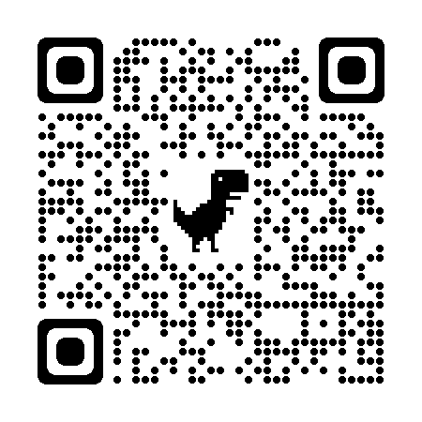
Phase 1: HBOT Pilot Post Discharge Outcomes
DOI: 10.1002/jhm.13201
*Patients seen in hospital between 9/1/2018 – 1/30/2023

Slide 11
Phase 2: HBOT Dissemination results
HBOT Scaling Patient Demographics N = | 4631
Demographic | N | Percent of Patient Population
Gender
Female | 1452 | 31.4%
Male | 3178 | 68.6%
Transgender | 1 | 0.0%
Unknown / Not Reported | 0 | 0.0%
Age
< 25 Years | 473 | 10.2%
25 - 34 Years | 1542 | 33.3%
35 - 44 Years | 1467 | 31.7%
45 - 54 Years | 686 | 14.8%
55 - 64 Years | 338 | 7.3%
≥ 65 Years | 119 | 2.6%
Self-Identified Race
American Indian | 6 | 0%
Asian | 21 | 0%
Black or African American | 1332 | 29%
Hispanic or Latino | 727 | 16%
Native Hawaiian | 3 | 0%
White or Caucasian | 2524 | 55%
Other | 47 | 1%
Unknown / Not Reported | 38 | 1%
Housing Status
Housed | 154 | 3%
No Housing, Stable | 0 | 0%
No Housing, Not Stable | 74 | 2%
Temporary Housing | 33 | 1%
Unknown / Not Reported | 4370 | 94%
Note: Fiscal year begins 9/1 and ends 8/31
Notes:
7149 screened
3065 started
795 linked

Slide 12
Phase 3: Pilot Site service expansion (SBIRT and MAUD)
If patient does not have a primary care provider: SUN and case manager communicate with outpatient clinic to facilitate a referral.
If patient is motivated to continue counseling for alcohol use: SUN refers patient to our partner FQHC addiction medicine clinic.
Contacting patient for follow-up:
1 week post-discharge: SUN calls patient to assist with needs such as appointment reminders, transportation, and filling prescriptions.
4-6 weeks post-discharge: SUN calls patient to re-administer a modified AUDIT and assess if any changes in drinking have occurred.
Audit-PC Patient Screening
Substance Use Navigator (SUN) Intervention
Pharmacotherapy
Follow Up
- Performed by nursing
- Admitted patients
- Full AUDIT assessment
- SBIRT administered
- Evaluation for pharmacotherapy
- Naltrexone or acamprosate prescribed when appropriate
- Initiated while inpatient
- Outpatient care coordination prior to hospital discharge
- Provide logistical support at 1 week
- AUDIT reassessment at 4-6 weeks

Slide 13
Phase 3: Pilot Site service expansion Results
 |  | AUDIT-PC Positive | 498 | AUDIT-PC Negative | 7859
Age | Mean Age | 50 |  | 54
Gender | Male | 397 | 79.7% | 4368 | 55.6%
 | Female | 101 | 20.3% | 3491 | 44.4%
Race | American Indian/Alaska Native | 6 | 1.2% | 57 | 0.7%
 | Asian | 3 | 0.6% | 167 | 2.1%
 | Black or African American | 45 | 9.0% | 1068 | 13.6%
 | Multiple | 9 | 1.8% | 108 | 1.4%
 | Native Hawaiian or Other Pacific Islander | 0 | 0.0% | 2 | 0.0%
 | Other Race | 10 | 2.0% | 95 | 1.2%
 | White | 370 | 74.3% | 5561 | 70.8%
Ethnic Group | Hispanic or Latino | 146 | 29.3% | 2613 | 33.2%
 | Not Hispanic or Latino | 254 | 51.0% | 3909 | 49.7%
Total |  | 498 | 100.0% | 7859 | 100.0%
Note: Fiscal year begins 9/1 and ends 8/31

Slide 14
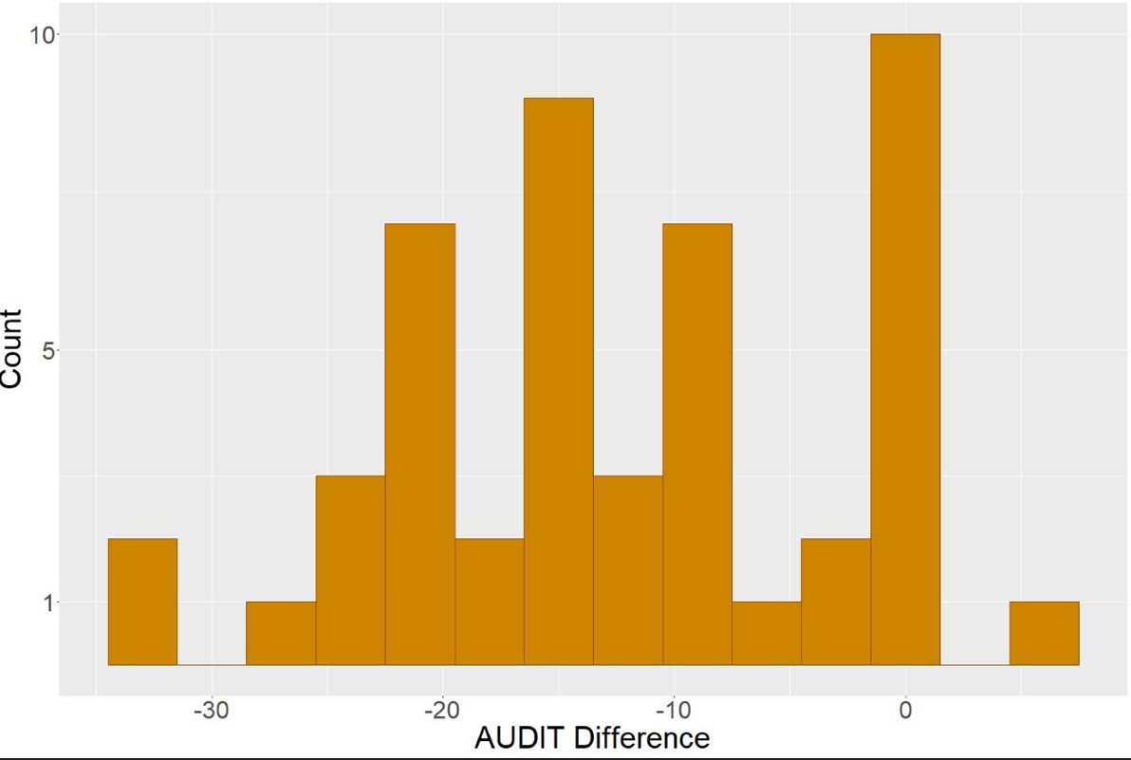
Phase 3: MAUD Pilot Site Post Discharge Outcomes
Mean difference: -12.1 (95% CI: -14.9, -9.4)
Notes:
37 (54.4%) patients manifested a decreased AUDIT score at follow up
20 (29.4%) patients declined to complete follow up AUDIT
11 (16.2%) patients had an increased or the same AUDIT score at follow up

Slide 15
Where we are now

Slide 16
Impact
He acknowledged that he was so relieved to not have been kicked out after having been caught using in the hospital, but more importantly, it really seemed to be about his feelings, and almost disbelief, that 'they actually really care about me.' It was kind of heartbreaking, but very awesome that you all have made such an impact.”

Slide 17
Take this home with you
A multidisciplinary team can promote an increase in screening and treatment of SUD for hospitalized patients even in the absence of existing structural or systemic support.
Every patient that is provided with SUD treatment or recovery support in the acute care setting is a person who might not otherwise have access to that care. Every patient matters.

Slide 18
Questions?
www.shoutx.org | www.resetstigma.org
Richard Bottner, DHA, PA-C
Richard.Bottner@cha.com
Alanna Boulton, MSHA, PMP
alanna.boulton@austin.utexas.edu
Nicholaus Christian, MD, MBA
christian.nicholaus@gmail.com
John Weems, MD, FASAM
John.Weems@communitycaretx.org

