Slide 1
Scaling a Virtual Buprenorphine Bridge Clinic: Outcomes and Lessons Learned
Nicole O’Donnell, CRS, BA – Program Manager
Patrick Dooley, CRS - Lead Substance Use Navigator
James Sherman, CRS, CHW - Substance Use Navigator
University of Pennsylvania
Center for Addiction Medicine & Policy
AMERSA | November 2024

Slide 2
Disclosures:
None

Slide 3
Project Aim:
To describe scaling and outcomes for patients with visits in our telemedicine buprenorphine bridge clinic.

Slide 4
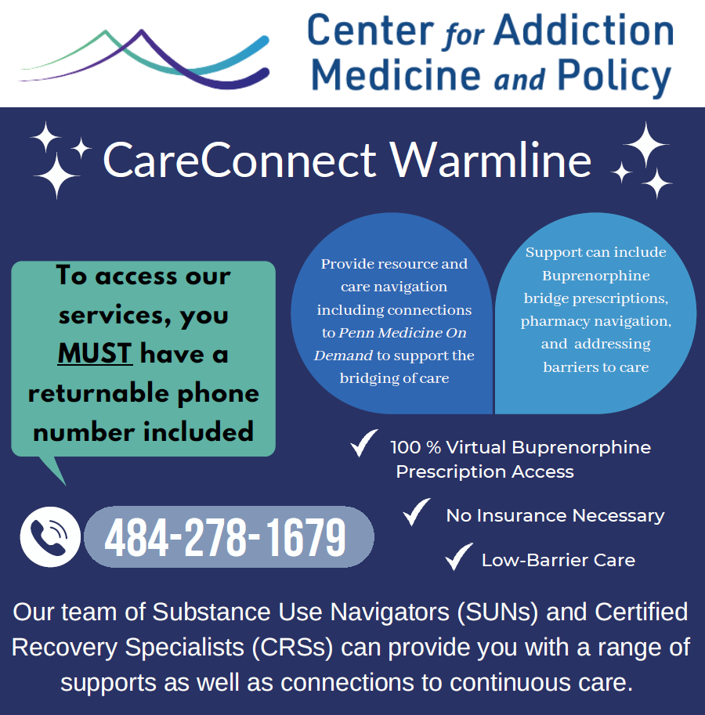




What is the CareConnect Warmline?
Peer led support services for individuals with SUD
Available to patients, providers, family members (7 days per week 9am-9pm)
Same day access to telehealth buprenorphine
Support navigating to other needed services (methadone, inpatient, wound care, ID, etc.)
Tailored support for continued treatment

Slide 5
CareConnect Process
Notes:
Touch on PMOD as a whole. Not specific to Addiction Med. Not just SUN aspect of the process. Use EHR for contact between SUN and PMOD

Slide 6
CareConnect Growth
Notes:
Can you change the graph legend to say “to date” instead of “thus far”
In reality, it looks like calls are going down since this is already mid November– maybe query a more up to date volume? Also what date is this from?

Slide 7


CareConnect Patient Demographics
11%
19%
45%
89%
36%
12%
23%
41%
65%
57%
1% Unknown
Notes:
Do we say Hispanic or Latin X? I don’t know the right terms… this data looks pretty…better than the hollow circles…
Should we also add how many already on bup so you can show how we are a safety net for continuation?

Slide 8






Numbers from CareConnect Warmline:
Total patients seen in the last year: 1674
78% Already in care(Bridge Rx). 22% Started Bupe
Number of Rx’s in last year: 1392
Pregnant Patients: 1%
Uninsured callers: 20%
Released from incarceration in past 30 days: 10%
Notes:
Add data for in care/new. 78% bridge and 22% new Rx. 92 pick up initial, 69 filled 1 additional, 51 had active at 30 days.

Slide 9
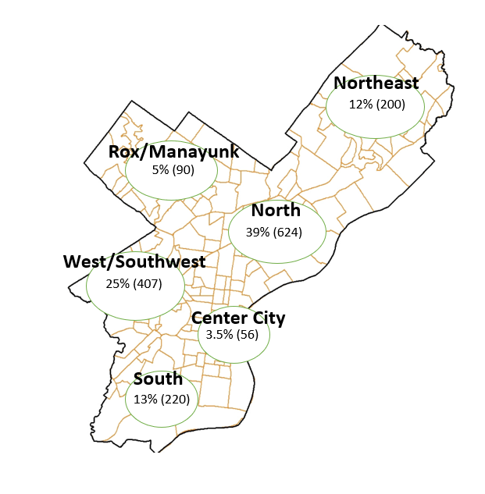
Calls by neighborhood:
Notes:
I made it bigger…

Slide 10
Lessons learned:
Pharmacy barriers
-No bupe in stock
-Pharmacies without over phone payment
-Stolen/Lost Rx’s requiring Prior Auth
Transportation issues
-On-going funding for ride share/SEPTA
-Assistance for medically comprised
-ED visits for lost/stolen medication
Partnerships built
-ED staff relationships
-Other providers
-Pharmacies
-Primary care offices
Missed populations
-Patients without reliable phone
-Patients who are not tech savvy
-Patients who are uninformed
Notes:
Maybe a caption– what we learned at top?>…

Slide 11
Conclusions:
Scaling up our virtual buprenorphine bridge clinic facilitated access to rapid support for patients with OUD seeking to initiate or continue buprenorphine treatment
Providing buprenorphine via a low barrier telehealth access point enhances continuity and prevents gaps in buprenorphine treatment, including for marginalized populations like pregnant and post-incarceration.
Future plans
  Increasing engagement of stakeholders connected to marginalized populations such as the jail and treatment centers.
  Raising awareness and disseminate OUD resources as a safety net to care continuation.
Notes:
Scaling up did not facilitate access it increased the numbers served.
The second sentence is not a conclusion…could add ”especially for marginalized pops…pregnant, post incarceration”
Future plans are to target stakeholders connected to marginalized pops such as the jail and treatment centers” to raise awareness and ddisseminate oru resources as a safety net to care continuation.

Slide 12
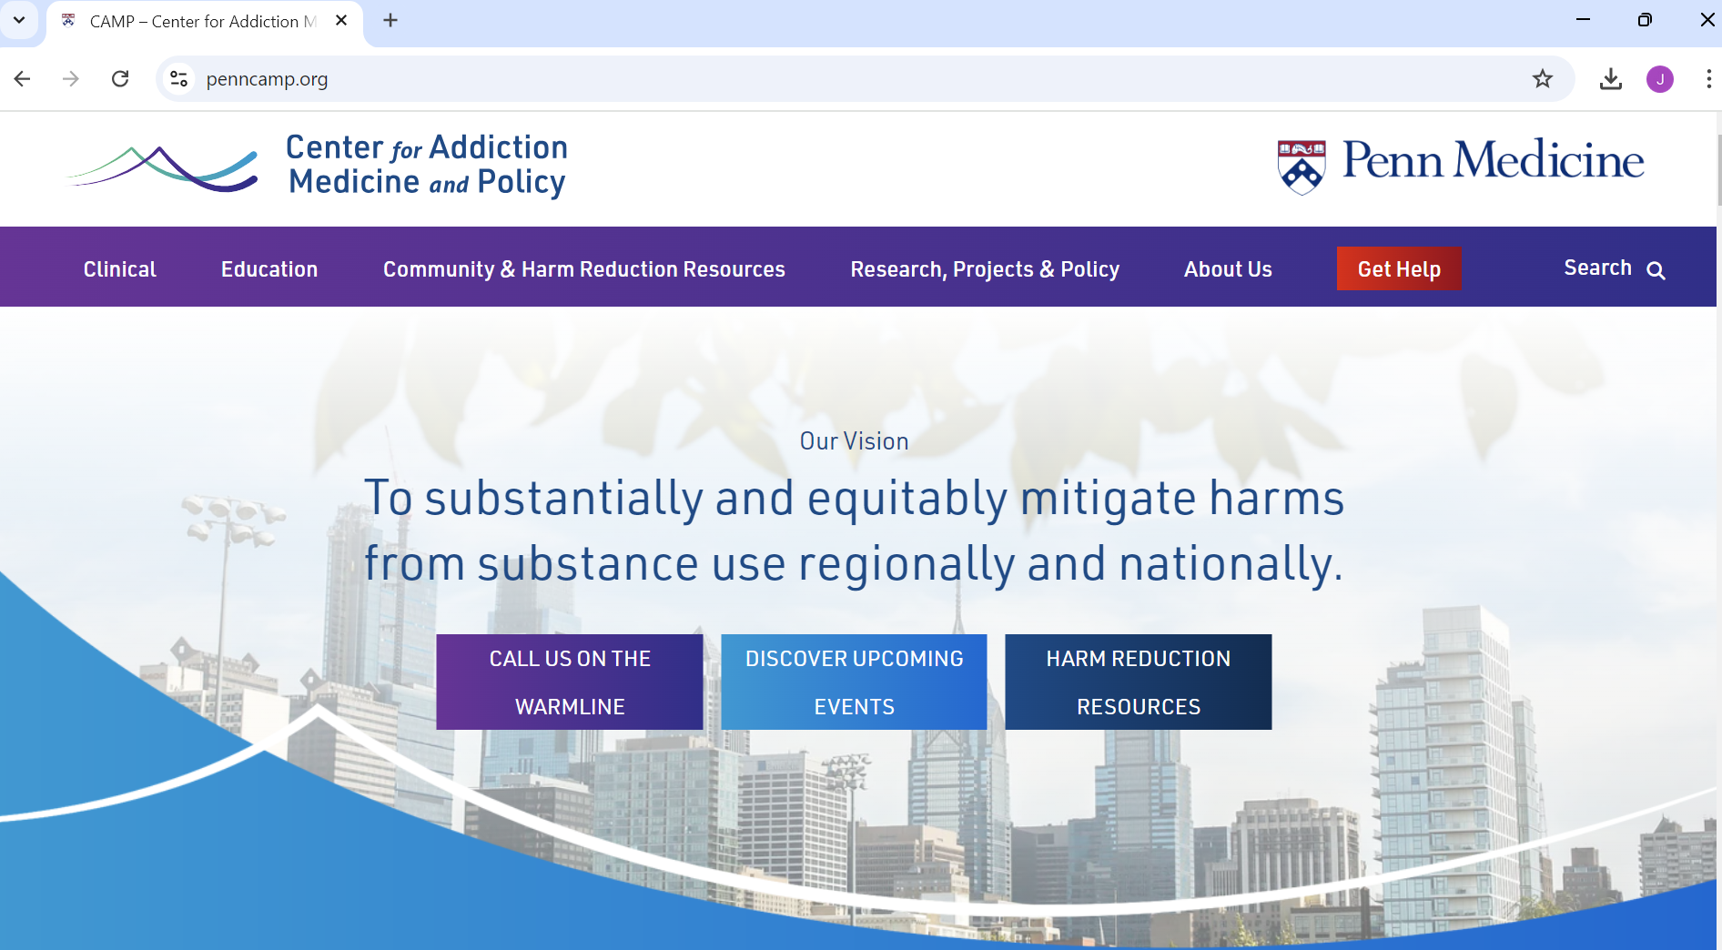
Authors:
Jasmine Barnes, MPH
Nicole O’Donnell, BA, CRS
Gilly Gehri, BA
Jon Pomeroy, DO
Emily Cubbage, BA
Susan McGinley, CRNP, MSN
Jeanmarie Perrone, MD
Margaret Lowenstein, MD, MPhil, MSHP
Acknowledgments:
Penn Medicine On Demand
Philadelphia Dept. of Public Health
penncamp.org
nicole.odonnell@pennmedicine.upenn.edu
patrick.dooley@pennmedicine.upenn.edu
james.sherman@pennmedicine.upenn.edu

Slide 13



Thank you!
Q&A

