Slide 1
Seize the moment: Inpatient Hepatitis C workup, curative treatment initiation, and linkage-to-care
AMERSA 2024
Chicago, IL
Notes:
Joshua/?Natalie

Slide 2
Presenters
Oregon Health & Science University (OHSU)
Ximena A. Levander, HaYoung Ryu, Carissa Williams
University of North Carolina
Madeline McCrary (former fellow), Kate Roberts (Bryn Mawr PhD candidate)
Washington University in St. Louis
Madeline McCrary, Jessica Gallegos
Lawrence General Hospital & Greater Lawrence Family Health Center
Joshua St. Louis, Natalie Stahl
Notes:
Individuals do brief introductions, "cultural introduction"
1 min per person
Add contact info on resource page

Slide 3
Please download and install the Slido app on all computers you use
Who is in the room?
ⓘ Start presenting to display the poll results on this slide.

Slide 4
Disclosures
XAL, HR, CW – supported by K12 HS026370
MM – co-PI on Gilead FOCUS grant supporting inpatient HIV, HBV, HCV linkage to care

Slide 5
Learning Objectives
Describe the key components of and notable gaps in the hepatitis C (HCV) care cascade
Identify facilitators and barriers to inpatient HCV treatment implementation
Develop a plan for a possible inpatient HCV treatment model for your home institution

Slide 6
Workshop Agenda
Introduction
Review of HCV management and care cascade
Interactive breakout session - barriers and facilitators
Review of inpatient HCV treatment models
Interactive breakout session - plan development for inpatient program
Large group sharing and discussion
Wrap-up/evaluation
Notes:
Joshua/?Natalie

Slide 7
2024 CDC Viral Hepatitis National Progress Report
Notes:
Madeline – Slides 7-15
The 2024 CDC viral hepatitis progress report shows that as of 2022, while we have made some progress in reducing Hepatitis C-related deaths, *we are NOT on target to reaching out 2025 goals for reducing new HCV infections overall and *in particular among people who inject drugs.

Slide 8
Timely HCV Treatment
Less than a third of people with health insurance in U.S. receive treatment within 1 year of HCV diagnosis
https://www.cdc.gov/nchhstp/newsroom/2022/2022-Hep-C-Vital-Signs.html

Slide 9
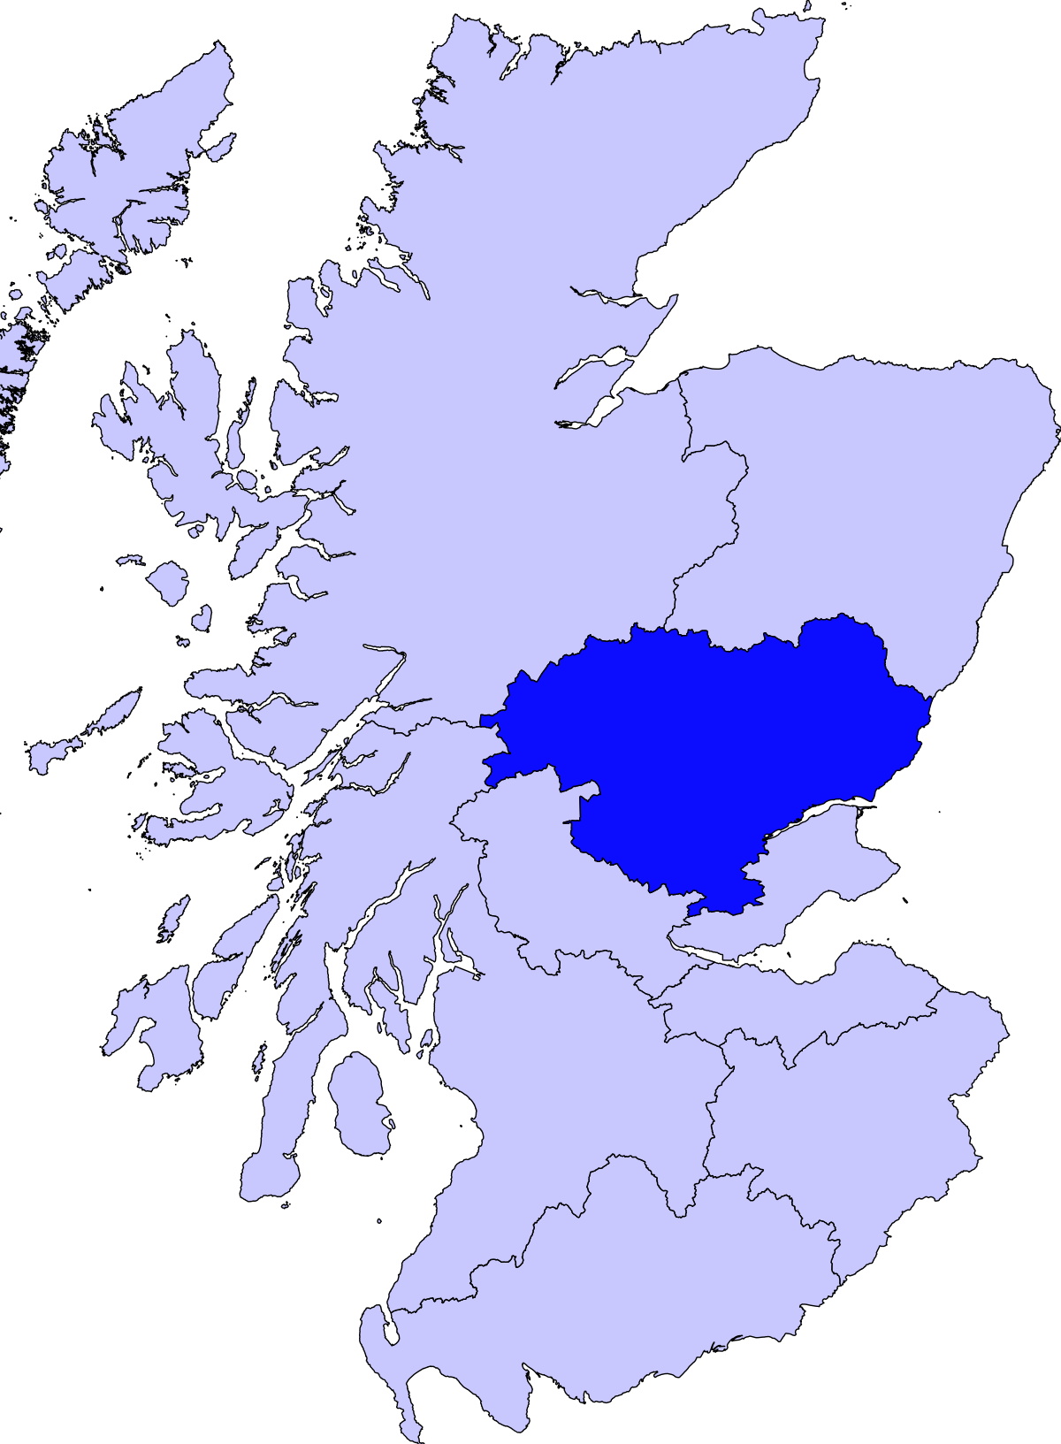
HCV Treatment as Prevention
“Real-world” impact of scaling up HCV treatment of people who inject drugs (PWID) on chronic HCV cases at the population-level
Rapid scale-up in Tayside, Scotland
200 treated in 2017
Goal of 500 total by 2019
National Needle Exchange Surveillance Initiative
Conducted every 2 years
Includes 10-15% of PWID
Compared HCV detection b/w Tayside, Greater Glasgow/Clyde (GGC), & rest of Scotland (RoS)
Notes:
﻿The current study forms one component of the ‘Evaluating the population impact of hepatitis C direct acting anti-viral treatment as prevention for people who inject drugs (EPIToPe)’ study, a mixed-methods evaluation of a natural experiment of HCV ‘Treatment as Prevention’ (TasP) among PWID. Greater Glasgow & Clyde and Rest of Scotland are controls and Tayside is the intervention.

Slide 10
HCV Treatment as Prevention

Slide 11
Who should be treated for HCV?
…most people
Notes:
We have incredibly effective treatments – part of curbing increases in Hep C cases must include treating people.
Now, pretty much everyone should be treated for Hepatitis C if their life expectancy is >12 months.
We also know that earlier treatment, meaning treating earlier in the disease course, leads to better long-term outcomes

Slide 12
Ongoing risk for reinfection and chance of acute infection not reasons to delay treatment
Notes:
Furthermore, past reasons to defer treatment, like active substance use or concerns for acute infection, are NO LONGER reasons to delay treatment. Guidelines suggest nearly everyone should be treated, AND at time of diagnosis.

Slide 13
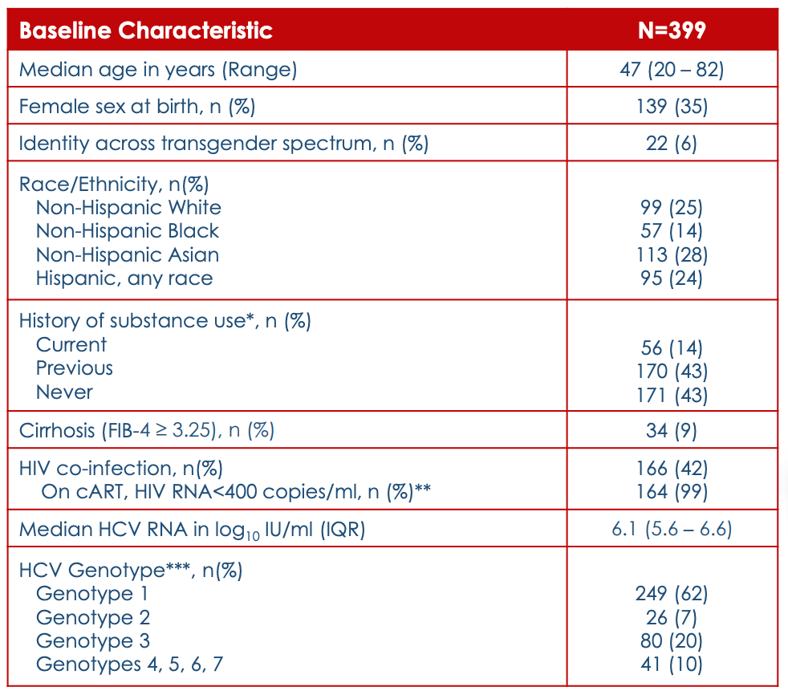
95% participants (379/399) achieved SVR
3.5% participants (14/397) with follow-up reported > SAE – none were tx related or led to stopping tx or death
PWUD and pts with cirrhosis were included
Notes:
While the medications we have are incredibly effective and safe - The real hurdle is getting them to the people that need it.
The MINMON study showed that 95% of patients were cured if they got the full course of DAAs in-hand. This was with very minimal pre-treatment labs and only remote check-ins at week 4 to check tolerance and week 22 to schedule cure labs.
Only 3.5% of patients reported any kind of symptomatic adverse event – none were treatment related or led to stopping treatment.
Finally, People with substance use and cirrhosis were included in this study

Slide 14
HCV Treatment is SIMPLE (for most patients)
AASLD/IDSA HCV guidance (www.hcvguidelines.org)
Notes:
In 2019, Simplified Treatment Pathways were implemented for patients who were treatment naïve without cirrhosis and with compensated cirrhosis.
The pathways outline eligibility criteria, recommend basic pre-treatment assessments and patients can be treated with one of the 2 pan-genotypic regimens.
No on-treatment lab monitoring is needed and patients just need to get “cure labs” 12 weeks or 3 months after completing treatment.
This means that treatment is 2-3 months depending on the regimen with labs 3 months later at month 5-6 and you’re done.

Slide 15
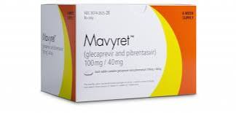
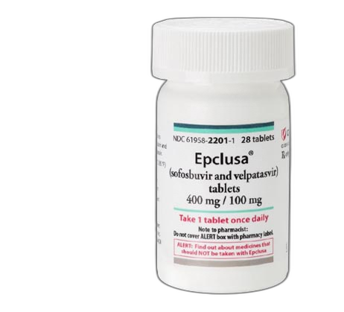
2 DAAs – both with >95% cure, pan-genotypic
Glecaprevir/pibrentasvir 100/40mg (GLE/PIB)
3 pills once per day with food x 8 weeks
Sofosbuvir/velpatasvir 400/100mg (SOF/VEL)
1 pill once per day w/wo food x 12 weeks
DAA selection based on several factors:
Insurance coverage, drug interactions, food insecurity,
pill burden, duration of treatment
Notes:
Madeline – Slides 7-15
The next step is checking for drug interactions and then prescribing. There are 2 options regardless of which simplified pathway you are going down.
Both treatment options are highly effective and well-tolerated. Really the decision comes down to insurance coverage unless the patient has a drug interaction that can’t be mitigated by holding the med or changing its timing while on Hep C treatment.
GleCAPrevir/pibRENtasvir is 3 pills once per day with food for 8 weeks. This is preferred by Missouri Medicaid and amazingly does NOT require a prior authorization. All 8 weeks can be dispensed at once if you write for it that way. This is amazing as prior auths can be a major barrier to treatment and having to coordinate refills often leads to incomplete treatment courses or breaks between boxes.
Sofosbuvir/velPAtasvir is 1 pill once per day with or without food for 12 weeks. This is preferred by most commercial insurance plans and some Illinois Medicaid plans.
Main DDI - atorvastatin
Preferred by MO Medicaid, can dispense all 8 weeks at once
Main DDI – antacids (separate in time)
Preferred by most commercial insurances
Often will only fill 1 mo at a time (2 refills)
May require certain specialty pharmacy
Size of the medication package! Mavyret = huge

Slide 16
HCV treatment is all care coordination
Nurse/nurse navigator
Education
Peer support specialist
Patient advocacy
Support with adherence
Pharmacist
Manage drug interactions
Adherence/ADE follow ups
Social worker
Identify barriers
Follow ups (visits, labs, etc.)
"role model"
Insurance/cost/refill troubleshooting
Assess/address barriers
Care coordination
Patient advocacy
Follow up reminders
Use of interdisciplinary team to increase engagement & treatment success
Notes:
Carissa/Jessica

Slide 17
HCV can be a source of shame and stigma but treatment can be transformative
“At first I didn’t want to take care of myself. I didn’t care about myself. I didn’t care how I looked, how I dressed. Today, I care how I look, how I dress, what people think of me, how they see the way I’ve changed”
“Everything changed. I stopped drug use. I stopped everything because I said if I beat the Hep C, I could beat that too”
“With this hepatitis and being clean, when I started [HCV treatment], I guess I started being responsible. You know, making responsible decisions about my life. In that aspect, it showed me where they all connect”
Batchelder AW et al. Drug Alcohol Depend. 2015 Aug 1;153:66-71. PMID: 26096534
Notes:
Ximena
Something that was not captured in the data, is the real potential transformative benefit of Hepatitis C treatment.
These quotes are from a qualitative work that conducted interviews among people enrolled in an integrated Hep C treatment program within an opioid treatment program, or methadone clinic, in New York and reflect how Hepatitis C treatment impacted their lives.
READ QUOTES

Slide 18
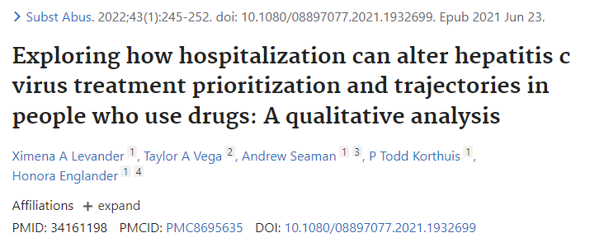
27 in-depth interviews conducted in 2019
"I’m gonna be here like six weeks. Why am I not doing [HCV treatment]? I am basically in a bubble. And I’m not going anywhere…I’ve had a stroke. I might as well get my stuff in order and I shouldn’t be worrying about ‘down the road, I might get Hep C again.’ I should focus on now."
"Every time I come into the hospital, [inpatient doctors] don’t ever talk about [HCV]…am I wondering, is it destroying my liver? Yeah…Why, [HCV] actually has to start affecting something before it gets brought up…I figured that there would have been more discussion about [HCV]…[HCV] put in my face. They wanna put abstinence and drug-abuse treatment, and all that, in my face every time I’m here."
Notes:
Ximena
Ximena – some patients see this as a key time for possible treatment or at least tee-ing up for outpatient treatment

Slide 19
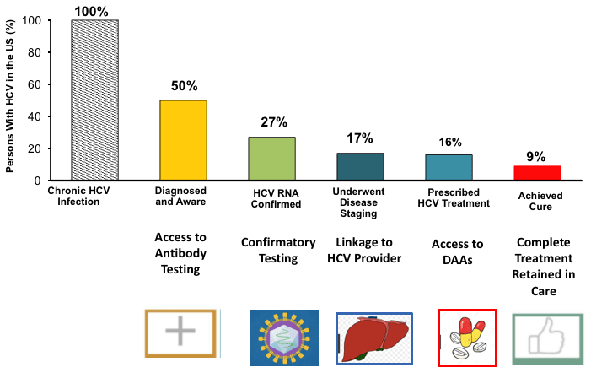
HCV Care Cascade
Terrault NA. Hepatitis C elimination: challenges with under-diagnosis and under-treatment. F1000Res. 2019 Jan 14;8:F1000 Faculty Rev-54. doi: 10.12688/f1000research.15892.1. PMID: 30687501; PMCID: PMC6338244.
Notes:
Slides 19-22 HaYoung
The way we conceptualize improving access to Hep C treatment is through care cascades. This is just a visual example of the Hep C care cascade in the US published in a review from 2019. In general the steps are screening and diagnosis, referral to a treating provider, actual prescription of DAAs and then confirmation of cure with follow-up labs. Cure is defined as “sustained virologic response” or SVR 12 weeks after completion of treatment.
Many of the efforts to improve access to DAAs aim to decrease drop offs with testing and referral – so reducing the number of times someone needs to come back to get labs, anticipating testing needs ahead of time and enabling frontline providers like PCPs to prescribe DAAs themselves, eliminating the barrier of a referral. Once people get medications, they tend to do amazingly well.

Slide 20
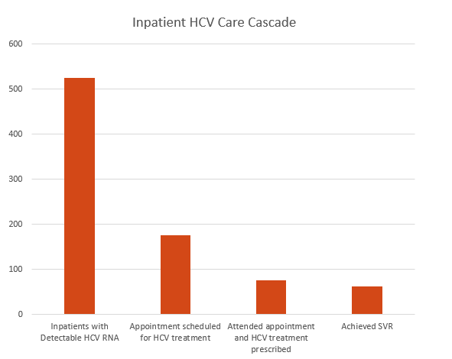
Low Rates of Successful Linkage to Care
Despite HCV being included in the ‘one-liner’, HCV was never addressed and no plan for care was ever made
WashU. Unpublished institutional data.
Notes:
Slides 19-22 HaYoung
Unpublished data at WashU over 500 patients with detectable HCV RNA at time of admission, a third made appointment, <20% attended appt
What our research team has found is that similar to elsewhere, overwhelmingly the issue is that HCV simply isn’t addressed as a problem inpatient. The majority of patients had Hep C listed in their ONE-LINER but it was NEVER Addressed and a plan of care was NEVER made
The downside to this approach is that, again, for many of these patients, this inpatient encounter may very well be the only contact they have with the healthcare system.

Slide 21
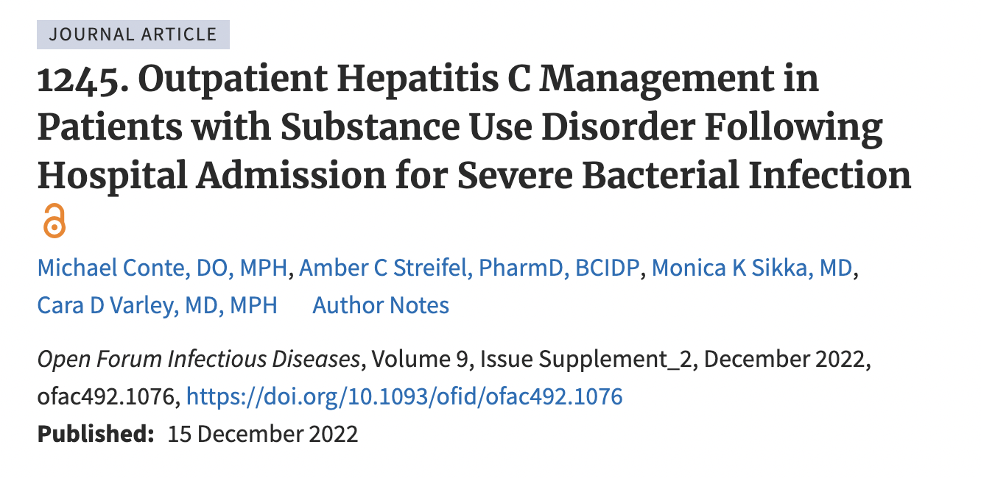
Low Rates of Successful Linkage to Care
Outpatient follow up recommended during hospitalization (48/108 HCV+)
2 years later...
<15% had evidence of treatment
Actual referral to hepatology placed during hospitalization with necessary pre-treatment work up completed
Low rates of successful linkage to appointment <3 months
Notes:
Slides 19-22 HaYoung
OHSU data 2015-2020 (Conte) chart review of 108 patients hospitalized with severe bacterial infection and hep C, 48 recommended to follow up (PCP or hepatology). Roughly 15% had evidence of treatment and cure in 2 years after the referral (even so only about half of those treated already had PCP prior to their indexed hospitalization) [https://doi.org/10.1093/ofid/ofac492.1076]

Slide 22
Breakout Session (15 min) Barriers & Facilitators
Notes:
Ximena/Josh to facilitate first breakout session

Slide 23
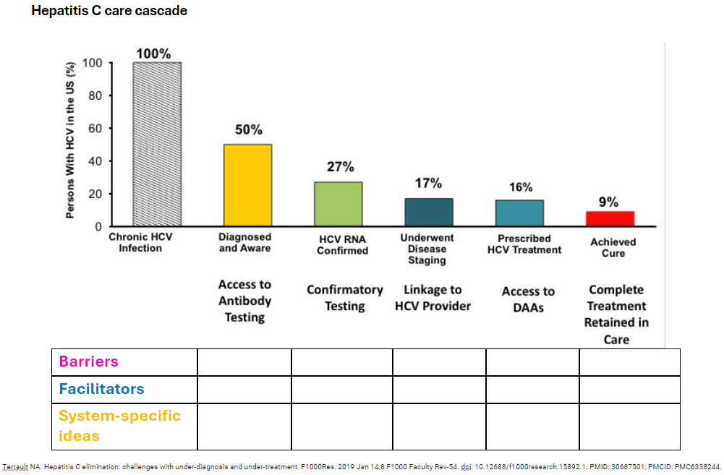
Breakout: Barriers & Facilitators
Notes:
Lots of ideas discussed here to increase active partipation – use of color-coded Post-its for people to write down barriers (pink), facilitators (blue), system-specific ideas (yellow) and post to wall
Ximena to print out a poster of the care cascade for the wall

Slide 24
Barriers Facilitators
Disposition​
Phones​
Housing status ​
Insurance coverage ​
Buy-in from institution stakeholders
Cost of inpatient work-up
Getting refills to patients, especially if at Skilled Nursing Facility ​ ​ ​
Patients are motivated and want this! ​
People deserve this!​
Effective​
Makes everyone happy! It feels good to cure!​​
Something to do while convalescing in hospital
Eliminate barriers to outpatient testing and follow up
Notes:
Ximena/Joshua

Slide 25
Notes:
Slides 27-31 Madeline
These findings were also similar to a study that came out last fall. It was a quote “pragmatic, open-label, stepped wedge cluster randomized trial” conducted in Norway from 2019-2021. It compared immediate testing and treatment during hospitalization to standard of care referral to outpatient treatment.
Of those in the immediate test and treat inpatient group, 68% of patients completed treatment within 6 months compared to 35% in the standard of care.
Granted, Norway has a much different health system than the US – this is similar to what we found -- the results are impressive and demonstrates that hospitalization should be considered a key gateway to reaching vulnerable populations with HCV.

Slide 26
UNC Model of Care
Addiction Medicine (Psychiatry Dept-based) SW
ID e-consultant (core group of 2 attendings +/- fellow)
UNC Specialty Pharmacy
Serves large rural population
Patients identified through consult service/referral
Start patients on DAAs in hospital if anticipated stay >2 weeks and not being “back-transferred” to original facility
If estimated remaining LOS ~3+ business days, would try to get DAA in-hand on discharge

Slide 27
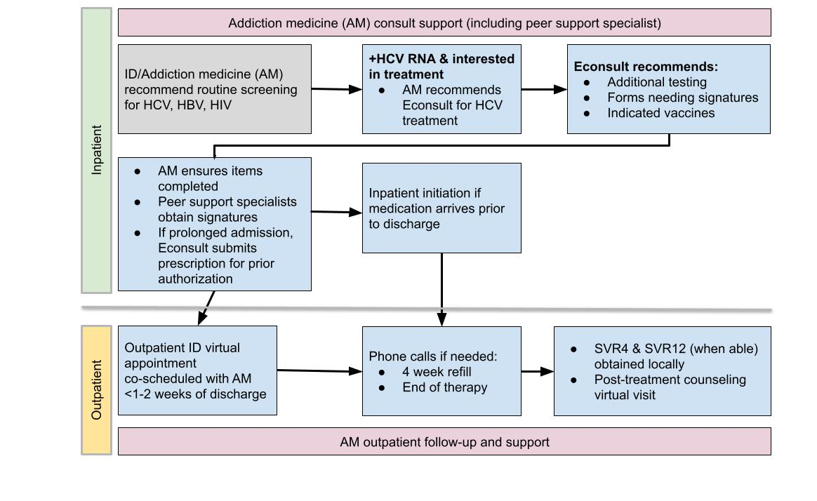
Addiction medicine SW
Inpatient
ID e-consult
ID telehealth appointments
Outpatient
Addiction medicine SW
Notes:
- This is the workflow but I like to think about it as a hamburger with ID assessing and treating the HCV and Addiction Medicine acting as the buns holding it all together
- ID does the inpatient e-consult, which was a billable chart review, to assess the patient for HCV treatment and recommend any needed labs, signatures and vaccines. Oftentimes, most patients already had all the labs and imaging already done just by virtue of their admission.
Addiction medicine ensures these are done and obtains any signatures if uninsured
ID prescribes and initiates treatment
Together, ID and Addiction Medicine coordinate care and when outpatient, they follow-up through co-scheduled virtual appointments

Slide 29
Notes:
Slides 27-31 Madeline

Slide 30
WashU HCV Model
ID-based but both ID MDs do both ID and SUD care
Bridge to Health
2 health coaches, 1 LCSW/case manager, 2 MDs
Patients hospitalized with drug use associated infections
LCSW and health coaches follow longitudinally from inpatient to outpatient Bridge clinic
ID clinic 340b pharmacy fills DAAs and someone walks them over to patient’s hospital room
Rural and urban population
Notes:
Slide 32-33 Jessica/Madeline

Slide 31
Some changes this year….
BPA screening + Nurse navigator
Funded by Gilead FOCUS program
BPA prompts HIV, viral hepatitis & RPR on all pts with h/o SUD & no testing w/in 1 year
Report generates list of +s
If +HIV/HBV/HCV, nurse navigator will see in hospital and LTC
If Bridge pt, will coordinate efforts with Jessica
Bridge to Health
Pts with DUA-infection, typically not inclusive of HCV alone
HCV program assess feasibility of inpatient start.
If inpatient start, patient seen by ID physician. If outpatient, nurse navigator links to care. Bridge LCSW follows all patients from treatment start to SVR if seen with WU ID.
If being actively seen by ID consults, they will discuss HCV treatment, but HCV program physician will determine if inpatient start feasible and coordinate medications etc with help from NN/LCSW/pharmacy.
If not actively seen by ID, HCV program physician will do consult if inpatient start appropriate.
Notes:
Slide 32-33 Jessica/Madeline

Slide 32
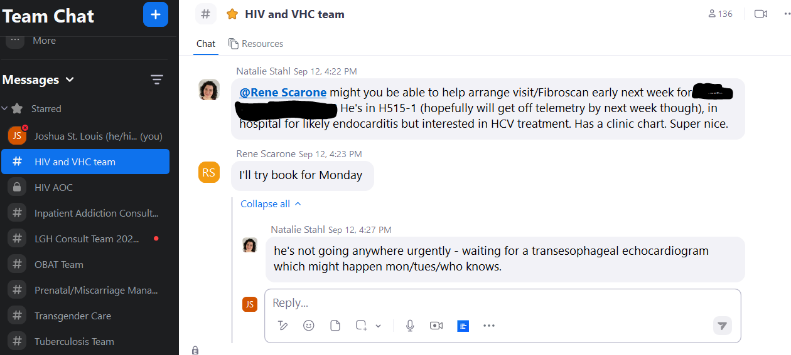
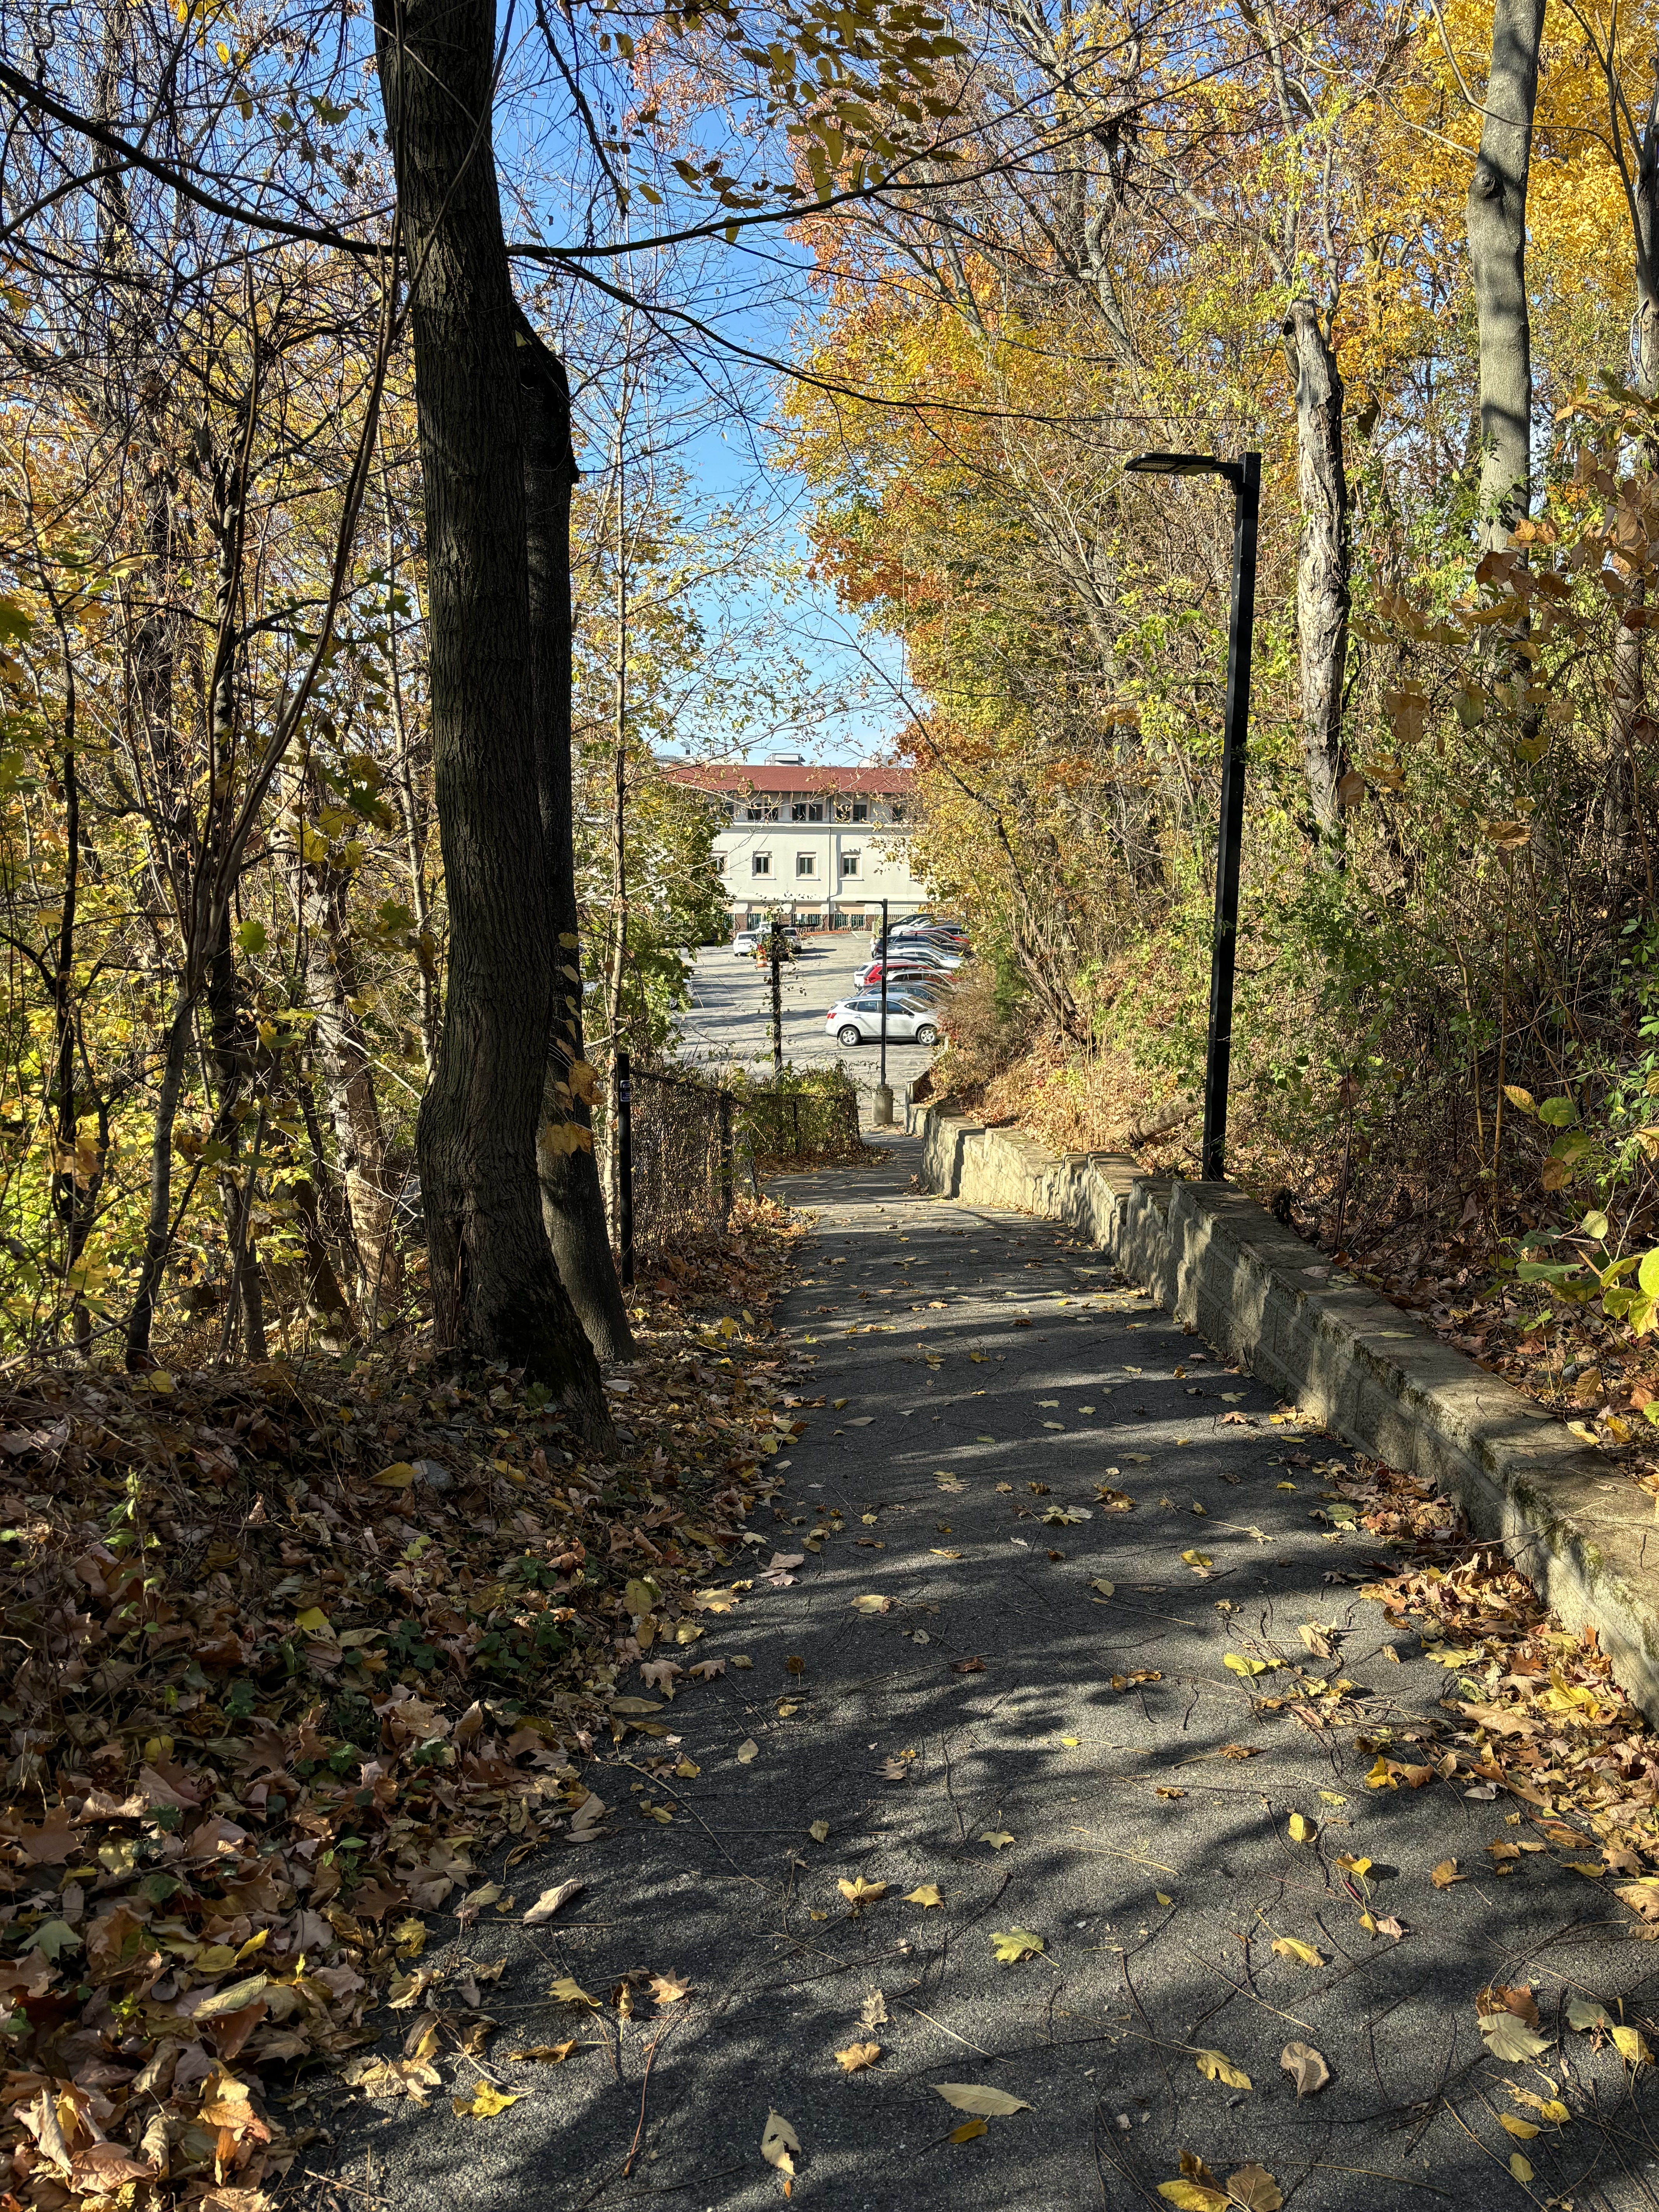
Lawrence General Hospital &
Greater Lawrence Family Health Center
Unique attributes
FQHC (with associated Family Medicine residency) does majority of HCV care (“MA Model”)
Explicit goal of community HCV eradication and low barrier treatment
FQHC already had dedicated Hep C nurses, CHW, HCV/HIV residents, and HCV/HIV “zoom channel”
FQHC (with 340b pharmacy) and Hospital are adjacent to one another (adorable forest path)
FQHC physicians staff the addiction medicine consult service for all patients in the hospital
Notes:
Slides 34-35 Josh/Natalie
HCV program has treated ~500 patients since DAAs first approved in 2013-2014, SVR12 rate > 95%
Began treating people with active SUDs in 2016-2017 (fentanyl spike), acquired Fibroscan machine in 2019

Slide 33
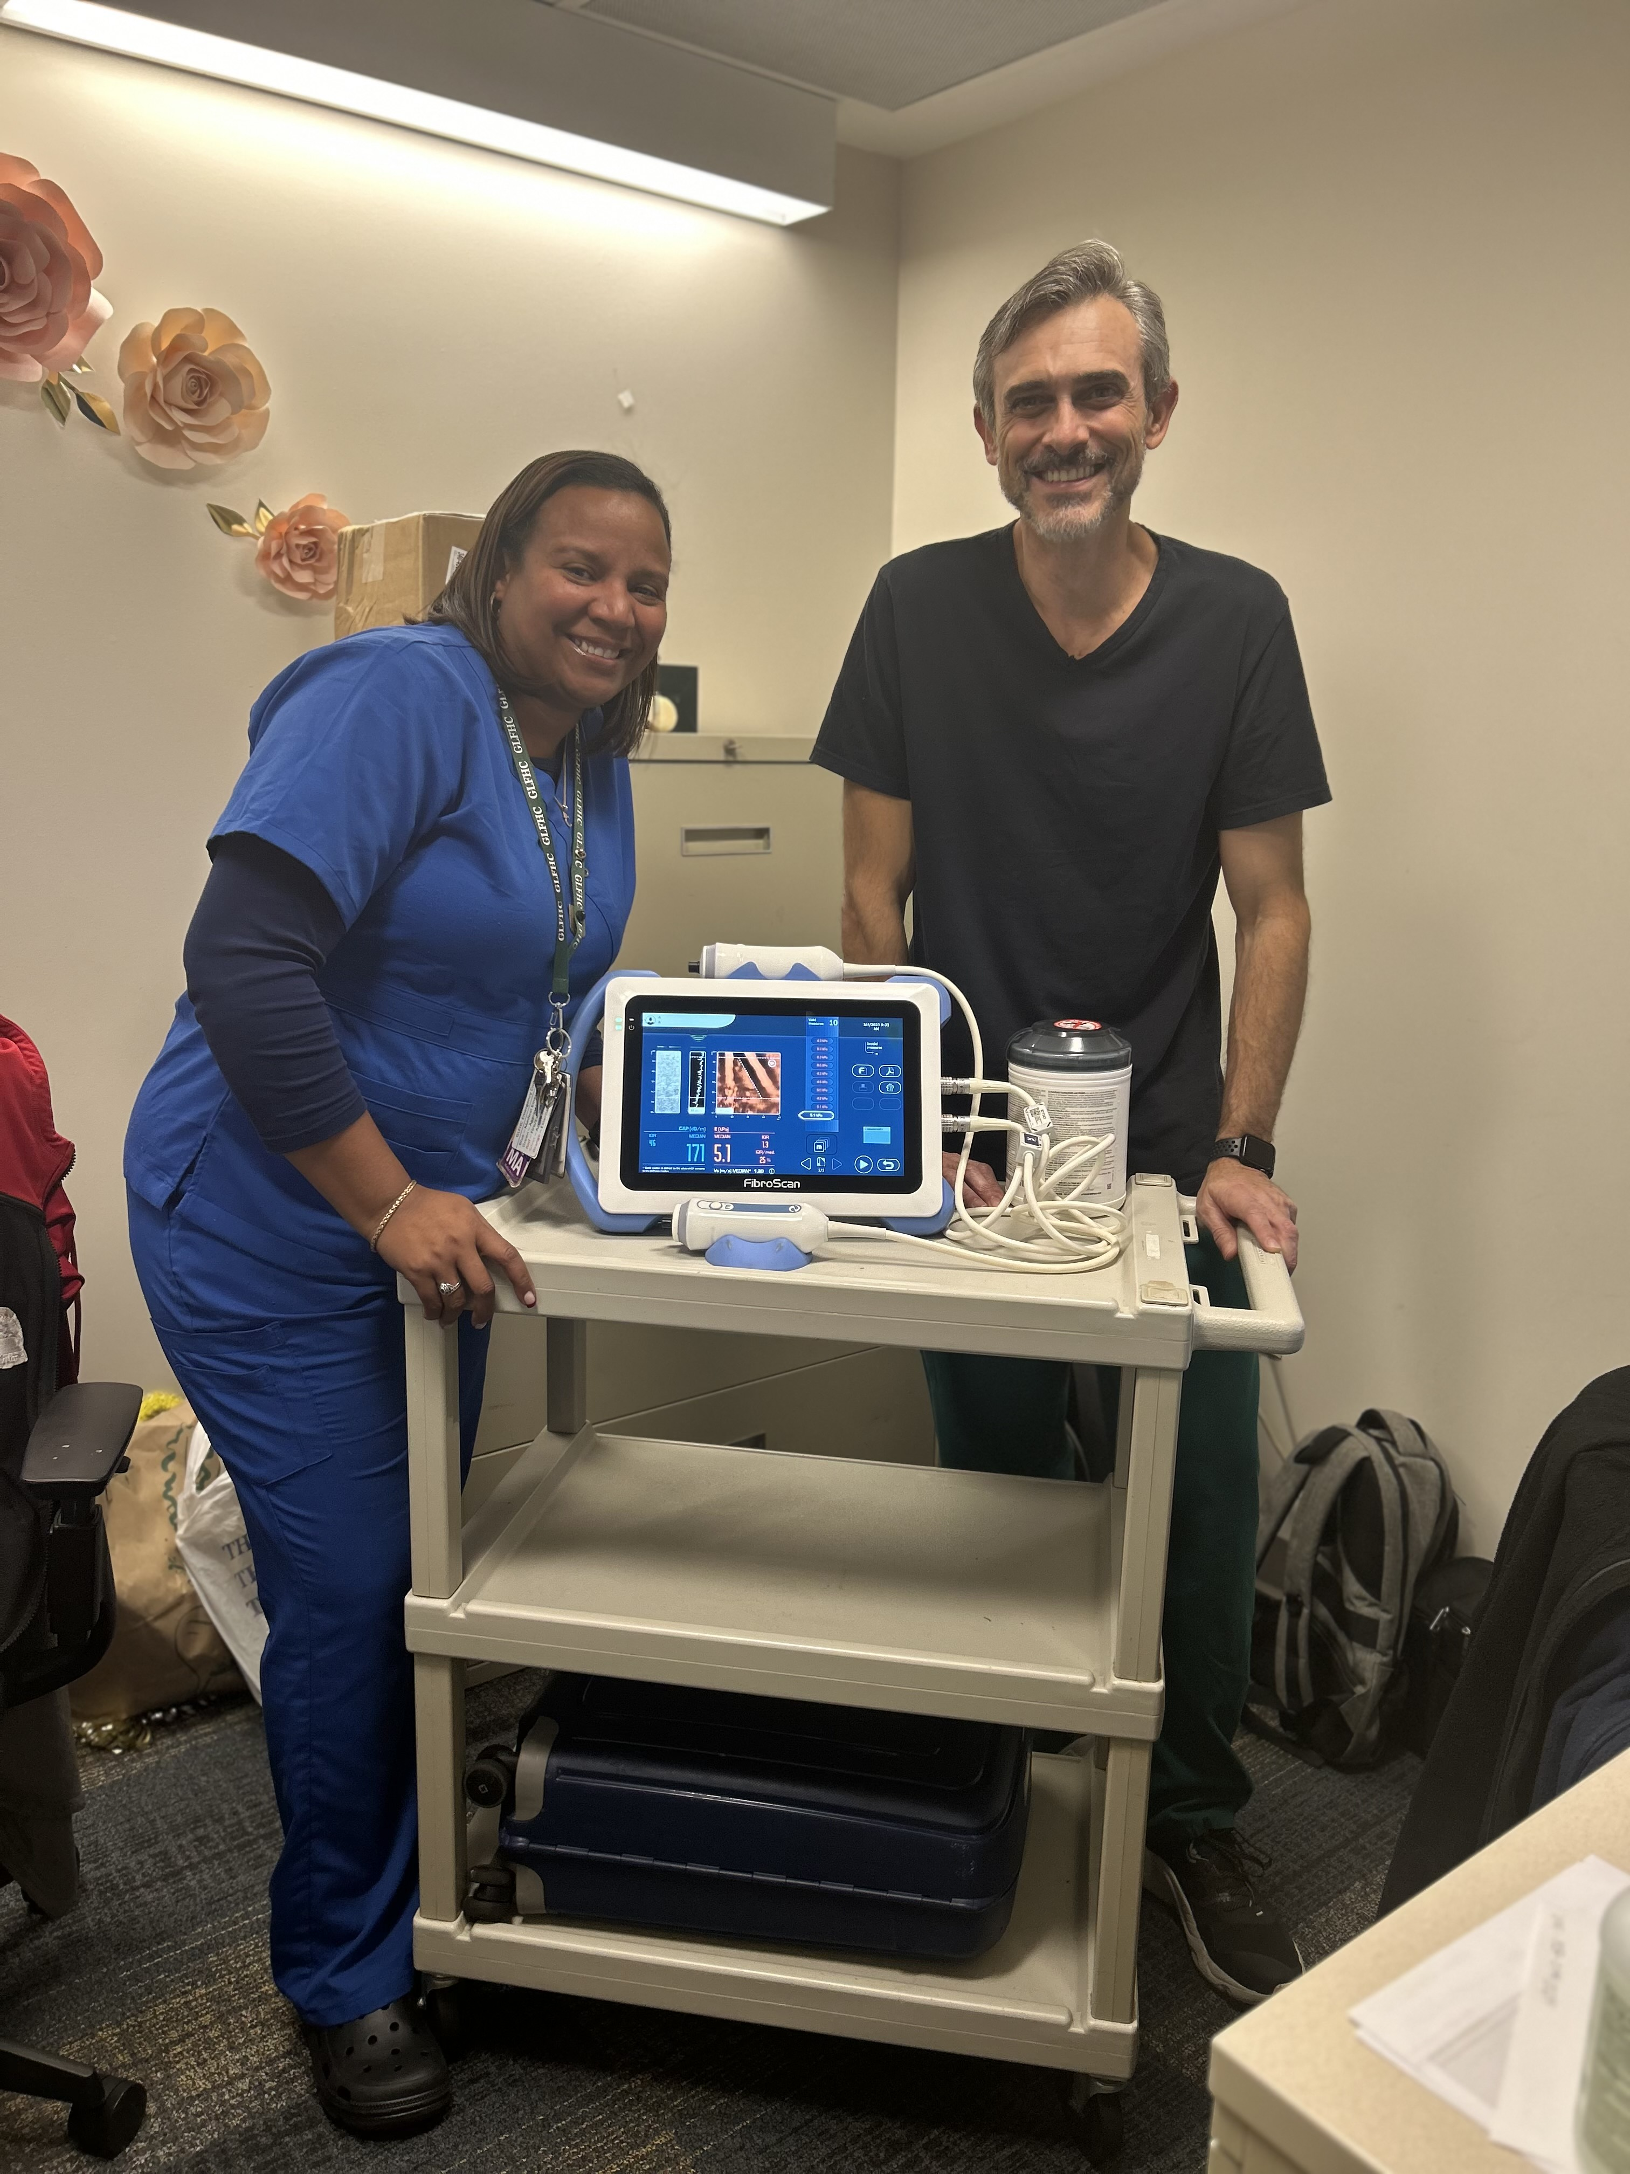
Inpatient starts- “Have Fibroscan, Will Travel”
Resident inpatient team or addiction consult team recognize untreated HCV case, order appropriate labs
Resident or faculty trained in HCV talk to patient, review case (med interactions, etc), offer treatment; most often documented in Addiction Medicine consult notes
As needed, HCV staff member walks over to from clinic to complete Fibroscan, read by credentialed attending
Med ordered to FQHC pharmacy; FQHC HCV team completes PAs prn (often automatic via MassHealth)
Addiction consult or HCV team or HCV team brings med from pharmacy and registers as “home medication”
Prior to discharge, ensure phone numbers for HCV team and follow-up plan in place (i.e. clinic visit for refill, delivery by staff, specialty pharmacy delivery) - primary team adds to discharge summary
Make sure appropriate info/documentation in outpatient chart (different EMR)
Notes:
Slides 34-35 Josh/Natalie
High level of complexity and volume in outpatient clinic allows us to feel comfortable starting treatment in hospital or with minimal contact (MHU, “same day” starts) Often use Zoom channel to “hand hold” for more complex patients

Slide 34
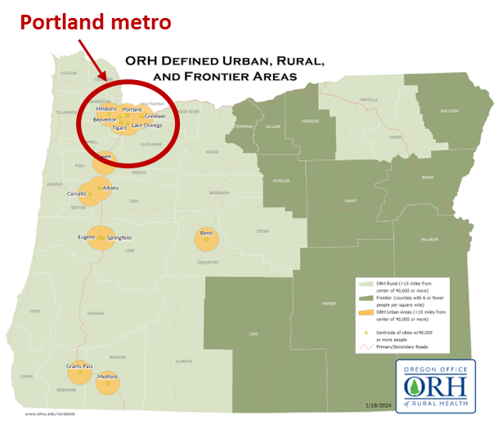
OHSU HCV Care Model
Hep C Transition-tO-Treatment (HCV-TOT) Program
Interdisciplinary team
MDs, pharmacists, social worker, care coordinator
Majority patients without PCP and unhoused/unstable housing
Portland metro + surrounding counties, including SW Washington
Patients identified via electronic surveillance report or by direct referral from hospital teams
Exclusion criteria: HBV coinfection, active HCC, decompensated cirrhosis*, pregnancy
Babiarz, Ryu, Williams et al. Inter J Drug Policy. 2024;127: 104396.
Notes:
Slides 36-38 HaYoung/Carissa
OHSU – only AMC in state of Oregon, tertiary care 560 beds
Program is largely funded by pharmacy department (provider/pharmacist) and transitional care (SW) department
About 51 enrolled in the last 2 years, team expanded only in the last 3 months with goal to increase enrollment to 75 per year
*conditional exclusion criteria (risk/benefit discussion)

Slide 35
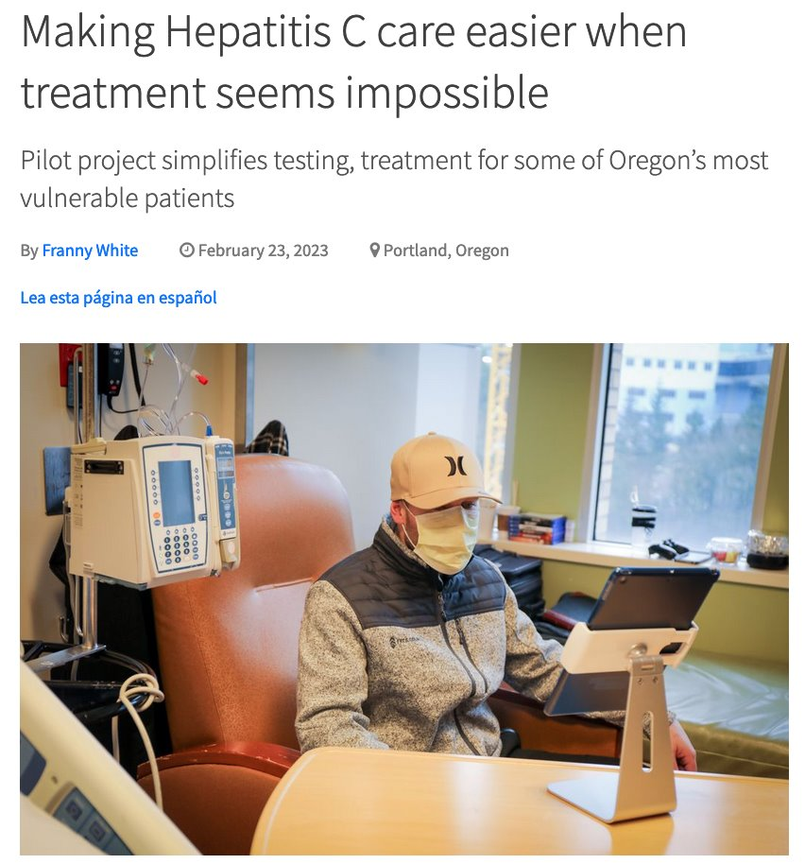
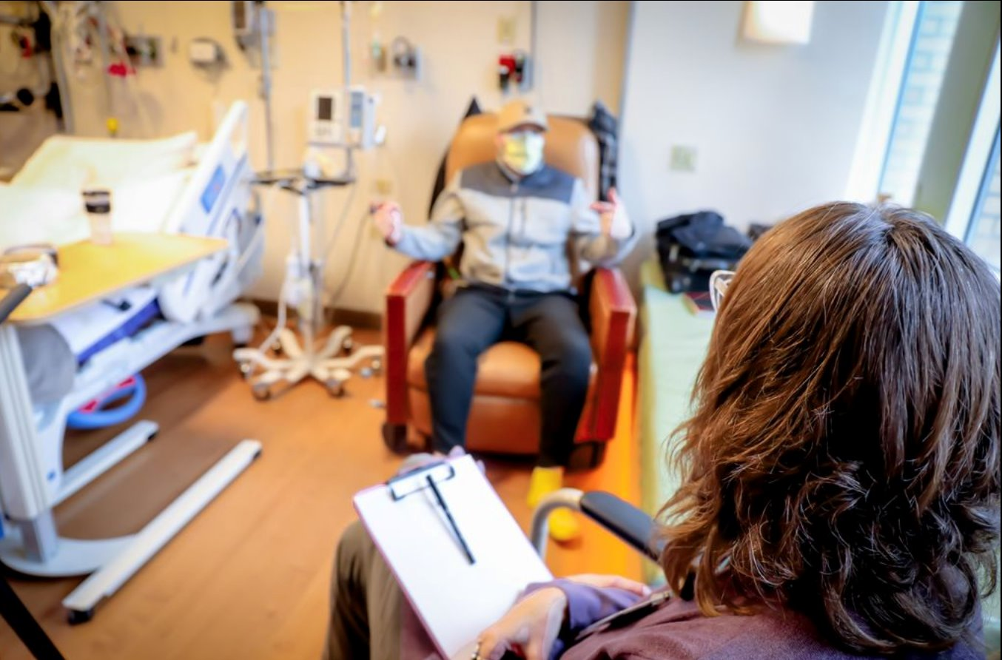

Slide 36
OHSU Care Model
ALL STEPS COULD BE DONE DURING HOSPITALIZATION!
Patients supported by pharmacist, social worker & care coordinator
PA request and drug procurement via institution's outpatient pharmacy
Telephonic outreach by PharmD during treatment
In-person and/or telephonic outreach by LCSW and coordinator throughout treatment and completion of final labs
Abbreviations: HCV, hepatitis C infection; SDOH, social determinants of health; DAA, direct acting antiviral; SVR12, sustained virologic response at 12 weeks post-treatment
Notes:
Slides 36-38 HaYoung/Carissa
SW supports tx adherence and addresses barriers & other support needs including SDOH, connection to PCP, connection to SUD tx. Care coordinator assists w/ transportation, appointment reminders, medication refill coordination and delivery, lab coordination. Both provide resources including bus tickets, phones, etc.
Heavy social work support and generous resources to provide temporary housing/shelter, phones for communication

Slide 37
Breakout Session Plan Development for HCV Treatment Program
Notes:
Carissa to lead into Breakout session #2
Break slide for transition, see next slide comments

Slide 38
Champions ("Team Members")
Funding Resources
Partnerships (specialists, pharmacies)
Screening & Patient Identification Tools
Community Resources
Other
Notes:
Carissa/Jessica to facilitate
Handout*

Slide 39
Large Group Discussion Plan Development for HCV Treatment Program
Notes:
Carissa/Jessica to facilitate
Break slide for transition, see next slide comments
Partnerships? (pharmacy? Social work? ID/hep specialists?)
Team members? (social workers? Peer support specialist? Pharmacists? Prescribers?)
Tools? (screening folks, outreach)

Slide 40
Please download and install the Slido app on all computers you use
What are your plans for HCV Treatment Program Development?
ⓘ Start presenting to display the poll results on this slide.

Slide 41
Wrap-Up & Evaluation

