Slide 1
Self-Reported Readiness to Change Alcohol Use in Emergency Department Patients With Alcohol Use Disorder Predicts Successful Linkage to Treatment
Caitlin Ryus MD MPH
Yale Department of Emergency Medicine
Friday November 15, 2025
AMERSA 48th Annual Conference
Funding: NIAA-1R01AA030568-01 (KH), NIDA - 2K12DA033312-11(CR, GD) and R61DA057675 (RH, TC, NS, MP, GD)

Slide 2
No Disclosures

Slide 3
Background: Project ASSERT
Project Alcohol and Substance use Services Education and Referral to Treatment (ASSERT)
Emergency Department (ED) based
Health Promotion Advocates (HPAs) perform screening, brief intervention, and referral to treatment program for unhealthy alcohol and other drug use
Long-standing program (since 1999) at Yale New Haven Hospitals
D’Onofrio G, Acad Emerg Med 2010 Aug;17(8):903-11.

Slide 4
Background: Brief Negotiation Interview (BNI)
BNI is a brief, structured conversation designed to motivate individuals with alcohol or substance use disorder to consider making a change.
Core Elements of BNI
Raise the Subject: Establishing rapport and trust with the patient.
Example: Ask “ Would you mind taking a few minutes to talk with me about your alcohol use….
Provide Feedback: Review Screen, Make a Connection and Offer Guidelines
Example: “ From what I understand you are drinking…… I am concerned about your use. What connection do you see between our drinking, and this ED visit? (or other medical issue)?
Enhance Motivation: Elicit reasons to change
Example: “On a scale of 1-10 how ready are you to change any aspect of your drinking?” “Why did you not choose a lower number?”
Negotiate and Advise: Negotiate a goal, give advice, summarize and refer
Example: “What’s the next step?” “What I hear you saying….” “Sounds like a good plan.” Arrange direct or indirect referrals.
D’Onofrio Acad Emerg Med. 2005 March; 12(3): 249–256.

Slide 5
Objective
To identify the relationship between patient self-reported readiness to change alcohol use and treatment engagement within 30 days among ED patients with alcohol use disorder who received a Brief Intervention during their ED encounter.

Slide 6
Methods

Slide 7
Methods
Study design
Retrospective cross-sectional study
Sample
All ED adult patients evaluated by Project ASSERT
Time Frame
2022-2023
Analytic Strategies
Descriptive statistics: Chi square and ANOVA
Binary logistic regression
Moderate/Severe Alcohol Use Disorder (AUD)

Slide 8
Methods
Outcomes:
Receipt of a direct referral (same day enrollment), indirect referral (provided with treatment program information), or declined referral
Enrolled in treatment at the 30 day follow up
Independent Variable of interest:
Self reported readiness to change alcohol use score (scale from 1-10)
Covariates included in the model:
Age, Gender, Race, Ethnicity, Insurance type

Slide 9
Results

Slide 10
Results
Analytic Sample Size
N= 2,648 visits by patients with AUD and a Brief Intervention by Project Assert
Age | Total Count | Mean
 | 2648 | 53.94
Race | Total Count | Percent
White | 1,783 | 60.50%
Black or African American | 778 | 26.40%
Asian | 8 | 0.30%
American Indian or Alaska Native | 3 | 0.10%
Native Hawaiian or Pacific Islander | 5 | 0.20%
Other | 358 | 12.10%
Missing | 13 | 0.40%
Gender | Total Count | Percent
Female | 1,878 | 70.90%
Male | 755 | 28.50%
Trans/Non-Binary | 10 | 0.34%
Missing | 5 | 0.20%
Insurance Type | Total Count | Percent
Private | 265 | 10.00%
Medicare | 332 | 12.50%
Medicaid | 1,794 | 67.70%
Other/None | 252 | 9.50%
Missing | 5 | 0.20%
Hispanic or Latino Ethnicity | Total Count | Percent
Yes | 500 | 18.90%
No | 2,138 | 80.70%
Missing | 10 | 0.40%

Slide 11
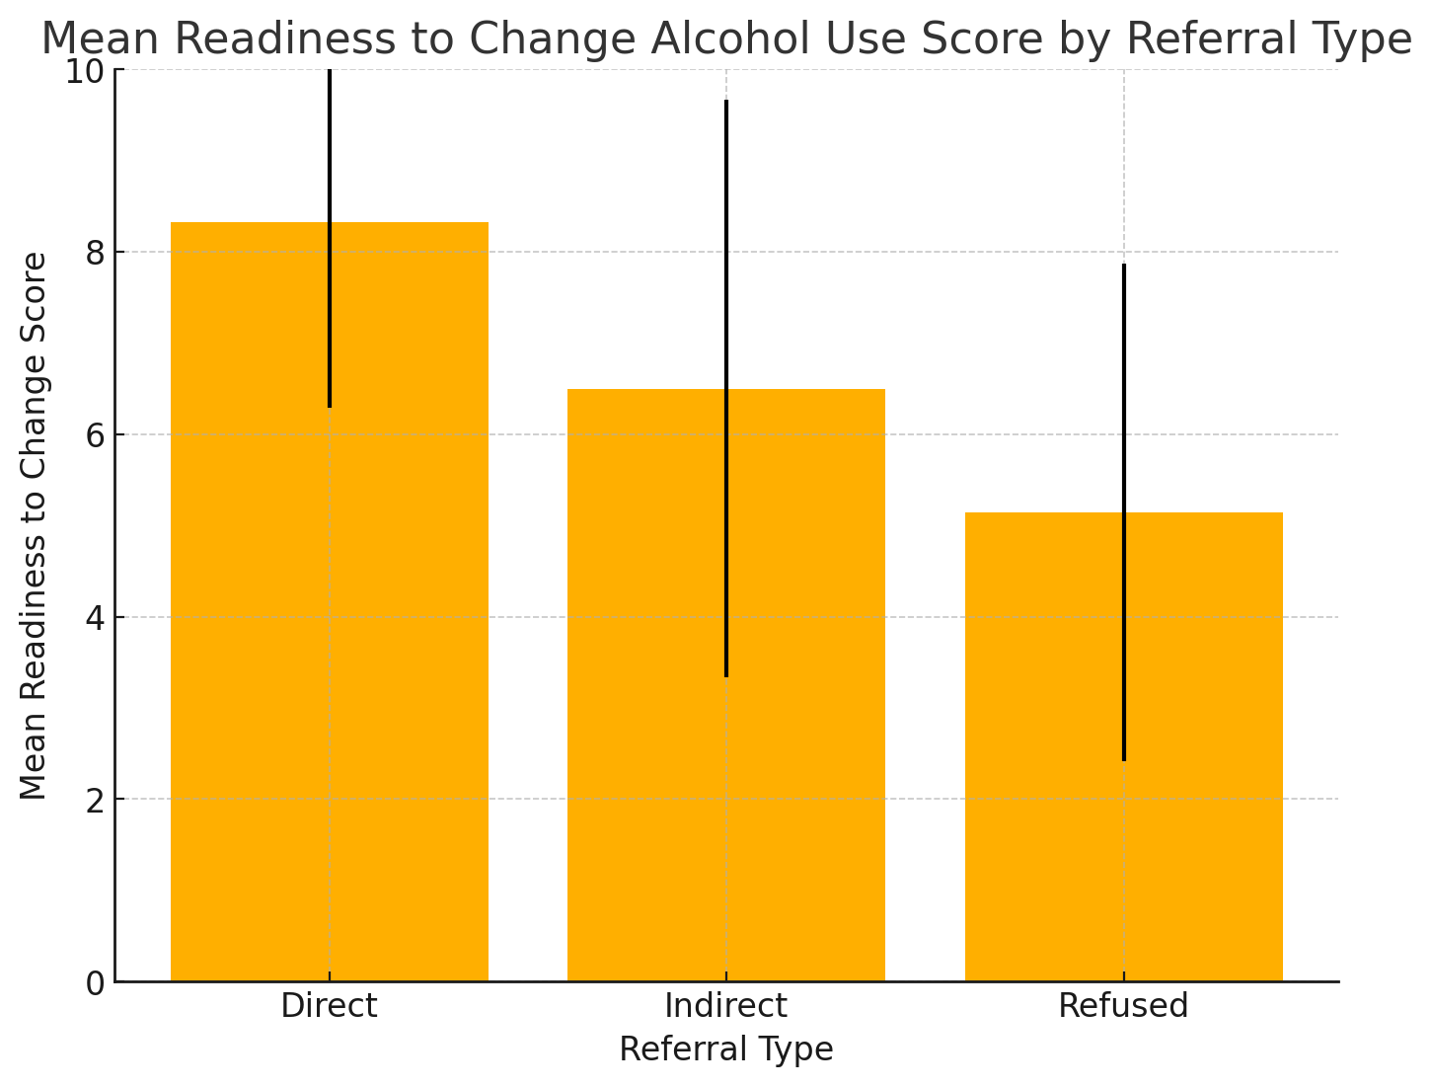
Results
Analytic Sample Size
N= 2,648 visits by patients with AUD and a Brief Intervention by Project Assert
Referral to Treatment Program
2389 (90.2%) received a referral to treatment
1,013 direct (42.4%)
1,376 indirect (57.6%)
Readiness to Change
The mean readiness to change alcohol use 7.14 (SD, 2.92)
Received a direct referral (M=8.32, SD=2.03)
Received indirect referral (M=6.50, SD=3.17)
Refused referral (M=5.14, SD=2.73)
Between group differences were significant, ANOVA, p<0.001
Follow up at 30 days
1,242 were enrolled in AUD treatment (46.9%)

Slide 12
Results
Increased readiness to change alcohol use corresponds to increased odds of treatment enrollment at 30 day follow up
For every single point increase on the readiness to change scale the odds of successful treatment linkage within 30 days increased by 15.7%
AOR 1.157, 95% CI 1.093-1.22
Controlling for demographics and insurance status

Slide 13
Conclusions
Self-reported readiness to change alcohol use is a strong predictor of successful linkage to treatment within 30 days.
Given the large morbidity and mortality associated with AUD and recognized gaps in treatment, strategies to increase ED patient readiness to change alcohol use should be widely disseminated

Slide 14
Acknowledgements
Kathryn Hawk
Turner Canty
Rebekah Heckmann
Nasim Sabounchi
Shara Martel
Shevonne Mack
Gregory Johnson
Michael Pantalone
Gail D’Onofrio
Funding: NIAA-1R01AA030568-01 (KH), NIDA - 2K12DA033312-11(CR, GD) and R61DA057675 (RH, TC, NS, MP, GD)

Slide 15
Thank you

