Slide 1
Silent Struggles: Unveiling Stigma in Healthcare with Perinatal Opioid Use Disorder
Dr. Rebecca Schapiro MD, MPH
Mentor: Dr. Nia Bhadra-Heintz MD, MSc
Hospital of the University of Pennsylvania,
Department of Obstetrics and Gynecology

Slide 2
Disclosures
None

Slide 3
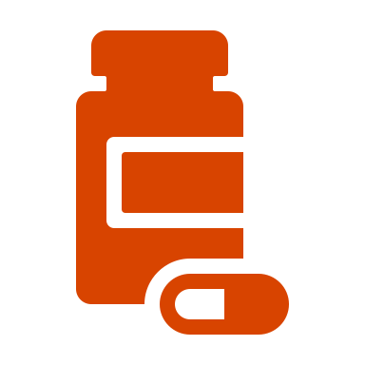
Background
The prevalence of perinatal opioid use disorder (OUD) has risen 131% from 2010 to 2017.¹
Pregnancy-associated overdose mortality is also rising, with a relative increase of 81% between 2017 and 2020.
Overdoses account for up to 16% of all pregnancy-related deaths. ²
Treatment with medications for opioid use disorder (MOUD), such as buprenorphine or methadone, is the standard of care for OUD in pregnancy. Medically supervised tapering or discontinuing MOUD is not recommended. ³
Pregnant patients on MOUD experience significant stigma, which can lead to decreased utilization of healthcare and poor outcomes. ⁴
Notes:
Add a line that it is not recommended to do a taper or

Slide 4
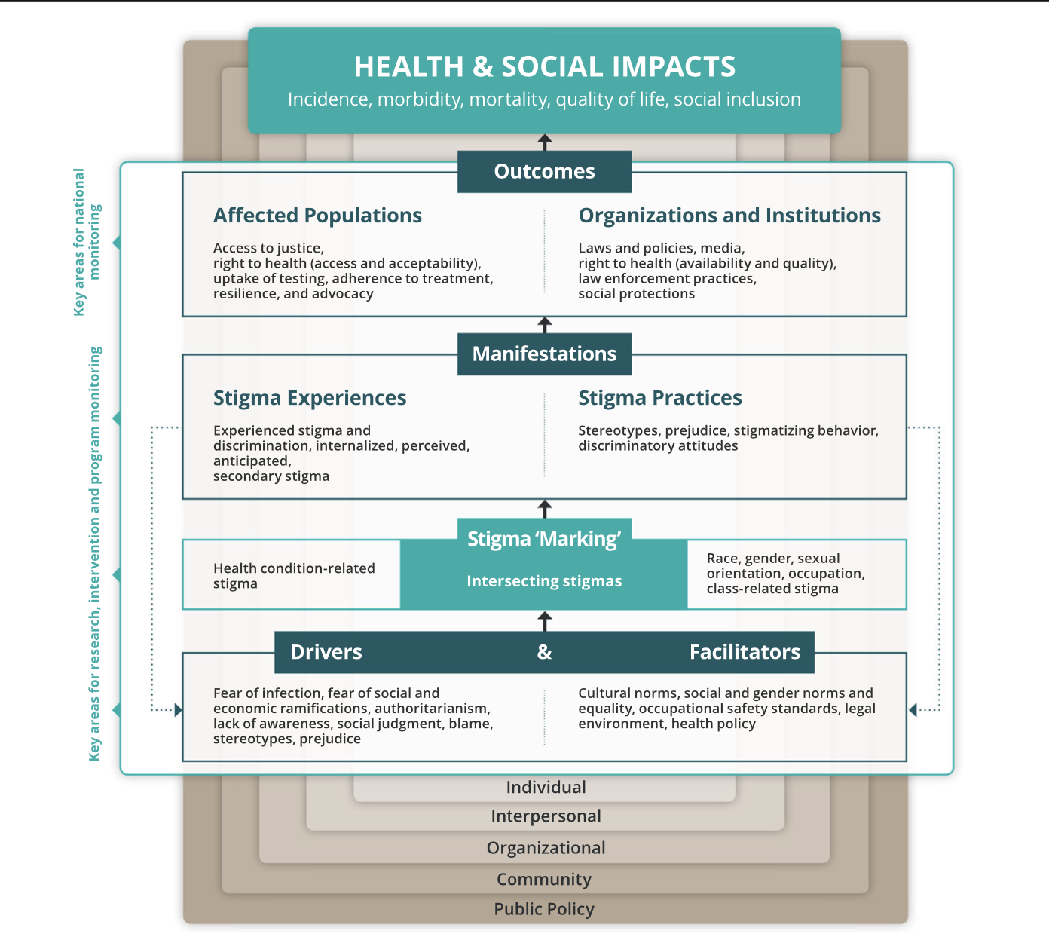
Study Aims
Uses the Health Stigma and Discrimination Framework to further understand stigmatization in healthcare-related interactions for pregnant patients on MOUD and the impact of stigma on patients and their health outcomes through the use of qualitative methods.
Stangl et al. 2019

Slide 5
Methods
Recruited from PROUD clinic
10 in-depth interviews
Phenomenology based analysis
All patients getting collocated perinatal care and MOUD treatment
Used convenience sampling
> 18 years old
Pregnant or within 1 year of pregnancy
Developed interview guide w/ focus on perceived areas of stigma in healthcare settings
Semi-structured interviews
All conducted by phone
Hand- transcribed
Coding began with an iterative and inductive approach using Nvivo
Developed codebook
Interpreted data within the lens of the adapted Health and Stigma Discrimination Framework

Slide 6
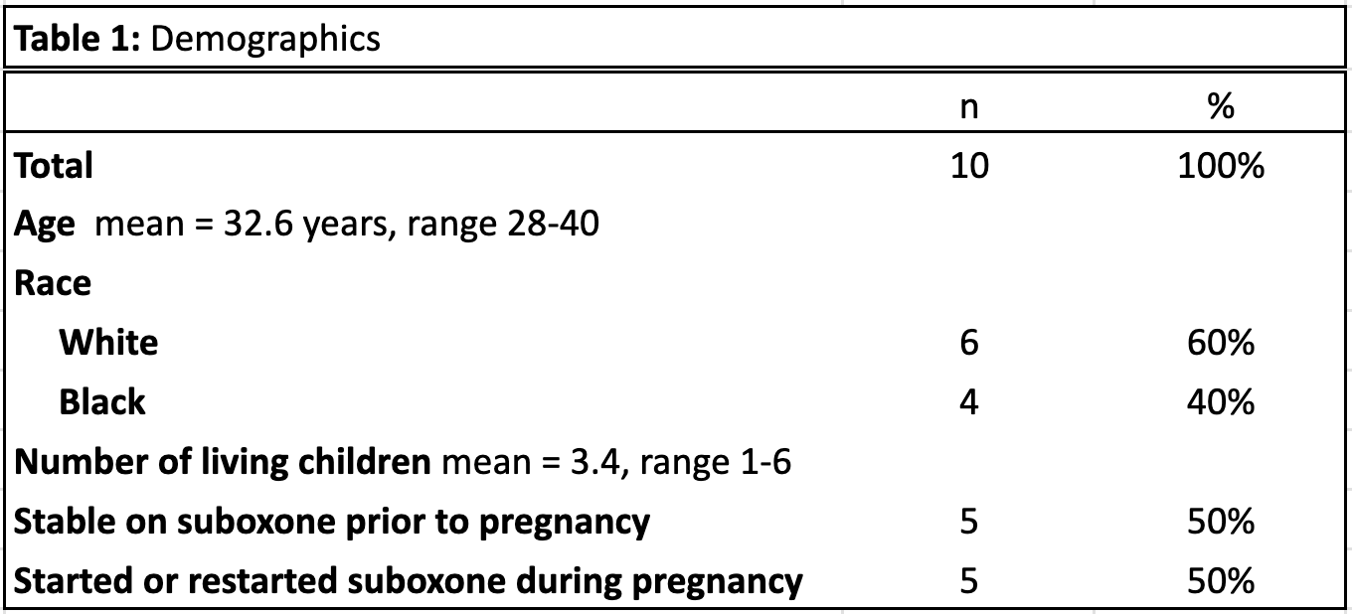
Study Sample

Slide 7
Key Findings
Drivers
Social Judgement
Prejudice
Lack of Education
Stigma Experiences
Receipt of Sub-par Care
Inadequate Pain Management
Internalized Stigma
Broken Trust in Healthcare Providers
Negative Health Outcomes
Sup-optimal MOUD Dosing
Plan to Discontinue in Future Pregnancies
Limited Options for Care
Facilitators
DHS Involvement
Conceptions of Parental Fitness

Slide 8
Drivers
“Some [providers] had their own opinions where they were thinking, ‘oh she’s still getting high [on suboxone]’…I feel like a lot were probably thinking, ‘why don’t you get off it during your pregnancy.” Participant 8

Slide 9
Facilitators
“This year I’m on [suboxone], and hopefully everything goes good. But, there is a downfall in it too. Just because you are on suboxone, they call the state on you… I don’t feel good about it because you’re doing what you gotta do, and it’s a medicine that they prescribed to you, so I don’t see why, they make it so positive… but then there is faults to it as well.”Participant 6

Slide 10
Stigma Experiences
“It can be nerve wracking because even though you are told [suboxone] doesn’t have a negative effect on your child… you feel like a bad parent… if it doesn’t have an effect on my kids, or can’t create an addiction for them, then why do they have to stay extra days in the hospital compared to other kids. Sometimes it just makes you, as a parent, feel like, damn I wish I could have done things a little bit differently and not feel like I’m hindering my child off the bat.” Participant 9

Slide 11
Stigma Experiences
“They didn’t want to give me any pain medication at all…I’ve had nurses physically go out of their way to try … and not give you what the doctor ordered. Specifically nurses. They feel like they know best, and I’m a nurse... I feel like they think, ‘She shouldn’t get be getting this, or she shouldn’t be taking it.’” Participant 5

Slide 12
Health Outcomes
"I guess the next time I get pregnant, if there is a next time, I’m not going to take the suboxones. I don’t feel like the experience I went through at the hospital is worth taking them, to be honest with you.” Participant 4
"I would say [going into withdrawal] was because of me. I was kind of in denial. I didn’t really want to take the suboxone, you know, while I was pregnant.” Participant 7

Slide 13
Key Take Aways
Advocacy and Policy Changes
Transparency about DHS Involvement
Addiction Medicine or Pain Management Involvement
Improved Education and Training

Slide 14
Acknowledgements
Dr. Nia Bhadra-Heintz
Dr. Karampreet “Peety” Kaur
Dr. Navid Roder
All of the physicians, staff, and patients at the PROUD clinic
The FOCUS Medical Student Fellowship in Women's Health supported by the Bertha Dagan Berman Award

Slide 15
References
1. Hirai, A. H., Ko, J. Y., Owens, P. L., Stocks, C., & Patrick, S. W. (2021). Neonatal Abstinence Syndrome and Maternal Opioid-Related Diagnoses in the US, 2010-2017. JAMA, 325(2), 146–155.
2. Bruzelius, E., & Martins, S. S. (2022a). US Trends in Drug Overdose Mortality Among Pregnant and Postpartum Persons, 2017-2020. JAMA, 328(21), 2159–2161
3. Opioid Use and Opioid Use Disorder in Pregnancy. (2017). Retrieved February 13, 2024, from https://www.acog.org/clinical/clinical-guidance/committee-opinion/articles/2017/08/opioid-use-and-opioid-use-disorder-in-pregnancy
4. Tsuda-McCaie, F., & Kotera, Y. (2022). A qualitative meta-synthesis of pregnant women’s experiences of accessing and receiving treatment for opioid use disorder. Drug and Alcohol Review, 41(4), 851–862.
5. Stangl, A. L., Earnshaw, V. A., Logie, C. H., van Brakel, W., C. Simbayi, L., Barré, I., & Dovidio, J. F. (2019). The Health Stigma and Discrimination Framework: A global, crosscutting framework to inform research, intervention development, and policy on health-related stigmas. BMC Medicine, 17(1), 31

Slide 16
Questions?
Notes:
Varies state to state: DHS notification /(different than report) to offer resources and support, not meant to be punitive
Eat sleep console: 5 days in the hospital, parents can stay the whole time
Long term effects: not that we know

Slide 17
Thank you!

