Slide 1
Stigma-Free Access to Harm Reduction Supplies: A Cross-Sector Approach
MATTERS: Medication for Addiction Treatment and Electronic Referrals
Shelby Arena, Harm Reduction Manager

Slide 2
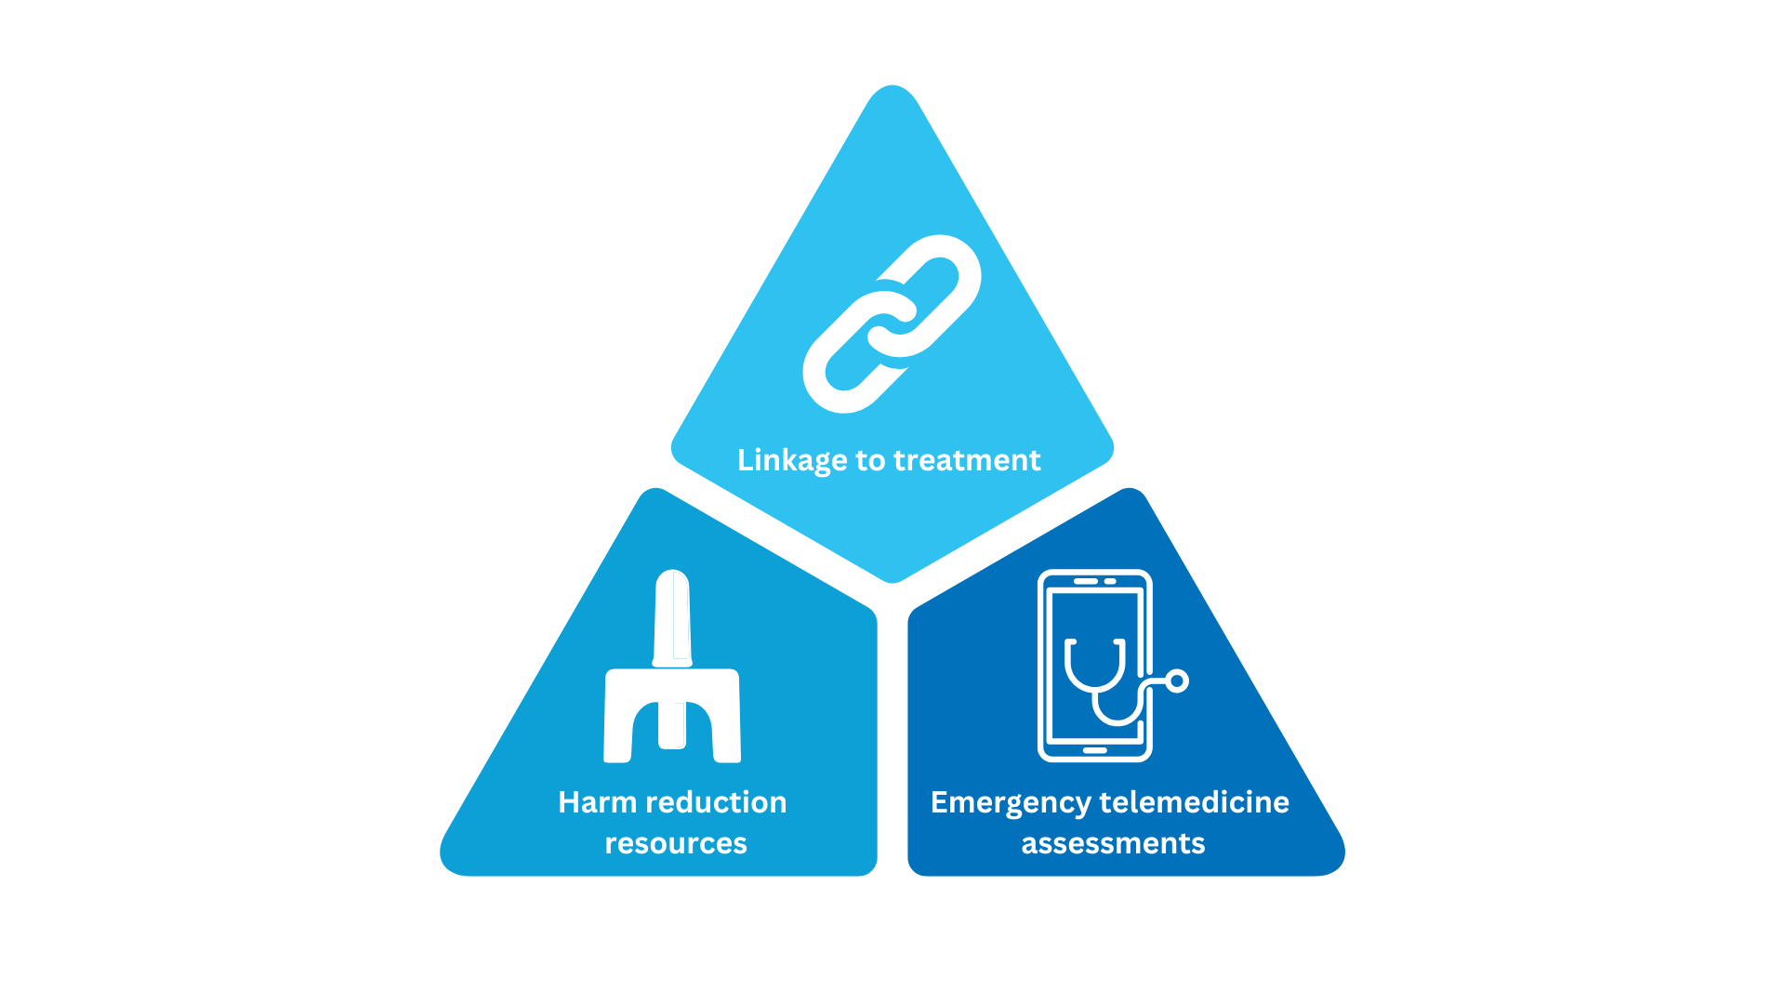

Slide 3
Harm Reduction
Initiatives Overview
Mail Order
Vending Machines
Next Steps
Statewide distribution of fentanyl and xylazine test strips to individuals and organizations.
18 harm reduction vending machines in New York State with plans to expand in 2025.
Syringe Services Program (SSP) and Community Advisory Committee (CAC) launching soon.

Slide 4
Creation and Scaling
Small pilot contract
Landscape changes – so do we!
Regional implementation possible w/ state funding
In August 2022, MATTERS launched its fentanyl test strip distribution program to hospital partners and has since expanded.
2022

Slide 5
Creation and Scaling
Small pilot contract
Landscape changes – so do we!
Regional implementation possible w/ state funding
With the help from BTNX and the input from community members/organizations, we started distributing fully-branded strips
2023

Slide 6
Cross-Sector
Partnerships
Our staff performs strategic outreach to various agencies to build partnerships & support the distribution of HR supplies.
"No Wrong Door”
Cross-Sector Collaboration
Government agencies, treatment centers, CBOs
Collaboration bolsters distribution/access
Tracking data for trends and usage

Slide 7
Results: Harm Reduction Supply Distribution Growth
MATTERS has received and implemented feedback from community members and network partners regarding the information displayed on the test strips.
Trend Analyses: We collect data on zip code and/or county, age range of individuals, times dispensing supplies, and repeat orders.
THEN
August 2022
NOW
October 2024
1,400 TS distributed
20M+ TS distributed
Notes:
Larger font

Slide 8
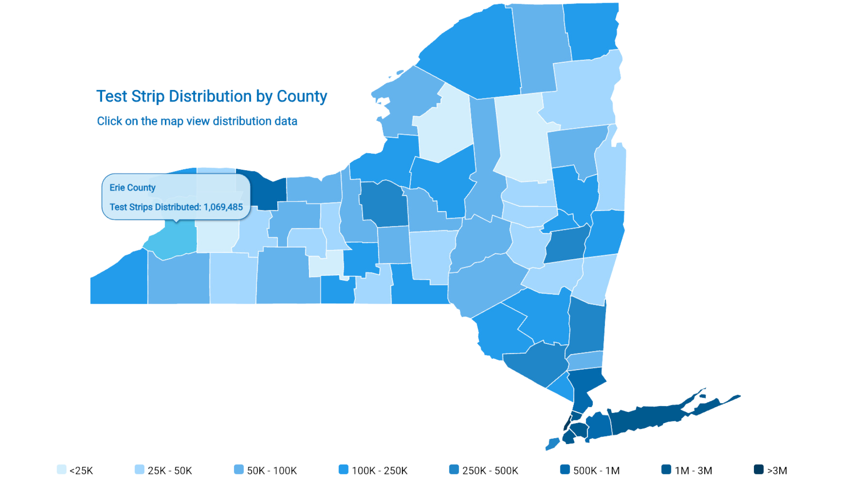
Notes:
Include time frame on this map – over what time period?

Slide 9
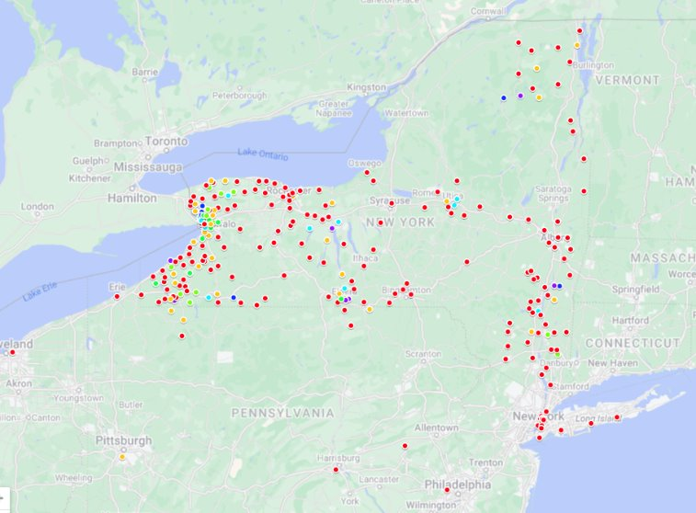
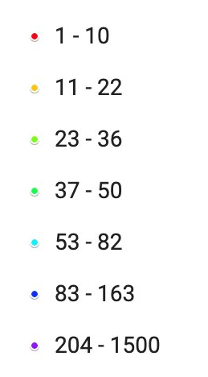
Frequency of Zip Codes Entered
10

Slide 10
DEI Integration in
Harm Reduction
MATTERS is dedicated to ensuring access to harm reduction supplies regardless of age, race, gender, and socioeconomic status.
MATTERS’ DEI Focus: Reducing stigma across all communities
Collaboration
Demographics
Strategic partnerships with community-based organizations serving marginalized groups
WHO
50+ age group, people experiencing homelessness, etc.
HOW
12

Slide 11
Syringe Services
Future Directions
Recently approved as mail-based program
MATTERS has seen great success in the introduction and expansion of its harm reduction services.
Vending Machine Expansion
Goal of 55 machines across
our networks
Learn More
Order Supplies
Validating Drug Test Strips
Publication on the impact of
test strips coming soon
Visit our website or download the 'MATTERS Network' mobile app to see our current harm reduction services.
DEI-Focused Harm Reduction
Tailoring approaches to be culturally sensitive

Slide 12
Questions?
Scan this QR code to visit our website, or email me at
sarena@mattersnetwork.org
Get in touch!

