Slide 1
Stimulant-involved overdose prevention: An electronic health record analysis of clinical touchpoints
T. Lopez-Castro, PhD (she/her)
Notes:
I'm pleased to be present this study, stimulant involved overdose prevention: an electronic health record analysis of clinical touchpoints.

Slide 2
Disclosures None
Funding
This project was supported by a CFAR Catalytic Pilot Grant #3A7479 (PI: Masyukova)​
Co-authors
Isabel Lamont, Mariya Masyukova, MD, MS, Chenshu Zhang, PhD, & Shadi Nahvi, MD, MS
Notes:
No disclosures and this project was funded by a pilot grant to Dr. Masyukova who conceived and developed this study. And tremendous thanks to my co-authors.

Slide 3
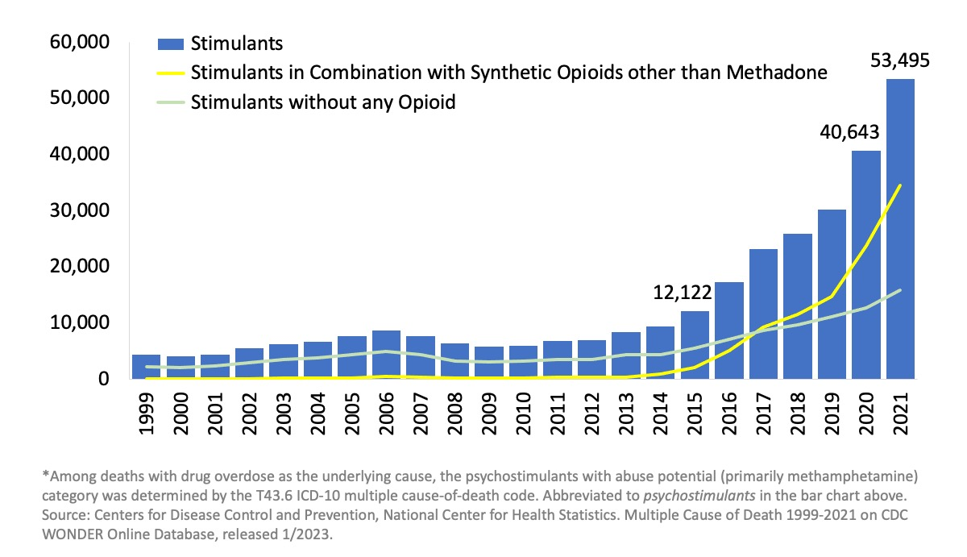
Increase in Deaths Involving Stimulants
Figure 1. National Overdose Deaths Involving Stimulants (Cocaine & Psychostimulants*), By Opioid Involvement, Number Among All Ages, 1999-2023
Notes:
Everyone in this room has likely seen this bar graph depicting the rise in stimulant-involved deaths in the US. What this graph also shows is that synthetic opioids are primarily implicated in the mortality associated with stimulant use--yellow line shows the number of deaths involving stimulants with synthetic opioids. With the the blue line, however, we also see the rise deaths from stimulants without any opioid involvement.
And finally, not depicted in this graph, are health disparities at play here with the population of Black men in the US experiencing the sharpest increase in stimulant-involved overdose deaths. This disparity is multidetermined – to name just a few by the disproportionate impact of criminalization of substance use and a host of treatment access barriers.
---------------
The bars are overlaid by lines showing the number of deaths or without any opioid. There is evidence to support that co-use of stimulants and opioids is on the rise. Nevertheless, the number of deaths involving stimulants has increased steadily since 2014 regardless of opioid involvement. 314% increase in methamphetamine related deaths, second only to fentanyl, and 206% increase in cocaine-related deaths. It also critical to note that there are health disparities at play here with the population of Black men in the US experiencing the sharpest increase in stimulant-involved overdose deaths.
The increase of co-use in the US:
In a national sample of people with opioid use disorder (OUD) from 2015 to 2017, past-month methamphetamine use increased significantly from 6.2 % to 19.1 % for those using heroin and 3.8 % to 7.9 % for those using prescription opioids (Strickland et al., 2019). In a study of people seeking OUD treatment over approximately the same period, the number of days of cocaine and amphetamine use doubled (Snyder et al., 2019). Among people with past-year OUD, stimulant use disorders are frequently co-diagnosed. Specifically, 12.5 % and 10.6 % of people with OUD had co-occurring cocaine and methamphetamine use disorder, respectively (Jones and McCance-Katz, 2019). In a study of veterans, the prevalence of OUD in combination with methamphetamine use disorder increased

Slide 4
Opportunities
Touchpoints are healthcare visits with the potential for delivery of evidence-based overdose prevention:
Naloxone
Medications for opioid use disorder
Referral to substance use disorder treatment
Stimulant-specific harm reduction strategies
Notes:
In this project we were interested in demonstrating the potential and opportunity of health care encounters to address this increase in stimulant-related mortality and morbidity. We use the term - touchpoints – to represent health care encounters with people who use stimulants, that can serve as opportunities to intervene using evidence-based methods like naloxone provision and the prescription for medications for opioid use disorder when opioids are involved, referral to substance use disorder treatment, and stimulant-specific harm reduction strategies such as conversations around how to reduced use and binge episodes.

Slide 5
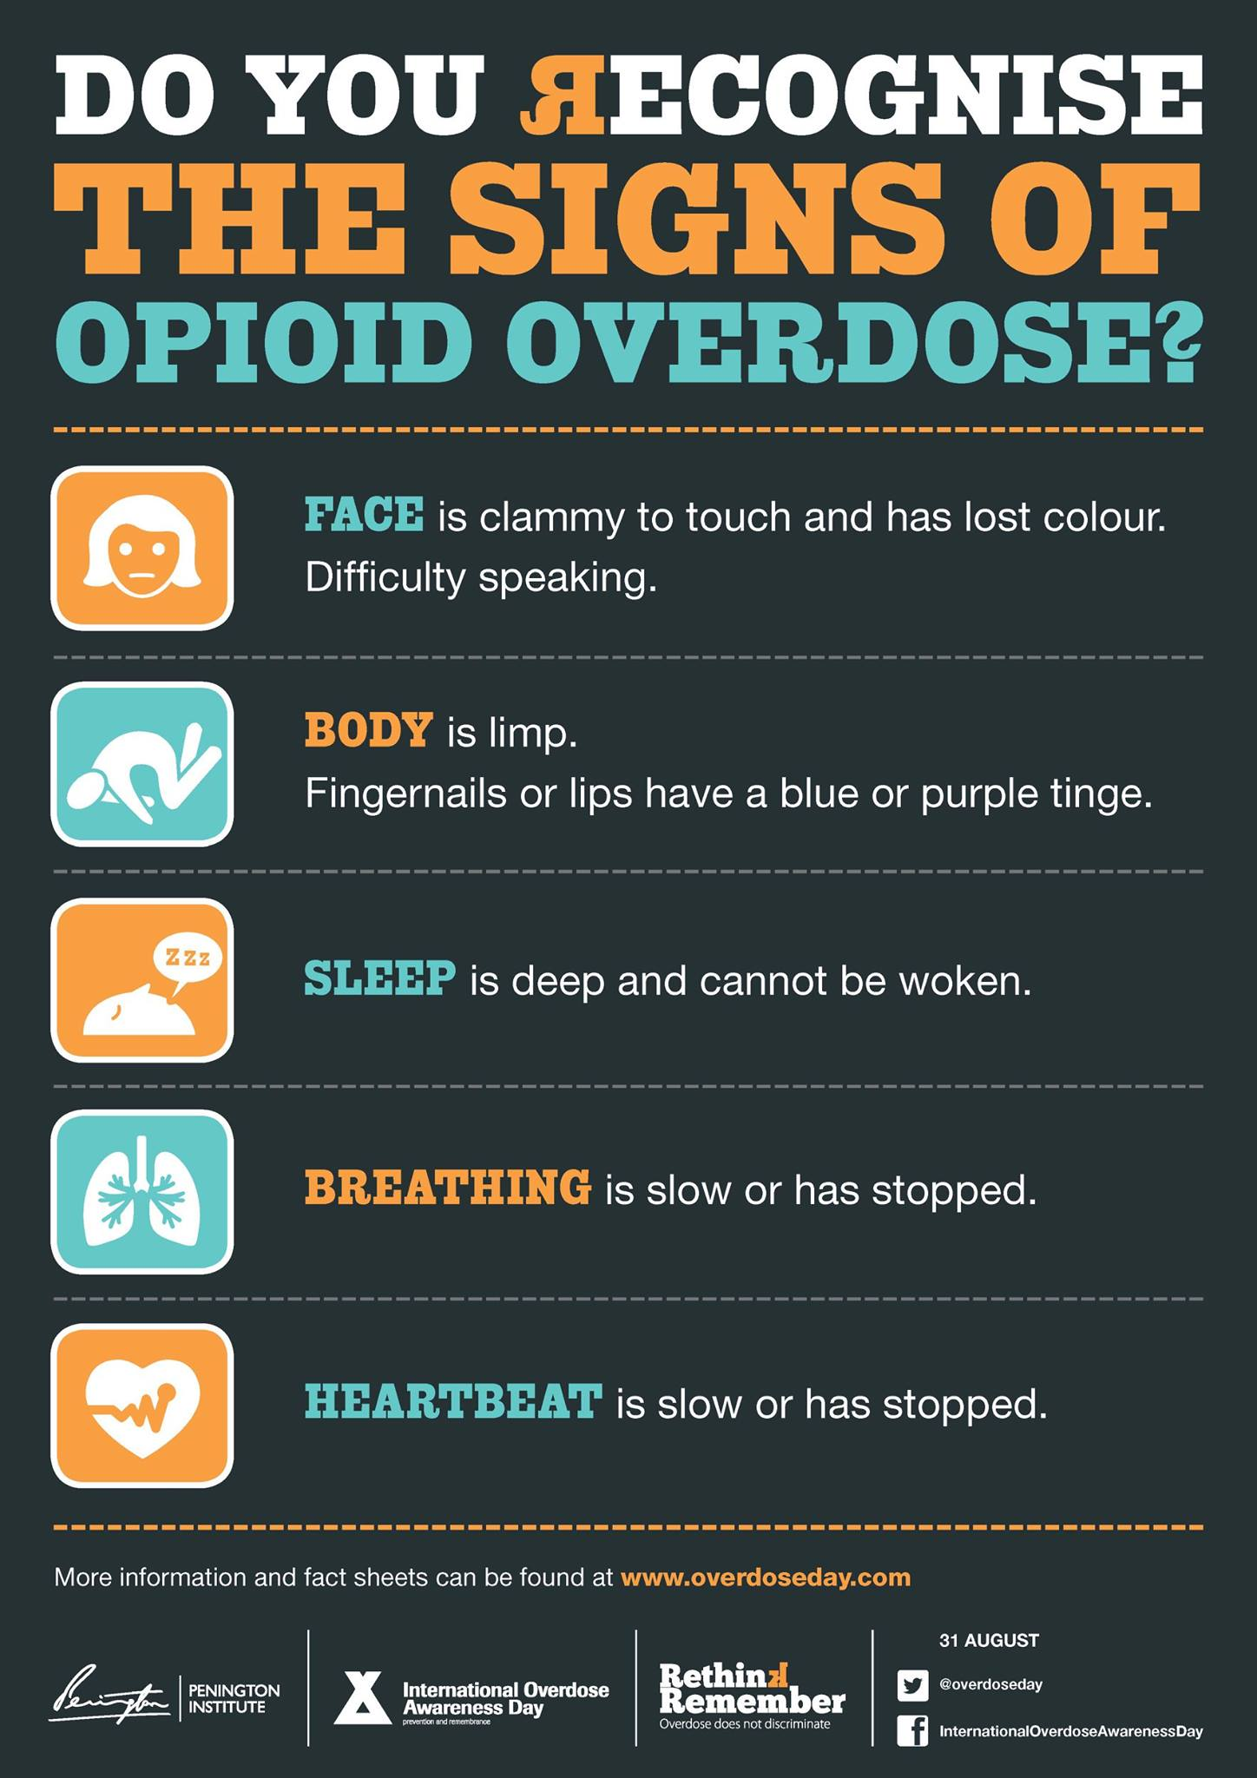
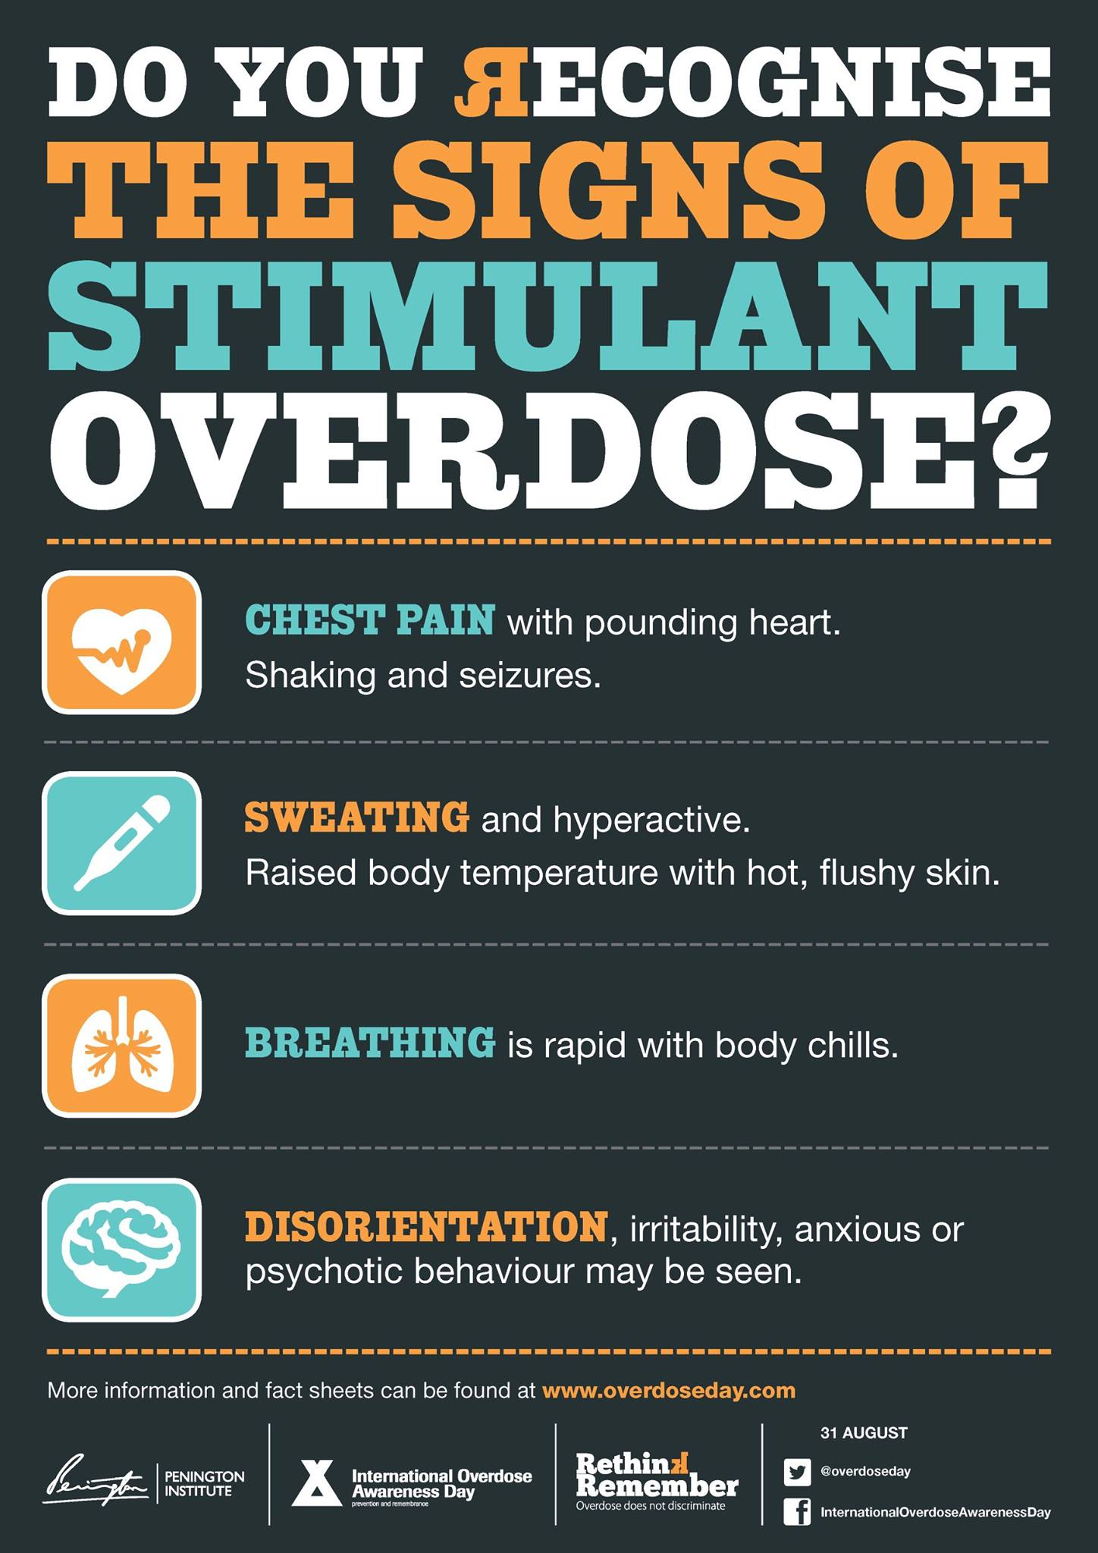
Understanding stimulant-involved “overdoses” and care opportunities
Opioid overdose prevention strategies limited for many stimulant-related harms
Deaths of chronic disease, rather than acute stimulant toxicity¹
Listen to people who use stimulants – this is not an “overdose”²
¹Riley, E.D., Hsue, P.Y. & Coffin, P.O. A chronic condition disguised as an acute event: The case for re-thinking stimulant overdose death. J Gen Intern Med 37, 3462–3464 (2022). https://doi.org/10.1007/s11606-022-07692-1
²Harding, R.W., Wagner, K.T., Fiuty, P. et al. “It’s called overamping”: Experiences of overdose among people who use methamphetamine. Harm Reduct J 19, 4 (2022). https://doi.org/10.1186/s12954-022-00588-7
Notes:
And here it is important to pause and consider that our efforts to date have been almost exclusively geared towards reducing the risk of death due to an opioid-related overdose. But it is becoming increasingly clear that we may need different paradigm for, and set, of interventions when we encounter stimulant-related health harms.
In contrast to the clarity with which we can clinically define an opioid overdose, the fatal mechanism as opioid-induced respiratory depression, stimulant-involved overdoses and deaths are far more complicated to define and identify. Work from both Australia and US have shown that many other factors outside of acute stimulant toxicity may explain the majority of stimulant-involved deaths. These include the co-involvement of other substances like opioids or sedatives and other causes of death such as those related to cardiac and cerebrovascular issues. Research from Phillip Coffin and colleagues have urged us to reconsider stimulant-involved mortality as a function of chronic exposure rather than an acute toxicity event. So If we conceptualize deaths related to stimulants not as an acute issue, but as the “end results of chronic insults.” (as Phillip Coffin and colleagues put it in their paper), then our healthcare system touchpoints become very important avenues for possible interventions.
As an aside, I use quotations for the term “overdose” in this presentation because we, the researchers, appear to be the only ones applying the terminology of “overdose” to describe stimulant toxicity. Qualitative work with people who use stimulants—in Nevada and New Mexico, from Karla Wagner’s group—has underscored that carrying over the term “overdose” term and here in NYC from our group--from opioids to stimulants is likely inappropriate. Rather, people who use simulants describe a set of psychological and physical symptoms that are experienced on a continuum from less to more severe.

Slide 6
Study Objectives
Quantify clinical touchpoints in the 12-month period before and after a stimulant-involved ED visit
Evaluate factors associated with healthcare utilization and receipt of opioid overdose prevention interventions
Notes:
With that background -
Our aim was to examine the 12-months before and after a stimulant-involved ED visit in order to identify opportunities for prevention and care of stimulant-related harms within the healthcare encounters. How much contact were individuals having in the 12 mos window before and after a stimulant-involved ed visit? Were they getting naloxone at the time of the ED.visit or after ? We also sought to iexamine whether sociocontextual factors might increase or decrease the likelihood of touchpoints and interventions.

Slide 7
Methods Data source
Einstein-Rockefeller-CUNY CFAR
HIV Clinical Cohort Database = Clinical data on 485,500 patients seen in Bronx, NYC
Individuals ≥ 18 with a drug overdose ED encounter
January 1, 2016 - December 31, 2021
Fatal and non-fatal overdoses involving stimulants
Notes:
We extracted healthcare data from ED, inpatient, ambulatory clinics, and behavioral health settings of the largest provider of healthcare in the Bronx, New York, a region of New York City by using the CFAR HIV Clnical Cohort Database, which contains demographic and clinical information for 480,000 patients, regardless of HIV status. [Does that by connecting to their EHR data.]
To build our cohort we sought individuals aged 18 years and older who had an emergency room encounter for drug overdose in the five year period between 2016-2021.

Slide 8
Methods | Stimulant-Involved ED Visits: Opioid Co-involvement
STIMULANT + OPIOID CO-INVOLVED
ED Visit
STIMULANT WITHOUT OPIOID
ED Visit
Presence of ICD-10 opioid poisoning codes
AND
One or more at the time of ED visit:
Encounters with stimulant-related dx codes
Poisoning codes for stimulant and/or cocaine
+ toxicology for stimulants
Absence of ICD-10 opioid poisoning codes
AND
One or more of at the time of ED visit:
Poisoning codes for stimulant and/or cocaine
Encounters with stimulant-related dx codes
+ toxicology for stimulants
Notes:
Based on the work I've already shared about the epidemiology of stimulant-involved adverse events, we knew it would be critical to distinguish between ED encounters where stimulants were co-used with opioids and those that did not involve opioids, ANIMATION
Using ICD-10 diagnostic codes, we designed an algorithm to identify and subtype stimulant-involved ED visits. ANIMATION
For the co-involvement subtype, the ED visit had to include poisoning by heroin, methadone, opioids, or other narcotics as well as either stimulant-specific diagnostic codes, toxicology results, or clinician notes. ANIMATIONThe subtype without opioid involvement was the same except excluded cases where opioids were present.

Slide 9
Methods | Study Design:
12-mos PRIOR to Index Overdose
ED Visit
Stimulant-
involved
Overdose
ED Visit
12-mos POST
Index Overdose
ED Visit
Clinical Care Touchpoints Before and After a Stimulant-Involved Overdose
TOUCHPOINT
Prevalence of any touchpoints in 12-months prior to index ED visit
Frequency of touchpoints in 12-months prior and following index ED visit
Bivariate associations between touchpoint frequency and sociocontextual factors (i.e. age, gender, race, ethnicity, and opioid co-involvement).
Notes:
Then we sought to create a picture of patients' healthcare utilization in the 12-mos before ANIMATION and after ANIMATION their stimulant-involved ED visit.
ANIMATION We were interested specifically in clinical care touchpoints which we operationalized using the Health Services and Resources Administration definition of a countable visit: which is a formula of “documented contact between a patient and a provider who exercises independent judgment in the provision of services to the individual.” Only encounters that met all of these criteria were defined as touchpoints such that we EXcluded procedural visits like drawing blood, collecting urine, performing lab tests, taking Xrays, and filling/dispensing prescriptions. We thus identified in the EHR data touchpoints at what we think would be quite a relatively high level of interaction with a health care provider for each participants in the 12p-mos before and after their ED visit.
[POSSIBLY REMOVE] ANIMATION, In terms of analyses, we calculated the prevalence of any touchpoint in those time windows, the frequency of touchpoints, whether indivdiuals received naloxone at the ed visit or after, time to first post-ED touchpoint, and examined relationships between touchpoint frequency and factors such as age, gender, race, and opioid co-involvement.
(Fatal overdoses included in pre-OD touchpoint analyses).

Slide 10
Results
index emergency department visits involving stimulants, N = 412
Primarily men (n = 288, 70%), and middle-aged (Mdn = 43, SD = 13.4)
Latinx (n = 181, 44%), Black (n = 152, 37%)
Table 1. Stimulant-involved Index Emergency Department Visit by Opioid Involvement, N = 412
Subtype of Index ED Visit , N = 412 | n | %
Stimulant in combination with opioid | 150 | 36
Stimulant without opioid involvement | 262 | 64
Ten overdoses were fatal; three of the fatal overdoses were opioid-co-involved.
Notes:
We identified 412 patients with a stimulant-involved overdose, ANIMATION
Our sample was primarily male, middle-aged, with strong representation from Black and Latino patients, accurately resembling the Bronx population.
ANIMATION
With regard to co-opioid involvement, we found that one-third (n = 150, 36%) of the index ED visits were a combination of opioid and stimulant involvement. Ten (2.4%) overdoses were fatal. Three of these involved opioids.

Slide 11
Results
touchpoints IN 12-MOS PRIOR to A STIMULANT-INVOLVED ED VISIT
56% (229) of patients (N=412) had at least one healthcare touchpoint.
Mean (SD) number of touchpoints in 12-mos prior to ED visit: 3.9 (8.7)
Percentage of patients who had at least one visit in prior 12-months to:
6% (13) of ED visits were stimulant-involved
Emergency Department
49% (201)
Notes:
In terms of touchpoints with the healthcare system before their ED visit, ANIMATION
more than half of patients had at least one touchpoint in the 12-months prior. ANIMATION
On average, patients had almost 4 healthcare encounters before their stimulant-involved ED visit, with a wide range from 0 to 88 visits. ANIMATION
In what kind of healthcare setting where these touchpoints occurring? ANIMATION
Lion’s share took place in the ED - almost half of patients had at least one prior ED visits, ANIMATION
a small percentage—6%--which were stimulant-involved.

Slide 12
Results
touchpoints IN 12-MOS PRIOR to A STIMULANT-INVOLVED ED VISIT
Percentage of patient who had at least one visit in prior 12-months to:
23% had 3 or more ED visits
6% (13) of ED visits were stimulant involved
Emergency Department
49% (201)
Inpatient
20% (82)
Non-SUD Specialty Care
13% (54)
Primary
Care
10% (41)
Only 5 (1.2%) individuals had one or more touchpoints in a specialty SUD setting in the 12-months prior to the stimulant-involved overdose.
ED VISIT
Notes:
If we were to take a look at the distribution of those who had ED visits in the 12 months prior, ANIMATION
23% had three or more ED visits before their index stimulant-involved ED visit.
ANIMATION
Touchpoints prior to the index ED visit were also occurring in the inpatient setting -- 20% had at least one inpatient admission.
ANIMATION
Outpatient visits were also common with 13% of patients having a non-SUD specialty visit and 10% having at least one primary care visit.
ANIMATION
Very few--just 5--had one or more visits to a specialty SUD setting in the year prior to the stimulant-involved overdose.

Slide 13
Results
touchpoints IN 12-MOS AFTER A STIMULANT-INVOLVED ED VISIT
Few patients (n = 20) prescribed naloxone in ED or following 12-month period.
60% (247) of patients (N=412) had at least one healthcare touchpoint.
37 days (IQR: 5-104 days): median time to first touchpoint:
Mean (SD) number of touchpoints in 12-mos after index ED visit: 4.1 (8.4) visits*
*Only sig. association was age.
5% (12) were specialty SUD visits.
First Touchpoint After Stimulant-Involved ED Visit
Notes:
What occurs after the stimulant-involved overdose? ANIMATION more than half of patients had at least one touchpoint in the 12 mos after ANIMATION -
Of note, very few prescriptions for naloxone were recorded at either the time of ED visit or in the 12 following months.
ANIMATION How much time was elapsing before the first touchpoint? A median of 37 days, but with great variability.
ANIMATION x 2
Most commonly, the first point of contact after a stimulant-involved overdose was – you guessed it – the ED.
ANIMATION - Less than a quarter of the first touchpoints after the index ED occurred in an outpatient setting--most frequently a non SUD specialty visit or a primary care visit–
ANIMATION and followed closely by an inpatient stay.
ANIMATION
Average number of touchpoints was very similar to the twelve months before the index ed. We found no associations between frequency of touchpoints before or after the index ED visit ecept for age: the older the patient, the more likely they would have more touchpoints both before and after.
Within the outpatient visits, first visits were:
Non-SUD Specialty Visit (8%)
Primary Care Visit (8%)
SUD specialty care (5%)
Mental Health Visit (2%)

Slide 14
Discussion
Multiple touchpoints pre- and post- stimulant-involved ED visits, and mostly in EDs!
Naloxone prescribing in ED context is key
Constraints of a single-system EHR analysis
Health care visits are opportunities for stimulant-specific harm reduction interventions.
Notes:
So, to sum this all up. ANIMATION
We found that people experiencing stimulant-involved ED visits interacted frequently with this healthcare system, both before and after a stimulant adverse event. Over half had at least one healthcare touchpoint in the year prior to their ED visit, most often in emergency care, less frequently in outpatient settings. This highlights what Dr. D’Onofrio shared yesterday—EDs are our front doors to the community—and because of this they represent a substantial opportunity for the healthcare system to engage with patients who are at risk for stimulant related harms. In this sampled healthcare system, we know these patients, they come to us frequently. ANIMATION
Only a small fraction of individuals received a naloxone prescription in the ED or post-12 mos period. This may be partially explained that this cohort was sampled before the historicallly unprecedented efforts to broaden this medidcation's reach. I would hope that this number would be far greater if we were to sample now. ANIMATION
Being a single-healthcare system EHR analysis carries substantial limitations.
ANIMATION
In terms of future directions, these analyses suggest that we must focus on characterizing better the nature of the ED visits, pulling in the perspective of the patients and providers, and finding ways to provide them with the best evidence-based care we have. ===
There's a clear opportunity to deliver stimulant-specific harm reduction strategies. Unlike opioids, stimulants lack an overdose reversal agent like naloxone, so our focus must shift toward other evidence-based harm reduction approaches that address stimulant risks and related health concerns. At CPDD this June Philip Coffin encouraged us to approach stimulant harm reduction as we do for alcohol, rather than opioids. Here we’re talking about having conversations with our clients about any positive change that involves reducing the amount of use and reducing binges. Importantly, assessing and addressing cardiovascular risks: incorporate routine assessment of stimulant use as a major risk factor for cardiovascular and cerebrovascular events during health-care encounter, prescribe preventative measures like statins when appropriate. All of these hinge on the leveraging of visits with health care providers that can invite people who use stimulants into compassionate and non-judgmental conversations about their health and stimulant use.
– [our only captures encounters within this healthcare system, cannot track utilization at other NYC hospitals, clinics, or healthcare facilities, may be underestimating total healthcare utilization, especially ED visits which could occur at closer/more convenient locations. We also canot account for historical changes in healthcare delivery or policy during study period, the five year cohort period overlapped with COVID, for instance.]

Slide 15
Thank you.
Teresa Lopez-Castro, PhD
Associate Professor, Psychology Department
tlopezcastro@ccny.cuny.edu

