Slide 1
Suicidal Ideation Among Non-Psychiatric Patients with Opioid Use Disorder in an Urban Emergency Department: Correlates and Future Overdose Events
Lauren K. Whiteside MD MS, Kayla Lovett MSW, Craig Field PhD, Caleb Banta-Green MSW PhD, Doug Zatzick MD

Slide 2
Disclosures
This work is funded by DA051462 (PI Whiteside)

Slide 3
Scope of the problem
82,000 opioid overdose deaths in 2022 in the US
134 people die every day in the US from suicide

Slide 4
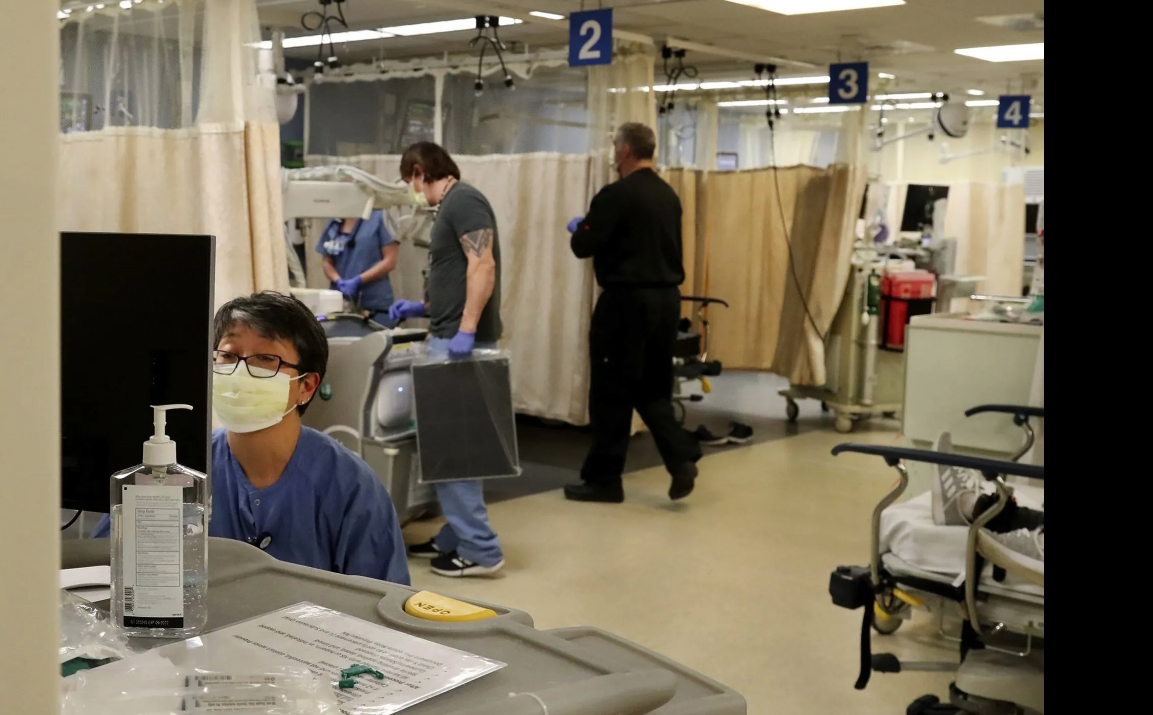
Greg Gilbert, Seattle Times 2022

Slide 5
Objectives
Secondary Analysis of a RCT to using baseline data to examine suicide risk among patients with OUD seeking non-psychiatric care in an urban ED
Investigate the relationship between baseline suicidal ideation and prospective overdose (fatal and non-fatal)

Slide 6
Setting and Participants: EDLINC study
Moderate or Severe OUD
Not requiring emergency psychiatrist or ICU care
English Speaking
18 years or older
Reside within a 50-mile radius of HMC
Cell phone or other contact method (e.g. email, social media)
Willing to provide alternate contact information for study tracking
Willing to have study review and use health information
Notes:
HMC picture and description of study site

Slide 7
Methods: Overdose over study period
All participants are followed for one year
RCT participant safety protocol includes tracking of possible serious adverse events (SAE’s) including overdose
Non-fatal overdose: participant who receives care at a hospital for for an opioid overdose as documented in the EMR or statewide health information exchange
Fatal overdose: death from overdose from opioids as a cause of death by the KC medical examiner or by report by family of opioid overdose death

Slide 8
Methods: Suicide Ideation and Risk Screening
PHQ-9 item 9 ‘in the past 2 weeks have you had thoughts that you would be better off dead, or thoughts of hurting yourself in some way’
Several days, or more
None at all
Colombia Suicide Severity Risk Scale
Q2. ‘In the past 30 days, have you actually had any thoughts about killing yourself?
YES
No
Notes:
Study flow diagram

Slide 9
Results: Suicide Ideation and Risk Screening among sample n=293
PHQ-9 item 9 ‘in the past two weeks have you had thoughts that you would be better off dead, or thoughts of hurting yourself in some way’
Several days, or more
N= 114 (39%)
None at all
N= 179 (61%)
Colombia Suicide Severity Risk Scale
Q2. In the past 30 days, have you actually had any thoughts about killing yourself?
YES
N= 56 (49%)
No
N= 58 (51%)
Notes:
Study flow diagram

Slide 10
Results: Demographics
 | Suicidal Ideation by PHQ-9 N=114 | No suicidal Ideation by PHQ-9 N=179
Age (mean, SD) | 43 years (11.26) | 40 years (12.65)
Male Sex | 81 (71.5%) | 81 (71.1%)
Race
White | 70 (61.4%) | 117 (65.4%)
African-American | 15 (13.2%) | 27 (15.1%)
Alaska Native/American Indian | 5 (4.4%) | 10 (5.6%)
Latinx Ethnicity | 11 (9.7%) | 17 (9.5%)
Unstable Housing | 57 (50.0%) | 72 (40.2%)

Slide 11
Results: Clinical Characteristics
 | Suicidal Ideation by PHQ-9 N=114 | No suicidal Ideation by PHQ-9 N=179
Injection Drug use | 72 (63.2%) | 115 (64.2%)
Overdose in the past 30 days | 22 (31.4%) | 23 (22.3%)
Other Substance Use (past 30 days)
Methamphetamine | 56 (49.1%) | 82 (45.8%)
Alcohol | 16 (14%) | 23 (12.8%)
Sedatives | 7 (6.1%) | 8 (4.5%)
Anxiety (GAD-7) | 91 (79.8%) | 91 (50.8%)
Currently on MOUD | 39 (34.2%) | 64 (35.8%)
Currently have Naloxone | 68 (68.7%) | 130 (80.2%)

Slide 12
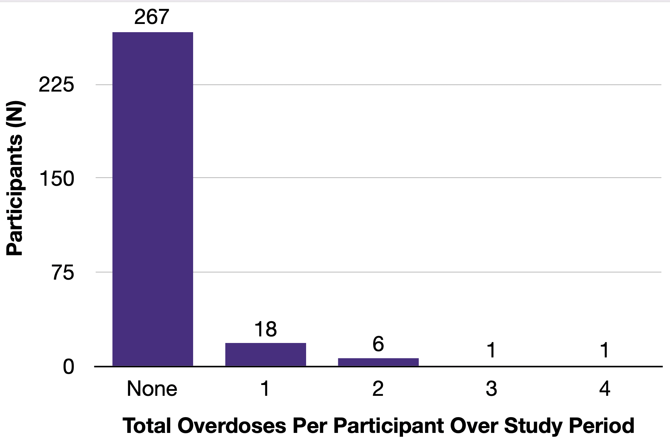
Outcome: Overdose

Slide 13
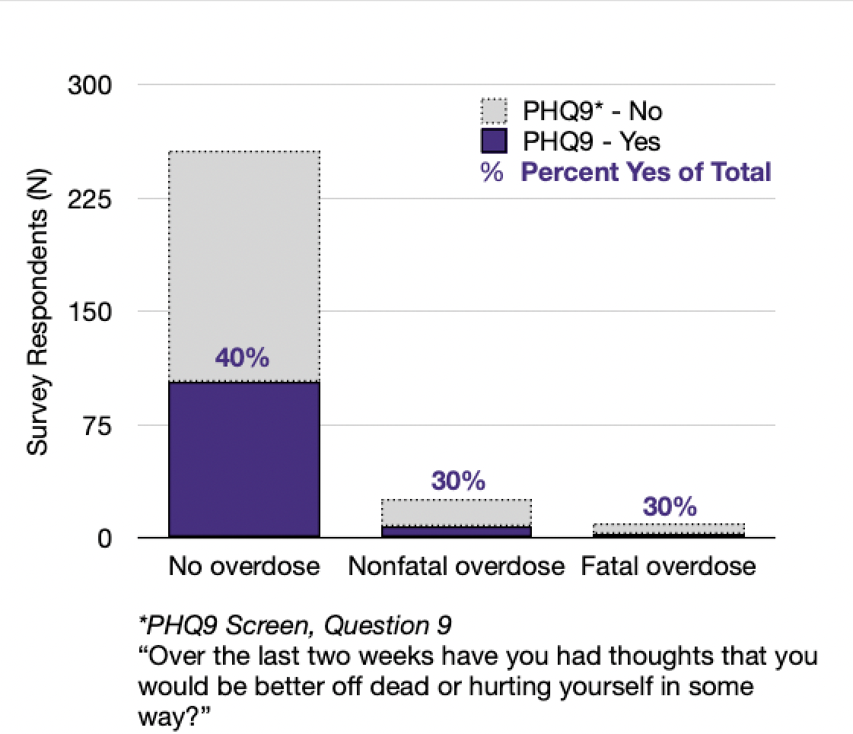
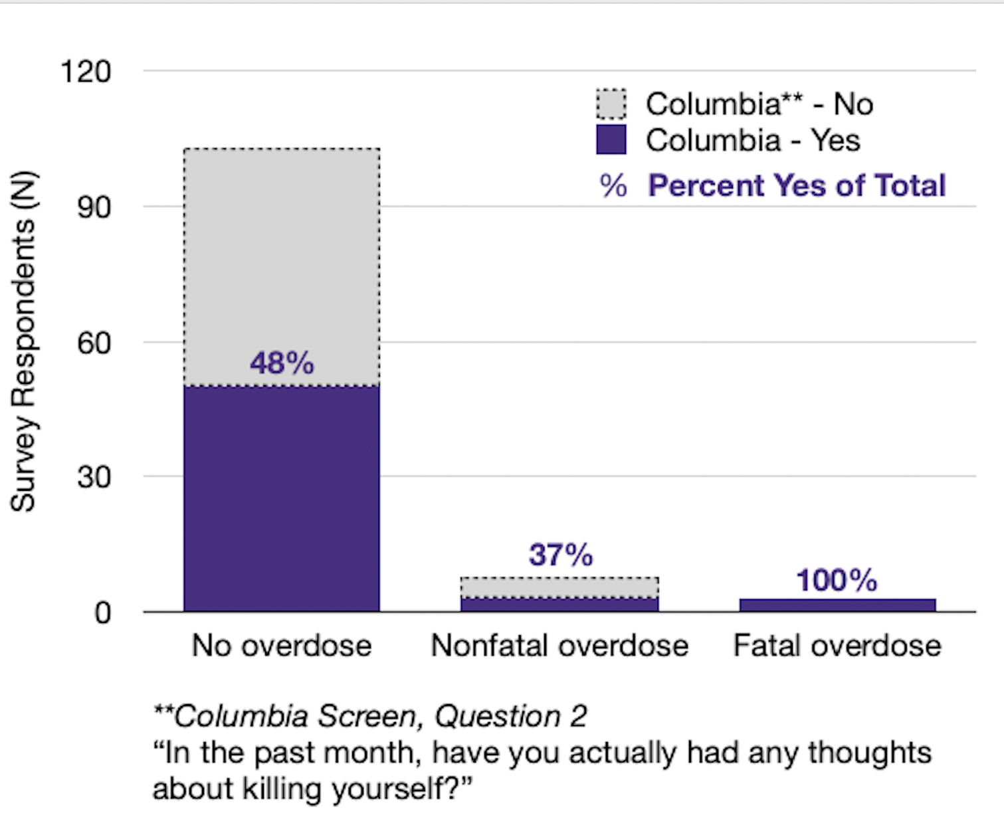
Baseline Suicide Screen and Future Overdose

Slide 14
Limitations
Fatal overdose data not systematically obtained (yet)
Not all participants in the cohort have participated for a year
Possible the number of overdoses will increase as every patient has full follow-up data
Despite the fact that there is a 3.4% mortality rate in the study population, the actual number of fatal overdoses were low n=10
Limits opportunity at this time for modeling
One urban hospital and results may not generalize

Slide 15
Conclusions & Future Directions
Rate of suicidal thoughts in a group of ED patients with OUD not seeking psychiatric care is 39%
Mortality from fatal overdose among this cohort is 3.4%
Baseline suicide risk does not seem to correlate to future overdose events
Future work will use logistic regression to model overdose events once more data is obtained
This population is at high risk of overdose and suicide and thus suicide screening and risk prevention should include a conversation on harm reduction, safe use, and naloxone

Slide 16
Questions?
laurenkw@uw.edu
With gratitude

