Slide 1
Supporting Hospitalized Adults with Stimulant Use Disorder using a Mobile App Contingency Management Program
Linda Peng, MD,¹ Hope Titus, BS¹, Kathleen Young, BSN, RN, CARN¹, Jon Peeples, MD², Eugene Song, BA¹, Provo Roellich, BA¹, Carol Defrancesco, MALS, RDN, LD¹, Rachel Lin, BS², Robert Phillips, CADC², Honora Englander, MD¹
¹ Oregon Health & Science University, Portland, OR, USA
² Affect Therapeutics, Inc., McLean, VA, USA

Slide 2
Background
Hospitalizations and deaths related to stimulant use disorder are rising rapidly, yet hospitalized patients with SUD experience poor outcomes due to:
Stigma
Inadequate pain/withdrawal management
Not being offered medications for OUD
Hospitalization is challenging especially those with stimulant use disorder due to a lack of FDA-approved medications.
Singh et al. PloS One. 2020.
Velez CM. J Gen Intern Med. 2017. Simon R. Subst Abus. 2020.
Notes:
Hospitalizations and deaths related to SUD, including stimulant use disorder are rising.
Hospitalization is a very challenging time for people with SUD. They often face increased stigma, are often not offered evidence-based treatment for addiction, and may leave before completing medical treatments. All of this leads to poor outcomes.
Hospitalization can be especially challenging for those with stimulant use disorder since we don't have any FDA approved medications that can support stimulant cravings or withdrawal.
Trim background slides – hospitalization is a reachable moment

Slide 3
Background
Contingency management (CM) is an evidence-based behavioral therapy for SUD that provides tangible incentives for behavior change.
CM is the most effective intervention for stimulant use disorders.
CM is robustly studied in ambulatory settings, but there is little evidence for using CM in the hospital.
CM can potentially support people who use stimulants with the challenges of hospitalization.
De Crescenzo F. PLoS Med. 2018.
Brown HD. Drug Alc Depend. 2020.
Notes:
Contingency management, CM, is an evidence-based treatment that uses positive rewards to incentivize behavior change.
CM is the most effective intervention for stimulant use disorders, with a NNT of 3-5.
CM has been robustly studied and demonstrated to be effective in ambulatory settings, but there's little evidence for using CM in the hospital.
Given the challenges of hospitalization for people who use stimulants, CM can potentially support patients through hospitalization.

Slide 4
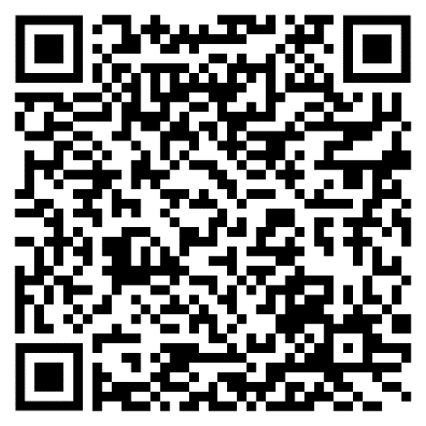
Adapting CM to the Hospital
We interviewed CM experts (5), hospitalized patients (8), and hospital staff (5).
Key CM adaptations for the hospital:
Adapted an existing mobile app-based CM program
Dedicated CM RN to support implementation
Targeted SUD behaviors with twice weekly saliva drug tests and counseling
Supporting hospital discharge transition with CM
Peng L. JAM. 2023.
Notes:
To adapt the CM to the hospital, we interviewed. Our paper shown here describes key considerations for adapting CM to the hospital which I won’t go into in detail for the sake of time.

Slide 5
Research Questions
Is it feasible to implement a hospital-based CM program for hospitalized patients with stimulant use disorder?
How do patients feel about a hospital CM program?
OHSU Hospital
Notes:
The goal of our pilot project was to adapt and implement CM for the hospital setting to support hospitalized patients with StUD.
The pilot was done at OHSU which is a large academic hospitals in Portland OR.
OHSU also has a robust addiction consult service, IMPACT, that sees patients with SUD. The IMPACT team was involved in many of the patients in our pilot, but not all patients were seen by IMPACT.
Put setting in methods. Objective of this is implement

Slide 6
Methods
Study Design Uncontrolled pilot of a novel mobile-app based hospital CM program
Setting OHSU is a large academic hospital in Portland, OR with a robust addiction consult service, IMPACT (Improving Addiction Care Team)¹.
Participants Hospitalized patients with moderate to severe stimulant use disorder and anticipated hospital LOS ≥2 weeks or diagnosis of heart failure
Data collection & analysis
Collected mobile-app engagement data
Completed semi-structured interviews with participants at two time points:
Hospital discharge
At the end of the CM program (8 weeks)
Semi-structured interviews focused on CM and hospital experience, barriers/facilitators, CM effect on substance use and physical health goals, and discharge transition
¹ Englander H. JGIM. 2019. Englander H. JHM. 2018.
Notes:
This was an uncontrolled pilot focused on adapting CM interventions to the hospital setting and then implementing a novel CM program with a focus on feasibility.
We assessed implementation outcomes use engagement data and semi-structured interviews focused on acc, ad, app, feasibility.
Research question is:
Then you do setting and intervention (look at typical methods)
We used this study to test

Slide 7
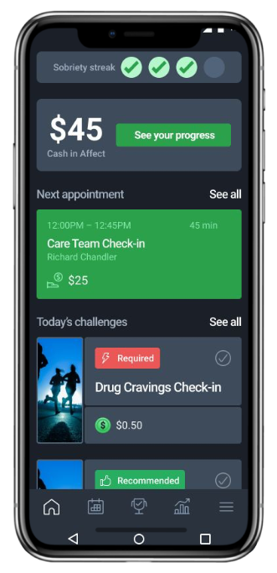
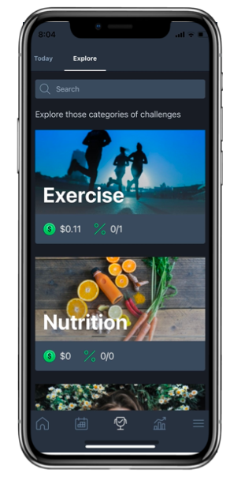
Hospital CM Mobile-app
Participants can earn up to $330 in gift cards in two months.
Saliva Drug Tests
Group Counseling
Daily App Activities
Twice weekly with a counselor
$3 for taking the test
$8 for every negative test
Bonus $10 for streaks of negative tests
$216 total
Twice weekly group counseling
$5 / meeting
$80 total
6 goals or reflections per day
$.60 / day
$34 total reward
Notes:
We decided on 2 months with the idea that this app would support people during hospitalization and the discharge transition, then they would continue with other SUD treatment if desired.

Slide 8
Hospital CM Mobile-app
Participants can earn up to $330 in gift cards in two months.
Program staff:
In-person CM RN supported implementation
CM counselor met with participants virtually
Mobile-app care coordinator assisted with enrollment & resources after end of program
Saliva Drug Tests
Group Counseling
Daily App Activities
Twice weekly with a counselor
$3 for taking the test
$8 for every negative test
Bonus $10 for streaks of negative tests
$216 total
Twice weekly group counseling
$5 / meeting
$80 total
6 goals or reflections per day
$.60 / day
$34 total reward
Notes:
We decided on 2 months with the idea that this app would support people during hospitalization and the discharge transition, then they would continue with other SUD treatment if desired.

Slide 9
Results
From August 2022- July 2024, enrolled 77 patients admitted to OHSU who met the inclusion criteria:
Patients with moderate to severe stimulant use disorder
AND
Anticipated hospital LOS ≥2 weeks OR diagnosis of heart failure
49 patients completed intake into the CM program
Assessed for eligibility (n = 185)
Did not meet inclusion criteria (n = 72)
Met inclusion criteria (n = 113)
Unable to engage due to mental health/cognitive impairment (n = 8)
Not interested (n = 28)
Consented and enrolled (n = 77)
Discharged from hospital sooner than anticipated (n = 15)
No longer interested / missed appointment (n = 10)
Became overwhelmed with hospitalization (n = 1)
Lost phone (n = 1)
Unable to engage due to cognitive function (n = 1)
Completed Affect intake process (n = 49)
Notes:
Started with group

Slide 10
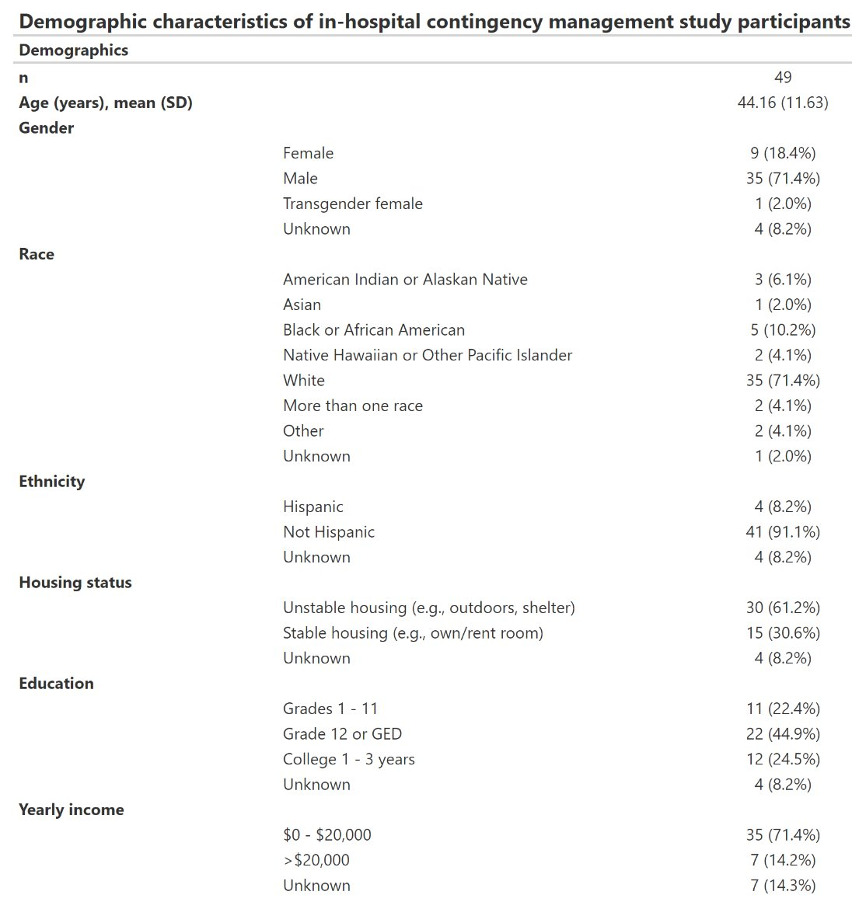
Demographics

Slide 11
Demographics
Notes:
Combine make font bigger

Slide 12
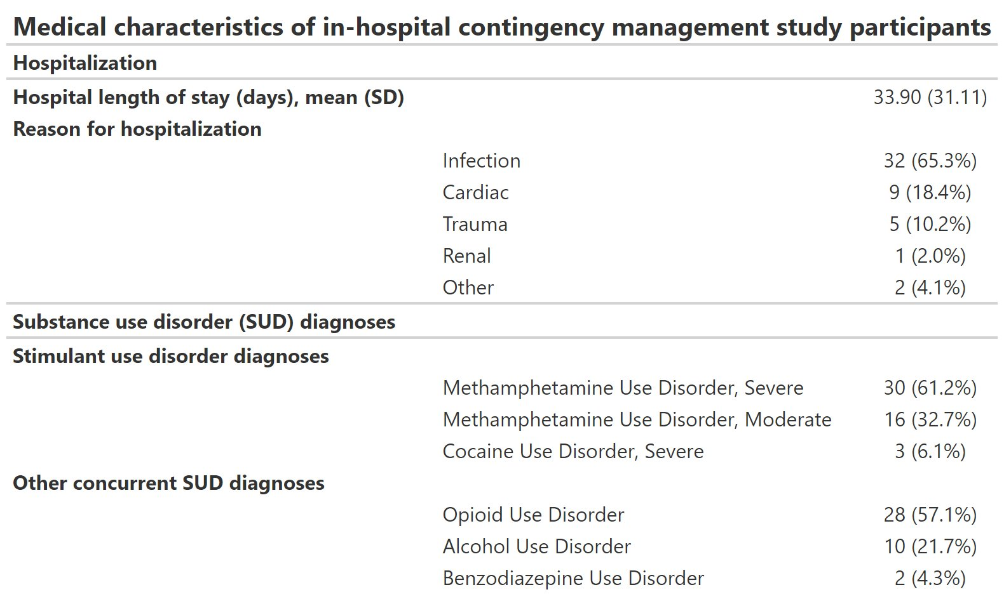
Medical and SUD Diagnoses

Slide 13
Hospital CM Engagement Data
(Participants can engage for up to 2 months)
Notes:
With the caveat that people are more likely to show up for drug tests if they know it's going to be negative, so the true negative rate is a lower percentage.

Slide 14
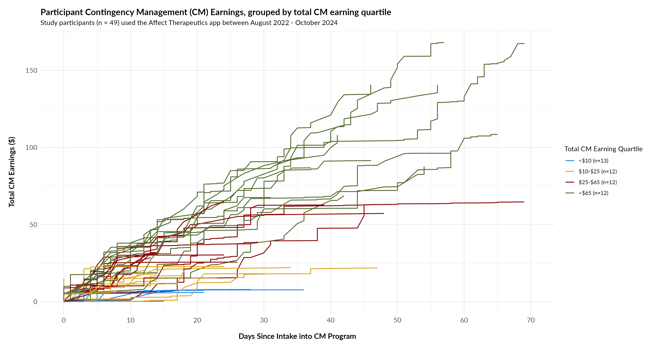
Hospital CM Engagement
Notes:
This graph shows participant engagement trajectories with total CM earnings on the y axis and days since starting program on the x-axis.

Slide 15
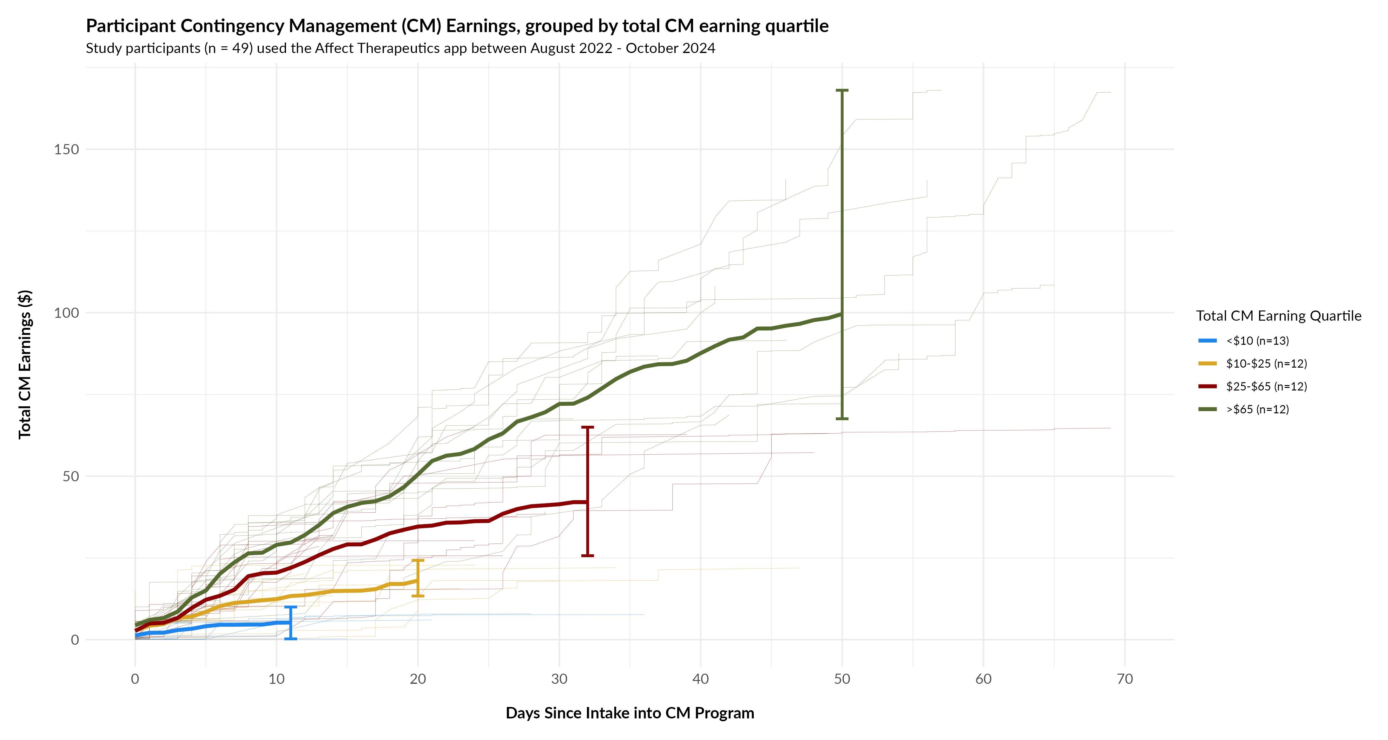
Hospital CM Engagement
Notes:
We divided the participants into quartiles.
The top quartile were highly engaged in the program for an average of 50 days with $100 average earnings.
The bottom quartile engaged minimally for just over 10 days earning less than $10.

Slide 16
Patient Semi-structured Interviews (n=24)
CM Program Experience
Structure and routine kept participants “focused” and “motivated because I’m thinking about it every day and doing positive things”
Incentives and “accountability” improved motivation
Counselor was especially supportive
Mobile app was accessible, flexible, and easy to use
Notes:
We interviewed 24 participants at the time of hospital discharge and at the end of the CM program.
We collected
Separate this into slides

Slide 17
Patient Semi-structured Interviews (n=24)
CM and Hospitalization
“Being in the hospital, I thought it’d be harder to stay clean, but the program kept me focused. Having the support and activities made it feel possible to get through without turning to anything.”
Enjoyed starting SUD treatment while hospitalized
Helped many focus on self-care
Increased engagement, empowerment around health
Decreased cravings
Reduced boredom, a common trigger→ less likely to use while hospitalized
Notes:
We completed *** semi-structured interviews with patients at the time of hospital discharge and at the end of the CM program.
We collected
Separate this into slides

Slide 18
Patient Semi-structured Interviews (n=24)
Barriers to Participation
“I had so much going on—appointments, medications, and just trying to get through each day. It was overwhelming…I couldn’t keep up with the program, even though I wanted to.”
Physical and health limitations
Feeling overwhelmed or preoccupied
Conflicting hospital schedule
Technological issues
Notes:
Structure and routine was helpful for keeping participants “focused” and “motivated because I’m thinking about it every day.”
Incentives improved motivation, though many felt this was not their primary motivation
Many participants felt the counselor and program staff were supportive and provided emotional support
Participants felt the mobile app was accessible, easy to use, and flexible

Slide 19
Patient Semi-structured Interviews (n=24)
Hospital Discharge Transition
Helpful tool to maintain focus on recovery during transition to different environment
Strong desire continue program limited by:
Technical challenges (no phone/data)
Changing schedules/routines
Balancing other responsibilities (e.g. work)
Returning to a chaotic environment, especially homelessness
Notes:
Structure and routine was helpful for keeping participants “focused” and “motivated because I’m thinking about it every day.”
Incentives improved motivation, though many felt this was not their primary motivation
Many participants felt the counselor and program staff were supportive and provided emotional support
Participants felt the mobile app was accessible, easy to use, and flexible

Slide 20
Conclusions
Implementing a mobile-app CM program was feasible in the hospital setting.
Participants felt participating in CM while hospitalized supported their SUD and health goals.
Participation varied widely with technological issues and competing priorities as common barriers.

Slide 21
Limitations and future direction
This was implemented at an academic hospital with a robust addiction consult service, limiting generalizability to other hospitals.
Implementation required relatively few staffing resources and could potentially be useful in hospital settings without fewer addiction resources.
Future research could focus on understanding factors that influence low vs. high engagement.
A controlled study could evaluate effectiveness of this intervention on hospital and health outcomes.

Slide 22
Thank You
Linda Peng
pengli@ohsu.edu

Slide 23
Hospital CM Process
Research team consents participant.
Mobile-app care coordinator completes enrollment and schedules intake by phone.
CM RN provides drug tests, support with technology, education.
Research staff emails gift card weekly. Reward amounts are shown on the mobile.
CM RN communicates with mobile-app care coordinators on hospital discharge plan.
Mobile-app care coordinators assist patients in finding ongoing treatment if desired at the end of the program.
Notes:
Here is the hospital CM process.
This program had relatively low staff needs:
8 hours /weekly of the CM RN
10 hours/weekly of the CM counselor
2-3 hours/weekly of the mobile-app care coordinator

