Slide 1
Surmounting Stigma MISSOURI FIRST RESPONDER STIGMA TOWARDS PEOPLE WHO USE DRUGS DECREASED FOLLOWING TRAINING
ST SIDDIQUI, L CONNORS, G BOAL, K VANCE, J WILSON, A AL-MALIKI, RP WINOGRAD

Slide 2
Disclosure
This work was supported by a grant from the Substance Abuse and Mental Health Services Administration, First Responders - Comprehensive Addiction and Recovery Act Grants.

Slide 3
Missouri Institute of Mental Health Addiction Science Team

Slide 4
MIMH Addiction Science
First responder/Public health focus
Overdose Response + Harm Reduction trainings
Law enforcement, EMS and Fire
Improve first responder (FR) attitudes and beliefs about people who use drugs (PWUD) and substance use disorder (SUD) treatment

Slide 5
Stigma in opioid overdose response
Stigma: negative attitudes and beliefs
Hinders effective overdose response¹
Creates a barrier to treatment²
Can be present in all types of FR
¹ Kruis et al., 2022
² Bergstein et al., 2021; Fadanelli et al., 2020

Slide 6
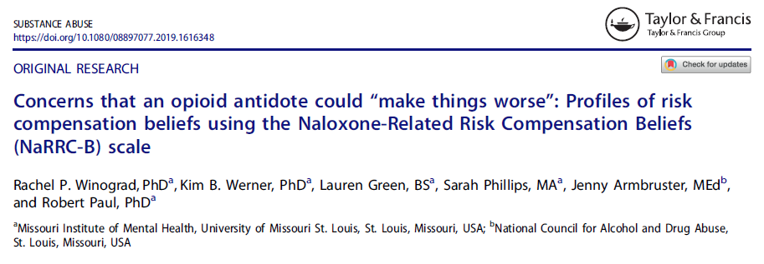
Improving FR attitudes towards PWUD through harm reduction training

Slide 7
Improving FR attitudes through harm reduction training??

Slide 8
Improving FR attitudes through harm reduction occupational safety training

Slide 9
Missouri Coordinating Overdose Response Partnerships & Support
MO-CORPS training aims to reduce FR stigma using:
overdose response best-practices
“Tacti-cool” language
Conducted by a team of
1 FR trainer
1 harm reduction trainer with lived experience of surviving an overdose
Available to all first responders

Slide 10
Defining stigma
Kruis et al (2020) scale describes stigma four dimensions:
Dangerousness
PWUD are a threat to safety
Blame
PWUD are responsible for their condition
Social distance
Desire to maintain distance from PWUD
Fatalism
PWUD have an intractable condition

Slide 11
Measuring stigma
Scale developed by Kruis et al (2020):
18 items/statements divided in 4 dimensions
5-point Likert scale records endorsement with each
Higher score indicates higher endorsement of stigma

Slide 12
MO-CORPS training
Module 1
Situational awareness
Disease model
Opioid overdoses in MO
Module 2
Field aid
Life-saving actions during an overdose
Fentanyl safety on scene
Module 3
Next level care
Effective post-overdose communication
Operational strategies that enable long-term recovery for PWUD

Slide 13
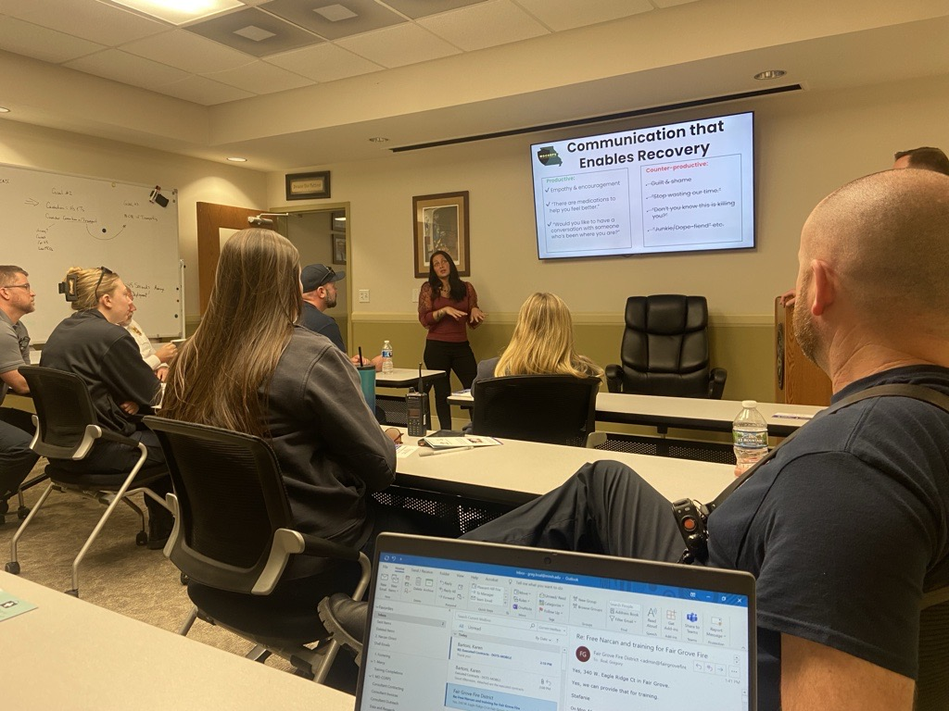
2,455 FRs trained between Jul 2023 and Oct 2024
208 training sessions

Slide 14
Research questions
Following training, is there a reduction in each dimension of stigma among first responders towards people who use drugs – while accounting for FR demographics?
Is there a difference in the change in each stigma dimension between type of first responder after the training?

Slide 15
Methods
Consenting participants fill out pre- and post-test survey
Demographics
4 dimensions of stigma, aggregated into mean scores
Comparison of pre- and post-training scores
Used regression to estimate stigma scores, accounting for
Interaction of profession type and time-point
Gender
Tenure length
Race
Estimate marginal mean stigma level through post-hoc analysis

Slide 16
N = 680
MEAN AGE: 35.6 years (±11.6) MEAN TENURE: 11.4 years (±10.9)

Slide 17
Stigma – Dangerousness (Min 1.00 to Max 5.00)

Slide 18
Stigma – Blame (Min 1.00 to Max 5.00)

Slide 19
Stigma – Social distance (Min 1.00 to Max 5.00)

Slide 20
Stigma – Fatalism (Min 1.00 to Max 5.00)

Slide 21
Anti-stigma training for Missouri First Responders
Overall associated with reduction in stigma scores at post-test
Floor effects might explain low and non-significant change in fatalism scores
EMS have higher post-test fatalism scores
more frequent response
responding to repeated overdoses ➔ increased stigma, professional burnout, compassion fatigue

Slide 22
Going forward
What is the relationship between burnout and stigma?
What is the baseline qualitative perspective of first responders regarding PWUD? How can it inform anti-stigma training?
What is the attributable effect of the training on FR stigma towards PWUD?
Does training diffuse from individual to their department?
Has the training made experiences qualitatively better for PWUD?
Does race of PWUD affect first responder stigma levels?

Slide 23
“The first time I overdosed, the first words that I heard from the medics when I woke up were ‘****** junkie…’ That sent me even further down a bad path. For a long time after that, I felt like anyone in a uniform was an enemy.
“But a while later, I had an encounter with some CIT officers. And they actually seemed like they were genuinely concerned about me. I had a lot of drugs on me, but instead of arresting me, they asked me if I’d rather sign myself into an in-patient behavioral health unit, which is where I met my recovery coach. That compassion really helped me turn things around at a critical moment.”

Slide 24
Thank you!
The First Responder/Public Health Team
The Addiction Science Team
SAMHSA
MO Department of Health & Senior Services
Our brilliant trainers and peers

Slide 25
Deaths from opioid overdose continue to be high in Missouri
Missouri Deaths from Opioid Overdose – Counts¹
MISSOURI DHSS DATA, 2024*
* Preliminary data

Slide 26
Stigma in opioid overdose response
Provider/FR Stigma
“…prejudice and discrimination voiced or exercised, consciously or unconsciously, by occupational groups designated to provide assistance to … persons who have or who display a socially undesirable attribute or characteristic, such as substance use dependency.”
Kruis et al., 2020

