Slide 1
Systematically Testing the Evidence on Marijuana (STEM)
Devan Kansagara MD MCR
Oregon Health and Science University
AMERSA Conference
11/15/24

Slide 2
I have no financial conflicts of interest to disclose. I am the Principal Investigator of the STEM project which is funded by the Veterans Health Administration’s Office of Rural Health

Slide 3
The Systematically Testing the Evidence on Marijuana Project
https://www.cannabisevidence.org/
“STEM is an independent, methodologically rigorous, and updated cannabis evidence resource for the health care sector that synthesizes what is known from research and what is left to learn about the health effects of cannabis.”
Empower clinicians to have evidence-informed discussions about cannabis with their patients
Spur research by identifying key gaps in understanding and facilitating networking among researchers
Funded by VA Office of Rural Health

Slide 4
Context
Description of STEM
Methods and development
Dissemination and reach
Future directions

Slide 5
“The most dangerous drug in America”
Notes:
Cannabis has been the subject of a very polarized debate for many decades. On one hand, its demonization is the foundation for a tumultuous social, legal, and political history that has included mass incarceration, the exacerbation of inequities, and also a dearth of good science. On the other hand, cannabis is also seen as an all-natural cure-all, a panacea with unalloyed benefits and no harms. Depending on where you are in the United States, cannabis is an illegal drug with no potential for health benefit, an over-the-counter remedy, a prescription medication, or a recreational substance. It is also a fast-growing industry worth tens of billions of dollars. My talk is not intended to provide a pro or con view of cannabis – I urge all of us to avoid the poles of this debate and to focus instead on becoming more familiar with cannabis and the science of its health effects.

Slide 6
Cannabis evolution in the US
Cannabis is more accessible than ever and is increasingly used
Nearly 20% of US adults have used in the last year
4% of all adults use daily
Daily use among young adults increasing (6 →10%)
The prevalence of CUD among past-year users is about 30%
Potency has increased markedly over time
It is a multi-billion dollar industry, and it is growing
The majority of the US population now lives in states where cannabis is legal for recreational and medical use
Compton WM, DAAD, 2019
El Sohly MA, Biol Psych, 2016
Cash MC, PLOS One, 2020
Hill M, Addict Behav, 2021

Slide 8
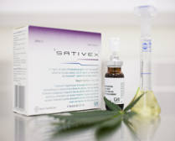
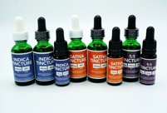
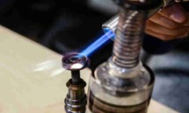
Cannabis is not one thing
POTENCY
4 16%
POTENCY

Slide 9
Time to move past dichotomies
YES/NO
What? How much? How often? How long?
For whom?
Who is at risk?
Who benefits the most?
How big is the benefit?
How large is the risk?
How does one minimize risk?
GOOD/BAD

Slide 10
The Systematically Testing the Evidence on Marijuana Project
https://www.cannabisevidence.org/
“STEM is an independent, methodologically rigorous, and updated cannabis evidence resource for the health care sector that synthesizes what is known from research and what is left to learn about the health effects of cannabis.”
Empower clinicians to have evidence-informed discussions about cannabis with their patients
Spur research by identifying key gaps in understanding and facilitating networking among researchers
Funded by VA Office of Rural Health

Slide 11
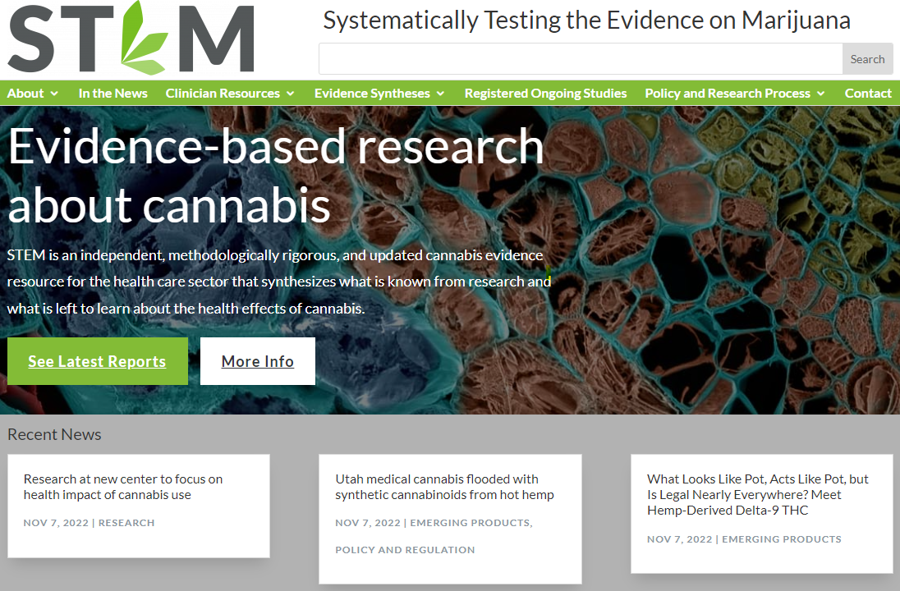
About
A primer on living systematic review methods
Information about the project, team, and expert panel
In the News
An updated selection of news articles, studies, funding announcements, and policy developments
Clinician Resources
Cannabis basics: An overview of cannabis terminology and pharmacology for nonexpert clinicians
Clinician briefs: Short, focused articles with an overview of evidence and contextual issues to consider for clinical settings
Evidence Syntheses
Living systematic reviews (visual abstract, brief summary, & formal report) on high-priority topics
Registered Ongoing Studies
A customized, searchable interface with ClinicalTrials.gov to identify ongoing studies on cannabis-related topics of interest
Research and Policy Process
Interactive state-level policy and data map of US
FAQs about the rules and regulations governing cannabis research in the US

Slide 12
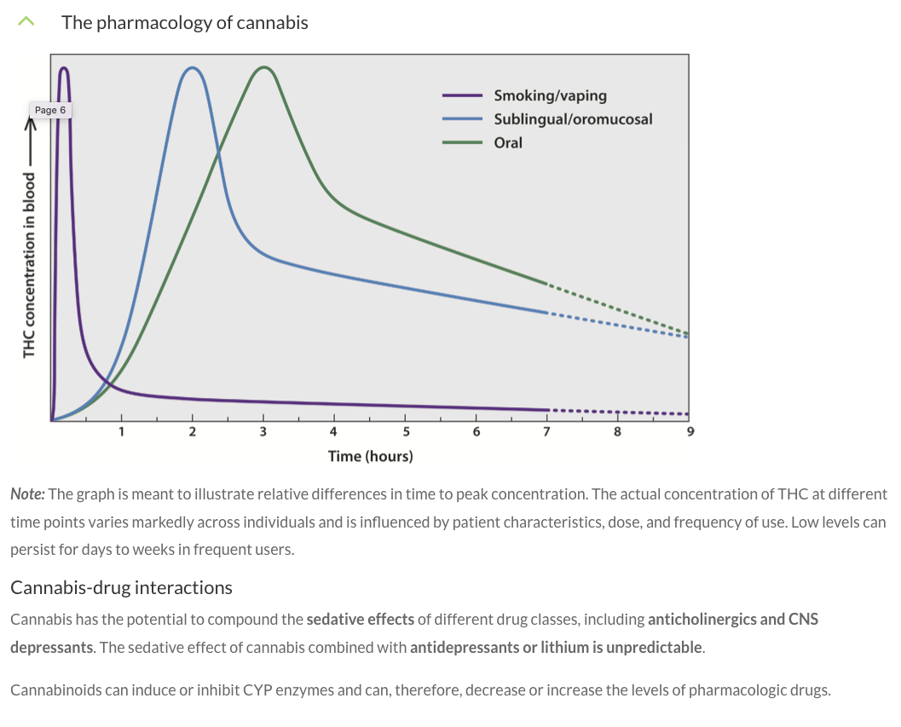
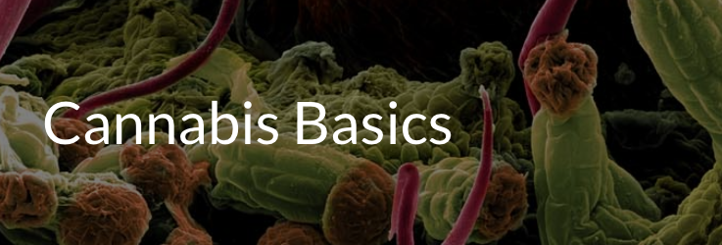

Slide 13
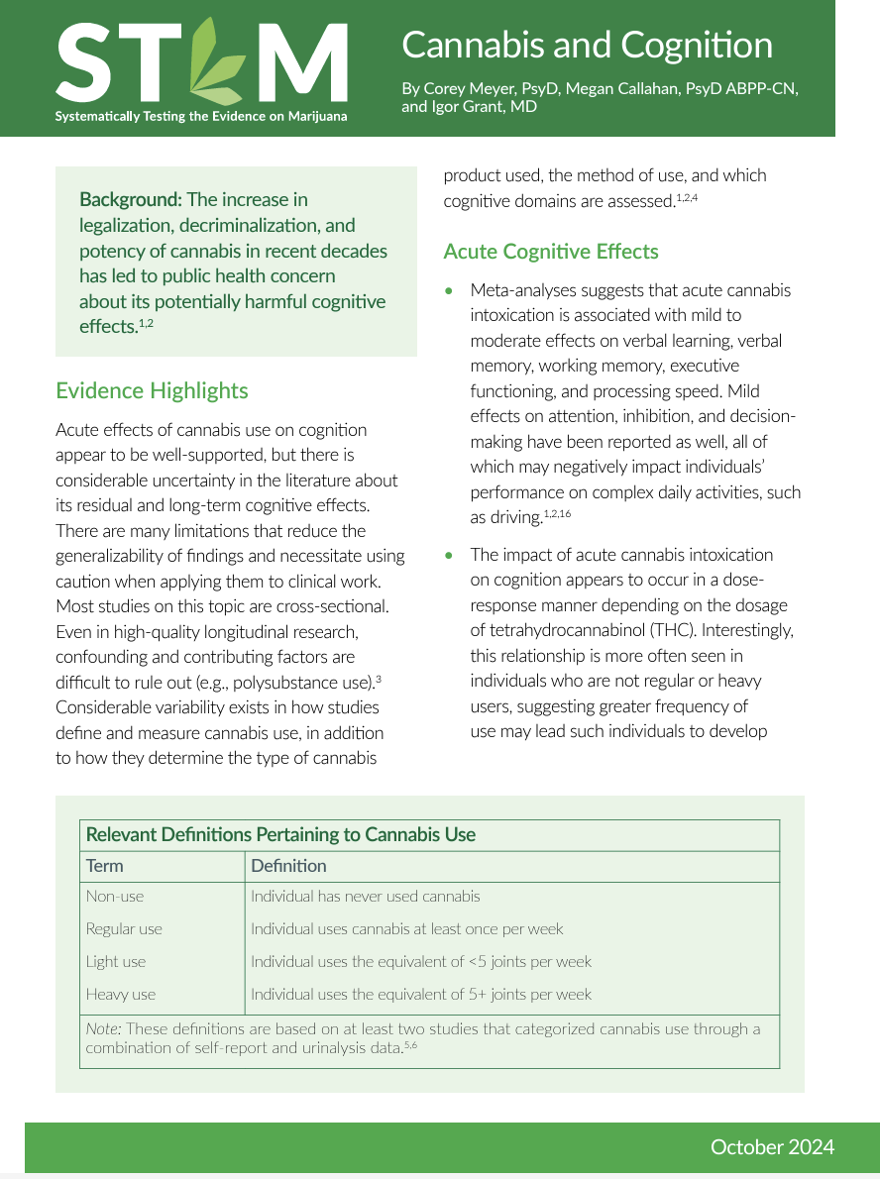
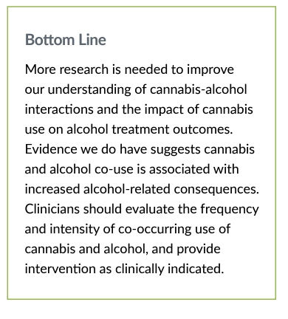
Clinician briefs

Slide 14
Living systematic reviews
Topics:
Treatment of PTSD
Cannabis use during pregnancy
Prevalence and risk factors for cannabis use disorder
Pharmacologic treatment of cannabis use disorder
Treatment of chronic pain
Treatment of anxiety and mood disorders

Slide 15
CME/MOC II activity

Slide 16
Development
Survey studies of primary care clinicians in VA and throughout Oregon
Qualitative studies of providers and patients
National survey of dispensary workers
Technical Expert Panel
Provides rationale for STEM:
- Relevant to clinical practice
- Little clinical training
- Variation in practice, knowledge, and attitudes
- Dispensaries not well-suited to counseling about benefits and harms
Inform STEM design:
- Topic prioritization
- User-centered design
Kansagara D, Pain Med, 2020
Christensen V, Fam Practice, 2020
Merlin J, JAMA NO, 2021

Slide 17
Methods
Living systematic review methodology
Adhere to contemporary review standards
Use GRADE approach
Annual surveillance, at minimum
Technical Expert Panel (TEP)
32 VA and non-VA clinicians and researchers
Differing areas of expertise and multidisciplinary
VA, NIH, and AHRQ all represented
Everything is peer-reviewed by at least two experts
Evaluate reach through web usage (Google analytics); formative evaluation through feedback from clinician outreach sessions and twice-yearly TEP meetings

Slide 18
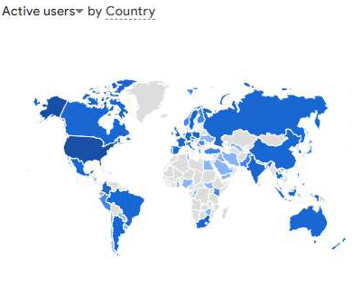
Dissemination and reach
Website analytics (Jan 2022 to Oct 2024)
Unique users: 21,850
Page views: 62,551
STEM Monthly Digest
267 subscribers

Slide 19
Dissemination and reach:
990 unique VA learners (through the first 6 of 8 sessions)
The series was well-received and impactful:
The content in this session was relevant to my practice and/or role = (85%)
I anticipate changing my clinical practice and/or work based on the content of this session= (69%)
My level of knowledge surrounding today's topic has improved = (93%)
I would like to hear from the faculty speaker(s) again = (94%)
Topics
Cannabis 101
Reproductive health
Young adults
Medicinal use
Cannabis use disorder
Cannabis and opioids
Cognitive and mental health
Cannabis research and Veterans

Slide 20
Current and upcoming STEM-related projects
Video-based qualitative study of Veterans’ experience with cannabis and discussing cannabis with providers:
- help providers understand Veteran perspective and how to discuss cannabis in ways that are most likely to be impactful
- help researchers understand the ways in which cannabis may be exerting beneficial or harmful effects
Delphi panel project to identify and prioritize key messages about cannabis health effects for primary care providers to discuss with their patients:
- clinicians, researchers, and laypeople with lived experience (enrollment completed)
- collaboration with RAND, U Pitt, Montefiore
Notes:
HERN: Qualitative interviews with Veterans using DIPEx. Their experiences obtaining cannabis, reliability of the information, and experiences/preferences on talking with clinician about cannabis
ORPRN: Clinician survey of OR/WA primary care (topic prioritization, clinician practices and barriers around conversations with patients on cannabis, and website feedback)
Cannabis Research Summit bringing together major cannabis and health research centers throughout the US to discuss ways to collaborate
Project ECHO: Cannabis ECHO course currently being offered in Oregon (overbooked!)
Expertlens: Online Delphi panel of ?? (I realized I have no idea what’s going on with this)
CME: coming soon to website (did we say we wanted it up already?)
NIH: ?

Slide 21
Current and upcoming STEM-related projects
How I Talk to Patients About___ (pilot):
- Brief videos of clinician/expert describing how they counsel patients about specific cannabis related health effects
- First video about cannabis health effects during pregnancy to be posted soon
Pilot and test incorporation of (non-generative) AI:
- Translate materials for use by laypeople
- Streamline updates of clinician briefs
- Take advantage of our evidence review organization networks to identify promising and potentially detrimental approaches
- Ultimately will help reduce cost of STEM maintenance/free up resources for further innovation and dissemination
Notes:
HERN: Qualitative interviews with Veterans using DIPEx. Their experiences obtaining cannabis, reliability of the information, and experiences/preferences on talking with clinician about cannabis
ORPRN: Clinician survey of OR/WA primary care (topic prioritization, clinician practices and barriers around conversations with patients on cannabis, and website feedback)
Cannabis Research Summit bringing together major cannabis and health research centers throughout the US to discuss ways to collaborate
Project ECHO: Cannabis ECHO course currently being offered in Oregon (overbooked!)
Expertlens: Online Delphi panel of ?? (I realized I have no idea what’s going on with this)
CME: coming soon to website (did we say we wanted it up already?)
NIH: ?

Slide 22
Summary
STEM is a web-based evidence resource about cannabis health effects for clinicians and researchers
Find us at www.cannabisevidence.org
We love to collaborate! Please reach out, particularly in the following areas:
Interest in writing a clinician brief
Dissemination of information to patients/general public; development of patient-facing material

Slide 23
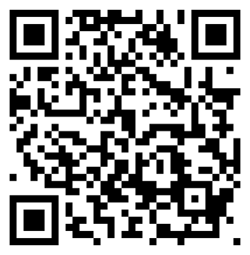
Thank you STEM team!
Chelsea Ayers
Beth Smith
Nicole Thompson
Shannon Robalino
Shauna Durbin
Landon Donsbach
Sneha Yaddala
Rachel Ward
Alison Eckhardt
Haley Holmer
Ben Morasco
Honora Englander
Jamie Lo
To sign up for our Monthly Digest and/or to reach out to collaborate, please visit us at www.cannabisevidence.org, scan the code below, or email me at kansagar@ohsu.edu:

