Slide 1




A Novel Adaptation of the Project ECHO Model to Convene Leaders in SUD Care
11/4/23
Dan Hoover, MD, Assistant Professor of Medicine, Addiction Medicine ECHO Director, OHSU
NithyaPriya Ramalingam, PhD, Senior Qualitative Data Analyst, Oregon Rural Practice-based Research Network, OHSU
Eowyn Rieke, MD, MPH, Medical Director of Outpatient and Residential Services, Fora Health
Maggie McLain McDonnell, MPH, Oregon ECHO Network Director, OHSU

Slide 2
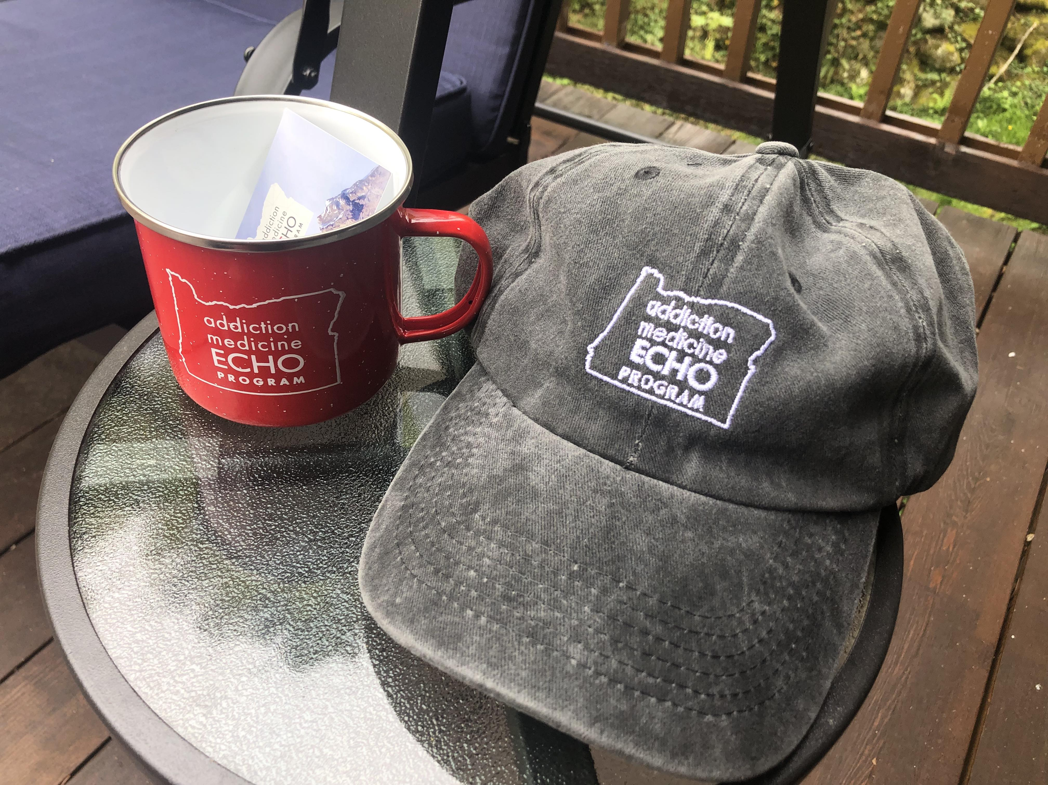
Funding Statement
SAMHSA State Opioid Response grant

Slide 3
Outline
Basics of ECHO
Oregon’s SUD Leadership ECHO
Qualitative evaluation SUD Leadership ECHO – 2022 cohort

Slide 4
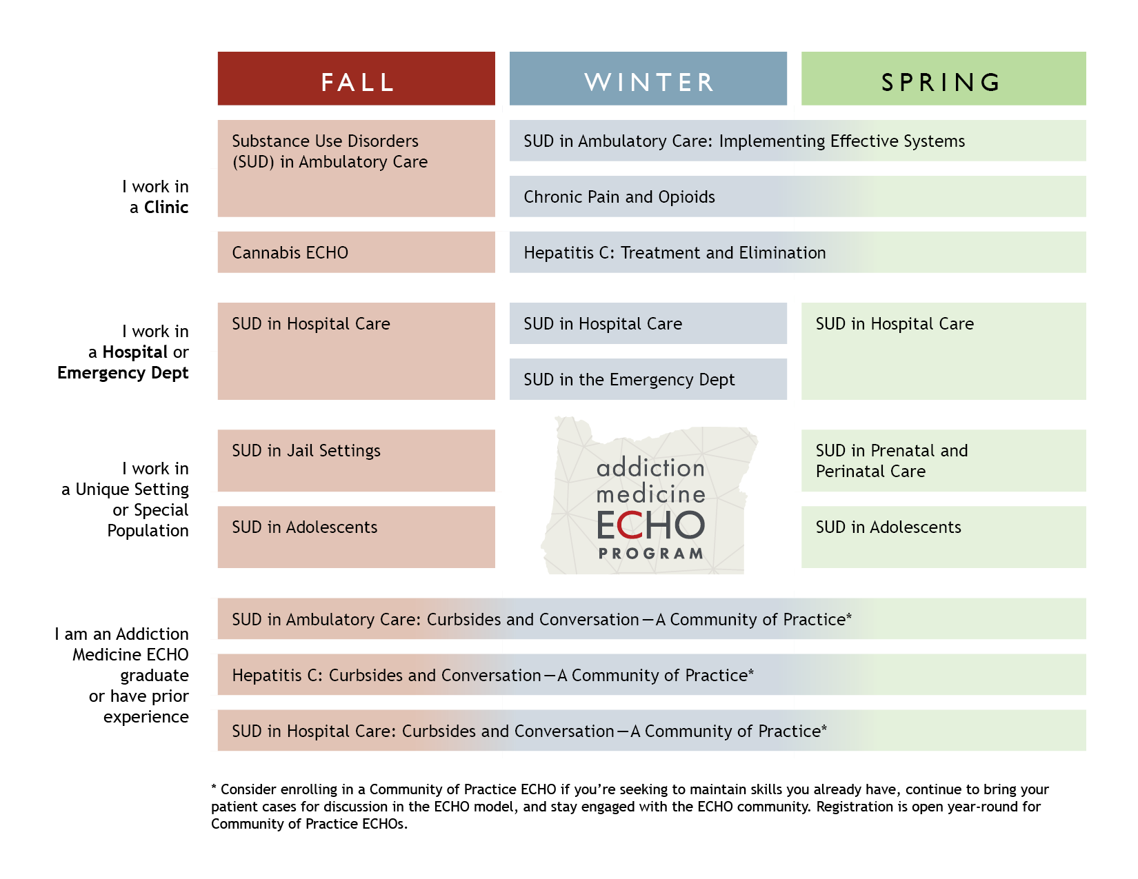

13 Addiction
Medicine ECHOs
Notes:
13 ECHOs
(Univ NM ECHO story):
Nearly 20 years ago, Dr. Sanjeev Arora walked into his clinic to find a 43-year-old woman with hepatitis C seeking treatment for the first time, after an initial diagnosis eight years earlier. When questioned why she would delay treatment, she said she couldn’t afford to take the time off of work to make the five-hour trip to Albuquerque; she was also a widow with two children to care for. She finally sought help when her abdominal pain began interfering with her ability to work.
But it was too late. The untreated hepatitis C had caused advanced liver cancer that was not suited for surgery or liver transplantation. She died six months later.
The medicine and expertise needed to treat this patient's illness were available. But, she died because the doctor in her community did not have the expertise required to treat her disease. The right knowledge didn’t exist at the right place at the right time.
This mother’s story was one of many Dr. Arora witnessed in his Albuquerque clinic. At the time, there were 28,000 patients with hepatitis C in New Mexico and only 1,500 had been treated. People were dying of a treatable and curable disease because they could not access timely treatment.
He decided to take action.
First, he sent out his protocol for treating hepatitis C to primary care physicians across the state. But he soon realized that simply providing the right information was not enough. To master the complexity of treating hepatitis C, providers needed something more.
Dr. Arora recruited primary care clinicians throughout the state to create a virtual “community of practice” or a space where doctors could learn from experts and each other; where they could discuss real-life case examples that offered insight on New Mexico’s unique patients and systems. In one year, these clinicians became experts in the treatment of hepatitis C – the first success story of the global organization now known as “Project ECHO.”

Slide 5

SUD Leadership ECHO 2022
Audience: multidisciplinary leaders in SUD Care
Systems level and emergent topics: no roadmap

Slide 6
SUD Leadership Cohort 2 | Didactic Presentation | Systems Case Scenario
January 2022 | Interviews with People Who Use Drugs in Oregon: Fentanyl Results | Increasing Oregon’s behavioral health workforce
February 2022 | Staff Well-being | Buprenorphine access barriers at Oregon pharmacies
March 2022 | SUD Care in Jail Setting: Example of Clackamas County Jail | Methadone access after hospital discharge
April 2022 | Integrating Somatic-based Care into SUD Treatment | Alcohol regulation and taxation
May 2022 | Psilocybin and SUD | Emerging adolescent non-pharmaceutical fentanyl use
June 2022 | Measure 110 Implementation Update | Non-pharmaceutical fentanyl and community overdose response

Slide 7
SUD Leadership ECHO Adaptations
ECHO Model | SUD Leadership ECHO, 2022
1 hour zoom
Half didactic with Q&A, half case discussion
Clinical individual patient case | Systems case
Listserv and broad-based recruitment | Individual recruitment, intensive process

Slide 8
History of the
SUD Leadership ECHO
2020
SUD COVID Response
SUD Leadership Cohort 1
2022
SUD Leadership Cohort 2
2022-23
SUD Leadership Cohort 3
2023-24
SUD Leadership Cohort 4
2020
Qualitative Evaluation
Notes:
We evaluate all our programs through participant session surveys and then pre/post program surveys.
But wanted to do a more in-depth evaluation of SUD Leadership ECHO due to it’s unique model and lofty goals

Slide 9
Methods
16 out of 53 ECHO participants
4 focus groups (for schedule flexibility), average 51 minutes
Focus groups led by qualitative analyst using guide
Deductive + inductive codes
Code book iteratively refined to develop final
Emergent themes were identified
Notes:
A fairly typical approach for qualitative research: focus groups to promote interaction and help all to recall the ECHO, since these meetings were 2-5 months after the ECHO completed.
Digitally recorded with verbal consent for the study
Transcripts dual-Coded by 2 qualitative analysts using final codebook

Slide 12
 | ECHO Cohort |  | Focus Groups
 | Number | % | Number | %
Gender of Participants
Woman | 31 | 58% | 8 | 50%
Man | 19 | 36% | 7 | 44%
Gender queer | 2 | 4% | 1 | 6%
Trans male | 1 | 2% | - | -
Race/Ethnicity of Participants
White | 41 | 77% | 14 | 88%
Asian or Asian American | 4 | 8% | - | -
Black or African American | 2 | 4% | - | -
Hispanic or Latinx | 2 | 4% | 1 | 6%
Prefer Not to Respond | 2 | 4% | - | -
American Indian or Alaska Native | 1 | 2% | 1 | 6%
White; American Indian or Alaska Native | 1 | 2% | - | -
Notes:
Oregon’s BH workforce is ~80% white. Whiter than the population it serves.

Slide 13

Results: Three Themes
ECHO Benefits
Practice & Policy Changes
ECHO Improvement

Slide 14
ECHO Benefits
A community across disciplines and organizations
“moving beyond… siloes”

Slide 15
ECHO Benefits
Engaging leaders beyond just physicians
“It [State Chapter of ASAM], is primarily physicians, and I don't participate in those activities in general…there's something really nice about the crosscutting nature of who comes to this ECHO.” – State or Regional Systems Leader

Slide 16
ECHO Benefits
Local implementation focus
“I hear and I learn a lot about what's going on in other parts of the country, but then for the, ‘well, how does that translate to Oregon, or are we doing....’ And these forums seem to be a great way to learn about what's happening in Oregon and where I might be able to connect with somebody here.” – Organization or Program Leader

Slide 17
ECHO Benefits
Reducing isolation among leaders
“Being in community with people who already understand that it's hard... In a room of normy’s [normal people] explaining the work we do and why it's important, is a lot of work. And so being able to be with this group of people who I don't have to explain why what I do is important.”- Organization or Program Leader

Slide 18
ECHO Benefits
Value of high-level leaders present
“[it’s] nice to have people that understand higher up level change and what we need to do and how systems work and not just like, oh, we need to do this, but don't understand the background of it.” – State or Regional Systems Leader

Slide 19
Practice and Policy Changes
adopting a model tried successfully by others within the state helped convince stakeholders in their home organizations to embrace changes

Slide 20
Practice and Policy Changes
Changes to Buprenorphine prescribing policy, trainings
Changing staff engagement and retention policies
Partnering with local jails for MOUD

Slide 21
Practice and Policy Changes:
Barriers
Lacking power with an organization: informal vs formal leadership
High level systems obstructed potential organization policy changes
Inspired by ECHO, but the change process is lengthy

Slide 22
ECHO Improvement
Too much content!
Prefer one issue from multiple perspectives
Didactic Presentation | Systems Case Scenario
SUD Care in Jail | Methadone access after hospital discharge

Slide 23
ECHO Improvement
The lack of “real accountability” was “a limitation of the Leadership ECHO” even though it gave “visibility and transparency where the problems are.” – State or Regional Systems Leader
Facilitate advocacy and solutions better
  Group petitions / letters
  Form sub-committees to continue solution development
  Track follow-through between sessions

Slide 24

Conclusions
  Connecting multidisciplinary leaders had multiple benefits
  Reduced isolation, helped inspire – may reduce burnout
  Best practices were implemented locally and translated between organizations
  The ECHO model of didactic + case needed adjustment: fidelity to ECHO model is now low
  Facilitating policy changes was hard to achieve
Notes:
Sparks Lake, central Oregon

Slide 25

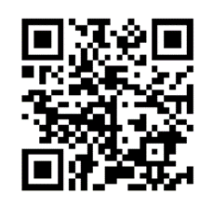
hooverda@ohsu.edu
Q&A - Discussion
Notes:
I am really excited about the breadth and depth of the program options that we have and glad to promote these at this summit!
I think the SUD workforce in WA especially may have a lot to benefit looking at these programs, not regularly operating AM-ECHOs. If you’re in ID or AK definitely compare to what your state’s ECHO is offering for SUD. Consider adding on a specialty program of ours if that area is important to your work.
I am excited and hoping we are all enriched with more collaboration from the across the region on ECHO this upcoming AY.
Come find our booth in the exhibit hall and bring your friends.

Slide 26
Leadership Level | Definition | Examples
Direct Care | Performs direct care of individuals in a professional context and does not lead a SUD care program. May be an informal leader among colleagues or a leader in community SUD associations outside of their primary employment context. | A behavioral health provider at a large health system. A pharmacist at a rural clinic who is a specialist in SUD pharmacotherapies.
Organizational or Program | Leads a SUD services program within their workplace or participates in leadership of an organization focused on SUD services. May also perform direct care of individuals. | A behavioral health program manager at a rural SUD services organization. A chief medical officer at a multi-site SUD and MOUD services clinic.
State or Regional systems | Employed by an organization that functions at the state or county level to direct the care of persons with SUD. May also perform direct care of individuals. Includes staff of accountable care organizations that manage Medicaid, termed coordinated care organizations in Oregon. | A manager at a non-profit advocacy group. A harm reduction project manager with County Public Health. Coordinated care organization personnel.

Slide 27
 | ECHO Cohort |  | Focus Groups
 | Number | % | Number | %
Cohort 2 Enrollment
Registered online | 68
Approved registrants | 61 | 90% | 16
Participants (attended ≥ 1 session) | 53 | 87% | 16 | 100%
Repeat participants from Cohort 1 | 20 | 38% | 7 | 44%
First time participants in an Oregon ECHO Network program | 27 | 51% | 4 | 25%

