Slide 1

Women, Power, and Addiction
Mishka Terplan MD MPH
Medical Director, Friends Research Institute
Substance Use Warmline Clinician, UCSF
Notes:
Examine gender and drugs, specifically women, primarily through a historical and critical lens

Slide 2
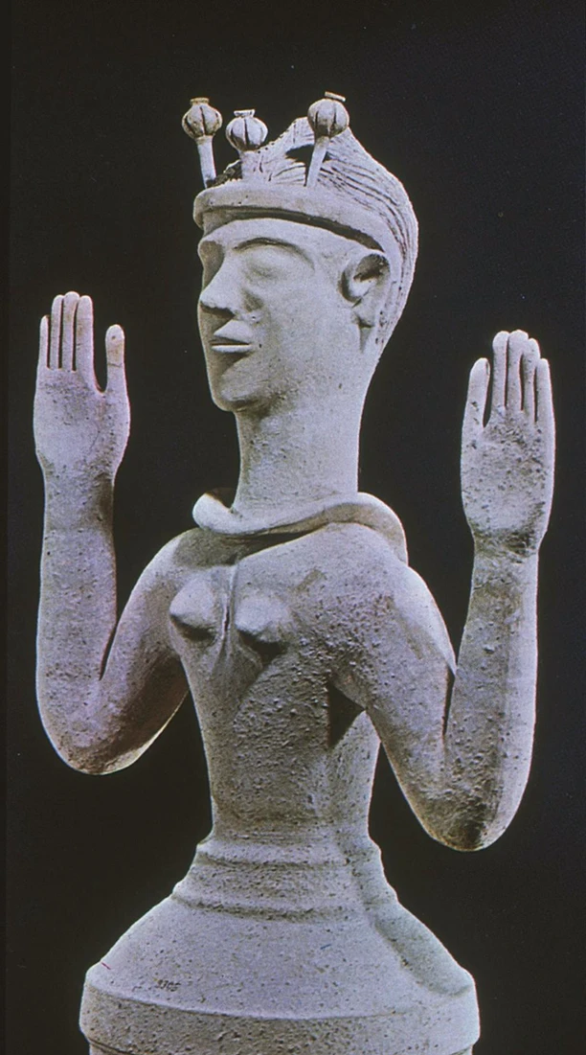
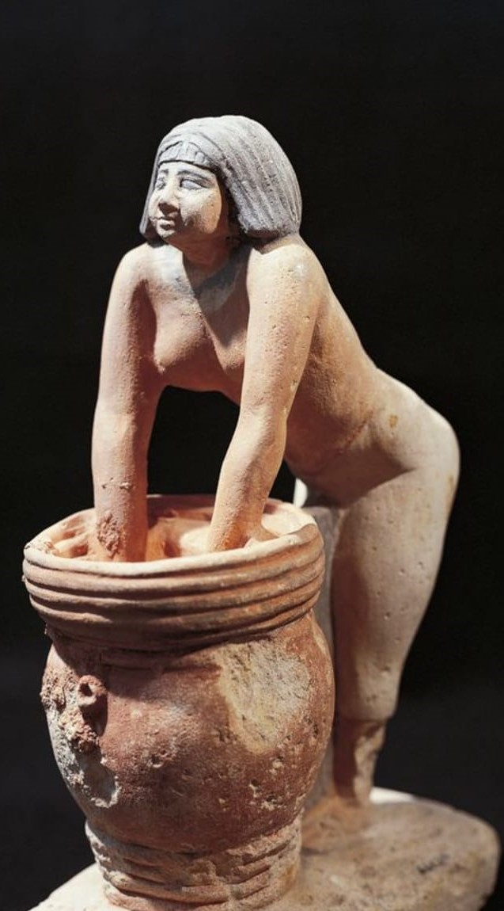
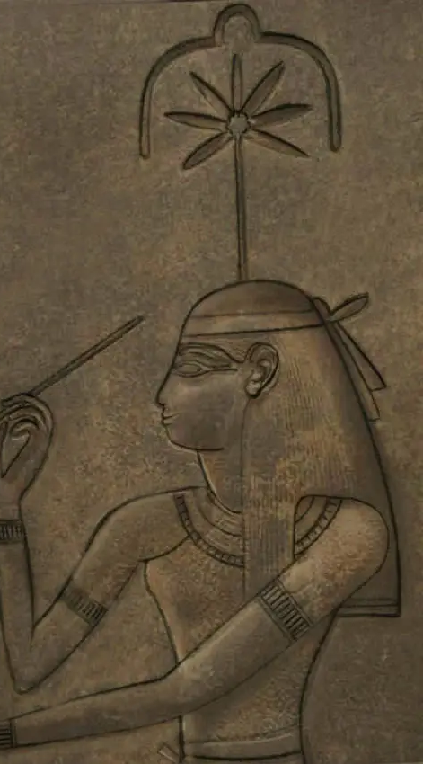
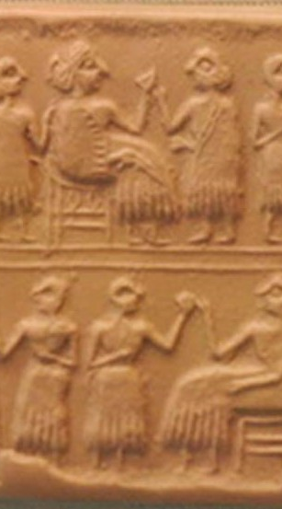
Substance Use is Ancient and Associated with Women
Notes:
Cylinder-seal of the "Lady" or "Queen" (Sumerian NIN) Puabi, one of the defuncts of the Royal Cemetery of Ur, c. 2600 BC. Banquet scene, typical of the Early Dynastic Period.
Minoan Poppy Goddess 1300 BCE

Slide 3
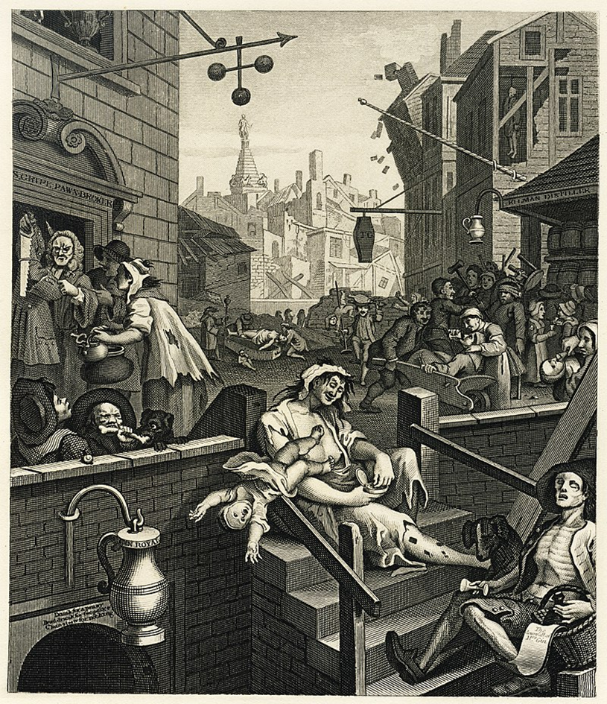
Addiction is Modern, an (side) effect of Modernity, Initially associated with Women
William Hogarth’s Gin Lane 1751
Notes:
Corresponds with development of capitalism – and alienation

Slide 4
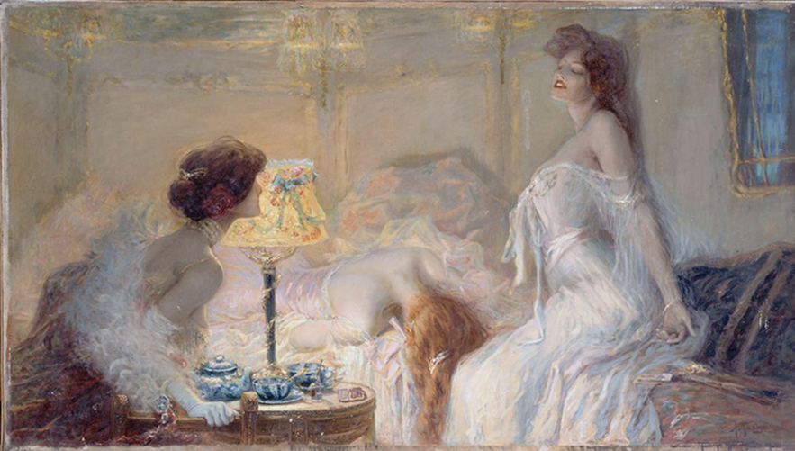
The First Opioid Crisis
Notes:
Alcohol first crisis – opioids second – and opioid addiction was a condition associated primarily w women

Slide 5
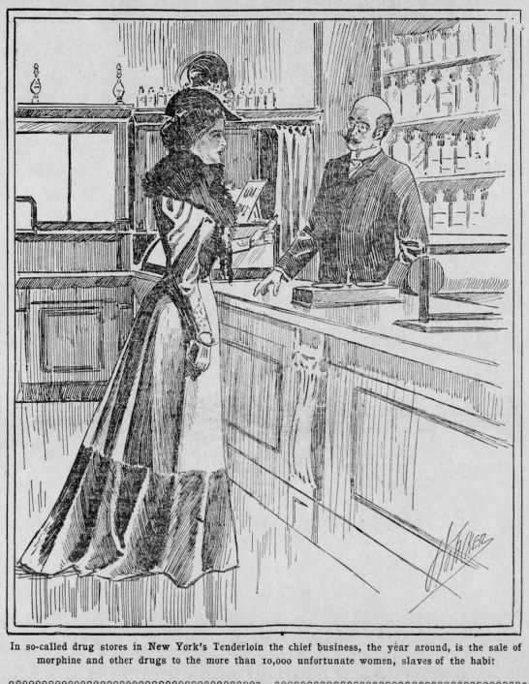
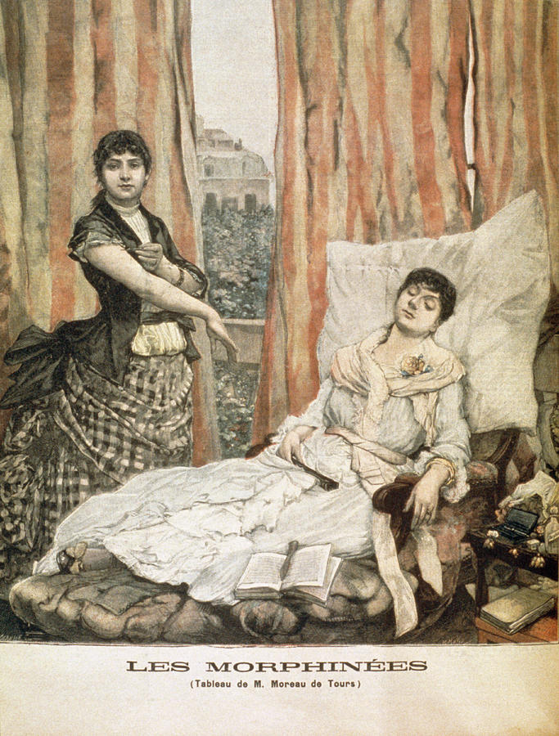
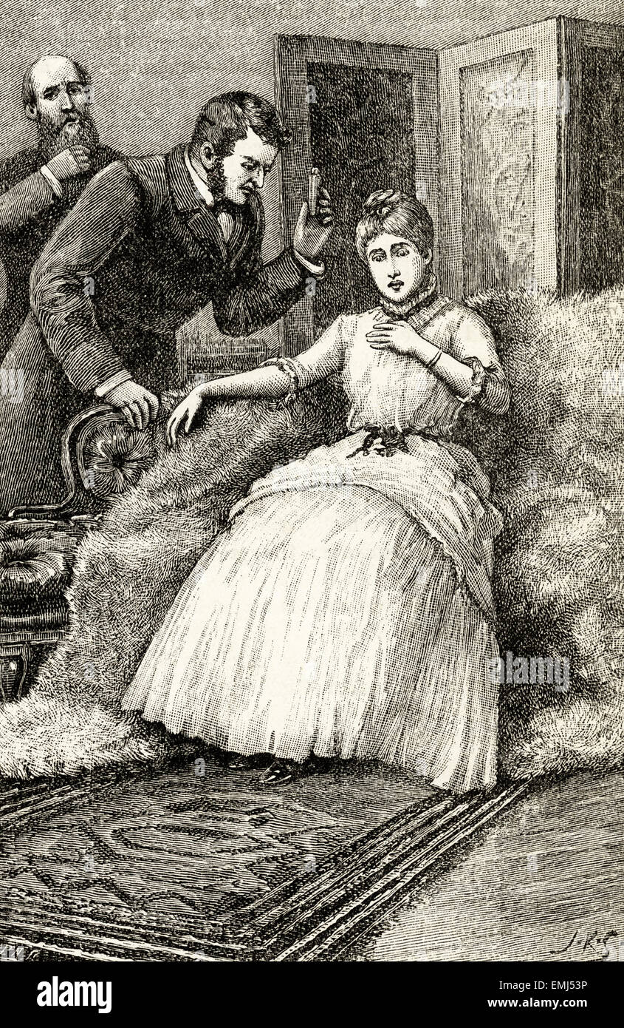
The Origin of the Modern Concept of Addiction (and the Establishment of Medical Authority)
Notes:
Not only does the modern concept and practice of addiction medicine emerge in this era, but we also can see the early establishment of medical authority
In the negotiation of iatrogenic dependence between the lying woman who is addicted to opioids and the male physician who enters into the private domestic space of the home – the traditional locus of female authority- we see
the beginning of the medical regulation of domestic and behavioral practices, the changing site of patriarchal authority from the male head of the household to first the doctor and then the state

Slide 6
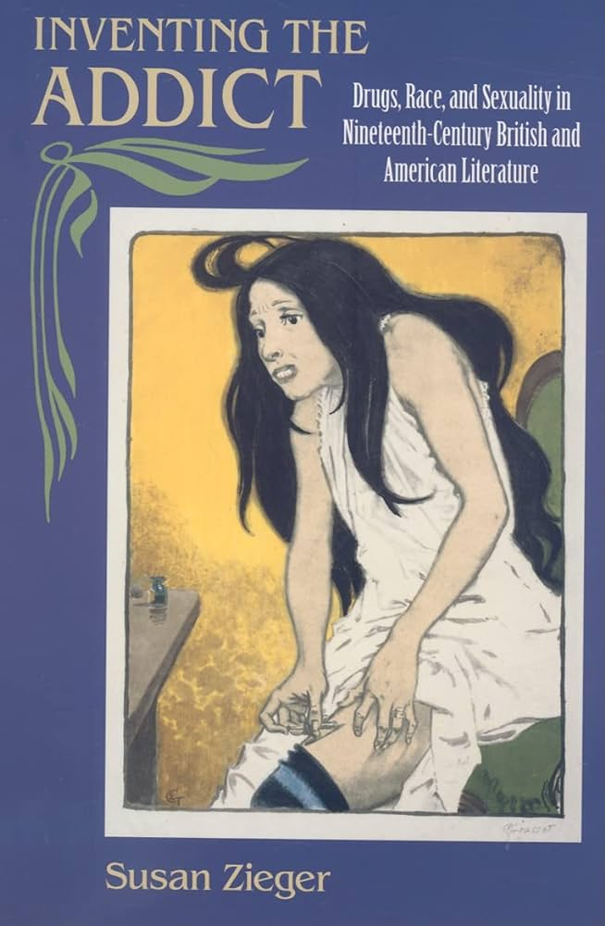
Women, Wealth, Consumerism, Alienation, Drugs, and Suffering
“ Women moved from the role of long-suffering drunkard’s wife into the discursive locus of a frightening modern self-reflection”
“Morphine had become a powerful symbol of the dilemmas over women’s roles and of this ambiguous meaning of their freedom”
Notes:
Addiction initially seen as proof of the weakness of women – their “self-pleasuring” disqualified them from political representation, the work of fiction helped to identify addiction as emerging from the disconnect between a changing society in conflict with fixed gender roles – Addiction is a symptom of social dis-eases to be addressed by suffrage

Slide 7
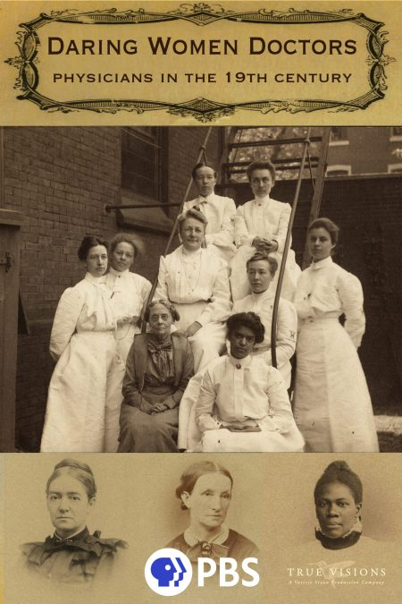
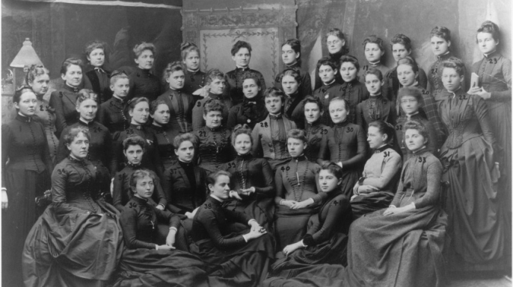
The First Era of Women Physicians
Notes:
Though men cared for wealthy white women – this is the first era of women physicians – who worked predominantly with the poor, with working women and their children, And whose presence was seen as a threat

Slide 8
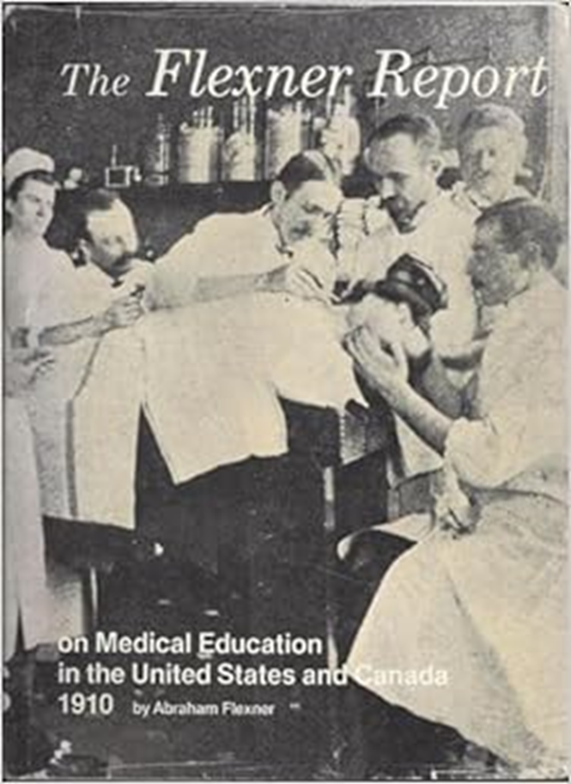
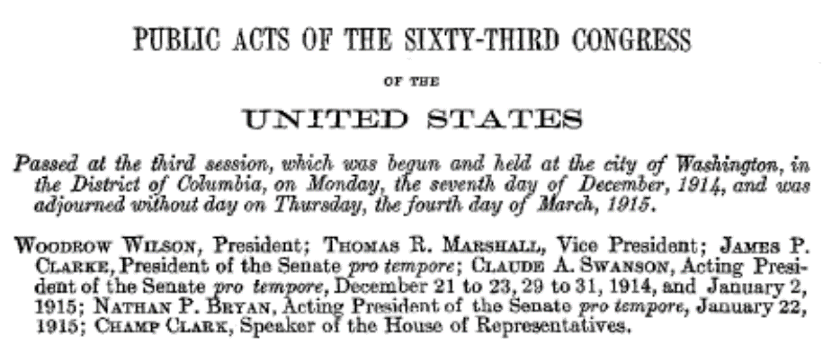
Addiction: 19th to 20th Century
19th Century
20th Century
Medical
and
Public Health
Women
White
Upper SES
Criminal Legal
Men
Non-White
Lower SES
Notes:
Shift in both who the person w addiction is and a shift in providers – the establishment of prohibitionist drug policy (Harrison narcotics)
ALSO - a consolidation of white male medical authority following publication of the Flexner report – women’s medical colleges, HBCUs, midwives

Slide 9
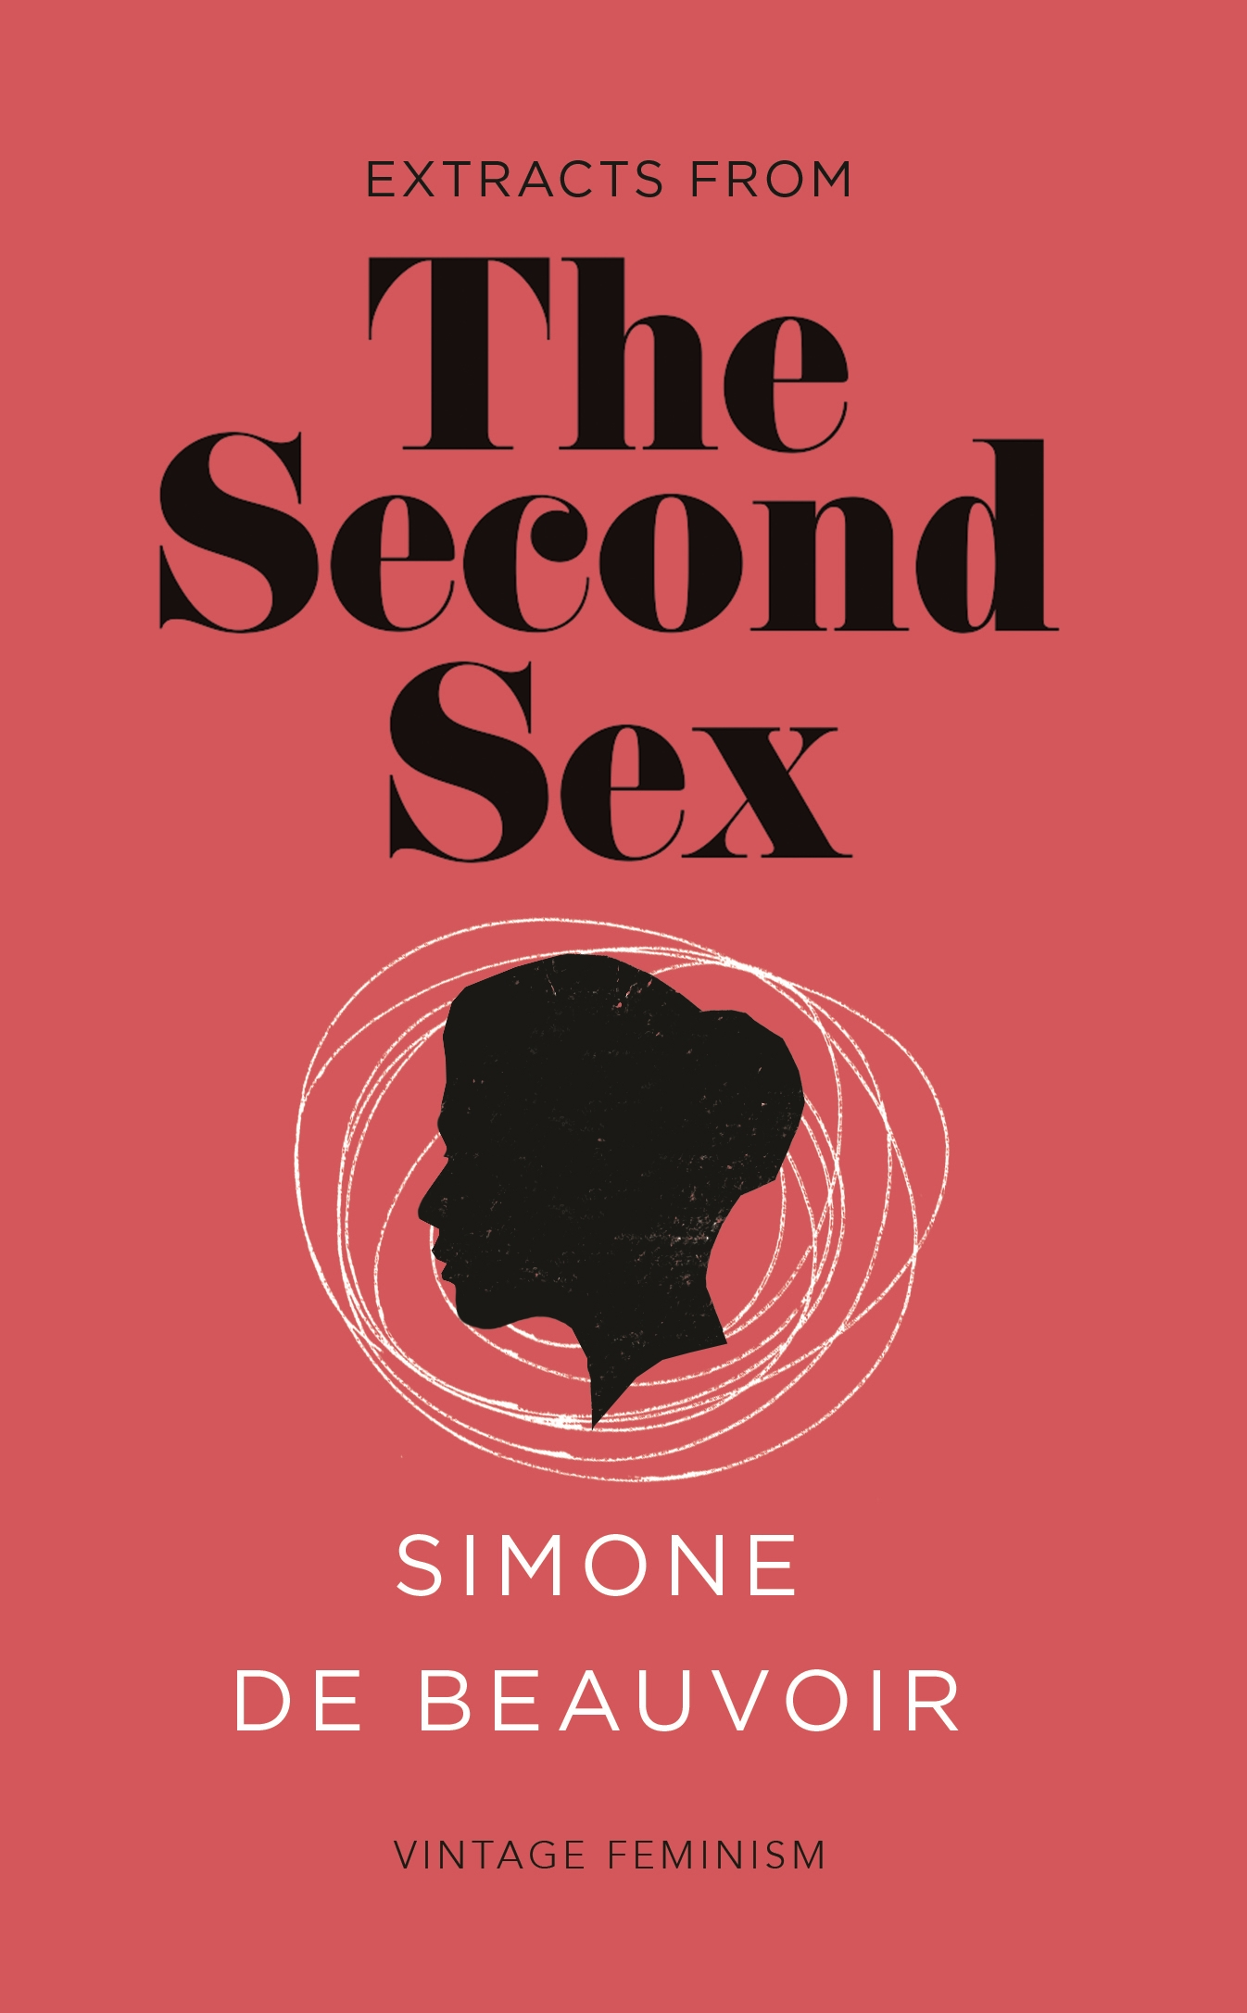
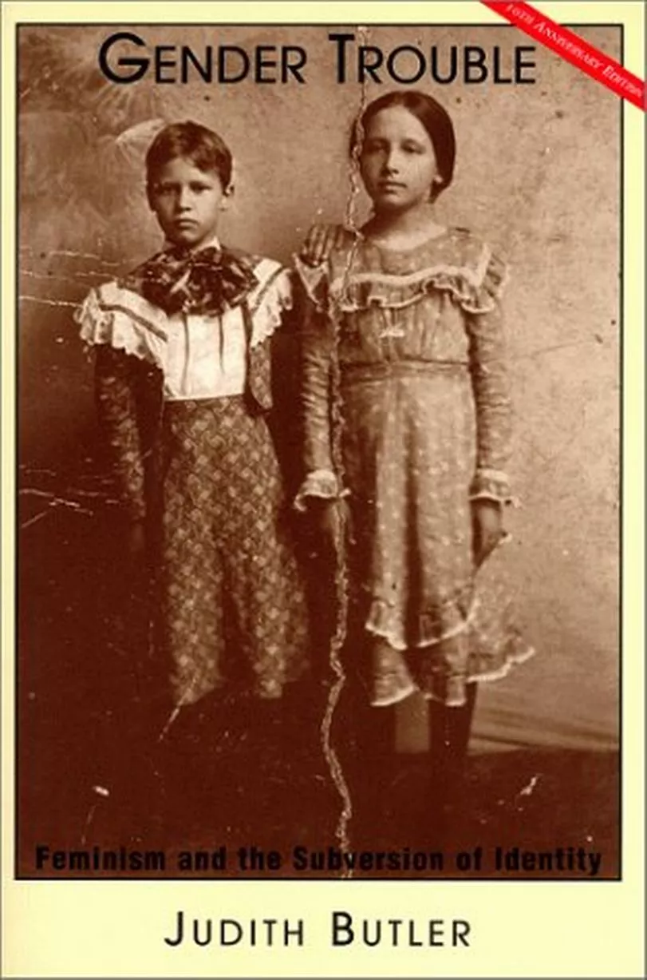
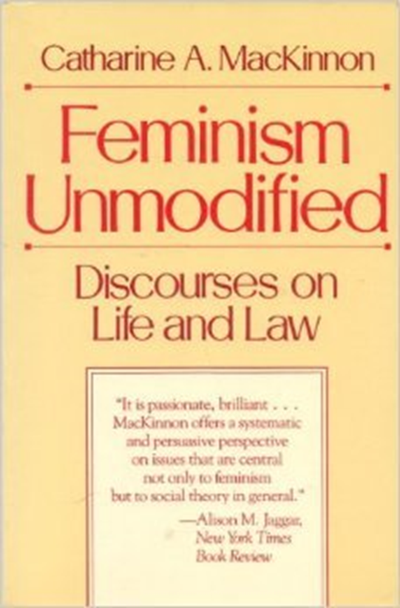
Gender (and Power)
“One is not born but becomes a woman”
Gender “performative”, reproduced (and changed) through speaking and doing
Gender “a system of social hierarchy and imposed inequality of power”
Notes:
Gender is more than gender identify – consists of social roles, norms, relations, and especially relations of power.
Simone de Beauvoir : “One is not born but becomes a woman”
Judith Butler: Gender is “performative”, reproduced (and changed) through ways of speaking and doing
Catharine MacKinnon: discussed how viewing gender as a matter of sameness and difference – covers up the reality of Gender which is “a system of social hierarchy and imposed inequality of power.”
“Political system of male dominance and female subordination that sexualizes power for men and powerlessness for women – how male supremacy gives women a survival stake in the system that destroys them.”

Slide 10
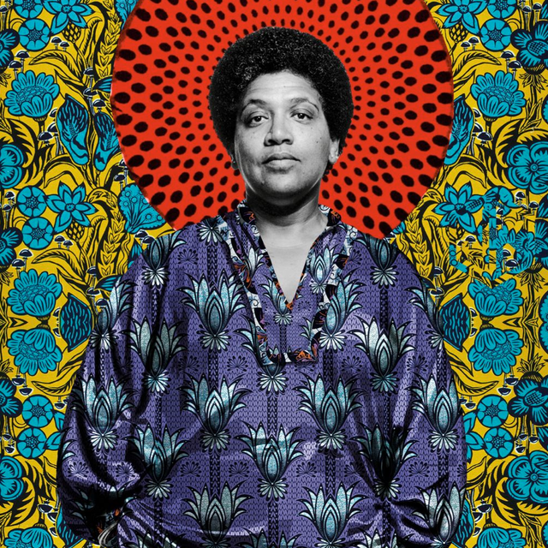
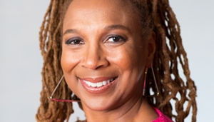
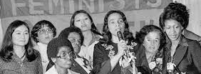
Notes:
This observation that women might partially benefit from a system that destroys them was much further developed by Black feminists, both the Combahee River Collective, (Angela Davis, not pictured) all noted that White women, though oppressed within the patriarchy are privileged in racial hierarchies, which Audre Lord expanded to include other oppressed identities such as class and sexual orientation, all of which comes together brilliantly in the seminal work of Kimberley Crenshaw as intersectionality

Slide 11
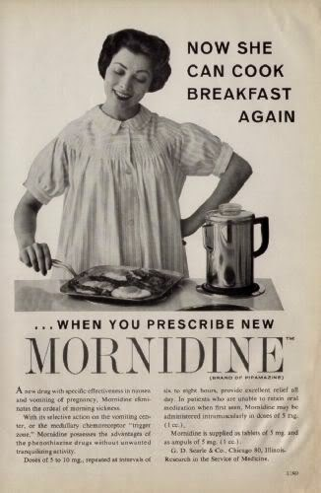
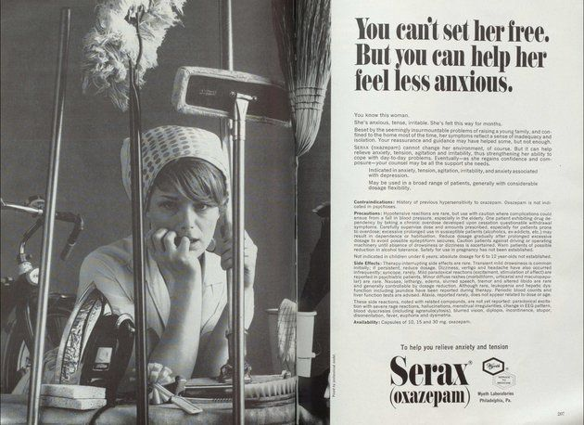
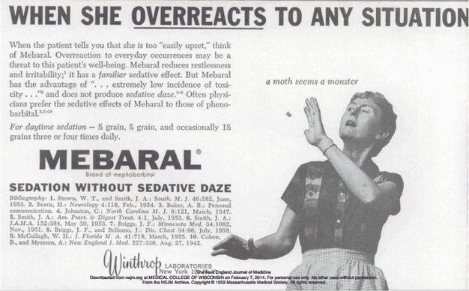
20th Century: Prescribing for the Patriarchy
Notes:
Intersectionality helps us understand the past - As medical authority organizes around white male supremacy in the 20th century, reaction depends upon what kind of woman
For white women … not in workforce, economically dependent upon men, who are experiencing stifling gender roles, their experiences of discrimination were transformed into medical diagnoses and managed by the house of medicine with psychoactive medications

Slide 12
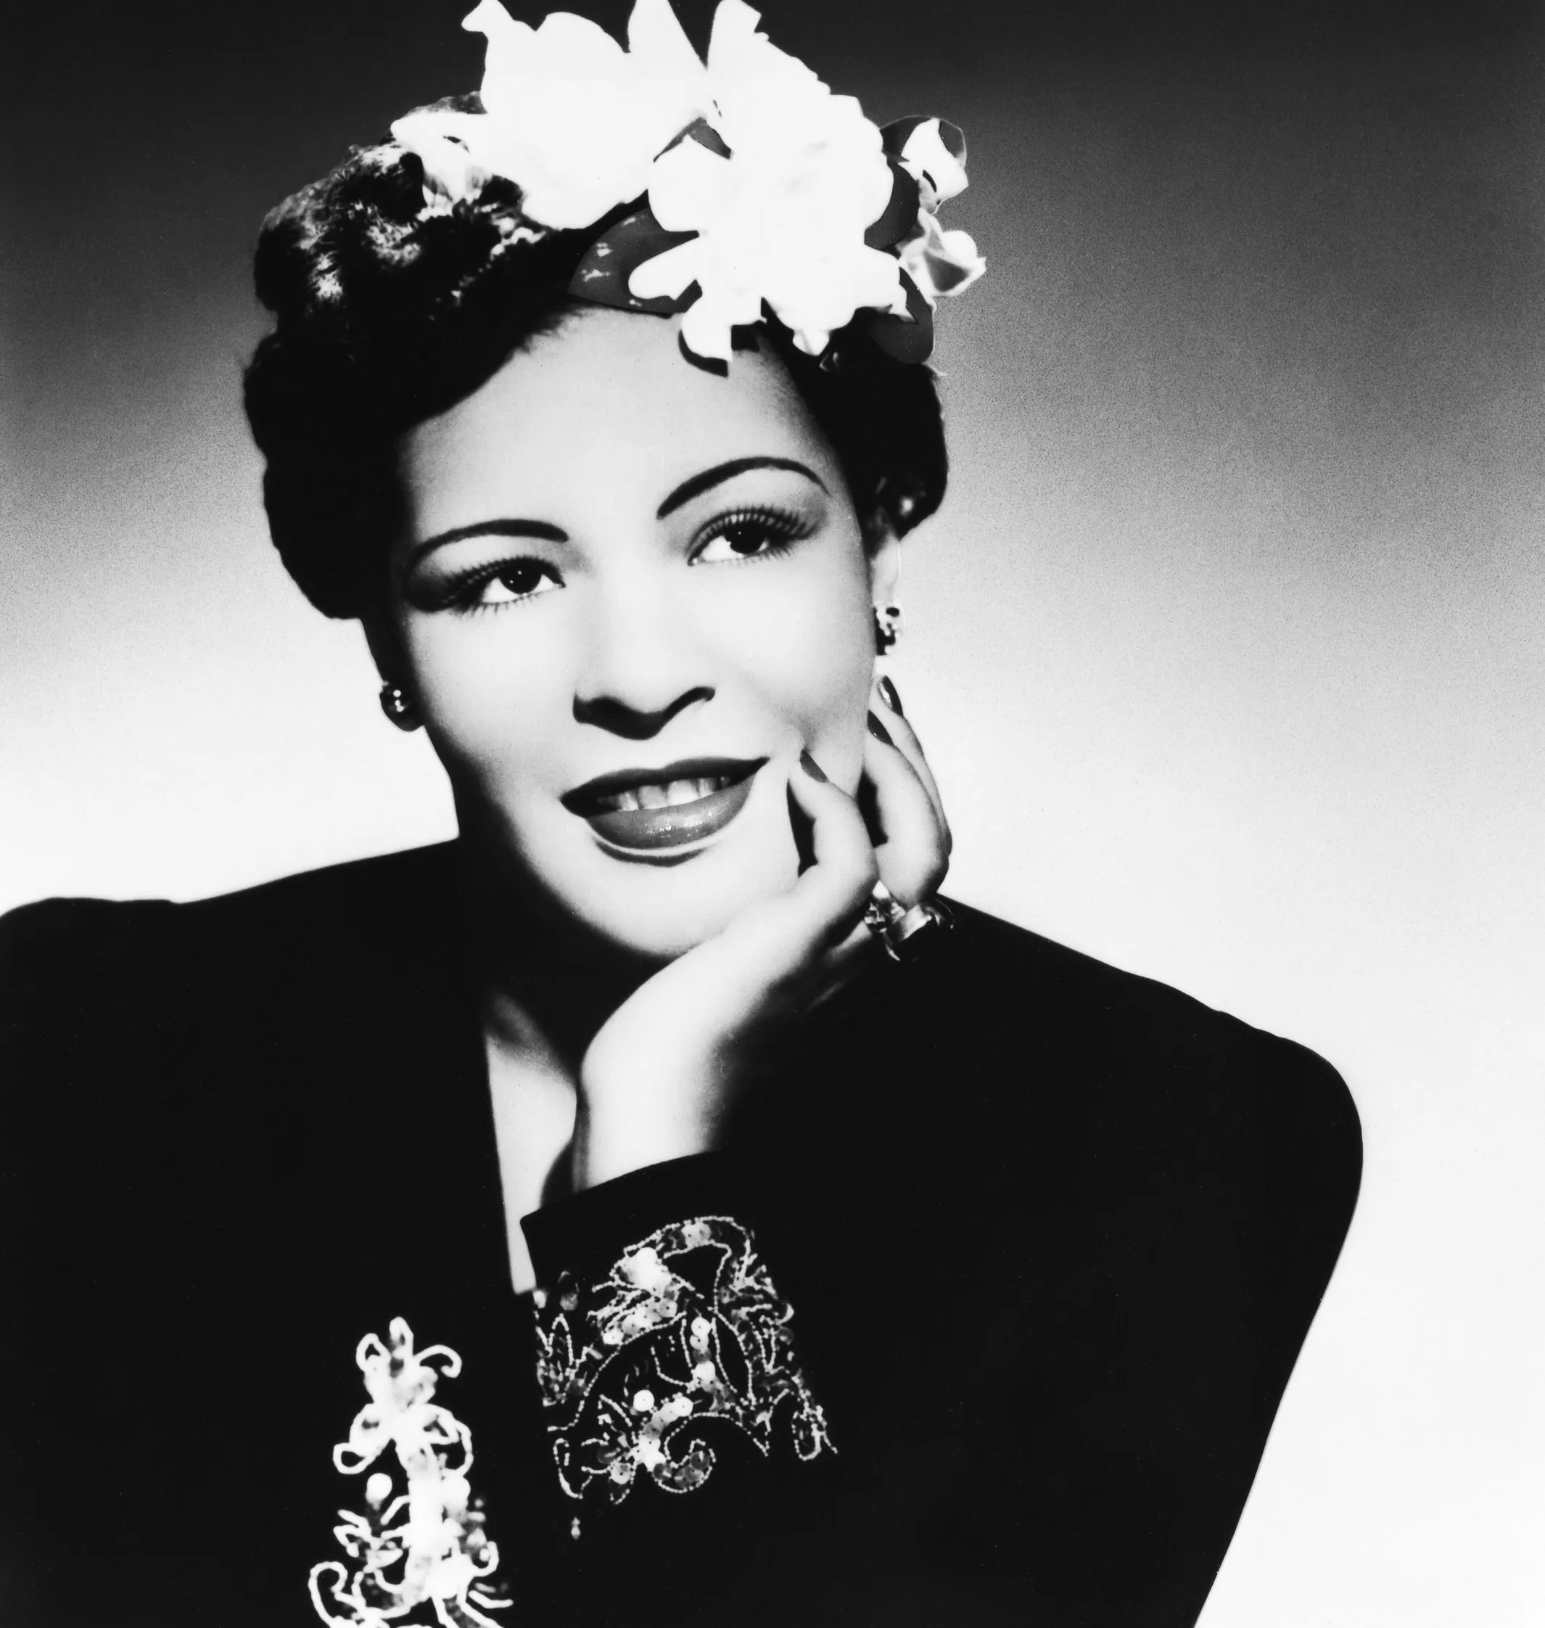
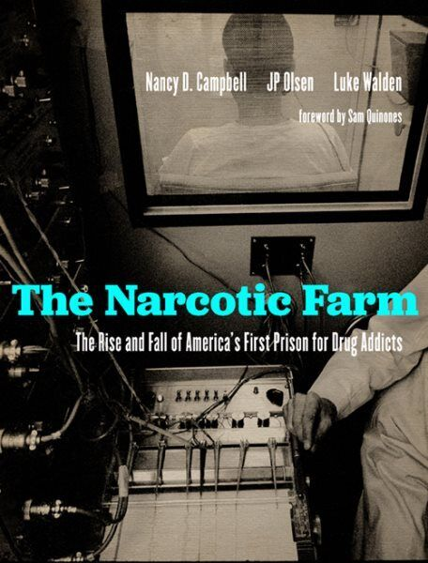
Addiction and Addiction Medicine, 20th Century
Notes:
For people who self-managed their alienation, especially by illegal drugs, people who were poor, non-white, they were criminalized, and might have been sent to the “public health prison”
Billie Holiday - The person who typifies a lifecourse of gender-based violence, experiences of racism and sexism, dismissal by health professionals, and who was literally hounded to her death by policing authorities yet produced some of the most enduring and outstanding art of the era

Slide 13
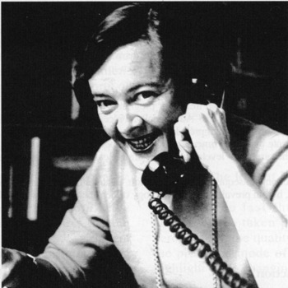
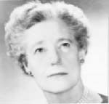
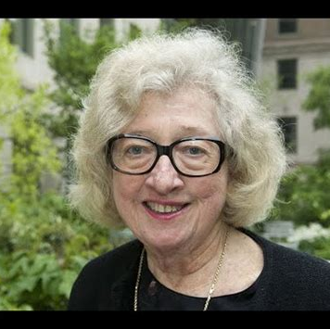
Addiction Medicine emerges from the work of Women
Notes:
Addiction Medicine, as the field we know today, emerges in this period of health system neglect and criminalization – and most of the pioneers of our field were women
We all know Ruth Fox, Mary Jeanne Kreek, Marie Nyswander

Slide 14
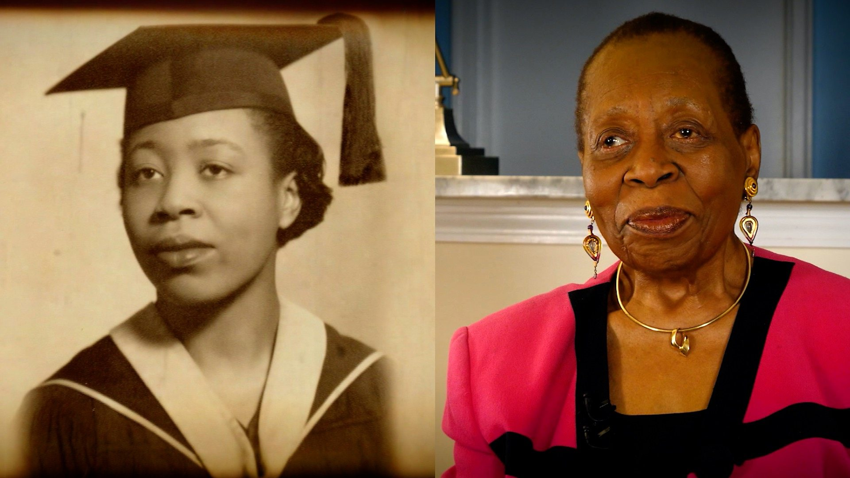
Dr Melissa Freeman: First to treat a woman with methadone
Notes:
One of 5 women to graduate from Howard in 1955 (?) – partnered w Dole and Nyswander in NYC – providing clinical care for people with OUD, still practicing today and
Unjustly unrecognized in the history of our field
https://amsterdamnews.com/news/2018/01/11/dr-melissa-freeman-granddaughter-slave-front-lines/

Slide 15
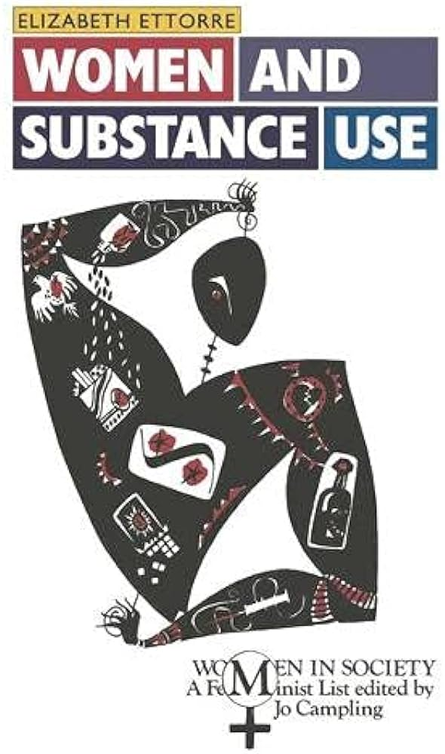
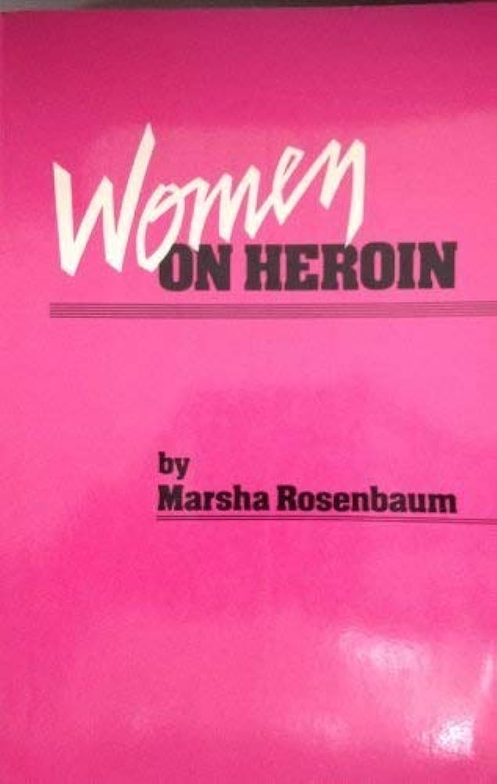
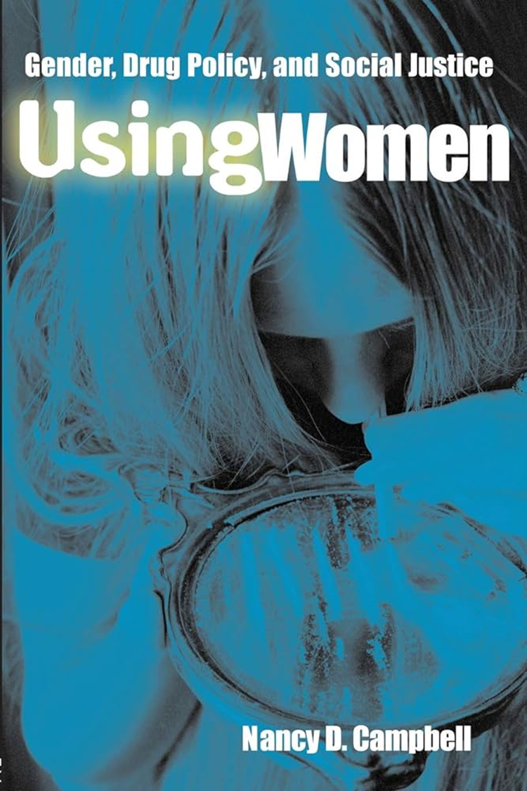
Gender and Drugs in the Late 20th Century:
Stereotype and Structure Unchanged
Notes:
Despite the development of addiction medicine (again work done more by women than men) – the focus of addiction medicine was more on men than on women
Following the advances of the second wave of feminism, Title 9 esp, doors opening for women in the halls of higher learning, and we have Golden age of research on women and drugs
Critical research from philosophy, ethnography and history all land at same place or worse from depiction of women who use drugs from the late 1880s:
Treatment: women continue to find themselves in male-dominated, sexist, “therapeutic settings” – experienced voyeurism, ridicule, sexual harassment, even assault
Ettore reflected: “the situations and needs of women were largely unacknowledged and unrecognized within both the treatment and the research world” – the study of female addiction a “non-field”

Slide 16
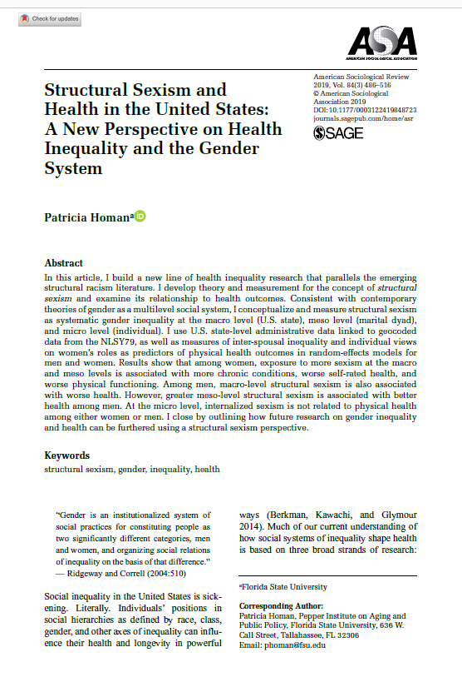
If sexism served no function, it would be easy to eliminate
Notes:
The reason for persistent gendered inequities lies in structural relations – Trish Homan
Gender = “multi level social system” Structural Sexism: Systemic gender inequality at macro level (US, State), meso level (marital dyad), and micro level (individual)
Resonates w Nancy Krieger ecosocial analysis of discrimination more broadly – not just legal or interpersonal but institutional structures of relations – dominance and oppression
To paraphrase n Krieger – if sexism served no function – it would be easy to eliminate

Slide 17
Addiction and the Current Opioid Crisis:
What happened to Gender?
19th Century
20th Century
21st Century
Medical
and
Public Health
Women
White
Upper SES
Criminal Legal
Men
Non-White
Lower SES
Medical
and
Public Health
Universalizing Language – of Sameness, of
Whiteness
Notes:
Paradigm shift
Universalizing language whitewashes race, erases gender, and is silent on intersectionality
Language that does not recognize structural inequities and a language that accepts rather than challenges the status quo
It is the status quo that makes us sick

Slide 18


Return to the Bedside
CDC
NIH
Notes:
Return to the parable – origin of both addiction medicine and medical authority in the Victorian era
What has changed – patient more likely to be a man, provider more likely to be a woman, and we meet not in a home but in a clinic reflecting the expanse of the structure of medicine and its authority
To cite Historian Anne Blaschke, Children of title 9 – promised equality – only to run up against persistent structural sexism

Slide 19
What are Women?
Notes:
What are women – this question is important –If we think gender is about identity, just about sameness or difference, if we think that women are little men, or men who sometimes menstruate, men who can reproduce, we neglect recognition of power and oppression and how the exercise of an uncritical medical authority supports the status quo
We need to be critical of the medicalization of human behavior, how medicine, as a normative field, structures and reinforces specific modes of being, “disciplines” bodies to “perform” gender through our therapeutic enterprise

Slide 20
“Objectivity” and the Scientific Subject
Fowler, “Imaging the addicted human brain” 2007
Notes:
If we don’t critically examine gender, we will continue to reproduce both the male bias of the neutral “objective gaze” and the assumptions of (White heteronormative man) research subject
We will continue to individualize complex social phenomena at the bedside and neglect attention to relations
Addiction medicine as a field is ahistorical, individualized and hence divorced from understandings of society of power and oppression

Slide 21
We are asking the wrong questions
Notes:
One of the great pleasures of addiction medicine is that it reflects the universe – in our work both clinical and research we witness: poverty, worsening inequities, political repression, commercial exploitation, political destabilization, increasing militarism, and environmental destruction – we are a deeply troubled society and it is making us sick – we are asking the wrong questions

Slide 22
Why addiction becomes us?
Notes:
Though exploration of brain function, medication response, clinical programming are useful – they don’t address the why of addiction
What is it about us, the last 150 years, capitalism, empire, - that aligns – dark alchemy – in addiction

Slide 23
Why addiction becomes us?
Explore the practice of medicine as radical, as transforming rather than reproducing norms
Rethink equality NOT as a project of sameness or difference
Imagine life after patriarchy
Listen to and learn from women who use drugs, their lived experiences, their embodied knowledge, and that of providers who are women; explore disparate academic fields, get uncomfortable with feminist philosophy and queer theory to ask better questions, to provide better care
Notes:
Embodied knowledge

Slide 24
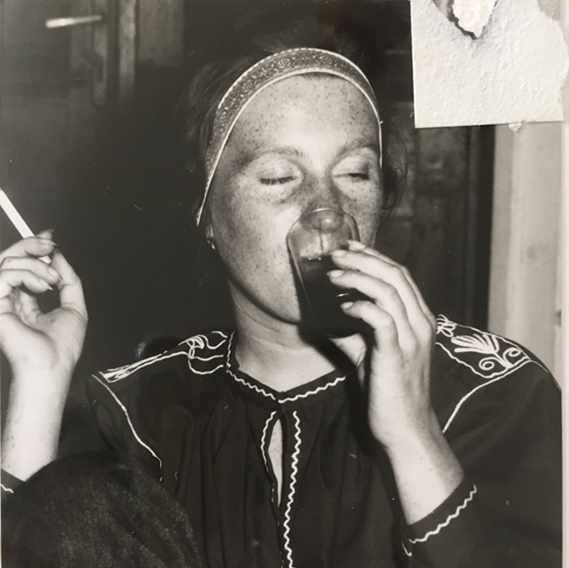
Thank you
Mishka Terplan
@Do_Less_Harm
mterplan@friendsresearch.org
Notes:
End with an observation – most forms of discrimination emerge initially from the unknown – we live in a society segregated in part by race and class – yet almost all are born to women, almost all grow up in intimate environments with mothers, aunts, sisters, many of us live and work our entire lives surrounded by women – yet male supremacy, though not a human cultural universal, the dehumanization of women, remains all too common

