Slide 1
Telemedicine Hotline to Improve Access to Medications for Opioid Use Disorder — Illinois and MAR NOW

Slide 2
Learning Objectives
Understand the guiding principles of medication-first, low barrier approaches to opioid use disorder (OUD) treatment.
Learn how the Medication Assisted Recovery Now (MAR NOW) model operates and reduces the wait time for access to the medications to treat OUD for patients in Illinois.
Gain information on how MAR NOW may be used to link patients struggling with opioid use to medications for the treatment of OUD.

Slide 3
MAR NOW launched May 9, 2022 as a Chicago Pilot
Expanded Sept. 1, 2022 Statewide
Funded by Chicago Department of Public Health (CDPH) and Illinois Department of Human Services Division of Substance Use Prevention and Recovery (IDHS/SUPR)
Operated by Family Guidance Centers, Inc. (FGC). FGC provides methadone, buprenorphine, and naltrexone at their Chicago and statewide clinics.
Operates through the existing 24/7 IL Helpline for Opioids and Other Substances: 833-234-6343
Provides low-barrier, rapid access to buprenorphine, methadone, and naltrexone to all callers regardless of insurance status, income, ability to pay, or documentation status.

Slide 4
Program provides access to medication within 48 hours of first call
Patient Options:
Buprenorphine home induction
Same or next-day MAR appointment at FGC (methadone, buprenorphine, naltrexone)
Connection to other SUD care in the community (withdrawal management, residential treatment)
Individual calls 24/7 IL Helpline for OUD treatment, withdrawal support
IL Helpline directly transfers caller to MAR NOW Care Manager
24/7 Access
Connected to Care Manager & Provider
Care Managers provide free transportation, insurance enrollment, assistance with pharmacy access, and follow up to ensure patient is connected to long-term care

Slide 5
Hub and spoke model to ensures connection to ongoing community care
MAR NOW works closely with pharmacies to ensure that they have medications available and are able to assist patients
Mental health providers
Pharmacies
Mental health, primary care, and harm reduction services are key referral points to and from MAR NOW
Harm reduction providers
MAR NOW
Primary care providers
All patients connected to outpatient MAR for long-term treatment in the community
Cook County Jail
Program is working closely with jail and homeless shelter providers to offer linkage to MAR NOW
Community MAR providers
Homeless shelters and encampment outreach
Patients that leave treatment can come back to MAR NOW and be connected again to treatment in the community. MAR NOW can also serve as a bridge clinic for patients waiting for care.

Slide 6
Initial Program Data & Learnings

Slide 7
Initial data indicates program model successfully connects patients to care
May 9, 2022 – August 4, 2024: MAR NOW Call Data | Number | Percent of Total
Calls from patients seeking OUD care | 2618
Patients seeking methadone | 383 | 14%
Patients seeking buprenorphine | 2118 | 81%
Patients seeking vivitrol | 6 | .2%
Patients seeking withdrawal management w/ medical stabilization on MAR | 66 | 3%
Patients seeking residential treatment | 45 | 1.8%
Patient Connection Data
Methadone patients attended first appointment | 310 | 81%
Buprenorphine patients connected to medication | 1994 | 94%
Vivitrol patients attended first appointment | 3 | 50%
Withdrawal management & medical stabilization patients who showed at appointment | 64 | 97%
Residential treatment patients who showed at appointment | 42 | 93%
Connection to care is high across all treatment options.
Patients connected to withdrawal management and medical stabilization are also connected to FGC's mobile van and MAR.

Slide 8
Initial data indicates program model successfully starts patients on medications and connects patients to care in the community
May 9, 2022 – August 4, 2024: Buprenorphine Patient Data
 | Number | Percent of Total
Calls from patients seeking buprenorphine | 2118
Buprenorphine patients connected to medication | 1994 | 94%
Patients connected to medication that received home induction | 1897 | 95%
Patients connected to medication that received in-person induction | 97 | 5%
Home induction patients connected to a community provider for ongoing care | 1873 | 99%
Home induction patients that experienced adverse events during induction | 2 | 0.1%
Home induction patients terminated from care due to suspicions of misuse or diversion | 0 | 0%
*Note: connection to care pending for recent callers, data current as of August 4, 2024
FGC physicians provide a 14-day prescription for home induction, after which patients are connected to a community provider.

Slide 9
Initial data demonstrates home induction is safe and effective
May 9, 2022 – August 4, 2024: Buprenorphine Patient Data
 | Number | Percent of Total
Calls from patients seeking buprenorphine | 2118
Buprenorphine patients connected to medication | 1994 | 94%
Patients connected to medication that received home induction | 1897 | 95%
Patients connected to medication that received in-person induction | 97 | 5%
Home induction patients connected to a community provider for ongoing care | 1873 | 99%
Home induction patients that experienced adverse events during induction | 2 | 0.1%
Home induction patients terminated from care due to suspicions of misuse or diversion | 0 | 0%
*Note: connection to care pending for recent callers, data current as of August 4, 2024
FGC physicians provide a 14-day prescription for home induction, after which patients are connected to a community provider.

Slide 10
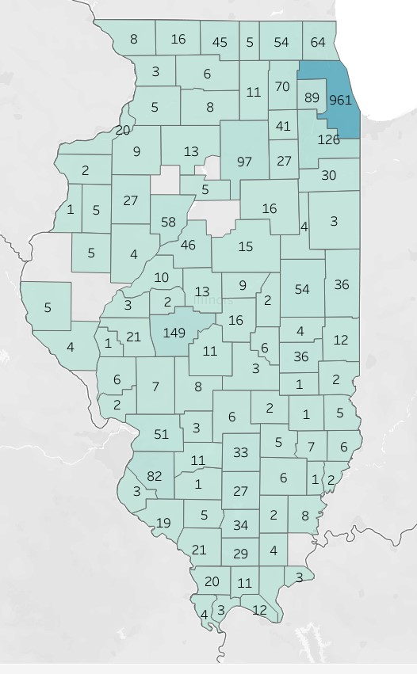
Helpline Calls Transferred to MAR Now
Data is from
May 2022 – September 20th, 2024
County | Transferred Calls
Adams | 5
Alexander | 4
Bond | 3
Boone | 5
Bureau | 13
Carroll | 3
Cass | 3
Champaign | 54
Christian | 11
Clark | 2
Clay | 5
Clinton | 11
Coles | 36
Cook | 961
Crawford | 5
Cumberland | 1
DeKalb | 11
DeWitt | 9
Douglas | 4
DuPage | 89
Edgar | 12
Edwards | 1
Effingham | 2
Fayette | 6
Ford | 4
Franklin | 34
Greene | 6
Grundy | 27
County | Transferred Calls
Hardin | 3
Henderson | 1
Henry | 9
Iroquois | 3
Jackson | 21
Jasper | 1
Jefferson | 27
Jersey | 2
Jo Daviess | 8
Johnson | 11
Kane | 70
Kankakee | 30
Kendall | 41
Knox | 27
Lake | 64
LaSalle | 97
Lawrence | 6
Lee | 8
Livingston | 18
Logan | 13
Macon | 16
Macoupin | 7
Madison | 51
Marion | 33
Marshall | 5
Mason | 10
Massac | 12
McDonough | 5
McHenry | 54
County | Transferred Calls
McLean | 15
Menard | 2
Mercer | 2
Monroe | 3
Montgomery | 8
Morgan | 21
Moultrie | 6
Ogle | 6
Peoria | 58
Perry | 5
Piatt | 2
Pike | 4
Pope | 1
Pulaski | 3
Randolph | 19
Richland | 7
Rock Island | 20
Saline | 4
Sangamon | 149
Scott | 1
Shelby | 3
St. Clair | 82
Stephenson | 16
Tazewell | 46
Union | 20
Vermilion | 36
Wabash | 2
Warren | 5
Wayne | 6
County | Transferred Calls
White | 8
Whiteside | 5
Will | 126
Williamson | 29
Winnebago | 45
Unknown | 1,987

Slide 11
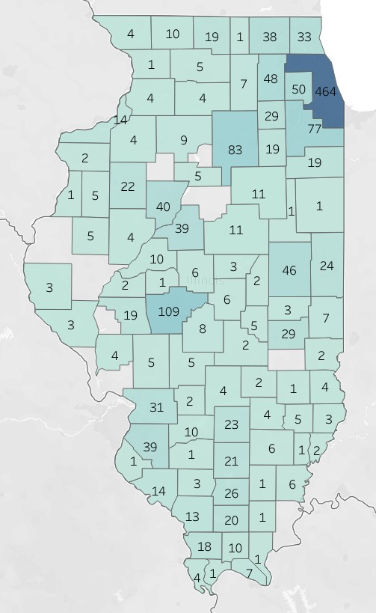
Helpline Calls Transferred to MAR Now for Callers Seeking Buprenorphine Services
Data is from
May 2022 – September 20th, 2024
County | Transferred Calls
Ford | 1
Franklin | 26
Fulton | 4
Greene | 4
Grundy | 19
Hamilton | 1
Henderson | 1
Henry | 4
Iroquois | 1
Jackson | 13
Jasper | 1
Jefferson | 21
Jo Daviess | 4
Johnson | 10
Kane | 48
Kankakee | 19
Kendall | 29
Knox | 22
Lake | 33
LaSalle | 83
Lawrence | 3
Lee | 4
Livingston | 11
County | Transferred Calls
Logan | 6
Macon | 6
Macoupin | 5
Madison | 31
Marion | 23
Marshall | 5
Mason | 10
Massac | 7
McDonough | 5
McHenry | 38
McLean | 11
Mercer | 2
Montgomery | 5
Morgan | 19
Moultrie | 5
Ogle | 5
Peoria | 40
Perry | 3
Piatt | 2
Pike | 3
Pope | 1
County | Transferred Calls
Pulaski | 1
Randolph | 14
Richland | 5
Rock Island | 14
Saline | 1
Sangamon | 109
Shelby | 2
St. Clair | 39
Stephenson | 10
Tazewell | 39
Union | 18
Vermilion | 24
Wabash | 2
Warren | 5
Wayne | 6
White | 6
Whiteside | 4
Will | 77
Williamson | 20
Winnebago | 19
County | Transferred Calls
Adams | 3
Alexander | 4
Bond | 2
Boone | 1
Bureau | 9
Cass | 2
Champaign | 46
Christian | 8
Clark | 2
Clay | 4
Clinton | 10
Coles | 29
Cook | 464
Crawford | 4
DeKalb | 7
DeWitt | 3
Douglas | 3
DuPage | 50
Edgar | 7
Effingham | 2
Fayette | 4

Slide 12
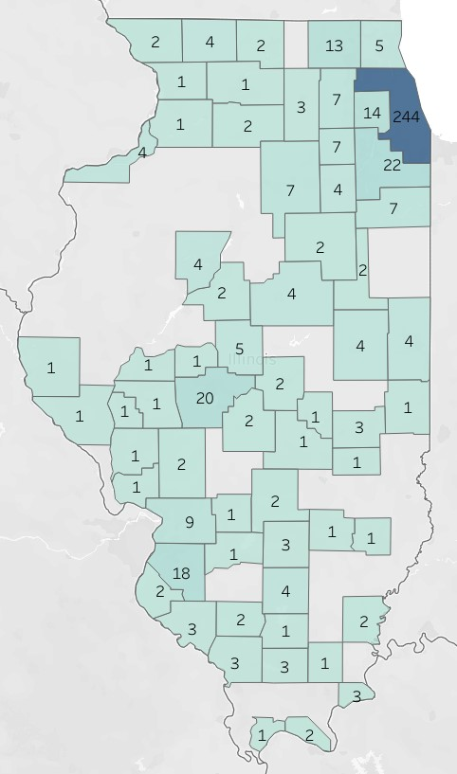
Helpline Calls Transferred to MAR Now for Callers Seeking Methadone Services
Data is from
May 2022 – September 20th, 2024
County | Transferred Calls
Adams | 1
Bond | 1
Carroll | 1
Cass | 1
Champaign | 4
Christian | 2
Clay | 1
Clinton | 1
Coles | 3
Cook | 244
Cumberland | 1
DeKalb | 3
DuPage | 14
Fayette | 2
Ford | 2
Franklin | 1
Grundy | 4
Hardin | 3
Jackson | 3
Jefferson | 4
Jersey | 1
County | Transferred Calls
Kane | 7
Kankakee | 7
Kendall | 7
Lake | 6
LaSalle | 7
Lee | 2
Livingston | 2
Logan | 5
Macon | 2
Macoupin | 2
Madison | 9
Marion | 3
Massac | 2
McHenry | 13
McLean | 4
Menard | 1
Monroe | 2
Moultrie | 1
Ogle | `1
Peoria | 4
Perry | 2
County | Transferred Calls
Pike | 1
Pulaski | 1
Randolph | 3
Rock Island | 4
Saline | 1
Sangamon | 20
Scott | 1
Shelby | 11
St. Clair | 18
Stephenson | 4
Tazewell | 2
Vermilion | 4
White | 2
Whiteside | 1
Will | 22
Williamson | 3
Winnebago | 2

Slide 13
Early Learnings
Providing transportation to clinic appointments and pharmacies lowers barriers to care and increases first appointment attendance rate
Concerted outreach to pharmacies is required to ensure that buprenorphine is available and pharmacists will fill prescriptions
Patients often need intensive follow-up from Care Managers to ensure they can make it to their first appointment.
Operating through the existing IL Helpline for Opioids and Other Substances provides baseline patient demand, aligns City and State efforts, streamlines expansion of program statewide, and allows for patient data matching to capture more information on demographics
Calls for withdrawal management and residential treatment are common, and provide opportunity for education around buprenorphine treatment.

Slide 14
Telebuprenophine Research
Aronowitz, Shoshana V et al. “Telehealth for opioid use disorder treatment in low-barrier clinic settings: an exploration of clinician and staff perspectives.”Harm reduction journal vol. 18,1 119. 25 Nov. 2021.
Clark, Seth A., et al. "Using telehealth to improve buprenorphine access during and after COVID-19: A rapid response initiative in Rhode Island. "Journal of Substance Abuse Treatment124 (2021): 108283.
Eibl, Joseph K., et al. "The effectiveness of telemedicine-delivered opioid agonist therapy in a supervised clinical setting. "Drug and AlcoholDependence176 (2017): 133-138.
Guille, Constance et al. “Treatment of Opioid Use Disorder in Pregnant Women via Telemedicine: A Nonrandomized Controlled Trial.”JAMA network open vol. 3,1 e1920177. 3 Jan. 2020.
Harris, Robert et al. “Utilizing telemedicine during COVID-19 pandemic for a low-threshold, street-based buprenorphine program. ”Drug and alcohol dependence vol. 230 (2022): 109187.
Nordeck, Courtney D et al. “Adapting a Low-threshold Buprenorphine Program for Vulnerable Populations During the COVID-19 Pandemic.” Journal of addiction medicine vol. 15,5 (2021): 364-369.
Samuels, Elizabeth A et al. “Innovation During COVID-19: Improving Addiction Treatment Access.” Journal of addiction medicine vol. 14,4 (2020): e8-e9.
Tofighi, Babak MD, MSc; McNeely, Jennifer MD, MSc; Walzer, Dalia BS; Fansiwala, Kush BA; Demner, Adam MD; Chaudhury, Chloe S. BS; Subudhi, Ipsita BS; Schatz, Daniel MD, MSc; Reed, Timothy MD; Krawczyk, Noa PhD A Telemedicine Buprenorphine Clinic to Serve New York City, Journal of Addiction Medicine: February 05, 2021.
Uscher-Pines, Lori et al. “Health center implementation of telemedicine for opioid use disorders: A qualitative assessment of adopters and nonadopters.”Journal of substance abuse treatment vol. 115 (2020): 108037.
Zheng, Wanhonget al. “Treatment Outcome Comparison Between Telepsychiatry and Face-to-face Buprenorphine Medication-assisted Treatment for Opioid Use Disorder: A 2-Year Retrospective Data Analysis.” Journal of addiction medicine vol. 11,2 (2017): 138-144.

Slide 15
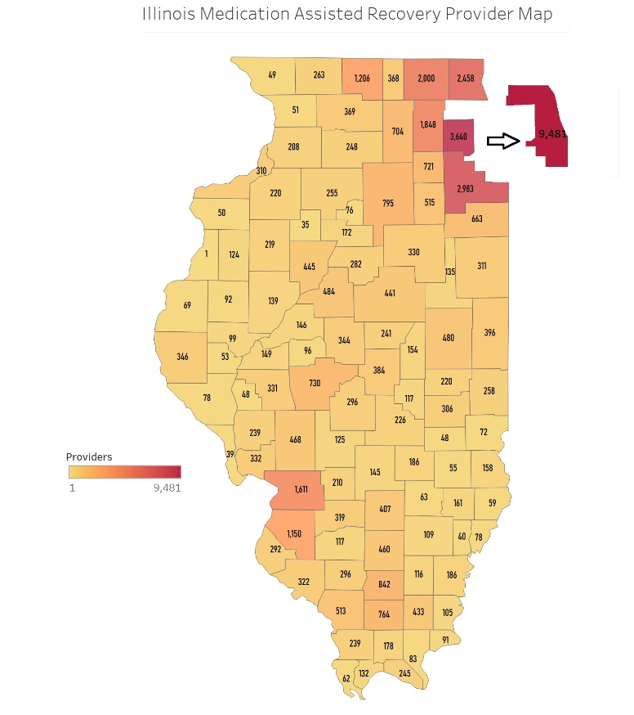
Additional Slides - Information

Slide 16
Case studies demonstrate importance of low-barrier, rapid access to MOUD at hub provider
A 63-year-old individual, confined to a wheelchair, was transferred to MAR NOW by the Illinois Helpline in mid-June at 11am. This caller was seeking methadone services and reported being a Medicaid (County Care) member.
The FGC Care Manager helped the caller arrange to come to an FGC location near their home that same day. The caller arrived shortly after 12:30 pm. and was able to see FGC’s physician and receive their first dose of methadone by 2 pm. They have not missed any doses and are actively participating in counseling services.

Slide 17
Case studies demonstrate importance of low-barrier, rapid access to MOUD at hub provider
A 40 year old female requesting buprenorphine for OUD treatment was connected to MAR NOW through the Illinois Helpline in mid-January. The caller was immediately connected to a FGC Medical Provider and was prescribed buprenorphine. The Care Manager verified they successfully obtained the medication at the pharmacy later that afternoon.
The next morning the Care Manager connected this caller to Cook County Health for ongoing MAR care. Following the warm-hand-off to the spoke provider, the Care Manager received confirmation the individual was able to continue MAR, uninterrupted. During the 2 week follow up call, the caller confirmed that she remains engaged in buprenorphine treatment with Cook County Health.

Slide 18
Case studies demonstrate importance of low-barrier, rapid access to MOUD at hub provider
A 43-year-old male requesting buprenorphine for OUD treatment was connected to MAR NOW by the Illinois Helpline on February 7th. The caller was immediately connected to a FGC Medical Provider and was prescribed buprenorphine. The Care Manager verified they successfully obtained the medication at the pharmacy a few hours later.
The Care Manager arranged a warm hand-off to Southern Illinois University (SIU) to set up ongoing care with a provider close to him. After an initial attempt with a potential provider was unsuccessful, SIU connected the caller to Chestnut Health. Since the appointment for Chestnut Health was going to be after the initial prescription would run out, the caller received a bridge extension through MAR NOW to cover him until his scheduled appointment.

Slide 19
Case studies demonstrate importance of low-barrier, rapid access to MOUD at hub provider
A 49-year-old male was transferred to MAR NOW by the Illinois Helpline in February. He was taken into custody by the Greene County Sheriff’s Department in Carrollton, IL after a court visit earlier that day. The caller reported experiencing withdrawal symptoms and was immediately connected to a medical provider and was prescribed buprenorphine. Within three hours of the initial call, the MAR NOW Care Manager verified that the medication was picked up at the local pharmacy. A Greene County Sheriff Officer also confirmed that they would send the caller home with the MAR NOW phone number to set up ongoing care upon release.
Thirteen days later the individual contacted the MAR NOW Care Manager starting he had been released and was seeking to establish buprenorphine treatment in his community. The caller was uninsured, so the Care Manager facilitated the hand-off to a provider able to support the caller’s treatment and medication with no out-of-pocket cost. The caller also received round-trip Uber Health transportation to the clinic, arranged by the MAR NOW Care Manager.

