Slide 1
Telemedicine Treatment Retention Characteristics from REACH, a Low Barrier, Community-Based Buprenorphine Clinic in Upstate
New York
Judith Griffin, MD
AMERSA
November 2, 2023

Slide 2
Land Acknowledgement
REACH Medical resides on the traditional homelands of the Gayogo̱hó꞉nǫ' (the Cayuga Nation). The Gayogo̱hó꞉nǫ' are members of the Haudenosaunee Confederacy, an alliance of six sovereign Nations and the original inhabitants of these lands. We recognize the painful history of dispossession suffered by the people of these nations. In recognition of these harms, we commit to honor and support their continuous connection, presence and access to the lands and waters we occupy.

Slide 3
No Financial Disclosures to Report
Funding from Pew Charitable Trusts
Salary support from HRSA

Slide 5
REACH Mission
To deliver Respectful, Equitable, Accessible, and Compassionate Healthcare (REACH) through a non-stigmatizing, low-threshold, evidence-based approach that emphasizes harm reduction. We serve individuals who experience substance use disorders, housing or food insecurity, and other social determinants of health that result in poor health outcomes.
Opened in 2018

Slide 6
REACH Model of Care
Low threshold, Harm Reduction, Anti-stigma
Team-based approach
Integrated care
Convenient and accessible

Slide 7
REACH
Integrated Services
Medications for Opioid Use Disorder (MOUD)
Primary & Acute Care
Hep C Testing & Treatment
Outreach/”Street Medicine”
PrEP/PEP
Integrated Behavioral Health
Overdose Prevention Education
Overdose Response Training
HIV Care
Case Management
Law Enforcement Assisted Diversion (LEAD)

Slide 8
REACH DEI and Peer Advisory Board
Clinical and administrative staff diversity recruitment and retention
Anti-racism policy
DE&I Committee
10 REACH Employees, 1 Board Member, & 1 Peer Advisory Board Member
Includes Nurses, Outreach and Research staff, Intake Specialist and HR/Administrative staff
Working with Consultant
Review Internal DE&I Policies & Procedures
Create Annual All Staff Training Model
New Employee Culture & Values Onboarding
Peer Advisory Board (PAB)
10 Members with Lived/Living Experience Around Drug Use
Some are pts of REACH, some are not
Research -Review survey/evaluation materials and provide feedback; Pilot Intake and Research assessments
Trainings -
Certified Recovery Peer Advocate Training (CRPA)
Naloxone Trainer Certification
Adult Mental Health First Aid
Advise REACH as to stay true to mission and values

Slide 9
Telemedicine Expansion
Rapid Transition to Telemedicine (March 2020)
Regulatory changes from DEA/SAMHSA
Insurance reimbursement for telemedicine
New Outreach services
CHW- Facilitated Telemedicine
Expanded access to rural counties

Slide 10
REACH’s Outreach Program
Nurse and community health worker team
Collaboration with other community-based organizations
Local homeless encampment(s), temporary housing, emergency shelter (hotel)
Facilitate telehealth services
Narcan training and distribution
COVID testing and vaccination
Bridging gaps into housing and other levels/types of care

Slide 11
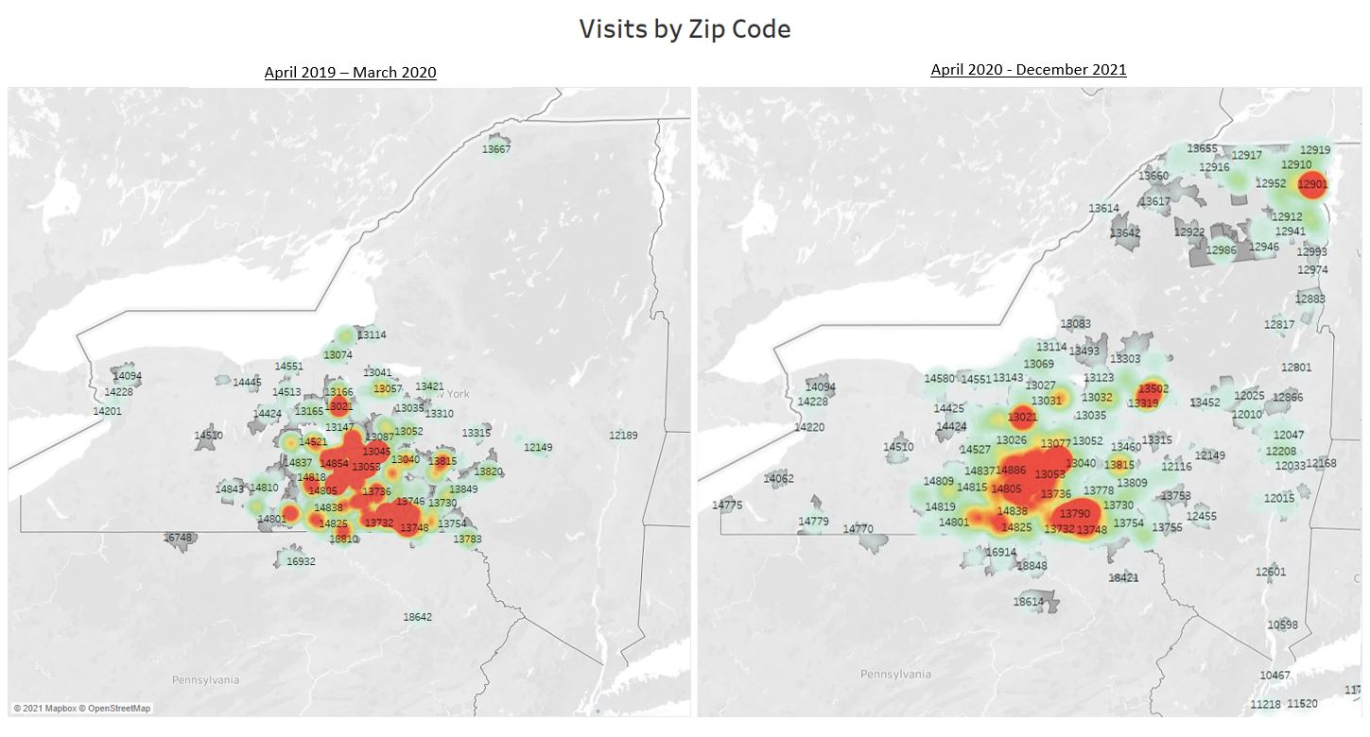

Slide 12
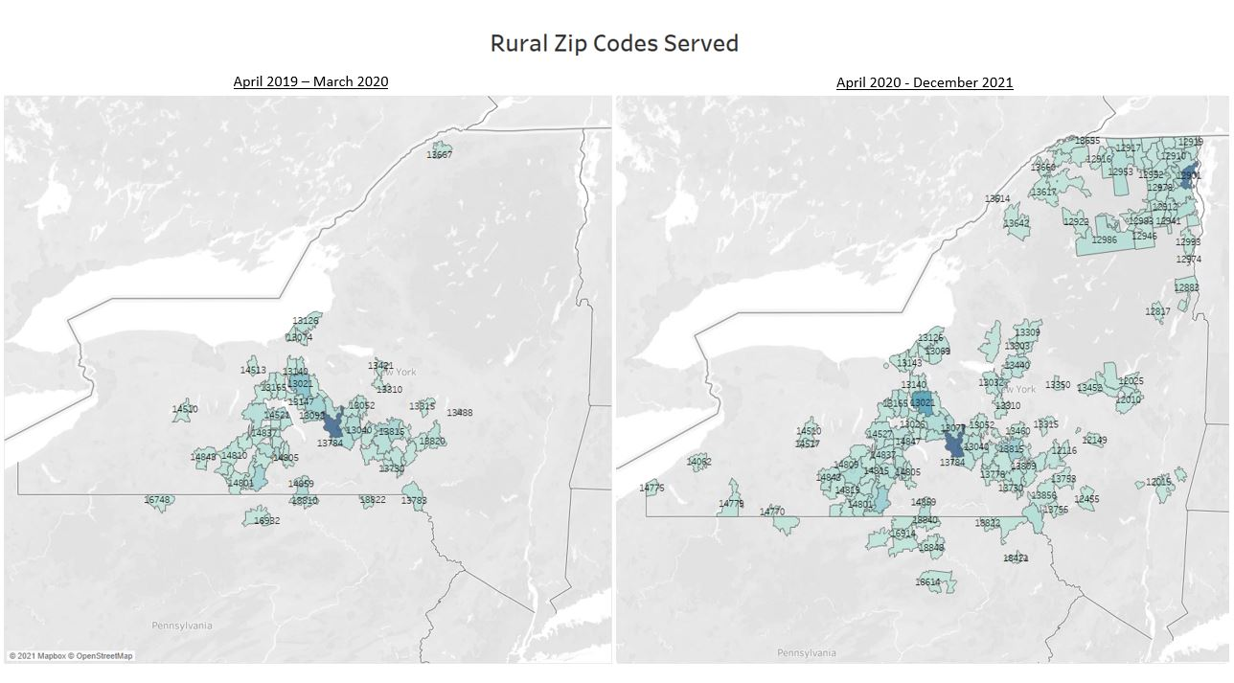
REACH experienced a 200% increase in volume after transition to telemed

Slide 13
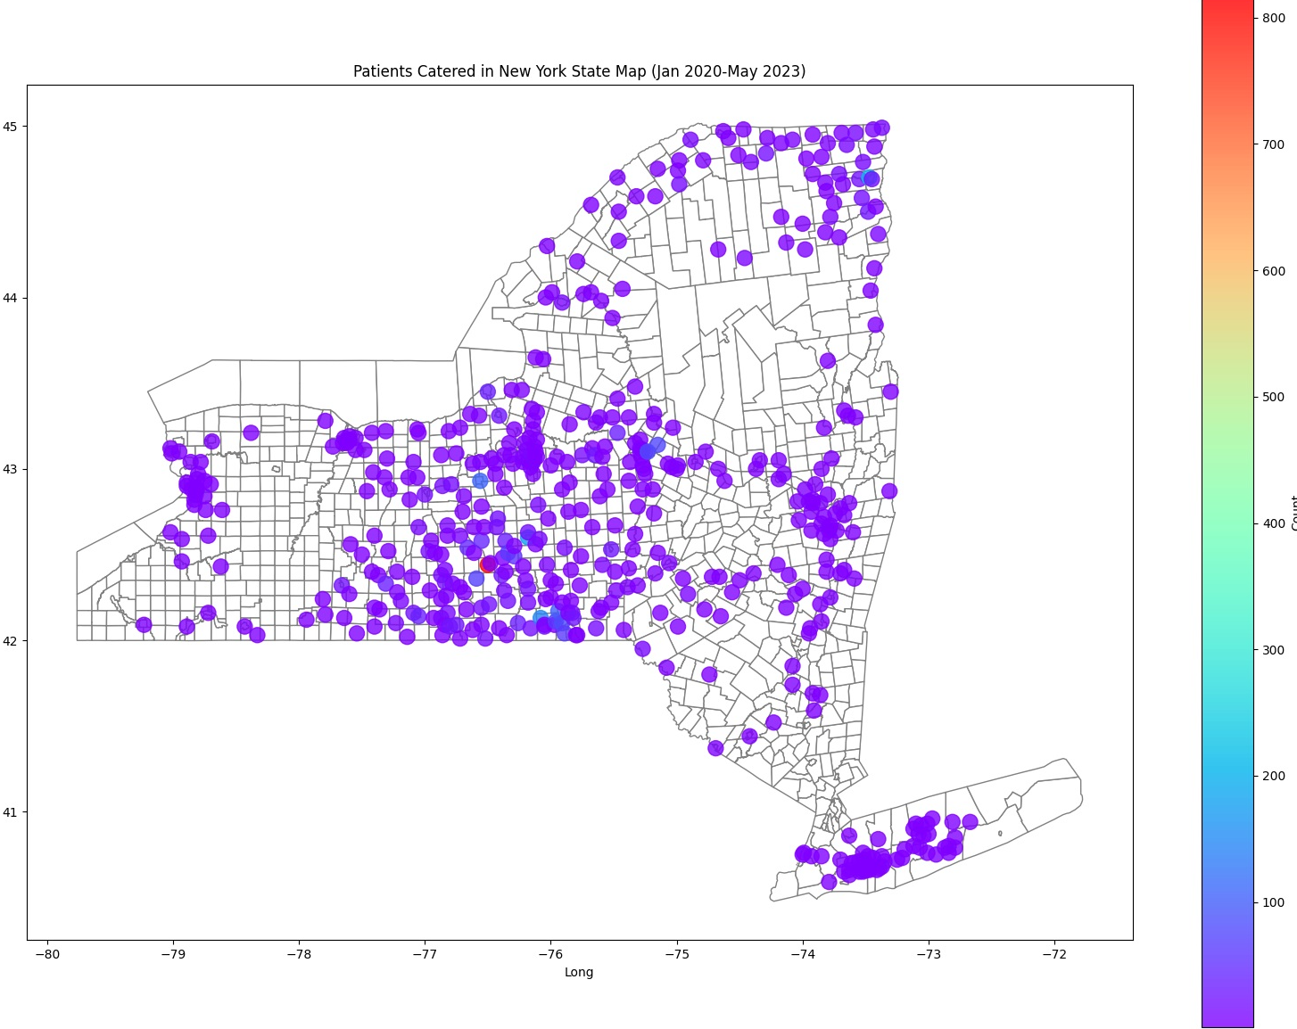
Serving patients from 56 NYS Counties
January 2020 - May 2023

Slide 14
Methods
Collected data from 1,996 new enrollees of the buprenorphine treatment program at REACH from September 1, 2019 to December 31, 2022.
Examined the association between sociodemographics (i.e., working status, race/ethnicity, sexual orientation, age, sex, and housing), telemedicine utilization, and experiencing an overdose in the past 6 months with 3 and 6 month retention outcomes using univariate and multivariate logistic regression analysis.

Slide 15
Defining Retention
Retained Within 3 Months: Patients who have had at least one appointment between 30 to 90 days of their initial appointment with REACH
Retained Within 6 Months: Patients who have had at least one appointment between 91 to 180 days of their initial appointment with REACH
Retained After 6 Months: Patients who have had at least one appointment after 180 days of their initial appointment with REACH

Slide 16
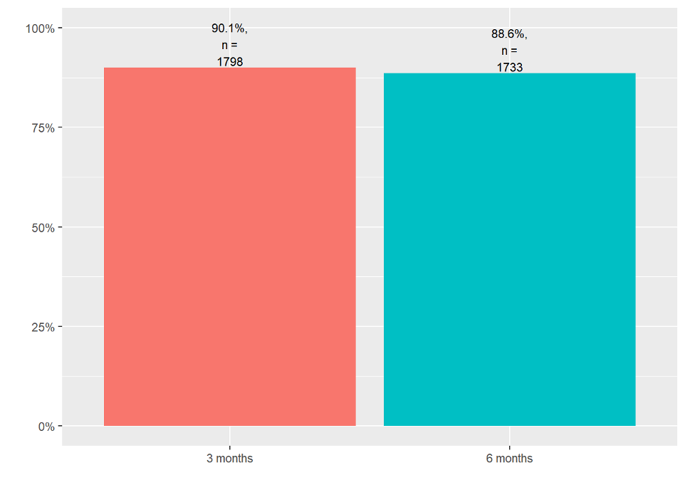
3-month retention = 90.1%
6-month retention = 88.6%
Treatment Retention
Notes:
HOw do we define retention??

Slide 17
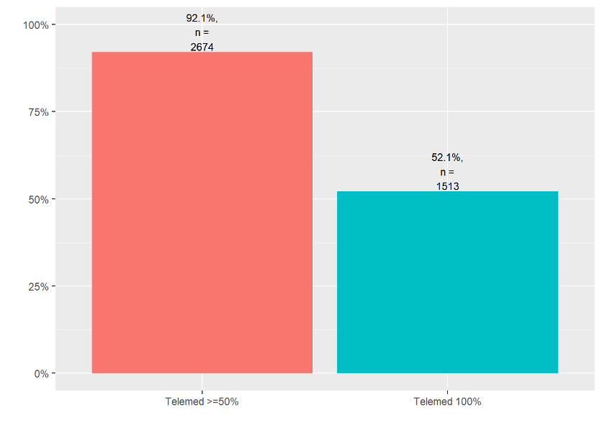
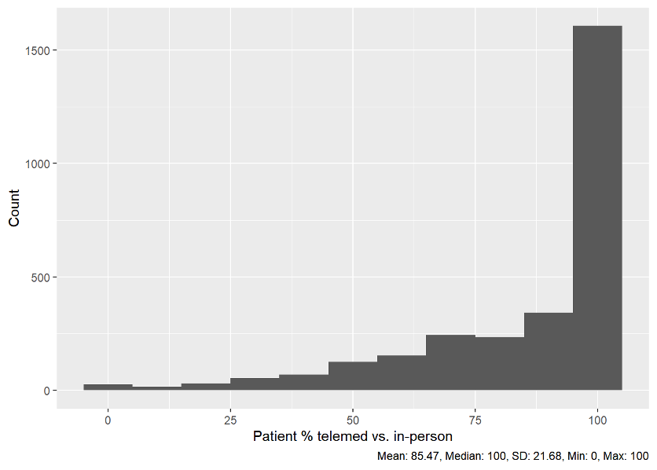
Telemed Utilization
52% had 100% telemed encounters
99.2% had at least one telemed encounter

Slide 18
Telemedicine utilization and retention
No difference in retention for 100% telemed vs hybrid care at 3 or 6 months
Those retained after 3 months have higher % telemed on average (t=2.2, df=221.9, p=0.02)
6-month retention was not associated with % telemed (t=1.2, df=266.5, p=0.24)

Slide 19
Patient characteristics not associated with retention
Age (median 39yo; range 19-76y0)
Race/Ethnicity
80.2% white; 4.5% Black ; 1% Native American ; 14% patient declined
95.4% non-Hispanic
Sexual orientation (76.2% straight, 12.5% chose not to disclose, 6.1% don’t know; 5.3% Lesbian/gay/bisexual/other)
Educational attainment (48.7% high school/GED, 29.3% more than high school, 22% less than high school)
Housing insecurity (78.7% not worried; 21.3% worried)

Slide 20
Patient characteristics associated with retention
Female sex assigned at birth (42%) associated with higher retention at 3- (p-value = 0.01) and 6-months (p-value = 0.05)
Hard to pay for basic necessities (“very hard”) was associated with lower retention at 3 months (p-value = 0.04) but not at 6 months (p-value = 0.49)
Not hard (35.5%) ; Somewhat hard (38.6%); Very hard (25.9%)
Justice involvement (17.9% in past 12 months)
Associated with lower retention at both 3- ( p<0.001) and 6-months (p<0.001)

Slide 21
Patient characteristics associated with retention
History of injection drug use (60.4%)
Ever injected drugs was not associated with 3-month retention ( p-value = 0.10) ; but was associated with lower retention at 6-months (p-value = 0.004)
Experienced overdose in past 6 months (17.6%)
Associated with lower retention at both 3- (p=0.003) and 6-months (p<0.001)

Slide 22
Multivariate Logistic Regression Analysis
Selected covariates:
•100% telemed (ref: no) –> main predictor of interest
•Age
•Sex (ref: F)
•Financial instability/Hard to pay for basic necessities (ref: not hard at all)
•Housing instability (ref: no)
•Justice involved in past 12 months (ref: no)
•Ever injected drugs (ref: no)
•Experienced overdose in past 6 months (ref: no)
3-month retention; no significant variables
6-month retention :
Previous Overdose experience associated with 45% reduction in retention
(AOR = 0.535; p=0.0397)

Slide 23
Conclusions
Treatment retention was very high at 3 and 6 months at this low barrier buprenorphine clinic with near universal telemedicine utilization
Recent overdose experience was associated with a significant decrease in retention
Future programming and research should explore the impact of interventions, such as peer services or case management to address this disparity
Provision of harm reduction services in conjunction with medication access is likely warranted

Slide 24
Thank you !
Question?
Email: jgriffin@reachmed.org

Slide 25
Extra slides

Slide 26
Retention Rates
Year | 90 Day Retention | 91-180 Day Retention | >180 Day Retention
2018 | 91% (212) | 85.8 % (199) | 100% (232)
2019 | 84.7% (373) | 77.95% (343) | 93.9% (413)
2020 | 87.1% (399) | 79.5% (364) | 81.8% (375)
2021 | 90.2% (633) | 79.8% (560) | 83.2% (584)
2022 | 90.6% (1023) | 79.2% (894) | 73.8% (833)
Total | 89.1% ( 2640) | (79.7%) (2630) | 83.2% (2437)

Slide 27
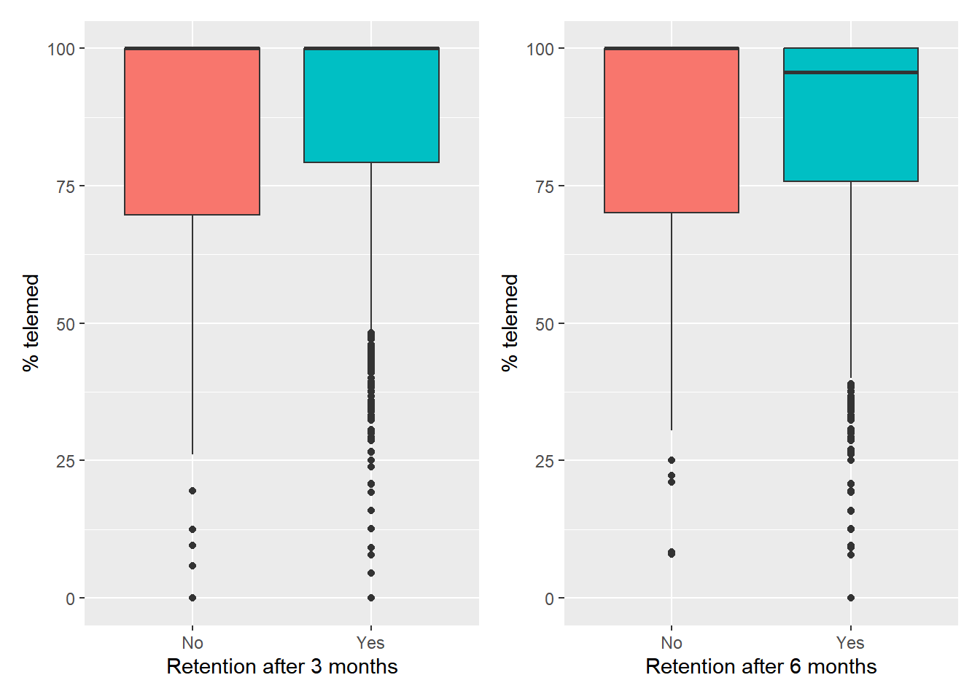
Telemed utilization
Those retained after 3 months have higher % telemed (t=2.2, df=221.9, p=0.02)
6-month retention was not associated with % telemed (t=1.2, df=266.5, p=0.24)

Slide 28
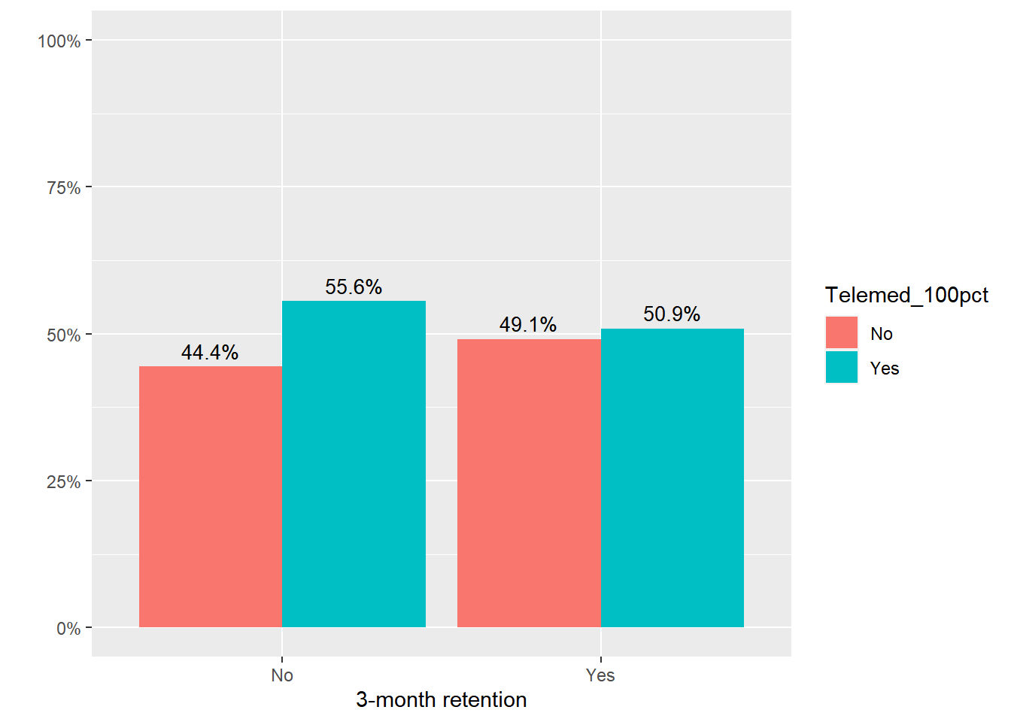
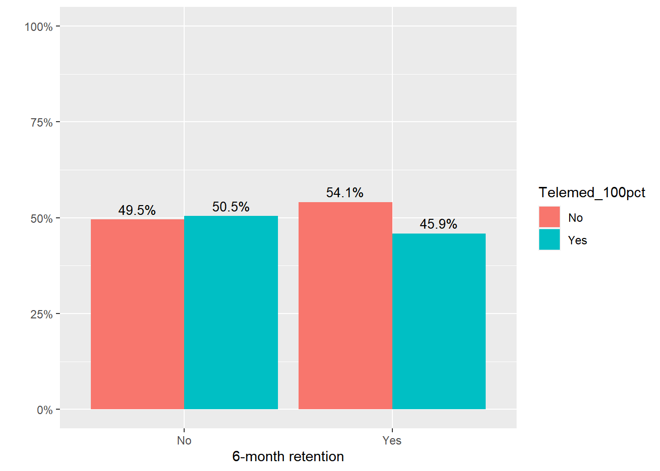
100% telemed utilization was not associated with 3- or 6-month retention.

Slide 29
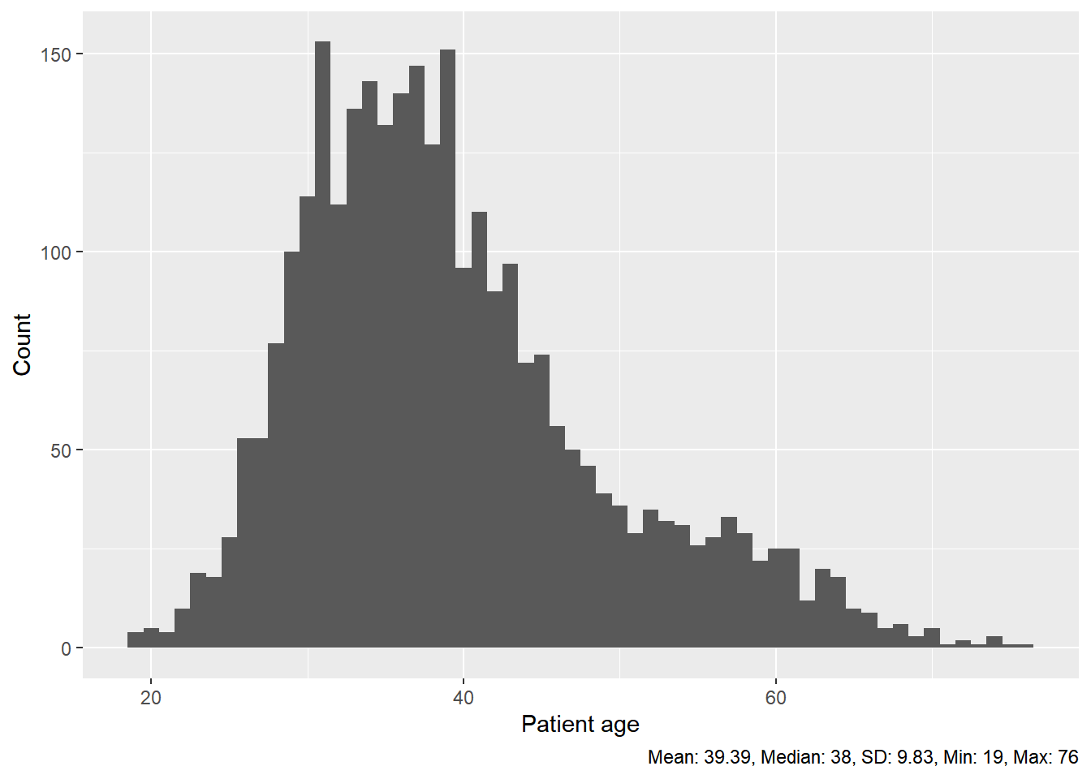
Age

Slide 30
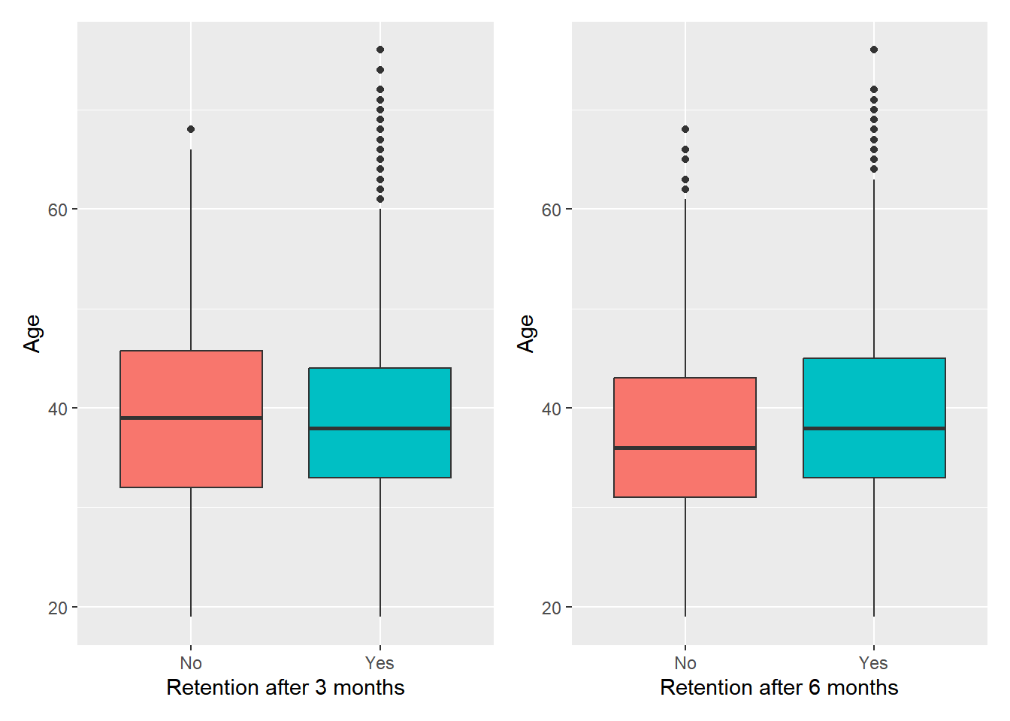
Age
Age (continuous) was not associated with 3-month (t=-1.0, df=234.7, p=0.30) or 6-month retention (t=1.7, df=275.1, p=0.09)

Slide 31
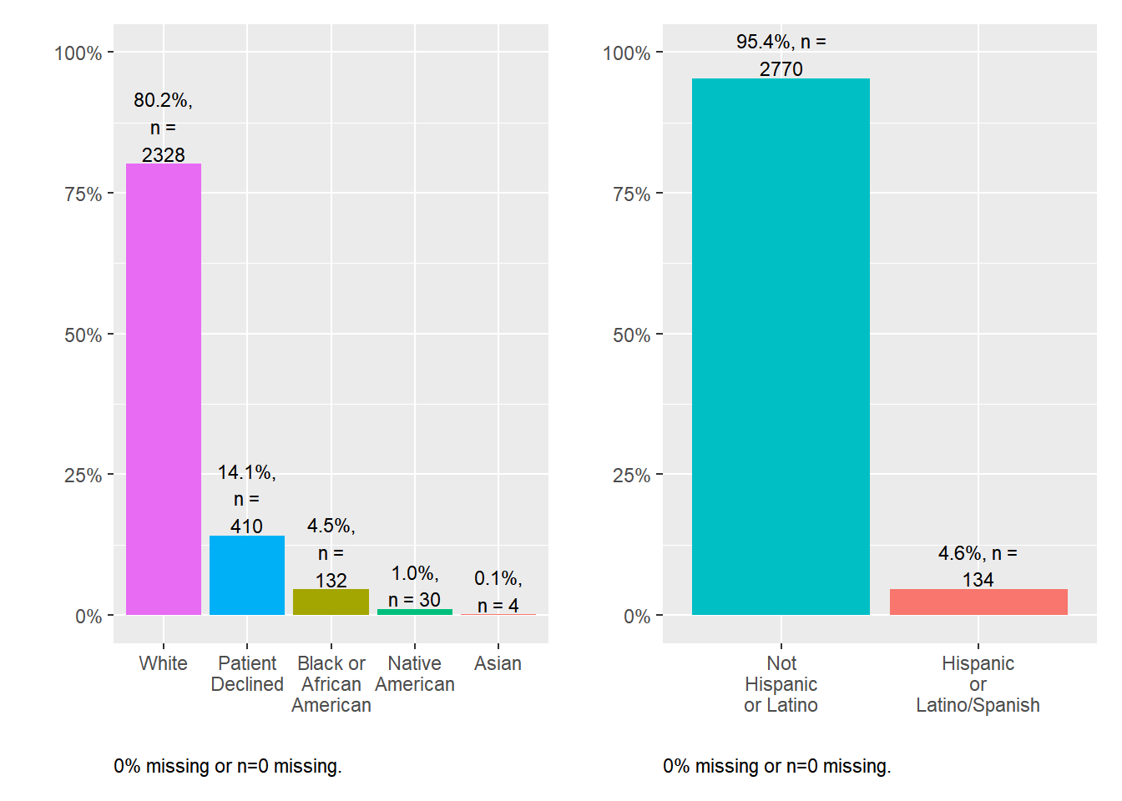
Race and ethnicity
Both race and ethnicity were not associated with 3- or 6-month retention

Slide 32
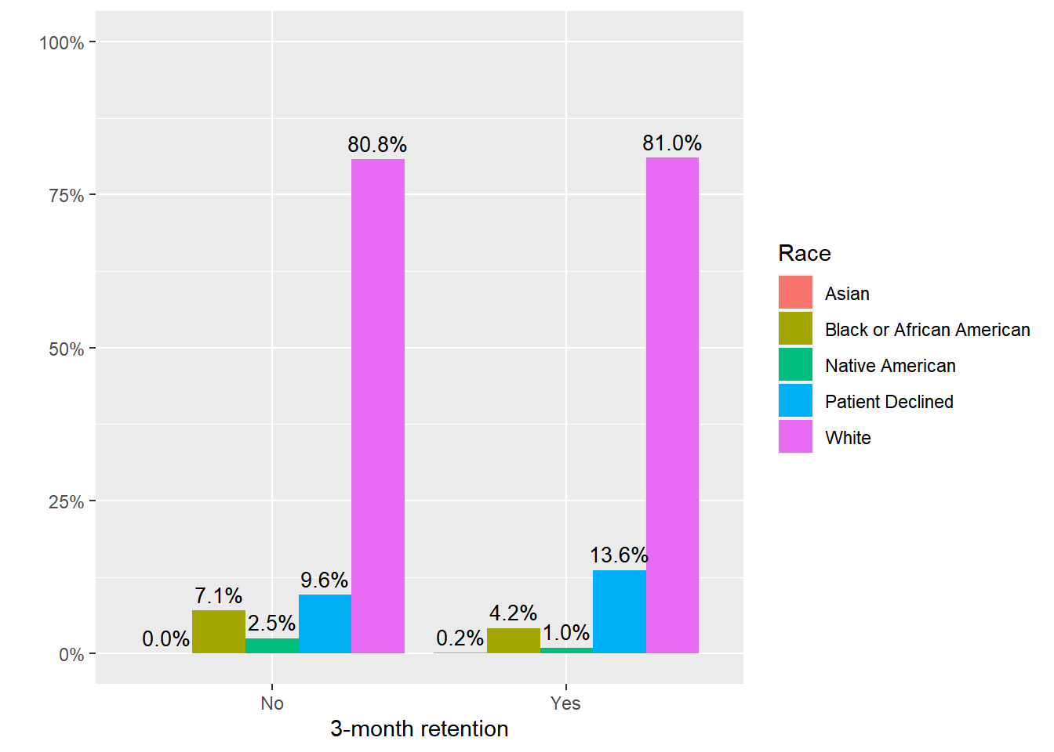
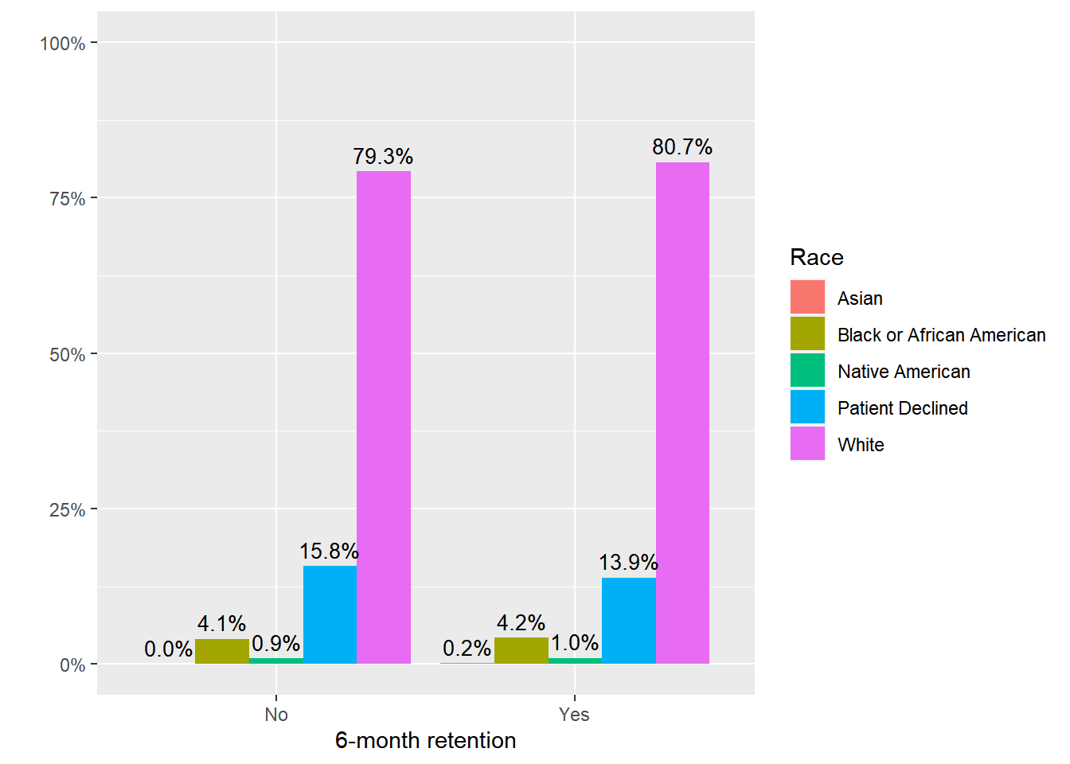
Fisher’s exact test p-value = 0.0512
Fisher’s exact test p-value = 0.9262

Slide 33
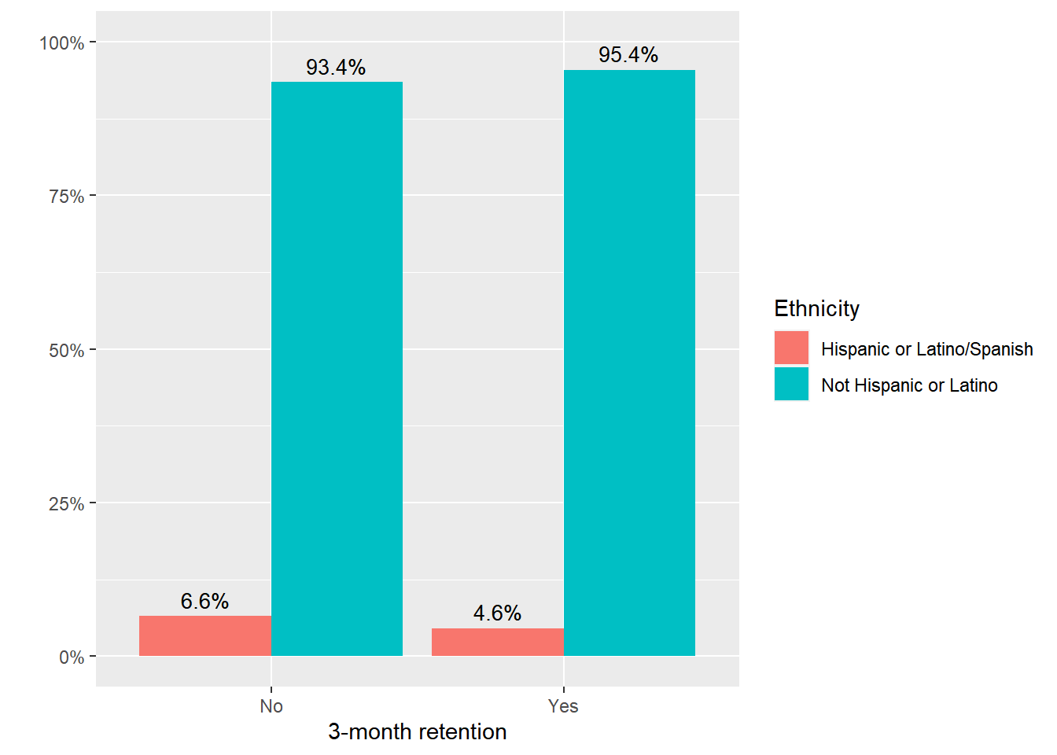
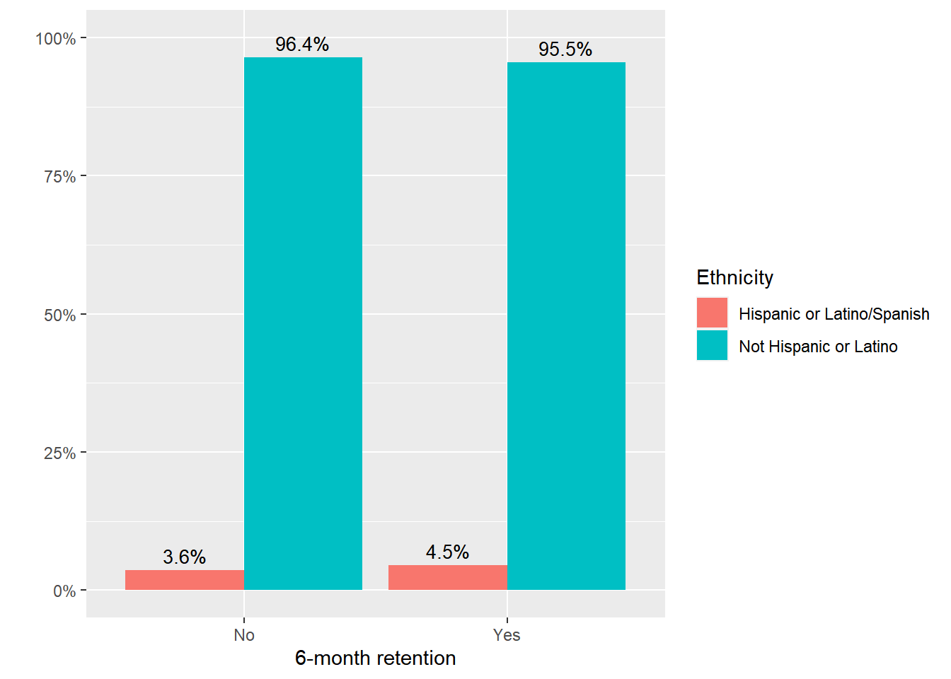

Slide 34
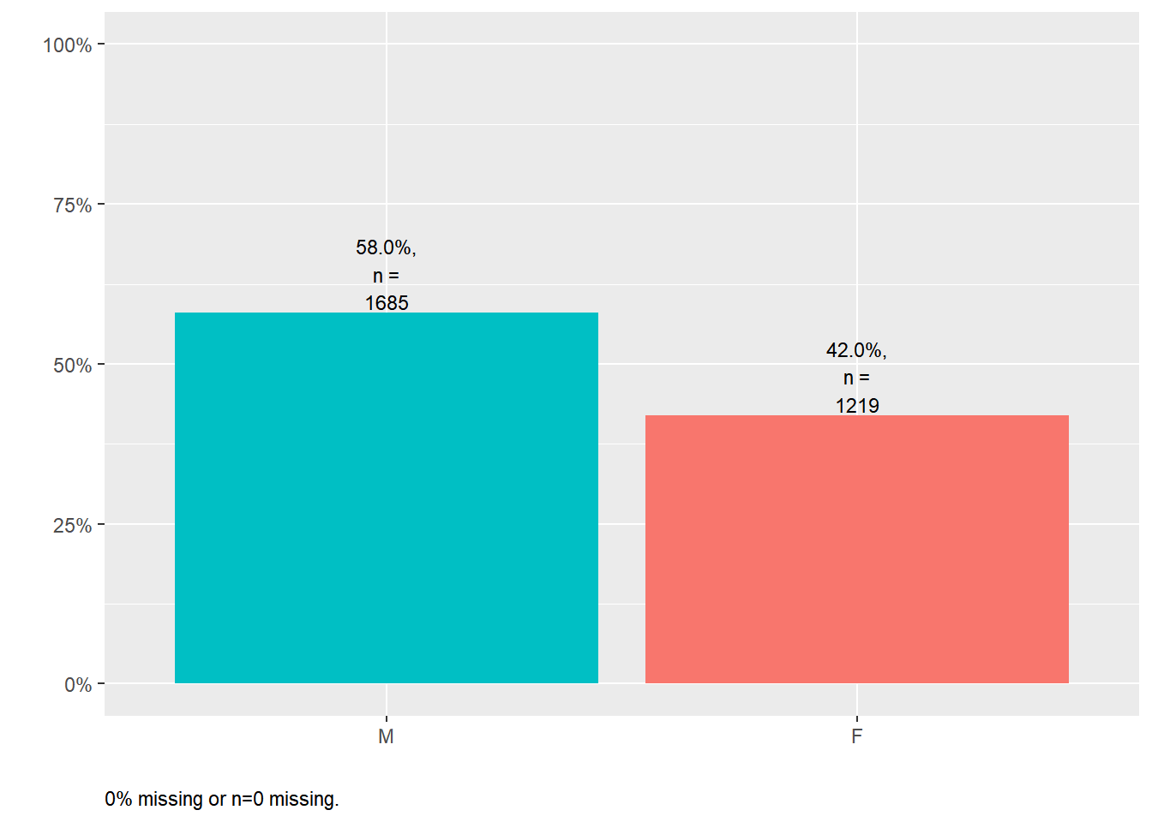
Sex assigned at birth

Slide 35
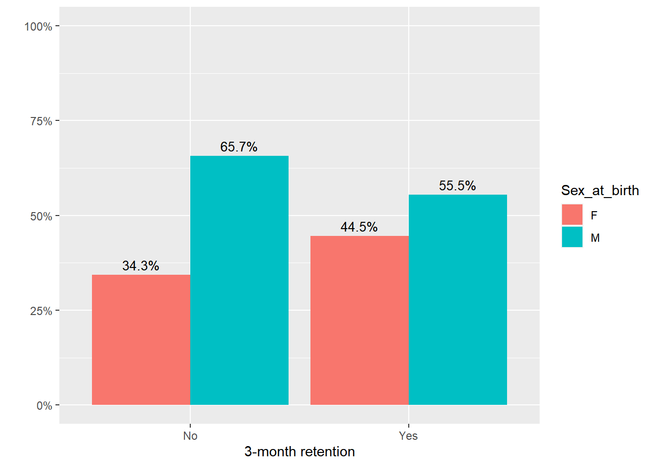
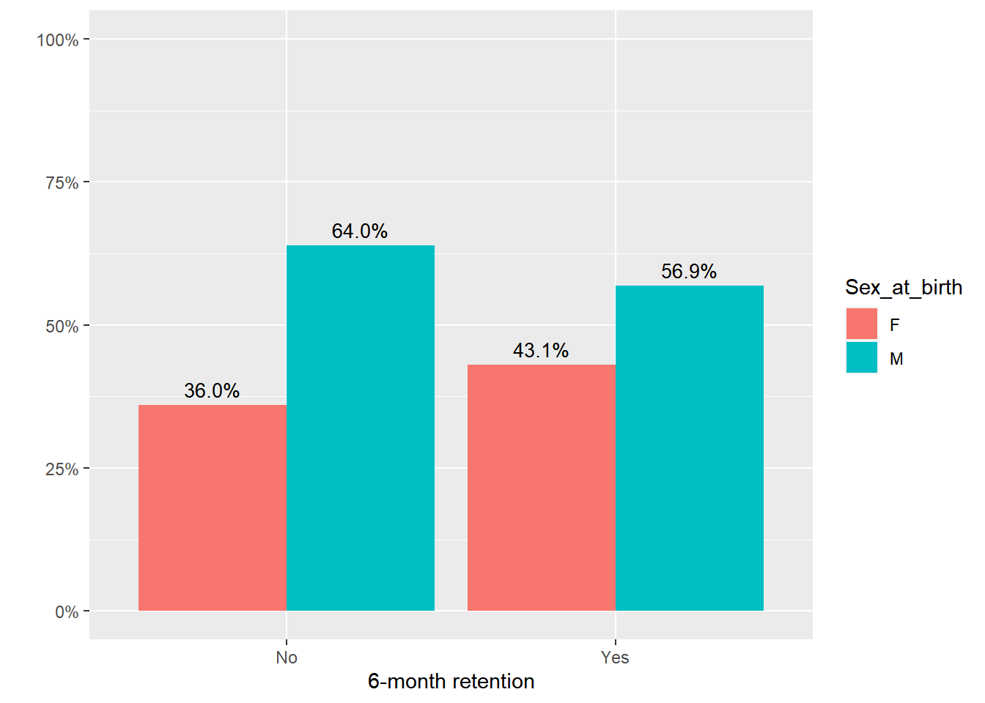
Sex assigned at birth was associated with 3-month retention but not 6-month retention
It is unclear due to current EMR limitations whether this variable was conflated with gender identity.

Slide 36
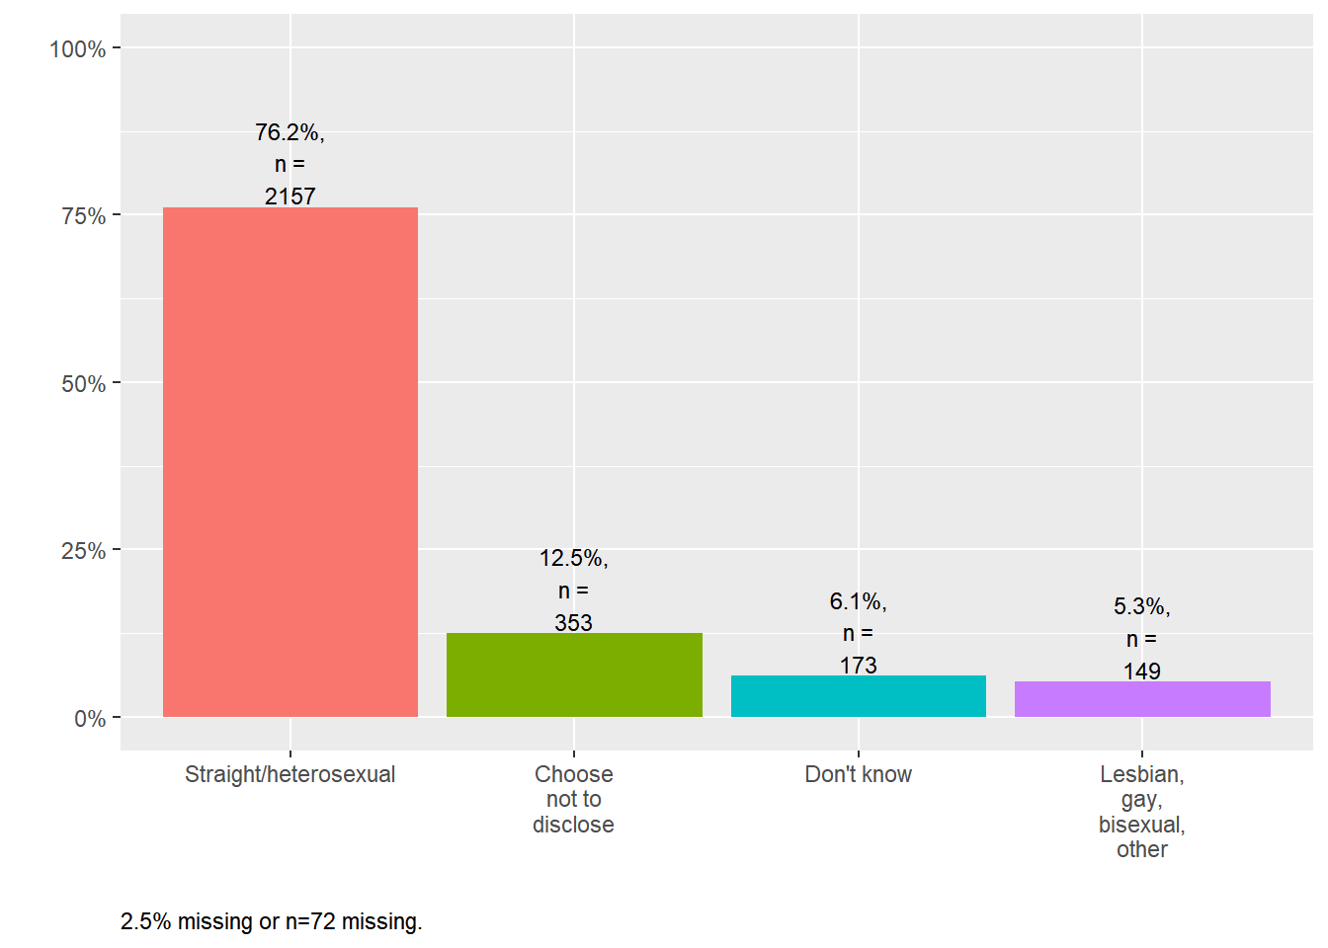
Sexual orientation

Slide 37
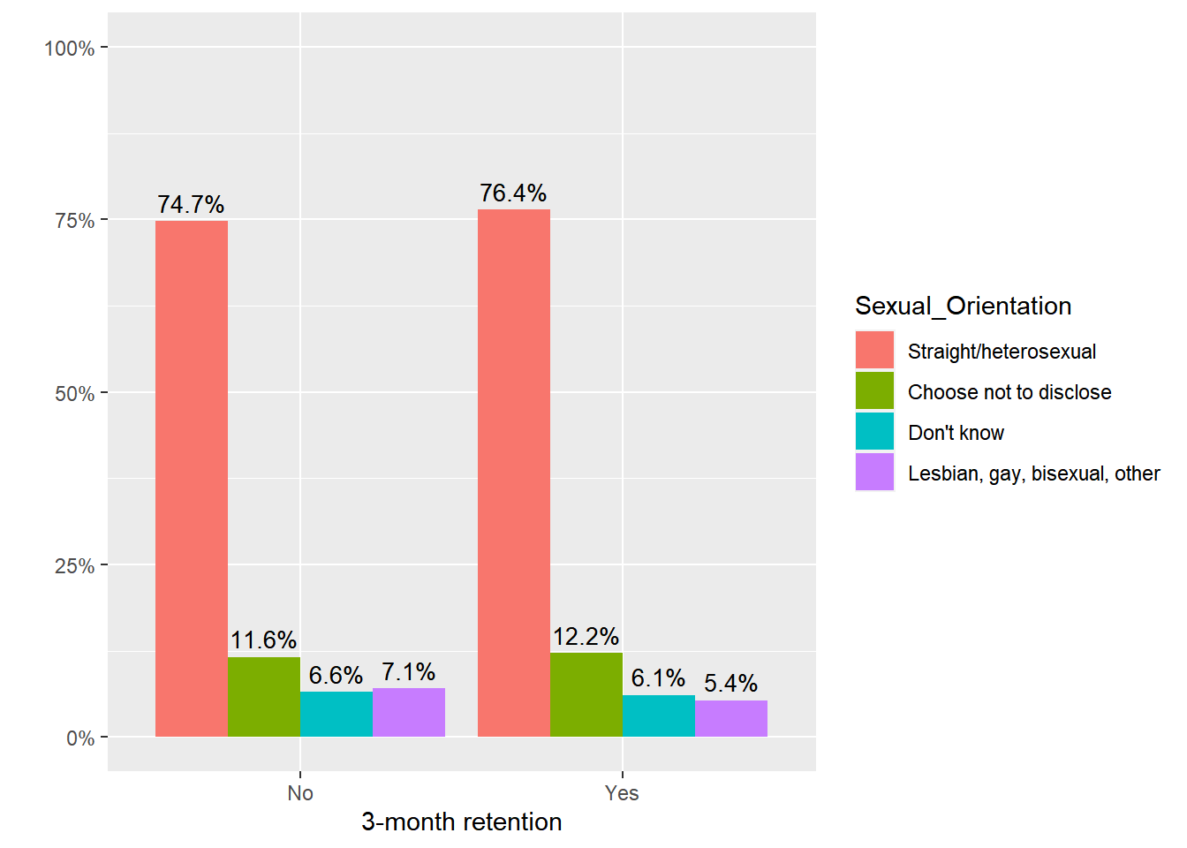
Sexual orientation was not associated with 3- or 6-month retention.

Slide 38
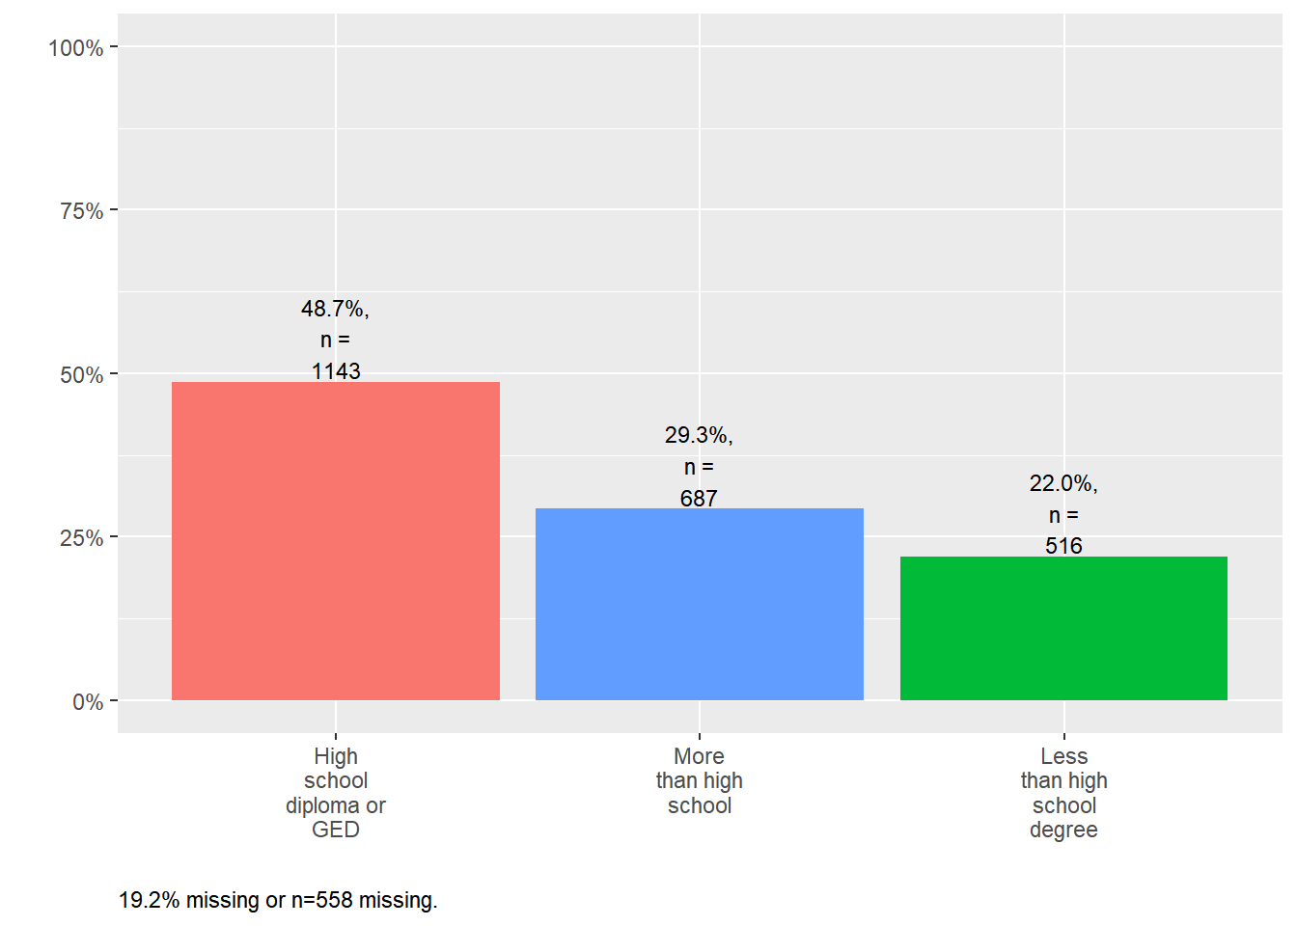
Education

Slide 39
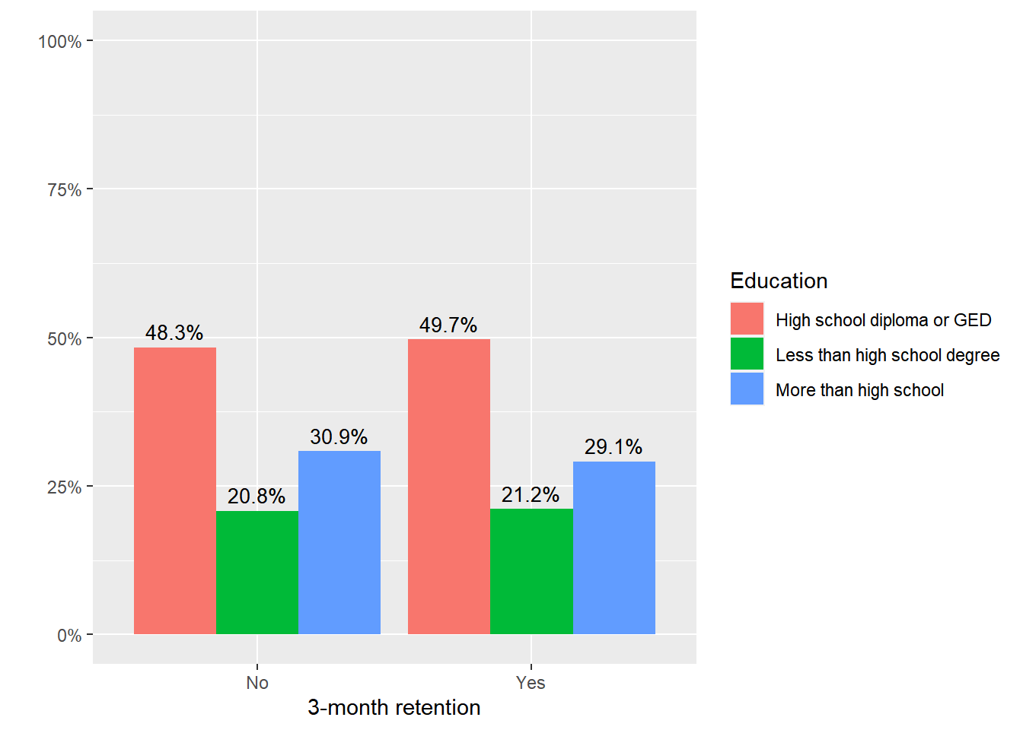
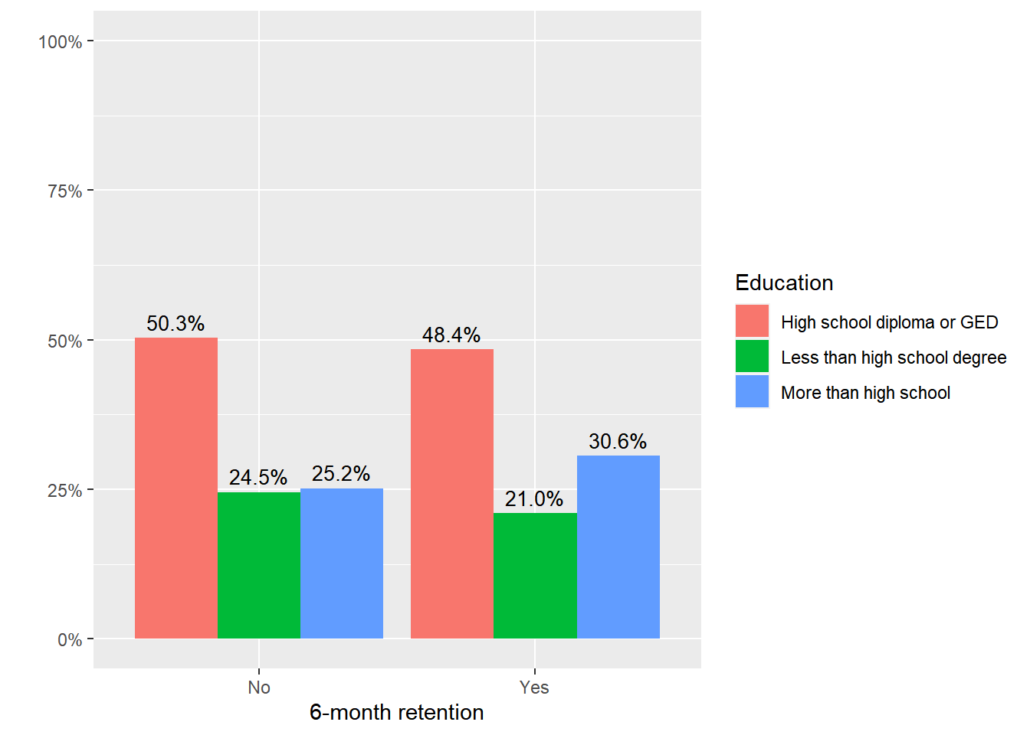
Educational attainment was not associated with 3- or 6-month retention.

Slide 40
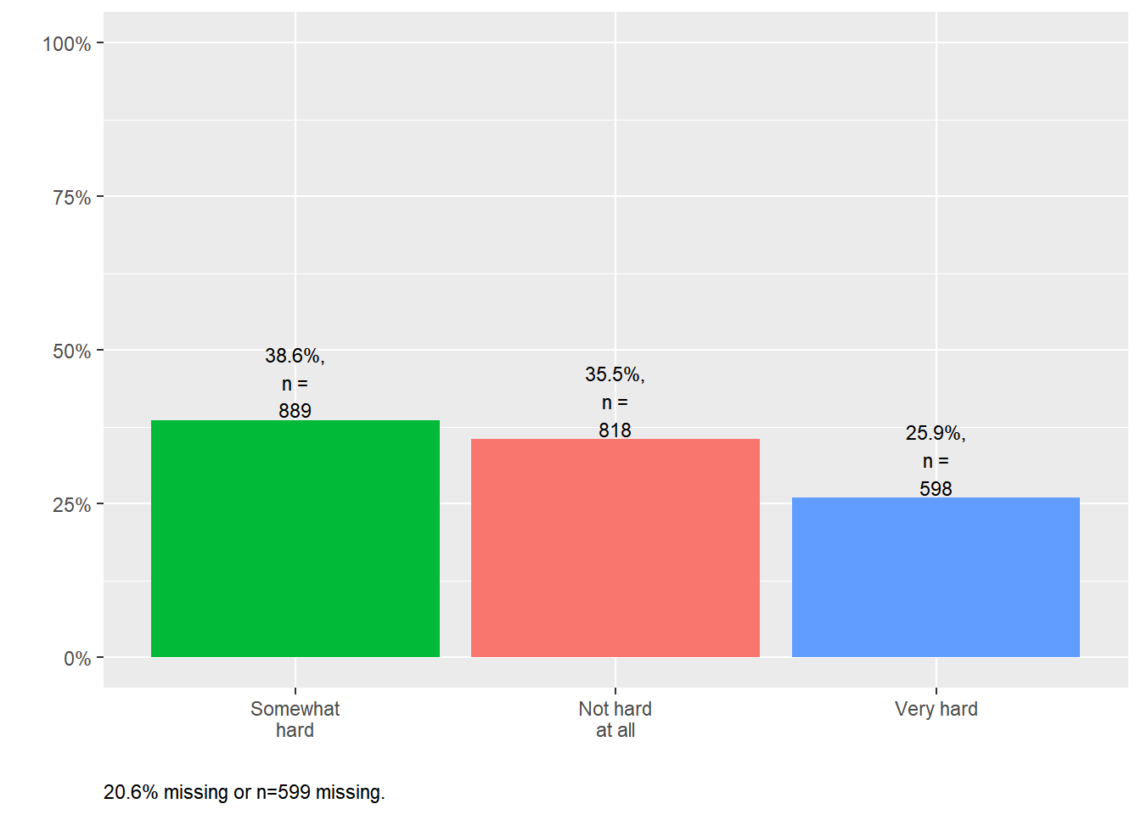
Hard to pay for basic necessities

Slide 41
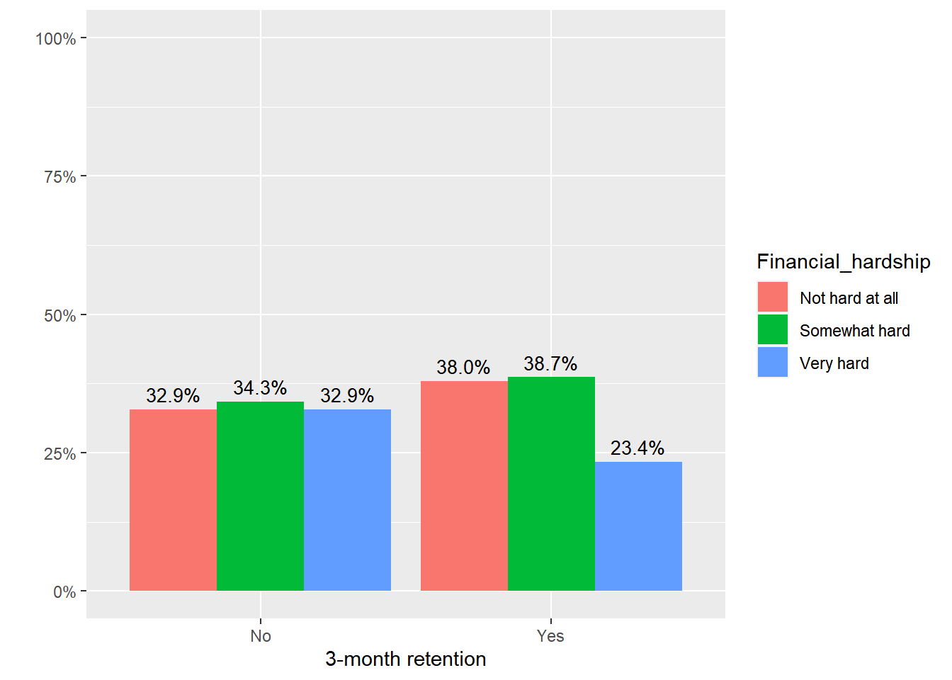
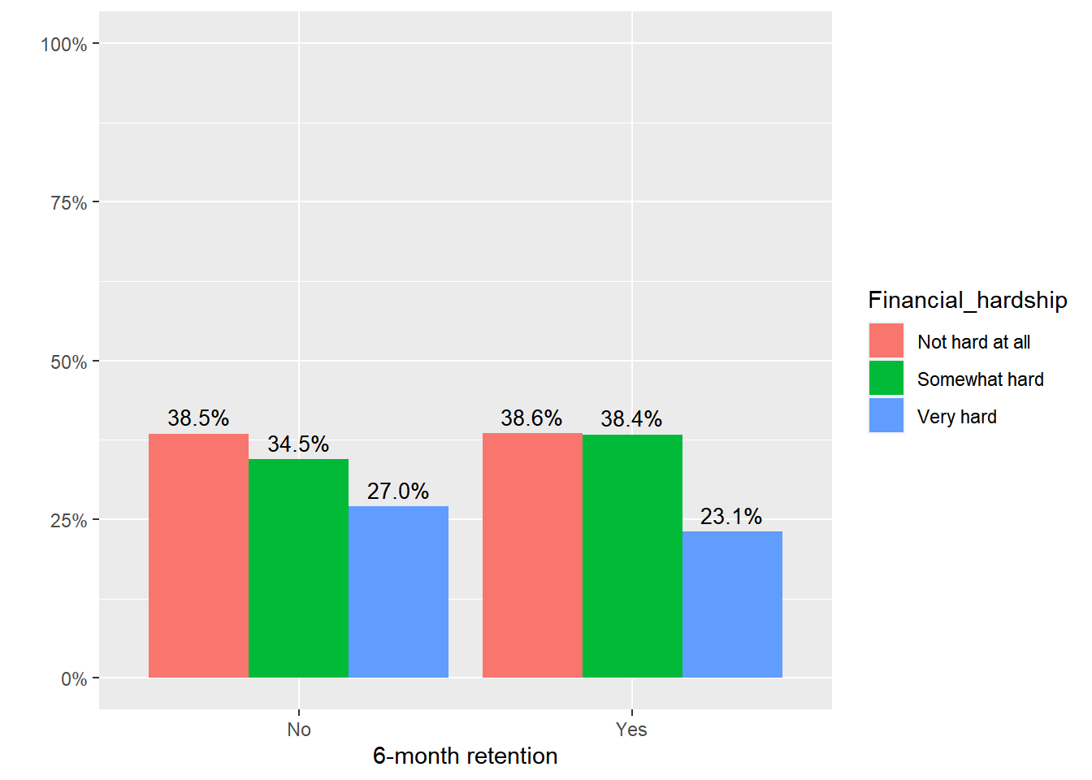
Associated with 3-month retention but not 6-month retention.

Slide 42
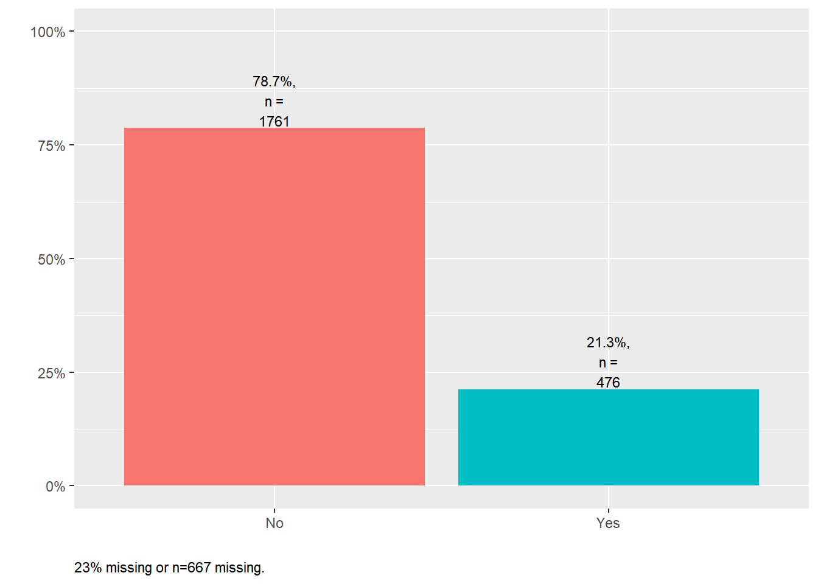
Worried about losing housing

Slide 43
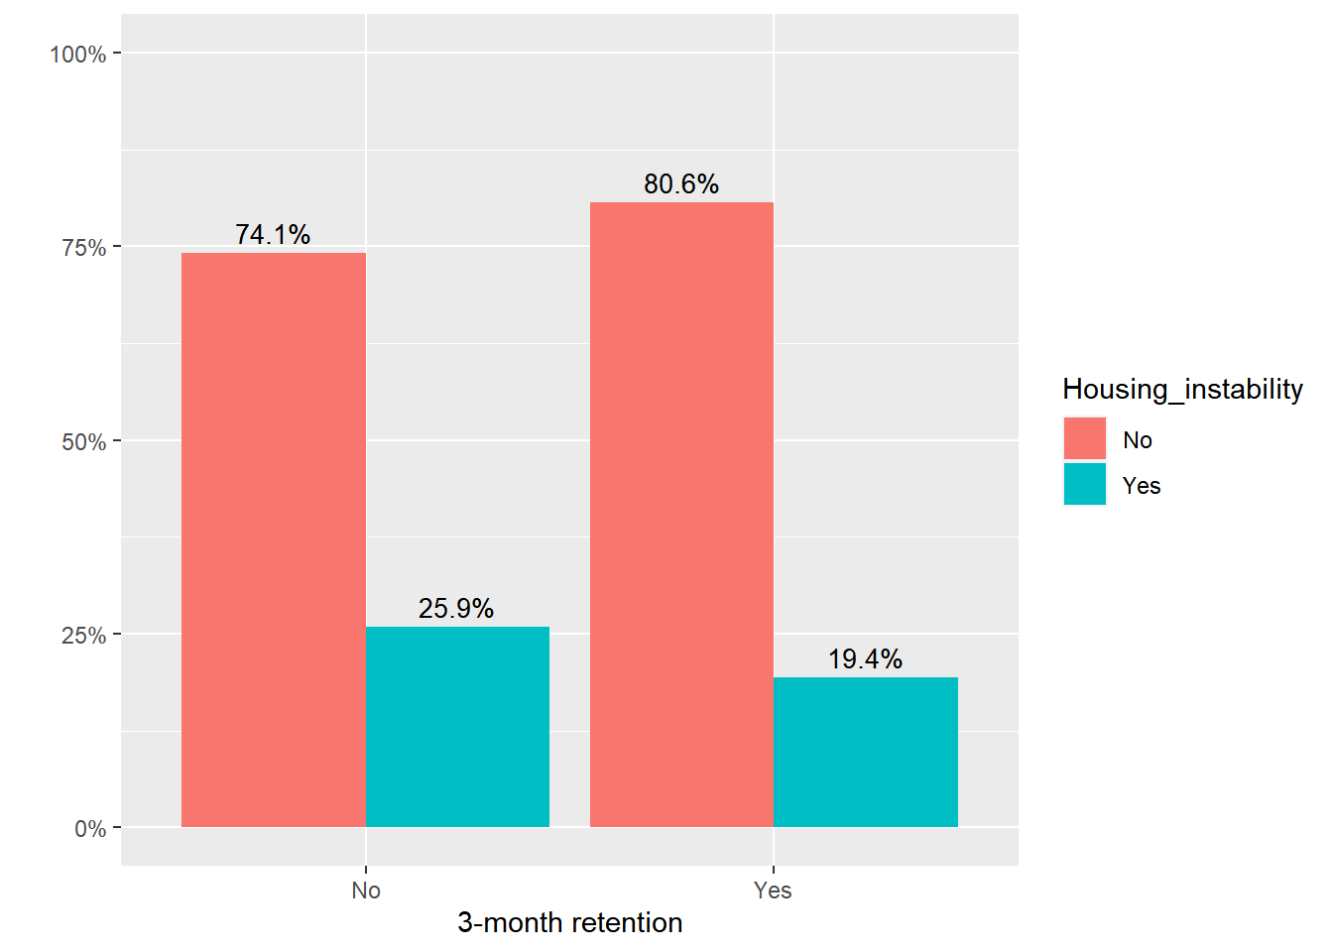
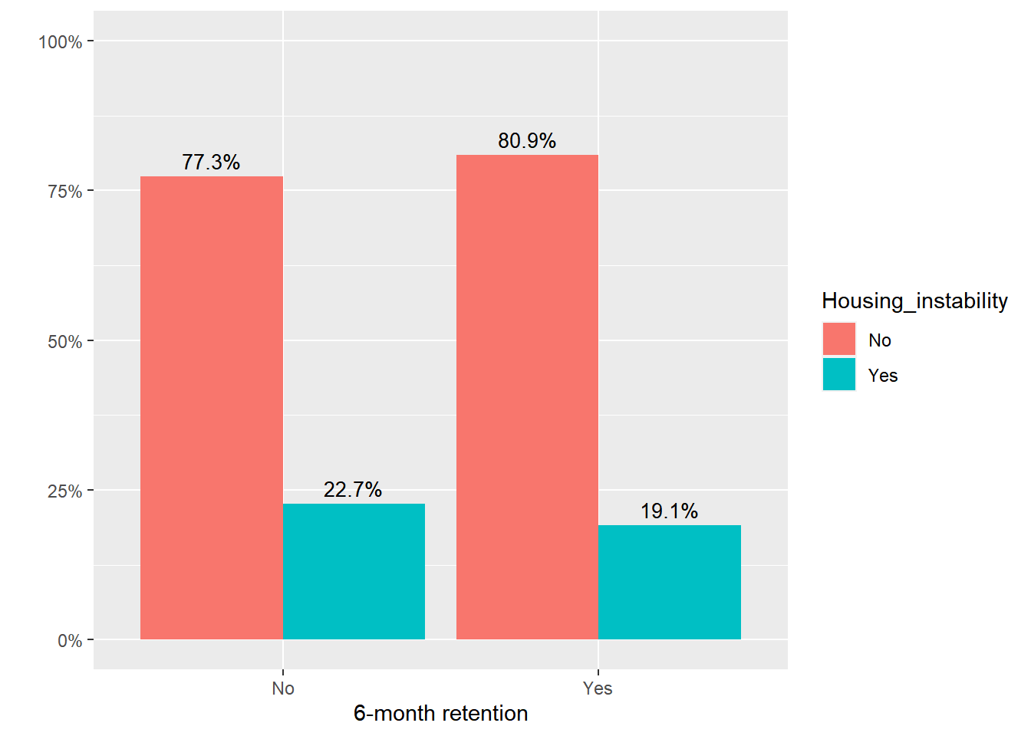
Not associated with 3- or 6-month retention.

Slide 44
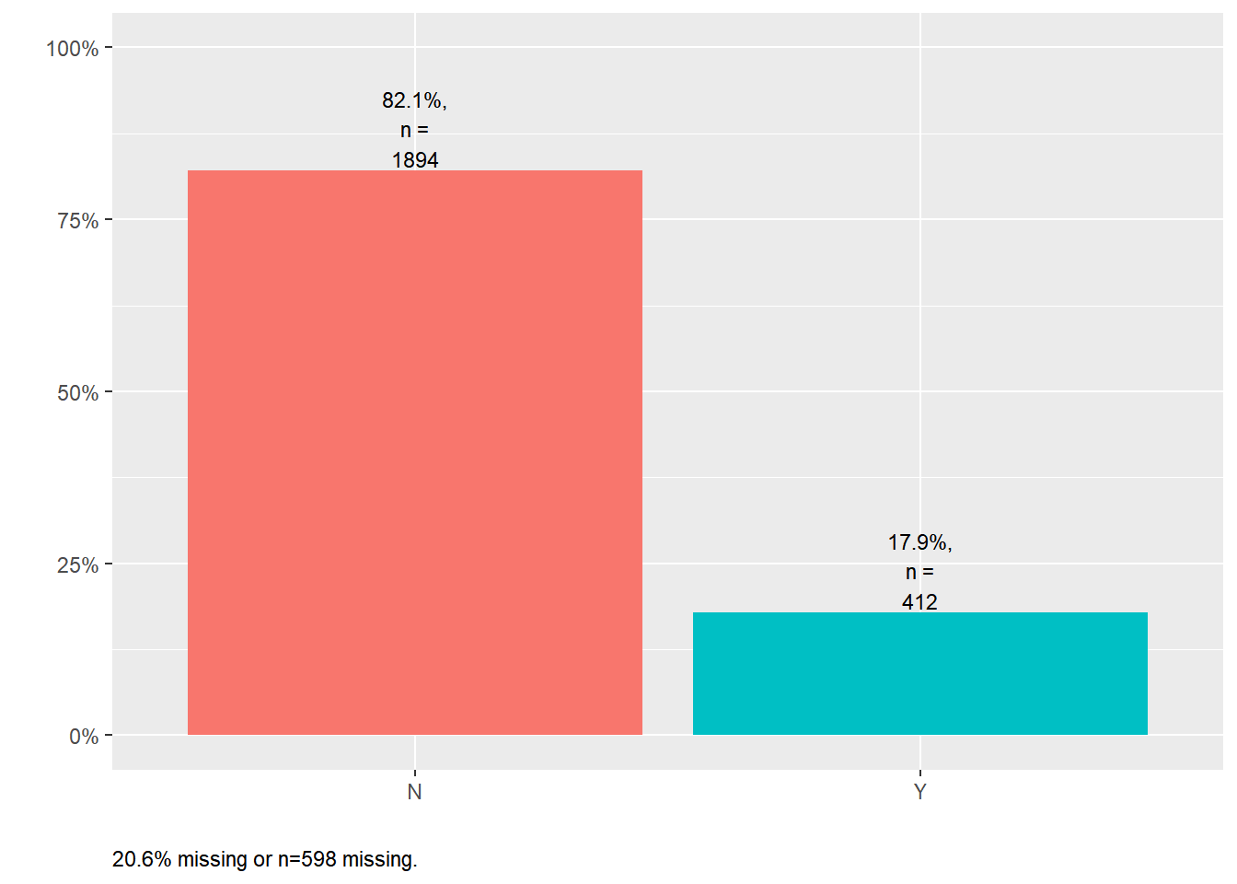
Justice involvement (past 12 months)

Slide 45
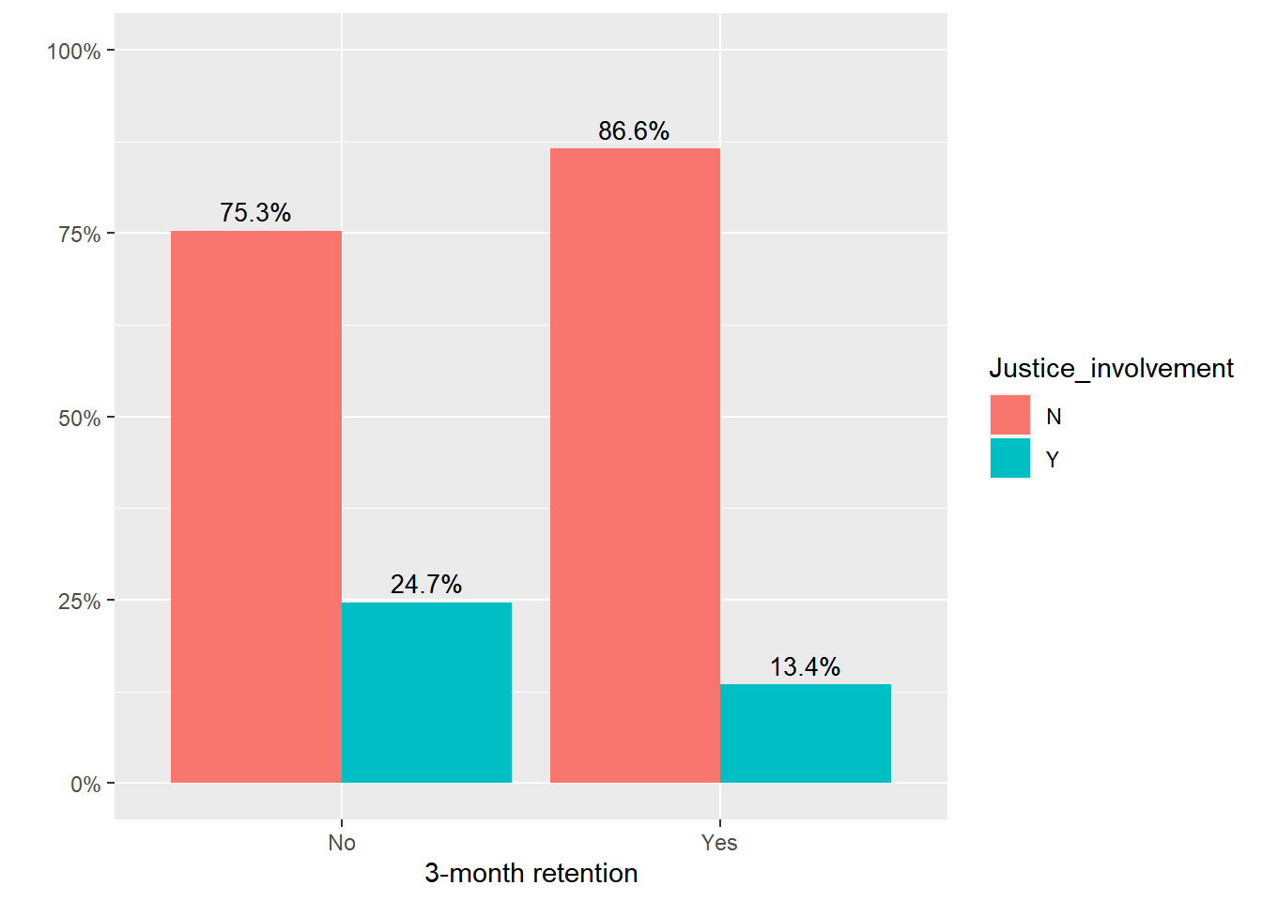
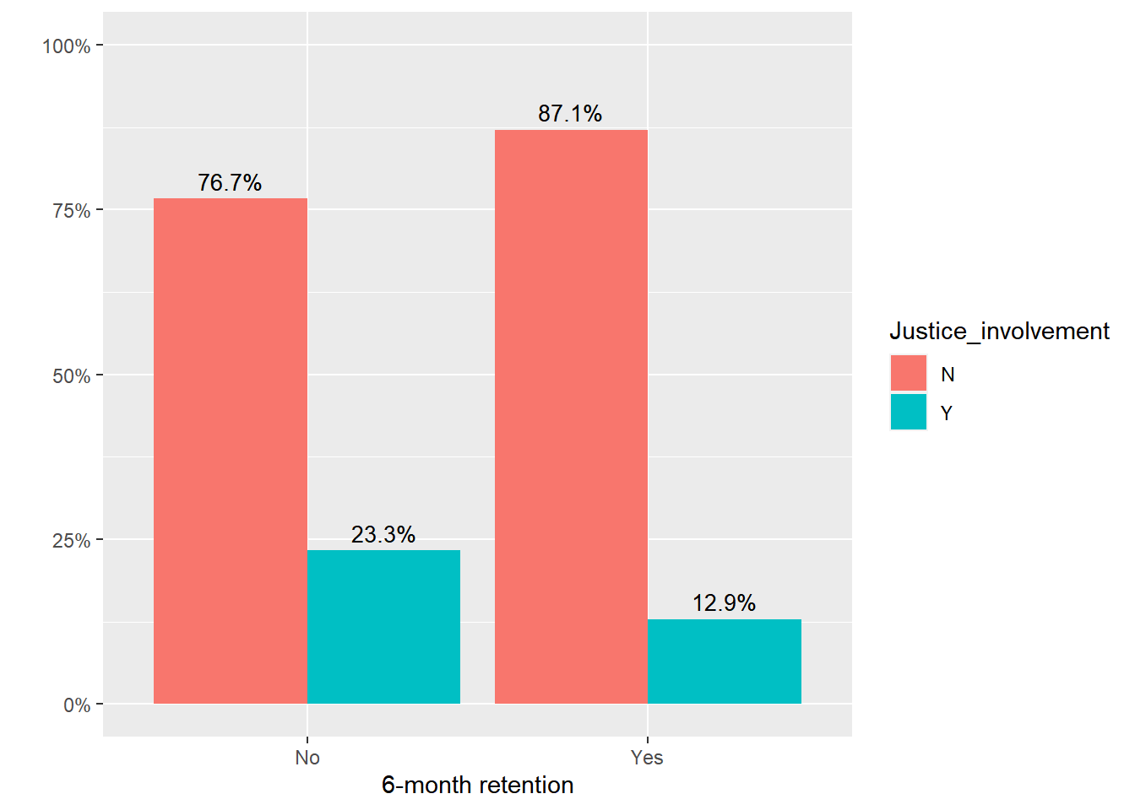
Associated with both 3-month and 6-month retention.

Slide 46
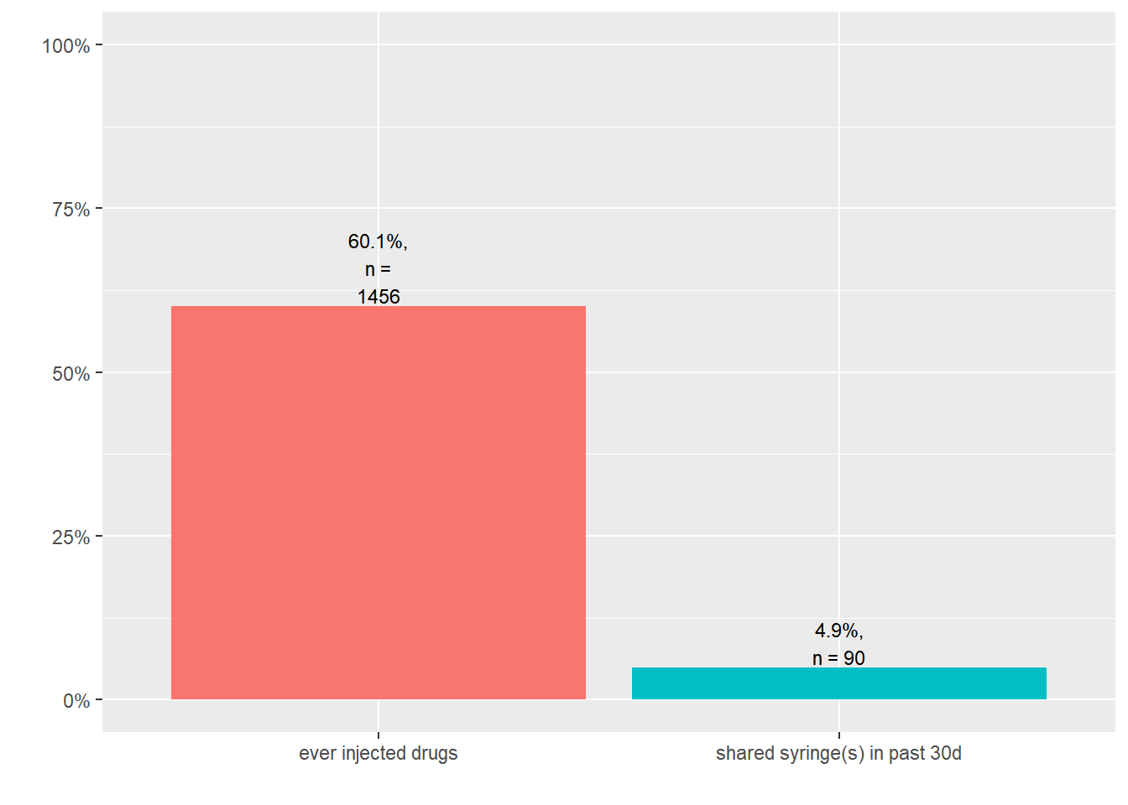
Injected drugs

Slide 47
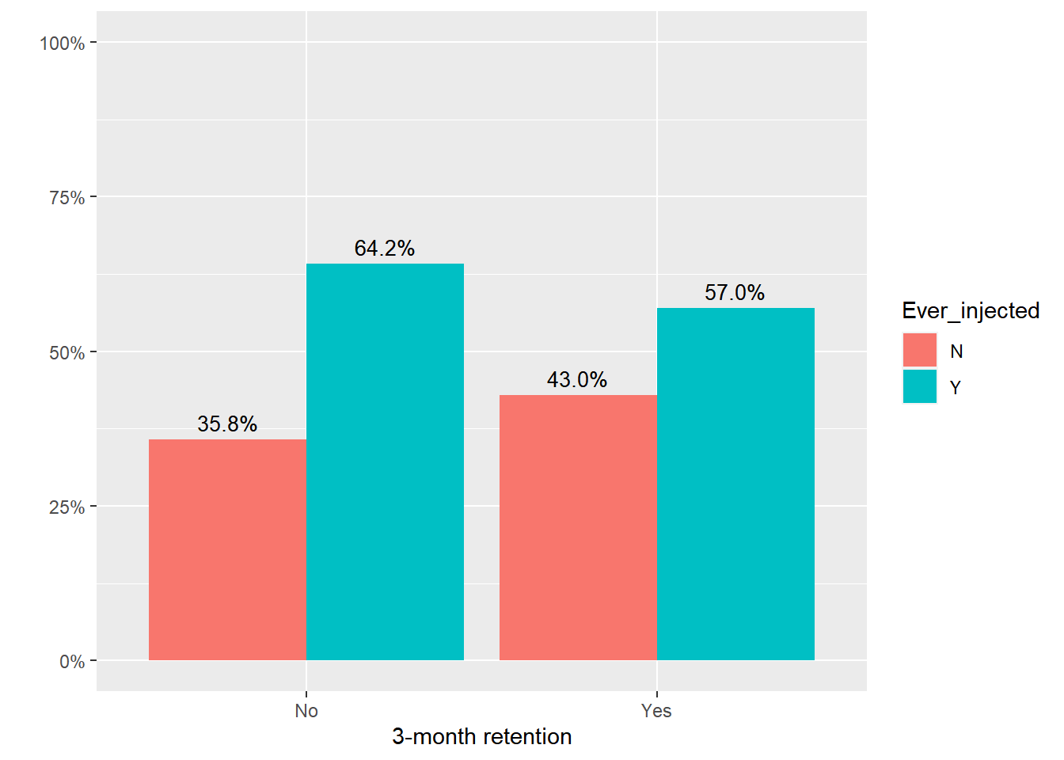
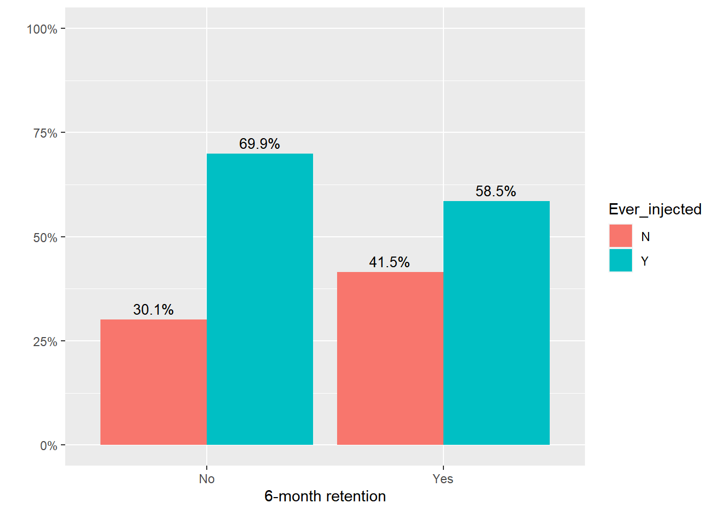
Ever injected drugs was not associated with 3-month retention but was associated with 6-month retention.

Slide 48
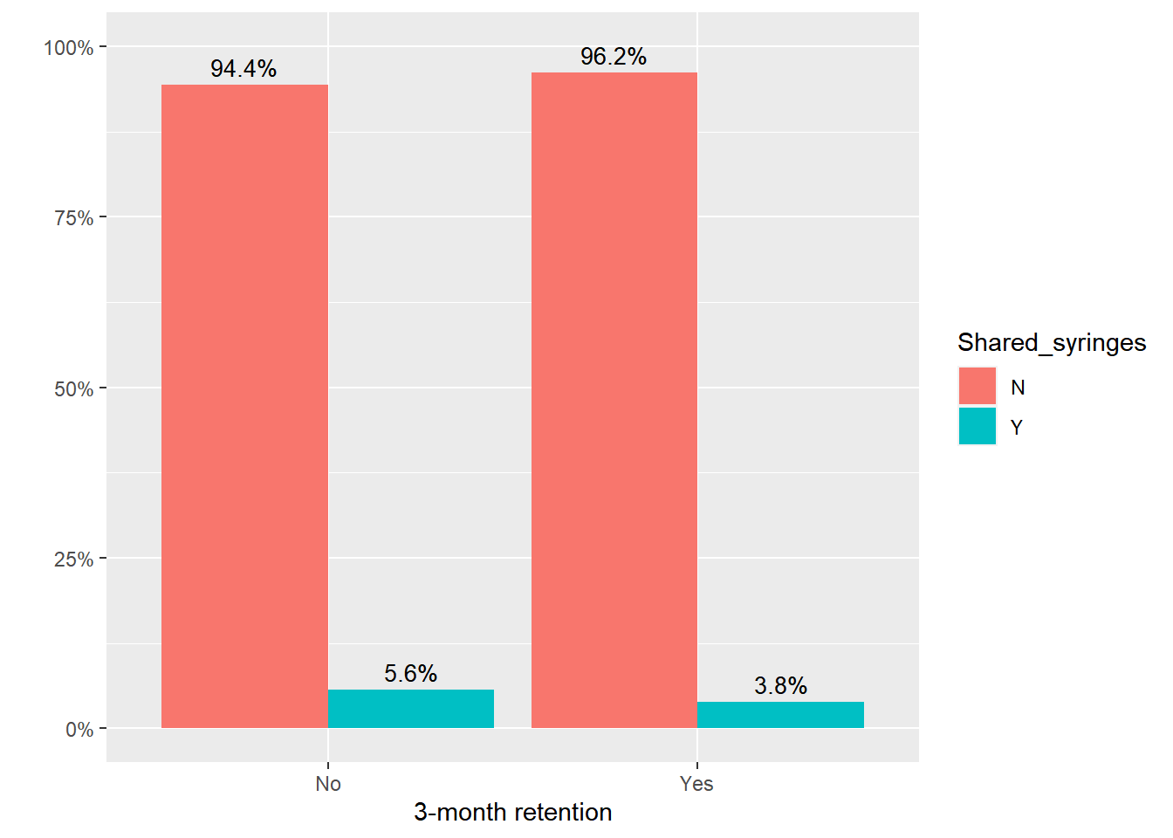
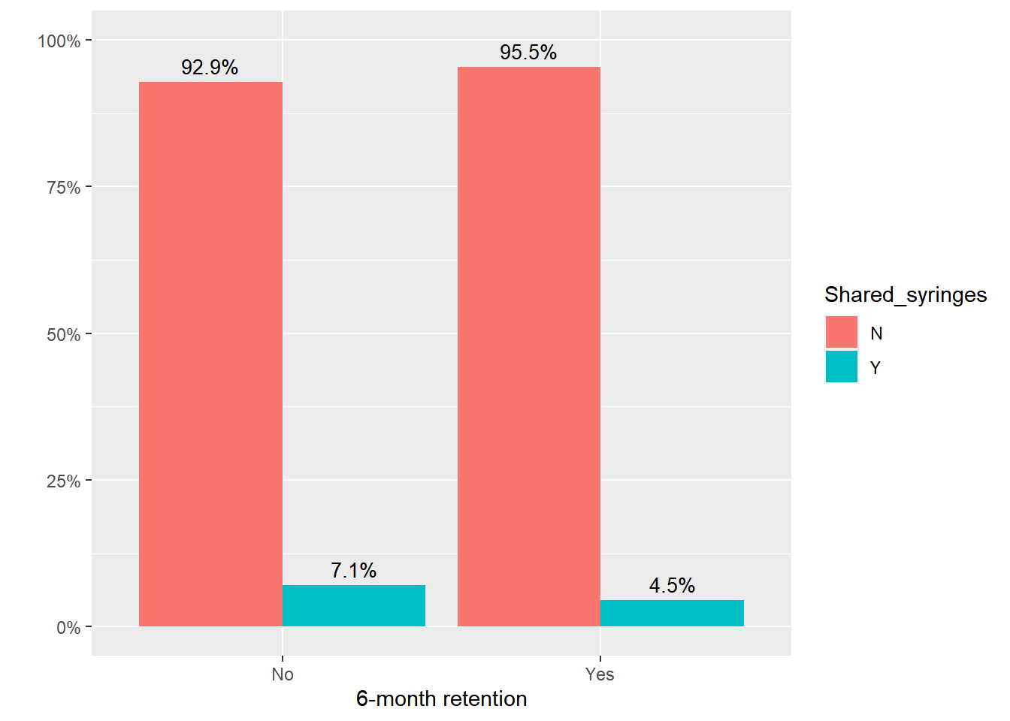
Sharing syringes in past 30 days was not associated with 3- and 6-month retention.

Slide 49
Experienced overdose in past 6 months

Slide 51
Multivariate logistic regression analysis
Selected covariates:
100% telemed (ref: no) –> main predictor of interest
Age
Sex (ref: F)
Financial instability/Hard to pay for basic necessities (ref: not hard at all)
Housing instability (ref: no)
Justice involved in past 12 months (ref: no)
Ever injected drugs (ref: no)
Experienced overdose in past 6 months (ref: no)

Slide 52
3-month retention (ref: no, n=790) 🡪 n.s.

Slide 53
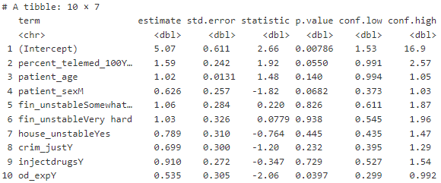
6-month retention (ref: no, n=724)

