Slide 1
TEST YOUR DRUGS,
NOT YOUR LIMITS:
ADVANCED DRUG CHECKING RESEARCH
AND PRACTICE AT BROCKTON NEIGHBORHOOD HEALTH CENTER
Allyson Pinkhover MPH, CPhT, CHO
Kelly Celata MSCJ, LADC-I
Darlene Andrade Fonseca BS
Sophal Sok DNP, FNP-BC
No conflicts of interest
Some work funded by RIZE Massachusetts Foundation

Slide 2
OVERVIEW
Drug checking research project/grant
Implementation of advanced drug checking
Together We RIZE project overview
TWR Project Findings
Clinical considerations
Clinical implications
Looking ahead
Q&A

Slide 3
Background on BNHC Drug Checking
We’re experts, we swear!
Began offering fentanyl test strips since 2018
In Fall 2020, met a patient who really catalyzed our thinking:
23 year old Cape Verdean male
Starting sniffing “Perc 30s” during high school and had recently starting injecting fentanyl
Shot a bad batch that ended up being baking soda
Ended up hospitalized and diagnosed with Stage III kidney disease
Unprecedented toxicity of the drug supply led us to pursue advanced technology for drug checking
Partnered with Brandeis University/MADDS for training and technical assistance
About 12 hours of training per person + ad hoc help
Offered FTIR testing as our schedules allowed...
May 2022
Drug checking pop up

Slide 4
EXPANDING DRUG CHECKING:
TOGETHER WE RIZE GRANT
Hired and trained dedicated Drug Checking Technician
What role, if any, does drug checking have in clinical practice?
What did participants think?
What did providers think?
What are the ethical considerations around this?
Darlene Andrade Fonseca
Nelice DaVeiga

Slide 5
EXPANDING DRUG CHECKING:
TOGETHER WE RIZE GRANT
Project Methods
Survey with program participants
Semi-structured interviews with participants
Analysis of samples (FTS, FTIR, GC-MS)
Semi-structured interviews with providers
Survey with providers

Slide 6
RIZE TWR:
FTIR RESULTS

Slide 7
RIZE TWR:
n=5 semi-structured interviews
PARTICIPANT FEEDBACK
Drug checking results can increase knowledge and facilitate behavior change
Trust and training are key in messengers of drug checking results
Drug checking and medical care were seen as bidirectional facilitators among participants
Access to advanced drug checking is desired by PWUD
Participants viewed drug checking as something protective to their health
Hesitancy exists about including drug checking results in a person’s medical record

Slide 8
RIZE TWR:
n=5 semi-structured interviews
PARTICIPANT FEEDBACK
Would you seek medical services
based upon your drug checking results?
What is useful about drug checking?
Yeah, so obviously it happens, and like I right now, I have those xylazine burns on me, so ... I don't know what to do to get it to stop spreading or get it to stop growing. That's an extra trip that I would take. -01
“The fact that I can find out what's in the drugs. Find out like, it's not that it's safe or not - the drugs aren’t safe to begin with. But like, I mean...I've saved a few people's lives who, like, didn't use fentanyl, but were smoking and like went out because of that. ... it's scary, you know I'm saying ... probably I've saved like 16 people.” - 03

Slide 9
RIZE TWR:
n=6 semi-structured interviews
PROVIDER FEEDBACK
Drug checking promotes patient education & tailored risk reduction strategies
Access to drug checking results may have positive or negative impacts on patient-provider relationships
Drug checking was viewed as something that could facilitate safer drug use behaviors
Drug checking was viewed as a tool for informing clinical care
Greater access to advanced drug checking is important to health care providers
Ethical concerns focus on who has access to potentially identifiable drug checking results

Slide 10
RIZE TWR:
n=6 semi-structured interviews
PROVIDER FEEDBACK
What is useful about drug checking?
Would you tailor your patient care
based on drug checking results?
“Yeah, so like if there is xylazine in there, I’d look up wound care guidelines for that. if they're doing uppers and downers then their mood's all over the place. So, I'm going to talk about their mood, I'm going to talk about like how the uppers and downers aren't the best combination” - 02
“I definitely think, one, there's safe practice using, right? So we are harm reduction, so it'd be good that patients know exactly what they're using to prevent overdoses or any other type of side effects that they might not expect. Two, treating the patient, like you said, like xylazine wounds or any type of potential side effects that they might be experiencing, we can know, like, okay, it could be from, this is what you're using in your drugs,” -03

Slide 11
Relationships with Healthcare
CLINICAL
IMPLICATIONS
Trust in a healthcare provider to adjust care to meet the patient’s current need
Changes in Policy
Increased instances of contaminated drug supply, alterations in management of drug screening
Trend Tracking
Ability to enhance public health by keeping people who use drugs informed on current supply trends
Health Literacy
Allowing patients to make informed decisions on their health and breaking down myths about drugs

Slide 12
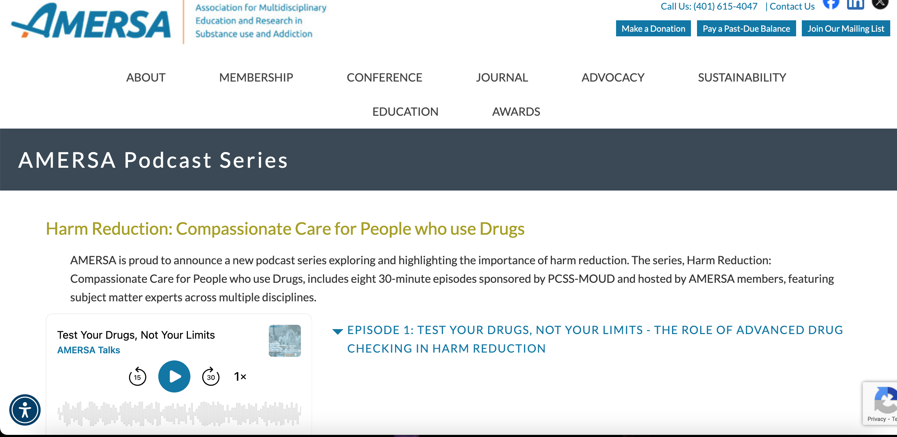
LOOKING AHEAD
POLICY CHANGES
FUNDING
Toxicology testing
New Test Strips
Detox Protocols
Opioid Settlement Funds
Overdose Data 2 Action (OD2A) allowable
VISIBILITY
AMERSA Harm Reduction podcast episode is out now!

Slide 13
CONTACT INFO
Allyson Pinkhover: pinkhovera@bnhc.org
Kelly Celata: celatak@bnhc.org
Sophal Sok: soksop@bnhc.org

