Slide 1
The Civil Right to MOUD
Amelia Caramadre (she/her), Esq., MPH
Ruchi Shah (she/her), DO
AMERSA 2024
Notes:
Dont forget to do brief intros here

Slide 2
Conflicts of Interest
Amelia Caramadre: none to report
Ruchi Shah: none to report

Slide 3
Learning Objectives
Understand the expansion of MOUD access in carceral settings
Learn what a physician and lawyer did to get an incarcerated patient MOUD
Learn how the ADA protects individuals with OUD, how physicians can advocate, and what lawyers can do in this context
Understand how to facilitate continued and increased access MOUD
Notes:
What we’re really excited to share is this real life medical-legal partnership

Slide 4
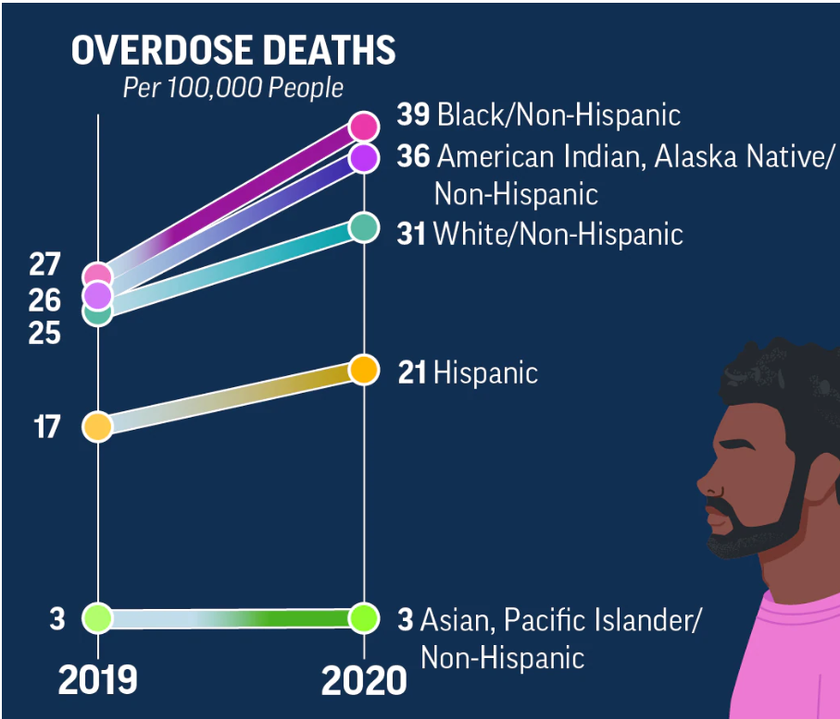
The Racist War on Drugs & Criminalization
~65% of US prison population has active SUD
20% under influence of substances at the time of ‘crime’
Incarcerated people up to 129x more likely to die from overdose 2 weeks after release vs general population
Mass incarceration & the overdose disproportionately impact BIPOC
Ensuring access to MOUD in carceral settings can reduce overdose and recidivism
Nat’l Inst. On Drug Abuse, Criminal Justice DrugFacts (2020), https://nida.nih.gov/sites/default/files/drugfacts-criminal-justice.pdf (last visited August 30, 2023).
See Ingrid A. Binswanger, Marc F. Stern, Richard A. Deyo, Patrick J. Heagerty, Allen Cheadle, Joann G. Elmore & Thomas D. Koepsell, Release From Prison — A High Risk of Death for Former Inmates, 365 New Eng. J. Med. no. 5 (January 2007), https://doi. org/10.1056/nejmsa064115.
2019-2020, https://www.cdc.gov/vitalsigns/overdose-death-disparities/index.html
https://www.usnews.com/news/best-states/articles/2021-10-13/report-highlights-staggering-racial-disparities-in-us-incarceration-rates
Notes:
One study found that incarcerated people are up to 129 times more likely to die from an overdose in the first 2 weeks after release compared to the general population largely because their drug tolerances dropped while they were in jail or prison.
Both mass incarceration and the overdose crisis disproportionately impact BIPOC: Black Americans 4.8x on average more likely to be incarcerated than white Americans
US drug policy has perpetuated a racist war on drugs through criminalization: the 1986 Anti-Drug Abuse Act targeted people of color with the same penalty for possession of 5 grams of rock cocaine (“crack”, most commonly used by Black Americans) and 500 grams of powder cocaine (more expensive and more commonly used by White Americans).²

Slide 5
How It Started
9/2022
Receive letter from county jail- no SL bupe/nlx
6/2022
Establishes care
Stable on SL bupe/nlx
1/2023
Pt becomes client of Amelia Caramadre
8/2022
Misses multiple appointments
9/2022-12/2022
Multiple phone calls with jail medical team
Notes:
A 52 year old man, recently released from jail, established primary care. He was adherent with his appointments and prescribed SL bupe/nlx 8mg-2mg TID, achieving his treatment goals. He became incarcerated again and informed his doctor that he was denied his MOUD. His doctor called the jail dozens of times to no avail. She reported this to the Assistant US Attorney, who then referred her to an attorney who accepted this patient as a client. The patient ultimately received his medication again through legal intervention.

Slide 6
SUD is a Disability under the Americans with Disabilities Act
Pesce v. Coppinger, 2018, D.MA
-Pt on methadone x2 years, had to serve a short sentence where they wouldn’t continue rx; ACLU filed suit under the ADA and Eighth Amendment to stop the forced w/d
-Court ordered methadone to be continued as OUD is a disability, he would be likely to succeed on his ADA and 8A claims, and he “will be irreparably harmed if denied methadone treatment while incarcerated.”
Smith v. Aroostook County, 2019, D.ME (aff’d 1st circ)
-Same outcome as Pesce, but with bupe
-Take aways: important to have federal courts ordering that OUD receives protections of ADA, forced withdrawal can cause irreparable harm, and MOUD is medically necessary

Slide 7
The Department of Justice and the Americans with Disabilities Act
DOJ has filed multiple lawsuits/settlements/letters of interest across the US
In 2022, DOJ issued a guidance making clear that the ADA applies to people with SUDs
People with SUDs cannot be discriminated against
“The ADA guarantees that people with disabilities have the same opportunities as everyone else to enjoy employment opportunities, participate in state and local government programs, and purchase goods and services. For example, the ADA protects people with disabilities from discrimination by social services agencies; child welfare agencies; courts; prisons and jails; medical facilities, including hospitals, doctors’ offices, and skilled nursing facilities; homeless shelters; and schools, colleges, and universities.”

Slide 8
What does that mean?
Court Systems
can’t base legal outcomes on medication status
can’t punish/reward for medication
can’t force one MOUD over another
Employment
can’t deny employment due to MOUD
Child Welfare
can’t prohibit MOUD as condition of child custody or visitation
Housing
Can’t deny public housing due to MOUD
Carceral
can’t deny continuation of MOUD
can’t force one MOUD over another
Healthcare
can’t refuse treatment/admission for SUD hx/MOUD status (think SNFs)
can’t force abstinence before accessing rehab services

Slide 9
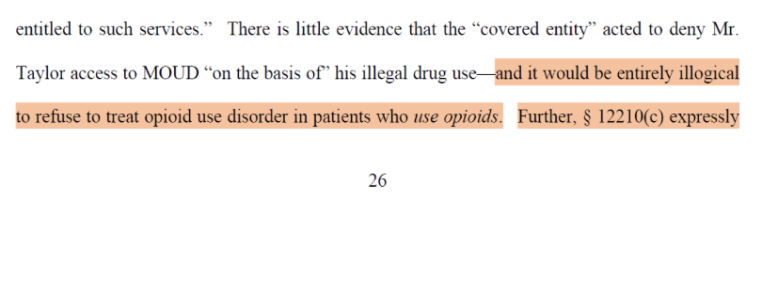
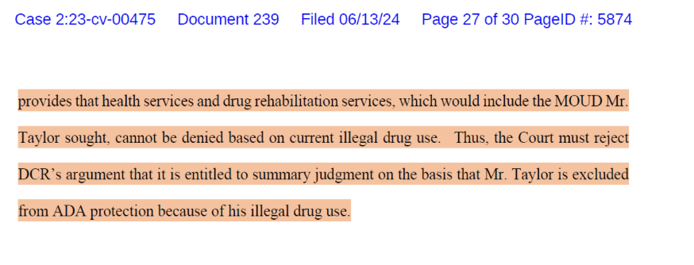
Exception to the exception: people in active use
Exception:
ADA protections do not apply if an individual is in active use or if they pose a danger to others
Exception to the exception:
They are protected, even if in active use, if seeking health services to which they are otherwise entitled
Taylor v. Wexford, et. al, (SDWVa) 2024

Slide 10
My options and approach
In this case:
Jail got nervous
Offered transfer to another jail with MOUD access
Pt got his SL buprenorphine/naloxone (Suboxone)
Didn’t need to file suit
Success facilitators:
Dedicated physician advocacy, bringing attention to the jail & to attorney, quick ROI to me; available for questions
Great AUSA in MA
First, meet client, get medical records
Second, did client request evaluation in prison and complete administrative grievance procedure?
Third, what advocacy did Dr. Shah already try?
Fourth, sent demand letter to general counsel at the prison.
Fifth, prepare for lawsuit
Notes:
Compassionate and committed advocacy

Slide 11
What can providers do? Speak up! And teach your staff how to!
Outpatient clinical practice
Prepare template letter
This is my pt
Dx of SUD/OUD
MOUD is medically necessary & denial will result in harm
Rx
Advise pt to submit sick call and grievance
Document everything in medical chart
All communications & efforts
All responses (or lack of) from jail
SNFs/Rehabs
Prepare letters- denying admission for SUD dx/MOUD is violation of federal law
Educate hospital staff to recognize illegal discrimination against patients
Consult attorney
Report to DOJ- locally to your civil rights division; nationally to disability rights section
Notes:
https://civilrights.justice.gov/report/?utm_campaign=499a0d26-884a-47aa-9afc-70094d92e6f5

Slide 12
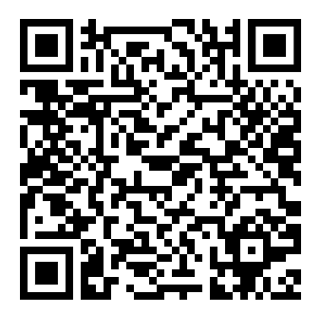
Reporting nationally to disability rights section
When to submit a complaint to the DOJ?
SNFs deny admission to patients because of MOUD or hx of SUD
PTs fired, custody denied, housing denied because of MOUD rx
Jail/prison denies treatment for OUD
ED turns patient away/fails to offer treatment after OD
Discriminated against in a commercial location or in a public place
Not sure if you should submit a complaint, or to where (national vs local)? Reach out!

Slide 13
Contact Info
Amelia Caramadre
Attorney, Kaplan & Grady
amelia@kaplangrady.com
312-815-2684
Call/email anytime
Ruchi Shah
Attending Physician/Assistant Professor, Montefiore Medical Center/Albert Einstein College of Medicine
rucshah@montefiore.org

