Slide 1
“The go-to response is let’s get them back in here:” factors influencing adoption of low-barrier treatment practices in outpatient buprenorphine
Maggie Lowenstein, MD, MPhil, MSHP
AMERSA Annual Meeting
November 16, 2024

Slide 2
I have no conflicts of interest to disclose

Slide 3
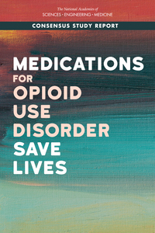
MOUDs save lives but few receive treatment
Inequities in Access to Care and Outcomes
NASEM, 2019; Dowell, 2024
Notes:
We all know that MOUDs are THE treatment for OUD
We also know that a minority of patients who receive treatment
And that there are significant racial and other inequities in outcomes and access to care

Slide 4
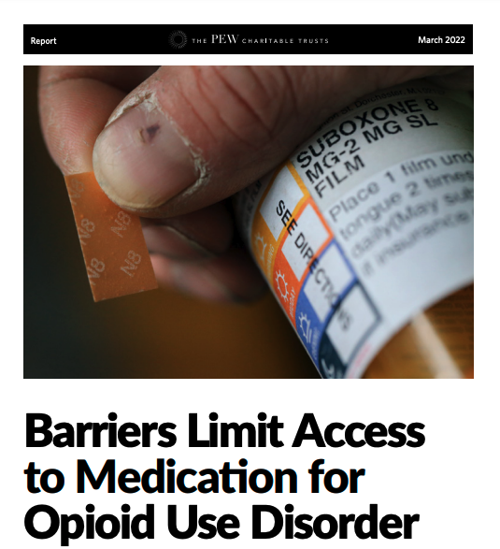
What gets in the way?
Policies (e.g. X-waiver)
Reimbursement and payor stipulations (e.g. prior authorization)
System navigation
Logistical barriers
Care coordination and competing priorities
Social determinants of health
Stigma toward OUD and MOUD
Pew, 2022
Jakubowski, 2019
Notes:
There is also a large literature on barriers to MOUDs/buprenorphine
Less research has focused on clinician/program attitudes and practices influnce access and retention in care`

Slide 5
What gets in the way?
Policies (e.g. X-waiver)
Reimbursement and payor stipulations (e.g. prior authorization)
System navigation
Logistical barriers
Care coordination and competing priorities
Social determinants of health
Stigma toward OUD and MOUD
Clinician/program attitudes and practices
Pew, 2022
Jakubowski, 2019
Notes:
There is also a large literature on barriers to MOUDs/buprenorphine
Less research has focused on the ways in which clinician/program attitudes and practices influnce access and retention in care`

Slide 6
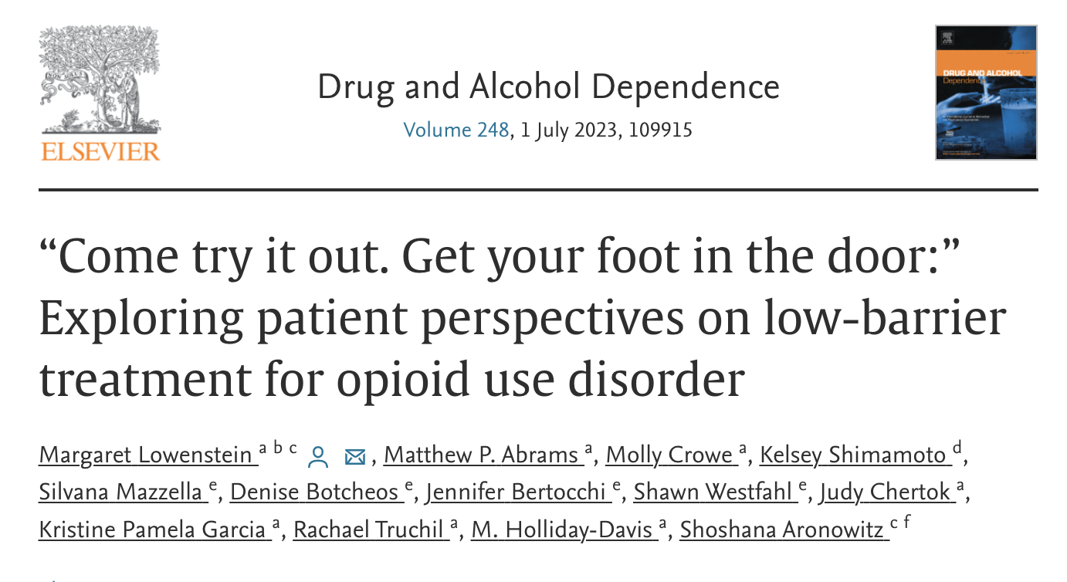
Lowenstein, 2023
Notes:
What do I mean by this?
Part of it that you know it when you see it
I work as a clinician and I have a sense about “good” and “bad” programs
We also hear from patients that they have preferences in treatment
But we don’t have much research focused on what this looks like and how it impacts care

Slide 7
Study Aim
To explore perspectives among opioid use disorder (OUD) treatment providers about adoption of high- vs. low-barrier buprenorphine prescribing practices.
Notes:
So our aim was ..

Slide 8
Methods
Semi-structured interviews with OUD treatment clinicians and staff in Philadelphia
Time Period: 2/2022-7/2023
Participants: Purposive sample of clinicians and staff from longitudinal buprenorphine programs
Interviews focused on buprenorphine prescribing practices and factors influencing these practices
Thematic content analysis
Notes:
To do this …

Slide 9
Participant Characteristics (n=29)
Characteristic | %
Professional Role
Physician | 66%
Counselor | 14%
Administrator | 10%
Other | 10%
≥5 years treating OUD | 85%
Age Range
<30 | 3%
31-40 | 40%
41-50 | 27%
>50 | 23%
Gender
Man | 60%
Woman | 40%
Race
White | 83%
Black/AA | 10%
Asian | 7%
Hispanic/Latinx Ethnicity | 0%
Notes:
Participants were 2/3 physicians and then a mix of other staff – counselors, admin, other (APP, case manager, etc)
Experienced 30s/40s/50s

Slide 10
Drivers of Practice Variability
Defining and incorporating harm reduction
Who is a good candidate for buprenorphine
Supporting treatment retention
Notes:
Data were rich and there was a lot to unpack
Today I’m going to highlight three areas where we saw a high degree of variability in both way clinicians or programs operated and the attitudes and beliefs that guided these approaches
These are…

Slide 11
Harm reduction
[Harm reduction is about] patient autonomy. I mean meet people where they're at, take them where they want to go, and don't be a judgmental bastard about it.
Notes:
We asked participants to reflect on how they defined harm reduction and how they operationalized this within their programs
We heard a lot about meeting people where they’re at, patient centered
Somewhat humorous illustrative quote

Slide 12
Harm reduction
In terms of the medication, we do practice harm reduction. There’s not a three strikes and you’re out type of program. What we do is, if someone is still using illicits and not using the Suboxone, we then we will work with that patient and strongly suggest that they go into inpatient.
Notes:
We also heard people using the term harm reduction in very different ways
Messaging has been received that we should be practicing in a “harm reduction” oriented way but that has not translated into practices that would be consistent with the I might define this

Slide 13
Who is a candidate for buprenorphine?
I will take anyone because … they have no other alternative, so then what? They go back to the street? I mean, how’s that helping them? I don’t know if there’s other providers that feel that way, but if not, they should really open their eyes.
Notes:
Another area of inquiry was asking people what made a person a good candidate for bup and fit for their program
One person

Slide 14
Who is a candidate for buprenorphine?
So basically patients who are willing to comply with the rules of the program … patients who are motivated and willing to cooperate, keep appointments, give urine samples, but mostly patients who are ready and are not gonna be using street drugs.
Notes:
Others focused much more on willingness to follow rules, abstinence goals
Very different approach to who deserves care

Slide 15
Assumptions about intentions
So, I pretty much know, by history, if they’re diverting [laughter]. And the UDS just kinda confirms it.
We really try to speak well of our patients, preserve their dignity and appreciate how difficult things are right now. So, even when they don’t have suboxone in their urine, it’s not necessarily assumed they’re diverting it.
Notes:
Baked into some of these were assumptions about intent

Slide 16
Supporting treatment retention
Usually it’s provider dependent, but we give two or three chances to determine if this is going to be a treatment that’s going to be appropriate and successful for them. And we talk about if they’re maybe more appropriate for methadone or if there’s things that is stopping them from consistently using?
Notes:
Finally we asked participants about ways in which they handled bumps in the road

Slide 17
Supporting treatment
So I would have to say that we’re just very quick to try to get people back in here once they miss an appointment … [We ask] are they okay? How can we help get them restarted with their treatment? So the go-to response is let’s get them back in here.

Slide 18
Study Limitations
Providers practicing in a single city
Social desirability bias
Unable to assess real-world practice, biases
No patient perspective
Notes:
bias

Slide 19
Discussion
High levels of variability in beliefs, approaches, and behaviors
Practices largely influenced by diverse beliefs about defining treatment “success”
Increasing buprenorphine access and retention requires us addressing this variability to improve care
Education, guidelines, and quality measures
Notes:
1. To summarize, we saw a high level variability in beliefs, approaches, and behaviors from clinicians and programs in Philadelphia
Relatively progressive city with access to a lot of support and training
2. Highly influenced by non-evidence based beliefs about defining treatment success
AMERSA bubble vs real world
Adoption of terminology
3. This likely has implications for patients – perhaps as much or more than the factors we hear a lot about
Likely that moving the needle on bupe access and retention will require us tackling some of this -
Some of that feels hard – may not change everyone into radical harm reductionists
But there are ways we can influence norms through education, guidelines, measure and incentivize quality

Slide 20
Discussion
Notes:
Heartened to see these new ASAM guidelines SAMHSA document
Important steps
When we think about our education+dissemination+implementation efforts and why people aren’t staying in treatment, focus needs to move towards not just providing treatment but on disseminating and incentivizing care that is truly effective

Slide 21
Acknowledgements
Research Team
M Holliday Davis, MA Hons
Selena Suhail-Sindhu, MPH
Gary McMurtrie, BA
Shoshana Aronowitz, PhD, MSHP
Funding
Pew Charitable Trusts

Slide 22
Questions?
Lowenstm@pennmedicine.upenn.edu
Notes:
With that, thank you and I would love to take your questions

Slide 23
Determining “success” in treatment
We require a urine drug screen every two weeks, which is when they pick up their buprenorphine … And, if there is benzo in the urine, more than one, we assess for if there’s a need for higher level of care. And, if there is not and the patient is not willing to stop, then that would be grounds for discharge from our buprenorphine program .. And anybody who is not able to engage four groups and four appointments, it’s self-selected basically because they discharge themselves out.
Notes:
Similar attitudes when it comes to determining success in treatment -
Adhere to expectations of attendance, abstinance

Slide 24
Determining “success” in treatment
We’re looking for what folks’ goals of care are and how we can support them in that and also a big component of harm reduction and overdose prevention, avoidance of injection-related complications and then addressing co-occurring psychiatric problems … screening for infectious diseases, contraception, and follow-up for acute medical complications.
Notes:
Patient-centered

