Slide 1
The Good, the Bad, and the Ugly: Patient Perspectives on Low Dose Buprenorphine Initiation in the Outpatient Setting in the Fentanyl Era
Leslie Suen, MD, MAS
Assistant Professor
UCSF Division of General Internal Medicine at San Francisco General Hospital
Notes:
Thank you CPDD for allowing me to speak today on our study on Comparative Effectiveness of Low Dose Induction Buprenorphine Protocols for People with Fentanyl Use Disorder

Slide 2
Disclosures
No conflicts of interest to report
This work is supported by:
Suen: AHRQ (K12HS026383), NIDA (K23DA060329)
Coffin: NIDA (K24DA042720)
Involves the use of off-label doses of buprenorphine
Notes:
I have no conflicts of interest to report
This work is funded by career development awards from the Agency for Health Care Research and Quality and NIDA for myself, and a K24 Mentoring Award for my primary mentor Dr. Phillip Coffin.
I will be discussing off-label doses of buprenorphine during my talk.

Slide 3
Background
The Good, the Bad, and the Ugly: Patient Perspectives on Low Dose Buprenorphine Initiation in the Outpatient Setting in the Fentanyl Era
Leslie Suen, MD, MAS | Leslie.Suen@ucsf.edu
Notes:
So first some background

Slide 4
Challenges with buprenorphine in the fentanyl era
Buprenorphine and methadone are gold-standard medications for opioid use disorder treatment with major mortality benefits
Only 1 in 5 patients with opioid use disorder access medications
Traditional buprenorphine induction requires opioid abstention and withdrawal, though some patients using fentanyl are still experiencing precipitated withdrawal when starting buprenorphine
Among patients using fentanyl, increasing fear of precipitated withdrawal is a major barrier to starting buprenorphine*
*Silverstein (IJDP 2019), Shearer (DAR 2021)
Notes:
I’m so lucky that I get to go after Dr. Thakrar because he did all the work explaining all the challenges with initiating buprenorphine in the fentanyl era
But as a refresher, buprenorphine and methadone are gold-standard medications for opioid use disorder treatment in the United States with major mortality benefits
However only 1 in 5 patients with OUD actually access these medications
In part, the challenge is because traditional buprenorphine induction requires opioid abstention and withdrawal, though as noted in our earlier presentation, some patients using fentanyl are still experiencing precipitated withdrawal when starting buprenorphine using traditional methods
We know from the literature that among patients using fentanyl, fear of precipitated withdrawal is perceived as a major barrier to starting buprenorphine, reducing its population health effects in curbing overdose deaths

Slide 5
Use of buprenorphine low dose inductions (LDI) has become a popular solution
LDI protocols use small, increasing doses of buprenorphine over several days while continuing fentanyl use
Theoretically, doses are too small to precipitate withdrawal & can allow gradual titrating to therapeutic doses
Our substance use treatment clinics offer two options for LDI (4-day & 7-day)
Medications bubble-packed through partner pharmacy for easier adherence
Day | 4-Day LDI | 7-Day LDI
Day 1 | 0.5mg q6 hours | 0.5mg once
Day 2 | 1mg q6 hours | 0.5mg twice a day
Day 3 | 2mg q6 hours | 0.5mg in AM, 1mg in afternoon & evening
Day 4 | 8mg twice a day* | 2mg twice a day
Day 5 | * | 3mg twice a day
Day 6 | * | 4mg twice a day
Day 7 | * | 8mg twice a day*
*Continue adjusting dosing as needed based on cravings

Slide 6
The Problem
Despite LDI’s increasing popularity and use, our prior work found that patients successfully complete LDI only a third of the time
Qualitative evaluation of patient experiences with LDI to identify barriers & facilitators to completing LDI needed

Slide 7
Methods
The Good, the Bad, and the Ugly: Patient Perspectives on Low Dose Buprenorphine Initiation in the Outpatient Setting in the Fentanyl Era
Leslie Suen, MD, MAS | Leslie.Suen@ucsf.edu

Slide 8
Study Methods
Semi-structured interviews with 19 patients prescribed LDI in the past year
Patients recruited from OBIC from Feb to Apr 2024, using purposive sampling to obtain diversity in race/ethnicity, gender, induction success, and LDI type
Interview guides focused on:
Experiences with buprenorphine in general
Experiences with LDI
Facilitators and barriers to LDI
Suggestions for future improvements
Interviews were audio recorded, transcribed, coded, and analyzed using thematic analysis

Slide 9
Results
The Good, the Bad, and the Ugly: Patient Perspectives on Low Dose Buprenorphine Initiation in the Outpatient Setting in the Fentanyl Era
Leslie Suen, MD, MAS | Leslie.Suen@ucsf.edu

Slide 10
Participant Characteristics
19 Participants
Mean Age: 39 years (SD 9)

Slide 11
Theme #1: Option for LDI was appealing for all patients, even for those who weren’t successful
The Good, the Bad, and the Ugly: Patient Perspectives on Low Dose Buprenorphine Initiation in the Outpatient Setting in the Fentanyl Era
Leslie Suen, MD, MAS | Leslie.Suen@ucsf.edu

Slide 12
Participant describing how the ability to continue using is appealing instead of stopping use for several days:
“The doctor's telling us that we can kind of still use. But trying to use it as spaced out as much as possible is definitely more appealing than stopping for three days and suffering for three days and then you can start it. I think it's a great idea. […] That option is definitely more appealing I know for users than to just being able to just stop completely.”
The Good, the Bad, and the Ugly: Patient Perspectives on Low Dose Buprenorphine Initiation in the Outpatient Setting in the Fentanyl Era
Leslie Suen, MD, MAS | Leslie.Suen@ucsf.edu

Slide 13
Participants appreciated the autonomy to decide when they would be ready to stop using fentanyl:
“I need to break up with my fentanyl and my meth on my time. Like I need to mentally prepare that I'm not going to use this anymore, and it can't be that night [when starting induction]. Like it's too quick. That’ll make me run away. Like I need to like literally break up with my boyfriend, you know what I mean, fentanyl and crystal meth, and do it on my time.”
The Good, the Bad, and the Ugly: Patient Perspectives on Low Dose Buprenorphine Initiation in the Outpatient Setting in the Fentanyl Era
Leslie Suen, MD, MAS | Leslie.Suen@ucsf.edu

Slide 14
Theme #2: While not experiencing precipitated withdrawal, ongoing symptoms of physical and mental discomfort were common
The Good, the Bad, and the Ugly: Patient Perspectives on Low Dose Buprenorphine Initiation in the Outpatient Setting in the Fentanyl Era
Leslie Suen, MD, MAS | Leslie.Suen@ucsf.edu

Slide 15
Participant describing waves of discomfort and constant fear of precipitated withdrawal
“Yeah, it was different. But it was still easy, it wasn't bad. […] But every time a wave hit me, I was like, it's never going to go away, like it's going to get worse. I'm going to start chucking like from across the room and whatever because that's what I would always be worried about, like am I going to start getting into the really bad dope sick, but I never did. It was all just like sweaty and just a little anxiety and like, [laughter] you know, scratching at the door.
The Good, the Bad, and the Ugly: Patient Perspectives on Low Dose Buprenorphine Initiation in the Outpatient Setting in the Fentanyl Era
Leslie Suen, MD, MAS | Leslie.Suen@ucsf.edu

Slide 16
Participant describing the mental battle of going through induction:
“I wasn't really dope sick, like I wasn't throwing up, I wasn’t, like--I was sweating but it wasn't really hard at all, it just was scared. Like I think it was the weakness in me was telling me, oh, wait, you got to use, like it ain't going to work. Physically I wasn't really going through anything, like I was like restless and, and sweating a little bit, but that was it. […] But I wouldn't even call it either withdrawing, like because I withdrew from fentanyl, and it's hell. The Subutex totally like slowed up the worst of the withdrawal symptoms, but like I said, this was the weakness in me trying to talk me out of just stopping.”
The Good, the Bad, and the Ugly: Patient Perspectives on Low Dose Buprenorphine Initiation in the Outpatient Setting in the Fentanyl Era
Leslie Suen, MD, MAS | Leslie.Suen@ucsf.edu

Slide 17
Theme #3: Buprenorphine blocking the effects of fentanyl without offering relief of symptoms increased risk of discontinuation
The Good, the Bad, and the Ugly: Patient Perspectives on Low Dose Buprenorphine Initiation in the Outpatient Setting in the Fentanyl Era
Leslie Suen, MD, MAS | Leslie.Suen@ucsf.edu

Slide 18
Participant describing frustration with buying fentanyl to not feel it, leading eventually to stopping buprenorphine
“Like you’re still trying to be buying drugs and using and you ain't even getting high, like what are you really doing, what's the point.[…] Like that first time, when I say like, on the third day I quit, the next morning after I didn't take [the fentanyl], I didn't feel it when I took it. I didn't take no more and then the next day I went and got some more, and I still didn't feel it.
But by the next day, that night of me not taking the Subutex in like a day and a half, I felt it like then, that second night I felt the, the high. I was like okay, and I didn't take no more Subutex for like a week and a half.”
The Good, the Bad, and the Ugly: Patient Perspectives on Low Dose Buprenorphine Initiation in the Outpatient Setting in the Fentanyl Era
Leslie Suen, MD, MAS | Leslie.Suen@ucsf.edu

Slide 19
Facilitators that helped ease LDI
Use of non-prescribed medications (cannabis, kratom, benzos)
Personal support systems
Bubble-packing medications to facilitate adherence
Non-stigmatizing, non-judgmental clinic environment
Everybody here like makes me feel very comfortable, they're not judging no matter how many times I’ve like been here starting over. They're not like the methadone clinic, where like if you have to start over again, you're kicked out.[…] It’s really nice to go somewhere where you're not judged. And I'm already like hard enough on myself, like I already feel like a piece of shit relapsing over and over, like I don't need my doctor to make me feel bad about this.”
The Good, the Bad, and the Ugly: Patient Perspectives on Low Dose Buprenorphine Initiation in the Outpatient Setting in the Fentanyl Era
Leslie Suen, MD, MAS | Leslie.Suen@ucsf.edu

Slide 20
Discussion
Comparative Effectiveness of Low Dose Initiation Buprenorphine Protocols for People with Fentanyl Use Disorder
Leslie Suen, MD, MAS | Leslie.Suen@ucsf.edu

Slide 21
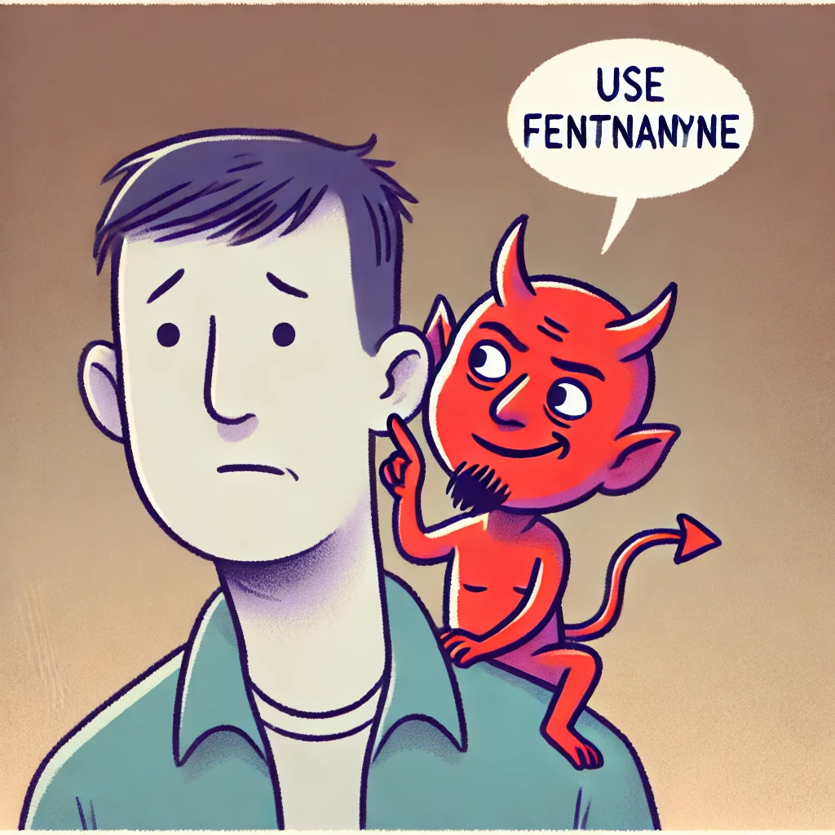
Keep using the fentanyl. Just skip the next dose of buprenorphine.
Barriers to LDI
🤢 Low grade discomfort throughout
😰Anxiety and fear of withdrawal
⚡Loss of fentanyl as coping mechanism during period of high vulnerability
🚫 Lack of relief from buprenorphine & blocking fentanyl effects
Discontinuation of Buprenorphine
💪😈

Slide 22
Strengths, Limitations, & Key Takeaways
Strengths: First qualitative study examining patient experiences with buprenorphine LDI in outpatient setting
Limitations
Specific to local experience and drug supply in San Francisco
Desirability bias as interviews conducted in same building as clinic
Key Takeaways
LDI is not a panacea & most people still experience discomfort
People need a lot of support to get through LDI
Need for evaluation of various interventions to support people through LDI

Slide 23
Thank you!
Study team: Elyssa Samayoa, Julie Chael, Christine Soran, Hannah Snyder, Kelly Knight, Phillip Coffin
Contact:
Leslie.Suen@ucsf.edu

