Slide 1
The Impact of Anti-Stigma Education in the Healthcare Field: A Program Design
Madison Walsh, MSc., Cara Poland, MD, MEd.
November 15, 2024

Slide 2
No Financial Disclosures

Slide 3
Learning Objectives
By the end of the presentation, attendees will be able to articulate and evaluate the rationale and components of the MI CARES anti-stigma education program, including the education implementation and its potential impact on healthcare professionals and patient outcomes.

Slide 4
The Need for SUD Treatment in the United States
Among people aged 12 or older in 2023 who needed substance use treatment in the past year, 23.6% received treatment.
Treatment includes:
inpatient location
outpatient location
via telehealth
prison, jail, or juvenile detention center
receipt of medication to treat alcohol use disorder or opioid use disorder
Source: Substance Abuse and Mental Health Services Administration. (2024). Key substance use and mental health indicators in the United States: Results from the 2023 National Survey on Drug Use and Health (HHS Publication No. PEP24-07-021, NSDUH Series H-59). Center for Behavioral Health Statistics and Quality, Substance Abuse and Mental Health Services Administration. https://www.samhsa.gov/data/report/2023-nsduh-annual-national-report

Slide 5
Medication for Substance Use Disorder
Among those with past-year AUD, 1.9% received medication for treatment of their AUD.
Among people with past-year OUD, 18% received medication to treat OUD.
Source: Substance Abuse and Mental Health Services Administration. (2024). Key substance use and mental health indicators in the United States: Results from the 2023 National Survey on Drug Use and Health (HHS Publication No. PEP24-07-021, NSDUH Series H-59). Center for Behavioral Health Statistics and Quality, Substance Abuse and Mental Health Services Administration. https://www.samhsa.gov/data/report/2023-nsduh-annual-national-report

Slide 6
Perceived Stigma in SUD Treatment
According to the World Health Organization, no other physical or mental illness is stigmatized more than substance use.
Health care professionals are the most commonly cited source of stigma for patients receiving treatment for substance use disorders.
Stigma among health care professionals leads to lower empathy, lower provider involvement, shorter visits, lower patient engagement and retention.
Source: Corrigan et al 2000; Crisp et al 2000; Luoma et al 2007; Avery et al 2017; Gilchrist et al 2011; Lindberg et al 2001

Slide 7
That’s where MI CARES comes in!
In 2018, the deans from all medical schools in Michigan convened to discuss undergraduate addiction medicine education.
The Michigan Collaborative for Addiction Resources and Education Systems was born.
Funded by State Opioid Response Dollars 2-4 from SAMHSA and NIDA R25.
MI CARES was developed in part to introduce the fundamentals of Addiction Medicine to medical students, with the goal of combating stigma.

Slide 8
Medical Education
35 addiction medicine educational modules adapted to UME and GME learners.
UME Learning:
Month-long elective for Michigan State University College of Human Medicine students since 2021.
Three, 2-week electives for Michigan State College of Human Medicine and College of Osteopathic Medicine students.
Curriculum adapted to five other medical schools in Michigan.
Notes:
Over 100 students educated through the intersession
Advanced elective now offered building upon previous elective and intersession

Slide 9
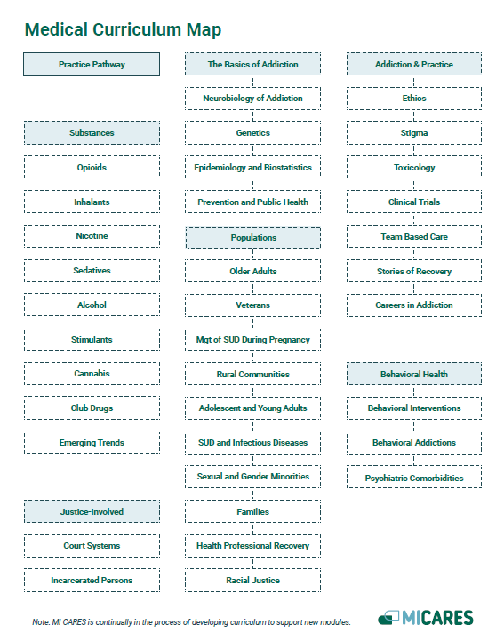
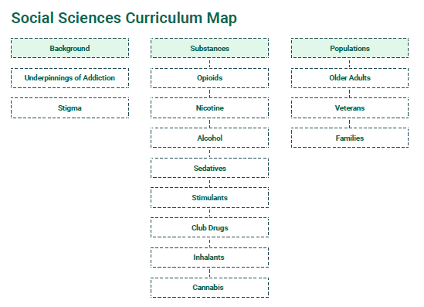
Curriculum Design

Slide 10
Anti-stigma Attitudes Survey
Question 1: Lifelong abstinence is a necessary goal in the treatment of substance use disorder.
Question 2: Once a person achieves abstinence for their substance use disorder through any means of treatment, they can never become a "social user" of substances.
Question 3: Physicians who diagnose substance use disorder early improve the chance of treatment success.
Question 4: Family involvement is a very important part of the treatment of substance use disorder.
Question 5: Once a patient is abstinent and off all medication for their substance use disorder, not further contact with a physician is necessary.
Question 6: Substance use disorder is a treatable disease.
Question 7: Alcohol use disorder is a treatable disease.
Question 8: A patient with substance use disorder who has relapsed several times probably cannot be treated.
Question 9: People with substance use disorders are unpleasant to work with as patients.
Question 10: A patient with a substance use disorder cannot be helped until he/she has hit "rock bottom."

Slide 11
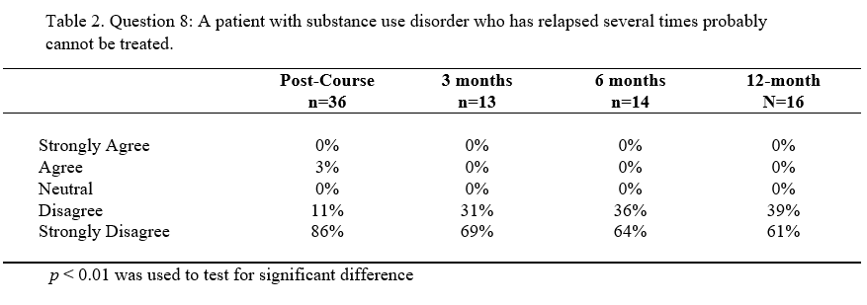
Results
Student attitudes show sustained attitude changes for one-year post-course.
Significant positive attitude changes included responses to the following survey questions.
Question 8 saw the greatest percentage of students switch from disagree (44%) to strongly disagree in the post-course survey.
86% percent strongly disagreeing that a patient with SUD who has relapsed several times probably cannot be treated, also signaling a change in attitude after the course was complete.
Most students changed from disagree (42%) to strongly disagree (81%) when asked if a patient with a SUD cannot be helped until they have hit “rock bottom”.

Slide 12
Current Impact and Future Directions
Over 1000 medical students from across the United States have completed the curriculum.
Partnered with 26 residency programs in Michigan.
47 residency program across the United States.
4,149 prescribers have completed the MATE Act training offered through MI CARES.
Adapted modules for social science.
Launched April 2024.
75 Social Work students throughout the United States.
Expansion to University of Alabama Medical School.
Future curriculum expansion to include case studies for individual learning modules.

Slide 13
MI CARES Vision
We envision a world where treatment is accessible for every individual with a substance use disorder, free of stigma and judgement. A world where there are enough Addiction Medicine Specialists in every health care field to meet the overwhelming demand of those struggling with substance use disorder in communities across the United States.

Slide 14
Contact Information:
www.micaresed.org
Madison Walsh, MSc.
walshm16@msu.edu
Cara Poland, MD, MEd.
polandc2@msu.edu

