Slide 1
The Impact of Near-Peer Teaching on a Naloxone Training Workshop and Opioid Overdose Simulation
Jachua Polcyn, MD Candidate, EMT-P
Nicole Rockich Winston, MS, PharmD, EdD

Slide 2
Conflict of Interests
We have no financial disclosure or conflicts of interest with the material in this presentation.

Slide 3
Introduction
Opioid related deaths have steadily increased to over 81,000 deaths in 2022.
Naloxone, though approved in the 1970s, was not made accessible to the general public until recently.
The implementation of government programs to provide naloxone to the community has improved accessibility and reduced stigma.

Slide 4
Purpose
The prevalence of opioid overdoses in general practice has made education on harm reduction and opioid overdose prevention an important topic in medical training.
Students must not only be trained on the administration of naloxone, but they must also be instructed on how to recognize an overdose and how to de-stigmatize the populations most affected by opioids.

Slide 5
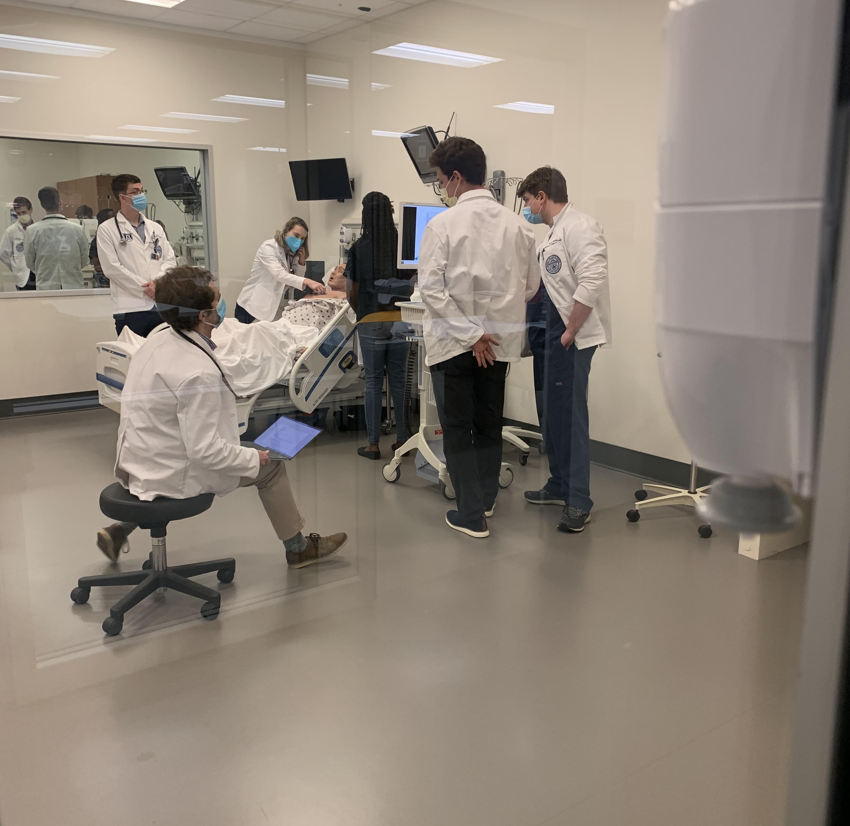
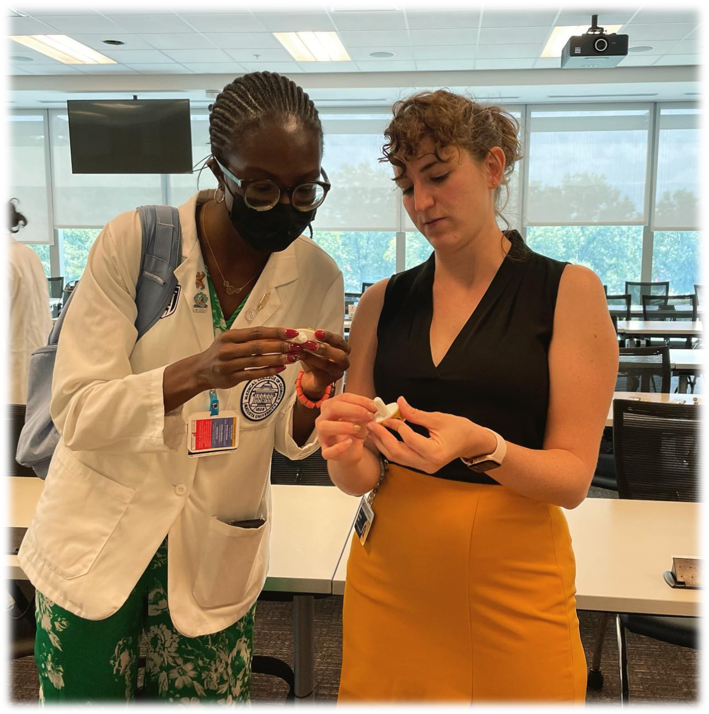
Methods
Pre-clinical students participated in a 1-hour workshop consisting of a simulated opioid overdose using high-fidelity mannequins followed by a hands-on naloxone training.
Faculty-Led Presenters: Emergency Physician and Clinical Pharmacist
Near-Peer Presenters: Student with Paramedic experience
Opioid Overdose Simulation
Naloxone Training

Slide 6
Methods
Pre- and post-tests/surveys were administered including the Opioid Overdose Knowledge Scale (OOKS) and Opioid Overdose Attitudes Scale (OOAS).
Descriptive statistics and independent t-tests assessed significant differences (p<0.05)
Qualitative analysis incorporated Glaser’s constant comparative method to identify themes.

Slide 7
Results
In total, 193 medical students participated in the workshop and 70 students completed the pre/post surveys.
Results from the OOKS survey demonstrated significantly higher knowledge scores (percent correct = 84.5% ± 0.09 versus 80.2% ± 0.1, p < 0.001 for near-peer and faculty-led, respectively) and more positive overall perceptions (OOAS) towards opioid overdoses (total score = 105.5 ± 8.4 versus 102.4 ±13.7, p = 0.02) for near-peer led sessions compared to faculty-led sessions.

Slide 8
OOKS | Faculty-Led Percent Correct (SD) (n=106) | Near-Peer Percent Correct (SD) (n=182) | P-Value
Overdose Risk Sub-scale | 77.6 (0.2) | 88.0 (0.2) | <0.001
Signs of Overdose Sub-scale | 75.6 (0.1) | 81.9 (0.1) | <0.001
Life Saving Actions Sub-scale | 86.5 (0.1) | 92.8 (0.1) | <0.001
Naloxone Use Sub-scale | 80.4 (0.1) | 77.9 (0.1) | <0.001
OOKS Total | 80.2 (0.1) | 84.5 (0.1) | <0.001
OOAS | Average (SD) | Average (SD)
Competence to Respond to an Overdose Sub-scale (score range: 10-50) | 38.7 (5.3) | 37.7 (3.1) | 0.044
Concerns About Intervening Sub-scale (score range: 7-35 | 26.7 (4.2) | 28.0 (3.6) | 0.006
Readiness to Intervene Sub-scale (score range: 9-45) | 36.7 (6.3) | 39.9 (3.8) | <0.001
OOAS Total (score range: 26-130) | 102.4 (13.7) | 105.5 (8.4) | 0.02

Slide 9
Results
Themes from open-ended questions included the effectiveness of the training by a peer medical student with previous emergency medical service training.

Slide 10
Significance
Our results demonstrate that a near-peer teaching, hands-on workshop focused on opioid overdose recognition and management significantly improved students' overall knowledge of and attitudes towards opioid overdoses.
The results align with current medical education literature that types of peer-assisted learning, including near-peer teaching, improve student comprehension

Slide 11
Strengths of Near Peer Teaching
In our study, the near-peer educator tailored the session to preclinical students’ level, focusing on relevant information to identify an opioid overdose in the community and appropriately manage.
Near-peer teaching also mitigates the traditional power dynamic between professional educator and student which improves engagement.
The feeling of equal footing also promotes comfort amongst peers and yields higher engagement.

Slide 12
Promotion of Diversity and Inclusion
By being taught by your peers who have diverse backgrounds and experience in various communities you can better understand and empathize with their experiences.
By placing an emphasis on healthcare disparities and the socioeconomic factors impacting the opioid epidemic, students can learn how to address said issues from classmates with similar limitations.

Slide 13
Limitations
The students were not required to complete the OOKS or the OOAS, so the results may not reflect the knowledge and attitudes of all students who participated in the training.
Additionally, our study captured data after the training program, and did not evaluate knowledge retention and attitudes longitudinally

Slide 14
Example Quotes
“The presentation was very informative and met us right where we are at in terms of knowledge. The emphasis on clinical relevance & non-biased approach to patients was great.”
“Fun, engaging speaker. Hit important clinic pearl points. I feel prepared with real knowledge instead of book knowledge after her talk.”

Slide 15
Conclusion
This 1-hour workshop can be implemented by other programs to address the current opioid epidemic by increasing the number of healthcare trainees trained in opioid overdose management.
The near-peer teaching model within the medical school curriculum can be advantageous for knowledge acquisition, and interprofessional collaboration, particularly by capitalizing on the unique backgrounds of students.

Slide 16
References
National Institute on Drug Abuse. Drug Overdose Death Rates. Retrieved from: https://nida.nih.gov/research-topics/trends-statistics/overdose-death-rates.
Tylleskar I, Gjersing L, Bjørnsen LP, et al. Prehospital naloxone administration - what influences choice of dose and route of administration?. BMC Emerg Med. 2020;20(1):71. doi:10.1186/s12873-020-00366-3
Bohler RM, Hodgkin D, Kreiner PW, Green TC. Predictors of US states' adoption of naloxone access laws, 2001-2017. Drug Alcohol Depend. 2021;225:108772. doi:10.1016/j.drugalcdep.2021.108772
Jack HE, Warren KE, Sundaram S, et al. Making Naloxone Rescue Part of Basic Life Support Training for Medical Students. AEM Educ Train. 2018;2(2):174-177. Published 2018 Mar 30. doi:10.1002/aet2.10095
Moses TEH, Moreno JL, Greenwald MK, Waineo E. Training medical students in opioid overdose prevention and response: Comparison of In-Person versus online formats. Med Educ Online. 2021;26(1):1994906. doi:10.1080/10872981.2021.1994906
Sandhu RK, Heller MV, Buckanavage J, et al. A longitudinal study of naloxone opioid overdose awareness and reversal training for first-year medical students: specific elements require reinforcement. Harm Reduct J. 2022;19(1):70. Published 2022 Jul 2. doi:10.1186/s12954-022-00656-y

Slide 17
References
Hallikainen J, Väisänen O, Rosenberg PH, Silfvast T, Niemi-Murola L. Interprofessional education of medical students and paramedics in emergency medicine. Acta Anaesthesiol Scand. 2007;51(3):372-377. doi:10.1111/j.1399-6576.2006.01224.x
Brierley C, Ellis L, Reid ER. Peer-assisted learning in medical education: A systematic review and meta-analysis. Med Educ. 2022;56(4):365-373. doi:10.1111/medu.14672
Loda T, Erschens R, Loenneker H, et al. Cognitive and social congruence in peer-assisted learning - A scoping review. PLoS One. 2019;14(9):e0222224. doi:10.1371/journal.pone.0222224
Williams AV, Strang J, Marsden J. Development of Opioid Overdose Knowledge (OOKS) and Attitudes (OOAS) Scales for take-home naloxone training evaluation. Drug Alcohol Depend. 2013;132(1-2):383-386. doi:10.1016/j.drugalcdep.2013.02.007
Glaser BG. The Constant Comparative Method of Qualitative Analysis. Social Problems, 1965; 12(4):436–445. doi.org/10.2307/798843
Nestel D, Kidd J. Peer tutoring in patient-centred interviewing skills: experience of a project for first-year students. Med Teach. 2003;25(4):398-403. doi:10.1080/0142159031000136752

Slide 18
References
Ten Cate O, Durning S. Dimensions and psychology of peer teaching in medical education. Med Teach. 2007;29(6):546-552. doi:10.1080/01421590701583816
Chng E, Yew EH, Schmidt HG. To what extent do tutor-related behaviours influence student learning in PBL? Adv Health Sci Edu. 2015; 20(1):5–21. doi.org/10.1007/s10459-014-9503-y
Tayler N, Hall S, Carr NJ, Stephens JR, Border S. Near peer teaching in medical curricula: integrating student teachers in pathology tutorials. Med Ed Online. 2015; 20: https://doi.org/10.3402/meo.v20.27921

Slide 19
References
Funding for this project was made possible by initiative GA1RH42874 from HRSA.

