Slide 1
The impact of SHIELD training on law enforcement officers’ harm reduction attitudes, beliefs, and knowledge
ST SIDDIQUI, Z BUDESA, L CONNORS, A LA MANNA, R SMITH, J GOULKA, L BELETSKY, RP WINOGRAD
Notes:
Hi! I’m Saad Siddiqui from the Missouri Institute of Mental Health in St. Louis, and
I will be presenting on the impact that SHIELD training had on law enforcement officer’s knowledge, harm reduction attitudes
And beliefs about overdose response

Slide 2
Disclosure
This work was supported by a grant from the Substance Abuse and Mental Health Services Administration, First Responders - Comprehensive Addiction and Recovery Act Grants.

Slide 3
Deaths from opioid overdose continue to rise in Missouri
Missouri Deaths from Opioid Overdose – Counts¹
MISSOURI DHSS DATA, 2023*
* Preliminary data
Notes:
There has been an upward trend in deaths from opioid overdose in Missouri, over the course of the last 8 years

Slide 4
Law enforcement in opioid overdose response
Law enforcement officers (LEOs) may be the first responders to overdoses
Initial contact for people who use drugs (PWUD)
Notes:
In Missouri, law enforcement officers respond to a lot of overdose calls
And as a result they are the first interaction for overdose survivors,
and an initial contact for people who use drugs

Slide 5
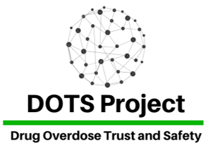
Law enforcement in opioid overdose response
In Missouri:
Connect the DOTS (Drug Overdose Trust & Safety) Project
Based on the Safety and Health Integration in the Enforcement of Laws on Drugs (SHIELD) model¹
¹ SHIELD Training Institute, Northeastern University
Notes:
Our project – called Connect the DOTS – has been training law enforcement in Missouri to improve their overdose response practices
It utilizes the SHIELD model, which stands for Safety and Health Integration in the Enforcement of Laws on Drugs,
developed by the SHIELD Training Institute at Northeastern University
This model uses an occupational safety lens to improve law enforcement harm reduction practices and attitudes

Slide 6
LEO attitudes/beliefs in opioid overdose response
LEO can have
naloxone-related risk compensation beliefs¹
negative attitudes towards PWUD²
Improving attitudes and beliefs to improve LEO–PWUD interactions
¹ Winograd et al., 2019
² Murphy & Russell, 2020
Notes:
Prior research has demonstrated that law enforcement can harbor naloxone-related risk compensation beliefs
These are concerns that easy access to a lifesaving drug such as naloxone can condone risky drug use
Research has also demonstrated that law enforcement can have negative attitudes towards people who use drugs
Improving such beliefs and attitudes is crucial towards improving interactions between law enforcement and people who use drugs, while also helping law enforcement justify naloxone rescues

Slide 7
SHIELD training
Module 1
Responder Resilience
Coping mechanisms
Burnout reduction
Module 2
Responder Safety
Occupational safety strategies
Module 3
Public Safety
Public health
Improve community relations—while also reducing stress and risks
Notes:
Here is a little bit about the SHIELD training
It comprises 3 modules, the first two of which deal with first responder mental health and occupational safety
Specifically, tools and strategies to reduce burnout, and reduce physical risks
The third module is about public safety and harm reduction, including strategies to improve community relations and enhance field impact

Slide 8
Our strategy
Occupational Safety
Harm reduction/ Improved attitudes towards PWUD
Notes:
We pitch our strategy as a win-win for law enforcement: they reduce their occupational risks, people who use drugs get harm reduction
We do not teach-to-the-test, per se
We talk occupational safety, officer mental health, and some public health practices
But as we will shortly demonstrate, we see improvement in officers’ beliefs and attitudes following training

Slide 9
SHIELD training
3 hour training
2 trainers
1 first responder
1 local harm reduction trainer with lived experience
Notes:
Trainings lasted approximately 3 hours
Conducted by a team of 2 trainers, 1 first responder and 1 harm reduction trainer who is a person with lived experience

Slide 10
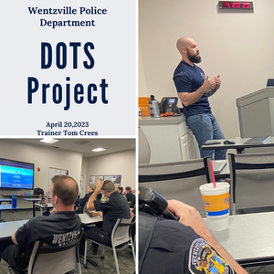
1,331 LEOs trained between Dec 2020 and May 2023
103 training sessions
94% reported learning something new
Notes:
Between December 2020 and May 2023, we trained 1,331 law enforcement officers
Through 103 training sessions,
And 94% of our participants reported they learned new information or skills as a result of the training

Slide 11
Evaluation questions
Following training, what is the change in law enforcement officers’
Knowledge of disease risk from needle-stick injury?
Knowledge of risk of overdose from fentanyl exposure (inhaling or touching)?
Attitudes towards people who use drugs?
Naloxone-related risk compensation beliefs?
Notes:
For knowledge evaluation, we asked, following training, what is the change in knowledge of disease risk from NSI
And what is the change in knowledge of risk of overdose from inhaling or touching fentanyl
For attitudes and beliefs, we asked:
what is the change in officers’ attitudes towards PWUD,
and what is the change in their naloxone-related risk compensation beliefs

Slide 12
Methods
Comparison of pre- and post-training scores:
Occupational safety knowledge
Needle-stick injury disease risk
Risk of overdose from fentanyl exposure
Attitudes and beliefs
Naloxone-related risk compensation beliefs
Negative attitudes towards people who use drugs
Notes:
We collected survey data at pre and post-training from consenting participants
The survey recorded demographic information, occupational safety knowledge, and attitudes and beliefs
In terms of specifics, for occupational safety we asked participants about
The disease that is most likely from needle-stick injury
With options like HIV, Hepatitis, TB and even heart disease. Correct answer in this case is hepatitis
We asked whether the risk of disease from NSI is high, which it is not
We further asked whether the risk of overdose from inhaling or touching fentanyl is high, which it is not
As you can see, we got very topical with occupational safety for law enforcement
I will discuss the attitudes and beliefs scales in detail next

Slide 13
Beliefs scale
Naloxone-related Risk Compensation Beliefs (NaRRC-B) Scale
4 items
4-point Likert scale
High score = high risk compensation beliefs
Notes:
To measure risk compensation beliefs, we utilized the Naloxone-related Risk Compensation Beliefs, or the NARRC-B scale
It comprised 4 items, measured on a 4-point Likert scale, from strongly disagree to strongly agree
High score represented high endorsement of risk compensation beliefs

Slide 14
Attitudes scale
Opioid Overdose Attitudes Scale (OOAS)
5 items
4-point Likert scale
High score = high negative attitudes towards PWUD
Notes:
To measure negative attitudes towards people who use drugs, we used the Opioid Overdose Attitudes Scale
Comprising 5 items
Measured across a 4-point Likert scale measuring agreement
High score meant high negative attitudes towards people who use drugs

Slide 15
811 pre-test | 632 post-test
MEAN AGE: 37.45 years (±10.14) MEAN TENURE: 12.03 years (±10.23)
Notes:
Pre-test surveys were completed by 811 participants, 85% of whom were men and 78% were White
The mean age was about 37 ½ years, and mean tenure in law enforcement was 12 years
Post-test surveys were completed by 632 participants.

Slide 16
Knowledge evaluation

Slide 17
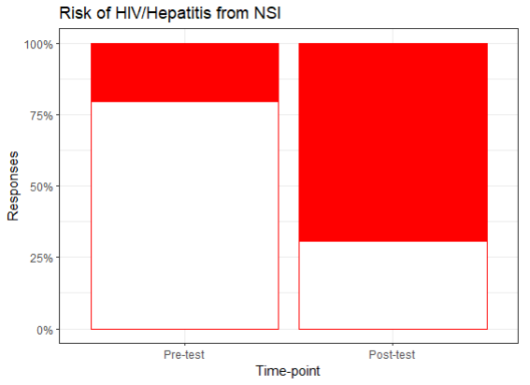
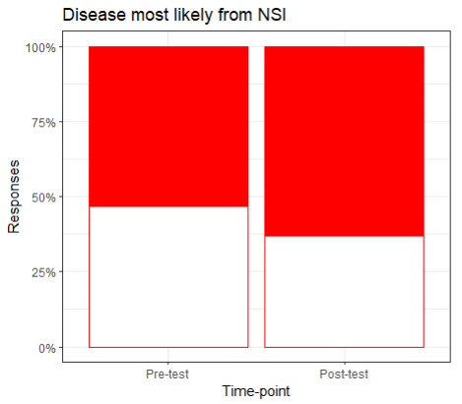
Disease risk from needle-stick injury
Risk of disease from needle-stick injury
Disease most likely from needle-stick injury
24% correct
53% correct
63% correct
77% correct
χ2 | p-value
213.14 | <0.001
χ2 | p-value
14.34 | <0.001
Notes:
Following training, there was an improvement in the knowledge of disease risk from NSI
Whether the disease risk was high, 24% answered “False” correctly at pretest, and 77% answered correctly at post.
About which disease was most likely, even though the improvement was not as high from 53% to 63%, it was still statistically significant.

Slide 18
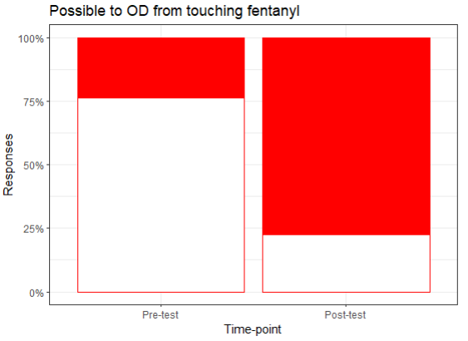
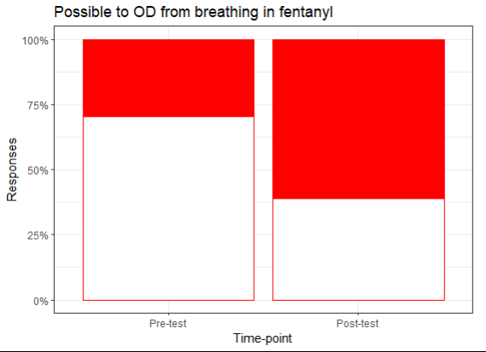
Overdose risk from inhaling/touching fentanyl
High OD risk from touching fentanyl
High OD risk from inhaling fentanyl
24% correct
29% correct
61% correct
77% correct
χ2 | p-value
228.17 | <0.001
χ2 | p-value
233.91 | <0.001
Notes:
There was an improvement in knowledge of the risk of overdose from touching or inhaling fentanyl
As you can see, the improvement in correct responses from pre- to posttest was large and statistically significant in both instances,
albeit a bit less for inhaling than for touching fentanyl

Slide 19
Beliefs/attitudes evaluation

Slide 20
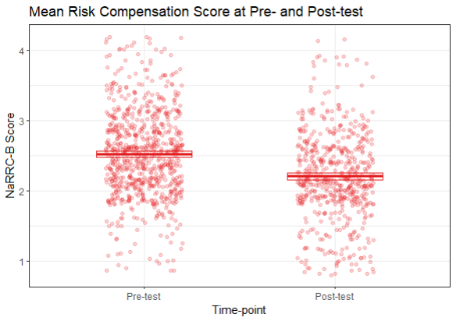
Naloxone- related risk compensation
t-statistic | p-value
13.23 | <0.001
2.52
2.21
Notes:
There was a statistically significant reduction in naloxone-related risk compensation beliefs
From 2.52 out of a possible 4 to 2.21 at post-test

Slide 21
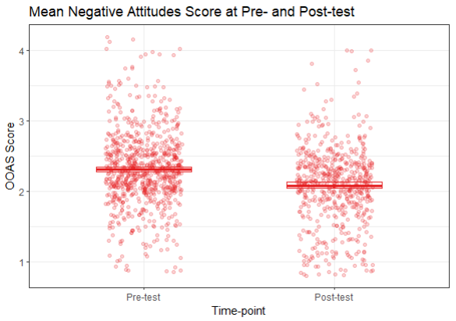
Negative attitudes towards PWUD
t-statistic | p-value
10.53 | <0.001
2.31
2.08
Notes:
There was also a statistically significant reduction in negative attitudes towards people who use drugs
From 2.31 out of a possible 4 to 2.08 at post-test

Slide 22
SHIELD training for Missouri law enforcement
Reduced NaRRC beliefs
Improved NSI knowledge
Improved fentanyl risk knowledge
Reduced negative attitudes towards PWUD
Notes:
Following SHIELD training, Missouri law enforcement officers had improved knowledge of
Fentanyl exposure risk
And NSI disease risk
As well as reduced naloxone-related risk compensation beliefs and reduced negative attitudes towards PWUD

Slide 23
SHIELD training for Missouri law enforcement
Reduction in adverse outcomes of LEO-PWUD interaction
Broader dissemination of the SHIELD model is warranted
Notes:
This improvement is critical to reduce adverse outcomes of interactions between LEOs and PWUD
While also encouraging harm reduction practices from LEO

Slide 24
Going forward
Qualitative, longitudinal evaluation of impact of training
Stigma reduction – MO-CORPS
Assessment of law enforcement attitudes and beliefs from PWUD perspective
Do LEO interact with people who use drugs differently based on race?
Notes:
Going forward, a mixed methods or qualitative study on the impact of training would help add to the evidence of attitudes and beliefs scores translating to on-field behaviors
A quasi-experimental design would be especially helpful in attributing change in knowledge and attitudes to the training
It has been a challenge in the way this intervention is set up to obtain a reliable perspective from our main stakeholders, people who use drugs
Most of our understanding has been anecdotal or indirect, and a direct qualitative assessment of their perspective is imperative
Additionally, an understanding of law enforcement attitudes and beliefs being consistent across races, sexualities and socio-demographic categories is necessary
Our next project, taking lessons from the current one and already underway, specifically addresses stigma reduction towards people who use drugs

Slide 25
“Thanks on behalf of the entire city police department and especially the roughly 550 officers trained this season. The content of the course was on target and well appreciated, and your cadre of instructors was universally praised. Even our most dedicated cynics couldn’t muster a complaint about this class.”
Notes:
Thank you!
And while I take your questions, I leave you with a testimonial we received about the training from the St. Louis Police Academy

Slide 26
Thank you!

