Slide 1
Mallet R. Reid PhD LMSW
AMERSA 2024 Oral Abstract Presentation
PhD Ecological-Community Psychology
Licensed Master Social Worker (Clinical)
Department of Family Medicine, Michigan State University
Latino Scholar-Activist focused on promoting racial equity
No conflicts of interest to declare.

Slide 2
Problems Posed by the Lack of Racial Diversity in Co-Occurring PTSD and SUD Research

Slide 3
Key Takeaways
Fundamental failure to address matters of race & racism
We are not including enough people of color in research
Not addressing people of color’s issues
Poorly equipping clinicians with tools that may:
Address racism
Help clients navigate racial stress & trauma

Slide 4
Posttraumatic Stress Disorder & Substance Use Disorder (American Psychiatric Association, 2013)
PTSD
SUD
Mental health condition triggered by trauma.
Problematic substance use leading to significant impairment & distress.
Notes:
A mental health condition triggered by experiencing or witnessing a traumatic event.
A problematic pattern of substance use leading to significant impairment and distress
American Psychiatric Association. (2022). Diagnostic and statistical manual of mental disorders (5th ed., text rev.). American Psychiatric Publishing.

Slide 5
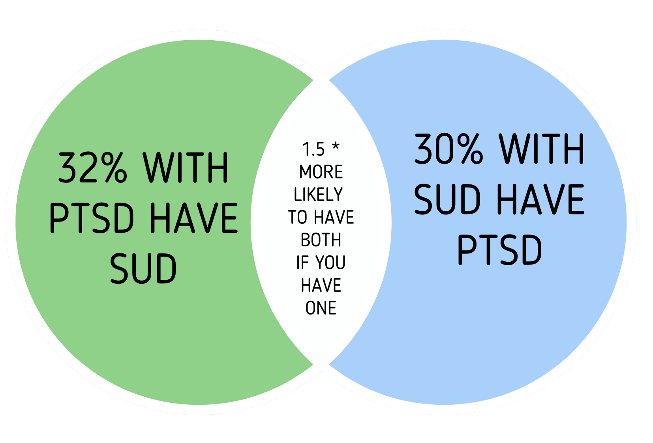
PTSD & SUD Frequently
Co-Occur
Smith & Cottler, 2018

Slide 6
Prevalence & Health Disparities
6 million US adults have PTSD/SUD
People of color odds of PTSD/SUD (Simpson et al., 2019; Blanco et al., 2017)
People of color have worse health outcomes (Emerson et al., 2019)
More severe & chronic symptoms, early mortality
Endure unique challenges linked with PTSD/SUD onset & severity
Racial discrimination & trauma, microaggressions (Bird et al., 2021; Vaeth et al., 2017)
Therapy often differentially effective by race (Sue et al., 2022)
PTSD & SUD treatments less effective (Windsor et al., 2015)
Notes:
Researchers hypothesize that because people of color are more often exposed to traumatic circumstances than White people and because they have fewer beneficial social resources to cope with problematic substance use or trauma, POC and White people likely have similar prevalence rates.
Pole, N., Gone, J. P., & Kulkarni, M. (2008). Posttraumatic Stress Disorder Among Ethnoracial Minorities in the United States. Clinical Psychology: Science and Practice, 15(1), 35-61. https://doi.org/https://doi.org/10.1111/j.1468-2850.2008.00109.x
Windsor, L. C., Jemal, A., & Alessi, E. J. (2015). Cognitive behavioral therapy: a meta-analysis of race and substance use outcomes. Cultural diversity & ethnic minority psychology, 21(2), 300-313. https://doi.org/10.1037/a0037929

Slide 7
Current Study
People of color > risk, worse health outcomes, unique clinical challenges, therapy less effective:
They must be included in clinical research!
But are they?
Is research targeting their unique challenges?
Is research ensuring treatments are effective?
Notes:
Detect differential efficacy of treatment across groups
Determine the distribution of benefits & risks of treatment across groups

Slide 8
Methods
Umbrella review & narrative synthesis
Amass systematic reviews/meta-analyses (Lazaros et al., 2022).
Qualitatively assess studies within reviews (Sutton et al., 2019).
Systematic search using PRISMA guidelines (Page et al., 2021)
Inclusion criteria:
PTSD/SUD Systematic reviews and/or meta-analyses.
Treatments for co-occurring SUD and PTSD.
US-based studies.
Notes:
Search terms: (“systematic review" OR "Scoping review" OR "state of the art review" OR "meta-analysis" OR "meta analysis" AND “Post-traumatic stress disorder” OR “PTSD” OR “alcohol use” OR “alcohol abuse” OR “alcohol addiction” OR “alcohol dependance” OR “alcoholism OR "substance use disorder" OR "opiod use disorder").
2020 PRISMA statement (Page et al., 2021).
Covidence for title, abstract, & full-text review

Slide 9
Results: Study Composition

Slide 10
Results: Racial Demographic Composition
Notes:
54.38% decline from White to Black people in terms of sample demographics
Indeed- somewhat mirrors the general population, but we know that when people have worse risk for a disease, we must be including them at rates adequate to mirror their risk severity- this data indicates that we are under including people of color as they have a higher risk rate compared to White people.
Stratification by risk in epi. When specific prevalence data is unavailable but there is general evidence indicating that people of color face higher risks of developing substance use disorders (SUD), stratification by risk still supports the need to include these groups in research at rates exceeding their general population proportions. Even without exact prevalence figures, the concept of stratification by risk highlights that higher-risk groups should be more thoroughly represented to capture meaningful insights into their unique risk factors, experiences, and responses to interventions.
In this case, stratification by risk implies that it’s scientifically and ethically appropriate to increase the representation of people of color in SUD studies beyond their baseline population percentage. Failing to do so risks underrepresenting their experiences and missing critical factors that could help improve prevention and treatment strategies tailored to these groups’ needs. The approach suggests prioritizing inclusion of people of color in ways that reflect their heightened vulnerability, thus facilitating research that can better address disparities in SUD outcomes.

Slide 11
So What?
Practically equivalent to general population
Greater risk means greater focus recruiting a population
No studies intentionally recruited people of color.
Yet they did so for other groups

Slide 12
> 50% studies for combat veterans treated combat trauma
100% studies for women treated either intimate partner or domestic violence
Evident that we target certain groups
Evident that we target certain issues

Slide 13
Attention to Race & Racism
We may pay attention to certain groups
We may pay attention to certain issues
We are not attending to people of color
We are not attending to race or racism
(Pearson et al., 2019)
Notes:
These data demonstrate that researchers recognize the importance of focusing studies on the needs of vulnerable groups like combat veterans & women. However, we have yet to systematically focus our efforts on addressing the needs of oppressed groups. Researchers clearly recognize that certain groups and certain challenges warrant investigation. They recognize certain contextual realities, but are not recognizing racism, or other issues relevant to race. This is problematic because we maintain ignorance around whether treatments for POC (either culturally informed or those specifically designed to address issues like racial trauma, discrimination, microaggressions, etc.) will help them cope better than TAU, will ensure they remain in tx longer. We don’t have to design studies specifically for these issues, either. We can sprinkle them in, but nobody referenced doing that if they did.

Slide 14
Results: Effectiveness of Treatment by Race
Results = treatment less effective for people of color.
Amaro et al., 2007
“… the effects of the intervention… were strongest for non-Hispanic white and weakest for other groups [people of color].”
Frisman et al., 2008
“…White participants improve[d] more than other participants… non-White males more likely to drink to intoxication or use illegal substances at the 12-month follow-up…”
Notes:
Two studies evaluated the effectiveness of their interventions by race.

Slide 15
Problems Results Pose?
Question generalizability/applicability of research
Treatment less effective for POC
Zero tools for POC’s unique challenges
Notes:
POC have higher odds of disorder & worse health outcomes, further, there is evidence that has been out for a while to suggest they aren’t responding as well to tx. We’re not recruiting them into studies @ sufficiently high rates enough to be able to test whether our interventions are effective
Frisman, L., Ford, J., Lin, H.-J., Mallon, S., & Chang, R. (2008). Outcomes of trauma treatment using the TARGET model. Journal of Groups in Addiction & Recovery, 3(3–4), 285–303.

Slide 16
What Can Clinicians Do?
Interrogate existing models of treatment
Tested/adapted for POC & effective for POC?
Acknowledge people of color have unique challenges
Bring this up in treatment
Formalize racial equity training (Chatterjee et al., 2022)
Increase knowledge race(ism) & relationship PTSD & SUD
Use protocols designed for race(ism)
Racial trauma scale & treatment protocols (Williams et al., 2018)
SUD culturally adapted treatments (Banks et al., 2023)
Notes:
https://liberationlab.education.illinois.edu/docs/librariesprovider10/default-document-library/cobras-short-and-long-forms296d7c3980b76a29a33dff05008a8698.pdf?sfvrsn=5cda1688_0

Slide 17
What Can Researchers Do?
Increase rates of people of color in PTSD/SUD research
Composite or combined group scores to determine tx effectiveness
Meta-analysis of treatment effectiveness across racial groups
More culturally tailored treatment investigations
Address unique issues like racial trauma
Acknowledge racism as a fundamental contextual issue influencing PTSD/SUD, people of color’s experience with clinical spaces

Slide 18
References
Amaro, H., Dai, J., Arévalo, S., Acevedo, A., Matsumoto, A., Nieves, R., & Prado, G. (2007). Effects of integrated trauma treatment on outcomes in a racially/ethnically diverse sample of women in urban community-based substance abuse treatment. Journal of Urban Health, 84, 508-522.
American Psychiatric Association. (2022). Diagnostic and statistical manual of mental disorders (5th ed., text rev.). American Psychiatric Publishing.
Blanco, C., Xu, Y., Brady, K., Pérez-Fuentes, G., Okuda, M., & Wang, S. (2013). Comorbidity of posttraumatic stress disorder with alcohol dependence among US adults: Results from national epidemiological survey on alcohol and related conditions. Drug and Alcohol Dependence, 132(3), 630-638. https://doi.org/doi.org/10.1016/j.drugalcdep.2013.04.016
Chatterjee, A., Glasgow, L., Bullard, M., Sabir, M., Hamilton, G., Chassler, D., ... & Martinez, L. S. (2022). Placing racial equity at the center of substance use research: lessons from the healing communities study. American Journal of Public Health, 112(2), 204-208. https://doi.org/10.2105/AJPH.2021.306572
Emerson, M. A., Moore, R. S., & Caetano, R. (2019). Correlates of alcohol‐related treatment among American Indians and Alaska natives with lifetime alcohol use disorder. Alcoholism: Clinical and Experimental Research, 43(1), 115-122. https://doi.org/https://doi.org/10.1111/acer.13907
Frisman, L., Ford, J., Lin, H.-J., Mallon, S., & Chang, R. (2008). Outcomes of trauma treatment using the TARGET model. Journal of Groups in Addiction & Recovery, 3(3–4), 285–303.
Lazaros, B., Vanesa, B., & John, P. A. I. (2022). Conducting umbrella reviews. BMJ Medicine, 1(1), e000071. https://doi.org/10.1136/bmjmed-2021-000071
Page, M. J., McKenzie, J. E., Bossuyt, P. M., Boutron, I., Hoffmann, T. C., Mulrow, C. D., Shamseer, L., Tetzlaff, J. M., Akl, E. A., & Brennan, S. E. (2021). The PRISMA 2020 statement: an updated guideline for reporting systematic reviews. International Journal of Surgery, 88, 105906. https://doi.org/https://doi.org/10.1136/bmj.n71
Pole, N., Gone, J. P., & Kulkarni, M. (2008). Posttraumatic Stress Disorder Among Ethnoracial Minorities in the United States. Clinical Psychology: Science and Practice, 15(1), 35-61. https://doi.org/https://doi.org/10.1111/j.1468-2850.2008.00109
Simpson, T. L., Rise, P., Browne, K. C., Lehavot, K., & Kaysen, D. (2019). Clinical presentations, social functioning, and treatment receipt among individuals with comorbid life‐time PTSD and alcohol use disorders versus drug use disorders: Findings from NESARC-III. Addiction, 114(6), 983-993. https://doi.org/doi.org/10.1111/add.14565
Smith, N. D. L., & Cottler, L. B. (2018). The epidemiology of post-traumatic stress disorder and alcohol use disorder. Alcohol Research, 39(2), 113-120.
Sue, D. W., Sue, D., Neville, H. A., & Smith, L. (2022). Counseling the culturally diverse: Theory and practice. John Wiley & Sons
Sutton, A., Clowes, M., Preston, L., & Booth, A. (2019). Meeting the review family: exploring review types and associated information retrieval requirements. Health Information & Libraries Journal, 36(3), 202-222.
Windsor, L. C., Jemal, A., & Alessi, E. J. (2015). Cognitive behavioral therapy: a meta-analysis of race and substance use outcomes. Cultural Diversity & Ethnic Minority Psychology, 21(2), 300-313. https://doi.org/10.1037/a0037929

Slide 19
Some Useful Resources
Chatterjee, A., Glasgow, L., Bullard, M., Sabir, M., Hamilton, G., Chassler, D., ... & Martinez, L. S. (2022). Placing racial equity at the center of substance use research: lessons from the healing communities study. American Journal of Public Health, 112(2), 204-208. https://doi.org/10.2105/AJPH.2021.306572
Neville, H. A., Awad, G. H., Brooks, J. E., Flores, M. P., & Bluemel, J. (2013). Color-blind racial ideology: theory, training, and measurement implications in psychology. American Psychologist, 68(6), 455. https://doi.org/10.1037/a0033282
Banks, D.E., Brown, K. & Saraiya, T.C. “Culturally Responsive” Substance Use Treatment: Contemporary Definitions and Approaches for Minoritized Racial/Ethnic Groups. Current Addiction Reports 10, 422–431 (2023). https://doi.org/10.1007/s40429-023-00489-0
Williams, M. T., Metzger, I., Leins, C., & DeLapp, C. (2018). Assessing racial trauma within a DSM-5 framework: the UCONN racial/ethnic stress & trauma survey. Practice Innovations, 3(4), 242-260. http://doi.org/10.1037/pri0000076
Williams, M. T., Holmes, S., Zare, M. Haeny, A. H., & Faber, S. C. (2023). An evidence-based approach for treating stress and trauma due to racism. Cognitive and Behavioral Practice, 30 (4), 565-588. https://doi.org/10.1016/j.cbpra.2022.07.001
Hardy, K. V. (Ed.). (2022). The enduring, invisible, and ubiquitous centrality of whiteness. WW Norton & Company.

Slide 20
Questions? Comments? Thoughts? Contact Me! reidmall@msu.edu

Slide 21
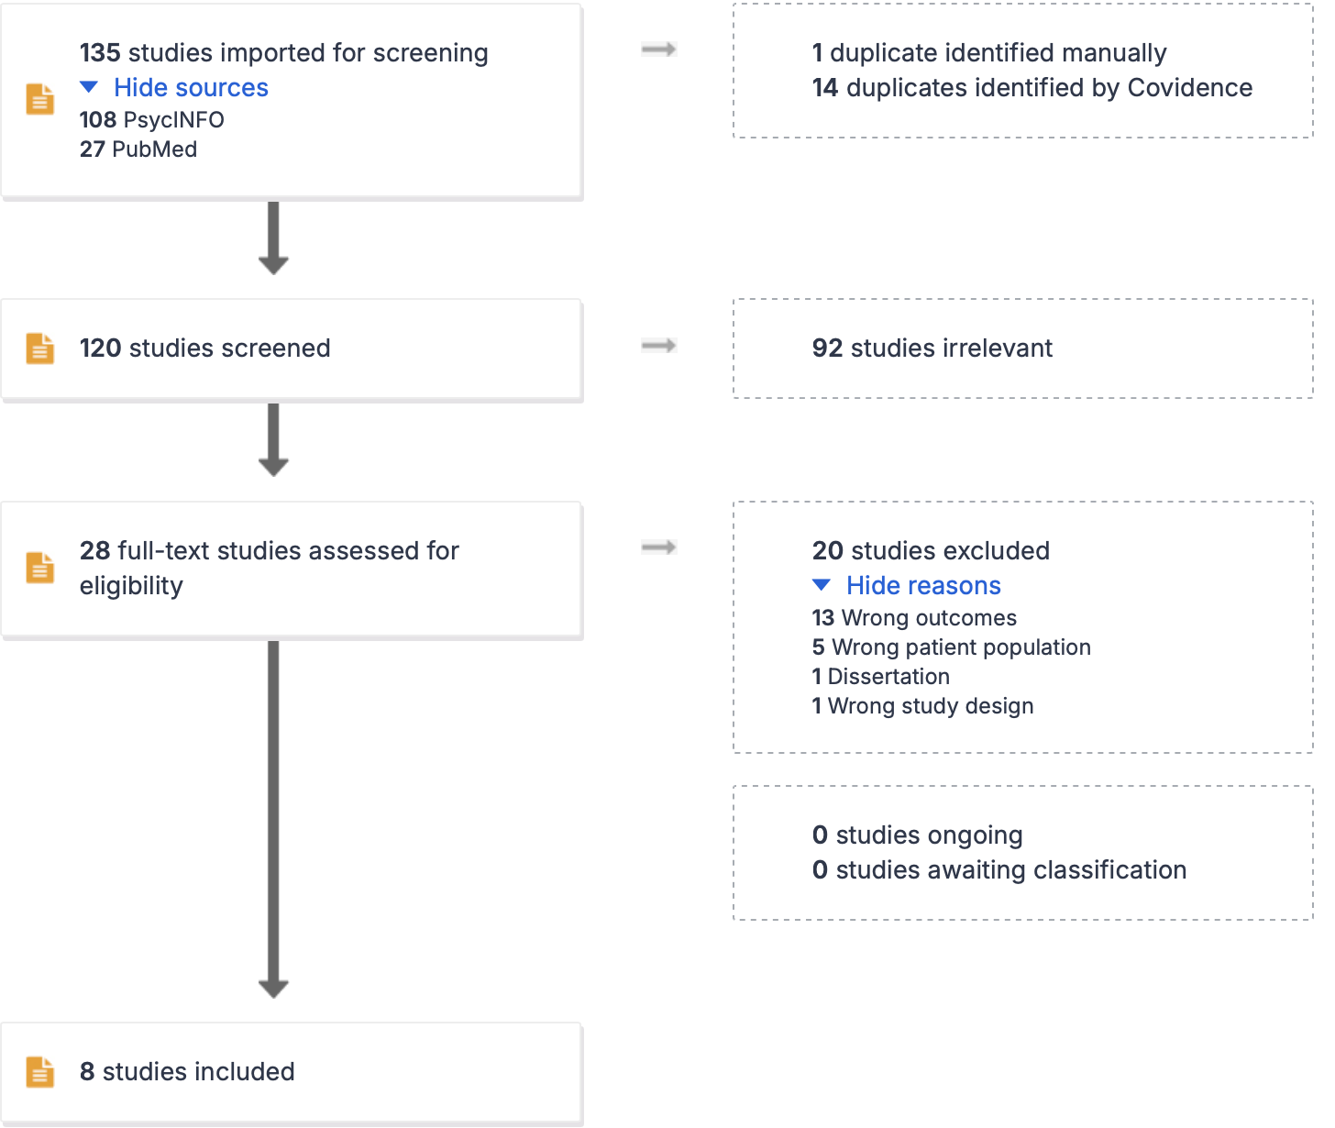
Results

Slide 22
Primary Takeaways
Rates of people of color in PTSD/SUD research must be increased
We do not know treatment effectiveness for people of color
Indications from 2 studies indicate- not as effective.
People of color’s interests are ignored
Researchers & clinicians must actively reduce disparities

Slide 23
Notes:
These are some of the giants of the field, and this is what they’re declaring… people have followed suit. This study is cited frequently in lit justifying the effectiveness of PTSD/SUD treatment.

Slide 24
No Wrong Doors?
Differential improvement rates? We don’t know!
My recent qualitative research found:
Race(ism) is relevant to PTSD/SUD onset & symptom experiences
Clinicians underprepared to work with POC’s challenges
People of color left treatment because of this
Notes:
Some research shows that in multicultural situations, therapists who are not trained or prepared with tools to handle multicultural matters may unwittingly commit harm- for instance, research has found they are more likely to commit microaggressions- perpetuation of harm via verbal or non-verbal actions that reveal bias against a particular person because of their identity.

