Slide 1
The Role of Hospital Climate and Nurse Stigma on Implementation of Chestfeeding and Skin-to-Skin Care for Neonatal Opioid Withdrawal Syndrome
Clayton J. Shuman, PhD, MSN, RN
University of Michigan School of Nursing
Co-authors:
Philip T. Veliz, PhD
Mikayla Morgan, BSN, CCRN, SRNA
Carol J. Boyd, PhD, RN, FIAAN, FAAN
Vanessa K. Dalton, MD, MPH

Slide 2
Acknowledgements & Disclosures
This work was funded by:
University of Michigan School of Nursing Early Investigator Grant
University of Chicago Center for Healthcare Delivery Science and Innovation Nursing Solutions grant
NICHD (K08HD105986)
No conflicts of interest to disclose.

Slide 3
NOWS occurs in up to 6.2 per 1,000 live births in the U.S.
Nonpharmacologic NOWS treatment practices reduce:
Symptom Severity
Need for & Length of
Pharmacologic Tx
Length of Hospital Stay
Costs

Slide 4
Chestfeeding and skin-to-skin care are effective, nonpharmacologic interventions for NOWS
However, chestfeeding rates among those eligible remain low, and little is known regarding skin-to-skin care.
Challenges to implementing may be due to context factors of implementation climate and nurse stigma.
Notes:
Family-delivered nonpharmacologic care is primary treatment for neonatal opioid withdrawal syndrome (NOWS). However, chestfeeding rates among birthing persons treated for opioid use disorder remain low, and little is known regarding skin-to-skin (StS) care. Challenges to implementing nonpharmacologic care may be due to context factors of implementation climate, or the receptivity of the clinical context to evidence-based practices, and clinician stigmatizing attitudes towards perinatal substance use (PSU).

Slide 5
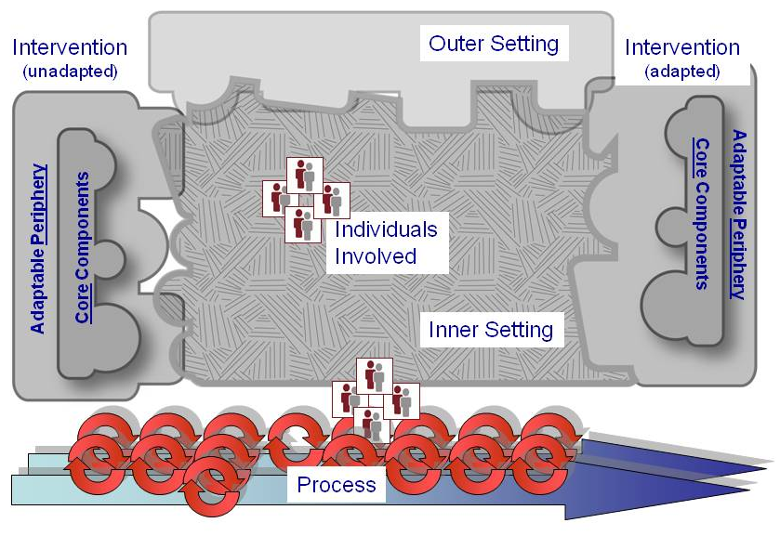
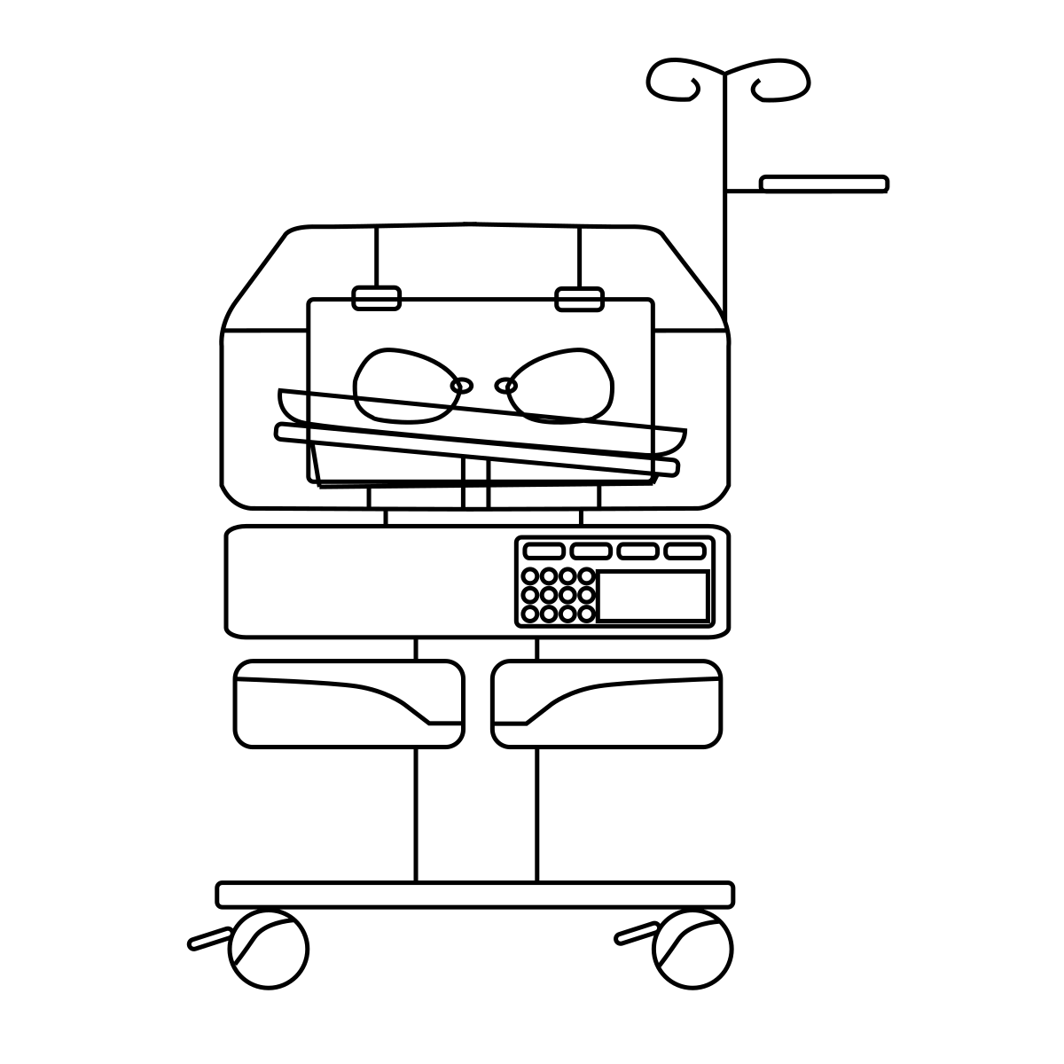
Implementation Science Approach
External Context
Community
Internal Context
Perinatal Units
External Context
Community
Is implementation climate and perinatal nurse stigma associated with (1) chest feeding and (2) skin-to-skin care outcomes for NOWS?
Adapted from the CFIR (Damschroder et al., 2009) and Social Dynamic Context Factor Framework (Shuman et al., 2017)

Slide 6
Methods
531 Perinatal Nurses (Labor, postpartum, NICU, peds) completed surveys
Implementation Climate Scale (scores >2.5= 1; <2.5=0)
Modified Attitudes About Drug Use in Pregnancy Scale (scores 4-5= 1; ≤3= 0)
254 Linked Maternal-Infant Medical Records (2016-19); eligible to chestfeed per org
Chestfeeding and skin-to-skin (1=at least once; 0=no occurrence)
Maternal age, home distance from hospital, reproductive history, infant gestational age, and NICU admission collected as covariates
Michigan
Ohio
Illinois
Minnesota
To determine the effect of implementation climate and stigma on chestfeeding and skin-to-skin, logistic regression models were estimated and accounted for clustering of observations by hospital.
Descriptive statistics were used to describe survey demographics and survey responses.

Slide 7
Mother-Infant Characteristics (N=254)
 | N (%)
Maternal Age <30 | 134 (52.8)
Race & Ethnicity White Not White Black Indigenous Latino/a | 141 (55.5) 113 (44.5) 80 (31.5) 28 (11) 5 (2)
Gravida <3 | 149 (58.7)
Vaginal Delivery | 179 (70.5)
Gestational Age ≥37 weeks | 183 (72)
NICU Admission | 110 (43.3)
Chestfeeding | 126 (49.6)
Skin-to-Skin | 130 (51.2)
Survey Sample Characteristics (N=531)
Age; M(SD) | 37.87 (10.99)
Female; n(%) | 417 (78.5)
Race; n(%) White Black Asian Other/Multiracial | 332 (62.5) 23 (4.3) 18 (3.3) 146 (27.5)
Years RN experience; M(SD) | 16.54 (9.56)
Education; n(%) Associates/Diploma Bachelors Masters or Doctorate | 103 (19.4) 277 (52.2) 49 (9.2)

Slide 8
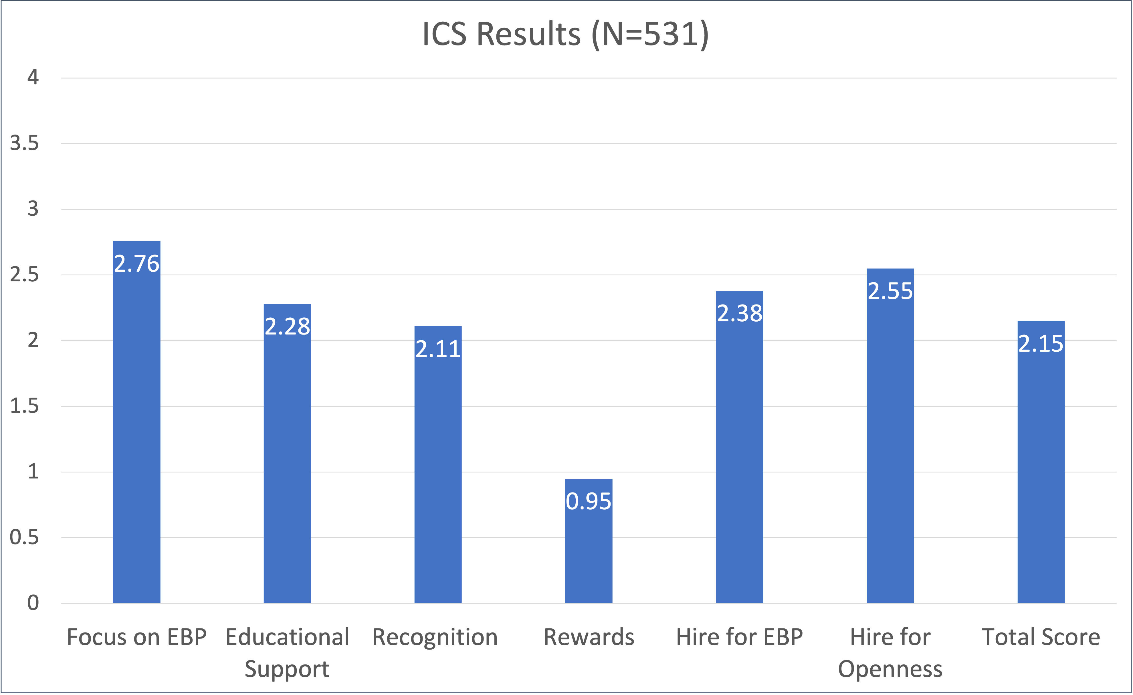
Implementation Climate
The staff shared perceptions of what is rewarded, supported, and expected by the organization in relation to implementing evidence-based interventions like chestfeeding and skin-to-skin care for NOWS

Slide 9
Nurse Stigma towards Perinatal Substance Use
Perinatal RN Stigma towards Perinatal Substance Use (N=531)
Unit Type | Identified Stigma (%)
Labor (n=147) | 52.2
Postpartum (n=93) | 55.4
NICU (n=194) | 49.3
Pediatrics (n=97) | 66.7
Modified Attitudes About Drug Use in Pregnancy; 4 Midwestern Hospitals; 17 units
Items with the highest levels of stigma:
Mothers are…
81% - manipulative and unreliable
69% - solely responsible for the effect on infants
64% - guilty of child abuse
61% - should go to jail
Shuman, JOGNN, 2022; Shuman, ANC, 2020; Shuman, BMC Ped, 2021

Slide 10
Association of Implementation Climate and Nurse Stigma with Chestfeeding and Skin-to-Skin Care Among Birthing Individuals with OUD (N=254)
 | Adjusted†
Chestfeeding | aOR | 95% CI
Positive Implementation Climate | 3.36 | (2.28, 5.07)
Less Nurse Stigma | 2.91 | (1.36, 6.24)
NICU Admission | 0.43 | (0.22, 0.86)
Skin-to-Skin Care
Positive Implementation Climate | 4.34 | (2.22, 8.49)
Less Nurse Stigma | 2.76 | (1.07, 7.12)
NICU Admission | 0.38 | (0.20, 0.71)
Note: All models account for clustering of records in hospitals †Adjusted for gestational age, delivery mode, maternal age, gravida, race, distance from hospital, & NICU admission (NICU Admission was the only significant covariate) Abbreviations: odds ratio (OR); adjusted odds ratio (aOR); confidence interval (CI); neonatal intensive care unit (NICU)

Slide 11
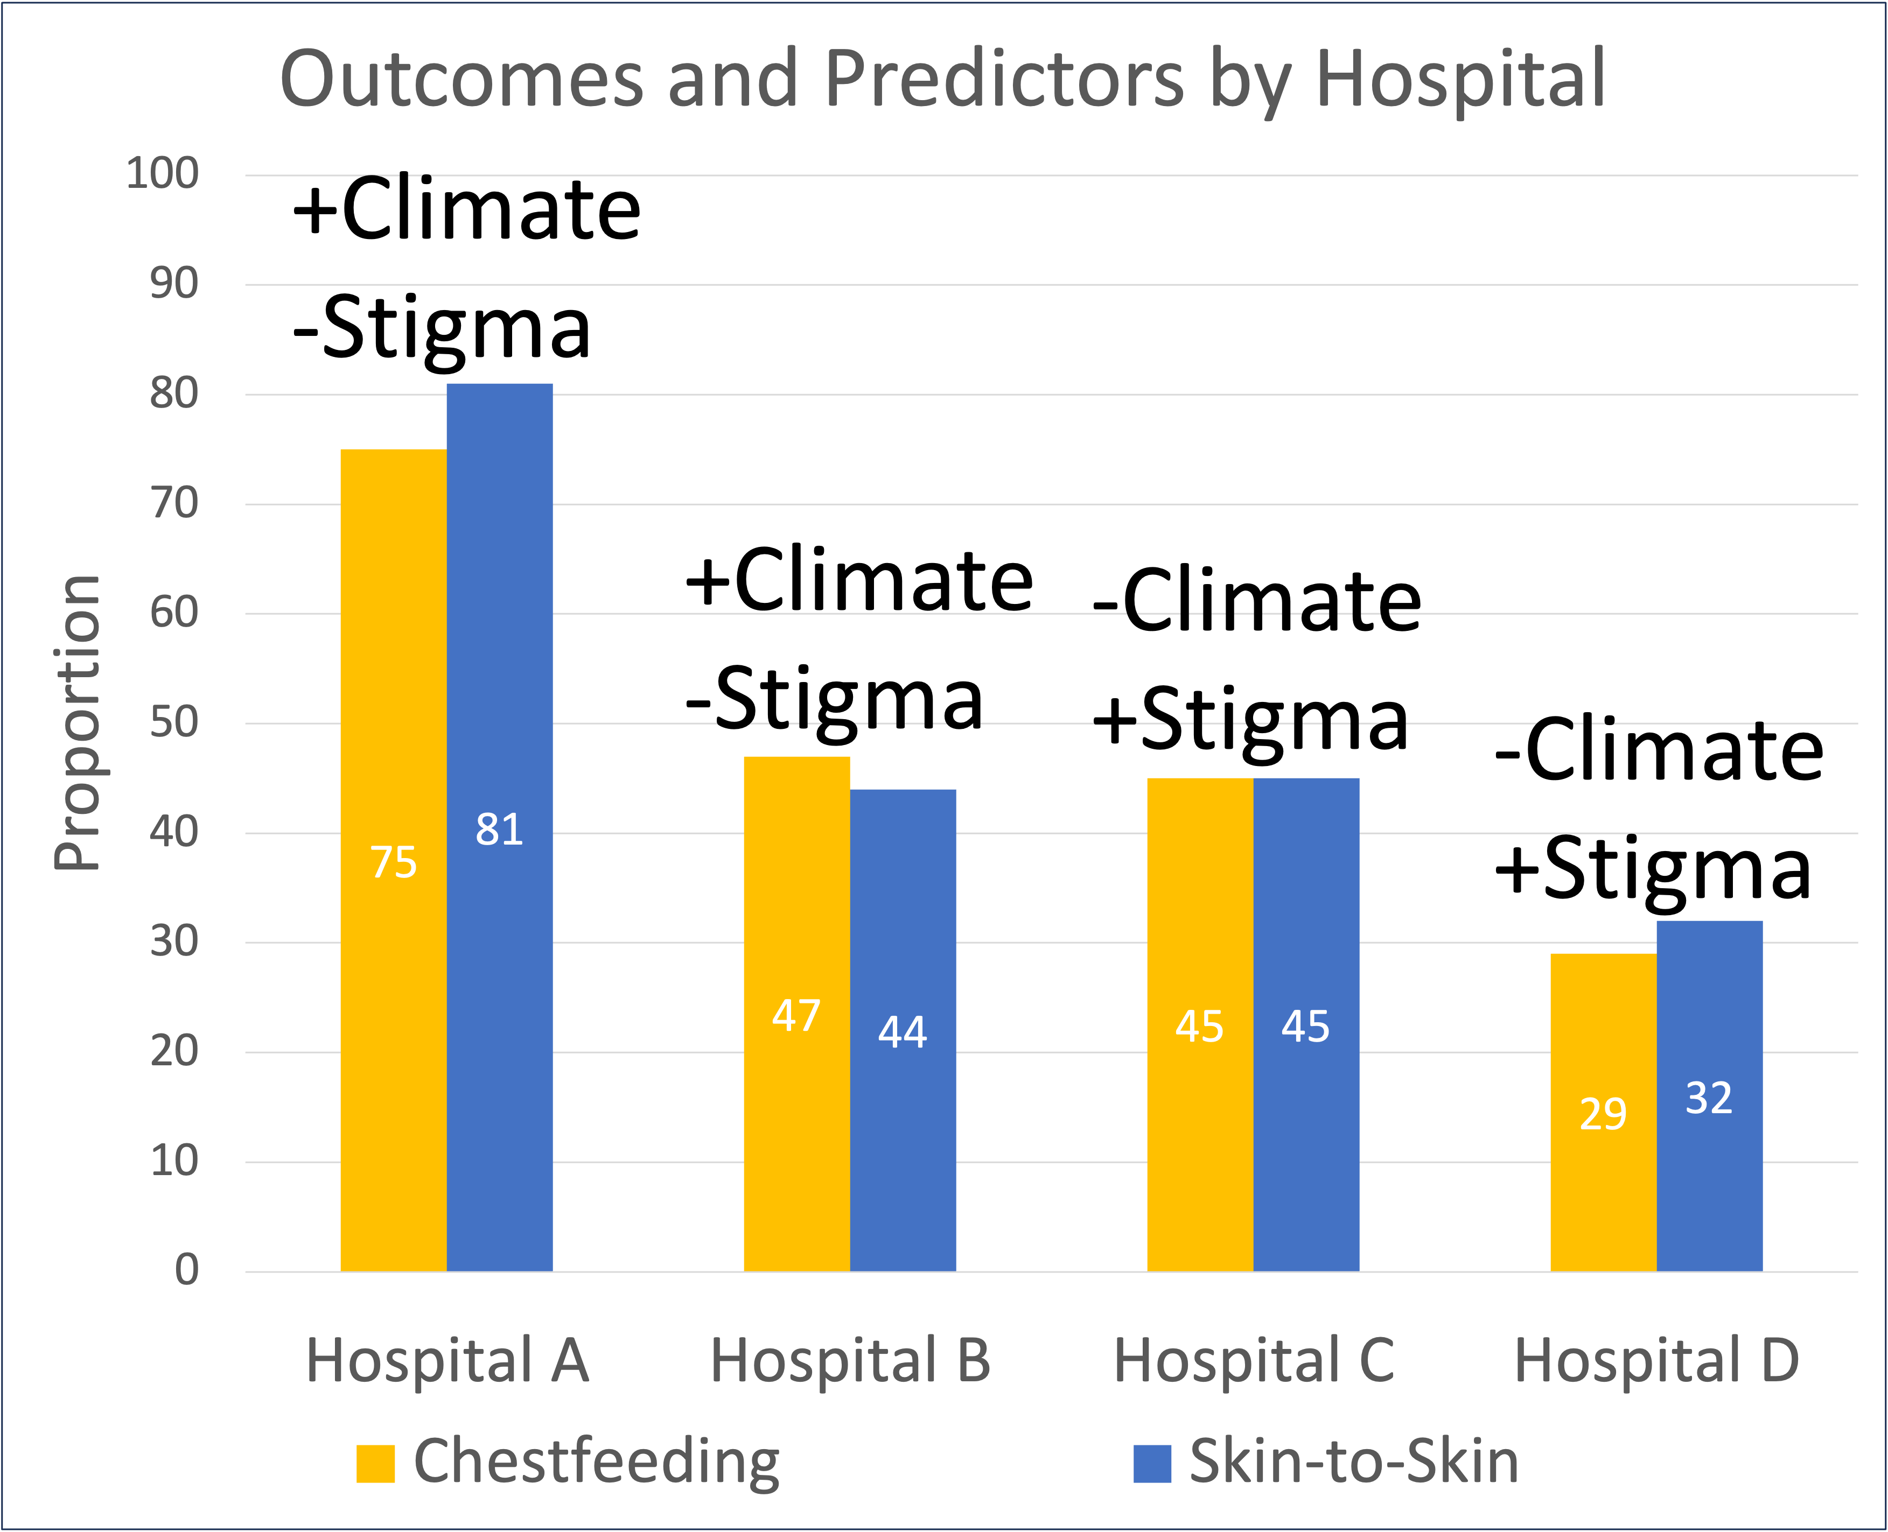
Born in a hospital with better implementation climate and lower nurse stigma associated with improved implementation of chestfeeding and skin-to-skin for NOWS
+Climate
-Stigma
+Climate
-Stigma
-Climate
+Stigma

Slide 12
Conclusions
Hospitals are encouraged to focus on improving unit climate for implementation of evidence-based practices.
More efforts are needed to address healthcare worker stigma to improve engagement of mothers in implementing NOWS care practices.
Organizational context factors may be more important than individual level factors in implementing nonpharmacologic care for NOWS. Only NICU admission was associated with outcomes.

Slide 13
Thank you
Clayton J. Shuman, PhD, MSN, RN
clayshu@umich.edu
Hirai AH et al. Neonatal abstinence syndrome and maternal opioid-related diagnoses in the US, 2010-2017. JAMA. 2021;325(2):146–155.
Abdel-Latif ME et al. Effects of breast milk on the severity and outcome of neonatal abstinence syndrome among infants of drug-dependent mothers. Pediatrics. 2006;117(6):e1163-9.
Walsh MC et al. Ohio Perinatal Quality Collaborative improves care of neonatal narcotic abstinence syndrome. Pediatrics. 2018:e20170900.
Grossman MR et al. An initiative to improve the quality of care of infants with neonatal abstinence syndrome. Pediatrics. 2017;139(6):e20163360.

