Slide 1

The Roles, Activities, and Opportunities of Clinical Pharmacists in a National Initiative to Improve Office-Based Buprenorphine Care
November 2, 2023
Spencer G. Calder, MPH
Marie Kenny, BA
Veldana Alliu, PharmD, BCPS
Terri L. Jorgenson, RPh, BCPS
Tera Moore, PharmD, BCACP
Hildi Hagedorn, PhD
Eric Hawkins, PhD
Adam J. Gordon, MD MPH
No COI, not speaking on behalf of an entity, DEI will be discussed

Slide 2
background
Despite the recent repeal of the X-waiver, there exists many barriers for treating opioid use disorder (OUD) with medications (MOUD)
Clinical pharmacist practitioners (CPPs) may provide important activities in the provision of MOUD
  largely an untapped provider resource, especially in office-based practices
The Veterans Health Administration’s (VHA) Stepped Care for Opioid Use Disorder Train the Trainer (SCOUTT) Initiative is implementing MOUD in at least 80 primary care, mental health, and pain clinics in 40 VHA facilities nationwide
  MOUD provision in SCOUTT often involves the CPP but what activities they provide have not been fully described

Slide 3
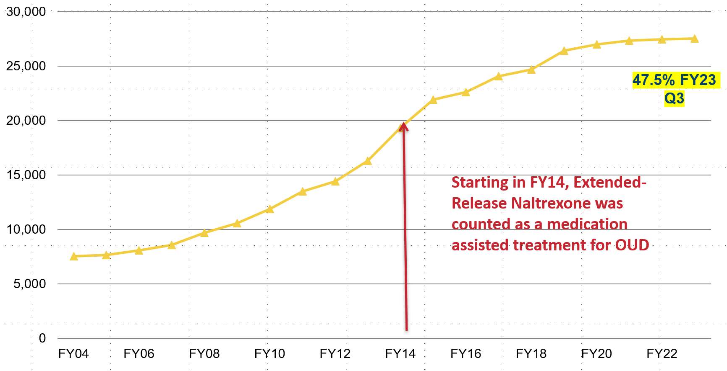
Veterans receiving MOUD

Slide 4
VA’S Stepped Care for Opioid Use Disorder
Gordon AJ, Drexler K, Hawkins EJ, Burden J, Codell NK, Mhatre-Owens A, Dungan MT, Hagedorn H. Stepped Care for Opioid Use Disorder Train the Trainer (SCOUTT) initiative: Expanding access to medication treatment for opioid use disorder within Veterans Health Administration facilities. Subst Abus. 2020;41(3):275-282

Slide 5
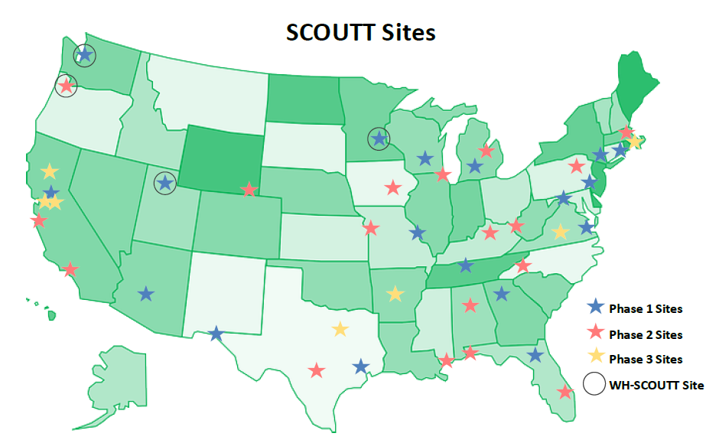
VA’s Stepped Care for Opioid Use Disorder Train the Trainer (SCOUTT) Initiative
The purpose of SCOUTT is to facilitate access to medication treatment for opioid use disorder (MOUD) in non-SUD care settings
  primary care
  mental health
  pain clinic
Gordon AJ, Drexler K, Hawkins EJ, Burden J, Codell NK, Mhatre-Owens A, Dungan MT, Hagedorn H. Stepped Care for Opioid Use Disorder Train the Trainer (SCOUTT) initiative: Expanding access to medication treatment for opioid use disorder within Veterans Health Administration facilities. Subst Abus. 2020;41(3):275-282
Notes:
Adam J. Gordon, MD MPH FACP DFASAM
Do not distribute without permission
adam.gordon@hsc.utah.edu
adam.gordon@va.gov

Slide 6
CPP – VA Definition and services
A Clinical Pharmacist Practitioner (CPP) is an interprofessional care team provider who is the medication management expert delivering comprehensive medication management via a patient centered approach in collaboration with the Veteran, physicians, and other members of the health care team
  VA CPP competency is ensured like all other VA prescribers through a robust credentialing and privileging process, including clinical care reviews
CPPs provide comprehensive SUD medication management under a scope of practice
  integrated into some intensive outpatient SUD programs
  inpatient psychiatric units
  SCOUTT clinics

Slide 7
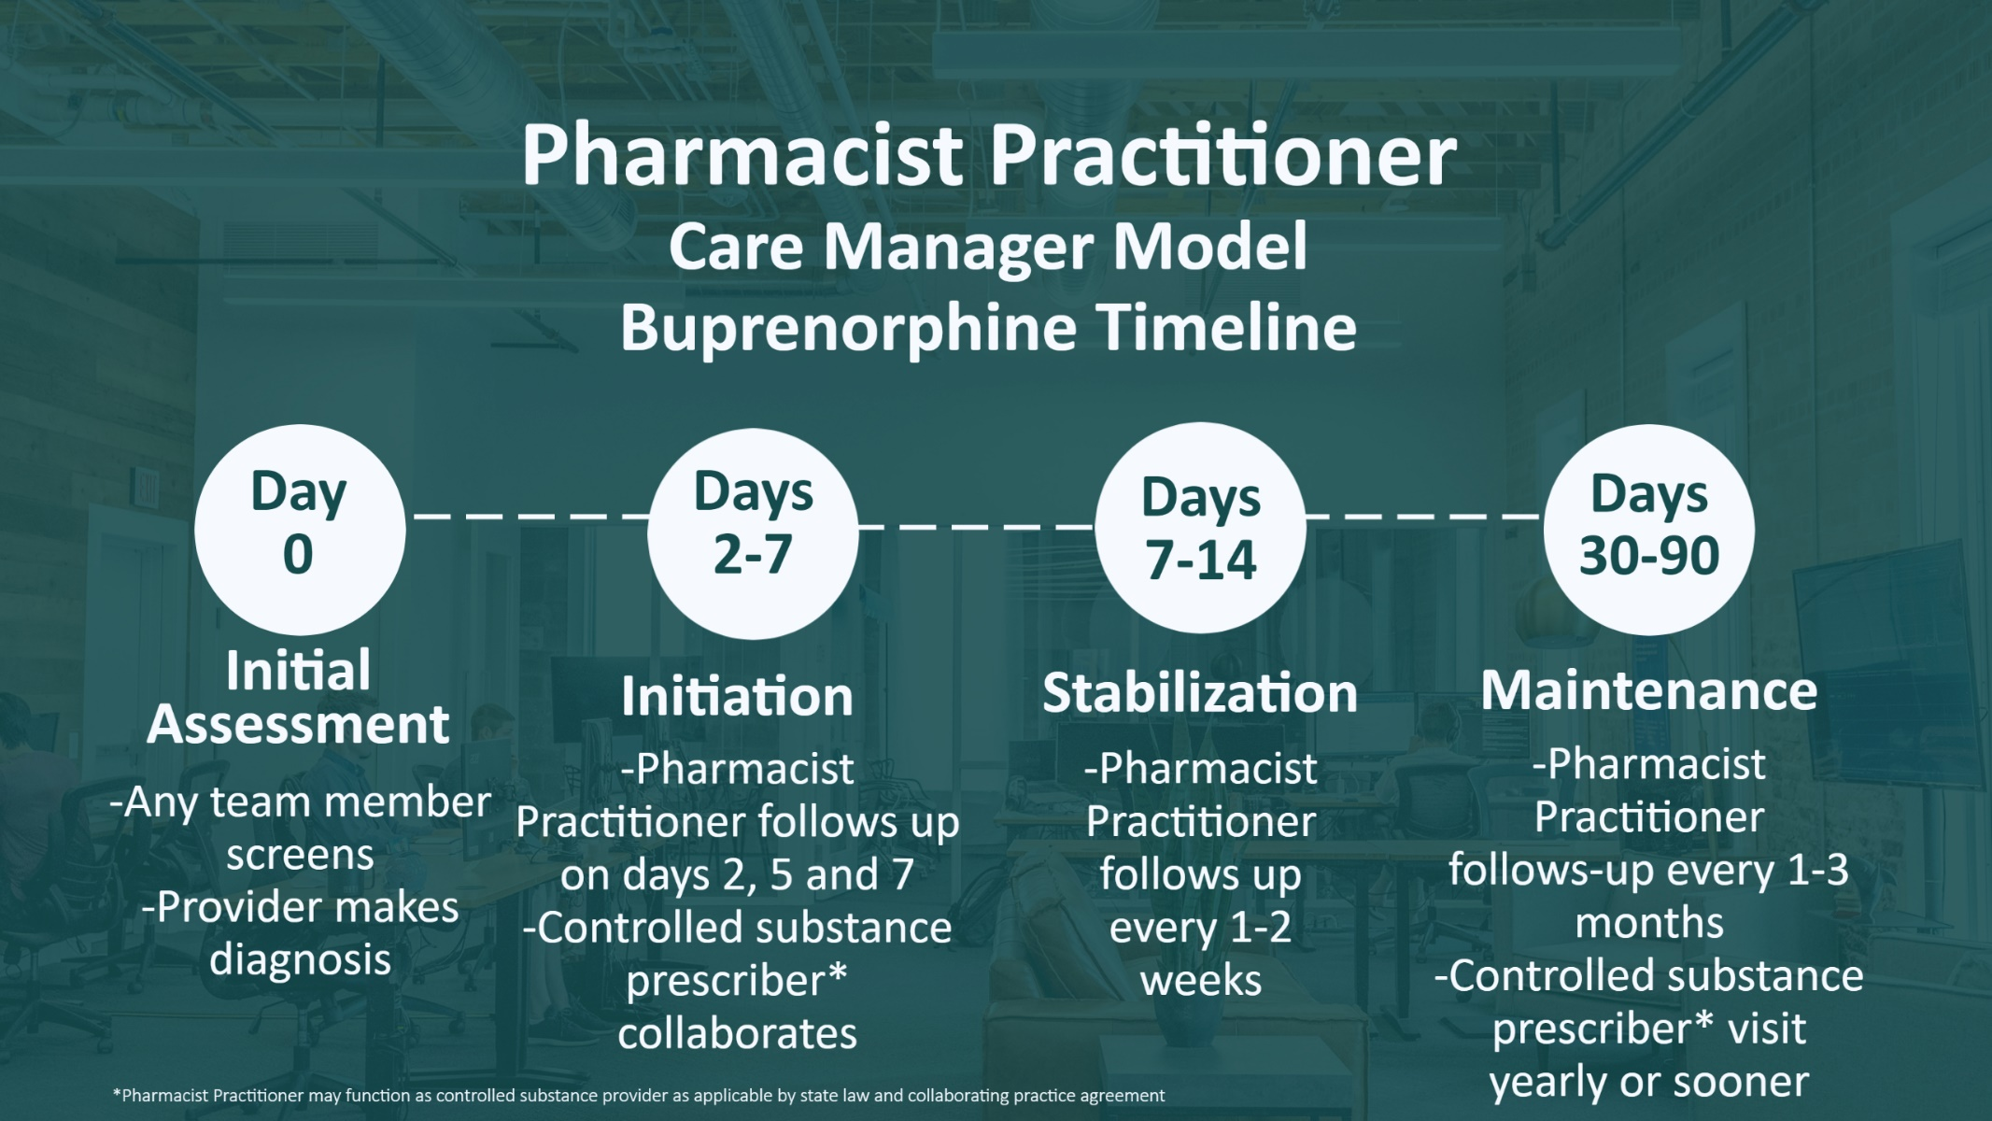
With the removal of the DATA-Waiver program, DEA registered VA CPPs now prescribe buprenorphine for OUD!
CPP Delivery of Comprehensive Care:
Multimodal care: initiate, monitor, adjust medication and non-pharmacologic treatments
Screening, brief intervention and referral for treatment (SBIRT)
AUD, OUD, StimUD care
Withdrawal management
Address other care needs: Chronic Diseases, Mental Health, Pain Care
Overdose education, prescribe naloxone
Monitor and respond to drug testing, PDMP query
Screen for suicide risk
Care Coordination, referrals
Notes:
When the CPP is integrated on the team and all members have clear, optimized roles, the benefits are exponential. This is example buprenorphine timeline using the CPP care manager model to deliver comprehensive care, after the OUD diagnosis is made. The CPP has the capacity to provide more frequent follow-up visits which save the controlled substance provider time. We heard earlier about the various SCOUTT models out there including the pharmacist care manager model. During the CPP visits with the Veteran, they are also providing withdrawal management, screening for suicide risk, overdose education and prescribing naloxone, all while addresses other care needs for chronic diseases in mental and health and pain care. This timeline applies to buprenorphine management regardless of where the Veteran is physically located. With the removal of the DATA-Waiver program, DEA registered VA CPPs now prescribe buprenorphine for OUD! To further expand access to MOUD and since removal of the X-waiver program (January – September 2023), 75 CPPs with controlled substance prescriptive authority have prescribed buprenorphine indicated for OUD to 861 Veterans across 42 VA facilities.

Slide 8
CPP PRESCRIPTIVE OPPORTUNITY – for MOUD
With the removal of the DATA-Waiver program (following passage of the 2023 Consolidated Appropriations Act)
  DEA registered VA CPPs now prescribe buprenorphine for OUD
Some CPPs can independently prescribe buprenorphine for OUD
  11+ states allow pharmacists to prescribe controlled substances under collaborative practice agreements (CPAs)
In the VA, from January – September 2023:
  75 CPPs with controlled substance prescriptive authority have prescribed buprenorphine for OUD to 861 Veterans across 42 VA facilities
Even in states without prescribing authority, CPPs with specialty training and board certification in mental health can improve treatment access and SUD medication management in a variety of ways
American Pharmacists Association. APhA scope of practice. Accessed June 13, 2022. https://www.pharmacist.com/Practice/Practice-Resources/Scope-of-Practice
Grgas M. Clinical psychiatric pharmacist involvement in an outpatient buprenorphine program. Ment Health Clin. 2013;3(6):290-291
DeRonne BM, Wong KR, Schultz E, Jones E, Krebs EE. Implementation of a pharmacist care manager model to expand availability of medications for opioid use disorder. Am J Health Syst Pharm. 2021;78(4):354-359
Dimitropoulos E, Bertucci S, Wong K. Integration of a clinical pharmacy specialist into a substance use disorder intensive outpatient treatment program to improve prescribing rates of alcohol use disorder pharmacotherapy. Subst Abus. 2018;39(2):190-192
Adams JA, Choipski NL, Adams AJ. Opportunities for pharmacists prescriptive authority of buprenorphine following passage of the Mainstreaming Addiction Treatment (MAT) Act. J Amer Pharm Assoc. 2023;63):1495-1499

Slide 9
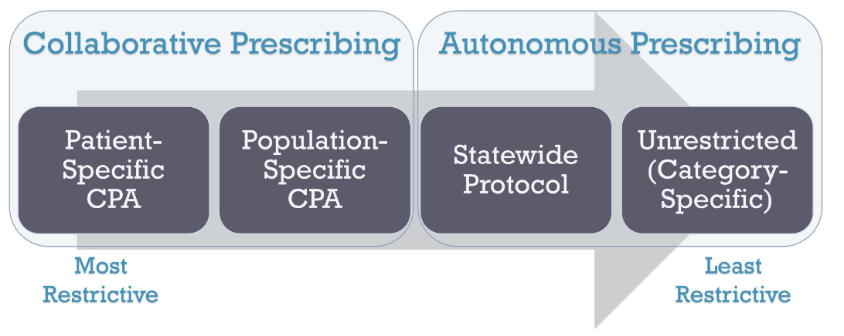
The OPPORTUNITIES FOR CPP to MANAGE and/r PRESCRIBE MOUD
178 bills pertaining to pharmacist scope of practice, payment for pharmacist-provided patient care services, and/or the designation of pharmacists as providers were introduced in 38 states in the 2022 state legislative sessions
Adams AJ, Weaver KK. The Continuum of Pharmacist Prescriptive Authority. Annals of Pharmacotherapy. 2016;50(9):778-784

Slide 10

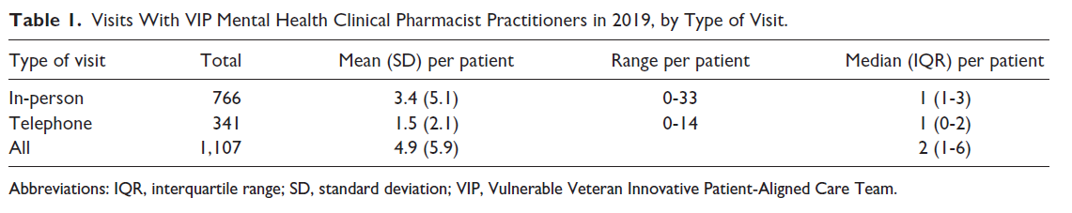
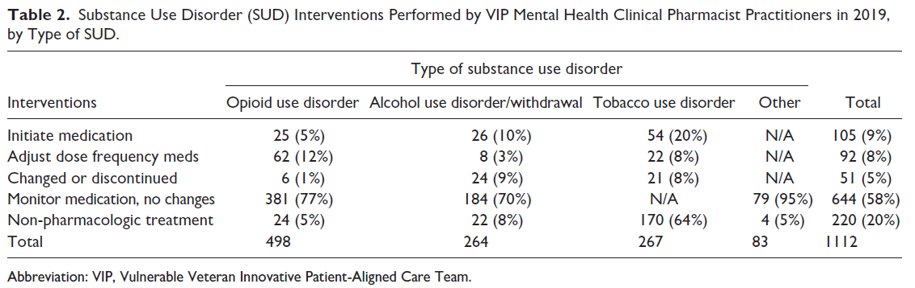
CPP Roles: A SCOUTT Clinic (2019)
2
1
Percy A, Kelley AT, Valentino N, Butz A, Baylis JD, Suo Y, Gordon AJ, Jones AL. Care Practices of Mental Health Clinical Pharmacist Practitioners Within an Interdisciplinary Primary Care Model for Patients With Substance Use Disorders. Subst Abus. 2023 Oct 15:8897077231198679
Codell N, Kelley AT, Jones AL, Dungan MT, Valentino N, Holtey AI, Knight TJ, Butz A, Gallop C, Erickson S, Patton J, Hyte-Richins LJ, Rollins BZ, Gordon AJ. Aims, development, and early results of an interdisciplinary primary care initiative to address patient vulnerabilities. Am J Drug Alcohol Abuse. 2021;47(2):160-169

Slide 11
objective
We sought to examine CPPs’ roles, typical activities, and opportunities to provide MOUD in SCOUTT

Slide 12
methods
In March 2023, a REDCap survey was sent to 22 known CPPs in SCOUTT clinics and to local SCOUTT leaders asking them to forward to CPPs
The survey asked about their clinic setting and their role in 25 tasks related to the provision of MOUD (e.g., patient intake, risk assessment, initiation, follow-up activities)
Questions also inquired about state licensure and whether they have or desired to obtain controlled substance prescriptive authority for prescribing MOUD
Some questions provided opportunity for free text answers; quotes were extracted to demonstrate common themes

Slide 13
RESULTS: Overall
All 22 SCOUTT CPPs responded to the survey
CPPs worked in the following settings (in SCOUTT)
  40.9% pain
  27.3% primary care
  22.7% mental health
  22.7% primary care mental health integration
CPPs indicated:
  95.5% work in a team-based environment
  95.5% act as the medication expert

Slide 14
RESULTS:
INTAKE ACTIVITIES
Performs history: 73%
Medication review 68%
Initial assessments: 68%
Triage patients: 59%
Performs exam: 5%
MONITORING
SUD Lab assessments: 91%
Rx Drug Monitoring: 91%
Laboratory Assessment: 82%
Database risk reviews: 77%
Screening Laboratories: 64%
INITIATION ACTIVITIES
SUD Medication Review: 91%
Opioid withdrawal treatment: 77%
Prescribes medications: 73%
Initiation of MOUD (no Rx): 73%
Prescribes MOUD: 27%
Prescribes CS medications: 23%
SERVICE ACTIVITIES
Naloxone education/dist. 95%
Follow up management: 95%
Relapse prevention: 86%
Follow up triage services: 73%
Population health services: 73%
Harm Reduction Services: 59%
Tapering (opioids/bup): 82%
Order consults: 77%
Patient related outcome data: 32%
RED indicates top third

Slide 15
RESULTS: Buprenorphine prescribing
95% believe they are managing buprenorphine-MOUD
  “A majority of the medication decisions are being made in a team-based environment, with the CPP acting as the medication expert.”
  “I have been following with primary care providers who are less familiar with using buprenorphine for OUD. They rely on me for the closer follow up, assessment of the patient, recommendations for adjusting therapy, referrals for other levels of care, and general education about buprenorphine.”
77% believe they are the PRIMARY CONDUIT for the patient
  “I am often the first contact or where Veterans are sent when they are interested in buprenorphine.”
  “In most cases, I am seeing the patients the most and the hub of the cogwheel for their care.”
86% either prescribe buprenorphine-MOUD or desire to do so
  “…following the elimination of the x-waiver, I immediately reciprocated my license to a state that allows pharmacist to prescribe DEA scheduled medications and applied for my DEA license specifically for this purpose. There is a gap in knowledge and care for OUD and pharmacist can help with both.”

Slide 16
CONCLUSIONS AND SIGNIFICANCE
In a sample of CPPs in the VHA’s SCOUTT Initiative, CPPs play a significant role in leading and collaboratively facilitating MOUD in non-addiction-specialty office-based clinics
Federal and state legislation play a critical role to support pharmacist provided care to address scope of practice, DEA authority, and reimbursement models
The VHA’s CPP management and prescribing MOUD efforts may be a model to emulate in other clinics and health systems to improve access to MOUD care

Slide 17
THANK YOU - aUTHORS
Spencer G. Calder, MPH,
  VA Salt Lake City Health Care System and University of Utah
Marie Kenny, BA
  Minneapolis VAMC
Veldana Alliu, PharmD, BCPS
  Department of Veterans Affairs – Pharmacy Benefits Management Clinical Pharmacy Practice Office
Terri L. Jorgenson, RPh, BCPS
  Department of Veterans Affairs – Pharmacy Benefits Management Clinical Pharmacy Practice Office
  Tera Moore, PharmD, BCACP
  Department of Veterans Affairs – Pharmacy Benefits Management Clinical Pharmacy Practice Office
Hildi Hagedorn, PhD
  Minneapolis VAMC and University of Minnesota
Eric Hawkins, PhD
  VA Puget Sound Health Care System and University of Washington
Adam J. Gordon, MD MPH
  VA Salt Lake City Health Care System and University of Utah
THANK YOU to all SCOUTT clinicians who exemplify transdisciplinary care approaches to improve Veteran access to MOUD treatment

Slide 18
SCOUTT-Related Literature to date
Gordon AJ, Drexler K, Hawkins EJ, Burden J, Codell NK, Mhatre-Owens A, Dungan MT, Hagedorn H. Stepped Care for Opioid Use Disorder Train the Trainer (SCOUTT) initiative: Expanding access to medication treatment for opioid use disorder within Veterans Health Administration facilities. Subst Abus. 2020;41(3):275-282. doi: 10.1080/08897077.2020.1787299. PMID: 32697170; PMCID: PMC7849630.
DeRonne BM, Wong KR, Schultz E, Jones E, Krebs EE. Implementation of a pharmacist care manager model to expand availability of medications for opioid use disorder. Am J Health Syst Pharm. 2021 Feb 8;78(4):354-359. doi: 10.1093/ajhp/zxaa405. PMID: 33326564.
Lei J, Butz A, Valentino N. Management of kratom dependence with buprenorphine/naloxone in a veteran population. Subst Abus. 2021;42(4):497-502. doi: 10.1080/08897077.2021.1878086. Epub 2021 Feb 22. PMID: 33617752.
Codell N, Kelley AT, Jones AL, Dungan MT, Valentino N, Holtey AI, Knight TJ, Butz A, Gallop C, Erickson S, Patton J, Hyte-Richins LJ, Rollins BZ, Gordon AJ. Aims, development, and early results of an interdisciplinary primary care initiative to address patient vulnerabilities. Am J Drug Alcohol Abuse. 2021 Mar 4;47(2):160-169. doi: 10.1080/00952990.2020.1832507. Epub 2020 Dec 10. PMID: 33301347; PMCID: PMC8062280.
Hawkins EJ, Danner AN, Malte CA, Blanchard BE, Williams EC, Hagedorn HJ, Gordon AJ, Drexler K, Burden JL, Knoeppel J, Lott A, Sayre GG, Midboe AM, Saxon AJ. Clinical leaders and providers' perspectives on delivering medications for the treatment of opioid use disorder in Veteran Affairs' facilities. Addict Sci Clin Pract. 2021 Sep 6;16(1):55. doi: 10.1186/s13722-021-00263-5. PMID: 34488892; PMCID: PMC8419813.
Kelley AT, Dungan MT, Gordon AJ. Barriers and Facilitators to Buprenorphine Prescribing for Opioid Use Disorder in the Veterans Health Administration During COVID-19. J Addict Med. 2021 Sep-Oct 01;15(5):439-440. doi: 10.1097/ADM.0000000000000786. PMID: 33323694; PMCID: PMC8489586.
Spelman JF, Edens EL, Maya S, Moore BA, Boggs A, MacLean RR, Ackland P, Becker WC, Lynch D, Garcia-Vassallo M, Burgo AL, Rosen MI, Gordon AJ. A Facility-Wide Plan to Increase Access to Medication for Opioid Use Disorder in Primary Care and General Mental Health Settings. Fed Pract. 2021 Oct;38(10):460-464. doi: 10.12788/fp.0186. PMID: 34733066; PMCID: PMC8560103.
Hawkins EJ, Malte CA, Gordon AJ, Williams EC, Hagedorn HJ, Drexler K, Blanchard BE, Burden JL, Knoeppel J, Danner AN, Lott A, Liberto JG, Saxon AJ. Accessibility to Medication for Opioid Use Disorder After Interventions to Improve Prescribing Among Nonaddiction Clinics in the US Veterans Health Care System. JAMA Netw Open. 2021 Dec 1;4(12):e2137238. doi: 10.1001/jamanetworkopen.2021.37238. PMID: 34870679; PMCID: PMC8649831.
Gordon AJ, Kenny M, Dungan M, Gustavson AM, Kelley AT, Jones AL, Hawkins E, Frank JW, Danner A, Liberto J, Hagedorn H. Are x-waiver trainings enough? Facilitators and barriers to buprenorphine prescribing after x-waiver trainings. Am J Addict. 2022 Mar;31(2):152-158. doi: 10.1111/ajad.13260. Epub 2022 Feb 3. PMID: 35118756.
Jones AL, Kelley AT, Suo Y, Baylis JD, Codell NK, West NA, Gordon AJ. Trends in Health Service Utilization After Enrollment in an Interdisciplinary Primary Care Clinic for Veterans with Addiction, Social Determinants of Health, or Other Vulnerabilities. J Gen Intern Med. 2022 Feb 22:1–9. doi: 10.1007/s11606-022-07456-x. Epub ahead of print. PMID: 35194740; PMCID: PMC8862702.
Radmall AO, Calder S, Codell N, Kelley AT, Hawkins E, Jones AL, Hagedorn H, Reynolds MA, Gordon AJ. Roles and perceptions of nurses during implementation of a medication treatment for opioid use disorder national initiative. J Addict Nurs. 2022;33(2):70-79. PMID: 3564010
Wyse JJ, Mackeu K, Lovejoy TI, Kansagara D, Tuepker A, Gordon AJ, Korthuis TP, Herreid-O’Neill A, Williams B, Morasco BJ. Expanding access to medications for opioid use disorder through locally initiated implementation. Addict Sci Clin Pract. 2022;17(1):32. PMID: 35725648
Kelley AT, Wilcox J, Baylis JD, Crossnohere NL, Magel J, Jones AL, Gordon AJ, Bridges JFP. Increasing Access to Buprenorphine for Opioid Use Disorder in Primary Care: an Assessment of Provider Incentives. J Gen Intern Med. 2022 Dec 5. doi: 10.1007/s11606-022-07975-7. Epub ahead of print. PMID: 36471194
Lott AM, Danner AN, Malte CA, Williams EC, Gordon AJ, Halvorson MA, Saxon AJ, Hagedorn HJ, Sayre GG, Hawkins EJ. Clinician Perspectives on Delivering Medication Treatment for Opioid Use Disorder during the COVID-19 Pandemic: A Qualitative Evaluation. J Addict Med. 2023 Mar 2. doi: 10.1097/ADM.0000000000001156. Epub ahead of print. PMID: 36862502
Percy A, Kelley AT, Valentino N, Butz A, Baylis JD, Suo Y, Gordon AJ, Jones AL. Care practices and utilization of clinical pharmacist practitioners in an interdisciplinary primary care model for the treatment of addiction and other patient vulnerabilities. Subst Abus. 2023. Epub ahead of print. PMID: 37840212

