Slide 1
Tianeptine Use Disorder Treated with Methadone Maintenance: A Case Report
Morgan Avery PA-C, MPH
D. Tyler Coyle MD, MS

Slide 2
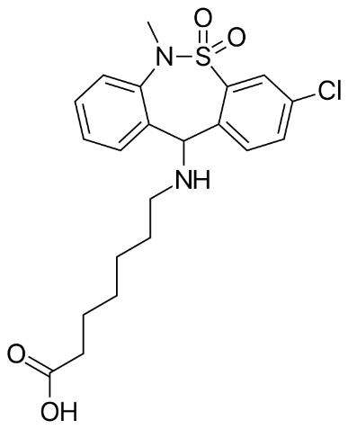
Tianeptine
Atypical Tricyclic Antidepressant
At increased doses, acts as a full mu-opioid receptor agonist
Responds to Naloxone in overdose instances
Half Life: 2.5 Hours
Tianeptine is not FDA Approved in the United States, but available at convenient stores, gas stations, etc.
Zaza
Tianna Red
Neptune's Fix

Slide 3
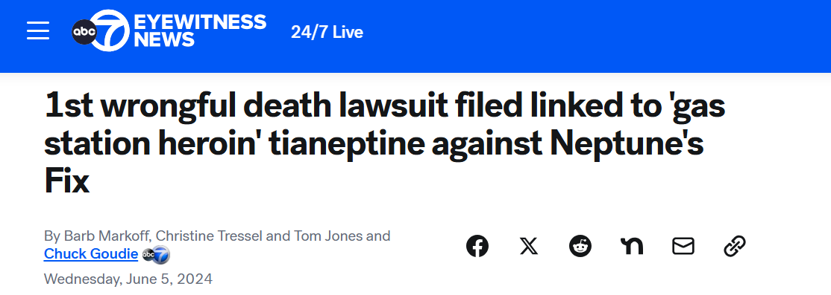
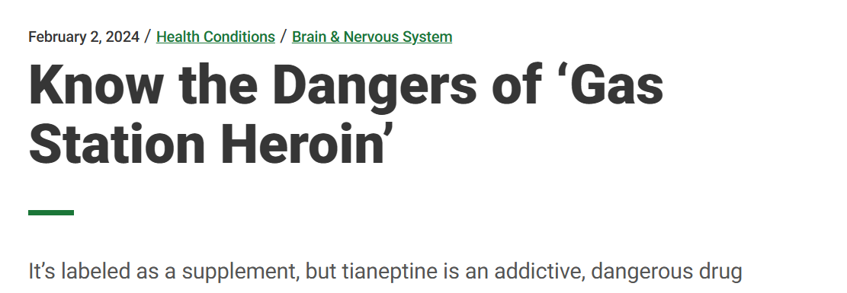
Tianeptine In the News

Slide 4
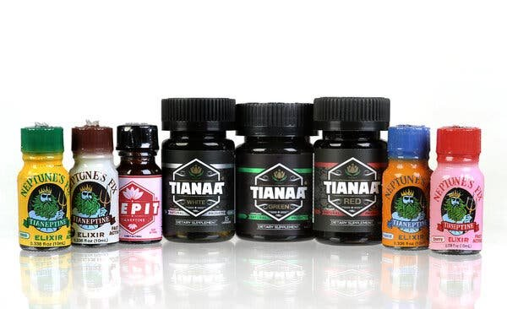
Background
In November 2023, the FDA issued a warning urging people to avoid purchasing the substance, stating tianeptine is a:
“potentially dangerous substance that is not FDA-approved for any medical use but is illegally sold with claims to improve brain function and treat anxiety, depression, pain and opioid use disorder.”

Slide 5
Research Gap
Tianeptine’s pharmacologic activity at the mu receptor, responsiveness to naloxone reversal upon overdose, and opioid withdrawal-like abstinence syndrome have prompted clinicians to use medications for opioid use disorder (MOUD) for the treatment of tianeptine use disorder.
Few reports exist outlining the treatment of tianeptine use disorder with MOUD.
Since 2017 there have been 4 reports on the use of Buprenorphine/Naloxone and 1 report on the use of Methadone ​for maintenance treatment
Notes:
.

Slide 6
Case Report
51-year-old woman presented to an opioid treatment program (OTP) seeking medical treatment for tianeptine dependence and withdrawal.
Use History
Past Medical History
Methadone Initiation
The patient now reports abstinence from tianeptine for over a year and has advanced to phase 6 in the OTP.

Slide 7
Implications
Urine Toxicology Screening Changes
Public Health Messaging
Patient Education

Slide 8
Conclusions
The inclusion of tianeptine-using patients in the normative opioid treatment paradigm fosters health equity by ensuring patients can access essential healthcare services for their medical needs, including tianeptine use disorder.
Providers should appreciate changing drug trends in their communities to respond using patient-centered, evidence-based treatment.
Patients with tianeptine use disorder may follow a similar clinical course to patients with OUD and providers should consider MOUD, specifically methadone, for long-term management.

Slide 9
References
Bailey SJ, Almatroudi A, Kouris A. Tianeptine: an atypical antidepressant with multimodal pharmacology. Curr Psychopharmacol [Internet]. 2018 Jan 2 [cited 2023 Mar 5];6(2).
Bakota EL, Samms WC, Gray TR, Oleske DA, Hines MO. Case reports of fatalities involving tianeptine in the United States. J Anal Toxicol. 2018;42(7):503–509. doi: 10.1093/jat/bky023.
Edinoff AN, Sall S, Beckman SP, Koepnick AD, Gold LC, Jackson ED, Wenger DM, Cornett EM, Murnane KS, Kaye AM, Kaye AD. Tianeptine, an Antidepressant with Opioid Agonist Effects: Pharmacology and Abuse Potential, a Narrative Review. Pain Ther. 2023 Oct;12(5):1121-1134. doi: 10.1007/s40122-023-00539-5. Epub 2023 Jul 15. PMID: 37453966; PMCID: PMC10444703.
Gassaway M, Rives ML, Kruegel A. et al. The atypical antidepressant and neurorestorative agent tianeptine is a μ-opioid receptor agonist. Translational Psychiatry 2014, 4: e411. PMID: 25026323
Janusz S, Wiesław JC. Tianeptine abuse and dependence in psychiatric patients: A review of 18 case reports in the literature. J Psychoactive Drugs 2018, 50:3, 275-280. PMID: 29494783
Nosser J, Rouhbakhsh R, Brahan R, Martin JL, Purvis A. Tianeptine withdrawal: A cause for public health concern in Mississippi. J Miss St Med Assn 2022, 63(10).
U.S. Food and Drug Administration, 2023. Accessed on 13JAN2024 from-neptunes-fix-or-any-tianeptine-product-due-serious-risk
Marraffa J, Stork C, Hoffman R, Su M. Poison control center experience with tianeptine: an unregulated pharmaceutical product with potential for abuse, Clin Tox 2018, 56:11; 1155-1158. PMID: 29799284
Trowbridge T, Walley A. Use of buprenorphine-naloxone in the treatment of tianeptine use disorder. J Add Med 2019, 13(4):331-333. PMID: 30550394
ious-harm-overdoses-death

Slide 10
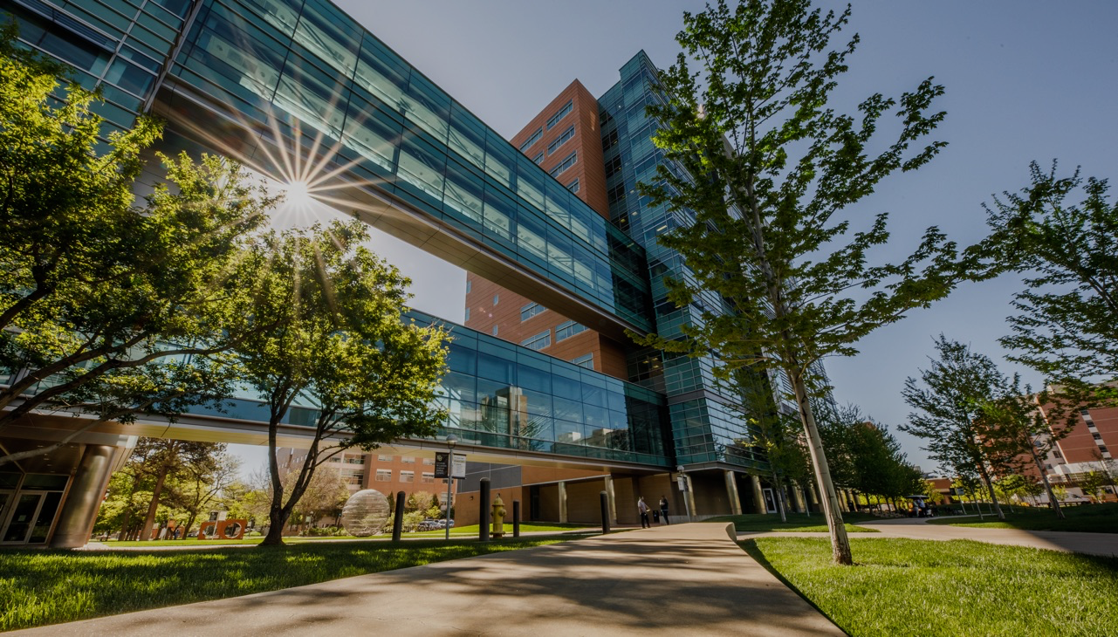
THANK YOU

