Slide 1
Toward a Deeper Understanding of Suicides That Follow Prescription Opioid Reduction in Pain: Preliminary Results from 19 Psychological Autopsies
Presenting: Stefan G. Kertesz, MD
Fundings: VA R&D
Coauthors:
Allyson Varley, PhD; Megan McCullough, PhD; April E. Hoge, MPH;Aerin J DeRussy, MPH; Anne Fuqua, BSN; Kevin R. Riggs, MD; Adam J. Gordon, MD;Thomas E. Joiner, PhD
Notes:
I greatly appreciate the chance to share these ideas with you . The title “Opioid deprescribing as a de-Implementation Science challenge” is meant to convey a reality: that there is a continuous back and forth influence between 2 levels of operation: what clinical thought leaders assess might be good care for patients, and what institutions do to change care through implementation, or de-implementation. But sometimes the elements of how institutions act to alter care, and what effects those actions have, falls off the radar of scientific deliberation and clinical debate. But it does not have to.

Slide 2
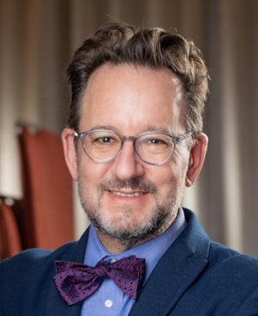
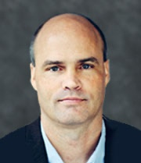
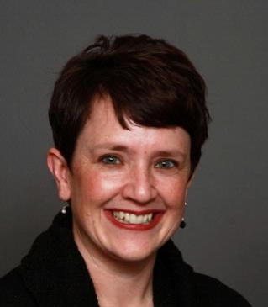
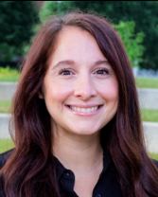
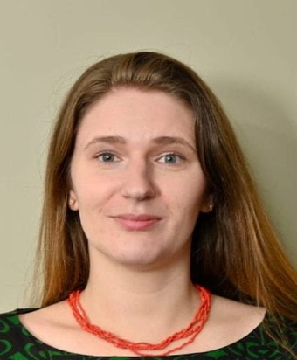
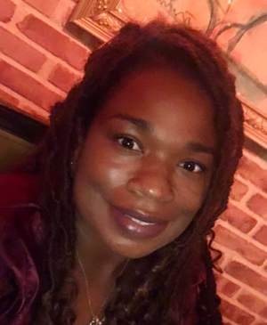
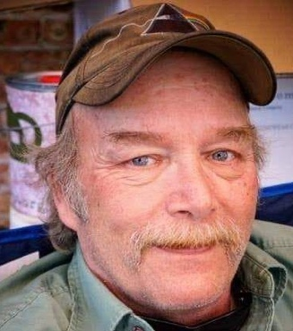
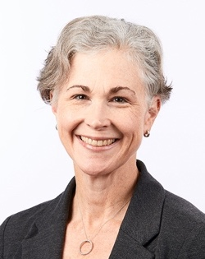
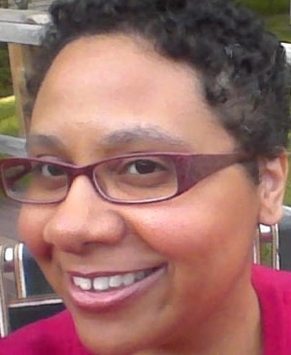
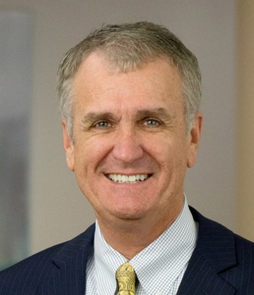
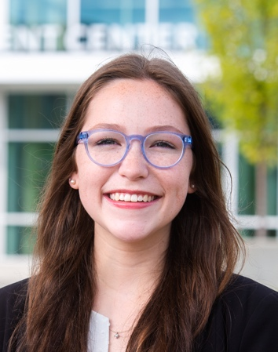
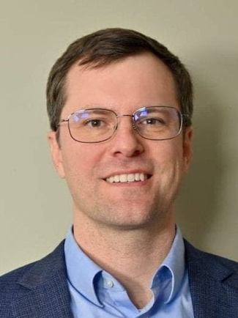
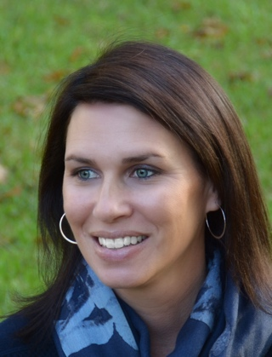
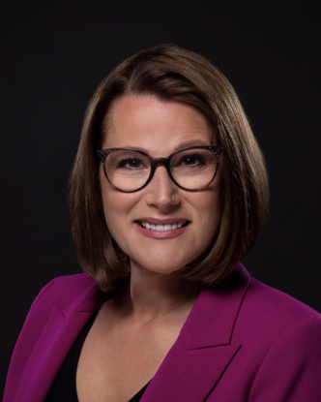
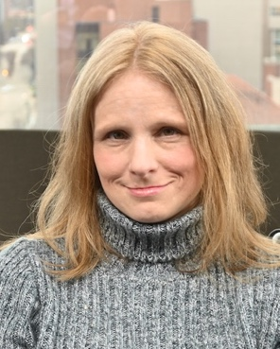
Stefan Kertesz, MD
Birmingham VAHCS
VA HSR&D research
Professor, UAB
(PI)
Allyson Varley, PhD
Birmingham VAHCS
Implementation Science
April E. Hoge, MPH
Birmingham VAHCS
(Project Coordinator)
Mary Gilmore, MPH
Birmingham VAHCS
(Research Assistant)
Adam J. Gordon, MD, MPH
VA Salt Lake City
VA HSR&D research
Professor
Thomas Joiner, PhD
Laboratory for the Study and Prevention of Suicide-Related Conditions and Behaviors
Robert O. Lawton Distinguished Professor, FSU
Aerin deRussy, MPH
Birmingham VAHCS
Health systems database analysis
Megan McCullough, PhD
VA Bedford
U.Mass-Lowell and Brandeis
HSR&D
Medical anthropology
Kevin Riggs, MD, MPH
Birmingham VAMC
Health Services Researcher
Anne Fuqua, BSN
Patient Advocate
Suicide ”tracker”
Stephanie Gamble, PhD
VISN 2 Center of Excellence for Suicide Prevention (CoE)
University of Rochester Medical Center
CaSonya Richardson-Slone
Advisor
Survivor
Dawn Gibson
Disability Health Advocate
Chrisin Veasley
Chronic Pain Research Alliance
Founder & Director
Mark Flower
Veteran
Advisor
Jim Elliott
Advisor
Survivor
Kate Nicholson, JD
National Pain Advocacy Center
Founder & Director
Lived experience

Slide 3
Background
Pain is a suicide risk factor (many studies)
Rx opioid reduction is a risk factor, and it’s not consistently tied to withdrawal
That doesn’t mean suicide is the uniform & expected outcome
Preventing suicide after opioid reduction requires inquiry regarding events and context surrounding actual deaths
Detailed inquiry for one suicide = “psychological autopsy”
Recruitment of suicide loss survivors from the US public at large is novel, and yet it’s the only way to ethically solicit the data
Agnoli, JAMA 2021;326(5):411-419.
Fenton, JAMA Netw Open 2022;5(6):e2216726.
Sabety, BMJ 2024 385:e076509
Hallvik, Pain 2022;163(1):83-90.
Oliva BMJ 2020;368:m283

Slide 4
Objectives
Today: To identify actionable opportunities for suicide prevention based on preliminary results from an ongoing psychological autopsy study
Aim 1: To characterize patient and context factors associated with death by suicide in the context of Rx opioid reduction

Slide 5
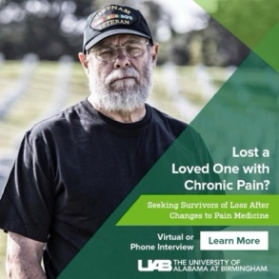
The major challenge: recruitment No “master list” and extreme stigma
Outreach
Interview
Detailed Screener
by phone or online
Coding
Prescreener
Adjudication
Consent
$100
$25
Interpre-tation
(Facebook or webpage)
Reporter confidence in
Rx opioid reduction, pain, suicide
Medical Record
Notes:
As you all know, this study relies on public-facing recruitment as usual methods of recruitment for psychological autopsy aren’t available to us for either informational pitfalls or ethical/logistic barriers.
In the earlier stages of this study, while we were attempting to work our way through the contracting phase, all outreach was done by our small time via public briefings, podcasts, and organizations doing related work agreeing to spread the word about our project. As of January this year, our social media marketing campaign finally went live, and we have seen an increase in overall interest in participation with a particular increase in interaction with individuals who have lost a Veteran.

Slide 6
Interview Topics
Decedent demographics
Suicide details
Substance use
Pain care
Mental Health
Physical Health
Social Environment
Housing
Employment
Legal Issues
Firearm ownership
Veteran-specific details
Thwarted belongingness
Perceived Burdensomeness
Communications with Others about Pain or Suicidal Distress
Suicide prevention

Slide 7
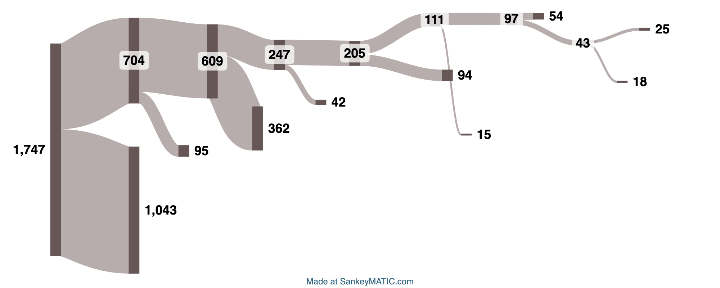
Recruitment as of 11/7/2024
Informed consents sent (49 DocuSign, 41 postal mail)
Unsigned informed consents (9 DocuSign, 41 postal mail)
Persons interacted with survey
Persons passed 4 pre-screening questions
Persons provided information to be adjudicated
Persons met inclusion standards
Persons consented to being contacted
Completed interviews
Persons failed to meet inclusion standards
Signed informed consents (39 DocuSign, 1 postal mail)
Incomplete interviews, yet to schedule
Persons accessed UAB detailed screener (2020-2024)
Persons not consented to contact, often left blank
Persons didn’t consent to being contacted
Persons unresponsive to outreach, did not provide mailing address
Persons did not meet eligibility criteria
Persons did not provide information
Interview 26 conducted November 8, 2024
New Recruitment Concepts in Play
Notes:
https://sankeymatic.com/build/?i=IYAg2g7ADALAuiARgKFGAjLAzAgxsxcANigE4EATA8UgVgQFNkHxacRnx0FOMoeWYAEw8K4ITAgIA5sjFgsRESAAWyaeKj0QAS3VgYIgFbIdXdNxABrUzXggANsis0iCALbOu2gHbJ34DDsAPb%2BrPAADsjBGAAcCACO0eLaAE7IAM46AF4sAO4gmFBQyCCqIDDF%2DsCp0jo%2BjoVCpSCpTS0ALoWxLYRCJYgauMEOwW0AxABm0zOdqcA%2BGRE1DD5dAJrIPsEU%2BYW0LSogsegAdAdlS8C49RqkJWWIY7ttDyAdKgzuLNs%2BTGXDUYTIgQWhEMEtYLLG4dACehWQk1GBVwAFdUgA3YAddEsKCnLA9Mr1T6pHQdSapYIBX7%2DECAsYgcaIWLAChsyHQ8nw9DIBzAWHBVFdZ4MNrAYXU7E6fBlIyojIdHSTQVkuqLEAAORa8sVythqwoGS1LVSDAxYoyDGk8wiR21ZWxHWuKnqw3cEQcDA6DEVwXe8x0DlufOAiAYDmNDImxVjb1duxNZVd0hUwdTXXxoJak2Ca0m1xYGQWGQAtFayZMWsG%2Dlcbj4NPjmmUzfylRasrlClUyu5gNIfPruyV%2BeGHD5gN8QMAIhEGDVjQ6QJ2WOgiSA8gwdBmKlVRxGsQ5USwZ3OFyBNmVJqiHA4Imablk8xeWhFglklc%2DgJMfekypvtxULpoBHMMIzfD8dC%2DSVgHTBo3gyXBPinCUOlCK8dFSRUkAYXMzV6M1gCsN96i6TBkEPY8QDwvsugAcgAGlOOjXzNSYdAADxAOiWMuVFpk47iWI%2BL4GGCaYrS6UA3kIXkARAN4xBKb5nRAb41igxYFisBhYVomUXzKYM9XcRBYIWXBfRfdxggtEAGlLfEyBgWIGIU04hCwdAIFIfxbJYCIQEc05MBgGA3OC9AwqIXkbLso5gq0IRXPcsgsCCPy7I0RK1zc%2DELBBTKWCMIKnIgIgUqctgvKK3RStOKAhGSvKGtICB0GaOKWBcRL%2BnC%2BrMBIWL%2DLU%2BrGuagaICwXyupAf1EqwRQIqc2IKqwWqEjG0giBa9AiH2oharaRKdvqoQopc2qWESmAwRaqAookIA

Slide 8
Data so far
N= 23 Decedents, 25 Interviews
Mean age 48.4
Race W: 20, B/AA: 3
Informants
Family, spouse: 20, Friends 5
Means: Gunshot 8, Overdose 9, Hanging 3, Laceration 1, Device-assisted 1, Voluntary Cessation Eating/Drinking 1
Global reliability rating (1-5): 3.3
Some may be excluded after contact with ME/Coroners

Slide 9
Preliminary Themes
Society: clinicians’ declared fears of investigation
Community: geographic moves, social isolation
Organizational (clinic): lack of integration (pain and mental health), lack of continuity
Interpersonal: feeling a burden to others, lack of belongingness
Individual: severe pain itself, adverse childhood, failed pain interventions, financial duress

Slide 10
One case story
Who we lost | Who Spoke to Us | Death
62 year old woman, African-American woman | A 48 year-old cousin who described her as a “beloved” older sister figure | January, 2023 Laceration to wrists

Slide 11
A story
Who we lost | Who Spoke to Us | Death | Notes
62 year old woman, African-American | A 48 year-old cousin who described her as a “beloved” older sister figure | January, 2023 Slit wists | Lived mostly in New York, served in the Army (overseas) Sexual assault in the Army->PTSD 2006: Unspecified car accident with back injury 2006 Disability benefits after return to civilian life
 |  |  | Disability worsened 2000s: VA prescribed opioids up to 100-140 mg oxycodone (per interview)
 |  |  | ~2020: Moved to join younger cousin in US South VA health care stopped 2022, ~75% dose reduction at a university-based clinic (from ~100-140 mg oxycodone to 20 mg oxycodone) No known explanation Suicide after 8 months (not acute withdrawal)

Slide 12
Quote: after medication change
“She just said that the medication isn’t helping her. She said that she’s not feeling like herself on the medication. And she just feels like she wants to give up.
But I kept her pushing, you know what I’m saying? Everybody say(s) they want to give up at some time. I don’t know, maybe that was the moment that I should have been more concerned.

Slide 13
Quote: on emotional state of a cousin
I just don’t think that she was getting the care that she needed. I mean they gave her something for therapy. But she said physical therapy was too painful….And I think she just kind of lost hope. I think she lost hope.”
“I don’t know. I think that’s one of the things that is real tricky. Was she just depressed from the PTSD? And so- but I think it was the medication change.

Slide 14
Quote: on the health care system
“The healthcare system definitely caused barriers. She wasn’t getting the help she needed…..I’m just being honest. There’s always help out there. And her being in the Army and being who she is, she know that. But I do feel like they betrayed her. Because they wasn’t there to give her the care that she needs to take a step by step to guide her through this process.
The VA, I’m very disappointed with them, because she shouldn’t have come down here in the condition that she was in with her PTSD.

Slide 15
Potential points of Leverage
Preventing interruption of care for patients with pain on opioids
Support for prescribing clinicians
Health systems could track and support
high risk patients on opioids who relocate
persons with history of failed pain interventions
Doing this may require mandates/impetus to act
May require changes by state boards, or parties to opioid litigation settlements that limit shipments

Slide 16
Do you know someone who lost someone after Rx opioid reduction?
Suicide is never the result of just one cause
A deeper understanding of the context and contributing factors is required, to save lives
Federally funded
IRB-approved
Certificates of confidentiality
PI: Stefan Kertesz, MD
Professor, U.Alabama Birmingham
Screening online or by phone
1-866-283-7223, Option 1
https://go.uab.edu/csiopioids
46-item Full Screener
General Info: www.csiopioids.org

Slide 17
CSI:OPIOIDs needs help to get the word out
General Study Information
www.csiopioids.org
46-item Full Screener
https://go.uab.edu/csiopioids
www.csiopioids.org

Slide 18
A theory: Interpersonal Theory of Suicide
Thomas Joiner, PhD
FSU
Advisor to CSI:OPIOIDs
Perceived burdensomeness
My death is worth more than my life
Thwarted belonging
Connections diminished
Acquired capability
Habituated to fear of death

Slide 19
Recruitment for suicides involving health status prior to death
Medical Examiners & Coroners
Health Records-based Outreach
Direct to Public
Media & Partnered
They lack information about health status or care prior to death
Not permitted
Unfavorable family perceptions
Not tried in prior psychological autopsy research
Requires:
Money
Trust
Partners

Slide 20
Signals Related to Suicide in Large Databases
Source | Adverse Finding | Reference
VA | Discontinuation-> suicide & OD death ↑ | Oliva BMJ 2020;368:m283
Oregon Medicaid | Suicide “event” 1.0% vs 0.3% (abrupt) 1.4% vs 0.2% (dose reduction) | Hallvik, Pain 2022;163(1):83-90.
Commercial & Medicare | Mental Health Crisis ↑ with 15% dose reduction, initially, and out to 24+ months | Agnoli, JAMA 2021;326(5):411-419. Fenton, JAMA Netw Open 2022;5(6):e2216726.
Medicare FFS and Advantage | Transient increase in suicide attempts, opioid and alcohol withdrawal and hospital/ED usage | Sabety, BMJ 2024 385:e076509
Variation in results Great variation in methods of comparison and statistical control None can say much about individual patients

Slide 21
Thank-you!
Write to: csiopioids@uabmc.edu

