Slide 1
Towards a taxonomy of strategies to support OUD care transitions following hospitalization
AMERSA 2024
Noa Krawczyk, PhD
Assistant Professor
Center for Opioid Epidemiology and Policy
Department of Population Health, NYU Grossman School of Medicine

Slide 2
Medications for OUD are highly effective

Slide 3
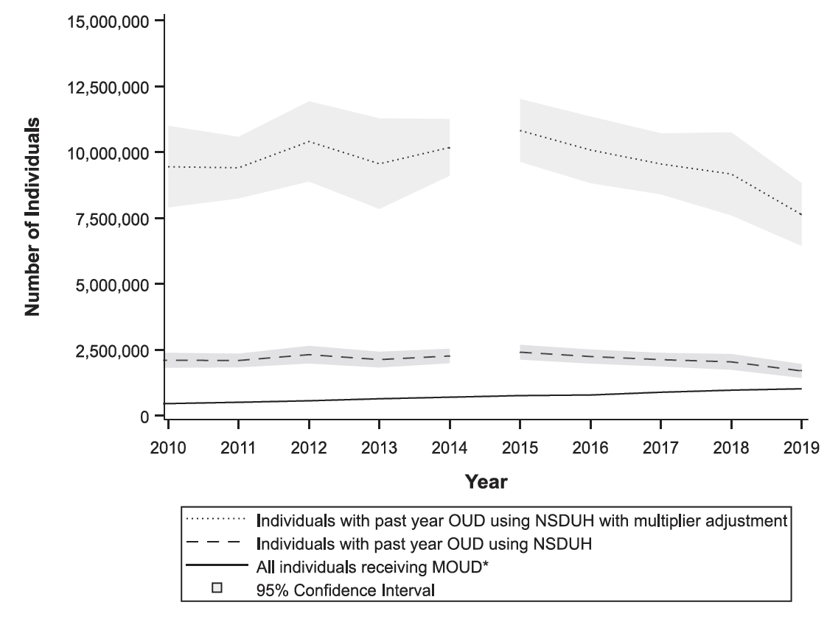
Medications for OUD are highly effective
Yet, 87% of people with OUD do not receive treatment
Estimated OUD prevalence
People receiving MOUD
Krawczyk, N., Rivera, B., Jent, V., Jones, C.M., Keyes, K., Cerdá, M ., Int J. Drug Policy (2022)

Slide 4
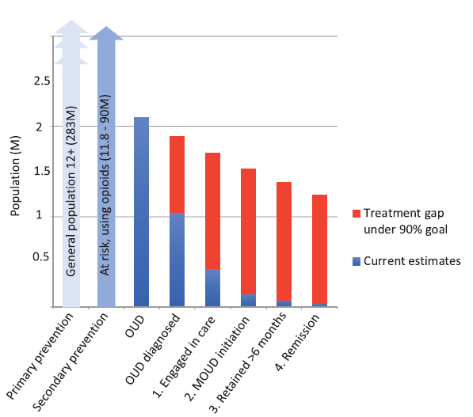
Losing people across the OUD Cascade of Care
Estimated OUD prevalence
People receiving MOUD
Krawczyk, N., Rivera, B., Jent, V., Jones, C.M., Keyes, K., Cerdá, M ., Int J. Drug Policy (2022)
Williams et al., Am J Alc Drug Abuse, 2019

Slide 5
Hospitals can serve as a critical touchpoint for engaging patients
in the OUD cascade of care
Singh and Cleveland, PLOS ONE, 2020

Slide 6
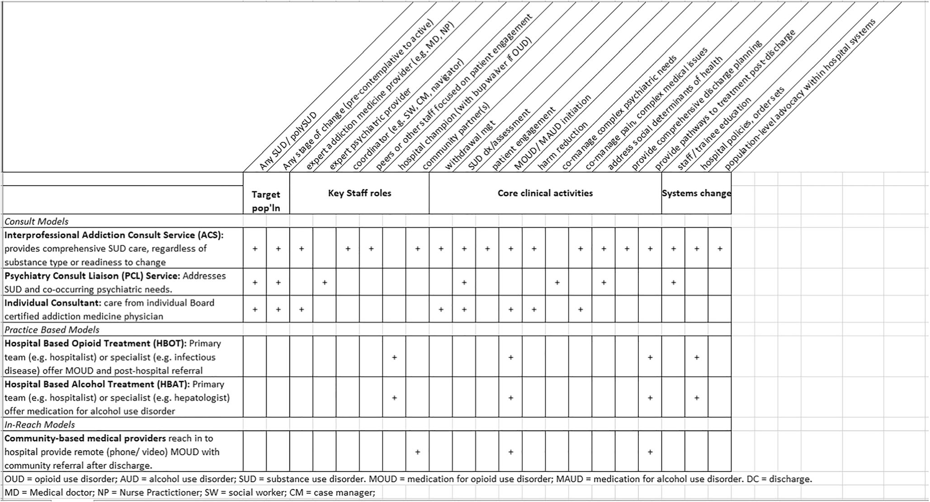
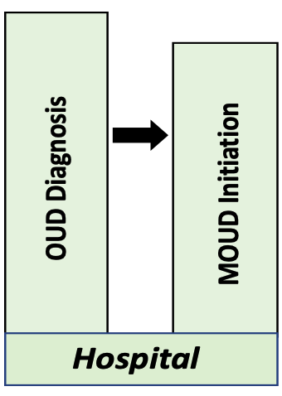
Recent proliferation of addiction services in acute care settings
Inpatient addition consult model characteristics
Link to outpatient care
Englander et al., J Gen Int Med, 2022
Notes:
emergency departments and, increasingly, inpatient settings

Slide 7
Initiation of hospital MOUD is highly effective at linking patients to care
?
Notes:
Amazing mentorship team

Slide 8
Initiation of hospital MOUD is highly effective at linking patients to care
But MOUD continuity following discharge remains a challenge
Grand majority of OUD patients do not continue MOUD in the community
Notes:
Amazing mentorship team

Slide 9
Initiation of hospital MOUD is highly effective at linking patients to care
But MOUD continuity following discharge remains a challenge
?
What strategies can help link patients from hospital settings to community-based care?
Notes:
Amazing mentorship team

Slide 10
Initiation of hospital MOUD is highly effective at linking patients to care
But MOUD continuity following discharge remains a challenge
What strategies can help link patients from hospital settings to community-based care?
Notes:
Amazing mentorship team

Slide 11
Initiation of hospital MOUD is highly effective at linking patients to care
But MOUD continuity following discharge remains a challenge
*Lack of terminology
*Lack of consensus
*Lack of evidence to support best practices
What strategies can help link patients from hospital settings to community-based care?
Notes:
Amazing mentorship team

Slide 12
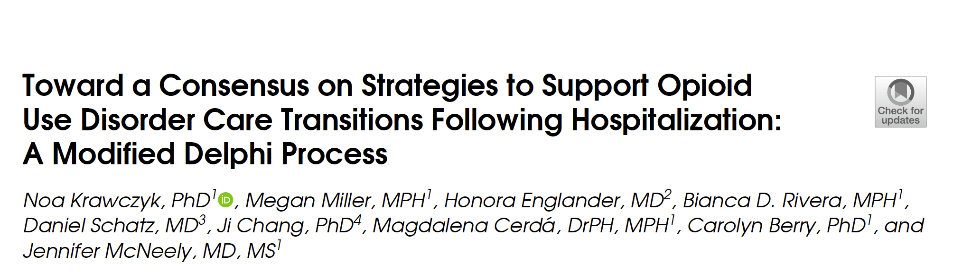
Study Objective:
Defining the “Black Box”: Can we gather expert consensus to generate taxonomy of OUD care transition strategies based on perceived impact and feasibility
Krawczyk et al., J Gen Int Med, 2024

Slide 13
3 Delphi Rounds
Step 1: Concept Mapping
Step 2: Delphi Consensus Process
Step 3: Synthesis of Taxonomy

Slide 14
Step 1: Concept Mapping
Expert team forms initial taxonomy items based on scoping review
Step 2: Delphi Consensus Process
3 rounds of surveys to assess consensus on taxonomy items
Step 3: Synthesis of Taxonomy
Synthesize and organize taxonomy based on effectiveness and feasibility
3 Delphi Rounds

Slide 15
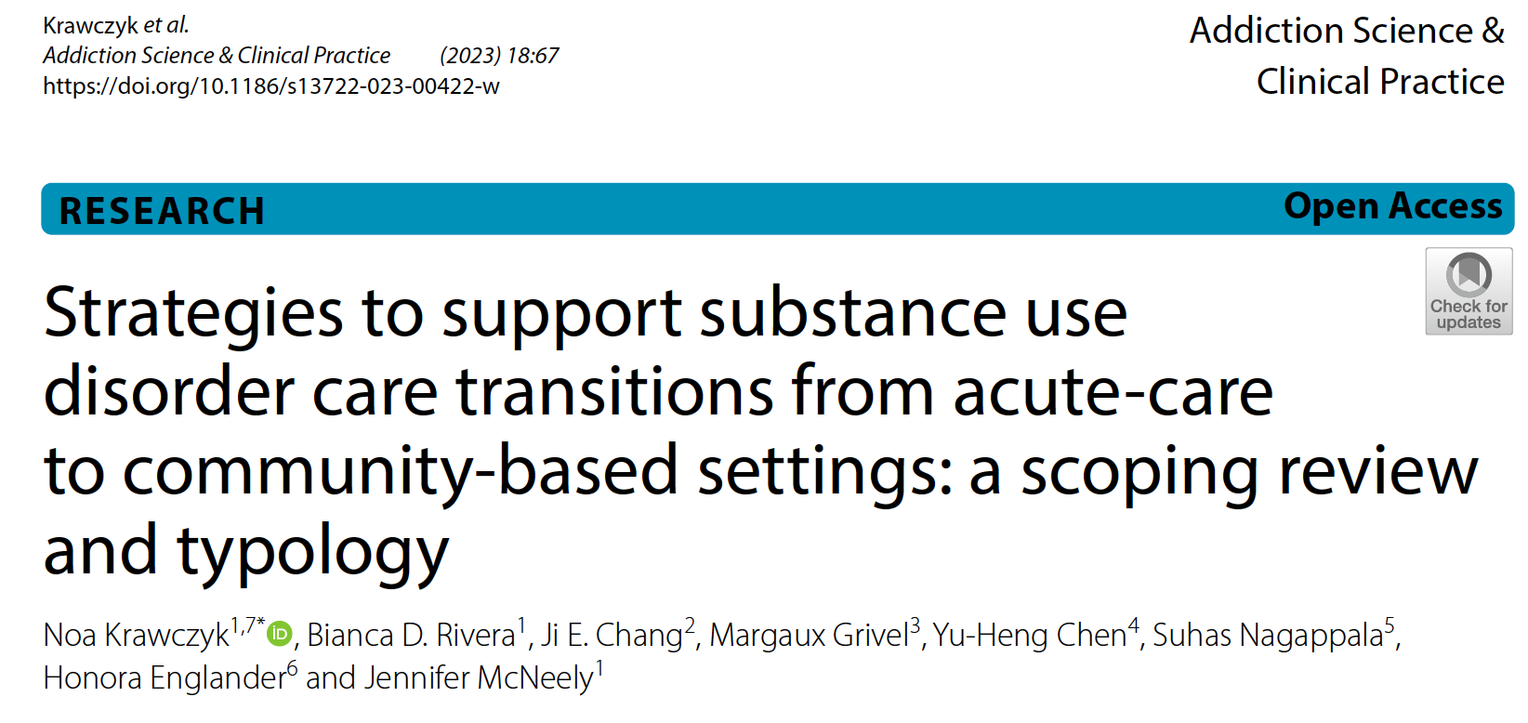
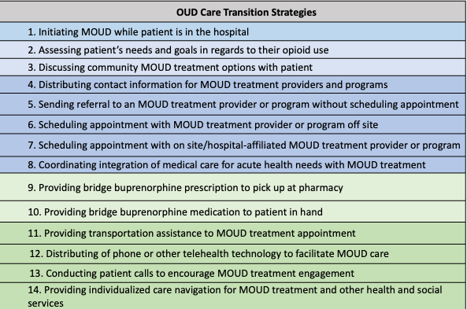
Step 1: Expert team forms initial taxonomy of 14 strategies based on literature

Slide 16
Step 1: Concept Mapping
Expert team forms initial taxonomy items based on scoping review
Step 2: Delphi Consensus Process
3 rounds of surveys to assess consensus on taxonomy items
Step 3: Synthesis of Taxonomy
Synthesize and organize taxonomy based on effectiveness and feasibility
3 Delphi Rounds

Slide 17
Step 1: Concept Mapping
Expert team forms initial taxonomy items based on scoping review
Step 2: Delphi Consensus Process
3 rounds of surveys to assess consensus on taxonomy items
Step 3: Synthesis of Taxonomy
Synthesize and organize taxonomy based on effectiveness and feasibility
3 Delphi Rounds

Slide 18
Step 2: A Modified Delphi panel to achieve consensus on strategies to support OUD care transitions following hospitalization
Invited 71 Delphi participants with expertise in hospital-based OUD care transitions:
Addiction researchers
Care transitions experts
Frontline hospital staff providing OUD care
3 Delphi Rounds
Round 1
45 respondents
Round 2
40 respondents
Round 3
35 respondents

Slide 19
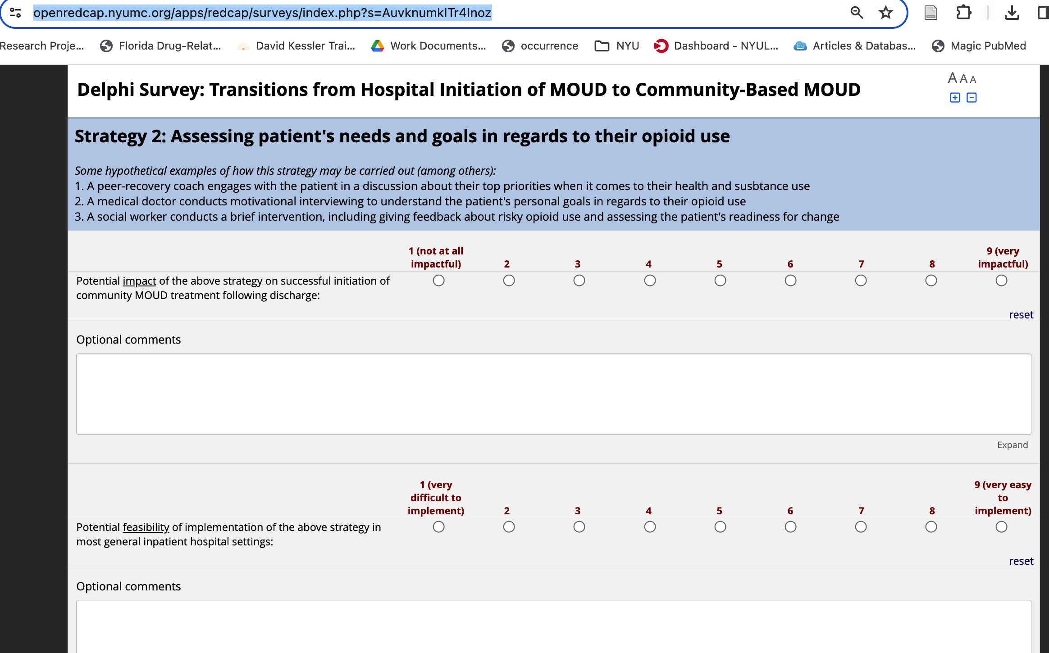
Step 2: A Modified Delphi panel to achieve consensus on strategies to support OUD care transitions following hospitalization
3 Delphi Rounds
Round 1 Survey: Rate strategies based on impact and feasibility

Slide 20
Step 2: A Modified Delphi panel to achieve consensus on strategies to support OUD care transitions following hospitalization
3 Delphi Rounds
Round 1 Survey: Rate strategies based on impact and feasibility

Slide 21
Step 2: A Modified Delphi panel to achieve consensus on strategies to support OUD care transitions following hospitalization
3 Delphi Rounds
Round 1 Survey: Rate strategies based on impact and feasibility

Slide 22
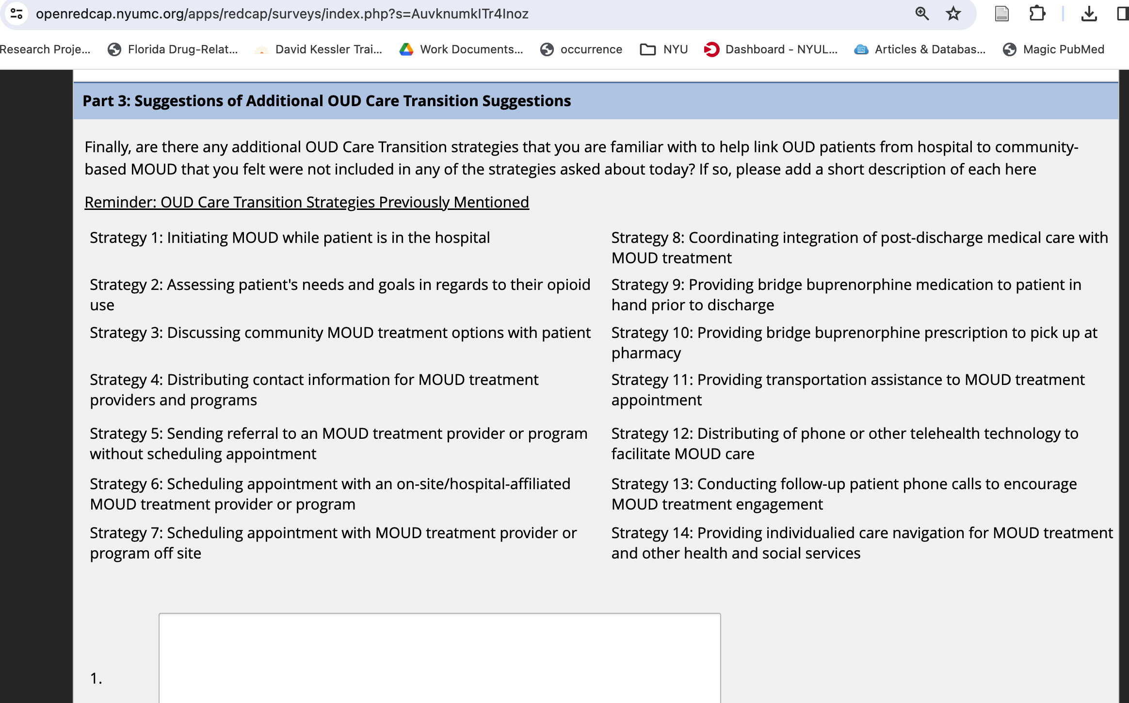
Step 2: A Modified Delphi panel to achieve consensus on strategies to support OUD care transitions following hospitalization
3 Delphi Rounds
Round 1 Survey: Option to propose additional strategies

Slide 23
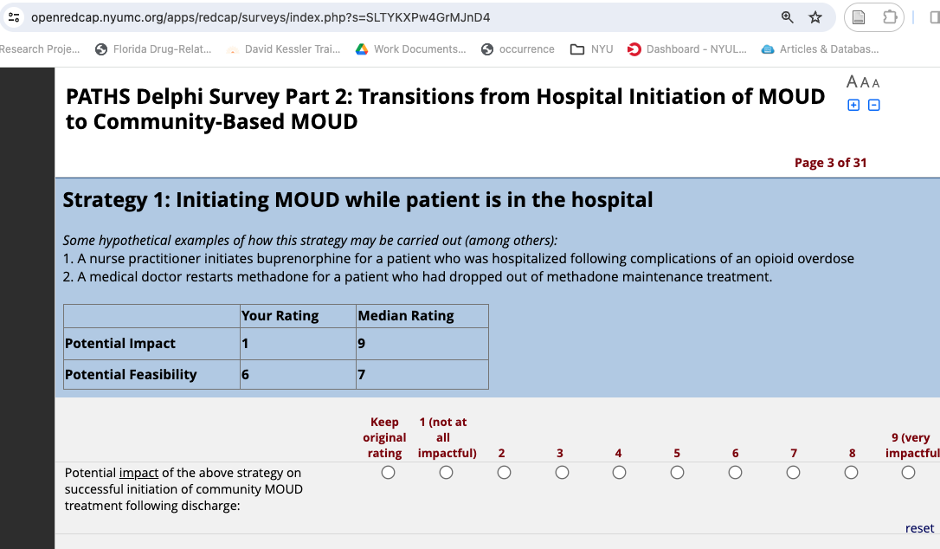
Step 2: A Modified Delphi panel to achieve consensus on strategies to support OUD care transitions following hospitalization
3 Delphi Rounds
Round 2 Survey: Option to revise rating based on median score

Slide 24
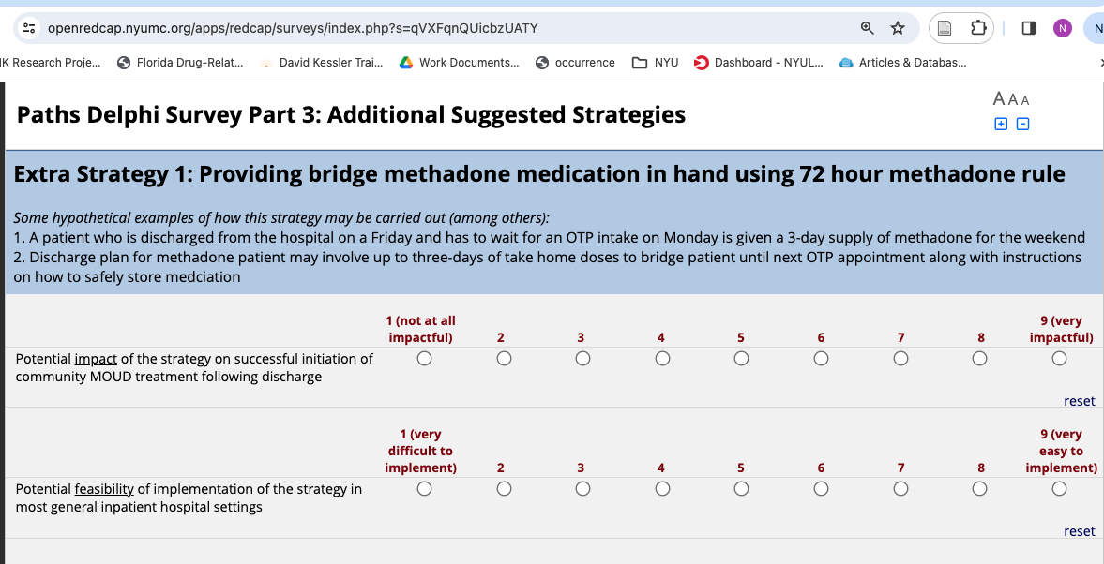
Step 2: A Modified Delphi panel to achieve consensus on strategies to support OUD care transitions following hospitalization
3 Delphi Rounds
Round 3 Survey:
Rate 8 new strategies proposed by Delphi panel in Rounds 1+2

Slide 25
3 Delphi Rounds
Step 1: Concept Mapping
Step 2: Delphi Consensus Process
  Expert team forms initial taxonomy items based on scoping review
  3 rounds of surveys to assess consensus on taxonomy items

Slide 26
Step 1: Concept Mapping
Expert team forms initial taxonomy items based on scoping review
Step 2: Delphi Consensus Process
3 rounds of surveys to assess consensus on taxonomy items
Step 3: Synthesis of Taxonomy
Synthesize and organize taxonomy based on imapct and feasibility
3 Delphi Rounds

Slide 27
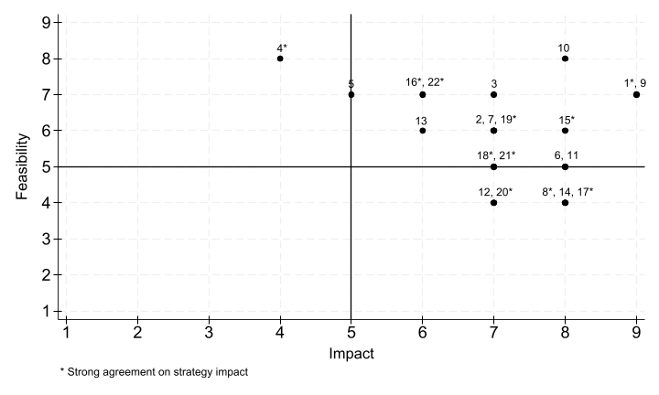
Step 3: Calculate median ratings on impact and feasibility
“strong agreement” >75% within 3pts of median
“moderate agreement” 51-74% within 3pts of median
“poor agreement” <51% of within 3pts of median
Medium
High

Slide 28
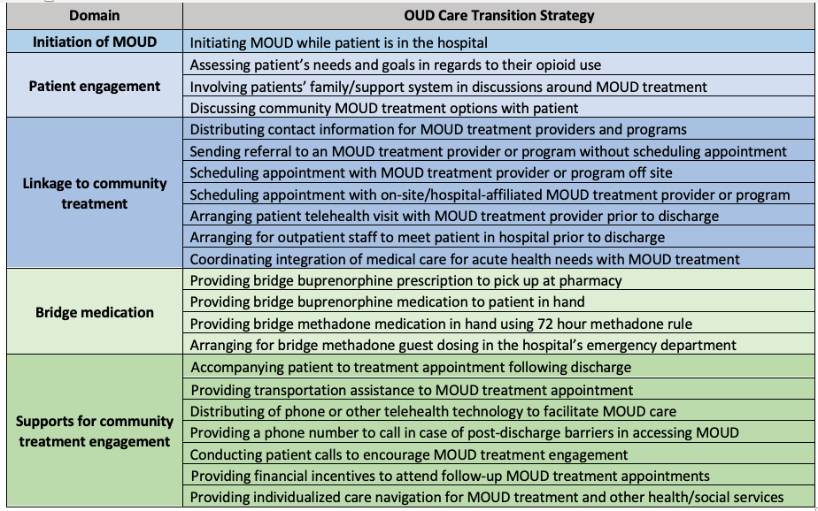
Step 3: Analyze results and inform final taxonomy of 22 strategies within five domains
*
*
*
*
*Rated as both high in impact and feasibility
Krawczyk et al.., J Gen Int Med (In Press)

Slide 29
Takeaways and next steps!
Strategies to best support the transition of OUD patients from hospitals to community-based treatment have been underexplored
Our study was able to establish expert consensus on 22 impactful and feasible strategies to support OUD care transitions from the hospital to community-based MOUD treatment
    MOUD initiation in hospital, discussing MOUD treatment options, bridge buprenorphine (prescribed or dispensed) were found to have highest impact and feasibility
  This taxonomy can set the stage for future work to study the direct impact of these strategies (especially those less researched), alone and in combination, on patient outcomes
  Success will depend on how well these strategies can be implemented across diverse hospital settings with variable resources
Notes:
The role and impact of specific strategies used to transition OUD patients from hospitals to community-based treatment is an underexplored area of research
Our study was able to establish expert consensus on 22 impactful and feasible strategies to support OUD care transitions from the hospital to community-based MOUD treatment
MOUD initiation in hospital, discussing MOUD treatment options, and bridge buprenorphine (prescribed or dispensed) were found to have highest impact and high feasibility
This taxonomy can set the stage for future work to study the direct impact of these strategies, alone and in combination, on patient treatment and health outcomes
Success will depend largely on how well these strategies can be implemented across diverse hospital settings with variable resources

Slide 30





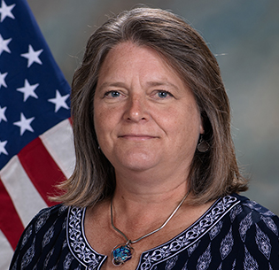


Thank you!
NIDA K01DA055758
Megan Miller, MPH
Honora Englander, MD
Bianca D. Rivera, MPH
Daniel Schatz, MD
Ji Chang, PhD
Magdalena Cerdá, DrPH, MPH
Carolyn Berry, PhD
Jennifer McNeely, MD, MS
Noa.Krawczyk@nyulangone.org
Twitter/X @NoaKrawczyk
Dream K01 Mentorship Team!
Magdalena Cerdá, DrPH
Jennifer McNeely, MD
Carolyn Berry, PhD
Charles Neighbors, PhD
Hildi Hagedorn, PhD
Honora Englander, MD
Charles Cleland, PhD
Daniel Schatz, MD
Charles Cleland, PhD
30

Slide 31
Appendix

Slide 32
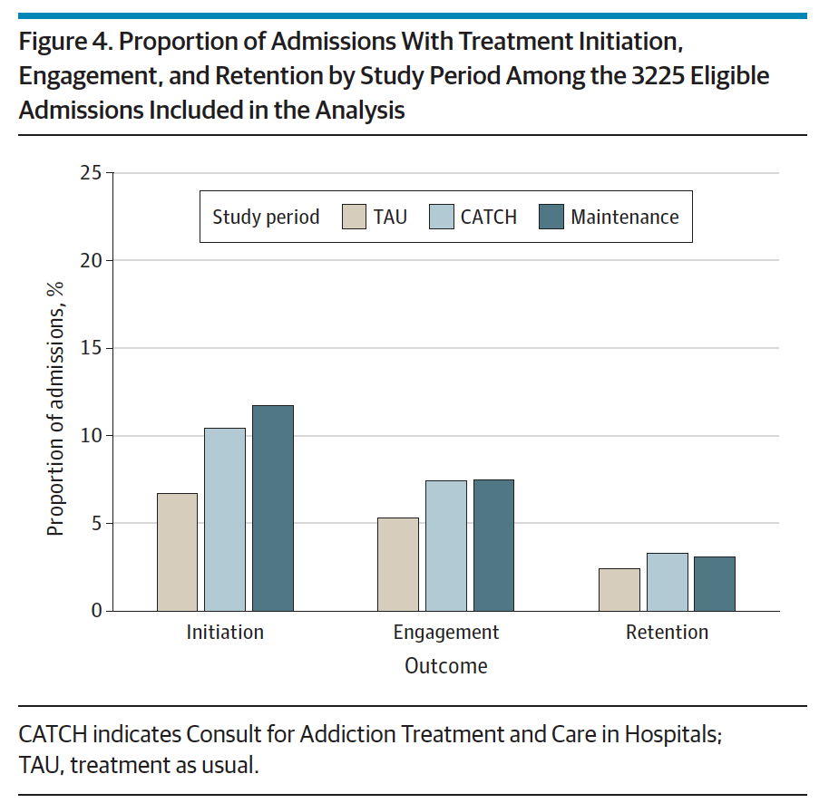
Initiation of MOUD in-hospital via addiction consults is highly effective at linking patients to care
^ 8x odds of MOUD initiation post-discharge
Still, only 12% initiate MOUD following discharge
Addiction consult
No Addiction consult
Engagement in treatment post-discharge remains low…
McNeely et al., JAMA Internal Medicine, 2024

Slide 33
Step 3: Analyze results and inform final taxonomy
 | Impact |  |  | Feasibilty
Strategy | Median score | Percent in 3 pt range | Agreement level | Median score | Percent in 3 pt range | Agreement level
Strategy 1 | 9 | 92.5% | Strong | 7 | 90% | Strong
Strategy 2 | 7 | 72% | Moderate | 6 | 75% | Strong
Strategy 3 | 7 | 60% | Moderate | 7 | 77% | Strong
Strategy 4 | 4 | 77.5% | Strong | 8 | 97.5% | Strong
Strategy 5 | 5 | 60% | Moderate | 7 | 87.5% | Strong
Strategy 6 | 8 | 97.5% | Strong | 5 | 70% | Moderate
Strategy 7 | 7 | 75% | Strong | 6 | 77.5% | Strong
Strategy 8 | 8 | 97.5% | Strong | 4 | 75% | Strong
Strategy 9 | 9 | 92.5% | Strong | 7 | 80% | Strong
Strategy 10 | 8 | 85% | Strong | 8 | 90% | Strong
Strategy 11 | 8 | 90% | Strong | 5 | 60% | Moderate
Strategy 12 | 7 | 67.5% | Moderate | 4 | 75% | Strong
Strategy 13 | 6 | 70% | Moderate | 6 | 75% | Strong
Strategy 14 | 8 | 95% | Strong | 4 | 65% | Moderate
Strategy 15* | 8 | 89% | Strong | 6 | 65% | Moderate
Strategy 16* | 6 | 73% | Moderate | 7 | 68% | Moderate
Strategy 17* | 8 | 78% | Moderate | 4 | 41% | Poor
Strategy 18* | 7 | 70% | Moderate | 5 | 49% | Poor
Strategy 19* | 7 | 76% | Strong | 6 | 62% | Moderate
Strategy 20* | 7 | 62% | Moderate | 4 | 32% | Poor
Strategy 21* | 7 | 76% | Strong | 5 | 54% | Moderate
Strategy 22* | 6 | 59% | Moderate | 7 | 41% | Poor
Medium
High
3 Delphi Rounds
“strong agreement” >75% of responses fell within 3pts of median
“moderate agreement” 51-74% of responses fell within 3pts of median
“poor agreement” <51% of responses fell within 3pts of median
*Participant added strategies, rated in Round 3 only (n = 37)

Slide 34
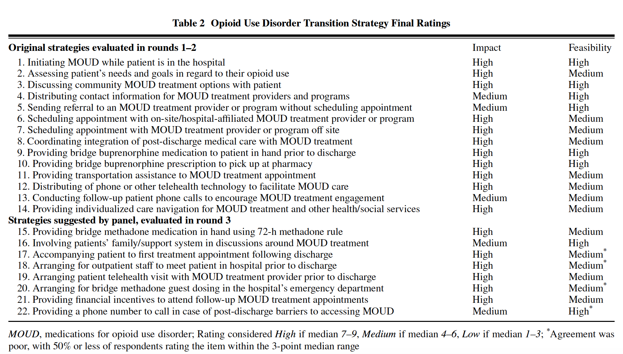

Slide 35
Next steps!
Aim 2: Understand barriers and facilitators Transitions of Care
Survey on strategies: 11 hospitals
Qualitative interviews: 4 hospitals
- Patients
- Hospital-based providers
- Community-based providers

Slide 36

Next steps!
Aim 3: Explore individual and hospital-level factors associated with improved treatment continuity
Link data at patient level

Slide 37

“PATHS” Promoting Addiction care Transitions across Healthcare Settings
Aim 1: Build a taxonomy of OUD care transition strategies (i.e. defining the “black box”)
Aim 2: Understand barriers and facilitators to supporting transitions of care
Aim 3: Explore relationship between patient characteristics, hospital transition practices, and treatment continuity post-discharge
Enhance adoption of care transition strategies that support
OUD treatment continuity across touchpoints
Translational goal
NIDA K01DA055758
Notes:
Amazing mentorship team

Slide 38
“PATHS” Promoting Addiction care Transitions across Healthcare Settings
Aim 1: Build a taxonomy of OUD care transition strategies (i.e. defining the “black box”)
Aim 2: Understand barriers and facilitators to supporting transitions of care
Aim 3: Explore relationship between patient characteristics, hospital transition practices, and treatment continuity post-discharge
Enhance adoption of care transition strategies that support
OUD treatment continuity across touchpoints
Translational goal
NIDA K01DA055758
Notes:
Amazing mentorship team

Slide 39
Study 1: Scoping review of transition strategies described in the academic literature to link patients with substance use disorder from acute-care to community settings
Search Criteria:
(1) Published and peer-reviewed 2000-2021
(2) Programs or interventions for adult patients with SUD, hospitalized in general acute-care settings (e.g. emergency (ED) or inpatient)
(3) Evaluated post-hospital treatment engagement outcomes
(4) Described practices for supporting patients’ transition from acute-care setting to community treatment ( ≥1 sentence)

Slide 40
Study 1: Scoping review of transition strategies described in the academic literature to link patients with substance use disorder from acute-care to community settings
Characteristics of included studies:
84% U.S. based
71% targeted patients with OUD
42% observational, 36% pilot/feasibility, 22% RCT
ED
(N=25)
Inpatient (N=17)
N=3

Slide 41
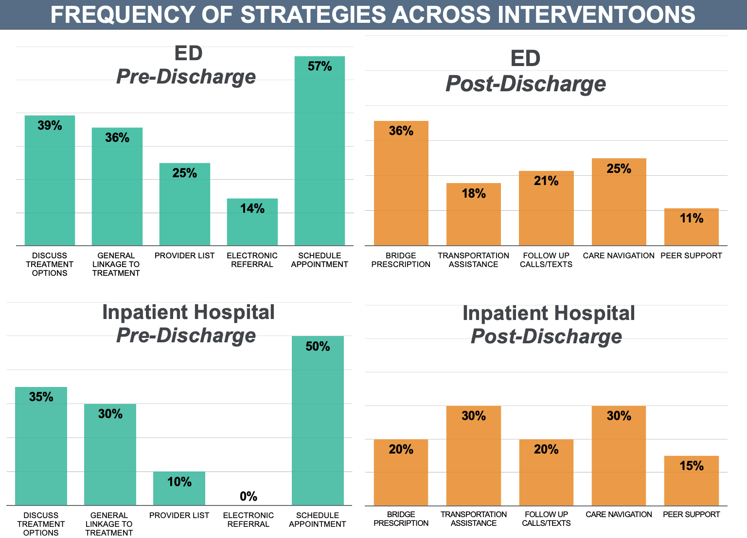
10 strategies identified in literature
Notes:
A third don’t say what they are
Currently, there is scarce information available about the nature of heterogenous transition strategies that are part of acute-care interventions for SUD, highlighting a need for greater emphasis on studying the transition portion of these interventions
The proposed typology can help us begin to better describe, compare and evaluate transition strategies implemented across acute-care and other care touchpoints, and inform interventions that maximize care continuity among patients with SUD

Slide 42
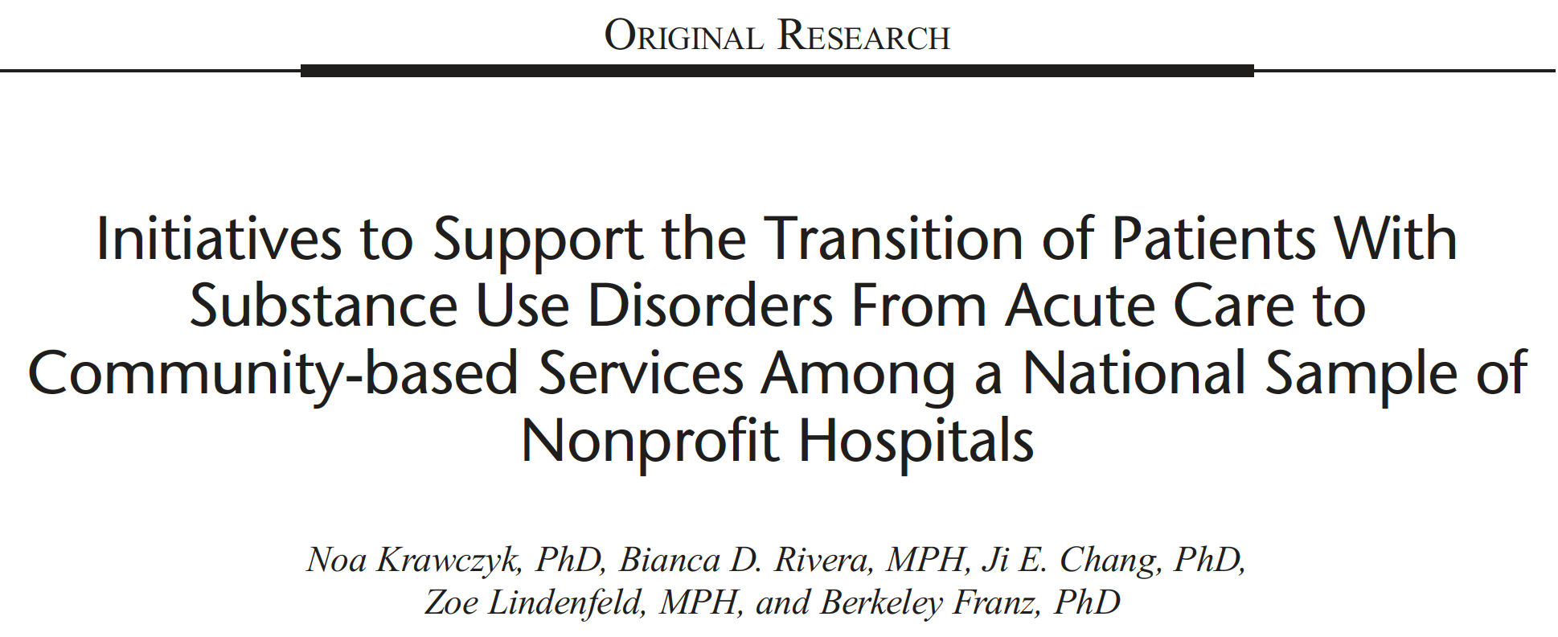
Study 2: Explore what substance use disorder care transition strategies are being offered across a national sample of nonprofit hospitals
Data Sample
20% random sample of all US nonprofit community hospitals from American Hospital Association's 2018 Annual Survey (n = 613)
Data on hospital practices extracted from 2019–2021 Community Health Needs Assessment (CHNA) and Implementation Plan (IP).
Coded the top 5 health needs identified in each hospital CHNA and IP: Limited to hospitals that identified SUD as a top 5 priority (n = 313).
Notes:
Community benefit reports which are mandated
by the Patient Protection and Affordable Care Act every
3 years for tax-exempt organizations.
and pulling CHNA and IPs from hospital Web sites.
If reports were not available, we contacted hospitals by telephone
and email (n = 125). If we did not receive a response, hospitals
were removed from the dataset (n = 123).

Slide 43
313 (51%) of hospitals in the sample noted SUD as a top five priority area

Slide 44
313 (51%) of hospitals in the sample noted SUD as a top five priority area
106 (34%) of hospitals that prioritized SUD noted efforts to address substance use in acute care settings

Slide 45
313 (51%) of hospitals in the sample noted SUD as a top five priority area
106 (34%) of hospitals that prioritized SUD noted efforts to address substance use in acute care settings
53 (50%) of hospitals with efforts to address SUD in acute care settings noted supporting transitions of care from acute to community-based settings

Slide 46
313 (51%) of hospitals in the sample noted SUD as a top five priority area
106 (34%) of hospitals that prioritized SUD noted efforts to address substance use in acute care settings
53 (50%) of hospitals with efforts to address SUD in acute care settings noted supporting transitions of care from acute to community-based settings
17 (32%) of hospitals noting supporting transitions of care from acute to community-based settings specified the transition strategy used to support linkage

Slide 47
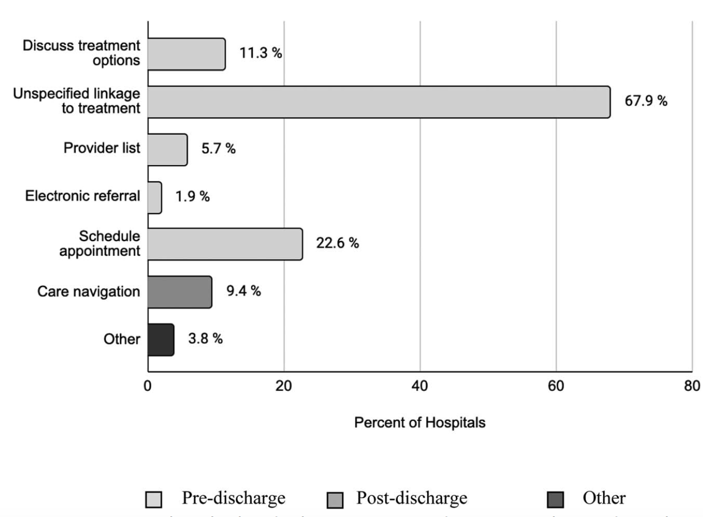
Transition strategy specified among hospitals supporting transitions of care for SUD (N=53)
313 (51%) of hospitals in the sample noted SUD as a top five priority area
106 (34%) of hospitals that prioritized SUD noted efforts to address substance use in acute care settings
53 (50%) of hospitals with efforts to address SUD in acute care settings noted supporting transitions of care from acute to community-based settings
17 (32%) of hospitals noting supporting transitions of care from acute to community-based settings specified the transition strategy used to support linkage
*Transition Strategies based on Scoping Review categories
Krawczyk et al.., J Addict Med (2023)

