Slide 1
Training clinicians to prescribe buprenorphine for opioid use disorder (OUD) in the era of changing regulations
Nikki Apana, BA, MS2
Jessica Ristau, MD, Assistant Professor of Medicine
Irina (Era) Kryzhanovskaya, MD, Associate Professor of Medicine
Notes:
team of clinician-educators based out of UCSF, including Dr. Era KryzshaNOVskaya who is with us today and our colleague Dr. Jesse Ristau
Today I will be presenting on…
crij-zha-nov-ska-ya

Slide 2
Disclosures/Conflicts of Interest
Nothing to declare

Slide 3
Background
Notes:
I am sure many of you have seen this slide before. But I would be remiss if I didn’t at least provide some context for this training.
Opioid-related overdose deaths have been on the rise. We are aware of three waves of the opioid epidemic. Wave 1 started with prescription opioids at the turn of the century.
This was followed by Wave 2 with a rise in Heroin use, related to changing regulations that limited access to prescription opioids.
Finally, there is wave 3, which is occurring now, and involves the rise of fentanyl (and other synthetic opioids) which have made the drug supply more deadly (50x more potent than heroin and 100x more potent than morphine). When we add in the COVID-19 pandemic to this picture of already rising death rates, it is a scary public health crisis. Prior to the pandemic, there were 60,000 opioid-related overdose deaths. This number rose to 100,000 in 2021.

Slide 4
Racial Disparities
Gondré-Lewis et al (2022)
Jones et al (2023)
Notes:
Especially of note, there is a disproportionate impact of opioid overdose deaths on Black, Latinx, and Indigenous communities. Notably, overdose death rates among Black individuals is 4-6x higher than for White individuals.
Recent studies attribute these disparities to disproportionate access to lifesaving medications for opioid use disorder, such as buprenorphine. In 2021, an estimated 2.5 million adults had an opioid use disorder, yet less than 25% (less than ¼) people received medications for opioid use disorder. Disparities in overdose deaths can be linked directly to disparities in access to treatment.

Slide 5
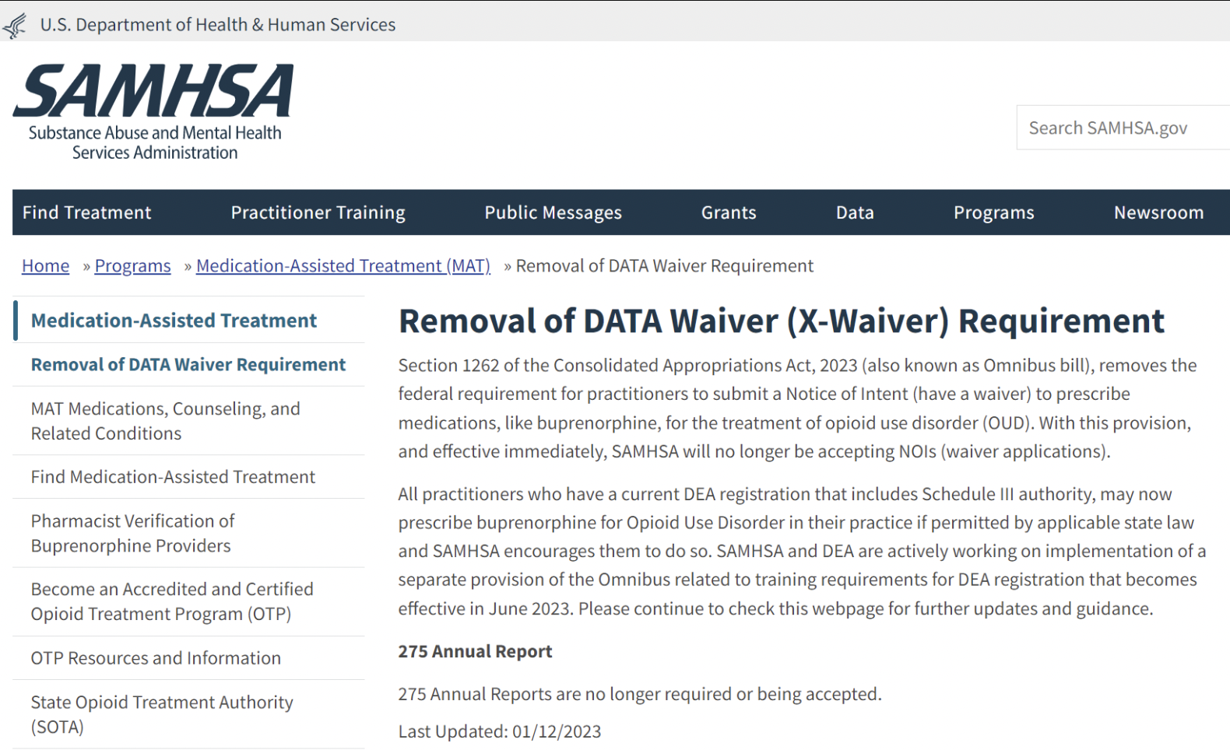
Consolidated Appropriations Act, 2023 (Omnibus bill)
SEC. 1262. Eliminating additional requirements for dispensing narcotic drugs in Schedule III, IV, and V for maintenance or detoxification treatment.
Notes:
Fortunately, there have been recent policy changes that EXPAND access to buprenorphine and other medications for opioid use disorder. President Biden signed the Omnibus bill that became effective January of this year and REMOVES the federal requirement for practitioners to have a waiver (also known as the X-waiver) in order to prescribe buprenorphine.
This X-waiver previously required that all prescribers attend extensive training (8 hours for MDs and 24 hours for NPs/PAs). With these changing regulations, there is great potential to eliminate the disparities in treatment access by enabling more clinicians in the community—especially in communities of color—to prescribe buprenorphine for OUD. However, with the removal of the X-waiver, there is an urgent need to train frontline clinicians on how to effectively prescribe these medications for opioids use order.

Slide 6
Purpose
To describe the UCSF clinician training on buprenorphine prescribing for the treatment of opioid use disorder (OUD)
Notes:
That’s where our curriculum seeks to fill the gap. Here I will share the UCSF clinician training that our INTERPROFESSIONAL AND INTERDISPLINARY team put together to provide abridged training around buprenorphine prescribing practices for the treatment of opioid use disorder.
We want to emphasize the involvement of not just addiction medicine docs, but also psych and pharmacy.
[This is an image from the third training we completed, prior to the official removal of the X-waiver! This is an image from our most recent training in October following the removal of the X-Waiver.]

Slide 7
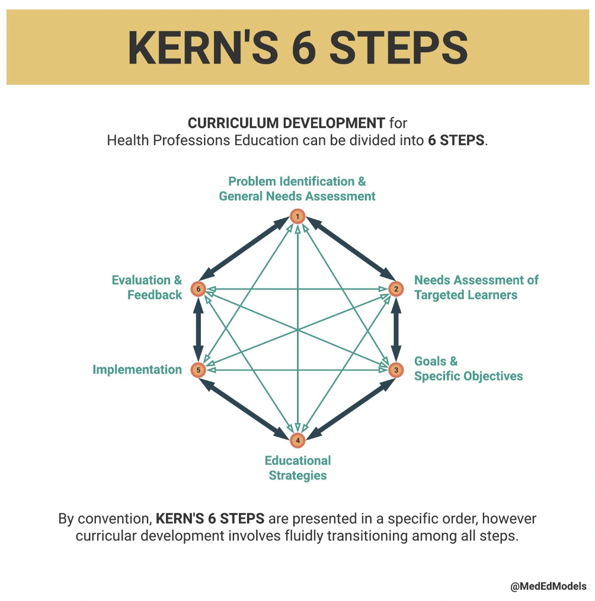
Methods - Approach
Notes:
In designing an effective, competency-based curriculum, we used Kern’s 6 steps

Slide 8
Methods - Approach
Notes:
starting with the needs assessment

Slide 9
Needs Assessment
Problem Identification
Jan 2023: X-waiver X’d
Trainees with insufficient training in buprenorphine prescribing
Target learners
Interprofessional (residents, practicing clinicians, pharmacists)
Notes:
I already provided some context earlier of the current state of changing regulations. In the backdrop of these changing regulations, there are clinicians who have insufficient training in buprenorphine prescribing practices. Frontline prescribers, especially those who serve vulnerable populations in low access areas would benefit most from our training. We determined the target audience should include interprofessional learners, moving beyond just trainees to also include practicing clinicians and pharmacists, among other professionals.

Slide 10
Methods – Curriculum
Notes:
Continuing with Kern’s 6 steps, we articulated the learning objectives and educational strategies we planned to deploy in the training.

Slide 11
Methods - Curriculum
Notes:
The curriculum’s three key learning objectives: 1) describe steps for starting buprenorphine for OUD. This involves answering the question “What does a clinician need to know before starting buprenorphine?” For example, is a pregnancy test necessary or is continued drug use a contraindication to MOUD (PS the answer is NO!)
We also articulated why buprenorphine is used to treat OUD (emphasizing that it’s a life-saving medication that reduces mortality/HIV/HCV transmission AND criminal justice involvement) We also dispelled any myths around buprenorphine, showing evidence that it is safe, effective, and does not cause sedation at proper dosing.
2) distinguish various ways to initiate buprenorphine in the outpatient setting. Discuss bupe films, tablets, and injections. Also explore microdosing, gradual uptitration, and macrodosing.
3) review steps for monitoring buprenorphine treatment. This includes monitoring with UDS, providing site-specific (addiction medicine consults) and national resources such as the Substance Use Warmline, run by the National Clinician Consultation Center, which offers free, confidential clinician to clinician consultation on substance use evaluation and management.

Slide 12
Methods - Curriculum
Didactic
Virtual and In-person options
90 minutes
Case-based and Interactive
Dual coding / Retrieval practice
Notes:
In thinking about instructional strategies for this didactic, we wanted to harness the most available and effective teaching methods that take into account the science of learning. Building off of numerous X-waiver training courses, we created a didactic focused on the most high-yield content that:
Could be virtual or in-person.
Was abbreviated to 90 minutes as opposed to 8 hours
Case-based and interactive
And incorporated evidence-based learning strategies such as dual coding and retrieval practice.

Slide 13
Notes:
Here is an example of a case-based scenario that was used to discuss buprenorphine initiation and maintenance. We followed Jane throughout the 90-minute training from diagnosis with OUD, to buprenorphine initiation, to maintenance treatment.

Slide 14
Notes:
After teaching about the options for buprenorphine maintenance, this is an example of a question we used for retrieval practice. This question asks people to apply interpretation of a UDS to Jane’s buprenorphine management plan. This case offers APPLICATION of the case-based teaching

Slide 15
Results
Notes:
Moving onto the last parts of Kern’s six steps, we have the implementation and evaluation steps.

Slide 16
Results
5 Trainings between April 2022 – October 2023
In-Person (3x)
45 UCSF Internal Medicine and Pediatric Residents
Zoom (2x)
4 Public Psychiatry Fellows
10 SFDPH Pharmacists
With assistance from:
Sarah Burbank, MD
Tauheed Zaman, MD
Stephen Leung, MD
Heidi Reetz, MD
Nicky Mehtani, MD
Stephen Matzat, MD
Irina (Era) Kryzhanovskaya, MD
Associate Professor of Clinical Medicine
Division of General Internal Medicine
Jessica Ristau, MD
Assistant Professor of Clinical Medicine
Division of General Internal Medicine
Notes:
From April 2022 to October 2023, the didactic, taught by Era and Jesse with the assistance of our interprofessional and interdisciplinary team, has been delivered a total of 5 times: three times in-person to 45 internal medicine residents and twice virtually to 4 public psychiatry fellows and 10 pharmacists.

Slide 17
Results
Integrated Feedback
Successes
High-yield, clinically relevant content
Q&A integrated throughout session
Areas for Improvement:
More cases
Opportunities to re-visit content
Notes:
Following each training, feedback from participants has informed iterative improvement of the didactic. Participants were offered a QR code to scan to offer their responses via Qualtrics survey. Feedback included appreciation of the abbreviated curriculum which contained high-yield, clinically-relevant content in a case-based format. Earlier sessions requested more Q and A so we incorporated this into more recent sessions, and that was a success.
Some areas for improvement include providing step-by-step practice for more cases and increasing access to reorientation at a later date.
Having witnesses these trainings, I think it’s revolutionary the way it’s taught in an interactive, case-based manner to mimic real patient cases. The training is also tailored to the audience, such as whether the clinicians are inpatient vs outpatient.

Slide 18
Discussion
Future Iterations
Formal surveys:
Participants’ knowledge, skills, and attitudes
Feedback on the curriculum and lesson plan
Expanding buprenorphine education mediums
Digital medication education (podcasts)
Notes:
Future iterations of the training will continue to include surveys that assess changes in participants’ knowledge, gather curricular feedback, and modify the didactic as prescribing barriers evolve.
Additionally, we are considering incorporating digital medical education (such as podcasts by addiction providers) into these trainings, either as prework, or as additional resources attendees can access after the trainings. My incredible mentor Era is a co-host for the Curbsiders Teach and producer for a few episodes of Curbsiders addiction medicine Podcast, which I am sure she would be happy to elaborate on in the Q and A

Slide 19
Conclusion
Implications to Practice
Provide abbreviated training for interprofessional learners
Reduce barriers to buprenorphine prescribing
Ensure clinicians have access to resources and training
…ensuring everyone has access to lifesaving medications
Notes:
Our training has many implications to practice. For one, we provide an abbreviated training for interprofessional learners than can be scaled at other institutions.
This training can reduce barriers to buprenorphine prescribing and ensure clinicians have easy access to resources to help them prescribe MOUD. (especially in light of the removal of the X-waiver training requirement).
This training has implications for tackling the future of the opioid crisis and preventing opioid use-related deaths at their root—ensuring everyone has access to lifesaving medications.

Slide 20
Thank you!
Nikki.Apana@ucsf.edu

Slide 21
References
American Society of Addiction Medicine. Advancing Access to Addiction Medications: Implications for Opioid Addiction Treatment. 2013. Available at: https://nosorh.org/wp-content/uploads/2017/05/Access-to-MAT-by-state.pdf. Accessed May 2, 2023.
Gondré-Lewis MC, Abijo T, Gondré-Lewis TA. The Opioid Epidemic: a Crisis Disproportionately Impacting Black Americans and Urban Communities. J Racial Ethn Health Disparities. Published online September 6, 2022:1-15. doi:10.1007/s40615-022-01384-6
Jones CM, Han B, Baldwin GT, Einstein EB, Compton WM. Use of Medication for Opioid Use Disorder Among Adults With Past-Year Opioid Use Disorder in the US, 2021. JAMA Network Open. 2023;6(8):e2327488. doi:10.1001/jamanetworkopen.2023.27488
Lanham HJ, Papac J, Olmos DI, et al. Survey of Barriers and Facilitators to Prescribing Buprenorphine and Clinician Perceptions on the Drug Addiction Treatment Act of 2000 Waiver. JAMA Netw Open. 2022;5(5):e2212419. doi:10.1001/jamanetworkopen.2022.12419
Opioid Data Analysis and Resources | Opioids | CDC. Published April 5, 2023. Accessed May 2, 2023. https://www.cdc.gov/opioids/data/analysis-resources.html
Sordo L, Barrio G, Bravo MJ, et al. Mortality risk during and after opioid substitution treatment: systematic review and meta-analysis of cohort studies. BMJ. 2017;357:j1550. doi:10.1136/bmj.j1550
Substance Abuse and Mental Health Services Administration. (2023). Removal of DATA Waiver (X-Waiver) Requirement.
1.

Slide 22
Notes:
Good afternoon! My name is Nikki Apana and I am a first-year medical student at UCSF. I am working with Dr. Era KryzhaNOVskaya and Dr. Jesse Ristau and I am here presenting on behalf of our team based out of UCSF Mt Zion. I will be discussing today Training clinicians to prescribe buprenorphine for opioid use disorder (OUD) in the era of changing regulations.

