Slide 1
‘Tranq burn’: Exploring the etiology of tranq-related soft tissue injuries
Daniel Ciccarone, George Karandinos, Alex Krotulski, Jeff Ondocsin, Nicole Holm, Fernando Montero, and Sarah Mars
University of California, San Francisco

Slide 2
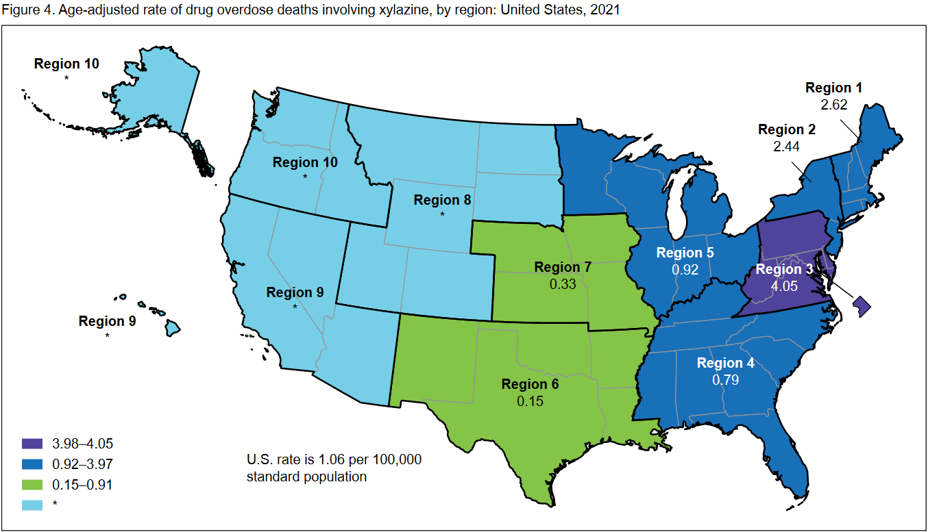
BACKGROUND: XYLAZINE
‘Tranq dope’ is a combination of xylazine and fentanyl that is becoming increasingly common throughout the US.
By 2019, xylazine was detected in over 90% of street opioid samples and over 30% of fatal overdoses in Philadelphia, PA.
Regional problem (thus far)¹
1. Spencer MR, Cisewski JA, Warner M, Garnett MF. Drug overdose deaths involving xylazine: United States, 2018–2021. Vital Statistics Rapid Release; no 30. Hyattsville, MD: National Center for Health Statistics. 2023. DOI: https://dx.doi.org/10.15620/cdc:129519

Slide 3
Xylazine: Clinical features
Alpha-2-agonist
Potentiates opioids
Reduces withdrawal sxs
CNS depression, bradycardia, and hypotension
Typically injected, its use appears related to severe skin and soft tissue injury (SSTI) through an unknown mechanism.
Peripheral vasoconstriction and reduced oxygen perfusion (photo)¹
Warning: The following slides contain graphic images of xylazine-related wounds
Malayala SV, Papudesi BN, Bobb R, Wimbush A. Xylazine-Induced Skin Ulcers in a Person Who Injects Drugs in Philadelphia, Pennsylvania, USA. Cureus. 2022 Aug 19;14(8):e28160. doi: 10.7759/cureus.28160. PMID: 36148197; PMCID: PMC9482722.

Slide 4
Qualitative Methodology
One week of ‘rapid ethnographic assessment’ in Philadelphia, Pennsylvania, in October 2023
Semi-structured interviews with 32 participants
Predominantly street-based recruitment in the Kensington area with some snowball sampling
Video and photographic observations of consumption techniques and presence of wounds

Slide 5
Participants (n=32)
Gender
 | Male | 18
 | Female | 14
Age (years)
 | 20-29 | 8
 | 30-39 | 13
 | 40-49 | 8
 | 50-59 | 1
Race/Ethnicity
 | White | 21
 | Black/African American | 5
 | Hispanic/Latino | 2
 | Asian American or Pacific Islander | 1
 | Multiracial | 3
Substances used (past month)*
 | ‘Tranq’ | 31
 | Cocaine | 12
 | Crack | 11
 | Methamphetamine | 13
 | Benzodiazepine (e.g. xanax) | 5
 | PCP | 2
 | K2 | 2
‘Tranq’ mode(s) of use*
 | Inject | 23
 | Smoke | 8
 | Snort | 5
Presence of wounds |  | 22
Consumes ‘speedballs’ |  | 11
*Self-report and ability to select multiple, numbers add to greater than 32

Slide 6
Qualitative Results
Observed SSTI were extraordinarily severe
Several themes emerged related to wound etiology:
1) Tranq dope injection caused burning sensations;
2) vein loss occurred following chronic use of tranq dope;
3) vein loss resulted in increased injection attempts, the use of large central veins (e.g., jugular and brachial), as well as more frequent ‘skin-popping’; and
4) wounds, called ‘tranq burns’, rapidly followed vein loss.

Slide 7
1) Tranq dope injection caused burning sensations
Interviewer: How does tranq feel when you miss your vein?
Respondent: It burns. It burns. Burns, burns, burns.
Interviewer: Is there any other chemical that it reminds you of in terms of the level of burning? Like if you missed a shot with coke, would it burn as much?
Respondent: It burns a little less than coke.

Slide 8
2) vein loss occurred following chronic use of tranq dope
Interviewer 1: Have people always had this much trouble injecting, or is this newer?
Respondent: No, no. I don’t think so. I don’t think that the drugs have been so noxious to the veins, either. Powder [cocaine], yes. We all know powder kind of destroys your veins, but we really didn’t know – or at least I wasn’t aware that tranq would be just as bad, if not worse, than powder shots.

Slide 9
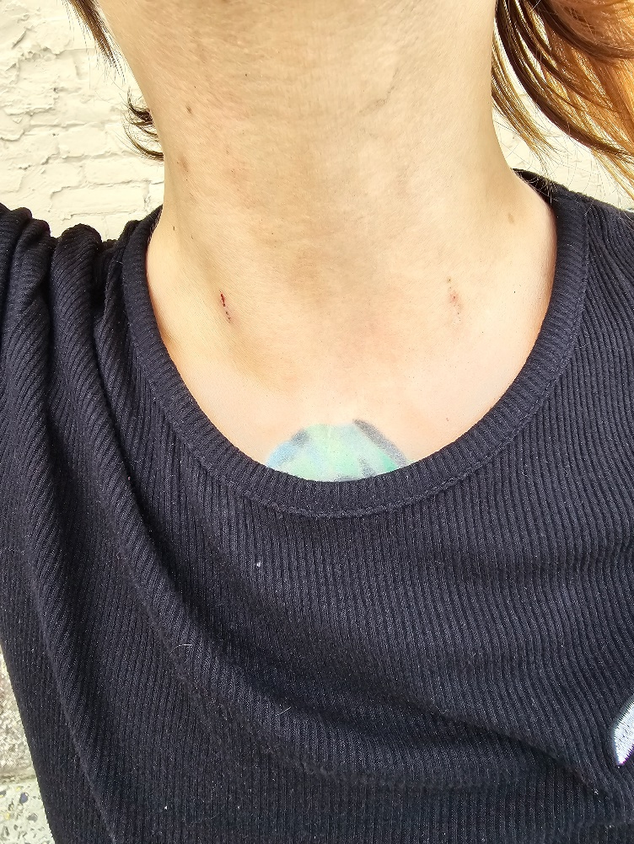
3) vein loss resulted in increased injection attempts, the use of large central veins
Interviewer: Tell me about those [large arm wounds]. How did you get them? How long have they been there?
Respondent: Oh, man. I've had them for about three years now. I got them from... I used all my veins up from shooting the xylazine. It tears your veins apart. You shoot one time, and you lose your veins. So I've gone through every single vein you can dream of in your body from feet, from head to toe, neck, everything.

Slide 10
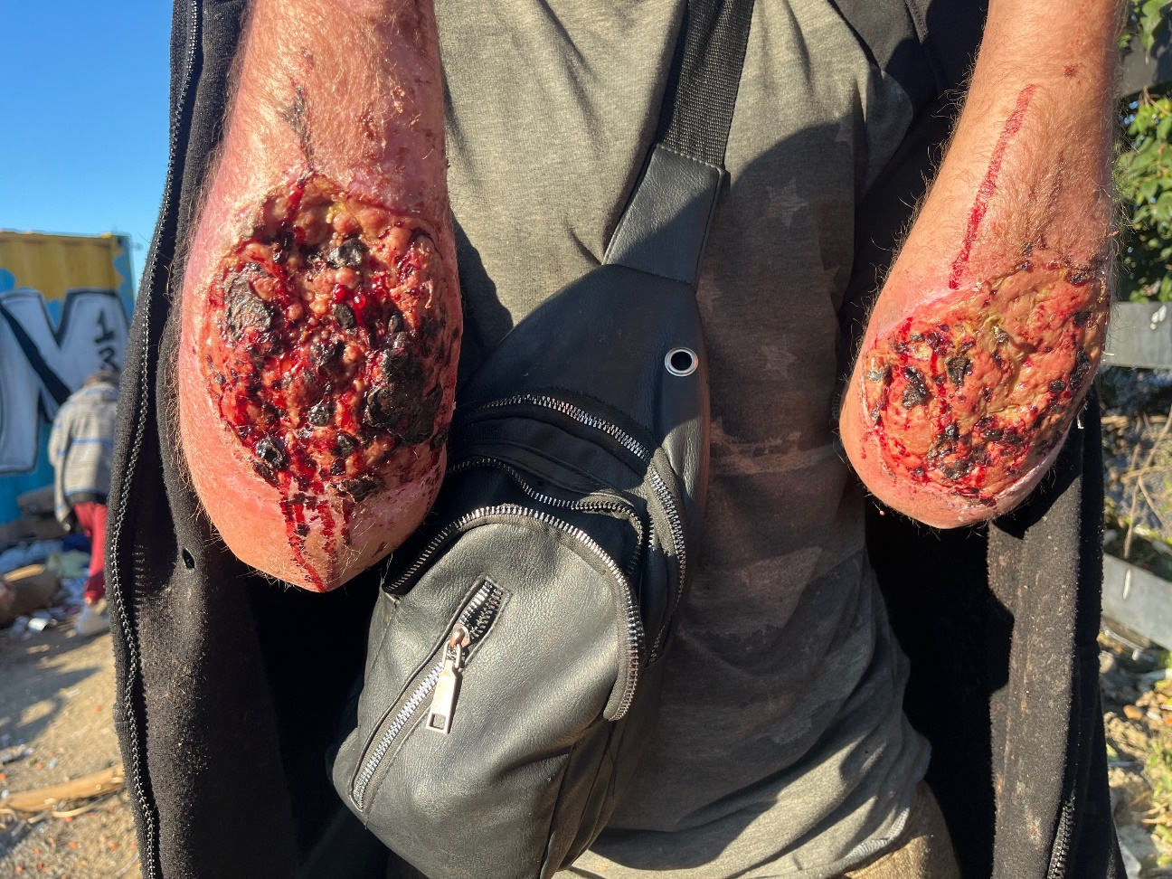
4) wounds, called ‘tranq burns’, rapidly followed vein loss

Slide 11
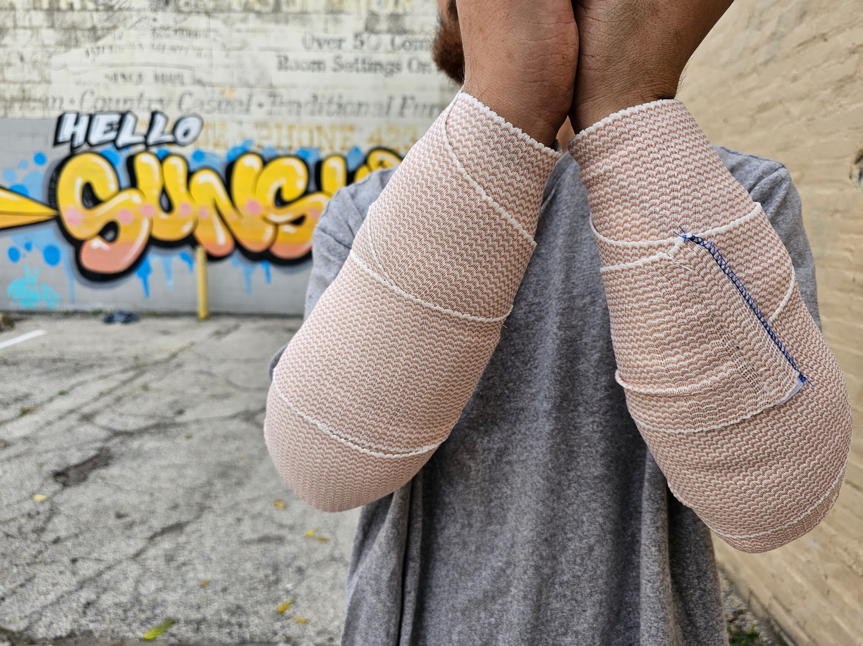

Slide 12
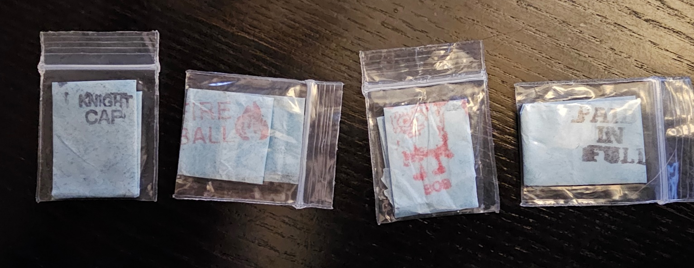
Laboratory ph testing
BACKGROUND: Previous research suggests that the high acidity of certain heroin source-forms contributes to vein damage and SSTI. We explore the possibility of an etiologic role between the acidity of tranq dope and SSTI.
METHODOLOGY: Dr Alex Krotulski @ The Center for Forensic Science
Research and Education (CFSRE)
Drug samples obtained through drug checking and surveillance initiatives.
Composition: Samples with enough mass (i.e., 5-10 mg) were aliquoted for quantitative analysis performed by GC-MS, including fentanyl, xylazine, and other substances, and results were reported as a weight-by-weight percent.
To determine the pH of samples, full glassine bags containing “dope” powder were transferred to a test tube, and 300 uL of water (pH 7.1) was added prior to taking the pH measurement using a lab-grade meter.

Slide 13
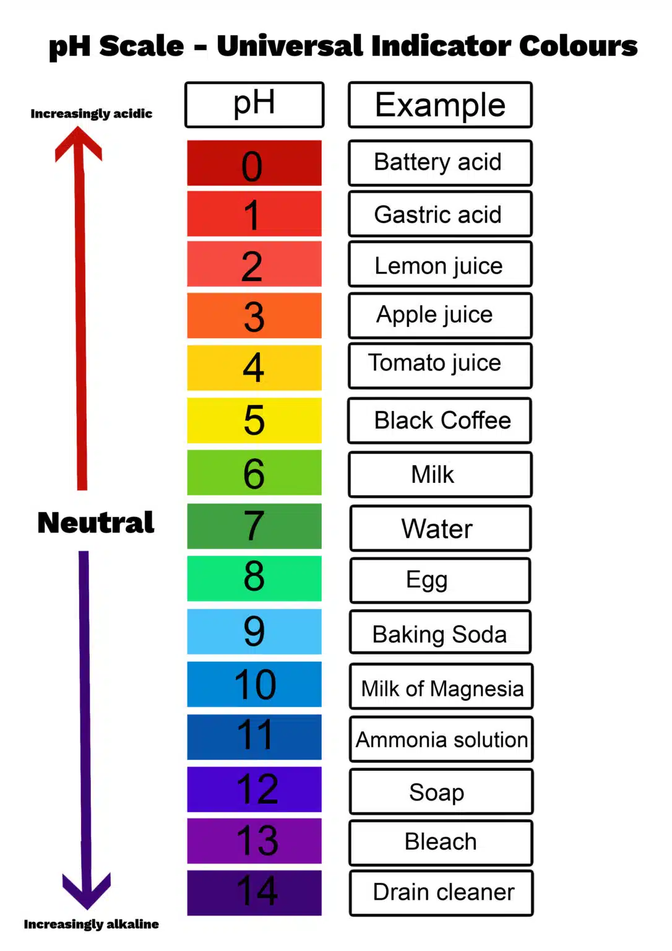
TABLE 1. LABORATORY PH ANALYSIS OF STREET DRUG SAMPLES
Sample ID | Type | Confirmation Results | Weight (mg) | Volume (uL) | pH | Additional Volume (uL)/pH | Comments
“Dope” only (heroin, fentanyl, but no xylazine)
PAG_0031 | Dope (No X) | Fentanyl (32.5%, 1p), 4-ANPP (11.1%, 0.3p), Phenethyl-4-ANPP (trace), Ethyl-4-ANPP (trace) | 80.1 | 300 | 2.1 | 600/2.2, 900/2.3, 1200/2.4 | Cloudy, white particulate, did not get better
PDPH_0363 | Dope (H,F, No X) | Heroin (16%, 1p), 6-MAM, Acetylcodeine, Fentanyl (10.4%, 0.4p), 4-ANPP (2.1%), Quinine (trace) | 125.9 | 400 | 3.6 | 700/3.6 | Not fully soluble
“Tranq dope” (heroin, fentanyl, and xylazine)
PDPH_0762 | Dope (F:X, 1:25+) | Fentanyl (2.3%, 1p), Xylazine (59.9%, 40.9p), 4-ANPP (1.1%, 0.5p), Bupropion (0.2p), Quetiapine (0.2p) | 23.6 | 150 | 5.9 | 300/6.1, 600/6.3 | -
PDPH_0739 | Dope (F:X, 1:10) | Fentanyl (5.1%, 1p), Xylazine (55.6%, 16.3p), 4-ANPP (0.7%, 0.1p), para-Fluorofentanyl (0.7%, trace), N-Desethyl Isotonitazine (Approx. 0.04%, trace), Bromazolam (trace), Phenethyl-4-ANPP (trace) | 26.1 | 150 | 4.9 | 300/5.4, 600/5.5 | -
PAG_0054 | Dope (F:X, 1:1) | Fentanyl (24.4%, 1p), Xylazine (37.7%, 1.4p), 4-ANPP (3.0%, 0.1p), Phenethyl-4-ANPP (trace), Ethyl-4-ANPP (trace) | 32.6 | 150 | 3.6 | 300/3.4, 600/3.5, 900/3.6, 1200/3.7 | Cloudy, white particulate, got better with H2O
PAG_0007 | Dope | Fentanyl (12.9%, 1p), Xylazine (43.9%, 3.8p), 4-ANPP (3.6%, 0.4p), Phenethyl-4-ANPP (trace) | 79 | 300 | 3.9 | 600/4.0 | -
Xylazine from lab sources
PAG_0049 | Xylazine (China) | Xylazine (82.4%) | 23.8 | 150 | 5.6 | 300/5.6, 600/5.7 | -
PAG_0050 | Xylazine (Vet Med) | Xylazine (71.1%), Methylparaben, Propylparaben | 24 | 150 | 4 | 300/4.2, 600/4.3 | -
Other drugs
BRAN_0289 | Coke | Cocaine (64.3%) | 119.8 | 400 | 3 | N/A | -
PAG_0062 | Meth | Methamphetamine (78.3%) | 182.2 | 600 | 5.7 | N/A | -
https://www.science-sparks.com/what-is-the-ph-scale/

Slide 14
Discussion
Combined use of xylazine and fentanyl leads to vein loss, which increases the risk of subsequent SSTI
The acidity of the combination likely plays an etiologic role
Heroin and fentanyl are HCL salts; xylazine?
The fentanyl component appears more acidic
Synergism between acidic scarring and vasoconstriction
Possible harm reduction interventions include dilution and buffering.
Stigma reduction and enhanced wound care are required in harm reduction and clinical settings.

Slide 15
Acknowledgements
The participants!
SYNC ethnographic study team:
Sarah Mars, Jeff Ondocsin, Nicole Holm, George Karandinos, Fernando Montero
NIH/NIDA Funding: R01DA054190
Dr Alex Krotulski and team @ The Center for Forensic Science Research and Education (CFSRE)

