Slide 1
Trends in nonfatal opioid overdose among Veterans Health Administration patients with opioid use disorder following COVID-related policy changes for opioid use disorder treatment AMERSA National Conference November 16, 2024
Madeline C. Frost, PhD, MPH
Madeline.Frost@va.gov
Postdoctoral Fellow, VA Puget Sound Health Systems Research
Research Scientist, University of Washington Dept. of Health Systems & Population Health

Slide 2
Co-authors
Pramit Maskey, BS
Jessica A. Chen, PhD
Evan P. Carey, PhD
David S. Fink, PhD, MPH
Julia A. Dunn, M.Sc.
Olivia V. Fletcher, MS
Varuna Ravi, BS
Emily C. Williams, PhD, MPH
Institutions: VA Eastern Colorado Health Systems Research; VA Puget Sound Health Systems Research; University of Colorado Department of Biostatistics and Informatics; University of Washington Department of Psychiatry and Behavioral Sciences; University of Washington Department of Health Systems and Population Health; New York State Psychiatric Institute

Slide 3
Acknowledgments
Support:
National Institute on Drug Abuse R01DA056232
VA Advanced Fellowship Program in HSR, Office of Academic Affiliations, US Department of Veterans Affairs
Disclosures: None.
Disclaimer: The opinions expressed in this work are the authors’ and do not necessarily reflect those of the Department of Veterans Affairs or the United States Government.

Slide 4
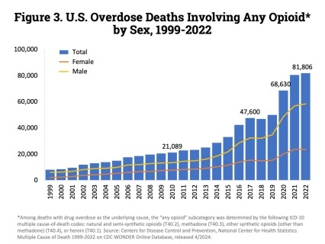
Background
Opioid-involved overdose deaths have increased substantially in the U.S.
COVID
From 2019 to 2022, there was a 64% increase.
During this period, the sharpest increase coincided with the COVID-19 pandemic.
Source: NIDA, 2024, Drug Overdose Deaths: Facts and Figures

Slide 5
Background
Medications for opioid use disorder (MOUD) prevent overdose among people with OUD.
The COVID-19 pandemic prompted federal policy changes that increased flexibility in the provision of MOUD.
Increased flexibility in telehealth provision of buprenorphine
Increased flexibility for take-home doses of methadone
Wakeman SE, et al. JAMA Netw Open. 2020
United States Code. 21 U.S.C. §, 802(54)
DEA, DEA qualifying practitioners, DEA qualifying other practitioners, 2020
SAMHSA, Methadone Take-Home Flexibilities Extension Guidance, 2024

Slide 6
Objective
We know that opioid-involved overdoses increased overall during the COVID-19 pandemic.
However, little is known about overdose trends among people with diagnosed OUD, who would have been impacted by COVID-related changes in MOUD policy.
We described monthly trends in nonfatal opioid overdose before and after COVID-related MOUD policy changes among patients with diagnosed OUD in the national Veterans Health Administration (VHA).

Slide 7
Data Source and Sample
Data Source: National VHA electronic health record (EHR)
Secondary analysis of data pulled for a study focused on trends in MOUD receipt
Study period: 3/1/2018-2/1/2022 (24-months prior to/following COVID-related policy changes in 3/2020)
Sample inclusion criteria:
Rolling cohorts of patients with ≥1 outpatient visit during the past year for each month in the study period.
OUD diagnosis (≥1 diagnostic code in past year)

Slide 8
Measures
Outcome: Nonfatal opioid overdose treated in VHA, defined as ≥1 diagnostic code for opioid poisoning during each month
Also examined type of opioid involved (e.g., prescription opioid)
Urban vs. rural residence: Measured via VHA Planning Systems Support Group classification of patient residence
Other demographic characteristics: Measured via EHR documentation

Slide 9
Analyses
Described sample demographic characteristics
Described monthly proportion with ≥1 nonfatal opioid overdose treated in VHA
Overall and in urban vs. rural areas
Examined proportion of monthly overdoses that were prescription opioids vs. other types of opioids

Slide 10
Results
Demographic characteristics of sample (N=110,144 unique patients):
Mean age was 56 years (SD: 14.5)
92% male, 8% female
73% White, 18% Black, 1% Asian or Pacific Islander, 1% American Indian or Alaska Native, 1% Multiple race
5% Hispanic ethnicity

Slide 11
Results
Monthly % of national VHA patients with OUD with nonfatal opioid-involved overdose treated in VHA, March 2018-February 2022
Month

Slide 12
Results
Monthly % of national VHA patients with OUD with nonfatal opioid-involved overdose treated in VHA, March 2018-February 2022
Month

Slide 13
Results
The majority of nonfatal overdoses treated in VHA during the study period were prescription opioid-involved overdoses.
Range from 42% to 76% within each month
Average of 57% over all months

Slide 14
Discussion
During a period when opioid overdoses were increasing in the broader population, nonfatal opioid overdoses treated in VHA among VHA patients with diagnosed OUD remained stable before and after COVID-related policy changes.
This was true for patients in both urban and rural areas.
Increased flexibility in MOUD policies may have helped prevent increases in overdose during this time period for people with diagnosed OUD, but other factors may be contributing to these findings.

Slide 15
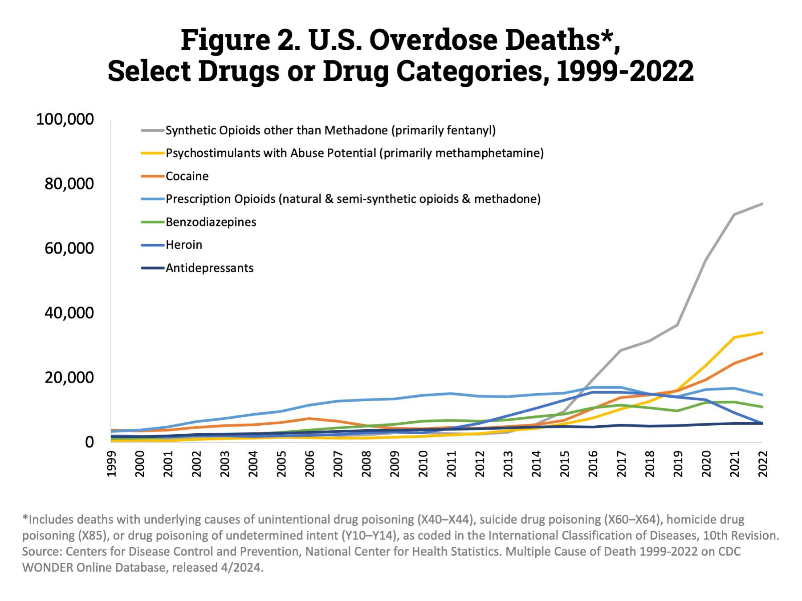
Discussion
:
A large proportion of the overdoses captured in our outcome were prescription opioid-involved overdoses, which are not driving broader increases in overdose deaths.
Source: NIDA, 2024, Drug Overdose Deaths: Facts and Figures

Slide 16
Discussion
Further research is needed to understand these trends:
Compare trends in nonfatal overdoses among VHA patients with and without diagnosed OUD over the same time period
Examine trends in fatal overdoses among VHA patients with diagnosed OUD over the same time period
Examine trends among patients with diagnosed OUD in another clinical setting that sees more fentanyl-involved overdoses

Slide 17
Limitations
OUD may not be diagnosed or documented in EHR for some patients
Outcome does not include fatal overdoses or nonfatal overdoses treated outside of VHA
Results may not be generalizable outside of the VHA setting

Slide 18
Thank you!
Madeline Frost, PhD, MPH
Madeline.Frost@va.gov
Postdoctoral Fellow, VA Puget Sound Health Systems Research
Research Scientist, University of Washington Dept. of Health Systems & Population Health

