Slide 1
US and Canadian Medical Student Attitudes Toward People
Who Inject Drugs: An Online Survey
Andrew Nelson, he/him, A.T. Still University SOMA
Tucker Avra, DVM, he/him, UCLA School of Medicine

Slide 2
Disclosures
The presenters have nothing to disclose.

Slide 3
Background
People who inject drugs often face discrimination and stigma in medical settings.
This creates barriers to care and worsens health outcomes.
Medical student attitudes toward people who inject drugs have not been evaluated
The prevalence of harm reduction related education in medical education has not been evaluated.

Slide 4
Objective
Explore and understand current attitudes and stigma toward people who inject drugs among medical students across the US and Canada.
Assess the prevalence of harm reduction related education among medical students in the US and Canada.

Slide 5
Methods
Anonymous online survey sent to medical students at 220 US and Canadian medical schools between May and July 2023
Survey:
A 10-point validated survey on attitudes toward people who inject drugs measured on a Likert scale
A 7-point survey assessing curriculum related to SUD treatment and harm reduction, with “Yes,” “No,” “Unsure.”

Slide 6
Methods: 10-Point Attitude Survey
“I won’t associate with people who inject drugs if I can help it.”
“People who inject drugs should be incarcerated to protect society.”
“People who inject drugs have a right to their lifestyle, if that’s the way they want to live.”
“Injection drug use is just plain wrong.”
“Injection drug use is immoral.”
“Injection drug use is merely a different kind of lifestyle that should not be condemned.”
“People who inject drugs are mistreated in our society.”
“People should feel sympathetic and understanding of people who inject drugs.”
“People who inject drugs should be accepted completely into society.”
“I avoid people who inject drugs whenever possible.”

Slide 7
Methods: 7-Point Curriculum Survey
In my medical school education I was taught…
“how to identify and treat opioid withdrawal.”
“the importance of syringe service programs.”
“how to counsel patients on safe drug injection practices.”
“how to recognize an opioid overdose.”
“how to administer naloxone.”
“how to prescribe methadone and/or buprenorphine.”
“about the principles and practices of harm reduction.”

Slide 8
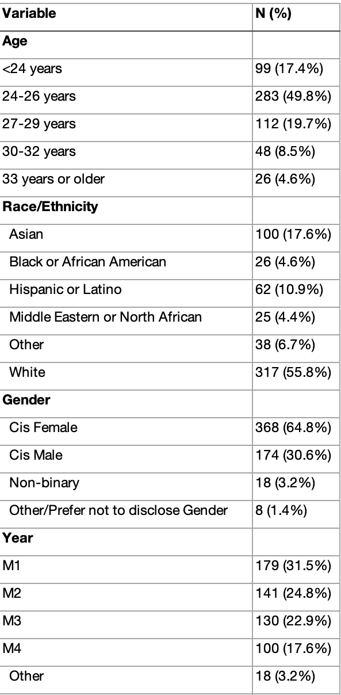
Results
Total Participants: 568 students from 52 medical schools.

Slide 9
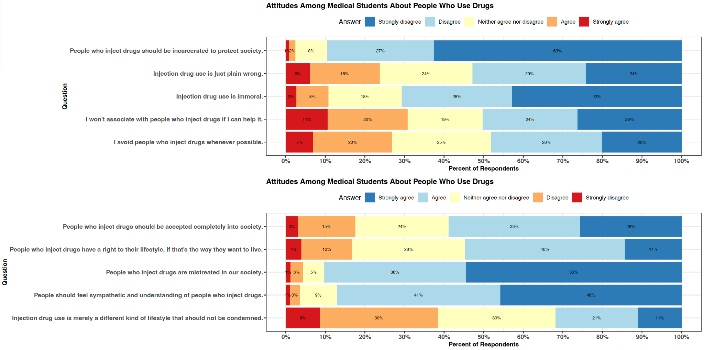
Notes:
A quarter of the med students surveyed felt that Injection drug use is just plain wrong
31% of students wouldn’t associate with people who inject drugs if they could help it
Nearly a fifth (18%) of students disagreed that people who inject drugs shoujld be accepted completely into society

Slide 10
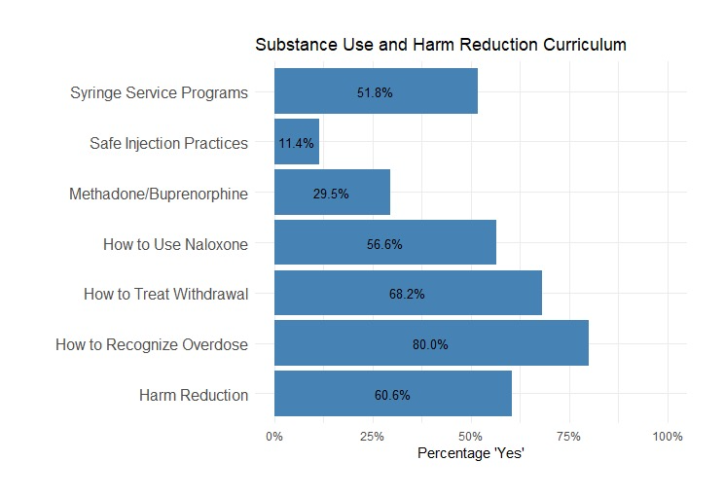
Medical School Curriculum

Slide 11
Discussion
Significant stigma toward people who inject drugs exists among US and Canadian medical students.
Addressing and reducing stigma is essential for improving care for people who inject drugs.
There are gaps in medical education surrounding substance use disorder treatment and harm reduction.
These gaps provide an opportunity to tailor interventions toward the reduction of stigma among medical students

Slide 12
Future Directions
Interventions:
Developing programs that effectively reduce stigma during medical training.
Longitudinal Evaluation:
Track how medical student attitudes evolve over time and after interventions.

Slide 13
Thank you!
Questions?

