Slide 1
“Un Attracteur de Soins”: Bringing People into Care. Qualitative Study of Interprofessional French Healthcare Clinicians’ Attitudes Towards Opioid Agonist Therapy (OAT)
Honora Englander MD
Benjamin Rolland MD
Marie Jauffret-Roustide PhD
englandh@ohsu.edu
AMERSA 2024
Notes:
Bonjour a toutes et a tous. Merci de me donner l'opportunité de m’adresser à vous aujourd’hui. C’est un grand honneur d'être parmi vous
Comparaison entre la France et EUs

Slide 2
Disclosures
No conflicts of interest
Funding for this work:
Franco-American Fulbright Commission
Neurodis Foundation
le Centre Hospitalier Vinatier

Slide 3
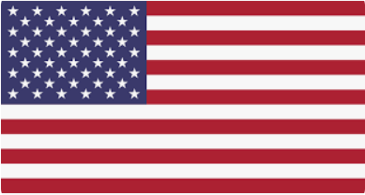
OUD treatment gap
Methadone and buprenorphine are the most effective treatment for opioid use disorder (OUD).
Yet <1 in 5 Americans receives them.
Wakeman JAMA 2020, Krawczyk IJDP 2022

Slide 4
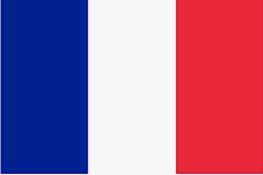
OUD Care in France
87% of French people with OUD receive methadone or buprenorphine
Overdose rates <32 x US rates
Methadone can be started in specialty addiction clinic or hospitals, with handoff to primary care. Buprenorphine can be prescribed in any setting. Both medications available in community pharmacies.
EMCDDA 2023, Nguemeni AJPH 2021

Slide 5
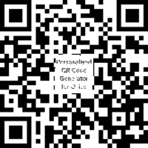
Policies governing methadone and buprenorphine differ
Englander IJDP 2024
Notes:
Policies governing methadone and buprenorphine differ widely between France and the US, and my team’s earlier work describes these policy differences in detail.

Slide 6
US policy reform is essential, but alone insufficient to expand access
In the year after US buprenorphine X-waiver was eliminated:
↑ prescribers
Small ↑ in new patient initiation
↔ total number of people receiving buprenorphine
Approaches to methadone and buprenorphine – including the goals and culture of care – matter.
Chua NEJM 2024
Notes:
However, even with policy reform, there are important questions about how to achieve such high rates of OAT adoption, and the US experience with buprenorphine demonstrates that

Slide 7
Research question: How do interprofessional French clinicians and stakeholders approach methadone and buprenorphine care?
Notes:
a country with among the highest OAT adoption and lowest opioid-related morbidity and mortality worldwide?

Slide 8
Methods

Slide 9
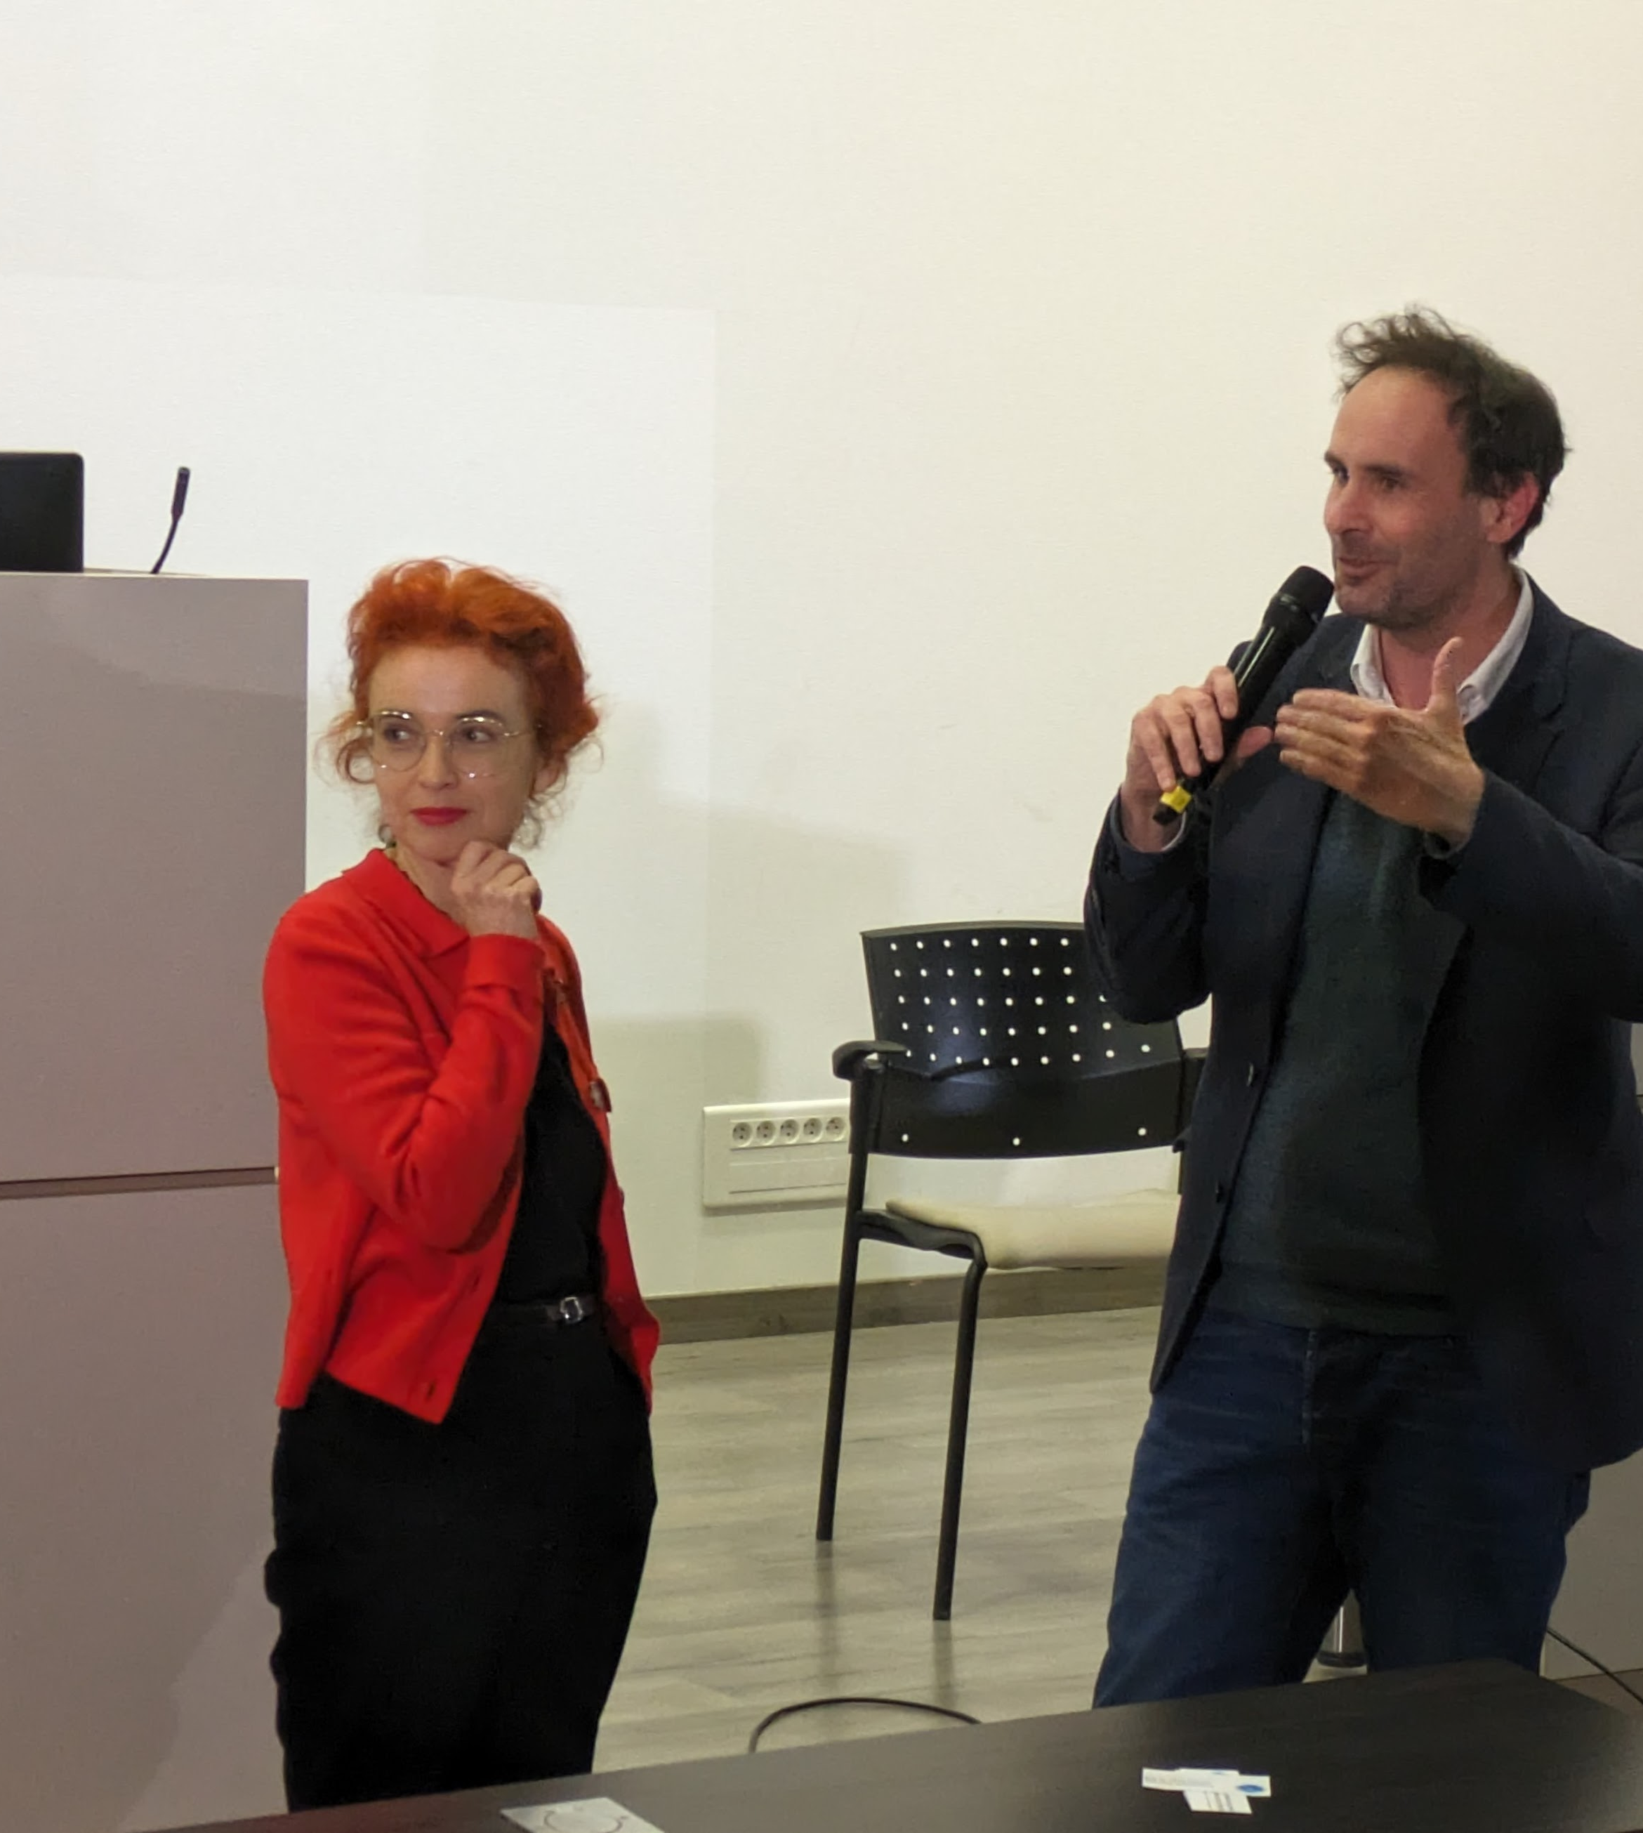
Positionality
I am a practicing US addiction medicine physician and researcher focused on improving health systems; lived in France for a year while conducting this research.
Conducted >25 site visits across France.
Collaborators include leading French socialist and addiction psychiatrist.
Notes:
And also, France is... France!

Slide 10
Qualitative interviews and analysis
Recruited participants across diverse professions, clinical settings, French regions; included historical and practicing professionals.
Conducted in-depth semi-structured interviews which we audio-recorded and transcribed.
Conducted a reflexive thematic analysis using an inductive approach.
Identified themes that held meaning to study participants and had implications for the US and other contexts.
Conducted interviews in French, confirmed final English translations with trained bilingual linguist.
Notes:
Translated quotes from French to English, confirmed with a trained linguist.

Slide 11
Results

Slide 12
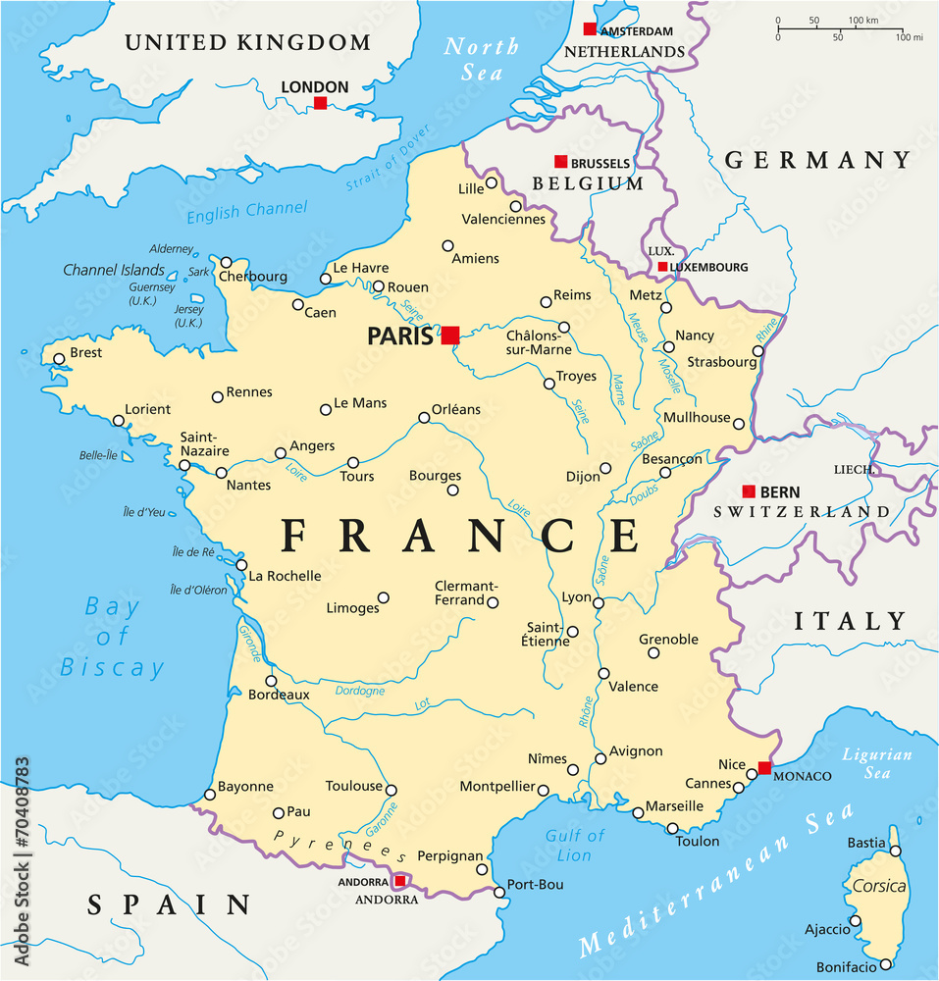
Participants
Characteristics (N=21 total) | N (%) or Avg (SD)
Age (years) | 51.3 | (13.4)
Male gender | 12 | (57%)
Professional role
MD (addiction, primary care, hospital) | 10 | (48%)
Pharmacist | 3 | (14%)
Public Health/ Administrator | 3 | (14%)
Nurse | 2 | (10%)
Drug user activist | 2 | (10%)
Health educator | 1 | (5%)
Professional/ Practice Setting(s)*
Specialty addiction setting | 10 | (48%)
Primary care | 4 | (19%)
Public health | 4 | (19%)
General hospital | 4 | (19%)
Harm reduction center | 3 | (14%)
Patient advocacy organization | 2 | (10%)
Community pharmacy | 1 | (5%)
6 Participant régions
*some participants had multiple settings.
France discourages collecting race/ethnicity data.
Notes:
We recruited 21 participants across France. Participants were on average 51 years old and about half were male, and represented a diverse range of roles including physicians, pharmacists, administrators, nurses and drug user union leaders, and had a wide range of practice settings including specialty addiction care, primary care, public health, harm reduction centers

Slide 13
Primary goal of OAT: bringing people into care
Engagement and accompaniment were the primary goal
Participants framed methadone and buprenorphine as powerful tools to alleviate withdrawal and craving, which then “opens the door” to other benefits of care.
“At the heart of it, there’s the issue of creating a connection. And the fact that methadone, it attracts people into care.”
(Addiction MD, P7)
Englander, unpublished

Slide 14
Imposing or expecting abstinence is harmful
Unprompted, no participants identified abstinence as a primary goal of OAT.
Almost all said imposing abstinence would be harmful, causing patients to feel “obligated to lie” or “lead a double life,” or feel “isolated,” “infantilized,” or “guilty.”
“What I don’t understand in terms of the objective of abstinence is that I don’t see what it changes for patients, except to put them in situations where they are out of step with their provider. If the patient knows that you want him to be abstinent, there’s a lot he’s not going to tell you.”
(Addiction MD, P14)
Englander, unpublished

Slide 15
Harms of imposing abstinence
“If your patients [on OAT] can’t tell you that they use cocaine once a week then you can’t even broach the question. You can’t offer them [safer use] equipment, discuss hepatitis C risks, or how to prevent abscesses. In that case, you’re not caring for your patient, you’re caring for his abstinence.”
(Addiction MD, P7)
Englander, unpublished

Slide 16
“Finding an equilibrium” between flexibility and structure
Flexibility promotes OAT access and engagement: “you can’t be too rigid, otherwise you have no more patients.”
OAT is not without risks, flexibility does not mean “laissez faire,” anything-goes.
“When you put too many constraints on someone, either they’re ultra, ultra motivated... or it’s easier in the street... It has to be simple for people [to get medication]. But... we must not fall into opposite extremes.
(Pharmacist, P6)
Englander, unpublished

Slide 17
Flexibility is important
Recognition that that patients’ context and priorities matter, and that not all substance use is harmful.
“[You have to] weigh risks and have a clearer vision informed by patients’ context. Otherwise, you stay in your medical practice, you say to yourself “oulala, this drug [methadone], it’s too risky.” Well, yes, except if you counterbalance that with, you take the same drug on the street, you’re much more likely to have something adulterated, something gone bad...”
(Addiction physician, P7)
Englander, unpublished
Notes:
“illegal market in which you take drugs whose quality you absolutely do not know.” As one physician summarized:
“[You have to] weigh risks and have a clearer vision informed by patients’ context. Otherwise, you stay in your medical practice, and you say to yourself “oulala, this drug, it’s too risky.” Well, yes, except if you counterbalance that with, you take the same drug on the street, you’re much more likely to have something adulterated, something gone bad, something cut, or someone who’ll sell you heroin at the same time, etc. So, if you think wholistically and compare risks in context, I think you can reassure yourself and have a clearer vision of...how things really happen on the ground.” (Addiction physician, P7)

Slide 18
Structure means support, not punishment or control.
Structure can include more frequent visits; adjusting medication doses; and consensual urine drug testing.
“[Care] is not, as we say in France, castrating. We don’t impose institutional violence, because we have this power to give treatment.”
“We are not in the logic of big brother.… we may reduce methadone [dose], but if so, we try to.... do it as best as possible to avoid the risks. We don’t punish people.”
(Nurse P19)
(Educator, P3)
Urine drug tests are useful “not for the sake of playing cop, but to open the discussion.”
(Primary Care MD, P17)
Englander, unpublished

Slide 19
Practice norms vary across settings and time
“The framework for OAT in 1995 was extremely constrained. People had to pass through stages [to earn OAT], and that’s what was criticized later... prescribing was extremely rigid, people could not take anything else… there were urine tests before people could get methadone. You see, it was very, very constrained.”
(Administrator, FR15)
Englander, unpublished

Slide 20
Discussion

Slide 21
Summary
Participants described engagement as the primary goal of methadone and buprenorphine care.
They viewed expecting or imposing abstinence as harmful.
Clinicians contextualized clinical decisions, balancing flexibility and structure.
Though study used an inductive approach, emergent themes align with harm reduction principles.
Notes:
Harm reduction prioritizes relationships; Not centered on abstinence; Promotes pragmatic, low-threshold access to services
French Participants described engagement as the primary goal of methadone and buprenorphine care. They viewed expecting or imposing abstinence as harmful. and contextualized clinical decisions around prescribing with patients' realities and other needs - including risks of an unregulated drug supply, ultimately balancing flexibility and structure in clinical decisions

Slide 22
Sharp contrast to the US
OUD care systems criticized as inflexible and often punitive
Methadone rooted in racist war on drugs with persistent racial disparities in OAT access, overdose and other key outcomes
In the US, abstinence is the goal, and often a condition of care
People are discharged from buprenorphine and methadone for consuming drugs
Harm reduction commonly framed in relation to abstinence
Positions harm reduction as a temporizing or a lesser goal
Peterkin JAM 2022, Frank J Psychoactive Drugs 2021, Tiako JAMA Network 2023,
ASAM Care of Non-abstinent patient 2024, Frank HRJ 2021, Bagley NEJM 2024

Slide 23
US treatment and harm reduction divide
Treatment and “Recovery”
Harm Reduction
Abstinence
Drug use is tolerated; for people who are “not ready” for treatment
Martin et al., 2019 , Krawczyk 2021 HRJ, Gannon and Pasman, 2023
https://thenounproject.com/
Notes:
Abstinences et une des conditions ou des exigences de participation

Slide 24
US approach does not match patients’ reality
People taking methadone and buprenorphine often use drugs
In a nationally representative sample of people receiving methadone or buprenorphine:
83% reported any drug use in the last month
52% reported injection drug use within the last week
8% went to a syringe exchange
Krawczyk HR Journal 2022

Slide 25
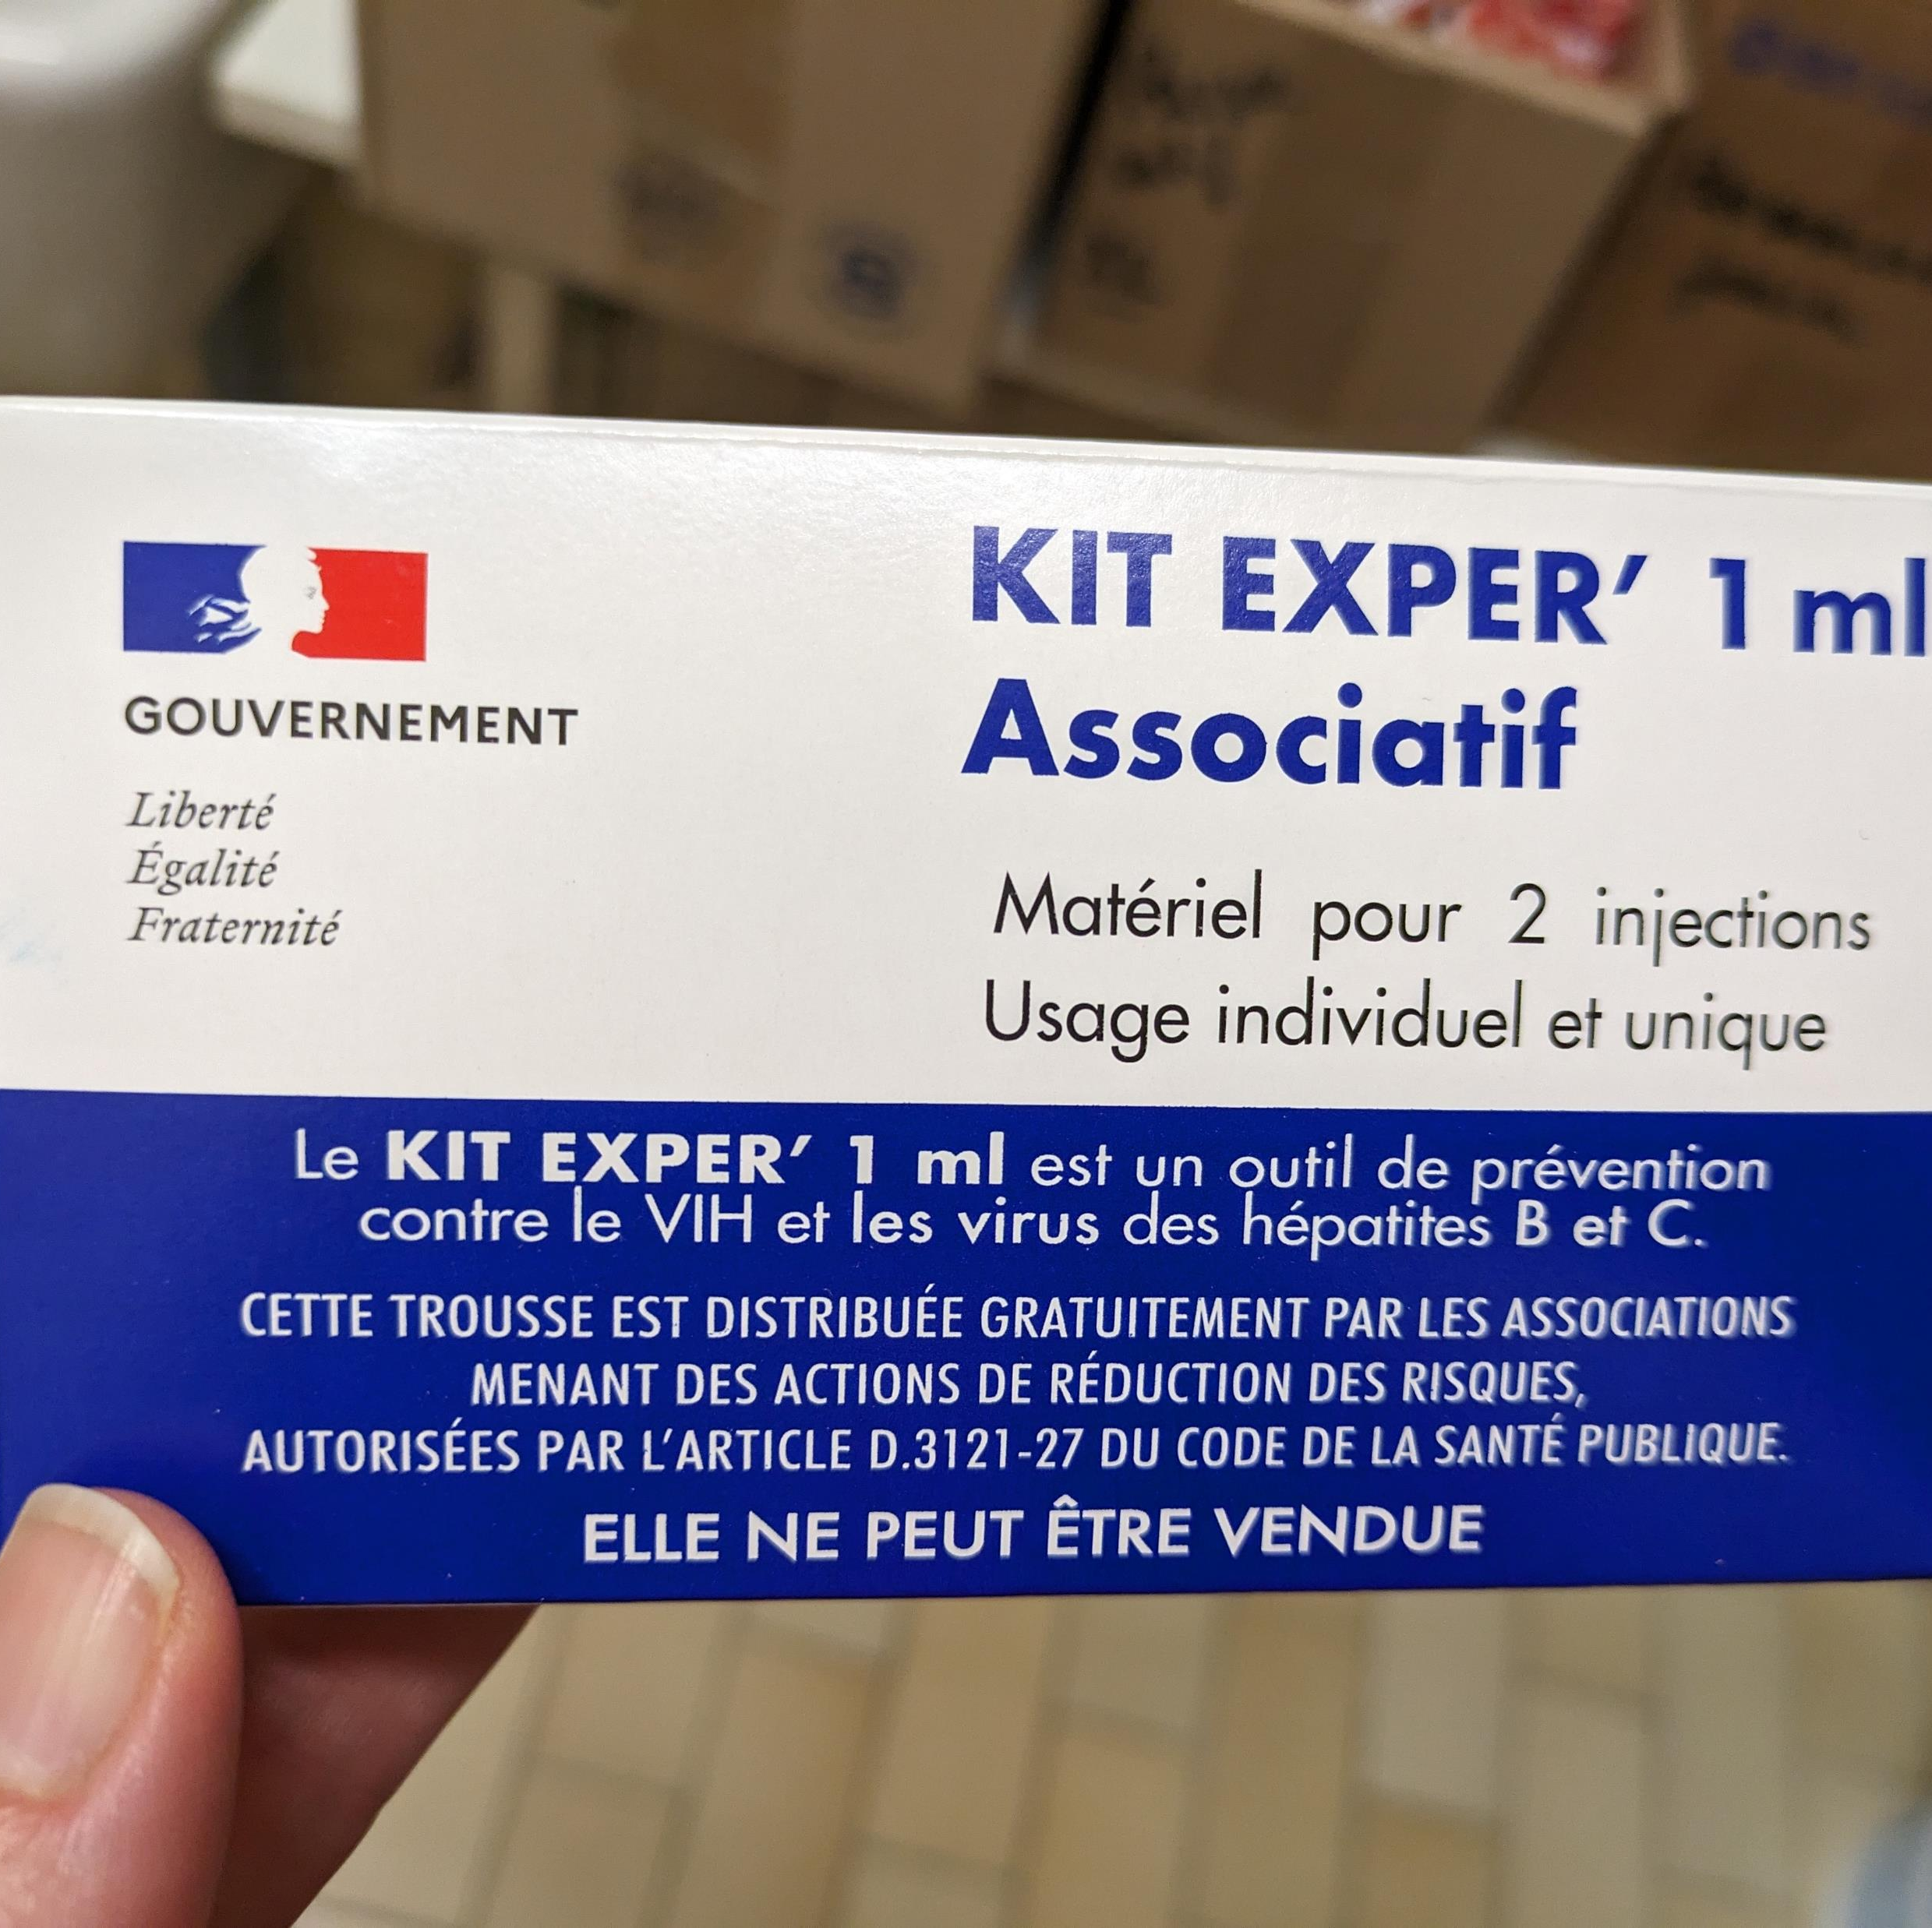
How might we rethink relationship between treatment and abstinence in the US?

Slide 26
Rethinking care
What would US care look like if the primary goal of methadone and buprenorphine was to bring people into care?
Policies and practice
Urine drug screens, mandatory counseling, minimum take-homes, administrative discharge
Clinician and staff expectations around abstinence
Conceptualizing risks in context
Pont du Gard, contruction completed 40-60 AD

Slide 27
Acknowledgments
Franco-American Fulbright Commission, Neurodis, Le Vinatier
OHSU DOM, DGIM, IMPACT: Katie Bensching, Bradley Buchheit, Beth Williams, Amelia Goff, Linda Peng, Hope Titus, Todd Korthuis, Eleasa Sokolski, many others
Hosts: Benjamin Rolland, Marie Jauffret-Roustide, many others
Bernie, Leo and Julien Miller, Familles Delpech, Caja, Collobert/Robin, Vasseur; Nadege Avene, Marion Jobron

Slide 28
Extra slides

Slide 29
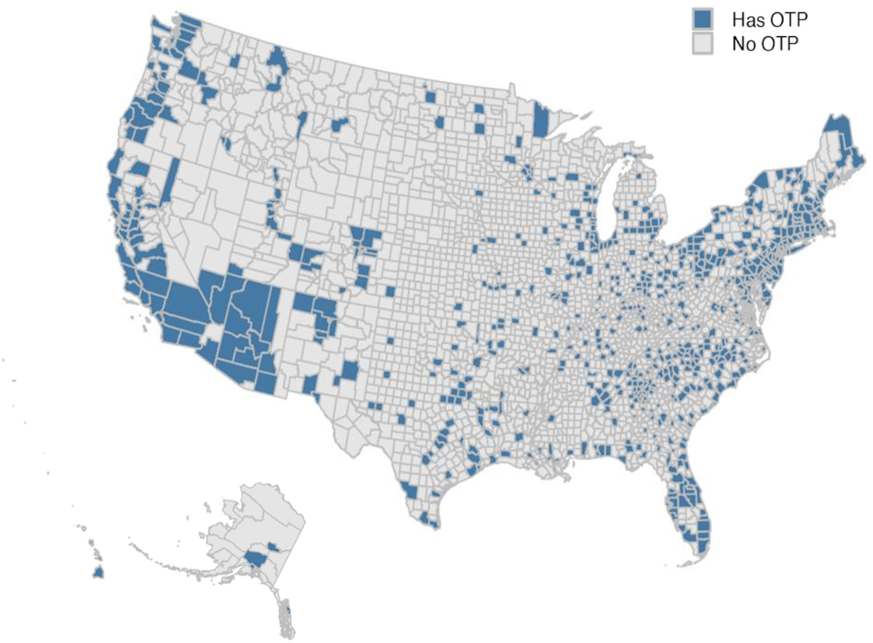
US Opioid Treatment Program distribution
In 2022, only 20% of US counties had an Opioid Treatment Program.
Large rural areas without any OTP, hence no methadone access.
Mobile methadone permitted, rare.
Krawczyk Health Affairs Scholar, 2023
Notes:
https://doi.org/10.1093/haschl/qxad018
Huge treatment deserts with areas in Oregon where I live where people would have to drive hours each way to go to a methadone clinic, even in more populated parts of the state.
Some states have extremely strict approval processes for OTPs, or even outright bans; for example, no OTP in the entire state of WY
There are entire geographic areas the size of France with no methadone access
France is smaller than the size of Texas
France: 211,209 square miles; 551,695 km²
Texas at 268,820 sq miles

Slide 30
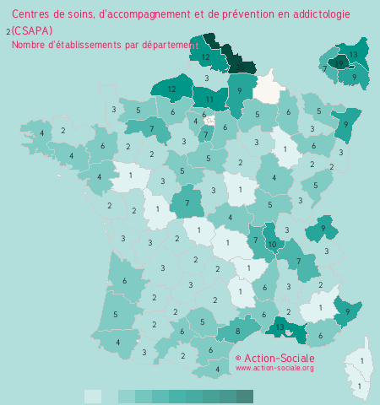
Distribution of specialty addiction treatment centers in France At least 1 in each of France’s 101 departments.

Slide 31
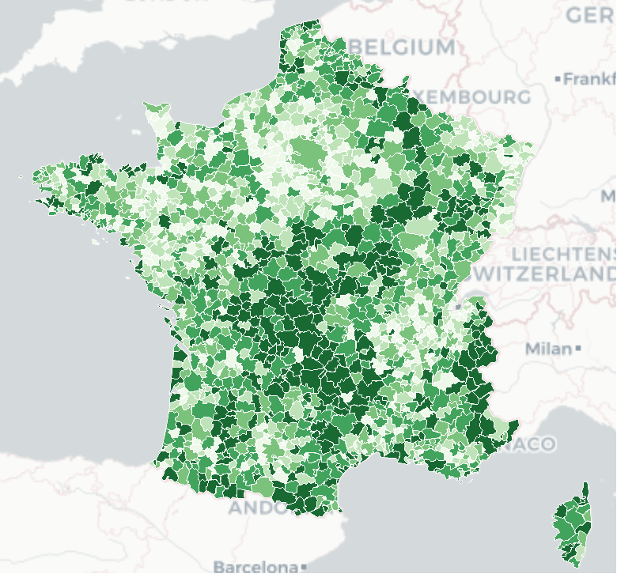
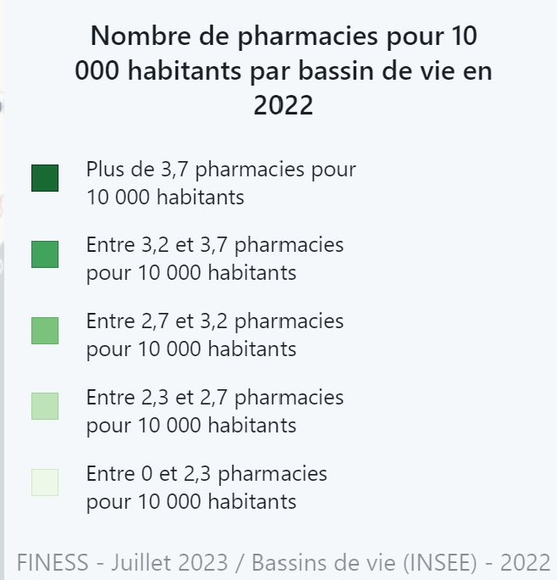
Pharmacies in France
https://www.data.gouv.fr/fr/reuses/terravisu-nombre-de-pharmacie-pour-10-000-habitants-par-bassin-de-vie-en-2023/
Notes:
Merci a Mathieu Chappy

