Slide 1
AMERSA Conference 2024 Understanding Resilience In People Who Use Methamphetamine Demographically Matched to Acute Stimulant Toxicity Decedents
Nigel Anderson, Grace Gundy, Vanessa McMahan, Xochitl Luna Marti, Yi-Shin Grace Chang, Sophia Tavasieff, Marley Antolin Muñiz, Phillip Coffin MD MIA
Center on Substance Use & Health - San Francisco Department of Public Health

Slide 2
Disclosures
No disclosures to report

Slide 3
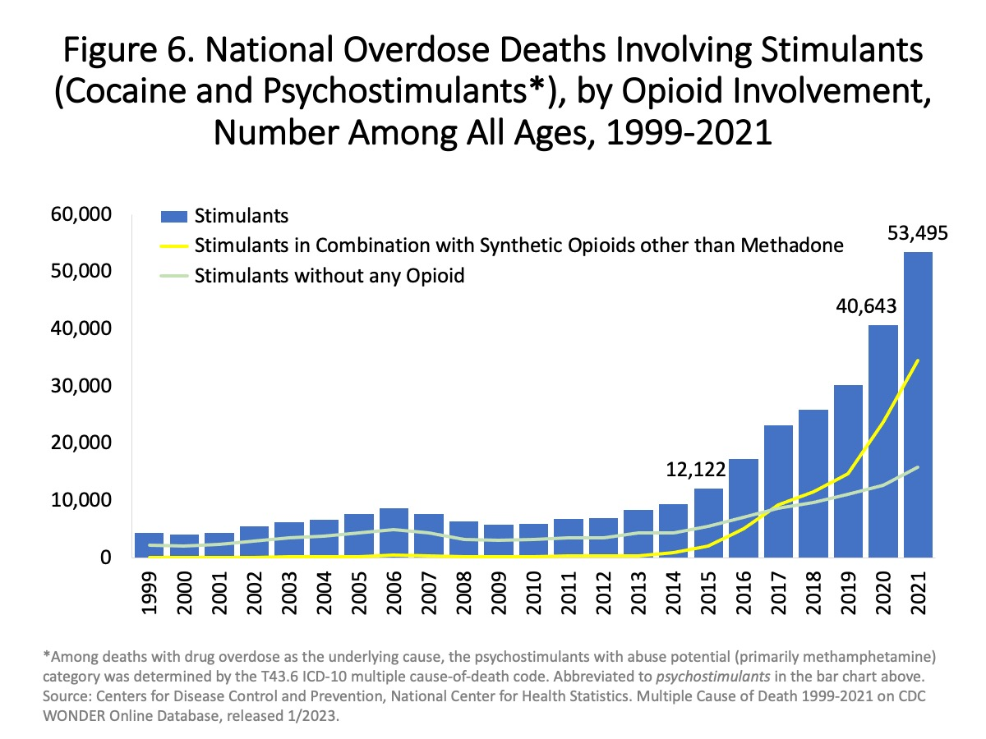
Background
Notes:
https://nida.nih.gov/research-topics/trends-statistics/overdose-death-rates

Slide 4
Background – Parent Study (LASSO)
Mixed-methods investigation of antecedents to death
101 decedents, 38 decedents in methamphetamine arm
Prior evidence → stimulant deaths often sequelae of chronic cardiovascular disease and physical stress

Slide 5
Background
Resilience – re·sil·ience
noun
the capacity to withstand or to recover quickly from difficulties

Slide 6
Objectives
Explore the role of resilience at the individual, interpersonal, and environmental levels among individuals who use methamphetamine in San Francisco

Slide 7
Methods
Participants
Demographically matched to deaths from acute stimulant toxicity
≥ 5 years of use, use ≥ 10 of past 30 days
No intentional opioid use
Interview
Semi-structured, validated questionnaires (e.g. Brief Resilience Scale)
Individual, interpersonal and environmental factors

Slide 8
Methods
Analysis
Categorized BRS scores into “low, medium and high” resilience
Code frequency, salient themes, and co-occurences

Slide 9
Demographic Characteristics of Participants who Primarily Use Methamphetamine and Decedents of Methamphetamine Toxicity
Demographic Characteristic |  | Participants who Primarily Use Methamphetamine (n=19) |  | Decedents of Methamphetamine-no-Opioid Toxicity (n=38)
 |  | n | % | n | %
Age [median, IQR] |  | 51 | 42-59 | 58 | 49-60
Gender ª
 | Male | 15 | 79% | 31 | 82%
 | Female ^{b} | 4 | 21% | 7 | 18%
Race/Ethnicity
 | Asian, Native Hawaiian, or Other Pacific Islander | 0 | 0% | 4 | 11%
 | Black/African American | 5 | 26% | 6 | 16%
 | Hispanic/Latine | 5 | 26% | 6 | 16%
 | Multiracial | 3 | 16% | 1 | 3%
 | Native American/Alaskan Native | 1 | 11% | 0 | 0%
 | White | 5 | 26% | 21 | 55%
a Gender in the decedent cohort reflects gender at death as determined by the medical examiner.
b Two female participants were transgender women.
Notes:
(*perceived gender at time of death, Medical Examiner M/F)

Slide 10
Results
Low (42%)
Normal (47%)
High (11%)
Resilience Scores
Notes:
BRS – The Brief Resilience Scale is a validated and abbreviated 6-question scale that aims to characterize resilience into a number which was then divided into 3 broad categories scoring either low, medium or high.

Slide 11
Results
Main co-occurring themes:
Harm reduction substance use patterns and routes
Perception of risk & acts of self-preservation
Positive interpersonal relationships

Slide 12
Harm reduction substance use patterns and routes
“I’m strictly mostly just smoking, just because if I’m going to do it the other way, then I’m going to dedicate…so I just stick to smoking…it is a part of my day”
(55Y, White, Male, BRS Score = 3.3 (normal))

Slide 13
Harm reduction substance use patterns and routes
“I wouldn’t share. I wouldn’t even share a pipe with somebody, just something I don’t do…if I got high with other people…”
(64Y, Latine, Male, BRS Score = 2 (low))
Notes:
Define code and clarify mindfulness in this context
How this ties back into resilience (2 examples of metrics used to employ mindfulness while using to promote wellness)
Consider a Pull quote mentioning specific route of use?

Slide 14
Perception of risk and acts of self-preservation
“I could do 3 days [awake] pretty easily. Beyond that, like I said, you got to feed and water your vessel….That’s what I learned at a certain point…if I didn’t make myself…then I wouldn’t….”
(28Y, White & Native American, Trans woman, BRS Score = 2.3 (low))

Slide 15
Perception of risk and acts of self-preservation
“It doesn’t make me really want to use…I just pick it up and use it. By the time I think, “Hey, didn’t I just say that to myself”, it’s a little too late because I just used it again. It’s a cycle and I don’t want to die this way.”
(46Y, Biracial, Male, BRS Score = 2 (low))
Notes:
LS1010

Slide 16
Positive interpersonal relationships
“…there really is a sense of community. People do, I mean, to the best of their ability, they do try to take care of each other. They try to help each other out and look after each other. I do like that.”
(36Y, Black/AA, Male, BRS Score 1.83 (low))

Slide 17
Positive interpersonal relationships
“…it was really hard for me because…I didn’t understand the amount of resources that were out here…So it just so happened that I’m talking to this guy and he’s like, ’what are you doing out here?’…from that conversation….I was able to get back on my feet again…I’m sheltered and I don’t have to worry like that…”
(36Y, Black/AA, Male, BRS Score = 1.83 (low))

Slide 18
Discussion
Large proportion of participants scored low in resilience despite identifying resilience strategies
Diverse sample with varied lived experiences highlighting multi-faceted role of resilience

Slide 19
Potential Future Research
Individual – further explore ways to measure + bolster individual resilience
Interpersonal – investigate interventions aimed at bolstering social & emotional support
Environmental/community level – harm reduction access, community support (housing with communal spaces/activities)

Slide 20
Limitations
Self-report
Generalizability

Slide 21
Acknowledgements
UCSF Yearlong Inquiry Program
CSUH Team and Family at SFDPH
Participants
NIDA / TL-1

Slide 22
Novel Measure of Methamphetamine Exposure
Gram-year history (grams used daily x years of use)
Median gram-year history = 19 gram-years
IQR = [9.1 – 47.2] gram years

Slide 23
Harm reduction substance use patterns and routes
“I don’t use as much…I don’t even hit it enough to get high…That’ what I do to make sure… I don’t have an episode…”
Notes:
Define code and clarify mindfulness in this context
How this ties back into resilience (2 examples of metrics used to employ mindfulness while using to promote wellness)
Consider a Pull quote mentioning specific route of use?

