Slide 1
Understanding & Applying a Novel Framework for Drug-Related Stigma
Shraddha Damaraju, MD, MPH
Evan Gale, MD
Wei Sum Li, MD
Sarah Wakeman, MD

Slide 2
Disclosures
Dr. Shraddha Damaraju: None to disclose
Dr. Evan Gale: None to disclose
Dr. Wei Sum Li: None to disclose
Dr. Sarah Wakeman:
Author, UpToDate
Textbook Editor, Wolters Kluwer & Springer

Slide 3
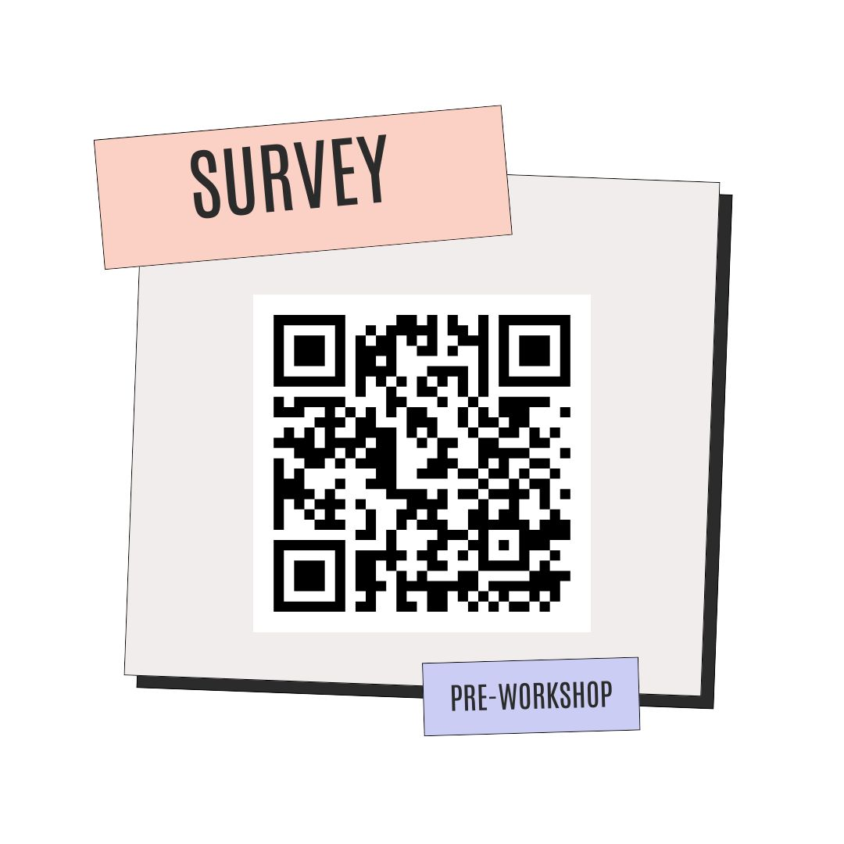

Slide 4
Basic Assumptions
Everyone in this community of attendees comes with a depth of experience, lived and academic, and is here to learn from one another.
Everyone has a shared goal of promoting health equity & justice, particularly for black & brown communities disproportionately made vulnerable by intersecting systems of oppression.
We (facilitators) are not perfect narrators, nor experts on lived experience with substance use disorder; we are here to learn alongside participants in today’s workshop.
Our framework is imperfect, and cannot capture the complex interplay between racism, classism, capitalism, the patriarchy, and other oppressive systems that produce drug-related stigma.

Slide 5
Objectives
Classify different examples of drug-related stigma into categories (person, substance, disorder) in a novel conceptual framework.
Synthesize the consequences of real instances of stigma faced by PWUD into three levels of effects (self, public, systemic).
Connect examples of stigmatizing beliefs related to drug use specifically faced by communities of color to the broader system of structural racism.
Design interventions addressing aforementioned instances of stigma, based on the three levels of effects (self, public, systemic).
Practice applying this framework to destigmatize clinical documentation for patients who use drugs.

Slide 6
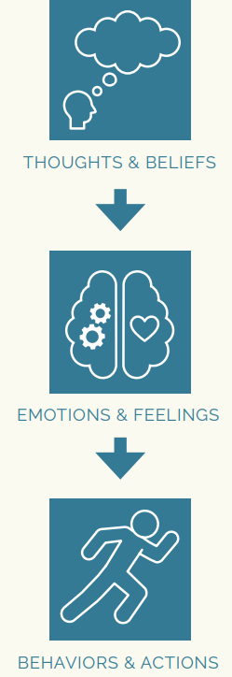
What is Stigma?
It is the relationship between an attribute, such as drug use, and a stereotype that assigns undesirable labels, qualities, and behaviors to a person exhibiting the attribute.
The National Center on Substance Abuse and Child Welfare
Notes:
https://ncsacw.acf.hhs.gov/files/disrupting-stigma-brief.pdf

Slide 7
Levels of Discrimination
Substance
Systemic
Foci of Stigma
Disorder
Public
Person
Self
THOUGHTS
Lead to
ACTIONS
Notes:
The focus/subject of stigma can be thought of in three categories that overlap with each other!
Stigma about the PERSON using drugs = centered around character, morality, choices of PWUD
Stigma about the SUBSTANCES = manifests as different judgements/reactions to different substances (licit vs. illicit substances, MOUD)
Stigma about the DISORDER = assumptions of what it means to have a substance use disorder (overmedicalization, pathologizing, patronizing, “rock bottom” philosophy)
Stigmatizing thoughts from each of these foci (and/or overlap) lead to ACTION (discrimination) on three different levels:
Systemic - policies, institutional practices, organizational barriers, etc that reduce access to care for PWUD
Public - othering/discrimination/devaluation of PWUD by people around them
Self - PWUD internalizing discrimination against them, shame → not engaging in care, leaning into stereotypes, etc.

Slide 8
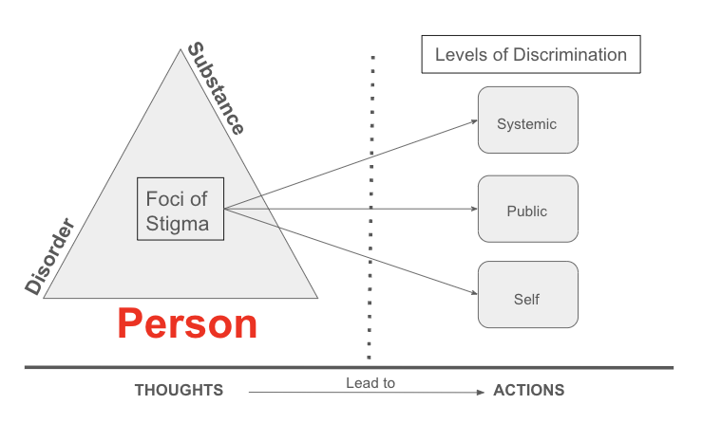
The Person
Stigma Focus
Core misconceptions:
PWUD are untrustworthy, immoral, dangerous, criminal, lazy, etc.
“Drug seeking” label
Conflating substance use with morality

Slide 9
The Person
Examples
SYSTEMIC: harm reduction services are seen as “enabling” and illegal in many states.
PUBLIC: NIMBYism; communities inherently mistrust and block public health interventions for SUD in favor of keeping their neighborhood more “safe”
SELF: people avoid seeking treatment for SUD, believing it’s their fault & lack of “willpower.”

Slide 10
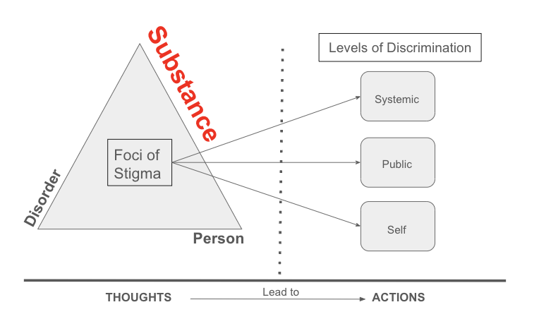
The Substance
Stigma Focus
Core misconceptions:
Licit vs. Illicit substances are inherently different
MOUD = “replacement addiction”

Slide 11
The Substance
Examples
SYSTEMIC: differential approach for overdose prevention centers vs. bars
PUBLIC: public attitudes on different substances inform how people who use different drugs are treated: cocaine (criminal) vs. adderall (“high functioning”, cool)
SELF: people avoid MOUD, internalizing that it’s just a “replacement addiction”

Slide 12
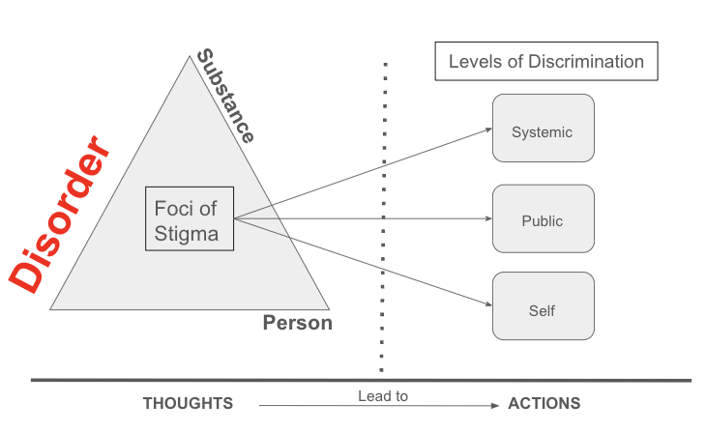
The Disorder
Stigma Focus
Core misconceptions:
Patronizing or over-medicalizing the experience of SUD
Assuming SUD = no autonomy
“Rock bottom” philosophy

Slide 13
The Disorder
Examples
SYSTEMIC: involuntary or coercive treatment modalities
PUBLIC: people don’t intervene & provide support to PWUD early on, believing that “tough love” or them needing to hit “rock bottom” is just part of the disease course
SELF: people believe that drug use & sequelae of SUD are not treatable

Slide 14
Stigma & Racism Are Intertwined
RACISM: the systemic oppression of a racial group to the social, economic, and political advantage of another.
War on Drugs
Mass incarceration
Disinvestment
Different narratives for different communities using drugs
Dr. Ayana Jordan’s work highlights the intersection of racism & drug-related stigma.
Longstanding harm to black & brown communities

Slide 15
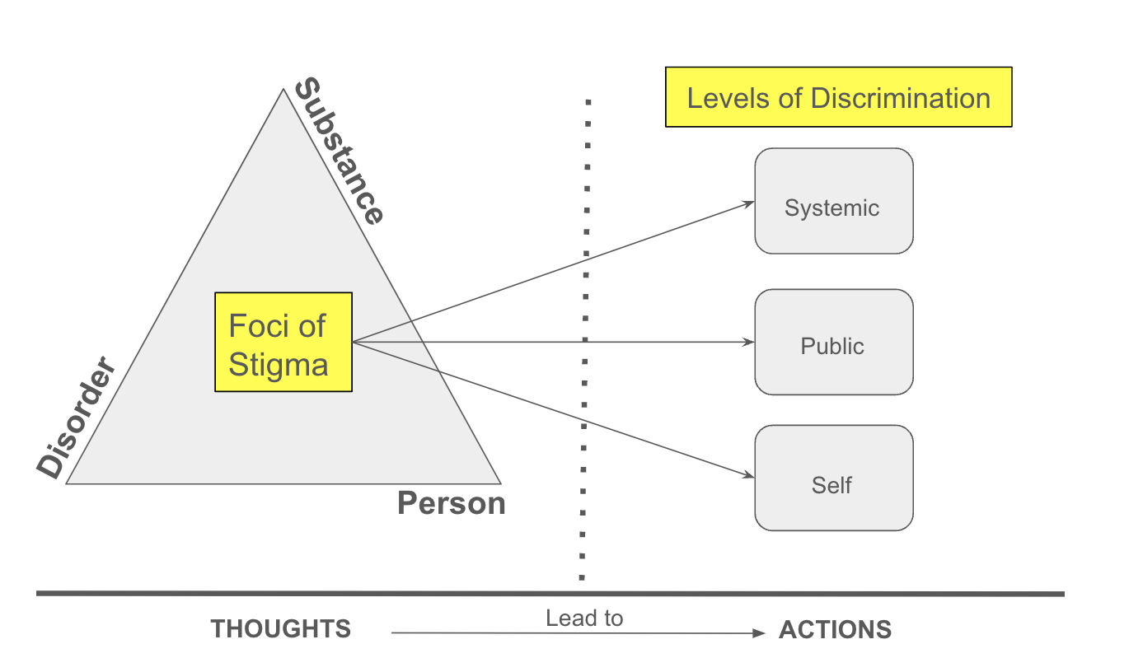
Stigmas Rooted in Racist Beliefs
Approach to crack vs. powder cocaine
Believing that OUD and overdose deaths affect predominantly white communities.
Treatment/rehab approach for white people, criminalization for POC.
Believing POC are more likely to buy, use, or sell drugs.

Slide 16
Case 1: Experiences of PWUD
Notes:
https://fxb.harvard.edu/opioidsummit/video/ Clip 16:30 – 19:30

Slide 17
Case 2: Destigmatizing Documentation

