Slide 1
Stakeholder Analysis and Community-Driven Strategies for Addressing Opioid Overdose in Boston.
Evans F Kyei, PhD. MSc.
Postdoctoral Research Fellow
Center for Substance Use Research and Related Conditions.
Capstone College of Nursing, The University of Alabama.

Slide 2
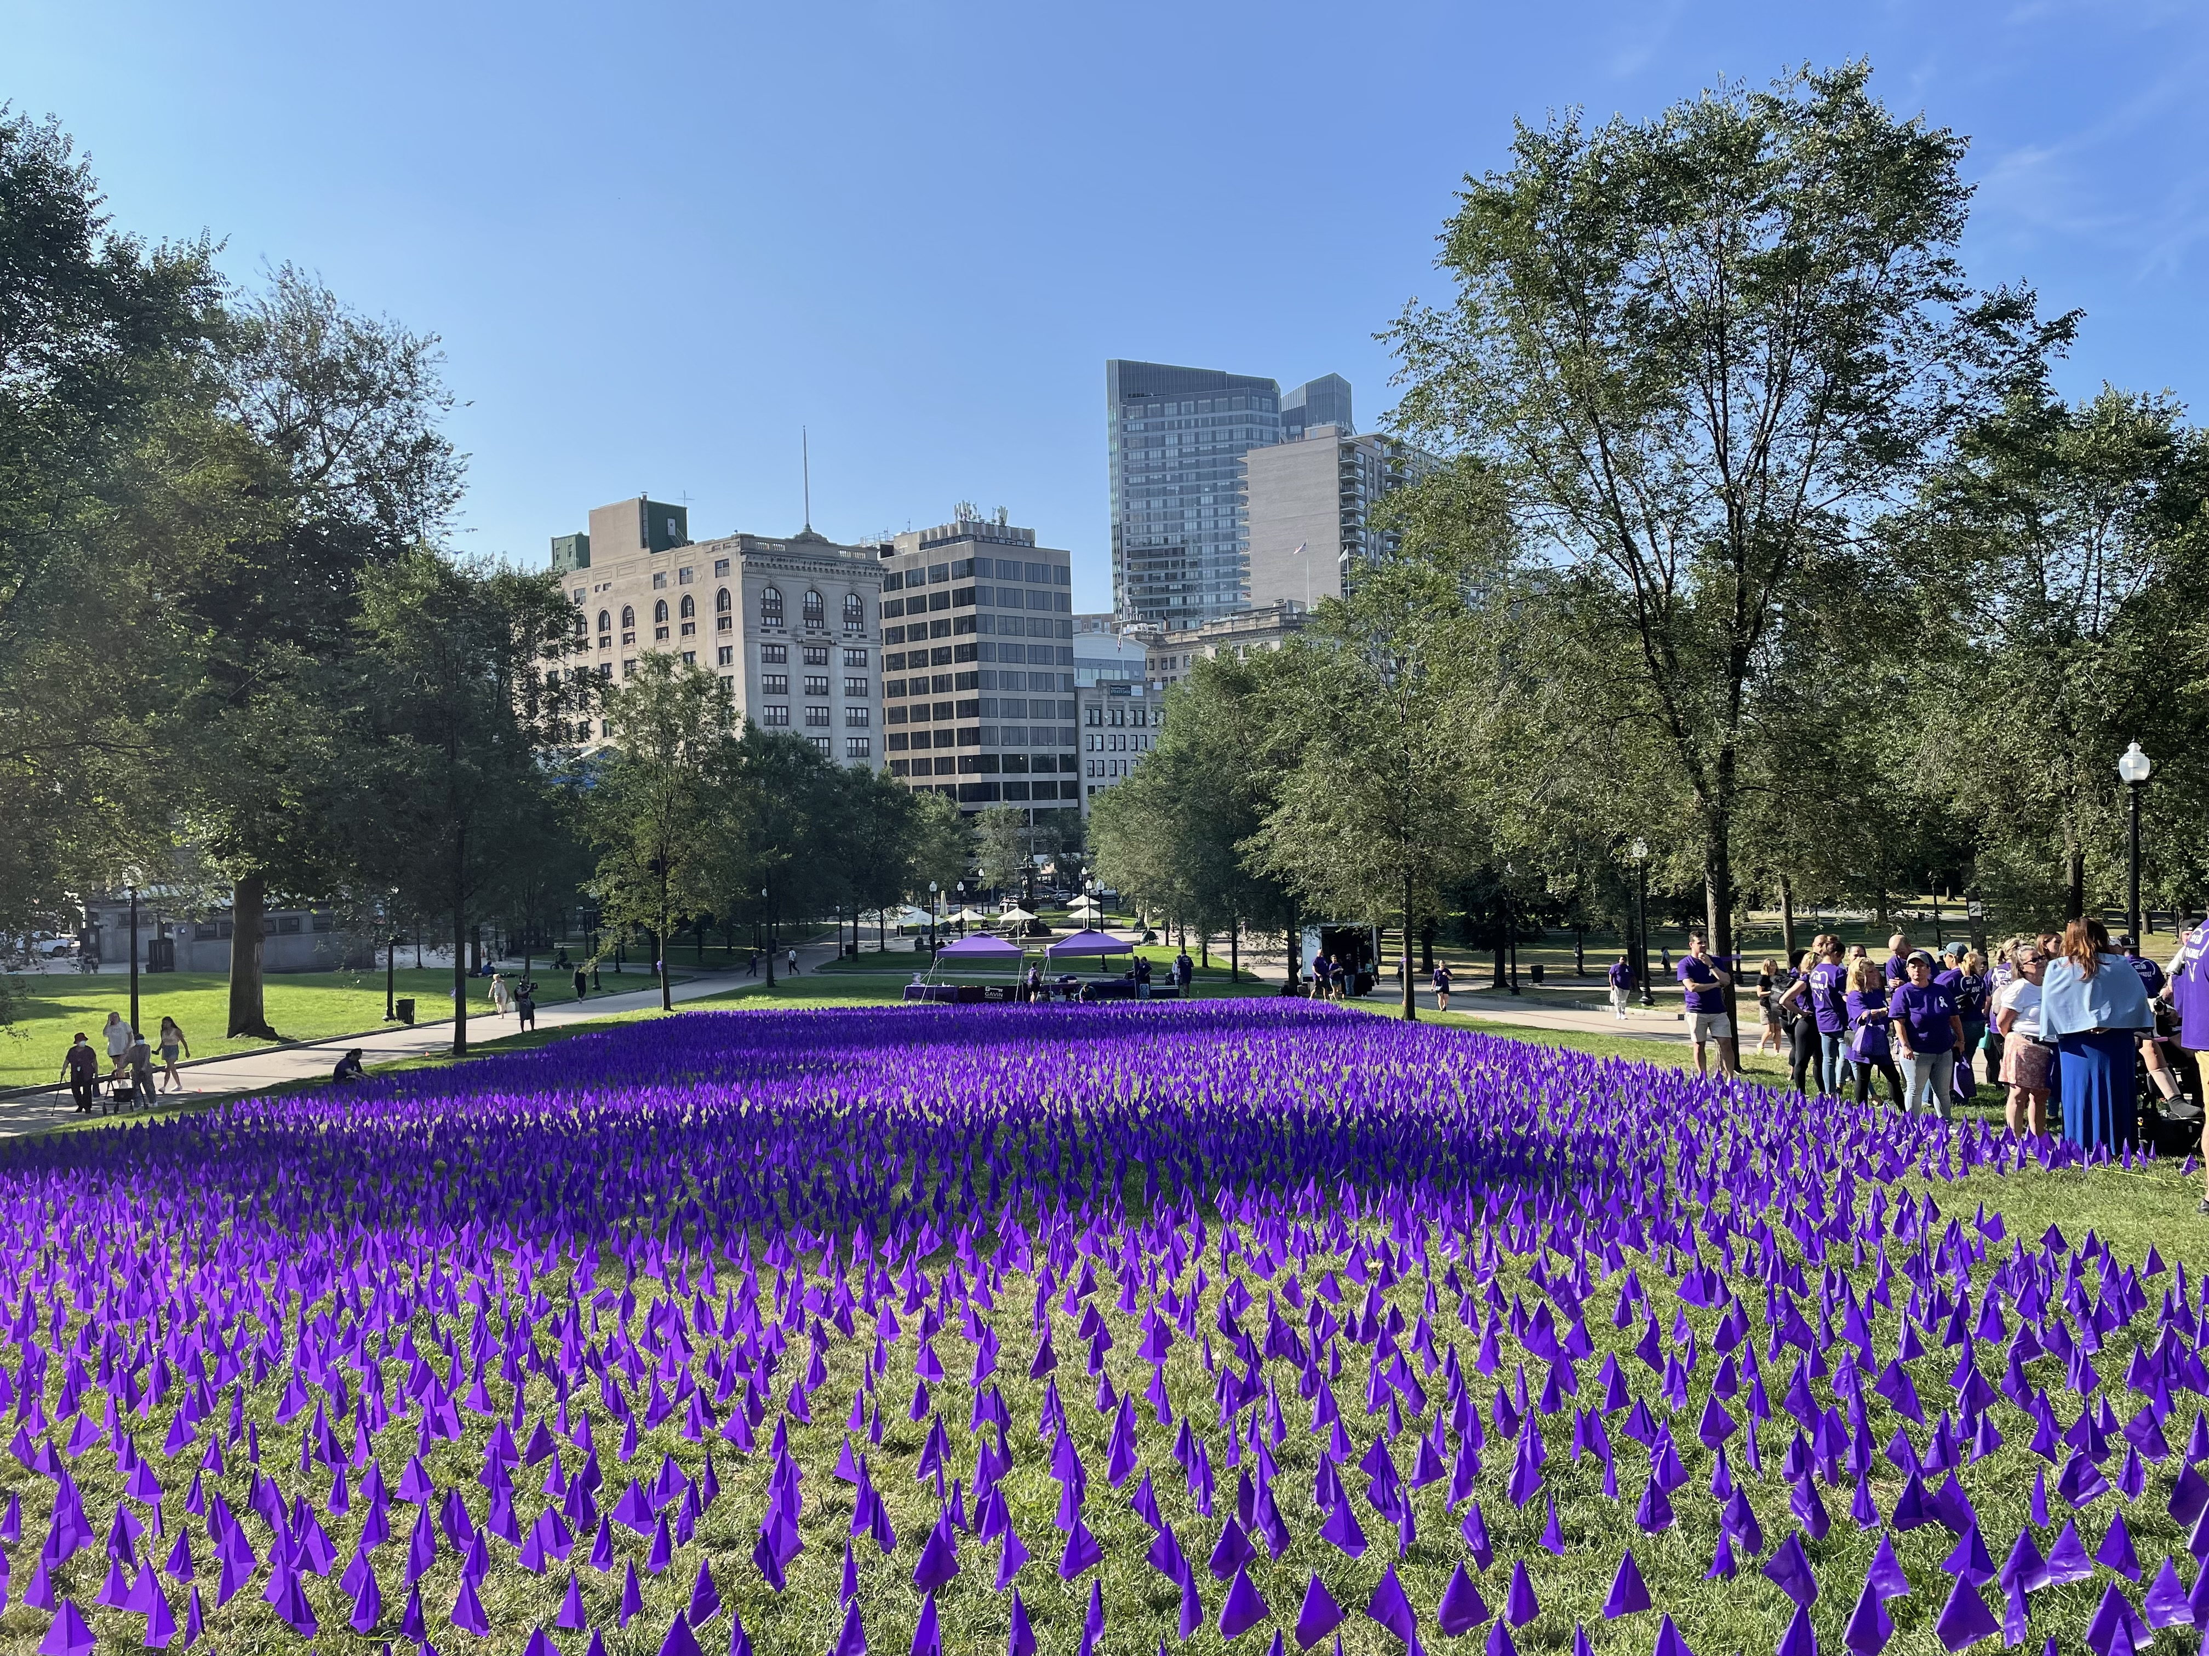
The Opioid Crisis in Boston
In 2022, Boston recorded 352 opioid-related deaths, marking a 36% increase since 2019.
This surge in opioid-related fatalities in Boston in 2022 was more than double the statewide rate.
These overdose deaths impact individuals from diverse backgrounds and communities.
Understand insights and perspectives of stakeholders on opioid overdose prevention in Boston.
Identify gaps and areas for improvement from stakeholder feedback.
Opioid Overdose Strategies | AMERSA Conference 2024

Slide 3
Research Questions
What insights and perspectives do stakeholders hold regarding opioid overdose prevention in Boston?
How do stakeholders support or resist opioid overdose prevention in Boston, and how can these insights inform strategies to enhance cooperation and support among stakeholders?
Opioid Overdose Strategies | AMERSA Conference 2024

Slide 4
Recruitment and Data Collection
Purposive selection of 15 stakeholders
Treatment and recovery, law enforcement, health policy, community leaders.
Personal contacts
Email requests
Mayor's Opioid Task Force
January to March 2024
Total interview duration: 870
10 in person and 5 via Zoom
Opioid Overdose Strategies | AMERSA Conference 2024

Slide 5
Descriptive Statistics
Characteristics | Number | Percent (%)
Stakeholder Group
Law Enforcement | 3 | 20.00
Healthcare Professionals | 6 | 40.00
Health Policy | 3 | 20.00
Community Leaders | 3 | 20.00
Interview Modality
Face to face | 10 | 66.67
Virtual (Zoom) | 5 | 33.33
Age (median, min-max) | 54, (37 - 65)
Gender
Male | 6 | 40.00
Female | 9 | 60.00
Race
Non-Hispanic White | 8 | 53.33
Non-Hispanic Black | 5 | 33.33
Latino | 2 | 13.33
Professional Experience in Years (median, min-max) | 11.5, (8 - 12)
Education
College degree | 9 | 60.00
Graduate degree | 6 | 40.00
Opioid Overdose Strategies | AMERSA Conference 2024

Slide 6
Stakeholder Analysis
Essential tool for understanding diverse views and needs in opioid overdose prevention (Drainoni et al., 2022b; Walker et al., 2022).
Ensures that interventions are comprehensive and sensitive to socio-economic and cultural contexts (Fuhrmann-Berger, 2018; Ghertner & Groves, 2018).
Aligns strategies with practical realities and actual community needs (Young et al., 2022).
Develop targeted, context-specific responses leveraging strengths and resources of all sectors involved (Kivits & Sawang, 2021).
Foster effective and sustainable health interventions addressing the multifaceted nature of the opioid crisis in Boston.
Opioid Overdose Strategies | AMERSA Conference 2024

Slide 7
AHRQ Stakeholder Analysis Tool
Component | Description
Stakeholder Group | Identifies stakeholders: healthcare professionals, law enforcement, community leaders, health policy officials.
Interest and Requirements | Assesses interests in prevention strategies, treatment access, crisis management, and community engagement.
 | Identifies requirements: understanding systemic barriers, trust-building with communities.
What the Project Needs from Them | Determines necessary collaboration, insights, and resources from each stakeholder group.
Perceived Attitudes/Risks | Evaluates stakeholder attitudes and risks: concerns about insurance, mistrust of medical professionals, racial disparities, stigma.
Actions Needed for Engagement | Identifies required actions for effective engagement: training, educational initiatives, multi-agency cooperation.
Stakeholder Recommended Strategies | Develops strategies for stakeholder contribution: harm reduction promotion, partnership strengthening, policy advocacy.
Opioid Overdose Strategies | AMERSA Conference 2024

Slide 8
Data Analysis and Synthesis
Interview transcripts analyzed using the adapted AHRQ stakeholder analysis tool.
Assessed stakeholder influence, requirements, and contributions.
Mapping Stakeholder Responses
Ensured alignment with strategic planning needs.
Synthesis of Insights: Transformed individual inputs into strategic points.
Systematic categorization of perceived barriers, contributions, and recommendations.
Validation and Accuracy: Second and Third reviewer.
Opioid Overdose Strategies | AMERSA Conference 2024

Slide 9
Stakeholder Group | Law Enforcement (n=3) | Healthcare Professionals (n = 6) | Health Policy Officials (n = 3) | Community Leaders (n = 3)
Interests and Requirements in Project | - Collaborative strategies for opioid overdose prevention and treatment accessibility. - Enhanced and tailored approaches to crisis management. - Advanced strategies for prevention and community engagement. | - Tailored strategies for specific populations (e.g., homeless, general opioid misuse). - Integrating mental health and substance use disorder treatments. - Enhancing access to care and addressing systemic biases. - Implementing diverse harm reduction and comprehensive recovery pathways. - Focus on accessible treatment for specific populations, including the homeless and Black communities. | Culturally competent healthcare and harm reduction for opioid overdose prevention. | Community-led initiatives for opioid misuse prevention and recovery support. - Faith-based support and engagement in opioid recovery.
Opioid Overdose Strategies | AMERSA Conference 2024

Slide 10
Similarities Across Stakeholder Groups
Emphasis on the need for combined efforts and integrated services.
Enhanced training in addiction awareness and cultural competence.
Widespread Narcan distribution and tailored education strategies.
Both groups advocate for extensive support services beyond traditional medical treatments.
Opioid Overdose Strategies | AMERSA Conference 2024

Slide 11
Differences in Perceived Barriers and Strategies
Stakeholder Group | Focus/Challenges | Strategies/Emphasis
Law Enforcement | Focus on community policing and building better community relationships. | Educational programs for officers on substance misuse. Crisis intervention models prioritizing health and recovery.
Healthcare Professionals | Challenges with treatment access, stigma, and systemic biases. | Advocacy for tailored, inclusive treatment strategies for vulnerable populations.
Health Policy Officials | Emphasis on policy reform to enhance harm reduction and recovery efforts. | Culturally competent healthcare practices and legislative changes.
Community Leaders | Focus on grassroots initiatives and engaging local stakeholders. | Addressing SDOH such as housing stability and employment opportunities.
Opioid Overdose Strategies | AMERSA Conference 2024

Slide 12
Stakeholder Unique Contribution to Overdose Prevention
Stakeholder Group | Roles and Contributions
Law Enforcement | Implementing front-line interventions and ensuring public safety.
Healthcare Professionals | Delivering direct treatment and recovery services.
Health Policy Officials | Shaping the regulatory environment to support effective prevention and treatment strategies.
Community Leaders | Mobilizing local resources and fostering community resilience.
Opioid Overdose Strategies | AMERSA Conference 2024

Slide 13
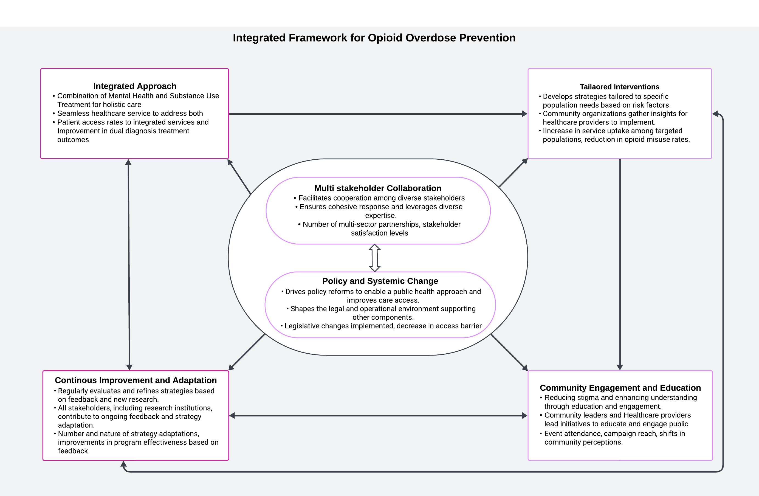
Opioid Overdose Strategies | AMERSA Conference 2024

Slide 14
Comparison of Integrated Framework to Established Models
Unique Emphasis:
Unlike the Recovery Community Center Office-Based Opioid Treatment and the CJ Continuum of Care, our framework uniquely emphasizes systemic policy changes and continuous improvement.
Adaptability:
Focuses on dynamic responses to emerging challenges.
Crucial for the rapidly changing landscape of opioid overdose prevention.
Critical Feature:
Ensures the framework remains relevant and effective amidst evolving public health needs.
Opioid Overdose Strategies | AMERSA Conference 2024

Slide 15
Implications for Practice and Policy
Integrate strategies for streamlined interventions and optimized resource use.
Implement culturally sensitive accessible training on naloxone use and MAT.
Advocate for easier access to comprehensive treatment services.
Cultural competence training across sectors
Opioid Overdose Strategies | AMERSA Conference 2024

Slide 16
Study Limitations
Limited to a specific urban area, potentially restricting perspective diversity.
Sample size and Representation may not be fully representative of all stakeholders involved in opioid overdose prevention and response efforts.
Recall bias - Statement of accounts may rely on their memory of events and experiences.
Response bias - Stakeholders may have presented bias that align with socially desirable or politically acceptable views.
Opioid Overdose Strategies | AMERSA Conference 2024

Slide 17
Conclusion
Emphasizes integrated strategies.
Provides a model for other urban settings.
Highlights the importance of refining strategies to align with evolving community needs.
Importance of systemic reforms to overcome barriers.
Opioid Overdose Strategies | AMERSA Conference 2024

Slide 18
References
Agency for Healthcare Research and Quality. (2013). Tool 1B: Stakeholder Analysis. https://www.ahrq.gov/patient-safety/settings/hospital/fall-prevention/toolkit/stakeholder-analysis.html
Alexander, R. S., Canver, B. R., Sue, K. L., & Morford, K. L. (2022). Xylazine and Overdoses: Trends, Concerns, and Recommendations. American Journal of Public Health, 112(8), 1212–1216. https://doi.org/10.2105/AJPH.2022.306881
Azagba, S., Shan, L., Manzione, L., Qeadan, F., & Wolfson, M. (2019). Trends in Opioid Misuse among Marijuana Users and Non-Users in the U.S. from 2007–2017. In International Journal of Environmental Research and Public Health (Vol. 16, Issue 22). https://doi.org/10.3390/ijerph16224585
Boston Indicators. (2023). In Five Charts: Opioid-Related Overdose Deaths Set Another Record High in 2022. Retrieved from https://www.bostonindicators.org/reports/report-website-pages/opioids-2023
Boston Public Health Commission. (2023). Services for active users. Retrieved January 4, 2024, from https://www.boston.gov/government/cabinets/boston-public-health-commission/recovery-services/services-active-users
Braun, V., & Clarke, V. (2006). Using thematic analysis in psychology. Qualitative Research in Psychology, 3(2), 77–101. https://doi.org/10.1191/1478088706qp063oa
Centers for Disease Control and Prevention. (2023). Provisional drug overdose death counts. National Center for Health Statistics. Retrieved from www.cdc.gov/nchs/nvss/vsrr/drug-overdose-data.htm
City of Boston. (2023). The City of Boston recognizes international overdose awareness day. Retrieved December 5, 2023, from https://www.boston.gov/news/city-boston-recognizes-international-overdose-awareness-day
Ellenbecker, C. H., Fawcett, J., Jones, E. J., Mahoney, D., Rowlands, B., & Waddell, A. (2017). A Staged Approach to Educating Nurses in Health Policy. Policy, Politics, & Nursing Practice, 18(1), 44–56. https://doi.org/10.1177/1527154417709254
Paradise, R. K., Desmarais, J., O’Malley, S. E., Hoyos-Cespedes, A., Nurani, A., Walley, A. Y., Clarke, J., Taylor, S., Dooley, D., Bazzi, A. R., & Kimmel, S. D. (2023). Perspectives and recommendations of opioid overdose survivors experiencing unsheltered homelessness on housing, overdose, and substance use treatment in Boston, MA. International Journal of Drug Policy, 119, 104127. https://doi.org/https://doi.org/10.1016/j.drugpo.2023.104127
Robinson, C., Wood, M., Grippa, F., & Avalon, E. (2020). Combining Social Capital and Geospatial Analysis to Measure the Boston’s Opioid Epidemic. In A. Przegalinska, F. Grippa, & P. A. Gloor (Eds.), Digital Transformation of Collaboration (pp. 261–278). Springer International Publishing.
Russell, G. E., & Fawcett, J. (2005). The Conceptual Model for Nursing and Health Policy Revisited. Policy, Politics, & Nursing Practice, 6(4), 319–326. https://doi.org/10.1177/1527154405283304
Sandelowski, M. (2000). Whatever happened to qualitative description? Research in Nursing & Health, 23(4), 334–340. https://doi.org/https://doi.org/10.1002/1098-240X(200008)23:4<334::AID-NUR9>3.0.CO;2-G
Scott, C. K., Dennis, M. L., Grella, C. E., Kurz, R., Sumpter, J., Nicholson, L., & Funk, R. R. (2020). A community outreach intervention to link individuals with opioid use disorders to medication-assisted treatment. Journal of Substance Abuse Treatment, 108(July 2019), 75–81. https://doi.org/10.1016/j.jsat.2019.07.001
Tiako, M. J. N. (2021). Addressing racial & socioeconomic disparities in access to medications for opioid use disorder amid COVID-19. Journal of Substance Abuse Treatment, 122.
Opioid Overdose Strategies | AMERSA Conference 2024

