Slide 1
Utilizing the First Sanctioned Overdose Prevention Center to Provide Directly-Observed Hepatitis C Virus (HCV) Treatment to People Who Inject Drugs in NYC
Brianna Norton, Gabrielle Ryan, Benjamin Hayes, Susan Spratt,
Kailin See, Julia Arnsten, Aaron Fox
Albert Einstein College of Medicine | Montefiore Medical Center
On Point NYC
Notes:
So, I’m not Brianna Norton, I’m her former colleague, Aaron Fox, from Montefiore-Einstein, and she was unable to travel, so she asked me – yesterday - to give this talk. So I’ll do my best to get through the slides.

Slide 2
Disclosures
Aaron Fox receives (very little) royalties from UpToDate
Notes:
I co-wrote a chapter for UpToDate, but it won’t provide a conflict of interest

Slide 3
Syndemics of Injection Drug Use and Infectious Diseases
HIV Outbreak in Scott County: Population of 4200
2000-2017: most US state saw increases in new HCV cases
92% coinfected with HCV
Notes:
The 2015 outbreak of HIV in Scott County Indiana symbolized how entwined injection drug use and HIV risks are, but the fact that 92% of people testing positive for HIV were also co-infected with HCV gets less attention.
Between the years 2000 and 2017, most states in the US saw increases in new HCV cases.

Slide 4
We are NOT reaching elimination!
Notes:
We now have highly effective directly acting antivirals, but we’re still not reaching HCV elimination goals. Incidence keep increases. The orange line here represents the annual targets for new HCV cases after 2017, and the blue bars are the actual numbers of new cases up to 2021.

Slide 5
We need to target HCV linkage to care, treatment, and cure to those who need it most
People who Inject Drugs (PWID)
Notes:
And so to better meet these goals, we must engage people who inject drugs – the group that most needs HCV linkage to care, treatment, and cure

Slide 6
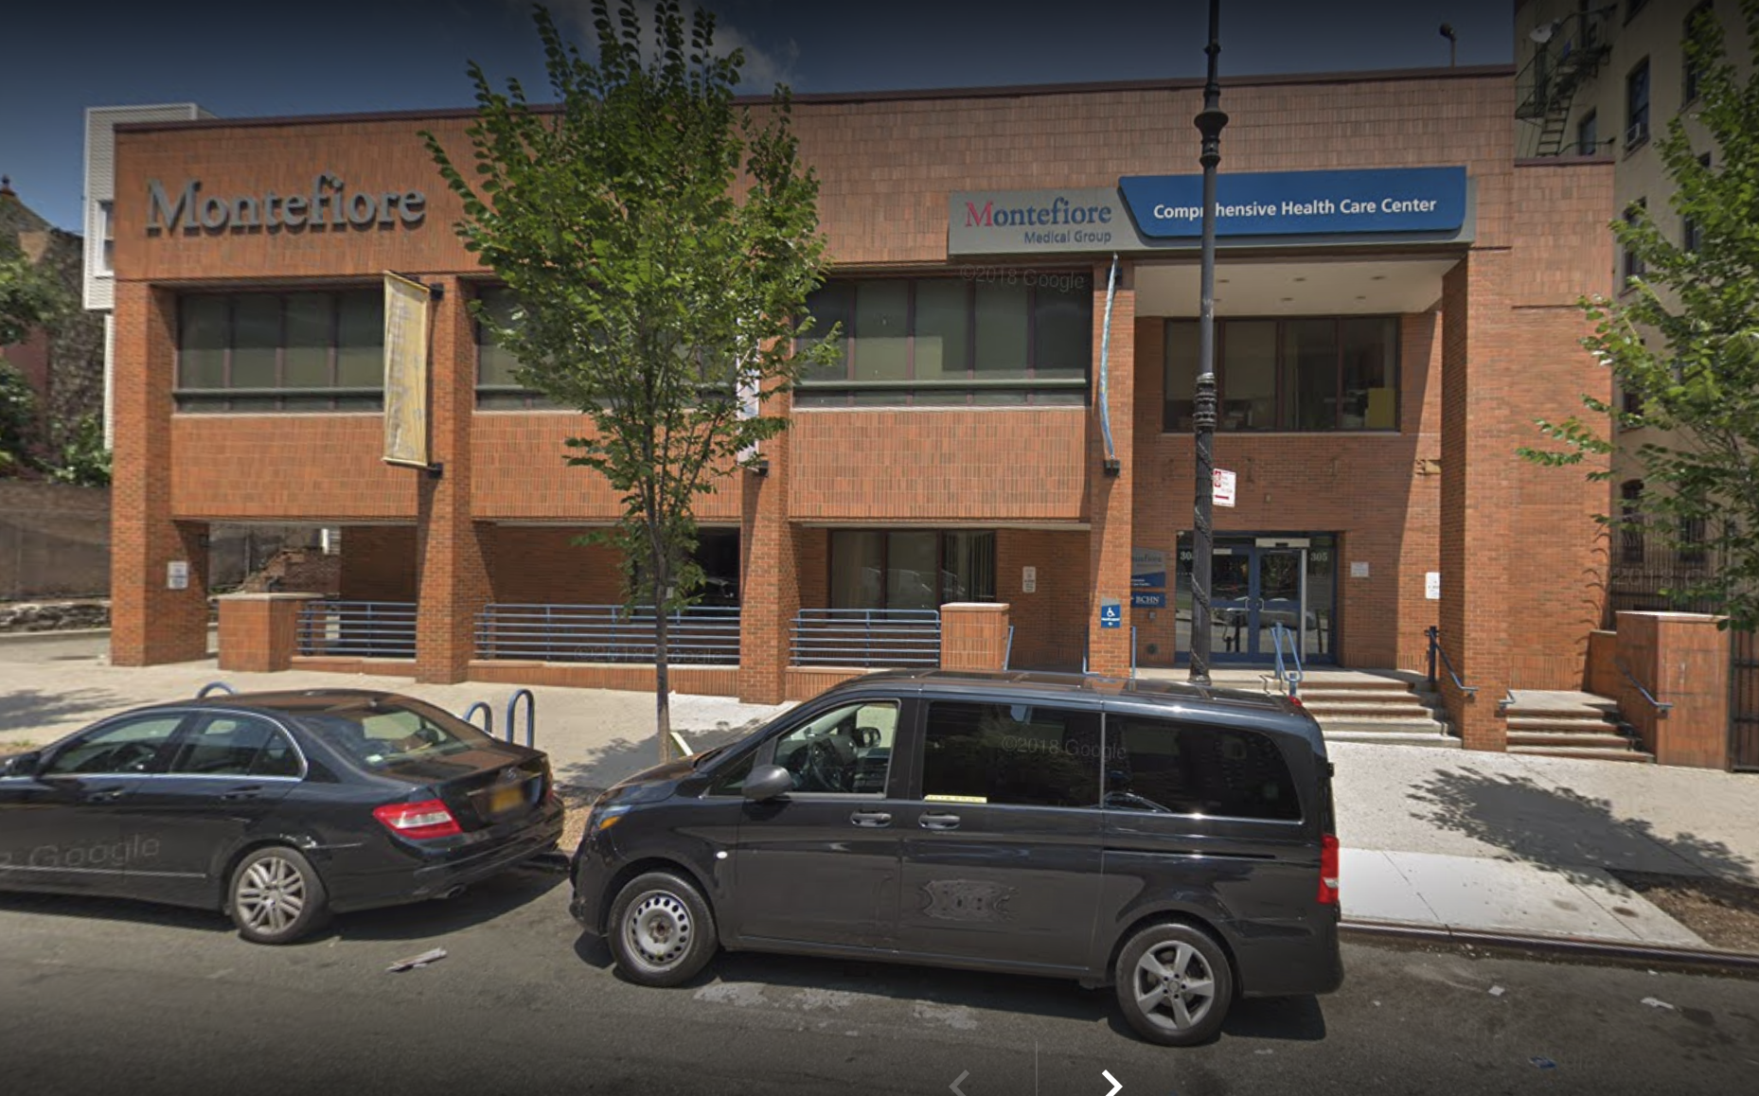
Pilot: HCV Linkage from OnPoint to Montefiore (community clinic)
3 subway stops away
Notes:
For many years, Dr. Norton was the medical director at a harm reduction agency in northern Manhattan called New York Harm Reduction Educators or NYHRE. It’s now called OnPointNYC. It’s only 3 subway stops away from our community health center, which had a comprehensive HCV treatment program, so Dr. Norton attempt to develop a referral program where NYHRE participants would be given transit passes and expedited appointments to start HCV treatment. Of 20 NYHRE participants who wanted HCV treatment, only 6 actually made it to the clinic for evaluation, and 4 initiated treatment.

Slide 7
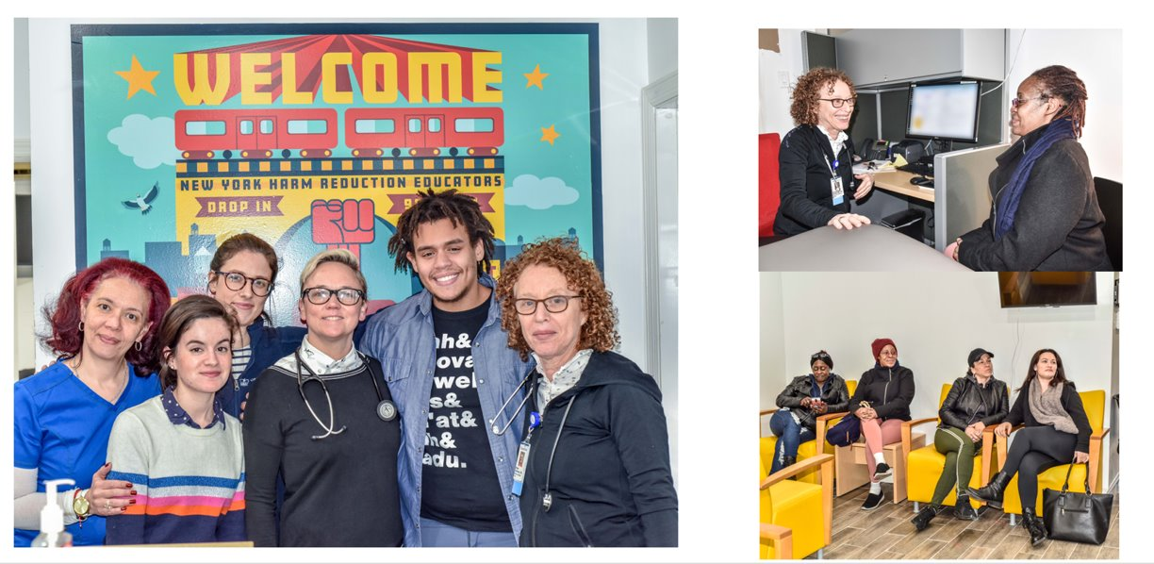
Collaborative Care with Syringe Services Program (SSP) Montefiore/NYHRE Clinic
Bring healthcare to where
people are at!
Notes:
So instead of referring patients, Dr. Norton and others decided to develop a clinic or Drug User Health Hub right onsite at the Harm Reduction Agency. Here’s Dr. Norton and the HCV treatment team who started seeing patients at NYHRE about 6 years ago.
One of the tenants of harm reduction is to meet people where they are – and in this case it literally meant bringing the clinic to the SSP where people who inject drugs were accessing services.

Slide 8
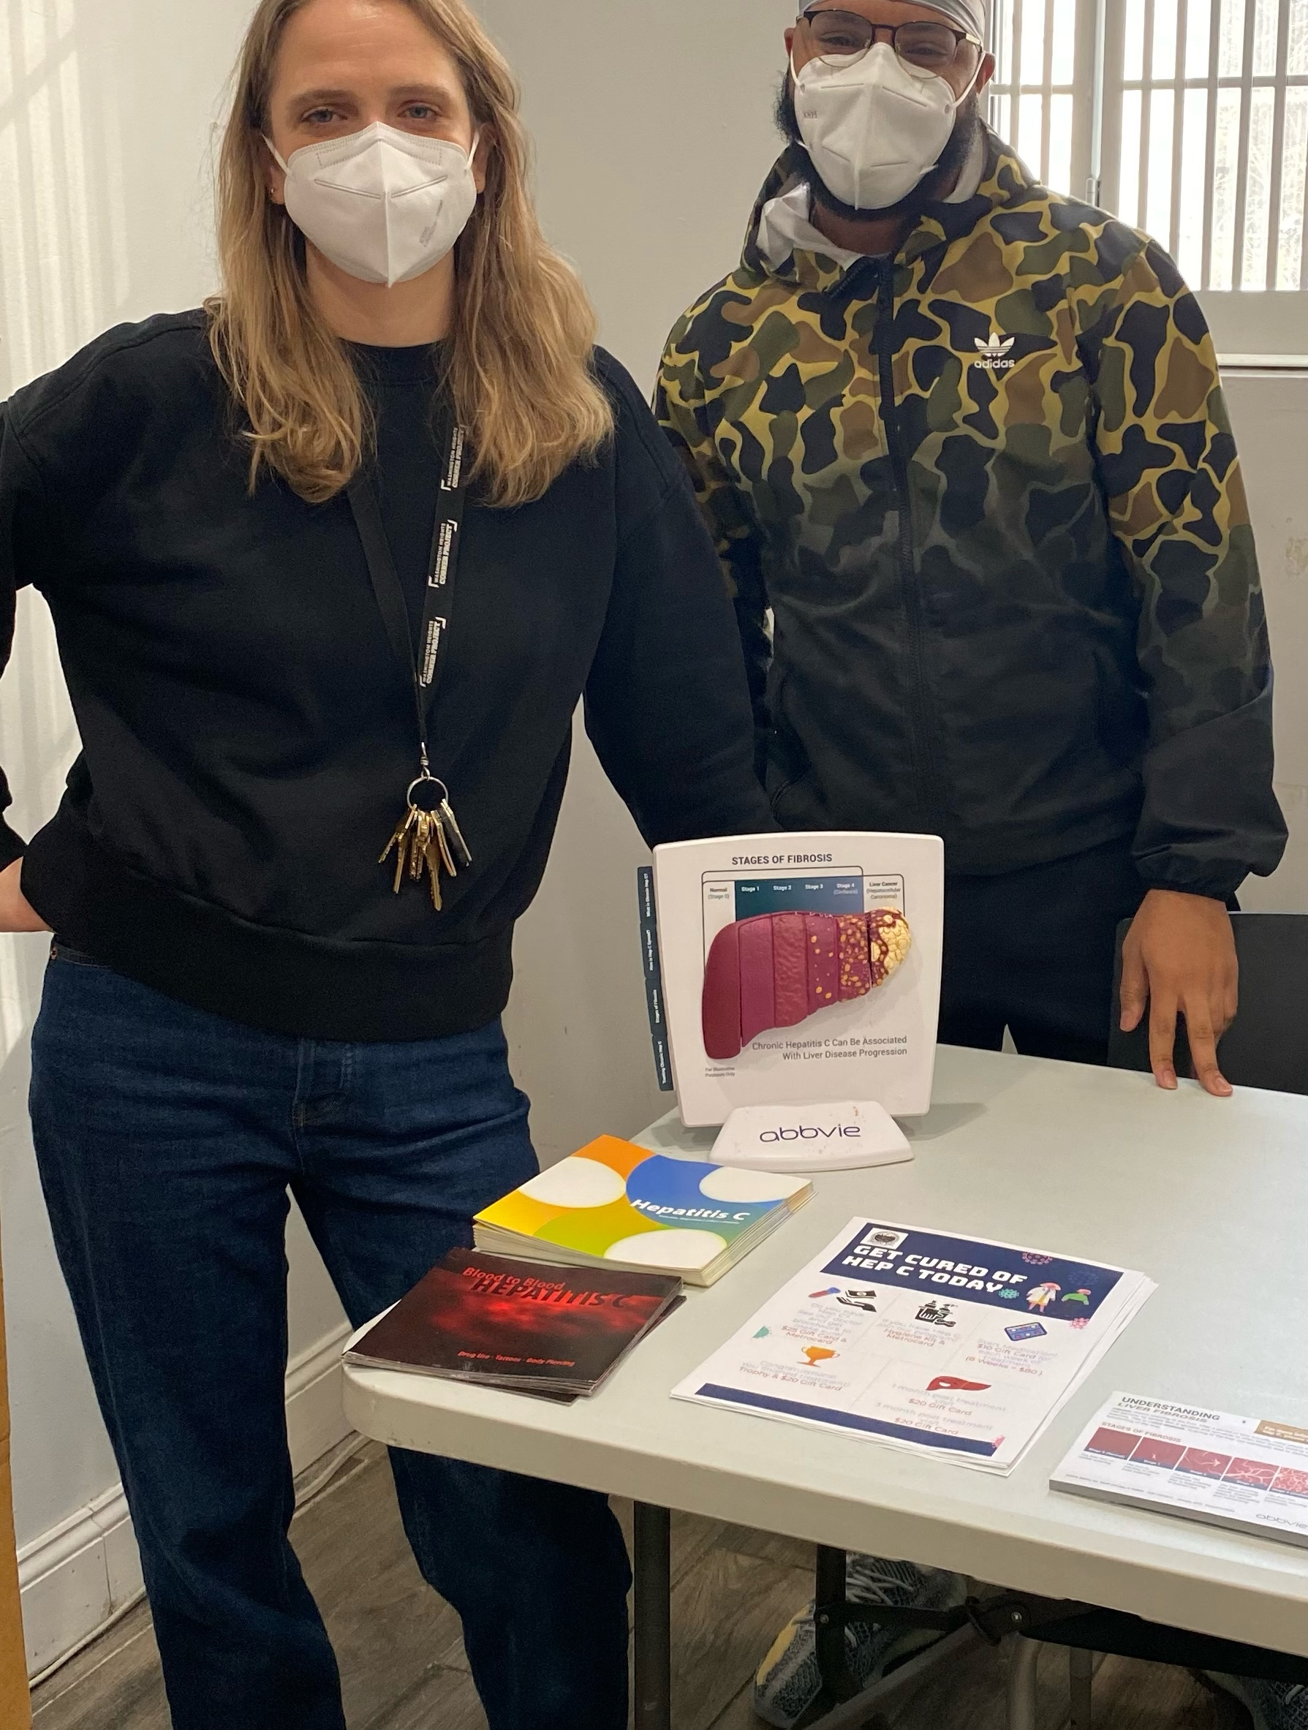
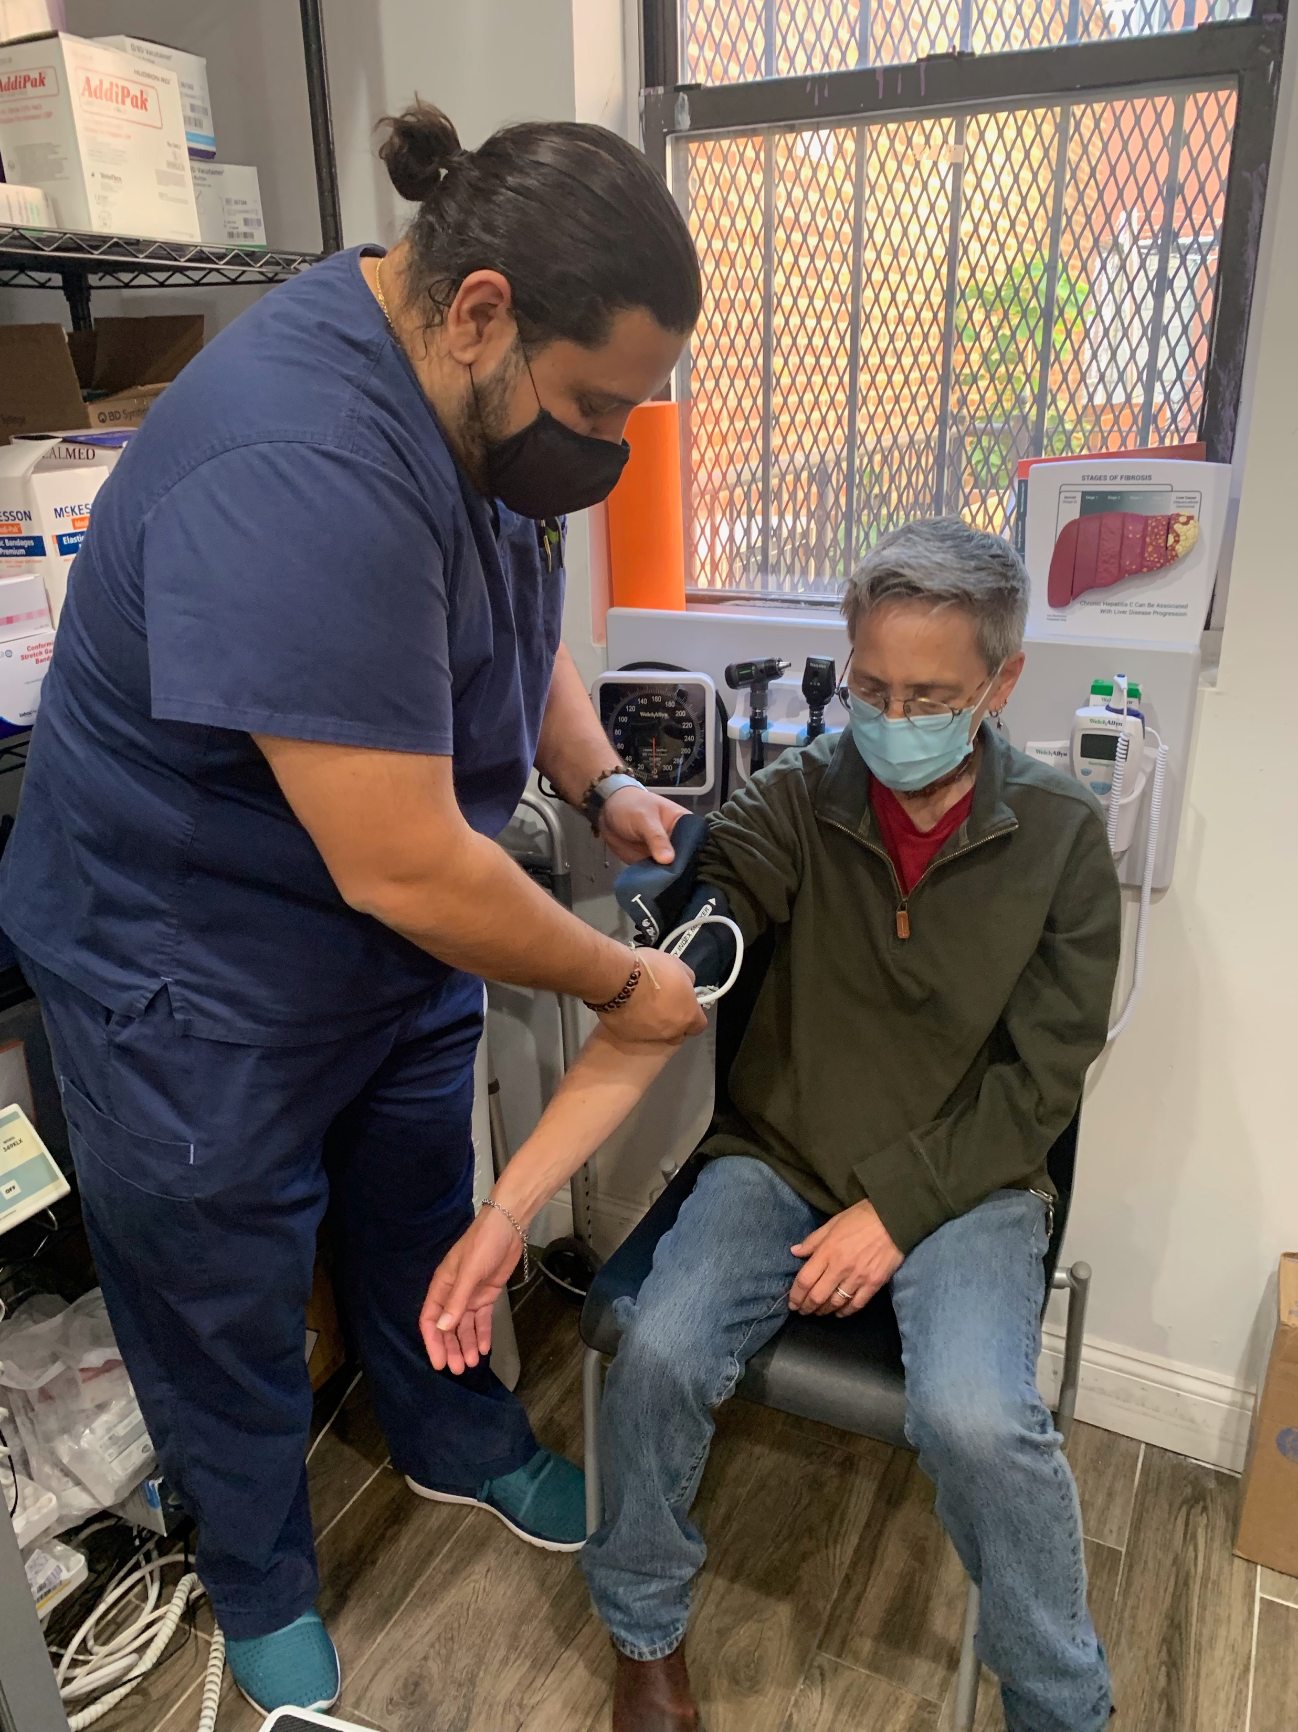
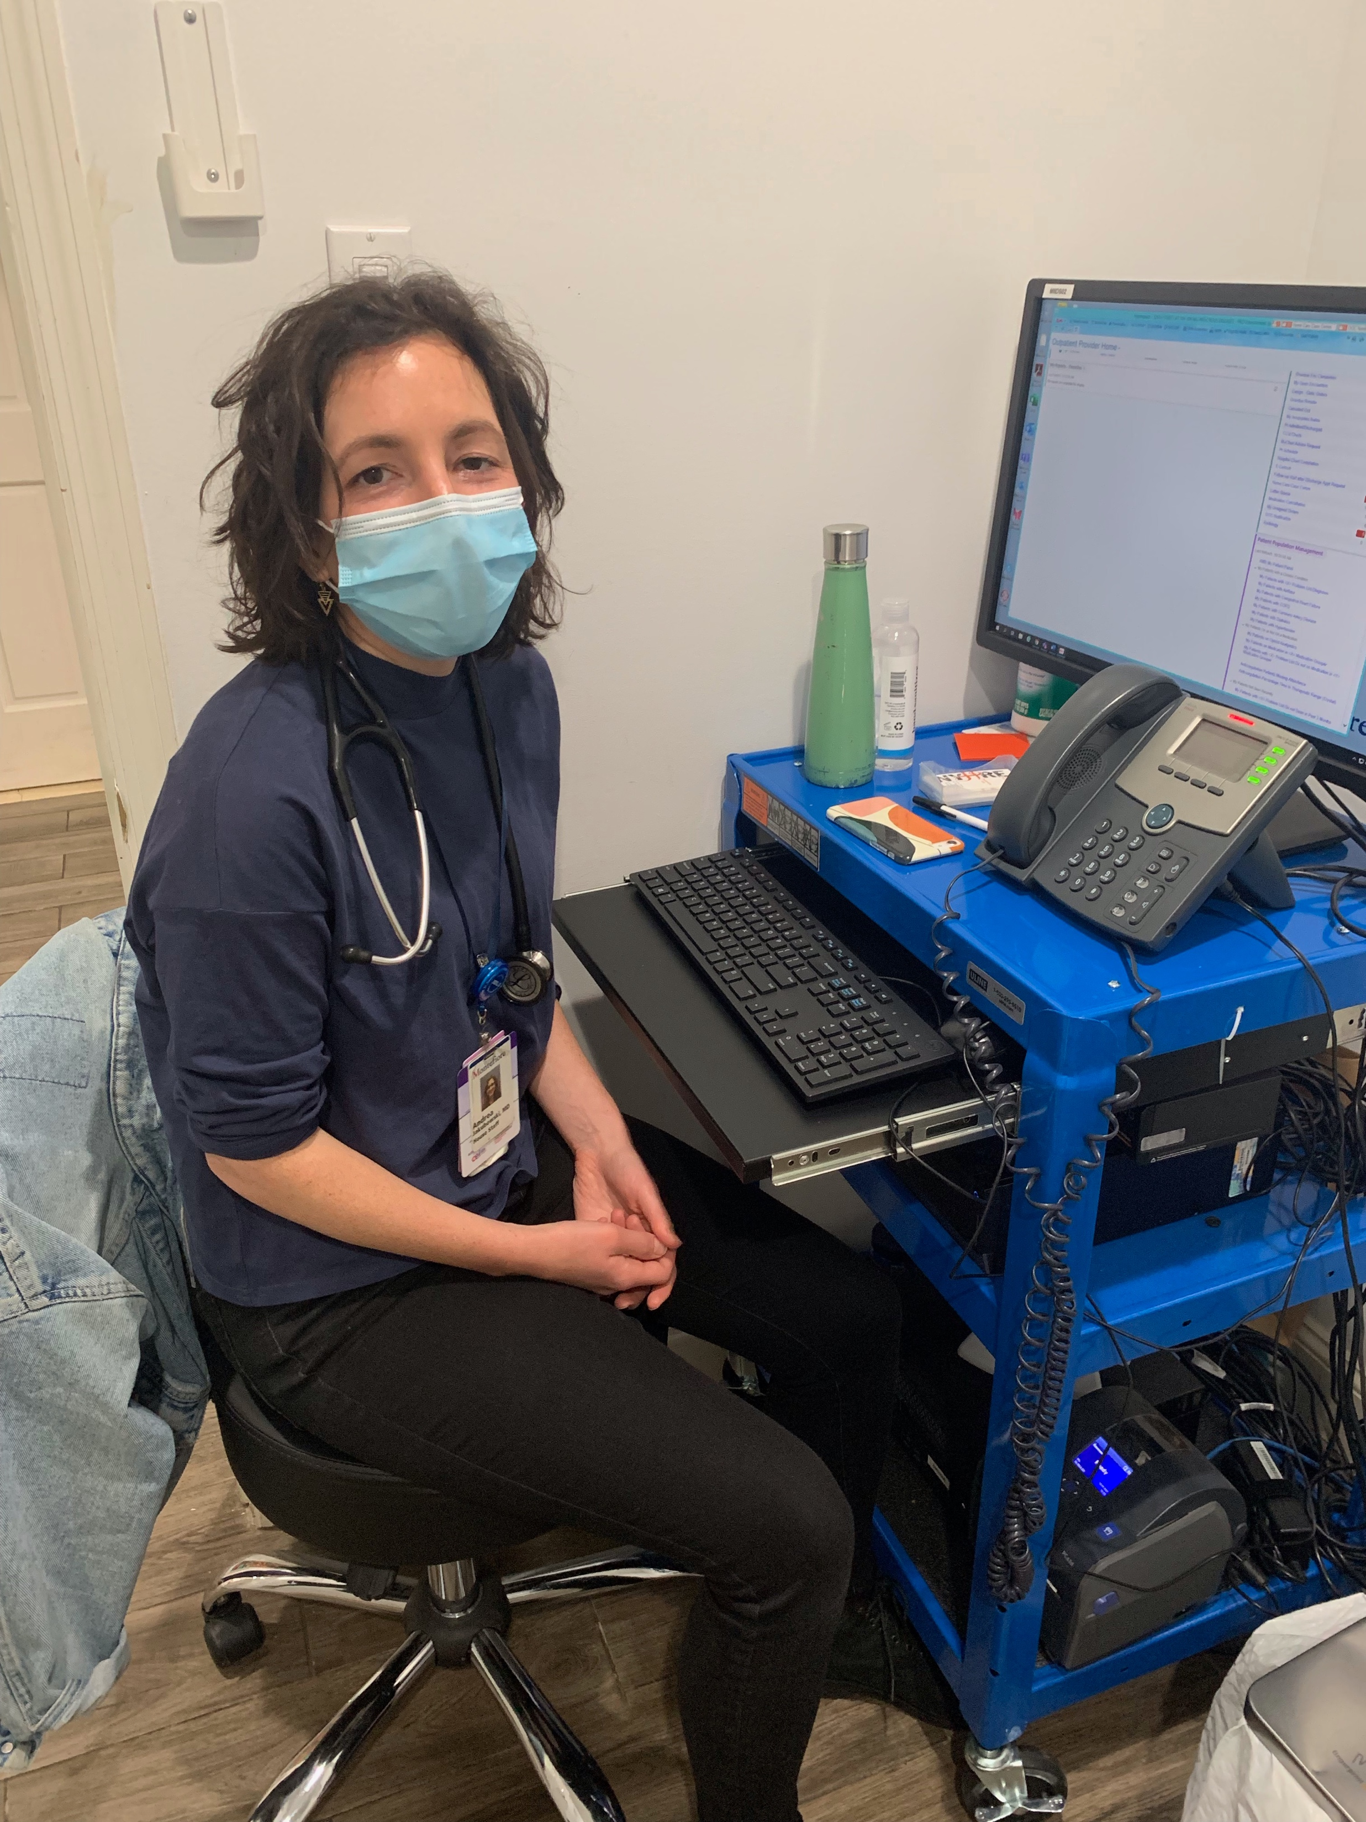
NYHRE/Montefiore Drug User Health Clinic We brought care to them....
Notes:
The team includes voluntary physicians, here’s Dr. Norton again, and another colleague Andrea Jakubowski. The same Electronic Health Record that is used at Montefiore was available at NYHRE. And here’s the clinic manager, a peer specialist, and nursing staff.
As an aside, if there are any students or residents in the audience, you should consider an addiction medicine fellowship with us at Montefiore, because you can see patients at this innovative clinic.

Slide 9
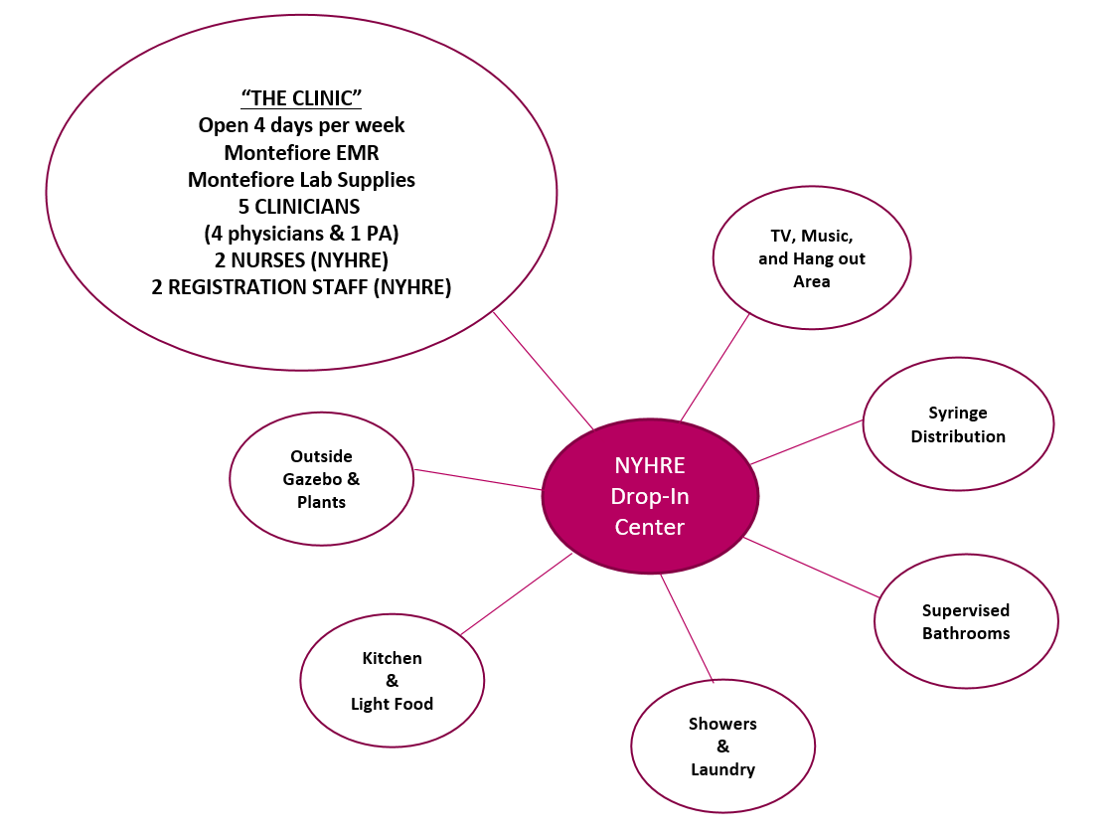
Our Model: One Spoke in the Wheel
Notes:
But the clinic is really only one of many services available at the Harm Reduction Agency. There’s syringe services, showers, laundry, food services, and the bathrooms were set up with an alarm system, so that people could use the bathrooms to inject drugs and someone would check on them regularly.

Slide 10
Innovative HCV SSP Program
Eligible patients: + HCV Rapid Test or self-reported HCV
Notes:
Participants were referred for HCV treatment if they self-reported HCV infection or peers could perform point of care HCV testing. There were incentives for getting bloods drawn, then meeting with an HCV care coordinator, and then treatment was available in group or individual formats.

Slide 11
Notes:
The program also provided medication in blister packs and additional incentives for reaching important treatment milestones. There was a monthly celebration for all patients who completed treatment.

Slide 12
November 2022 NYHRE Becomes First Sanctioned Overdose Prevention Center in US
945 Overdose Interventions
3,395 Registered Participants
78,161 Number of Times OPCs Utilized
1,472,137 Hazardous Waste Diverted
through July 2023
Notes:
Then in 2022, NYHRE opened up the first sanctioned overdose prevention center in the US. This means that participants could bring pre-obtained drugs to use under the supervision of staff members, who could respond to overdose events with oxygen, naloxone, or other interventions. In less than a year of operation, the OPC staff responded to 945 overdoses and served 3,395 participants.

Slide 13
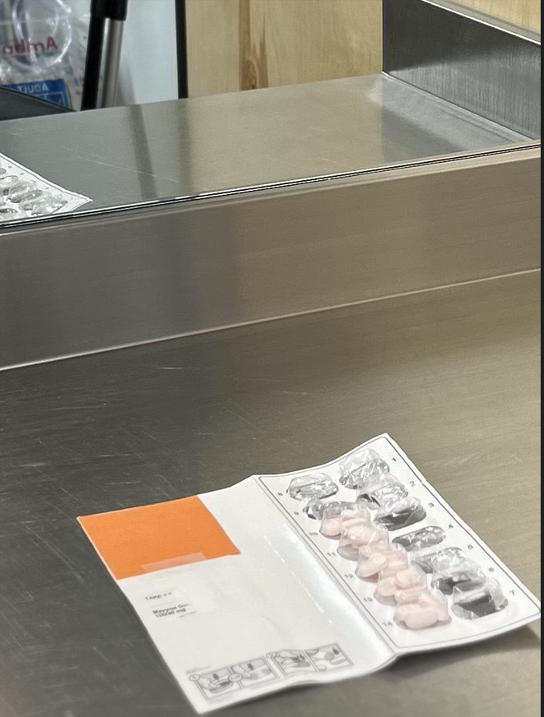
HCV Directly Observed Therapy (DOT) Program at the OPC
Direct-acting antivirals for HCV through DOT at the OPC
HCV medications are safely locked in the OPC storage cabinet
OPC staff deliver daily medications to patients as they prepare to inject
Notes:
Because there were OPC clients who were using the sites every single day, and many had chronic HCV infection, it created the opportunity to include OPC clients in the HCV treatment program and use the OPC for directly observed therapy. You can see on the left, these stalls have space for people to prepare their drugs, there’s sufficient lighting, the steel tables can be easily cleaned. So those that wanted to undergo HCV evaluation, the doctors would prescribe medications, the patients could elect to store the medications at the OPC, and the staff could give them their medication everyday. The patients would come in, get right, and then the OPC staff will give them their medicine. On the right, you can see the medication in blister packs.

Slide 14
Preliminary Data
HCV Treatment at OPC since February 2023
10 patients initiated treatment
7 patients opted for DOT
4 patients CURED
2 finished treatment and awaiting SVR
1 did not finish treatment, irregular OPC use
3 patients opted for take home HCV meds
2 CURED
1 lost to follow-up
Notes:
Here are preliminary data. Since February, Dr. Norton and the fellows have treated 10 patients, 7 of whom opted for DOT. Of these 4 patients were cured, 2 have finished treatment and are waiting for 12 weeks to pass to check for SVR. 1 patient didn’t finish treatment. Of the 3 who opted to take their medication at home, 2 were cured.

Slide 15
High HCV cure rate with DOT at the OPC
Patient story:
Mr. J was injecting heroin daily at the OPC
Started HCV treatment at the OPC w/ DOT
He was cured of HCV!
Mr. J was excited to be cured, engaged with care providers
Able to control drug use and got a job at OnPoint
Mr. J is doing well and employed!
86% Cure
Notes:
And so we believe this is proof of concept that HCV DOT can be delivered in an OPC. Dr. Norton also wanted me to share a patient story.

Slide 16
Conclusions
Decentralize HCV treatment
OPCs link PWID to many needed services
OPC-based DOT may work in other health conditions
Clinicians and health departments should work with OPCs to provide needed services
Vaccines
HCV treatment
TB treatment
Notes:
So in conclusion, we think this is a good model of decentralized HCV treatment. Patients were able to receive treatment, including DOT in a site that they trusted. The project demonstrates how OPCs can link people who inject drugs to many needed services. We believe that DOT in OPCs may work for other health indications. And clinicians and health department should work with OPCs to provided needed services.
Just another word - my own thoughts from this conference – one of the speakers from the native health plenary reflected that they would provide people with love until they could love themselves. And I saw the same thing in the rural health plenary, from Alicia who stuck by her client with her arm wounds. And in my 20 years of working with harm reduction agencies, this is exactly what I’ve seen from their staff members. The provide unconditional love until people can love themselves.

Slide 17
Thank you!
Questions?
16

