Slide 1
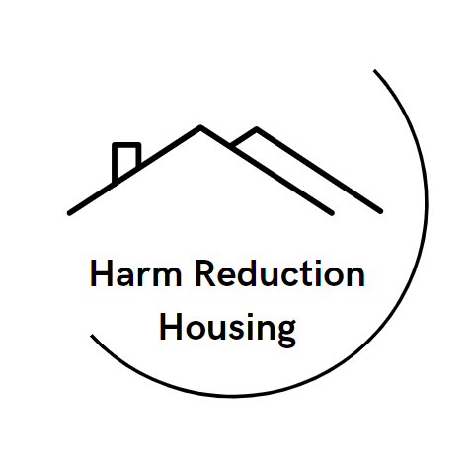
What a Difference This home Makes: Changes in Drug Use, HIV Risk and Prevention Behaviors Among Residents Relocated from Encampments to Low-Threshold Harm Reduction Housing Sites in Boston
Traci C. Green, PhD, MSc
Heller School for Social Policy & Management
Brandeis University
Notes:
Unhoused Populations on Thursday, November 14, 2024 at 3:51 PM at the Radisson Blu in the Bering
Presenters should address DEI content in their presentation with a minimum of 1 slide dedicated to this topic or that DEI is integrated throughout the presentation. We acknowledge that some presenters already have extensive contributions in this space and that some individuals are members of communities disproportionately impacted by systemic oppression; nevertheless, we ask all presenters to include this content so we can all learn together.

Slide 2
I have no conflicts of interest to disclose.
I am grateful to NIH/NIDA for funding R21DA058581 and to my co-authors
Joseph Silcox, PhD; Sofia Zaragoza, BA; Sabrina Rapisarda, MA, M.Ed; Charlie Summers, BA; Patricia Case, ScD, MPH; Sarah Kosakowski, MPH; Clara To, MPH; Avik Chaterjee, MD

Slide 3
Background
Since 2014, Boston has struggled with visibility of substance use and homelessness, as well as an HIV outbreak associated with homelessness, methamphetamine use, and injection drug use.
Following a series of rapid tent encampment removals in 2021-2022 around an area known for concentrated public drug use and homelessness, city and state jurisdictions collaborated with police to relocate 612 unhoused people into 7 low-threshold harm reduction housing (HRH) sites.
Uniquely, HRH sites did not require abstinence from drug use and were equipped with many harm reduction services, supplies, policies, security measures and access to or co-located medical care.
For more information, see: Joint MDPH and BPHC Clinical Advisory: Increase in newly diagnosed HIV infections among persons who inject drugs in Boston, March 15, 2021, available at: https://www.mass.gov/doc/joint-mdph-and-bphc-clinical-advisory-hiv-transmission-through-injection-drug-use-in-boston-march-15-2021/download

Slide 4
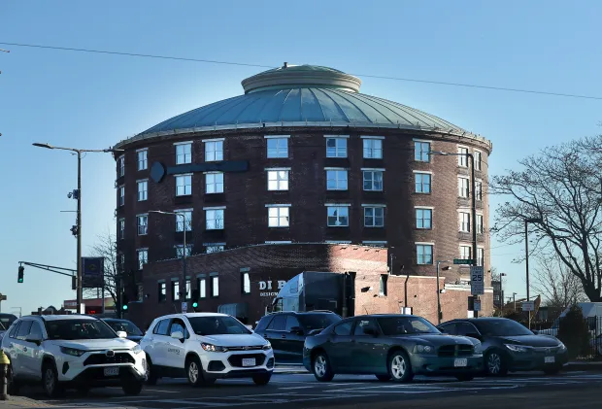
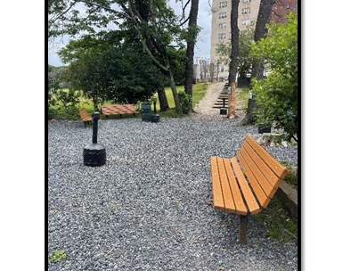
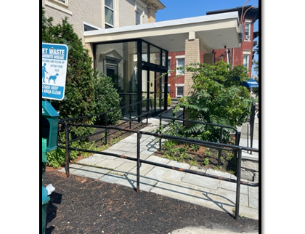
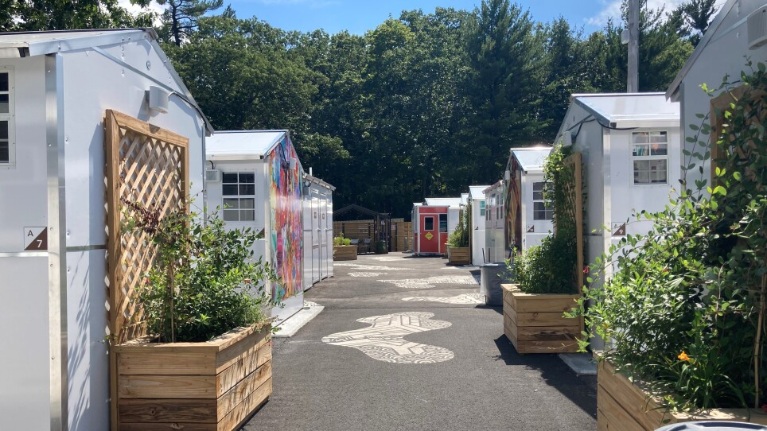
Harm Reduction Housing
Harm Reduction Supply Accessibility
Co-Located Medical Services
Resident Autonomy and Privacy
Resident Safety and Security
Community Promotion
Transitional Supports
Source: Zaragoza S, Silcox J, Rapisarda S, et al. Developing a Comprehensive Inventory to Define Harm Reduction Housing, 15 October 2024, PREPRINT (Version 1) available at Research Square [https://doi.org/10.21203/rs.3.rs-4999367/v1]

Slide 5
Objective
To measure self-reported changes in drug use, HIV risk and prevention behaviors from before to after placement in HRH.

Slide 6
Methods & Analysis
Interviewers administered surveys to 106 residents recruited from 7 HRH sites between September 2023-February 2024.
Survey items derived from prior formative rapid assessments of the same population. Questions gathered current and perceived change in behaviors and care from prior to relocation to present.
We used descriptive statistics to summarize data.

Slide 7
Sample Surveyed (N=106)
 | n | %
Male Gender | 61 | 57.5
Age
18–35 | 17 | 16
36–45 | 42 | 39.6
46–55 | 30 | 28.3
56+ | 17 | 16
Race (multi-response)
White | 55 | 51.9
Black | 29 | 27.4
American Indian | 11 | 10.4
Some other race | 24 | 22.6
Hispanic/unknown ethnicity | 31 | 29.2
Current Drug Use (multi-response)
Cocaine | 58 | 54.7
Crack | 60 | 56.6
Heroin | 79 | 74.5
Fentanyl | 60 | 56.6
Methamphetamine | 27 | 25.5
Marijuana | 44 | 41.5
Other drugs (fake pills etc) | 39 | 36.8
Current Injection Drug Use | 65 | 61.3
HIV Positive | 8 | 7.5

Slide 8
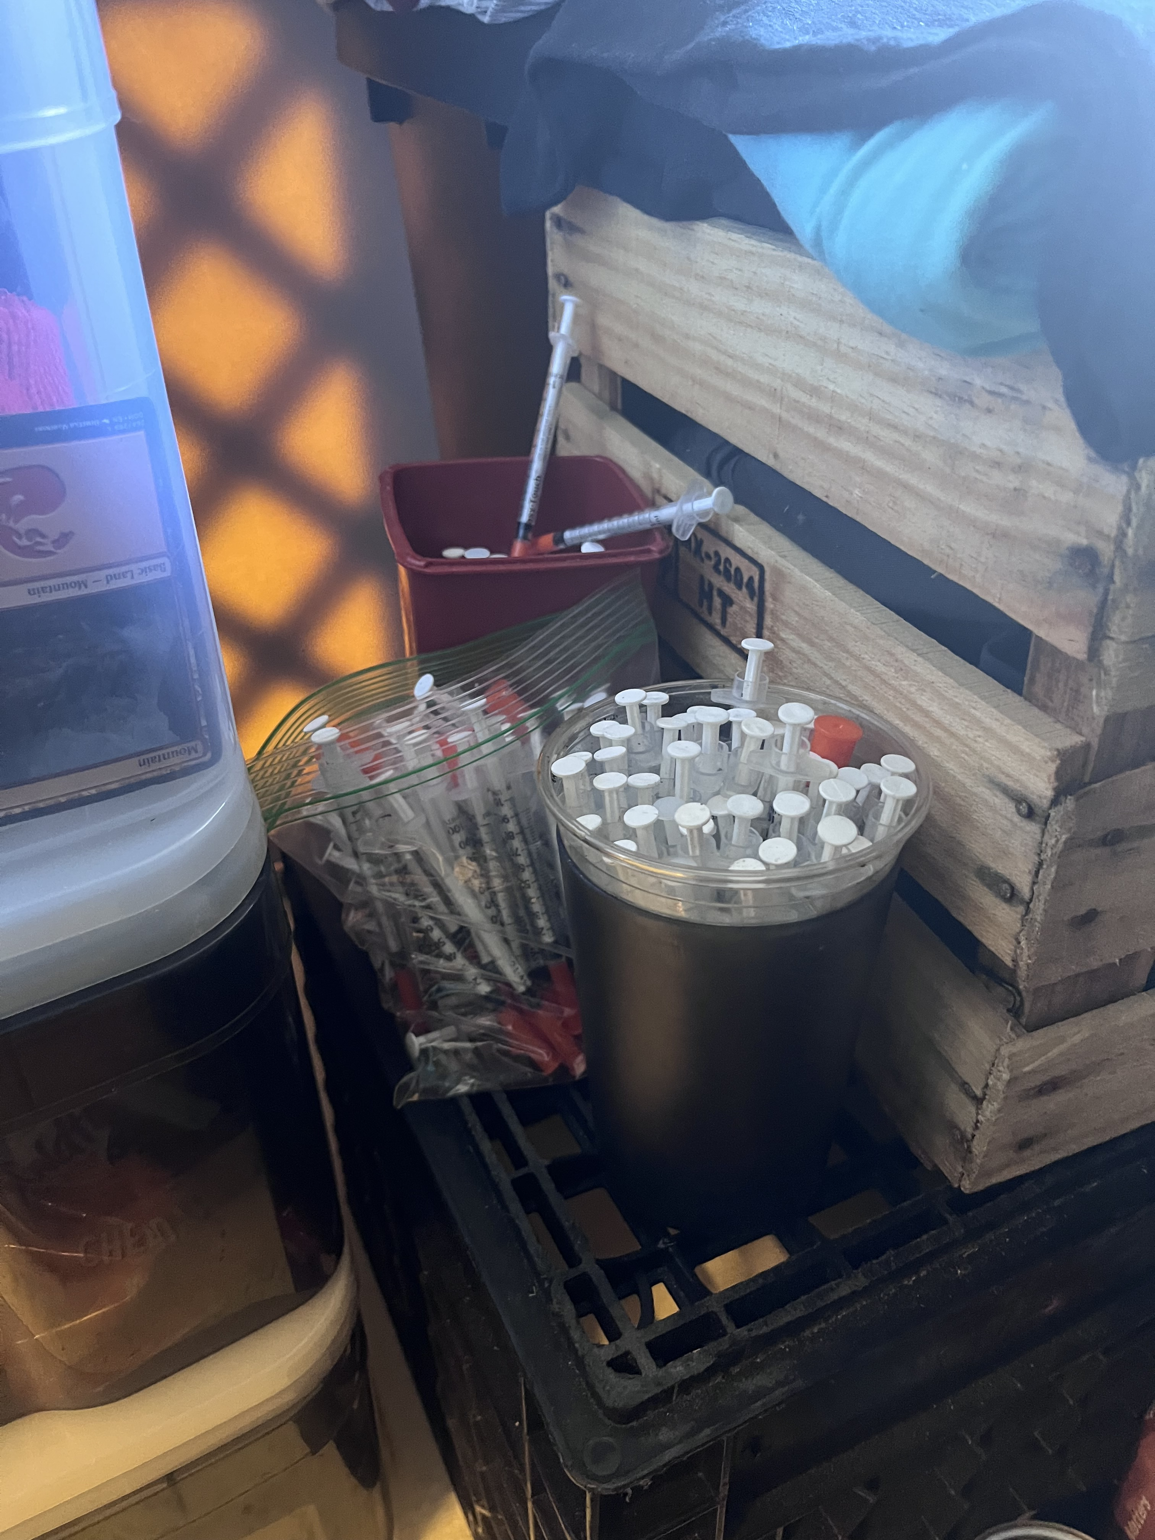
Results
All but one resident reported active drug use.
Since relocation to HRH, residents reported reductions in crack/cocaine (69.9%), methamphetamine (71.4%) and opioid (71.2%) use, obtaining drugs from fewer dealers (an overdose risk; 35.8%), and less drug use in public (55.7%).
Drug use and overdose risk
For the 65 residents continuing to inject drugs, 44.6% named their HRH site as the main source of sterile syringes and 29 of 85 (34.1%) residents smoking drugs sourced safer smoking supplies from HRH sites.

Slide 9
Results
Still, not having a syringe (12 of 30 instances), borrowing a syringe (10 of 24 instances), and using alone (55 of 88 instances) in the past month at the HRH site were not uncommon events.
HIV risk behaviors

Slide 10
Results
HIV testing and counseling was offered on-site at HRH. 53 (50%) residents were aware it was available there and, of those, 33 (62%) took part in the service, with all rating this as helpful to staying safe from overdose and other drug related harm.
Eighteen (17.0%) HRH residents reported starting pre-exposure prophylaxis for HIV prevention at or facilitated by their HRH site.
None of the 8 HIV+ residents experienced HIV medication or treatment disruption.
HIV prevention behaviors and care

Slide 11
Results
Since coming to HRH, a majority (71.7%) stated having longer and better quality sleep.
Additionally, 28 (26.4%) residents initiated or centralized primary healthcare at HRH or began care proximal to HRH.
Other notable health changes following HRH relocation

Slide 12
Conclusion
Relocation to HRH resulted in reductions in resident-reported drug use, risk behaviors, and unsafe living conditions while simultaneously improving or maintaining essential HIV prevention, treatment, and sleep quality.
Transitional housing needs to be harm reduction housing: Transitional housing sites must secure sufficient, 24/7 access to harm reduction supplies on-site and support residents in not using alone.

Slide 13
THANK YOU
Contact:
Traci C. Green PhD, MSc
tracigreen@brandeis.edu
heller.brandeis.edu/opioid-policy

