Slide 1
We could, couldn’t we? Measuring attitudinal and capacity barriers to supporting residents on MOUD in recovery housing
Rachel P. Winograd, PhD
Associate Professor & Director of Addiction Science
Department of Psychological Sciences & Missouri Institute of Mental Health
University of Missouri, St. Louis
Co-authored by: Rashmi Ghonasgi, Brandon Park, Maria Paschke, Lindsey Vondras, Micah Nellis, Dez Smith, & Dr. Amy Mericle

Slide 2
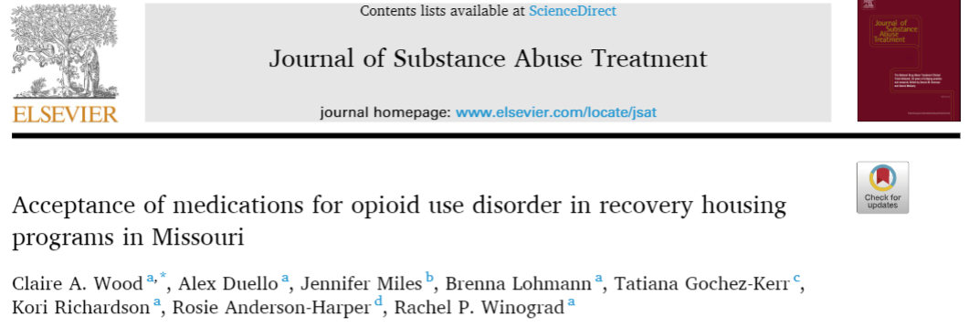
Do recovery houses “allow” people on MOUD?
National Alliance of Recovery Residences (NARR)
Substance-free, home-like environment, social model
No specific standard on MOUD
Illegal to deny residency based on MOUD status (ADA)
But can do so “if essential for the safety and welfare of residents and essential for the maintenance of the home-like environment” (NARR, 2018)
Fair Housing Act (FHA) → does not apply to homes with ‘active drug use’… what about MOUD?
Missouri-based study
Of 64 houses, only 1 allowed all three forms of MOUD
Notes:
In recent work from our team examining various factors within the recovery housing landscape across Missouri, we assessed acceptance of different types and courses of MOUD among recovery housing operators within programs that had reportedly expanded their abstinence-based programs to be inclusive of MOUD. Although recovery homes were required (per funding restrictions) to accept residents using medication, variation existed in the extent to which house operators reported medication acceptance. Specifically, results indicated methadone was the least accepted medication for long term use, followed by buprenorphine and then naltrexone. Recovery house managers reporting significantly lower overall acceptance of methadone were more likely to report encouraging residents to “taper off” MOUD.¹⁸ Given the limited number of items used in this study and the dearth of research related to MOUD attitudes and actions in recovery housing settings more broadly, these findings highlight the need for standardized, validated measures related to MOUD use within recovery homes, with particular attention to various manifestations of stigma toward MOUD.

Slide 3
If we don’t know what the barriers are, how can we address them?
Time to develop a measure!
**Attitudes**
**Capacity**

Slide 4
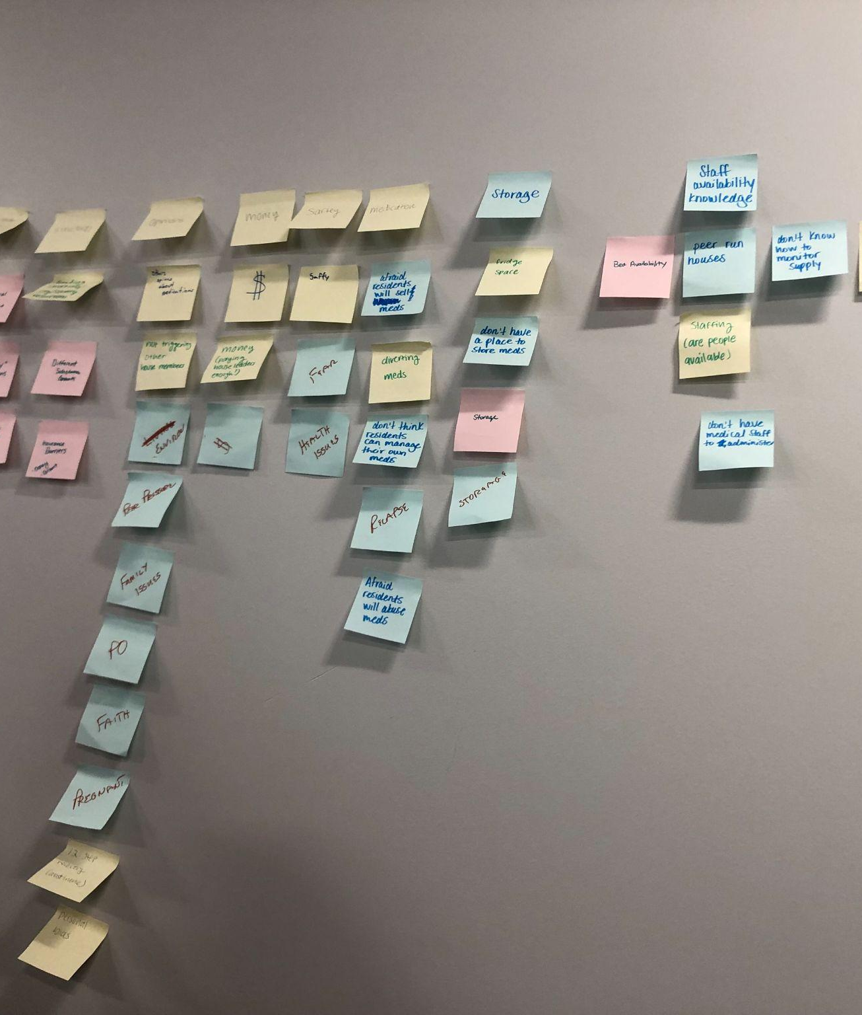
Workshop, Calls, & Focus groups with Subject Matter Experts
Identified key roadblocks, concerns, and struggles to support MOUD
Created and refined survey items with their input
Voiced tension between ‘social model’ & desire to support evidence-based interventions

Slide 5
What do we already know about barriers to MOUD?
Attitudinal Barriers – 8 domains (5+3)
Erin Madden’s (2019) concept of Intervention Stigma
Pharmacological properties
Regulatory and administrative barriers
Preference for psychosocial treatment over medication
Mistrust of scientific research on MOUD
Suspicion of profit motives
Plus others that came up
General stigma toward MOUD
Recovery housing-specific MOUD stigma
Risk of Diversion
Madden EF. Intervention stigma: How medication-assisted treatment marginalizes patients and providers. Soc Sci Med. 2019;

Slide 6
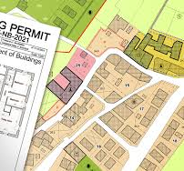
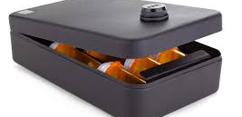
Not just attitudes… also CAPACITIES
Safe storage
Locked refrigerators, safes…
Staff to monitor
Transportation to/from clinics and pharmacies
Zoning laws/Rules around direct administration
Lack of medical knowledge/expertise
… and more

Slide 7
Survey Launch Feb ‘24
Operator online survey ~ 15-20 mins
Resident online survey ~ 10-15 mins
All participants received $15 Amazon e-gift cards
National online data collection February – June 2024

Slide 8
Acceptance of Residents on MOUD by type (N=145)
 | Accept | Accept w/ restrictions/taper | Not Accept
Buprenorphine | 104 (72%) | 27 (19%) | 14 (10%)
Methadone | 85 (59%) | 29 (20%) | 31 (21%)
Naltrexone | 117 (81%) | 21 (15%) | 7 (5%)

Slide 9
Capacity Barriers
Most needed by both Operators & Residents:
Transportation to/from MOUD visits/pharmacy
Internal Training
Operators (HOW to support)
Residents (WHAT/WHY MOUD is good)

Slide 10
MOUD Attitudinal Items (Operators) – 15 items
Time-limited:
The sooner you get off buprenorphine, the better.
The sooner you get off methadone, the better.
The sooner you get off naltrexone, the better.
I support MAT as a form of short term recovery, but people should not stay on it for years and years.
Pharmacological Properties:
Methadone gets people high just like street opioids.
Buprenorphine (e.g., Suboxone) is often used to get high by people who aren't prescribed it.
Methadone is often used to get high by people who aren't prescribed it.
Suspecting profit motives:
MAT was developed so companies and doctors can make more money.
Buprenorphine (e.g., Suboxone) was developed by the pharmaceutical companies to keep people dependent or hooked.
Methadone was developed by the pharmaceutical companies to keep people dependent or hooked.
Recovery house-specific:
Having residents on buprenorphine (e.g., Suboxone) worsens the environment of a recovery house.
Having residents on methadone worsens the environment of a recovery house.
Allowing residents to be on MAT is unfair to residents who are not on MAT.
MAT use within a recovery house is triggering to other residents.
People using MAT cannot be considered clean and sober.
Alpha = .92

Slide 11
MOUD Attitudinal Items (Residents) – 10 items
Mistrust of Research
Research supporting the use of buprenorphine (e.g., Suboxone) does not tell the negative sides of it.
Research supporting the use of methadone does not tell the negative sides of it.
Research supporting the use of naltrexone (e.g., Vivitrol) does not tell the negative sides of it
Recovery house-specific
Having residents on buprenorphine (e.g., Suboxone) worsens the environment of a recovery house.
Having residents on methadone worsens the environment of a recovery house.
Seeing other residents in my recovery house "nod off " makes me a little jealous or triggered.
Time-limited + Need for Counseling:
The sooner you get off methadone, the better.
I support MAT as a form of short-term recovery, but people should not stay on it for years and years.
The best way for someone to break free from opioid addiction is to address it in therapy or counseling.
MAT is only effective if it is delivered alongside counseling or talk therapy.
Alpha = .81
Notes:
F3 Mistrust of research
F4 Related to recovery/sober living environments (Setting-specific)
F2 Need for short-term use and prioritizing psychosocial treatment

Slide 12
Mann-Whitney U; W = 10139, p<.001
Notes:
Operator MAT Attitudinal score was significantly different from Resident MAT Attitudinal score (Mann-Whitney U test, also known as Wilcoxon rank sum test -- used due to non-normality and unequal variances, W = 10139, p < .001).

Slide 13
Take-aways
By MOUD type
Acceptance in inverse order of effectiveness (naltrexone > buprenorphine > methadone)
Some shared domains between Operators & Residents
Recovery housing is uniquely difficult for MOUD
Emphasis on MOUD being short-term/time-limited
Some amount of mistrust and suspicion toward research/healthcare
Operators have more favorable attitudes (than Residents) toward MOUD

Slide 14
Practical Applications of this Research
Recovery housing operators assessing differences within and across their homes
Certification/accreditation bodies assessing recovery housing applicants
Design and deliver tailored trainings to address specific barriers
Federal and state funders issue funding to fill specific capacity-related gaps

Slide 15
Thank You!
Brandon Park (!!!)
Dr. Amy Mericle
Rashmi Ghonasgi
Maria Paschke
Lindsey VonDras
Anusha Challa
Rece Lipsey
& All our Missouri subject matter experts and national focus group participants!
Check out more of our work:
www.MIMHAddSci.org & https://www.umsl.edu/psychology/aspire-lab/index.html & @mimh_addisci on Twitter
Reach me at Rachel.Winograd@umsl.edu

Slide 16
Primary initial aims:
Derive factor structure of attitudes
Use EFA and CFA to establish latent factor structure with specific items
Create measure of MOUD (attitudinal) barriers in recovery housing
With versions for both operators and residents

Slide 17
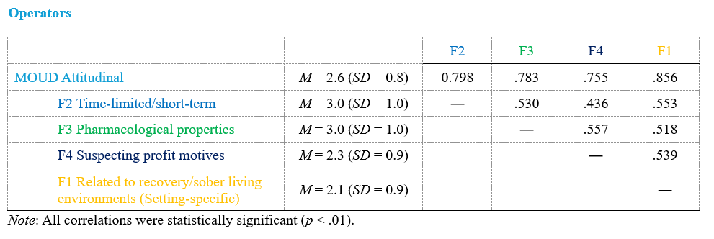
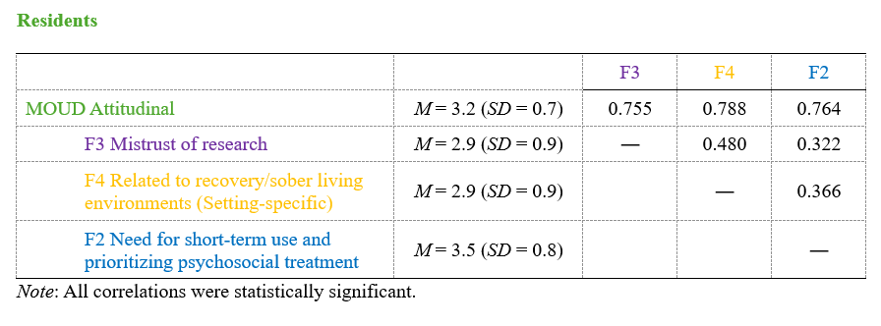
FIT STATS
Notes:
RMSEA = .058 (95% CI: [.04, .077])
TLI = .928
CFI = .961
SRMR = .03
df-corrected SRMR = .04

Slide 18
Process Flow
Operators receive link to eligibility screener
Pass eligibility screener
Operators redirected to MO ISTARR Survey
After completing the survey
Residents complete the
MO ISTARR Survey
Operators receive a unique survey link for up to 10 of their residents
Ability to understand and compare MAT barriers and solutions based on 400+ responses from recovery house operators and residents
Notes:
Cut some of the squares + delete the background
After completing the survey
Add attention checks?

Slide 19
Example
General stigma
The sooner you get off _____, the better.
General stigma - Recovery Housing
MAT use within a recovery house is triggering to other residents
Pharmacological properties:
People using MAT are addicted to it.
Theoretical orientation:
People using MAT cannot be considered clean and sober.
Preferring psychosocial treatments over medication
MAT is only effective if it is delivered alongside counseling or talk therapy
Mistrust of scientific research of MOUD (Valuing experiential knowledge and anecdote)
Research studies about the benefits of MAT are untrustworthy
Suspecting profit/negative motives
MAT was developed so companies and doctors can make more money
Risk of diversion
People on MAT too often sell it or share it.

Slide 20
Preliminary Findings – Overall Snapshot
Types of Recovery Homes (N = 145)
Housing Type | n (%)
Peer-run housing (NARR Level 1) | 14 (10%)
Monitored housing (NARR Level 2) | 56 (39%)
Supervised housing (NARR Level 3) | 53 (37%)
Service provider housing (NARR Level 4) | 12 (8%)
Oxford house | 3 (2%)
Respite/crisis stabilization house | 1 (0.7%)
Other | 2 (1%)
I don’t know | 4 (3%)

Slide 21
Preliminary Finding Snippets - Attitudes
Operators (n=145), Residents (n=250)
Highest scored subscales so far –
General ‘stigma’
Preferring psychosocial treatments over MAT
Mistrust of scientific research supporting MAT
Risk of diversion
Highest scored items so far
I support MAT as a form of short-term recovery, but people should not stay on it for years and years
People using MAT are addicted to it
The best way for someone to break free from opioid addiction is to address it in therapy or counseling

Slide 22
Attack of the Bots!
Week 8 of data collection
Hundreds of surveys started within hours… uh oh!
Tried to add more protections…
“In a word or two, please tell us - what are the residents in your house recovering from?” (kindof worked)
“What is the screener password?” (did not work)
… hundreds more… and more…
On Day 5, we created a NEW link…
Revamped recruitment
(no more links on social media!)
Notes:
happened during week 8 (probably due to Operator screener link being posted on social media) – no bots detected prior to these bot attacks
during first and second bot attacks (Wed. and Thurs.), Operator screener and survey turned off within 2-3 hours
during third bot attack (Sun.), Operator screener and survey turned off within 12 hours
only one person knows how to turn the screener/survey off, and they were away-from-phone on Sun. (which is why more responses on Sun.)

Slide 23
Preliminary Findings Snippets - Capacity
EXISTING Capacity
(among Operators)
61% provide telemedicine equipment for MAT appointments
76% have safe storage or lockers
59% have dedicated staff to help with MAT coordination
(among Residents)
19% of residents on MAT have been rejected from housing for being on MAT
79% of residents on MAT say their house makes it easy to get it when it’s time to dose
69% say their house can help them get MAT appointments when needed
DESIRED Capacity – same top 3 endorsed by Operators and Residents!
Transportation
Training on how to support people on MAT
Education/awareness training for residents

