Slide 1
Wound Characteristics Among Patients Exposed to Xylazine: A Case Series
AMERSA 2024
Published November 13th, 2024 in JAMA Dermatology
Lydia Lutz, MD; Rachel McFadden, BSN, RN, MPH; Lin Xu, MS; Ranvir Bhatia, MD; M Holliday Davis, MA; Natasa Rohacs, BA; Jenny Wei, MD; Jeanmarie Perrone, MD; Margaret Lowenstein, MD, MPhil, MSHP; Ashish P. Thakrar, MD, MS, FASAM
llutz3@jh.edu
PGY-1, Internal Medicine and Pediatrics
Johns Hopkins Hospital

Slide 2
Disclosures and Acknowledgements
No conflicts of interest
Use of anonymized photographs approved by an IRB at Penn
Acknowledgements: co-authors and patients
Wound Characteristics Among Patients Exposed to Xylazine
AMERSA 2024 I Lutz et al. 2024, JAMA Dermatology | llutz3@jh.edu
Notes:
Gives fentanyl “legs”
Far from injection site

Slide 3
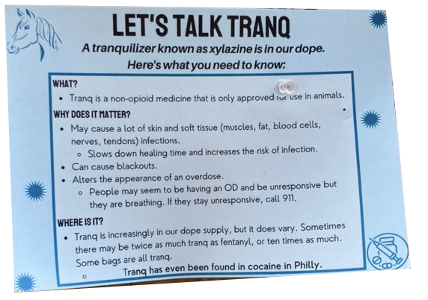
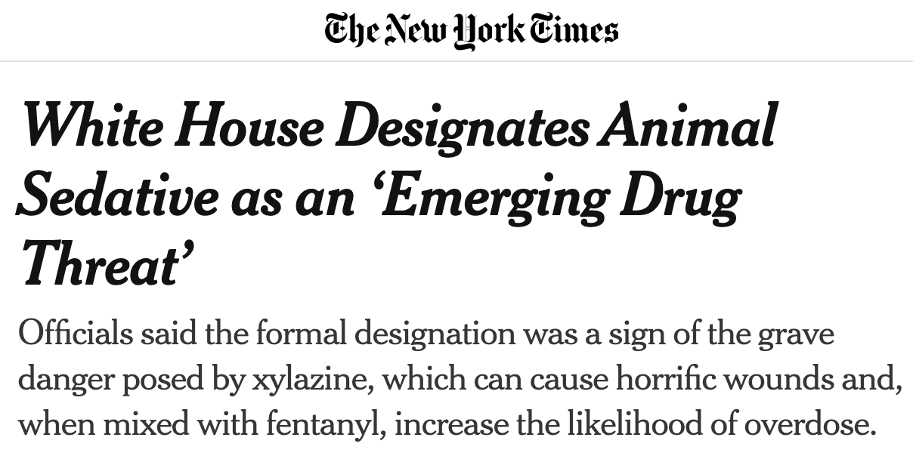
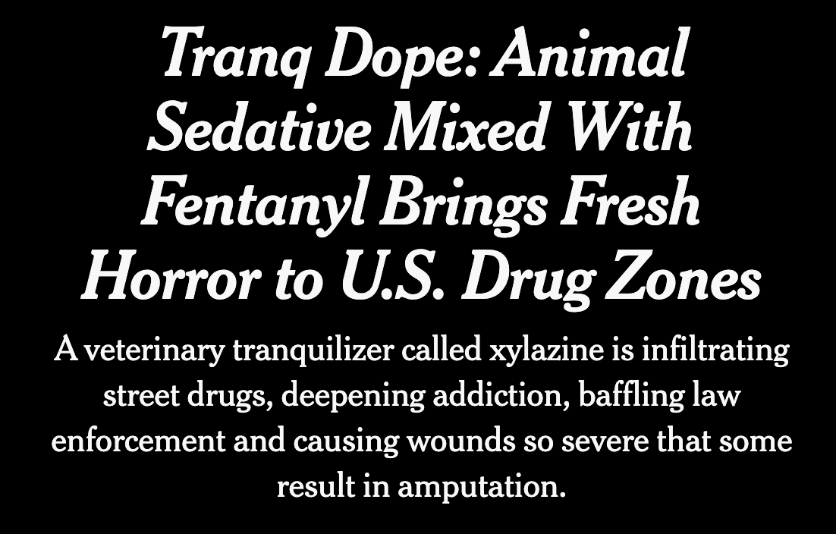
Xylazine is a non-opioid, alpha-2 agonist detected in >98% of unregulated fentanyl in Philadelphia Associated with wounds first in Puerto Rico (early 2000s), recently in continental US with case reports Wounds appear to be distinct from classic wounds associated with IV drug use (eg. cellulitis, abscess) What’s missing: systematic description of xylazine-associated wound location, wound beds, and size
Background
Wound Characteristics Among Patients Exposed to Xylazine
AMERSA 2024 I Lutz et al. 2024, JAMA Dermatology | llutz3@jh.edu
Notes:
Non-opioid alpha 2 agonist increasingly found as an adulterant in the illicit fentanyl supply
In Philly, in >98% of unregulated fentanyl. Gives fentanyl “legs” (demand driven adulteration)
First in PR, now here and gaining attention
PWUD and clinicians note distinctions from wounds associated with IV drug use, often far from injection site - cellulitis, abscesses, scars, “track marks”
I learned about xylazine as tranq through outreach work in Kensington

Slide 4
Aim: To systematically characterize wounds among hospitalized patients with confirmed xylazine exposure Design & Setting: Case series of ED and hospitalized patients at 3 urban academic hospitals in Philadelphia from April 2022 – February 2023 Inclusion Criteria: Xylazine in urine & wound-related ED chief complaint *Xylazine testing ordered at clinician discretion using Penn lab GC-MS
Methods: Aim & Design
Wound Characteristics Among Patients Exposed to Xylazine
AMERSA 2024 I Lutz et al. 2024, JAMA Dermatology | llutz3@jh.edu

Slide 5
Methods: Wound Description
For patients with multiple wounds, we selected the 3 largest wounds We abstracted data from Epic into REDCap with a structured codebook:
1. Location & Size: small (<1 cm²), medium (1 cm² – hand), large 2. Wound bed & exposed deep structures
3. Patient-reported chronicity: acute (<1 mo), subacute (1-3 mo), chronic 4. Other: Signs of infection, hospitalization outcomes
Wound Characteristics Among Patients Exposed to Xylazine
AMERSA 2024 I Lutz et al. 2024, JAMA Dermatology | llutz3@jh.edu

Slide 6
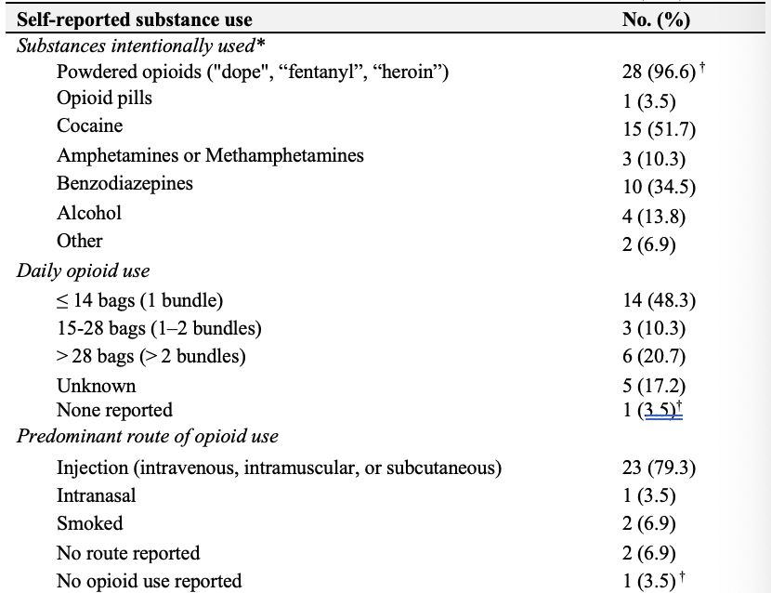
Results: Patient Population
Number of patients: n=29
Mean age 39.4 years, 52% male 90% insured by Medicaid 55% unstably housed
97% reported opioid use, 100% tested positive for opioid exposure
Number of wounds: n=59
87% (of 39 with patient-reported etiology) started at injection site
Wound Characteristics Among Patients Exposed to Xylazine
AMERSA 2024 I Lutz et al. 2024, JAMA Dermatology | llutz3@jh.edu
Notes:
29 patients – most Medicaid, majority w/ unstable housing
All with opioid exposure
59 wounds
87% of those who reported etiology started at injection site; however some explicitly clarified wounds far from injection or at sites of previous trauma

Slide 7
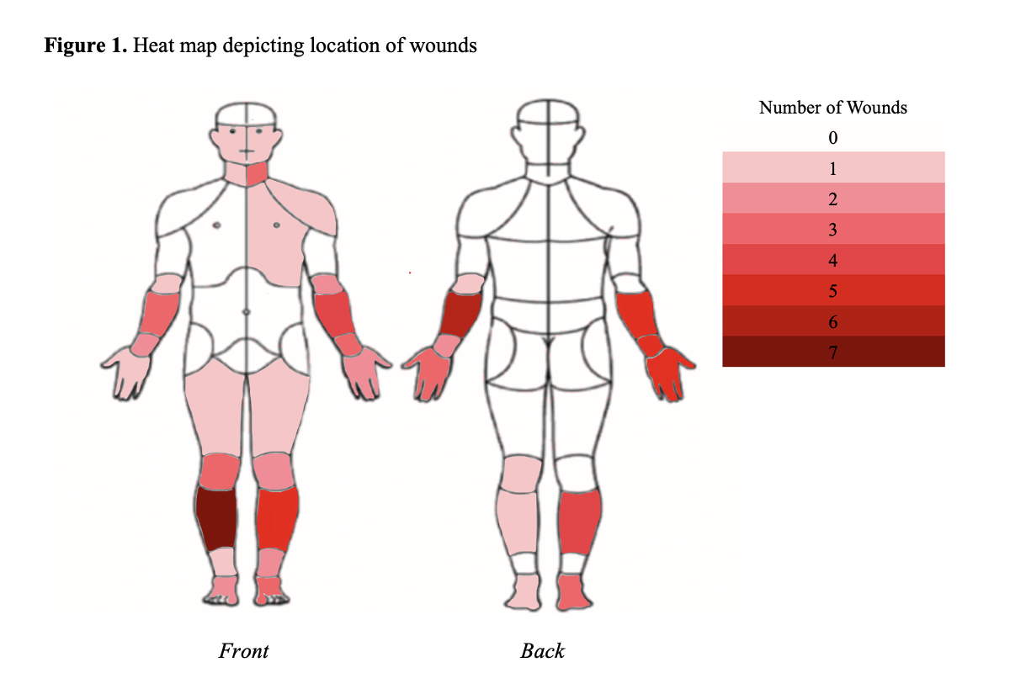
90% of wounds involved the extremities 70% of wounds involved the extensor surfaces of extremities 24% were large (>size of a hand), 56% medium (1cm² - a hand), and 20% small (<1cm²)
Results: Wound Location & Size
Heat map of common wound locations
Wound Characteristics Among Patients Exposed to Xylazine
AMERSA 2024 I Lutz et al. 2024, JAMA Dermatology | llutz3@jh.edu

Slide 8
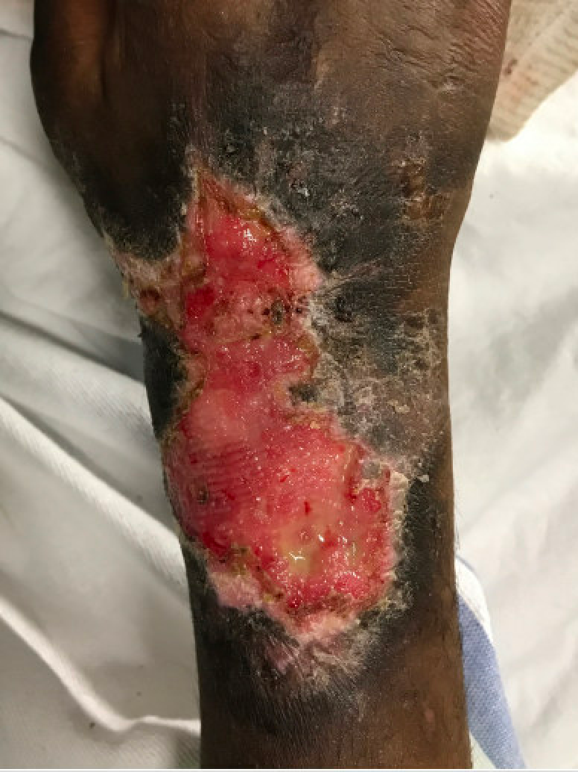
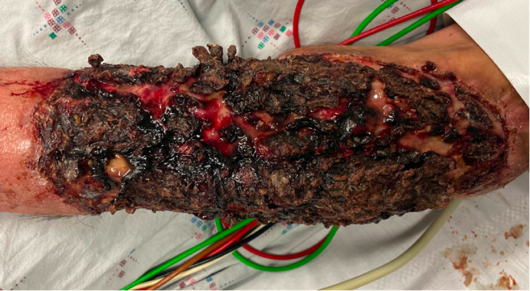
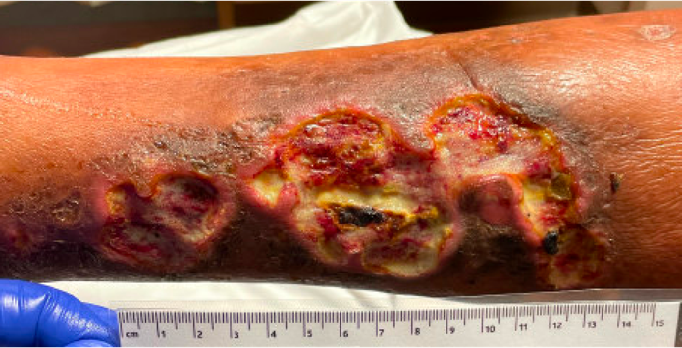
Results: Wound Bed Characteristics
Devitalized (eschar)
Blister
Granulation
Mixed: eschar, granulation, slough
Wound Characteristics Among Patients Exposed to Xylazine
AMERSA 2024 I Lutz et al. 2024, JAMA Dermatology | llutz3@jh.edu
Silva-Torres (2014), Gaertner (1987), Störchle (2018), Lee (2002), Nagle (2024), Nichols (2015), Metcalf (2013)
Notes:
60% of wound beds demonstrated a high burden of devitalized tissue (eschar and/or slough)
63% single wound area; 37% multifocal
8% with exposed deeper structures
58% erythema, 25% purulence, 31% without either sign of infection

Slide 9
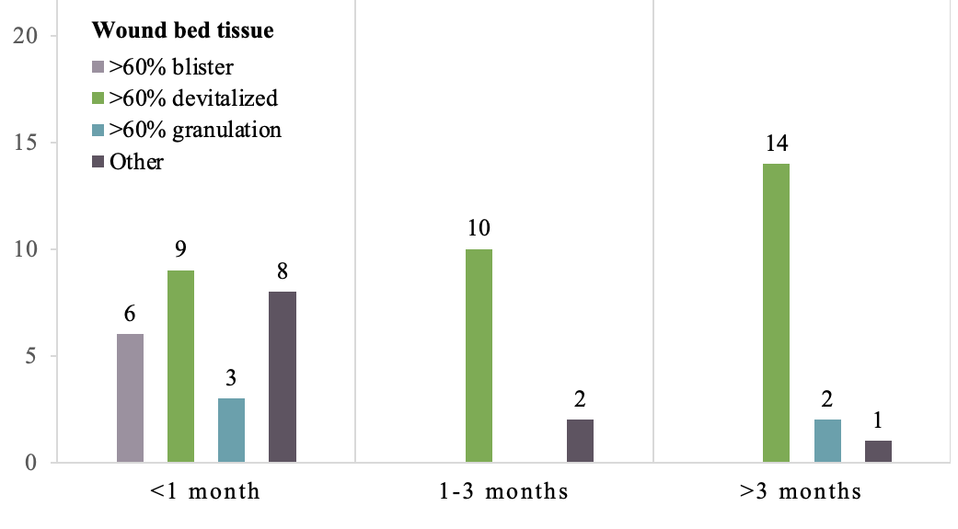
Chronicity: 48% <1mo, 20% 1-3mo, 29% >3mo, 3% not reported
Results: Patient-Reported Chronicity
Subacute or chronic wounds more frequently had devitalized wound beds (OR 9.5; 95% CI 2.9-37.0 using Fischer exact test)
Wound Characteristics Among Patients Exposed to Xylazine
AMERSA 2024 I Lutz et al. 2024, JAMA Dermatology | llutz3@jh.edu
Notes:
Subacute or chronic wounds more frequently had devitalized wound beds

Slide 10
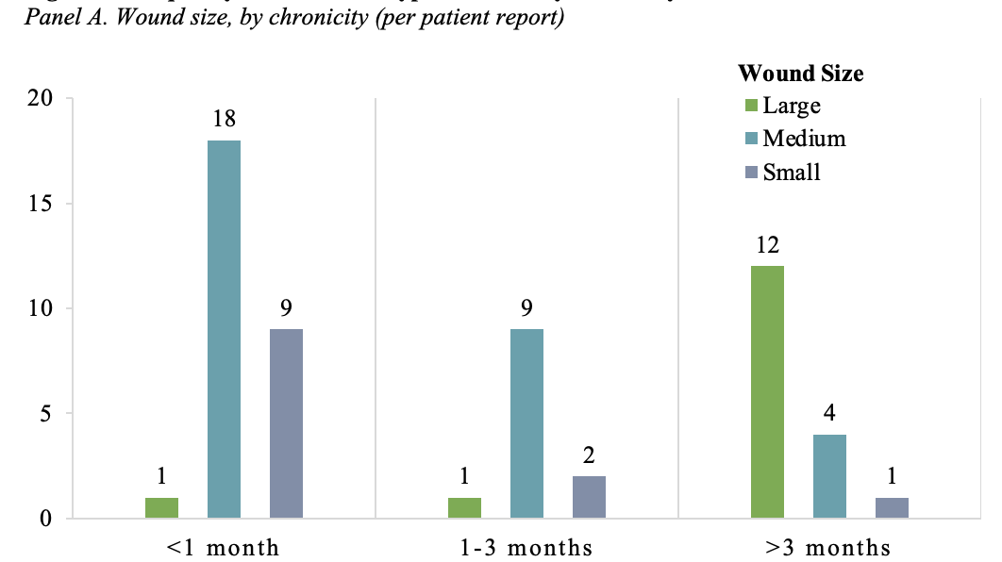
Chronicity: 48% <1mo, 20% 1-3mo, 29% >3mo, 3% not reported
Results: Patient-Reported Chronicity
Subacute or chronic wounds were more often medium or large, compared to acute wounds
(OR 48.5; 95% CI 8.2-1274.8)
Wound Characteristics Among Patients Exposed to Xylazine
AMERSA 2024 I Lutz et al. 2024, JAMA Dermatology | llutz3@jh.edu
Notes:
Subacute or chronic wounds were more often medium or large, compared to acute wounds
Devitalized tissue was more common in medium or large wound beds

Slide 11
- Limbs as common sites of injection, possibly implicating local tissue injury and direct cytotoxicity - Vasoconstrictive properties resulting in tissue hypoperfusion - Thin dermis and hypodermis of extensor limb surfaces may be more prone to injury
- Physical barriers to epithelialization - Pro-inflammatory biofilms inhibiting healing
Clinical Experience With Xylazine Wounds
Xylazine wounds do not exclusively occur at sites of injection. They are also found in patients who do not inject fentanyl/dope.
The care of patients suffering from these wounds is multi-disciplinary and resource-intensive, requiring attention to social determinants (e.g. housing); however, these wounds can heal.
Wound Characteristics Among Patients Exposed to Xylazine
AMERSA 2024 I Lutz et al. 2024, JAMA Dermatology | llutz3@jh.edu
McFadden (2024)
Notes:
Limbs are common sites of injection.
Local tissue injury and direct cytotoxicity?
Vasoconstrictive properties of xylazine?
Thin dermis and hypodermis of extensor limb surfaces may be more prone to injury?

Slide 12
Strengths: largest case series to date, confirmed xylazine exposure, systematic characterization of wounds
- Physical barriers to epithelialization - Pro-inflammatory biofilms inhibiting healing
Strengths, Limitations, and Conclusions
Conclusions: for people exposed to xylazine, wounds were commonly located on extensor surfaces of the extremities and wound chronicity was associated with larger wounds with a greater burden of devitalized tissue
Limitations: retrospective design, single clinical encounter, 3 largest wounds, need to maintain a broad differential for the etiology of these wounds
Next steps: prospective, longitudinal research with (serial) biopsies & cultures
Wound Characteristics Among Patients Exposed to Xylazine
AMERSA 2024 I Lutz et al. 2024, JAMA Dermatology | llutz3@jh.edu
Silva-Torres (2014), Gaertner (1987), Störchle (2018), Lee (2002), Nagle (2024), Nichols (2015), Metcalf (2013)
Notes:
Besides xylazine-associated ulcers, the differential diagnosis for wounds with devitalized, granulation, or mixed tissue wound beds includes chronic ulcers seen in the setting of pyoderma gangrenosum, venous stasis, vasculitis, vasculopathy, or atypical infections. Blisters could be seen in ecthyma, herpetic whitlow, and mpox infection, as well as neutrophilic dermatoses such as Sweet syndrome and neutrophilic dermatosis of the dorsal hands
Strengths: chronic exposure, Philly as epicenter, size of case series
Limitations:
Lack of utility of negative predictive value preventing comparison of wounds in patients with and without xylazine exposure
Review of a single chart encounter precludes a fuller understanding of the clinical course and natural history of these wounds
Bias toward choosing larger and more severe wounds
Did not capture patient experiences with wounds (pain, loss of function, stigma, discrimination, barrier to receiving other care)

Slide 13
Lutz, L., McFadden, R., Xu, L., Bhatia, R., Davis, M.H., Rohacs, N., Wei, J., Perrone, J., Lowenstein, M., and Thakrar, A. Xylazine-Associated Wound Characteristics Among Hospitalized Patients: A Case Series. JAMA Dermatology. Published online November 13, 2024. D’Orazio J, Nelson L, Perrone J, Wightman R, Haroz R. Xylazine adulteration of the heroin–fentanyl drug supply: a narrative review. Ann Intern Med. 2023;176(10):1370-1376. doi:10.7326/M23-2001 McFadden R, Wallace-Keeshen S, Petrillo Straub K, et al. Xylazine-associated wounds: clinical experience from a low-barrier wound care clinic in philadelphia. J Addict Med. 2024;18(1):9-12. doi:10.1097/ADM.0000000000001245 O’Neil J, Kovach S. Xylazine-associated skin injury. N Engl J Med. 2023;388(24):2274-2274. doi:10.1056/NEJMicm2303601 Rodríguez N, Vargas Vidot J, Panelli J, Colón H, Ritchie B, Yamamura Y. GC–MS confirmation of xylazine (Rompun), a veterinary sedative, in exchanged needles. Drug and Alcohol Dependence. 2008;96(3):290-293. doi:10.1016/j.drugalcdep.2008.03.005 Reyes JC, Negrón JL, Colón HM, et al. The emerging of xylazine as a new drug of abuse and its health consequences among drug users in puerto rico. J Urban Health. 2012;89(3):519-526. doi:10.1007/s11524-011-9662-6 Torruella RA. Xylazine (Veterinary sedative) use in puerto rico. Subst Abuse Treat Prev Policy. 2011;6(1):7. doi:10.1186/1747-597X-6-7 CFSRE: The Center for Forensic Science Research & Education, NPS Discovery, City of Philadelphia Department of Public Health. Drug Checking Report: Q3 2022. Accessed December 16, 2022. https://www.cfsre.org/nps-discovery/drug-checking/drug-checking-q3-2022-philadelphia-pennsylvania-usa3. Hoffman RS. Closing the xylazine knowledge gap. Clinical Toxicology. 2023;61(12):1013-1016. doi:10.1080/15563650.2023.2294619 Nagle SM, Stevens KA, Wilbraham SC. Wound assessment. In: StatPearls. StatPearls Publishing; 2024. Accessed March 25, 2024. http://www.ncbi.nlm.nih.gov/books/NBK482198/
References
Wound Characteristics Among Patients Exposed to Xylazine
AMERSA 2024 I Lutz et al. 2024, JAMA Dermatology | llutz3@jh.edu

Slide 14
Nichols E. Describing a Wound: From Presentation to Healing. Wound Essentials. 2015;10(1):56-61. Silva-Torres LA, Vélez C, Lyvia Alvarez J, Ortiz JG, Zayas B. Toxic effects of xylazine on endothelial cells in combination with cocaine and 6-monoacetylmorphine. Toxicology in Vitro. 2014;28(7):1312-1319. doi:10.1016/j.tiv.2014.06.013 Gaertner DJ, Boschert KR, Schoeb TR. Muscle necrosis in Syrian hamsters resulting from intramuscular injections of ketamine and xylazine. Lab Anim Sci. 1987;37(1):80-83. Störchle P, Müller W, Sengeis M, Lackner S, Holasek S, Fürhapter-Rieger A. Measurement of mean subcutaneous fat thickness: eight standardised ultrasound sites compared to 216 randomly selected sites. Sci Rep. 2018;8(1):16268. doi:10.1038/s41598-018-34213-0 Lee Y, Hwang K. Skin thickness of Korean adults. Surgical and Radiologic Anatomy. 2002;24(3-4):183-189. doi:10.1007/s00276-002-0034-5 Metcalf DG, Bowler PG. Biofilm delays wound healing: A review of the evidence. Burns Trauma. 2013;1(1):5-12. doi:10.4103/2321-3868.113329 Philadelphia Department of Public Health, Division of Substance Use Prevention and Harm Reduction. Recommendations for Caring for Individuals with Xylazine-Associated Wounds.; 2024. https://hip.phila.gov/document/4148/Recommendations_for_Caring_for_People_with _Xylazine-Associated_Wounds_1.12.pdf/ McFadden, R. Xylazine wounds are a growing crisis among drug users in Philly – a nurse explains potential causes and proper treatment. The Conversation. July 24, 2024. http://kinampark.com/DDS/files/McFadden%202024%2C%20Xylazine%20wounds%20are%20a%20growing%20crisis%20among%20drug%20users%20in%20Philly.pdf
References
Wound Characteristics Among Patients Exposed to Xylazine
AMERSA 2024 I Lutz et al. 2024, JAMA Dermatology | llutz3@jh.edu

Slide 15
Wound Characteristics Among Patients Exposed to Xylazine
AMERSA 2024 I Lutz et al. 2024, JAMA Dermatology | llutz3@jh.edu

Slide 16
Extra Slides
Wound Characteristics Among Patients Exposed to Xylazine
AMERSA 2024 I Lutz et al. 2024, JAMA Dermatology | llutz3@jh.edu

Slide 17
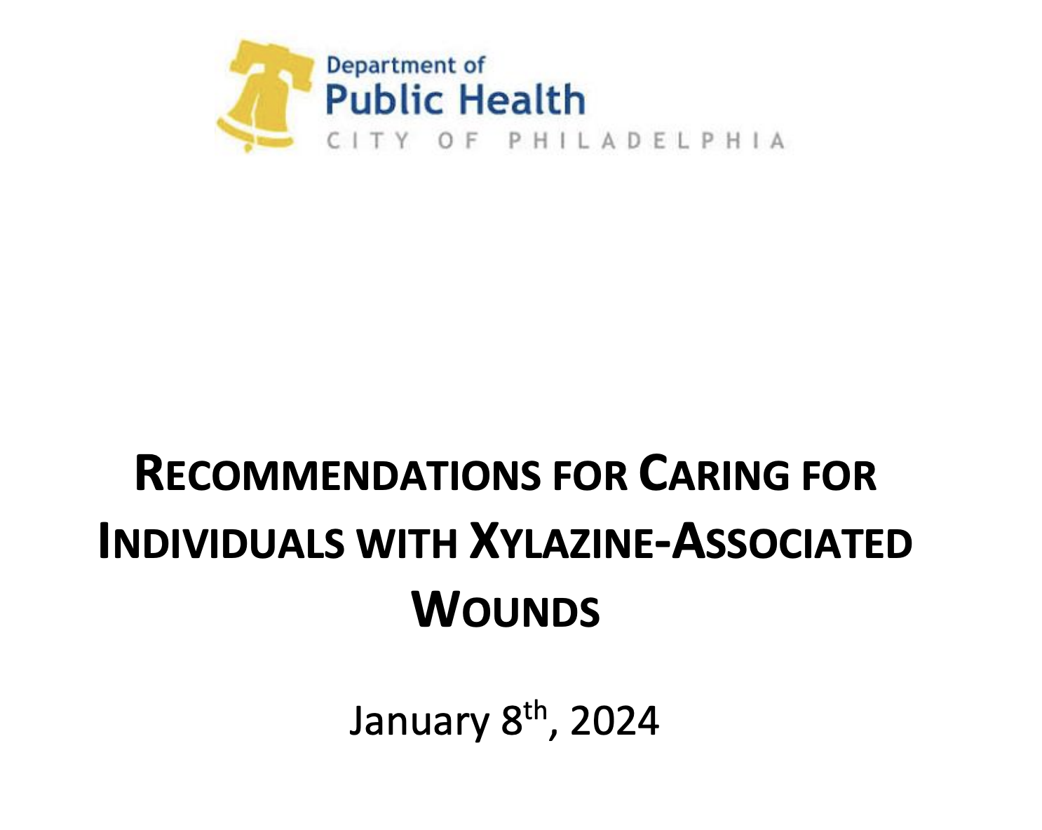
83% admitted, 51% self-directed discharge, 31% re-presented within 30 days 24% underwent surgical debridement or I&D Unlike prior case studies, there were no amputations or grafts, which may reflect changes in clinical practice, especially for harm reduction in the setting of ongoing drug use For 10% of patients, there was documentation that surgical interventions were not pursued secondary to ongoing use
Results: Clinical Course
Wound Characteristics Among Patients Exposed to Xylazine
AMERSA 2024 I Lutz et al. 2024, JAMA Dermatology | llutz3@jh.edu
Philadelphia Department of Public Health (2024), McFadden (2024)

Slide 18
Xylazine wounds are commonly found on distal, extensor surfaces of the extremities. Limbs are common sites of injection. Local tissue injury and direct cytotoxicity? Vasoconstrictive properties of xylazine? Thin dermis and hypodermis of extensor limb surfaces may be more prone to injury?
- Physical barriers to epithelialization - Pro-inflammatory biofilms inhibiting healing
Discussion: Wound Distribution & Evolution
These wounds may progression from small multifocal blisters to larger confluent areas of devitalized eschar and slough. Devitalized tissue results in a physical barrier to epithelialization. Pro-inflammatory biofilms inhibit healing of devitalized wounds.
Wound Characteristics Among Patients Exposed to Xylazine
AMERSA 2024 I Lutz et al. 2024, JAMA Dermatology | llutz3@jh.edu
Silva-Torres (2014), Gaertner (1987), Störchle (2018), Lee (2002), Nagle (2024), Nichols (2015), Metcalf (2013)

