Slide 1
Xylazine in the Illicit Drug Supply A Need for Responsive Educational Models
2023 AMERSA National Conference
11/4/2023
Raagini Jawa MD, MPH, FASAM
Infectious Disease-Addiction Medicine
Assistant Professor of Medicine
Center for Research on Healthcare, University of Pittsburgh
Clinical Harm Reduction Specialist, Grayken Center for Addiction
jawar@upmc.edu
@Raaginizzle
Stephen Murray MPH, NRP
Harm Reduction Program Manager
Director, Massachusetts Overdose Prevention Helpline
Boston Medical Center
Stephen.murray@bmc.org
@stephenHRNRP
Notes:
14 slides

Slide 2
Disclosures, Funding, Acknowledgement
Presentation co-authors: Samantha Blakemore MPH, Tavi Hristova, Alexa Wilder, MPH, Margaret Shang MD, Alicia S. Ventura MPH, Colleen LaBelle MSN, RN-BC, CARN
None of the presenters have any relevant financial or other conflicts of interest to disclose relating to this presentation
Funding: NIDA K12DA050607 (RJ), MA Department of Public Health Bureau of Substance Addiction Services INTF2330M04500824223 (TTA)
Our sincere gratitude to the persons who use drugs, front-line harm reduction organizations, advocates and clinicians, health department epidemiologists, drug checking labs, and researchers who made the background for our program possible.
SM
Notes:
SM

Slide 3
Learning Objective
Describe the impact of a novel virtual xylazine training targeting a diverse group of professionals working with people who use drugs
SM
Notes:
SM

Slide 4
Background
1962
Xylazine FDA approved for veterinary use
Early 2000s
Adulterant in heroin: Puerto Rico
2019
2021
Sporadic detection in Northeast region
↑ Xylazine in illicit opioid supply
↑ Reports of clinical harms
Lack of accessible xylazine provider education and information needed to reduce harms
7/2022
Xylazine Training & Technical Assistance begins
SM
Notes:
SM
Novel adulterants and synthetic substances are rapidly infiltrating the United States’ (US) and international drug supply. The shifting drug landscape in the US has resulted in more people accessing an increasingly dangerous and unregulated drug supply. US efforts to reduce the over prescription of opioids compounded by increased pressure from law enforcement has led to shifts in the drug market and forced people to seek illicit sources which are at risk of adulteration. Fentanyl, a potent synthetic opioid, was initially an adulterant,¹ but has now largely replaced heroin as the dominant illicit opioid in the US,² causing an exponential rise in fatal overdoses and other drug-related harms. As the addiction care community continues to navigate the challenges posed by fentanyl, the nation must now adapt to yet another emerging substance, xylazine, contaminating the drug supply.
Xylazine, a veterinary tranquilizer, was initially identified as an adulterant to heroin in Puerto Rico during the early 2000s³ and was intermittently detected in the illicit drug supply prior to 2019.^{4,5} Since then, xylazine adulteration has expanded across the US at an alarming rate, its presence now greatest in the Northeast, with over 90% of recent opioid drug samples in Philadelphia testing positive.⁶ From January 2019 to June 2022, deaths involving fentanyl combined with xylazine increased by 276%,⁷ leading the Office of National Drug Control Policy to declare xylazine-fentanyl an “emerging national drug threat” in April 2023.⁸ However, due to inadequate national surveillance of the drug supply and lack of accessible low-barrier drug checking services, awareness of evolving drug trends are frequently unknown,⁹ and awareness develops only after noticeable patterns of new or amplified drug-related harms appear¹⁰ and the raising of alarms by people who use drugs and harm reductionists.
In fact, as early as 2020, frontline harm reduction organizations began reporting upticks in “bad bags” to alert their clientele to a potential new danger, and professionals caring for people who use drugs (PWUD) began publishing limited reports on clinical harms associated with xylazine use,¹¹⁻¹³ including withdrawal, prolonged sedation, and chronic wounds.¹¹ However, despite growing concerns among PWUD and those directly interacting with them, there was a lack of accessible provider training about xylazine and its clinical implications in the care for PWUD. To bridge this critical gap, we describe our experience and lessons learned leveraging an existing training and technical assistance (TTA) model to develop and conduct responsive xylazine education to a wide range of health care professionals and provide recommendations for future educational initiatives.

Slide 5
Program Description
Leverage existing Grayken Center for Addiction Training and Technical Assistance (TTA) program
July 2022 developed an one-hour virtual session on xylazine
RJ
Notes:
rj
We tailored the training to be applicable to a multidisciplinary audience. While the training format did not change significantly over time, the content was updated monthly as new research and data sources on xylazine became available. These adaptations included availability and use of commercially available xylazine test strips (XTS),¹⁴ modified overdose prevention and response strategies, novel xylazine withdrawal protocols,¹⁵ and wound care best practices.¹⁶ The adaptive training content also allowed us to provide a counter-narrative to rampant media misinformation, stigma, and fear regarding xylazine,¹⁷ advocate for necessary policy changes, and discuss areas for future research while providing pragmatic strategies for professionals to implement in their practice, including low-barrier distribution of XTS and development of clinical protocols for management.

Slide 6
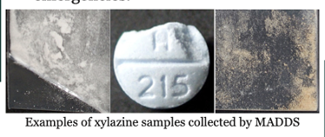
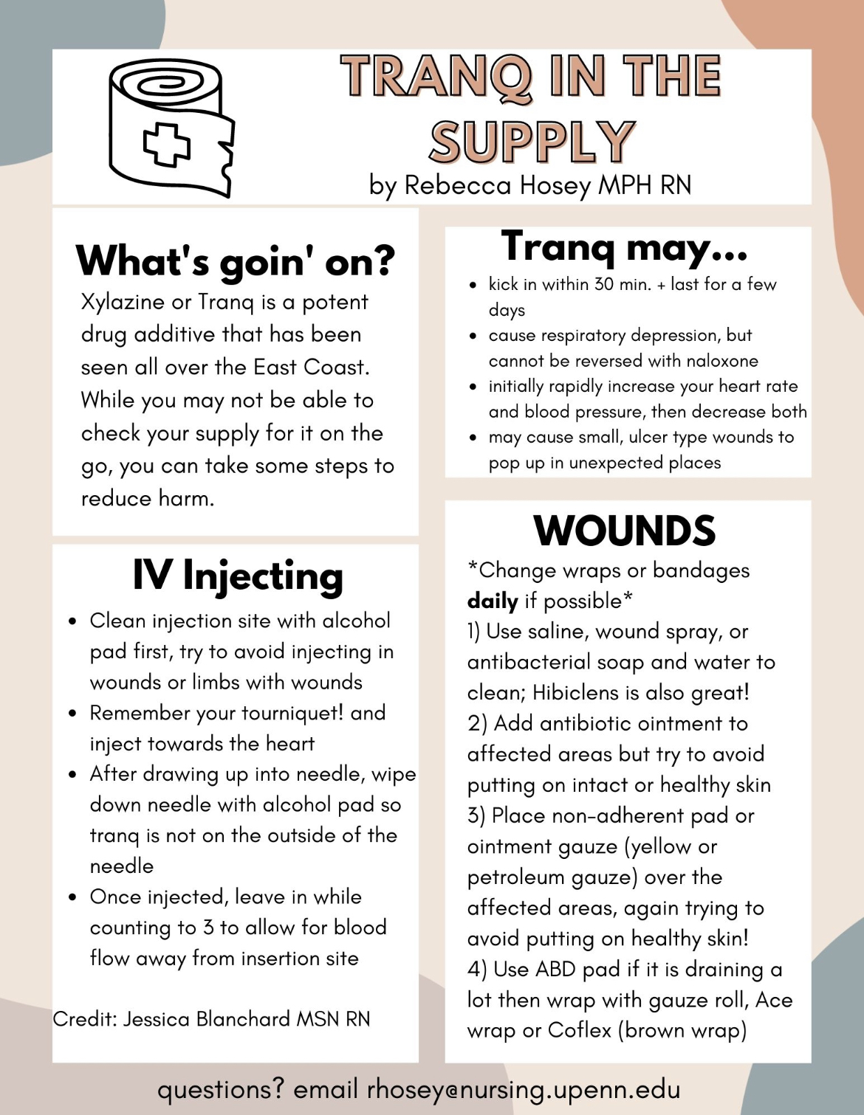
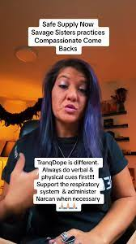
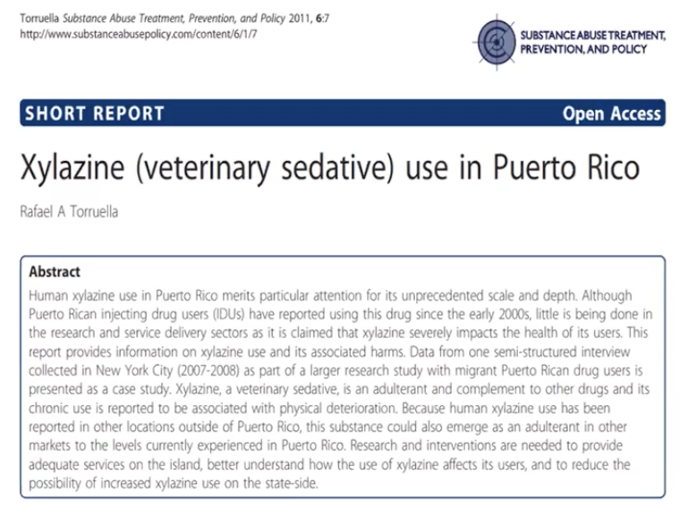
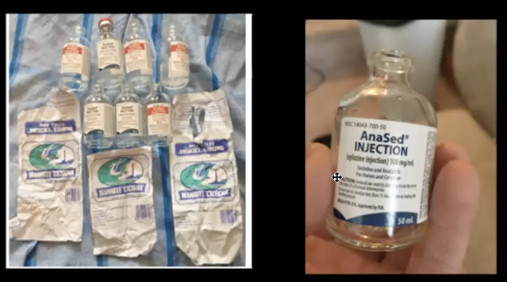
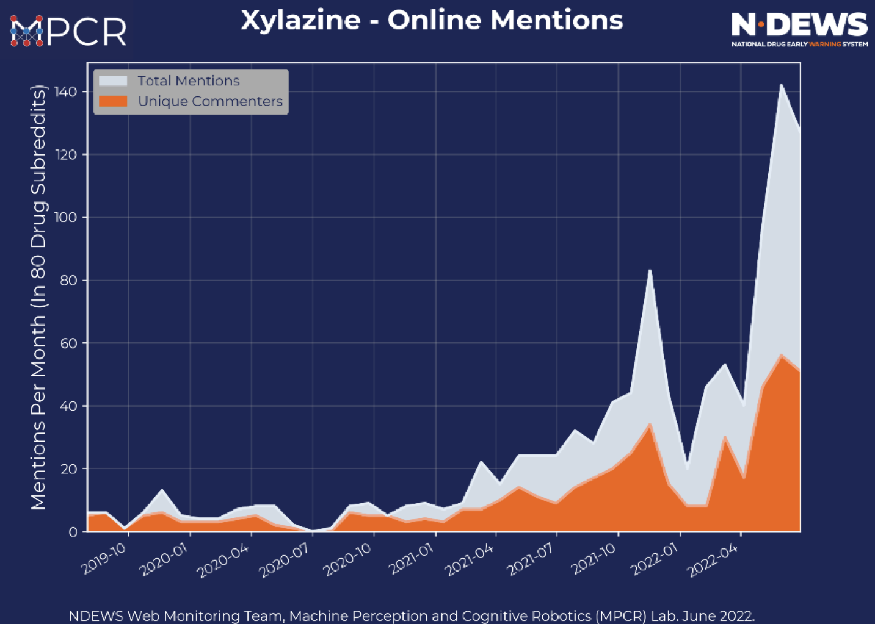
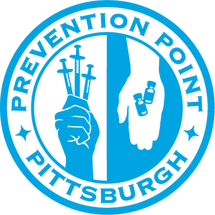
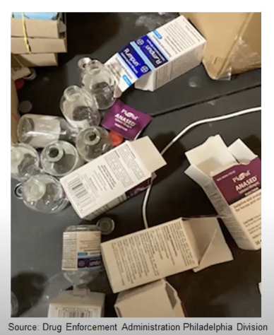
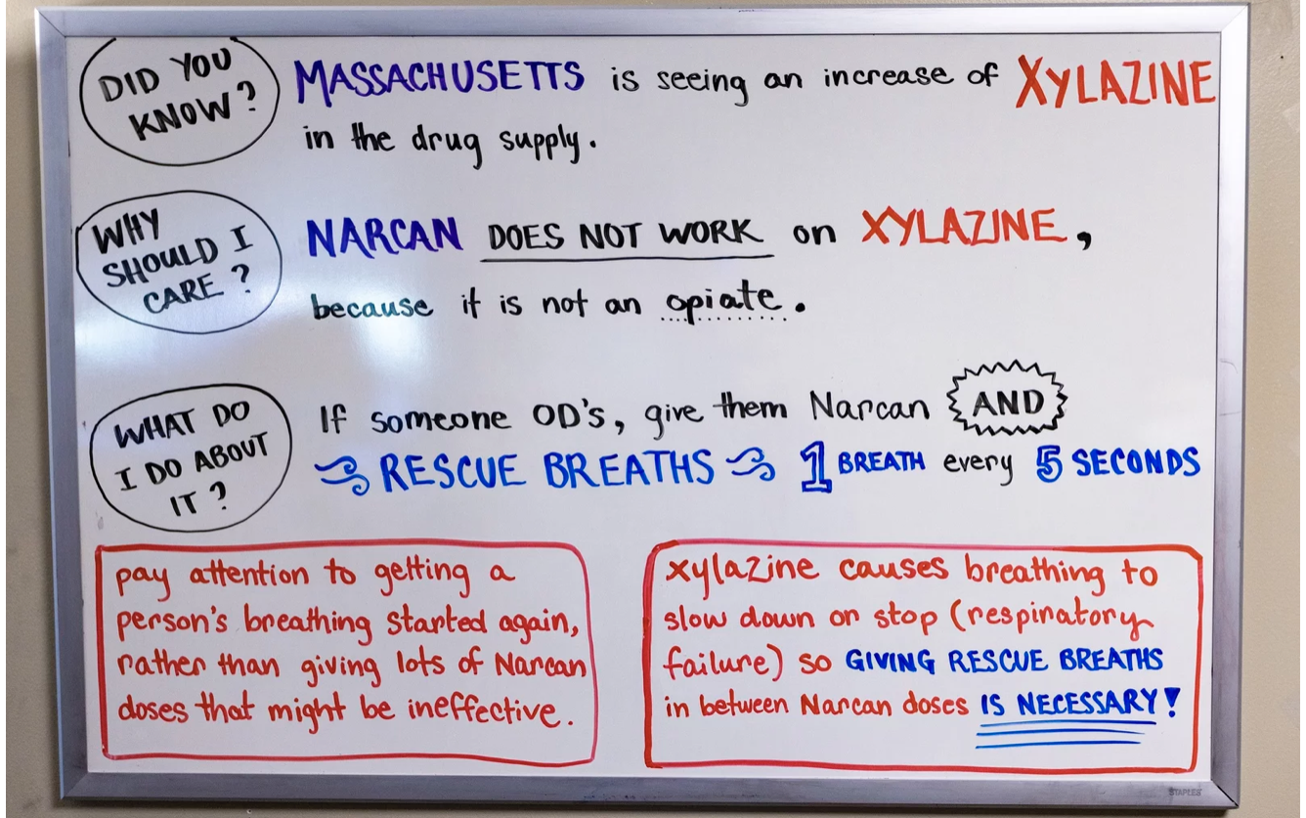
Notes:
Rj
need for education on xylazine related harms came from clinician reports in 2022 of suspected xylazine in the illicit drug supply due to patients presenting with atypical extremity wounds at a skin and soft tissue infectious disease clinic. Grayken TTA immediately partnered with an addiction medicine and infectious disease clinician who worked alongside the team’s harm reduction specialist with lived experience to develop xylazine-specific training content. From July to September 2022, the team, led by these topic experts, developed a training for addiction professionals to help mitigate the harms related to increased presence of xylazine in the drug supply. Due to limited published domestic and international literature, we relied heavily on non-traditional sources of information. These included Drug Enforcement Administration and local drug checking reports, scanning social media content (i.e., Reddit forums, YouTube, Twitter, news alerts, etc.), and consultations with PWUD, frontline providers, harm reduction organizations, wound care nurses, and other relevant experts in high prevalence to understand xylazine’s clinical effects and harms and to determine appropriate harm reduction responses.

Slide 7
Program Description
Leverage existing Grayken Center for Addiction Training and Technical Assistance (TTA) program
July 2022 developed an one-hour virtual session on xylazine
The training objectives:
Introduce xylazine as an adulterant
Review xylazine-associated harms
Introduce harm reduction and clinical strategies related to xylazine use
RJ
Notes:
Rj
Monthly trainings co-led by an Addiction medicine clinician and a harm reduction specialist with lived experience
We tailored the training to be applicable to a multidisciplinary audience. While the training format did not change significantly over time, the content was updated monthly as new research and data sources on xylazine became available. These adaptations included availability and use of commercially available xylazine test strips (XTS),¹⁴ modified overdose prevention and response strategies, novel xylazine withdrawal protocols,¹⁵ and wound care best practices.¹⁶ The adaptive training content also allowed us to provide a counter-narrative to rampant media misinformation, stigma, and fear regarding xylazine,¹⁷ advocate for necessary policy changes, and discuss areas for future research while providing pragmatic strategies for professionals to implement in their practice, including low-barrier distribution of XTS and development of clinical protocols for management.

Slide 8
Prolonged sedation
Xylazine associated
overdose
Xylazine associated wounds
Extended immobility = ↑risk:
Blood clots, soft tissue, muscle and nerve damage
Environmental Injury
Harm reduction strategies:
Sit/lay down in a safe place after using
Place in recovery position, avoid atypical positions
Administer naloxone!!
Place in recovery position
Wait 2-3 minutes, redoes if needed
Supportive field management until sedation wears off:
Rescue breathing
Continuous pulse oximetry, supplemental O2
Rotating positions
Range in presentation, injection and non-injection sites
Healing with low-barrier wound care
Framework for wound care:
Evaluate for infection
Cleanse
Moisturize/Medicate
Cover/ wrap
SM
Notes:
Sm
the pre-training non-traditional research you did then I would say include and reference as such.

Slide 9
Evolving landscape
7/2022
Xylazine Training and Technical Assistance begins
FDA alerts Healthcare professionals of Xylazine risks
10/2022
DEA Joint Intelligence Report: Xylazine
11/2022
3/2023
Xylazine Test Strips Available
4/2023
Fentanyl-Xylazine Designated U.S. Emerging Threat
7/2023
ONDCP releases National Plan
RJ
Notes:
Rj
Evolving landscape = adapting content to incorporate new data, alerts, research, and address the rise in misinformation/stigma, glaring need for public health messenging and deliverables

Slide 10
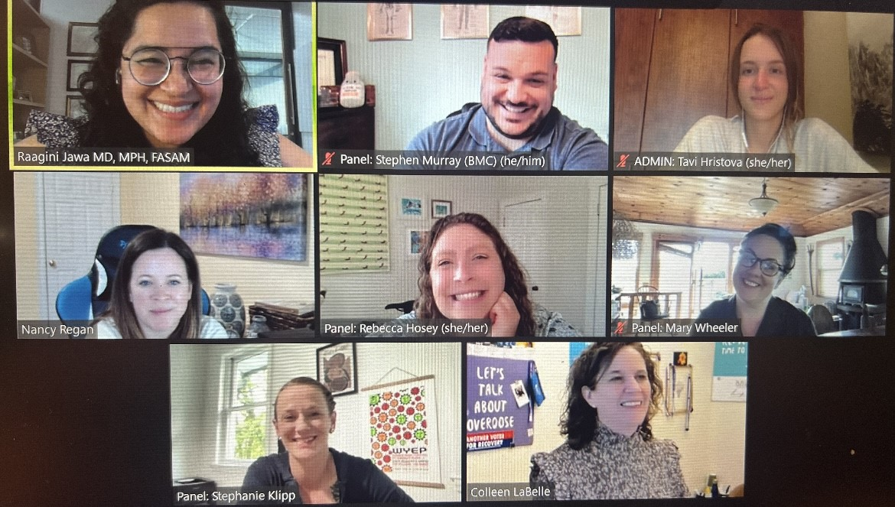
Diversity, Equity, Inclusion
Educational material was created with intent to apply to wide audiences
Proactive involvement of front-line harm reduction experts and persons with lived experienced was essential
Adaptive education included bidirectional feedback, open attendance, and equitable partnerships with all persons involved
RJ
Notes:
rj

Slide 11
Methods
Participants completed a post-training survey that asked, “How did this program affect professional development, clinical practice, or patient outcomes?”
Demographic data from the registration system were analyzed to assess program reach, and post-training survey responses were coded and analyzed using inductive thematic analysis.
Requests for TTA related to xylazine were summed.
RJ
Notes:
rj

Slide 12
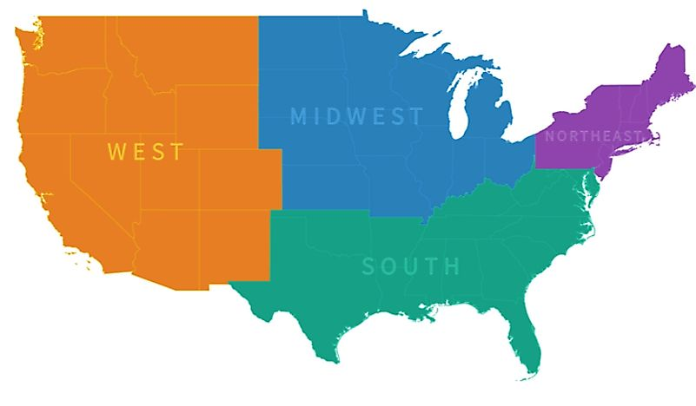
Xylazine Training Reach October-July 2023 (n=2,312)
Total trainings: 14
Mean participants/training: 184 (range 98-295)
Geography: 88% Urban, 10% Rural
Primary Professional Credential | n (%)
Nurse | 510 (22)
Recovery Support/Peer | 485 (21)
Mental Health Professional | 362 (16)
Advanced Practice Provider | 220 (10)
Physician | 139 (6)
Master of Public Health | 92 (4)
Allied Health Professional | 73 (3)
Student | 52 (2)
Pharmacist | 44 (2)
None | 186 (8)
Other | 149 (6)
Functional Role | n (%)
Clinical | 1,228 (53)
Administration/Management | 394 (17)
Community/Outreach | 295 (13)
Academia/Research | 201 (9)
Recovery Support | 143 (6)
Other | 51 (2)
14%
12%
61%
12%
<1% International
Jawa et al. 2023 Under review
RJ
Notes:
rj
The first xylazine training was in October 2022; due to high national demand we continued offering this training once or twice per month. Over a 10-month period, we conducted a total of 14 public virtual instructor-led training sessions, with a median of 182 (IQR 153, 208) attendees per session and a total of 2,312 unique attendees. As part of a quality improvement initiative, we analyzed participant geographic and occupation data from the registration system to assess training reach.
Based on pre-registration demographic data, participants represented 49 of 50 states, with 61% from the Northeast region (Table 1). Most participants were practicing in an urban region (88.2%), which we defined using the provided zip code and Rural-Urban Commuting Area classifications created by the US Department of Agriculture, Economic Research Service. Slightly more than half (53.1%) of participants were working in a clinical role. There was significant diversity in attendees’ professional backgrounds, ranging from clinicians to harm reduction organization personnel to persons with lived experience. Over the course of our trainings, we received over 22 requests for organization specific training and technical assistance (TTA) from a wide range of sources, primarily from the northeast. Approximately 50% (n=1,253) of unique participants completed the optional post-training evaluation. Most respondents indicated increased knowledge, satisfaction with the training, and intent to change their practice. Ninety-six percent of survey respondents completed a free text response to the question, “How did this program/course affect professional development, clinical practice, or patient outcomes?” The responses included three primary themes: (i) intention to provide education about xylazine to patients, colleagues, and the community, (ii) increased understanding and recognition of xylazine-associated harms, and (iii) increased confidence in managing sequelae of xylazine exposure (e.g., appropriate wound care, overdose response, and withdrawal management).

Slide 13
“How did this program/course affect professional development, clinical practice, or patient outcomes?”
Intention to provide education about xylazine to patients, colleagues, and community
Increased understanding and recognition of xylazine-associated harms
Increased confidence managing sequelae of xylazine (e.g., appropriate wound care, overdose response, and withdrawal management)
Jawa et al. 2023 Under review
SM
Notes:
Sm
Post-training Evaluation (n=1,253)
I would just say when you present this that participants overwhelmingly reported satisfaction with the training and knowledge gain as a result.

Slide 14
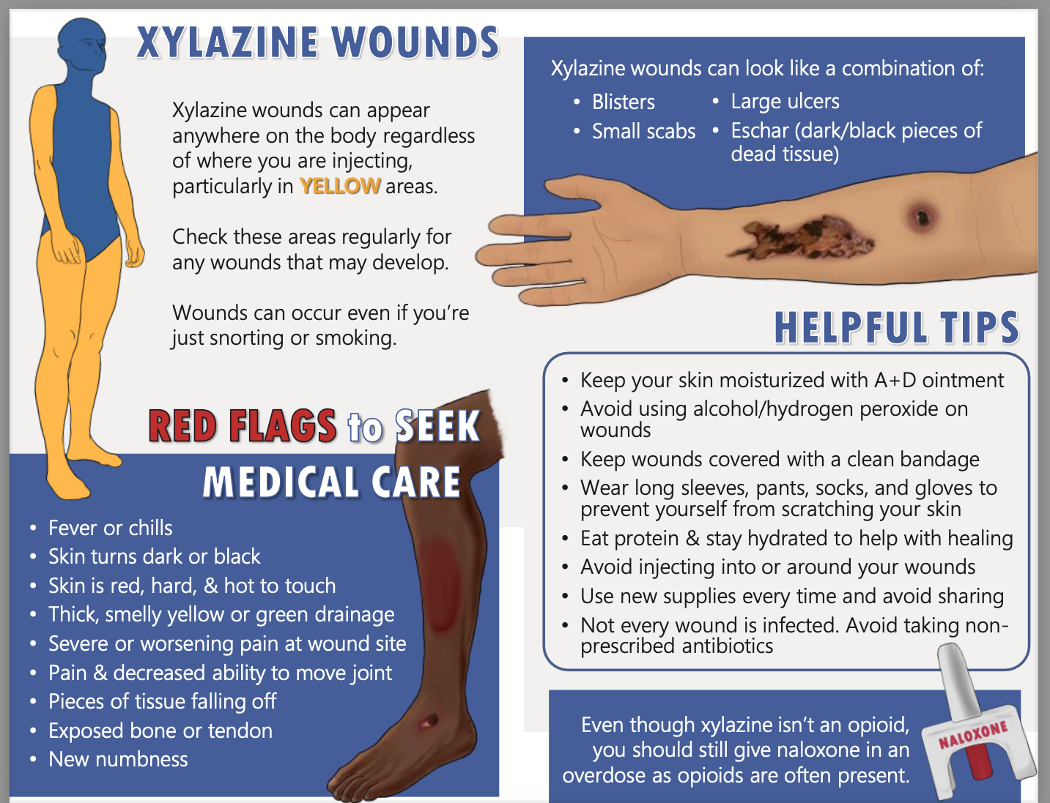
Identified needs
RJ
Notes:
RJ
Shout out Maggie and Sam
Xylazine training identified needs that robust TTA infrastructure was able to help address through other materials and formats.

Slide 15
Additional requests for organization specific xylazine training and technical assistance (TTA)
Selection of agencies requesting xylazine TTA
Local police and fire departments
High Intensity Drug Trafficking Areas programs
Front-line correctional and court probation officers
Local hospitals and substance use disorder programs
Community health centers
Harm reduction learning collaboratives
Providers Clinical Support System
Emergency medical services
RJ
Notes:
RJ
Additional requests for organization specific xylazine training and technical assistance (TTA)" State TTA program received >50 requests during time period.

Slide 16
Conclusions
Leveraging existing TTA infrastructure allowed us to disseminate information and create additional educational materials.
Adaptive model was critical to continuously update educational content, counter mis-information and disseminate pragmatic harm reduction strategies.
Interest in training content from participants without traditional medical backgrounds required educational resources to consider all potential audiences.
Increased training to physicians and other difficult to reach professionals, such as rural providers, and those not generally in engaged in addiction work may require targeted outreach.
RJ
Notes:
RJ
Professionals require education that mirrors the rapidly changing drug supply to address and mitigate drug-related harms
Leveraging existing TTA infrastructure with broad reach allowed us to easily disseminate information and create additional educational materials
Don't need to wait for peer-reviewed, scientific literature to respond to emerging threats and new drug-related harm
Non-traditional sources of information, as well as relevant existing clinical protocols, can be used to provide responsive educational content in a timely manner
Flexibility needed to continuously update educational content, counter mis-information and disseminate pragmatic harm reduction strategies
Interest in training content from participants without traditional medical backgrounds requires educational resources consider all potential audiences
Increased training to physicians and other difficult to reach professionals, such as rural providers, may require targeted outreach

Slide 17
Thank You!!
People who assisted with trainings:
Rebecca Hosey RN, BSN, MPH University of Pennsylvania Perelman School of Medicine
Stephanie Klipp RN, CARN, CAAP, CRS; Wound RN Specialist & Community Harm Reduction Nurse,
Mary Wheeler Program Director Healthy Streets Outreach, Lynn, MA
Tehya Johnson, RN, BSN, AGPCNP-BC, Boston Health Care for the Homeless Program
People who informed content development:
Grayken Center for Training and Technical Assistance
University of Pittsburgh Center for Research in Healthcare
Alice Bell, LCSW, Prevention Point Pittsburgh
Rebecca Hosey, Prevention Point Philadelphia
Jen Shinefeld, MS, City of Philadelphia, Dpt of Public Health
Dr Jennifer J. Carrol PhD, MPH, North Carolina State University
Dr. Nabarun Dasgupta PhD, MPH, UNC Street Drug Analysis Lab
Christopher Moraff, Journalist in Philadelphia, PA
Sarah Laurel, Savage Sisters Recovery
Dr Ashish P. Thakrar, MD University of Penn CAMP
Claire Zagorski, MSc, LP, University of Texas at Austin
Dr. Joseph D’Orazio MD, FAAEM, FACMT, FASAM, FCPP, Cooper University Health Care
NASTAD Beyond the Alerts. 2023
Jason Beinert, RN, Johns Hopkins Bloomberg School of Public Health
RJ
Notes:
RJ

Slide 18
Questions
Raagini Jawa MD, MPH, FASAM
jawar@upmc.edu
@Raaginizzle
Stephen Murray MPH, NRP
Stephen.murray@bmc.org
@stephenHRNRP

